Slide 1
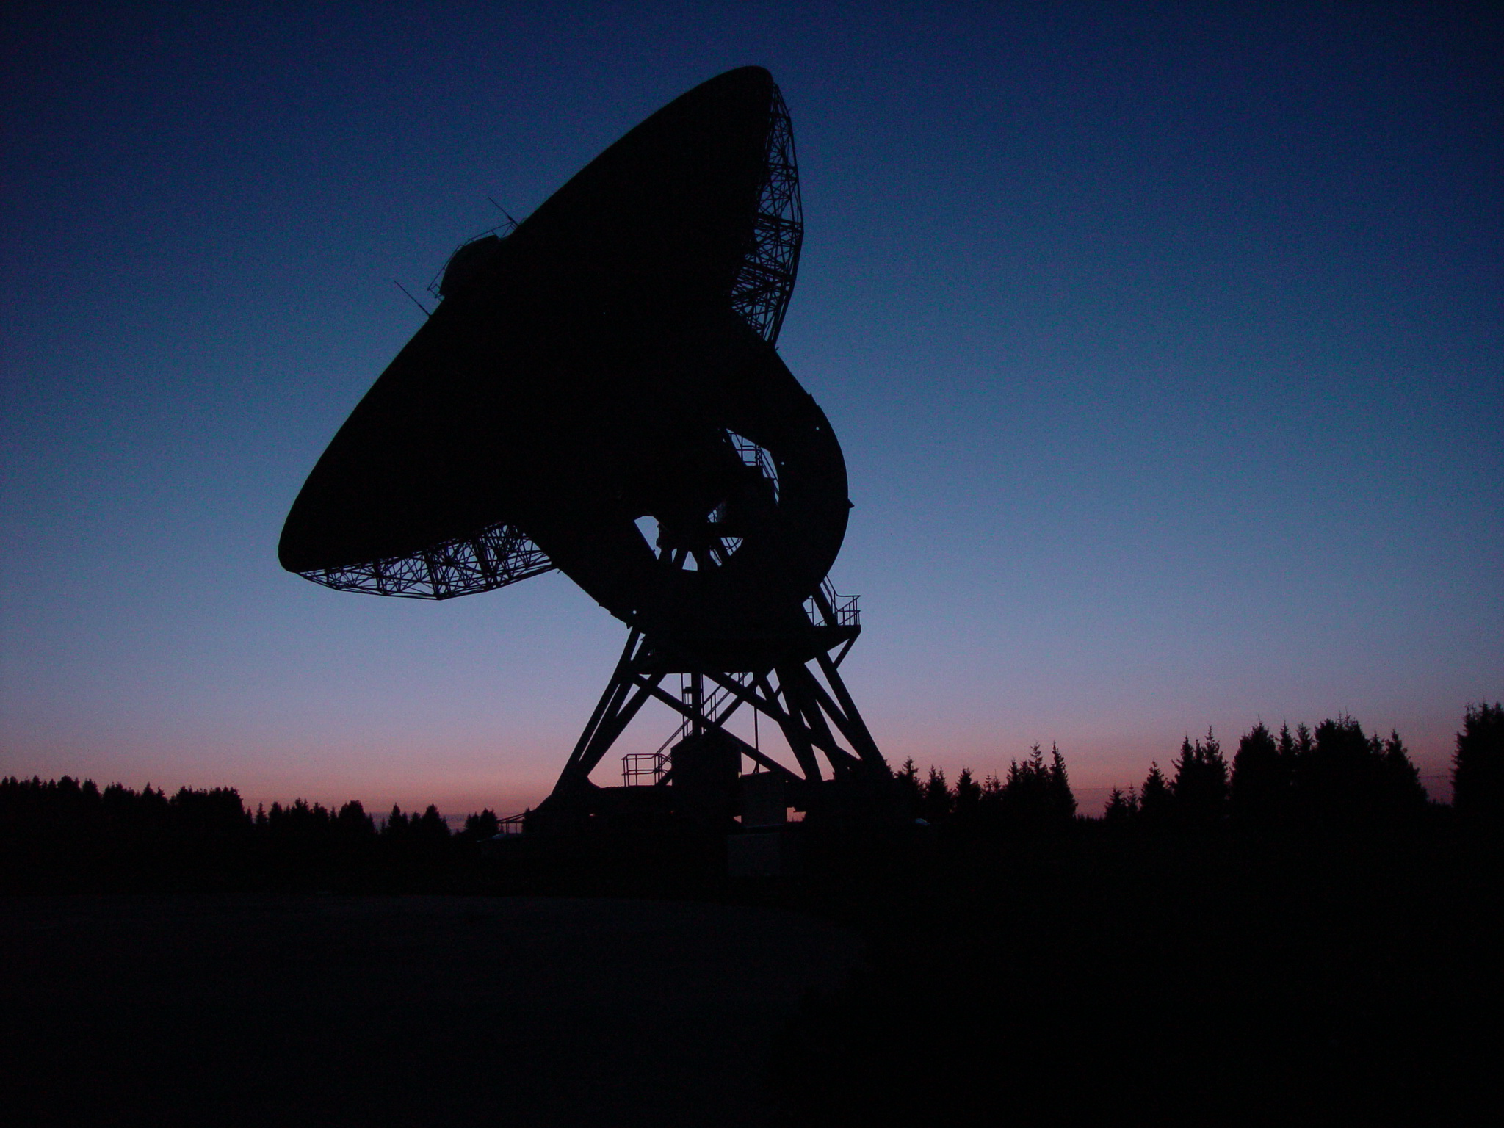
The Sino-German 6cm polarization survey of the Galactic plane
Xiaohui Sun
NAOC
Total intensity
Polarized intensity
http://159.226.88.6/zmtt/6cm

Slide 2
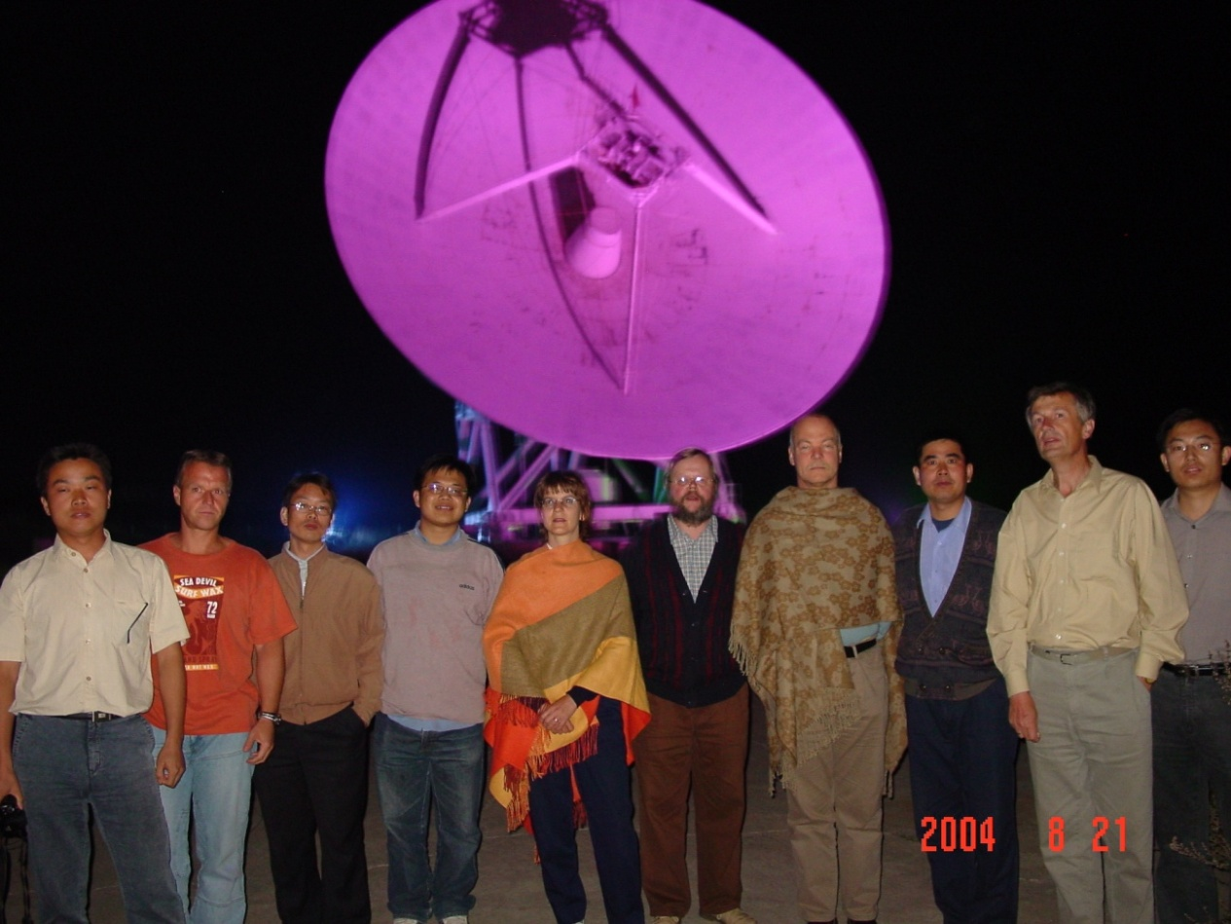
The Survey Team
Jinlin Han (NAOC)
Xiaohui Sun (NAOC)
Li Xiao (NAOC)
Xuyang Gao (NAOC)
Weibin Shi (SDU)
Maozheng Chen (UAO, NAOC)
Jun Ma (UAO, NAOC)
Richard Wielebinksi (MPIfR)
Wolfgang Reich (MPIfR)
Patricia Reich (MPIfR)
Ernst Fürst (MPIfR)
Peter Müller (MPIfR)
Otmar Lochner (MPIfR)

Slide 3
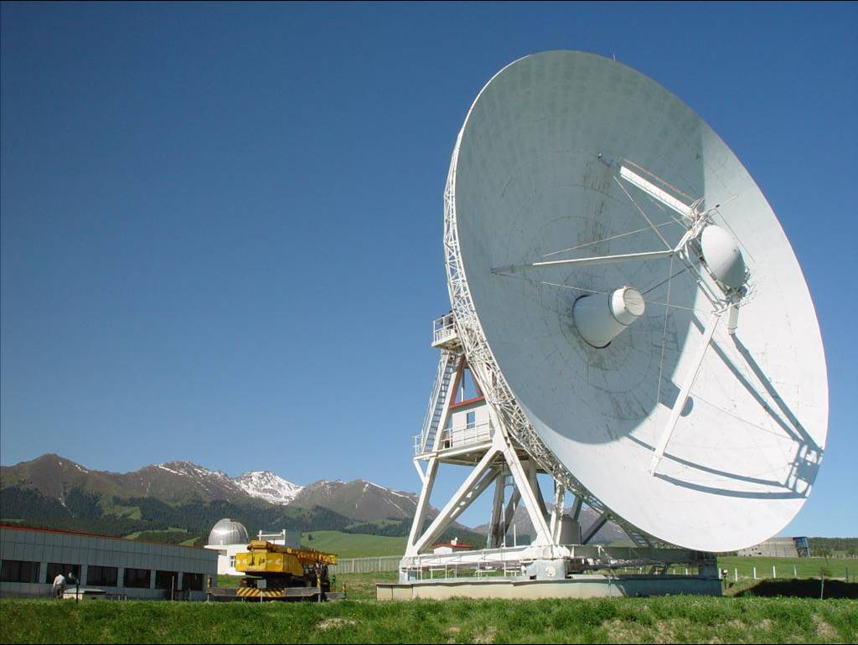
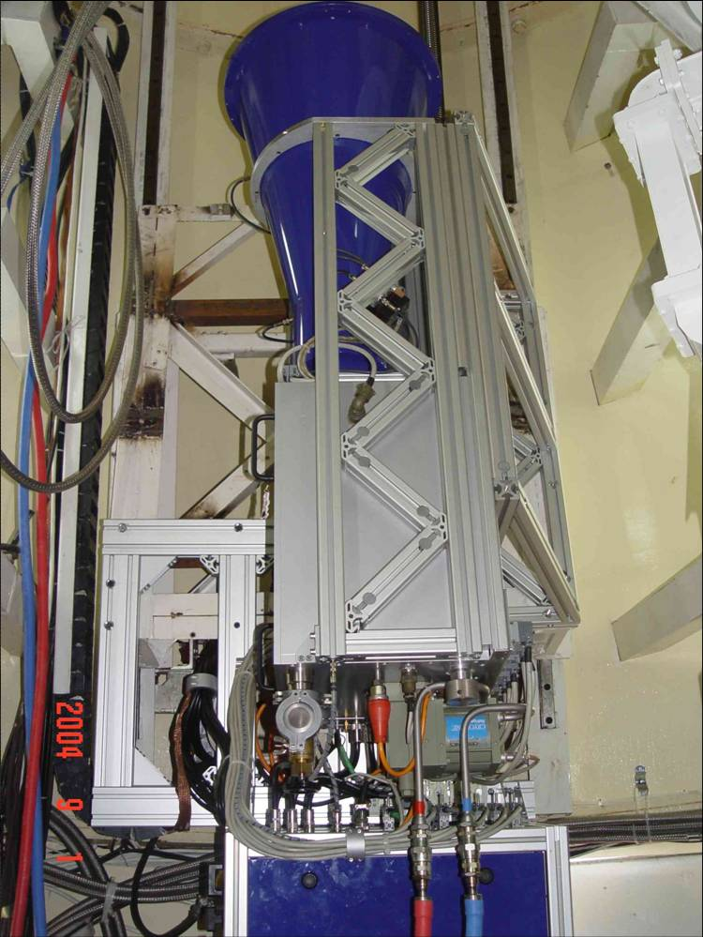
The 6cm receiving system
Urumqi telescope
D：25m
longitude：87º E
latitude：43º N
altitude：2029m
central frequency: 4.8/4.963 GHz
bandwidth: 600 MHz/295 MHz
system temperature: 22 K-25 K
HPBW: 9.5arcmin
first side lobe: 2%
instrumental polarization: <2%
beam efficiency: 67%
conversion factor: 0.164 K/Jy
Installed in August 2004

Slide 4
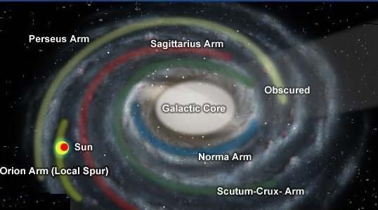
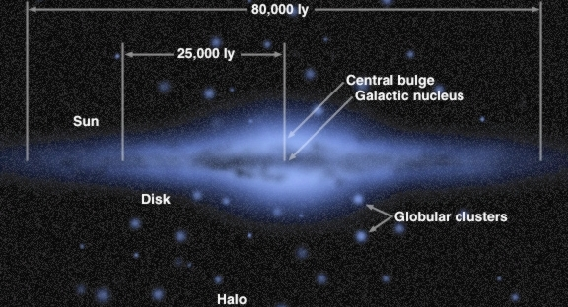
Observations
Goal: 10°< l < 230°, |b|<5°
Method: raster scan
l+b-scan
V: 4°/min
Δ: 3´
Calibrator: 3C286
7.5 Jy 11.3% 33°
Reduction: MPIfR NOD2 software
-- baseline adjustment
-- scanning effects suppression
-- weave
Time line:
Start: August, 2004
finished: April, 2009
Release: ~ end of 2010
rms-noise:
I: 1 mK T_{B} PI: 0.5 mK T_{B}

Slide 5
Survey publications
Survey regions:
10-60: Sun, Han, Reich, et al. 2010, A&A, to be submitted
60-122: Xiao, Han, Reich, et al. 2010, A&A, to be submitted
122-129: Sun, Han, Reich, et al. 2007, A&A, 463, 993
129-230: Gao, Reich, Han, et al. 2010, A&A, in press
SNRs:
The Cygnus Loop: Sun, Reich, Han, et al., 2006, A&A, 447, 937
G156.2+5.7: Xu, Han, Sun, et al. 2007, A&A, 470, 969
HB3: Shi, Han, Gao, et al. 2008, A&A, 487, 601
S147: Xiao, Furst, Reich, et al. 2008, A&A, 482, 783
G65.2+5.7: Xiao, Reich, Furst, et al. 2009, A&A, 503, 827
HII regions:
OA184: Foster, Kothes, Sun, et al. 2006, A&A, 454, 517
New HII regions: Shi, Sun, Han, et al. 2008, ChJAA, 8, 575
Instruments:
ground profile: Wang, Han, Sun, et al. 2007, PNAOC, 4, 181

Slide 6
I
U
Q
PI
129<l<230 Gao et al. 2010, A&A, in press
Notes:
SNRs: PKS 0646+06, Monoceros Nebula, PKS 0607+17, IC 443.
Nebulae: Seagull nebula, rosette nebula, fox fur nebula,

Slide 7
Faraday Screen
I
U
Q
PI
Notes:
SNRs: PKS 0646+06, Monoceros Nebula, PKS 0607+17, IC 443.
Nebulae: Seagull nebula, rosette nebula, fox fur nebula,

Slide 8
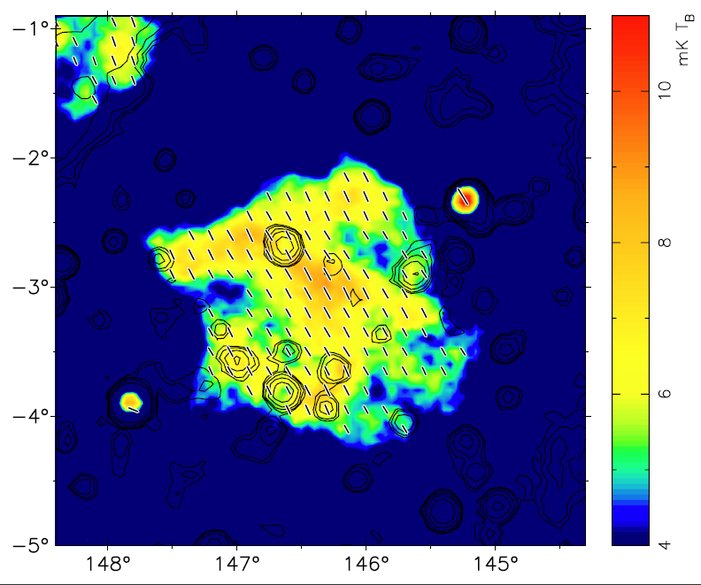
Faraday Screen
PI (image) + B (bar) + I (contour)
This feature is polarized?
Absolute calibration first!!!
use 5yr WMAP K-band data
-- smooth KMAP and 6cm to 2deg
-- extrapolate KMAP to 6cm β= -2.9
-- check the difference
-- add the difference to original 6cm U/Q
An absorption feature now!

Slide 9
Faraday Screen: Model
f: depolarization of background
c: fraction of foreground PI in total PI
Ψ_{s}: rotation of the Faraday screen
Fit PI_{on}/PI_{off} and ψ_{on}-- ψ_{off}
→ RMs → B

Slide 10
FS G146.4-3.0
Excessive RMs found for two EGSs in catalogue of Taylor et al. (2009)
Gao et al. 2010, A&A, in press

Slide 11
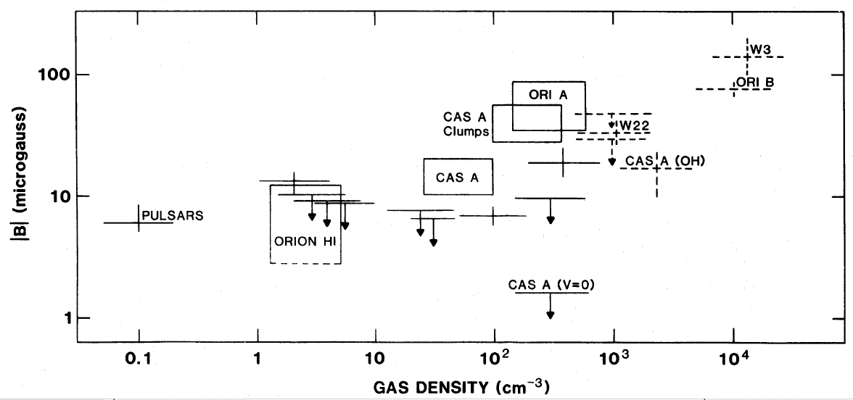
Faraday Screens
no total intensity correspondence: ne <~ 1 cm⁻³
RM around 200 rad m⁻²: B||>~10 μG
FS
Troland & Heiles 1986: |B| ~ n^{~0.5}
Cannot be found at low frequency as too large RMs
Should be carefully omitted for analysis of RMs of EGSs

Slide 12
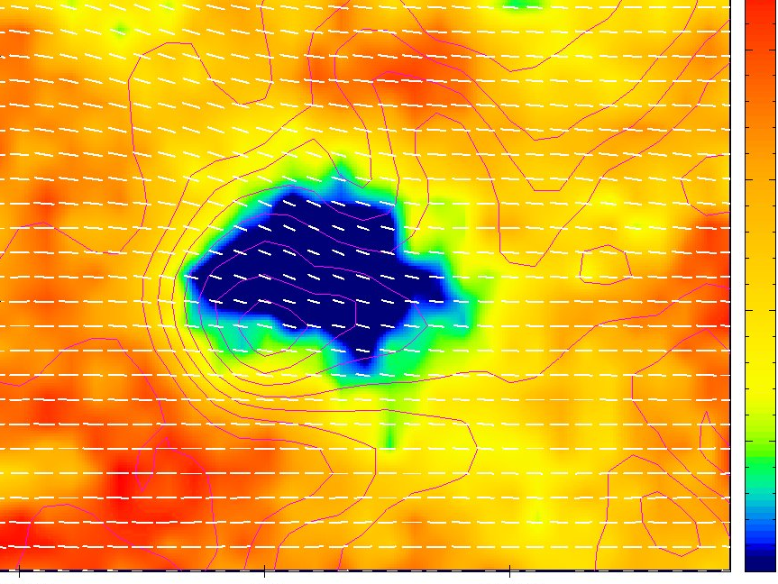
Polarization structures
Polarization voids:
depth depolarization NO
beam depolarization NO
BG + FS + FG
PI (image) + B (bar) + I (contour)

Slide 13
Polarization structures
PI (image) + B (bar) + I (contour)
Polarized Patches:
BG+FS+FG difficult
turbulent field probably
→ properties of turbulent fileds?
Canals:
external RM gradient NO
boundaries of patches

Slide 14
Summary 1. The Galactic plane is surveyed for polarization at 6cm 2. Polarization structures: voids, canals, patches, Faraday screens, depolarization regions…… 3. SNRs & HII regions detected 4. Diffuse emission & polarization: Thermal & non-thermal

Slide 15
Thanks!

