Slide 1
Detecting Cosmic Magnetic Fields through Cross-Correlation
Shea Brown
Bolton Postdoctoral Fellow
CSIRO, Astronomy & Space Science
Day Month, 2010

Slide 2
Take Home Messages
Background
  Cosmological magnetic fields are important (K. Dolag’s talk)
  The “synchrotron cosmic-web” is an important way of probing cosmological magnetic fields
  Confusion and intrinsically low surface-brightness makes direct detection nearly impossible with current (and planned) observations
Cross-correlation
  Statistical detection via Cross-correlation and Stacking techniques is a powerful tool for inferring the average properties of the synchrotron cosmic-web
  Inferring upper limits from non-detections is model dependent and must be done with extreme care NEED HELP FROM SIMULATIONS!

Slide 3
Cosmological Magnetic Fields
z=4
z=0
Donnert et al. (2008)

Slide 4
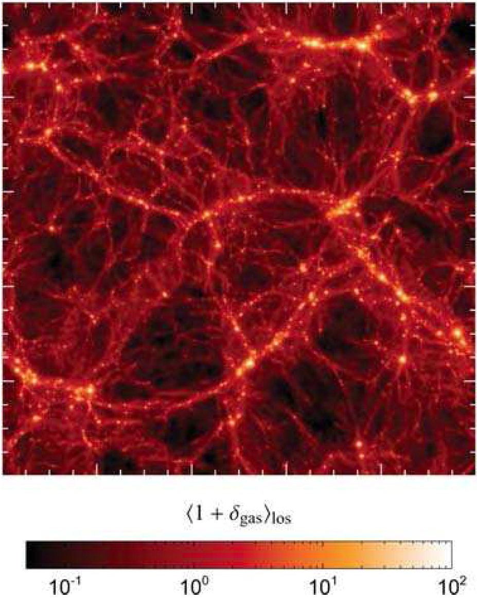
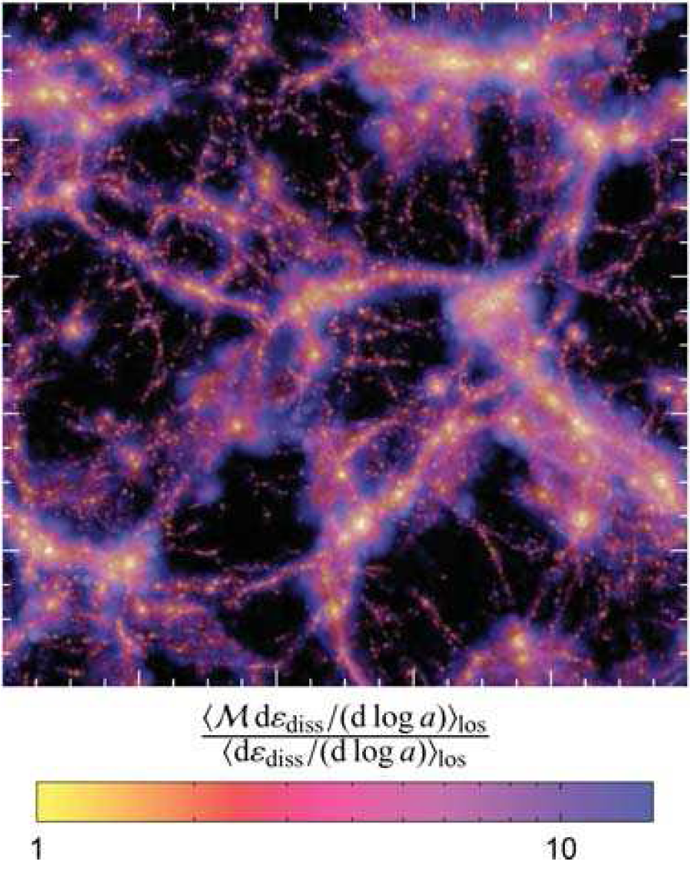
Background: The Synchrotron Cosmic-Web
Pfrommer et al. 2006
Surface brightness in filaments
not known, but probably not stronger
than ~10⁻³ μJy/arcmin²

Slide 5
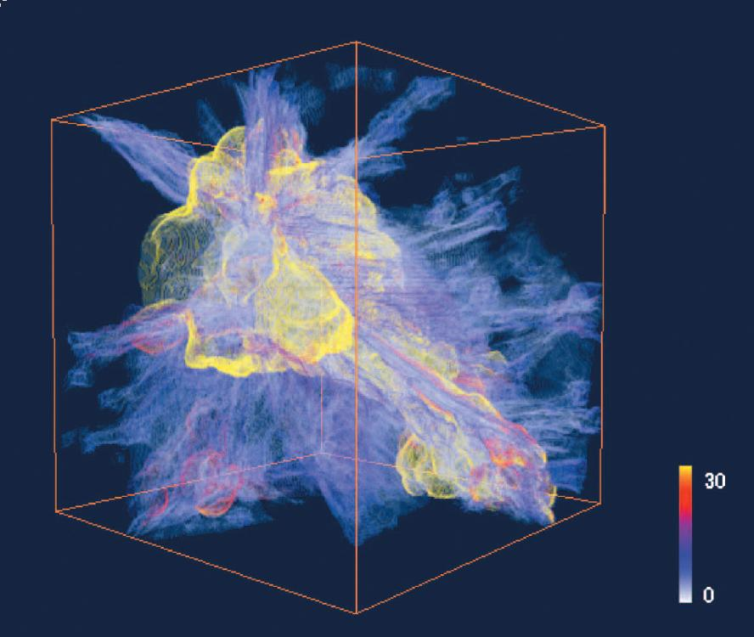
Background: The Synchrotron Cosmic-Web
Need high
sensitivity
to large scales
Ryu et al. 2003

Slide 6
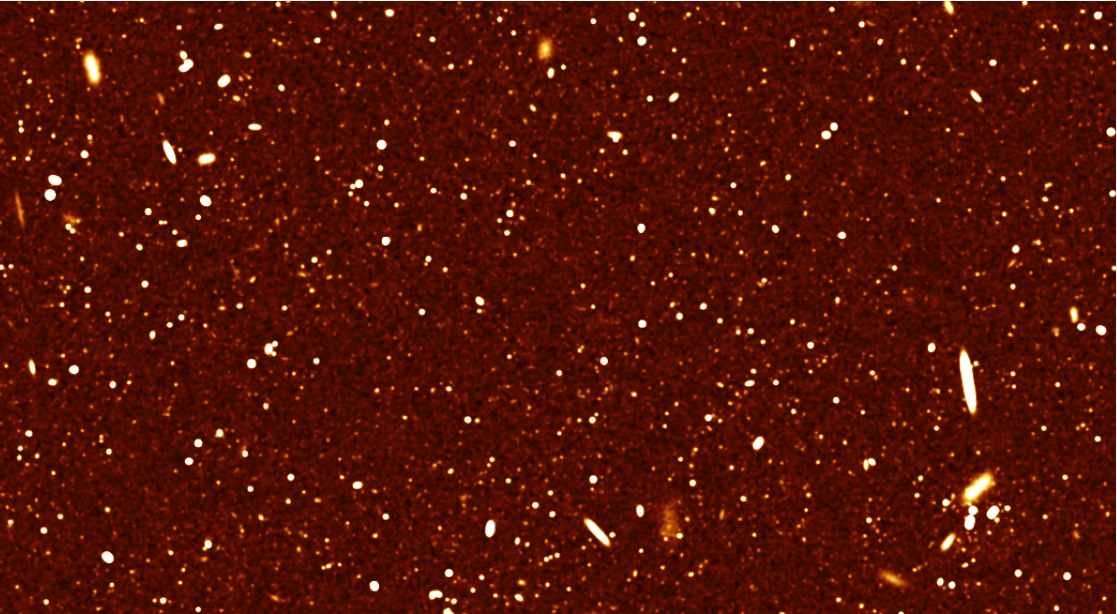

Slide 7
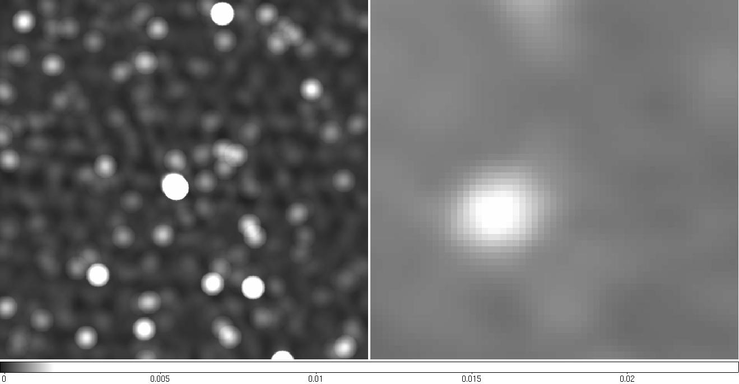
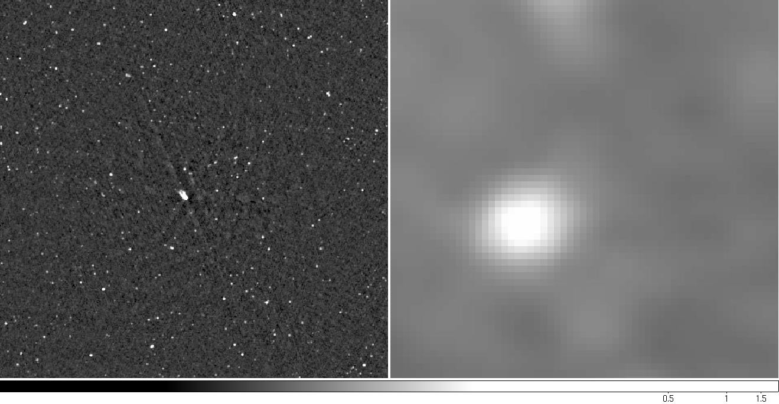
Confusion: Point Sources
Very sensitive observations
of the point-sources are needed

Slide 8
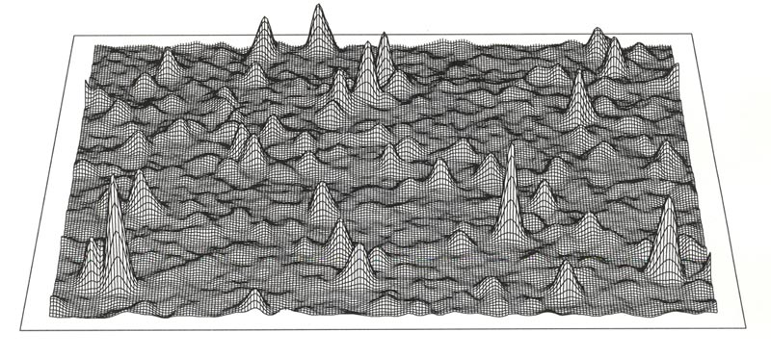
Confusion: Point Sources
Green Bank 300 foot 1.4 GHz
45 square degrees around the North Cel. Pole
0.2 ν^{-0.7} ө²

Slide 9
Confusion: Point Sources
0.2 ν^{-0.7} ө²
I_{ν}~ν⁻¹⁻² Lower frequency helps (if you keep resolution)

Slide 10
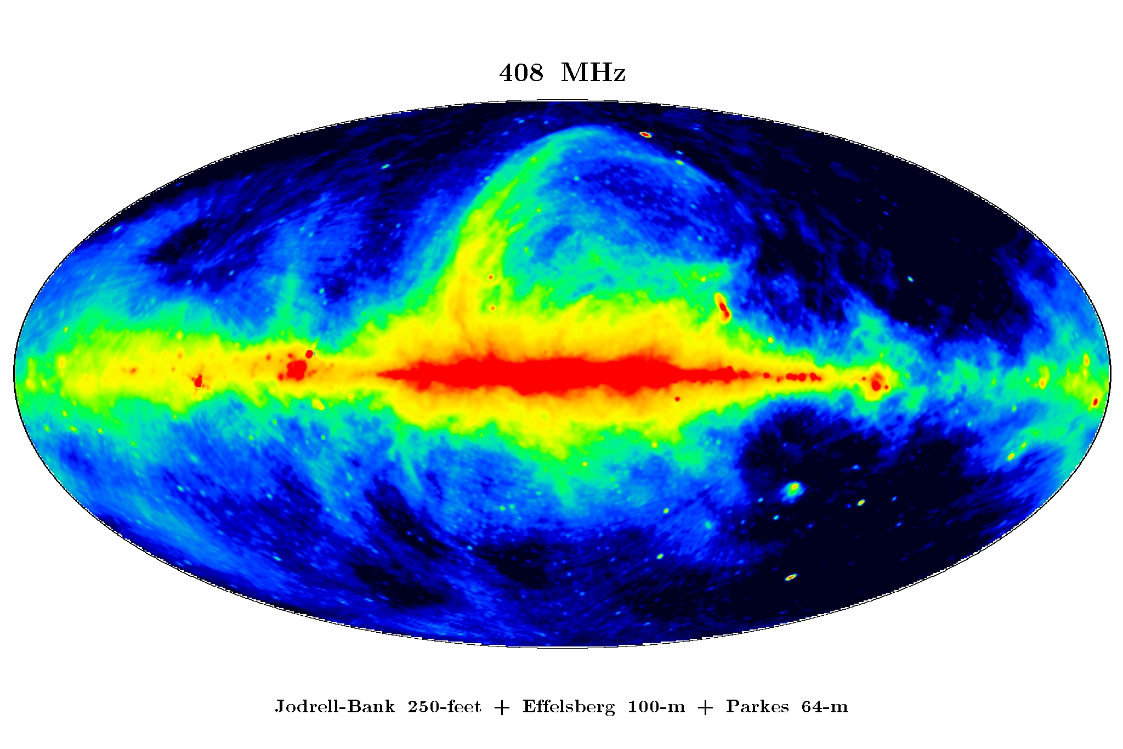
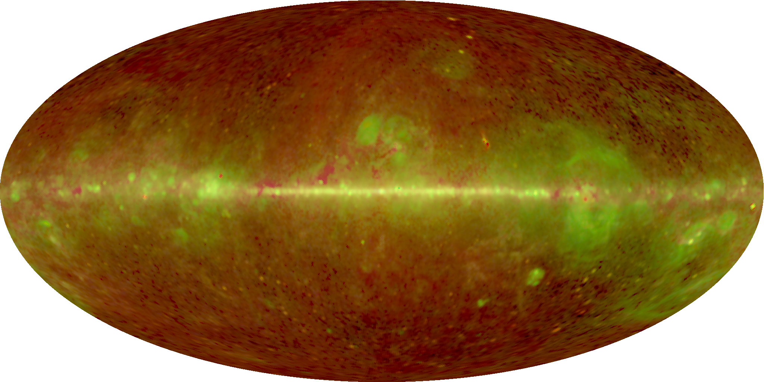
Confusion: Diffuse

Slide 11
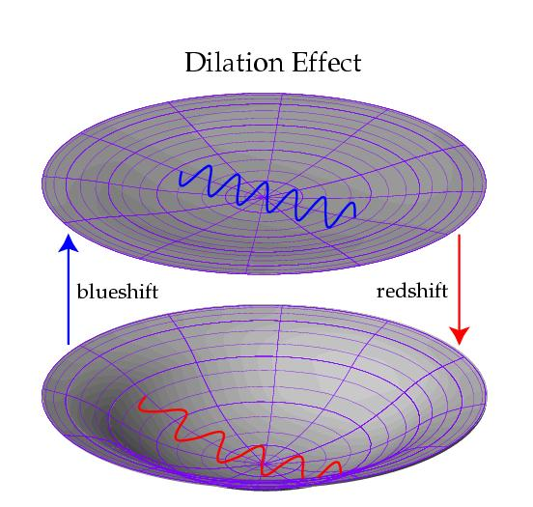
Cross-correlation: ISW analogy
Integrated Sachs-Wolfe Effect

Slide 12
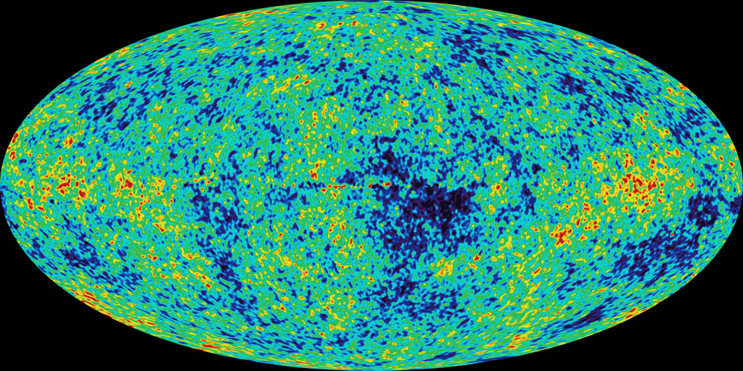
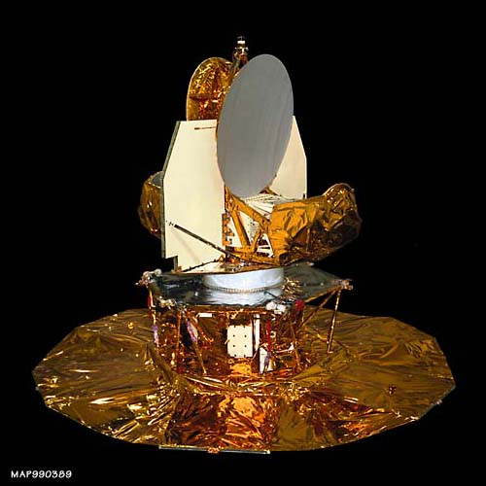
Cross-correlation: ISW analogy
ISW effect is too faint
to detect directly…

Slide 13
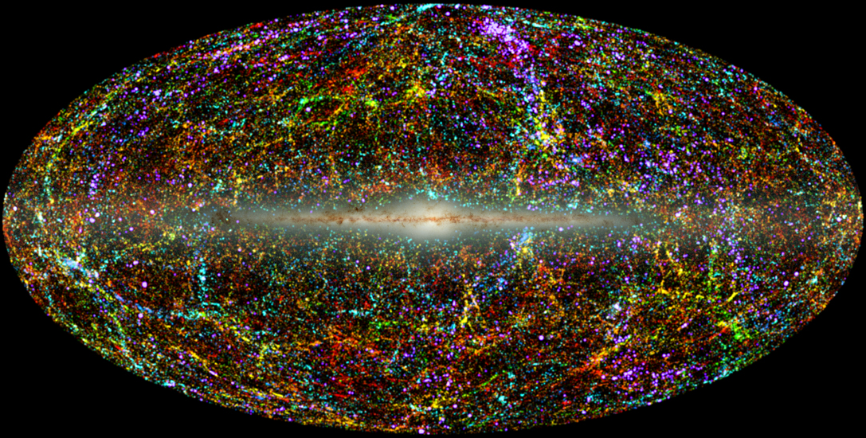
Cross-correlation: ISW analogy
…but it should be
correlated with LSS
http://spider.ipac.caltech.edu/staff/jarrett/2mass/LSS/

Slide 14
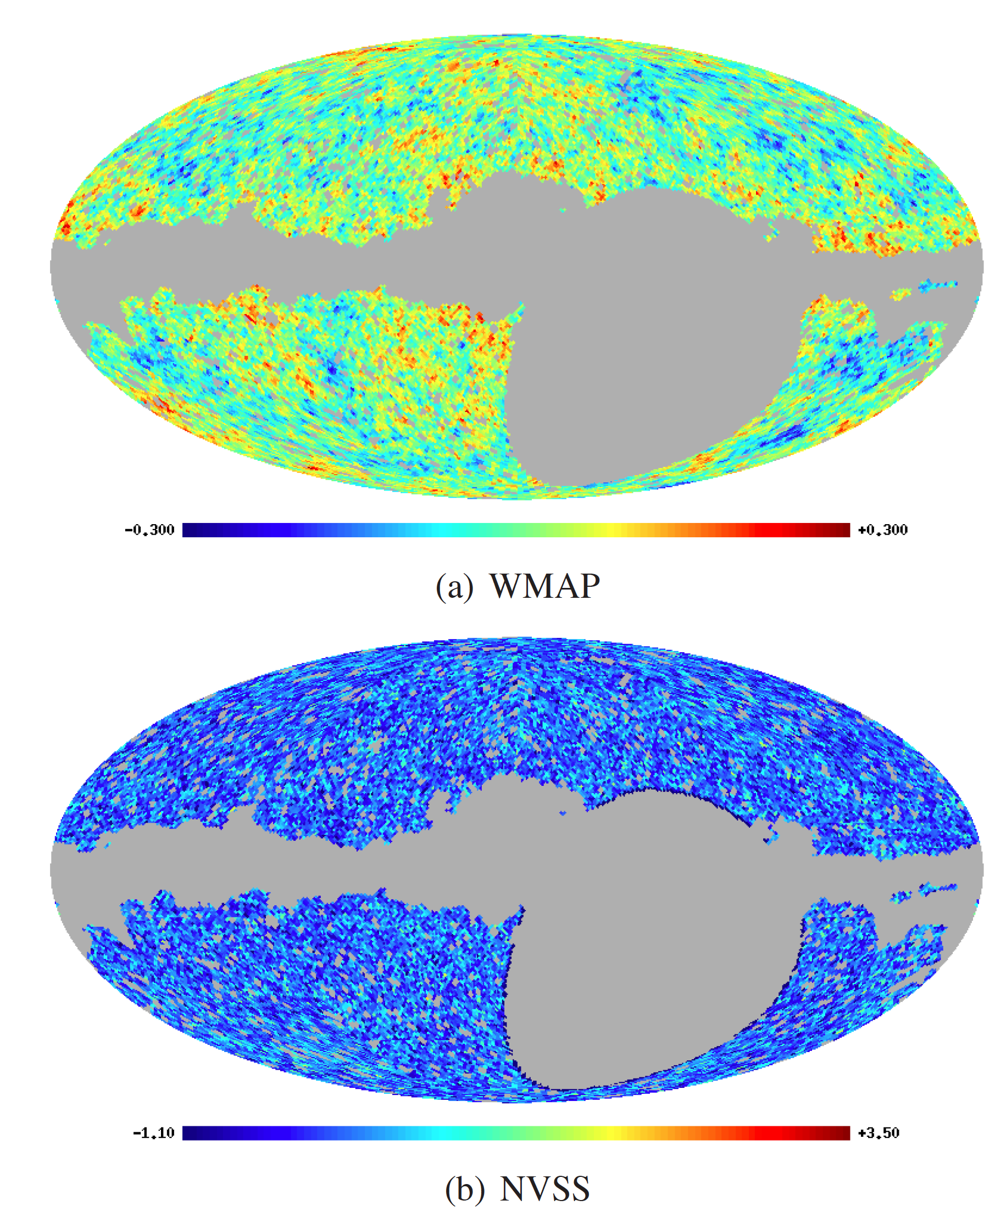
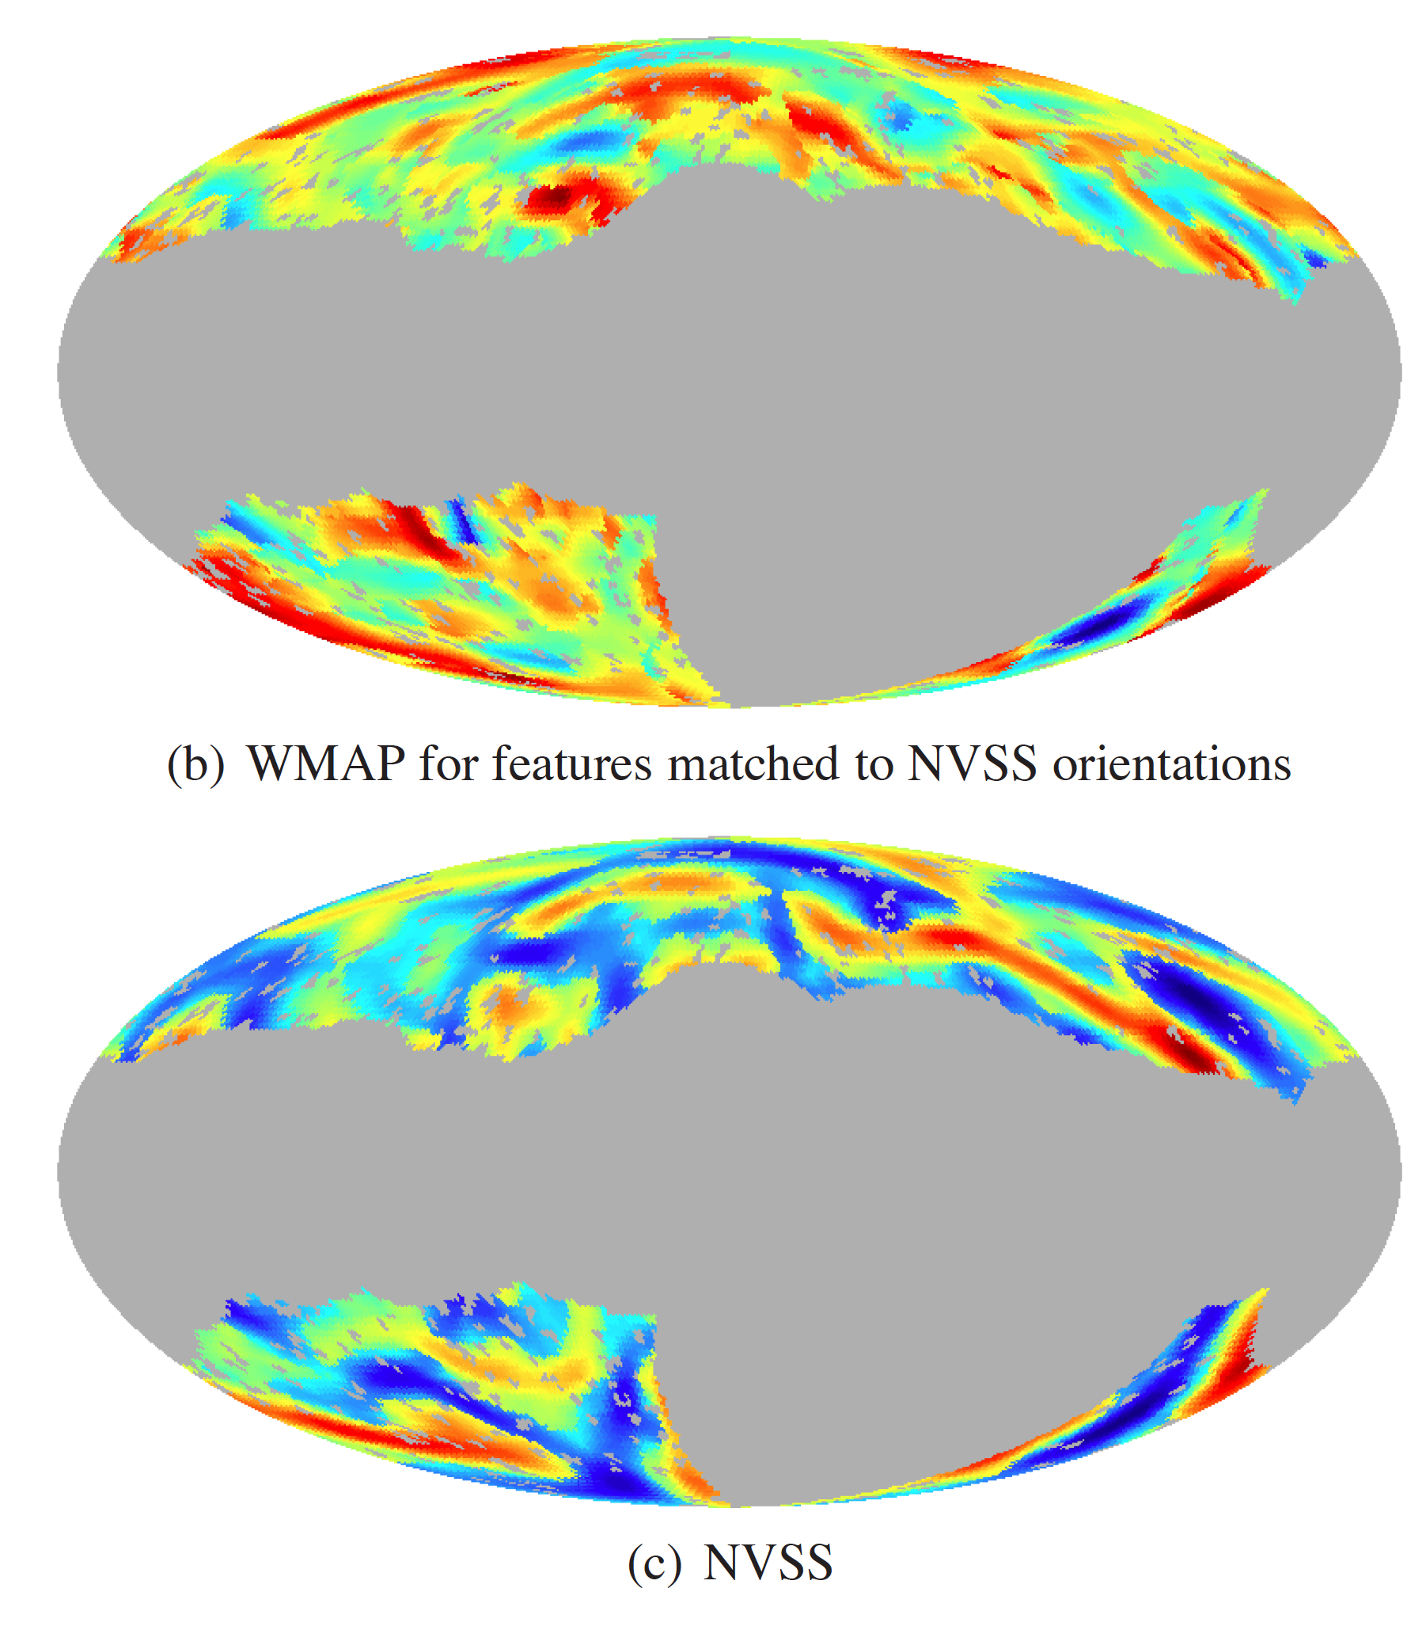
Cross-Correlation: WMAP & NVSS
This is an example of a Section Divider slide
Arial Regular, 44pt
McEwen et al. (2009)

Slide 15
Cross-correlation: LSS & Diffuse Radio
13’
Synchrotron cosmic-web
too faint
to detect directly…

Slide 16
Cross-correlation: LSS & Diffuse Radio
…but it should also be
correlated with LSS
http://spider.ipac.caltech.edu/staff/jarrett/2mass/LSS/

Slide 17
Cross-correlation: LSS & Diffuse Radio
Reasons for a positive correlation
  AGN (core)
  Starbursts and disk emission
  AGN (WAT and NAT associated with clusters)
  Cluster halos
  Cluster relics
  Synchrotron cosmic-web
Reasons for a negative correlation
  Galactic extinction
    (galaxy number counts down, synchrotron up)
increasing
angular
scale

Slide 18
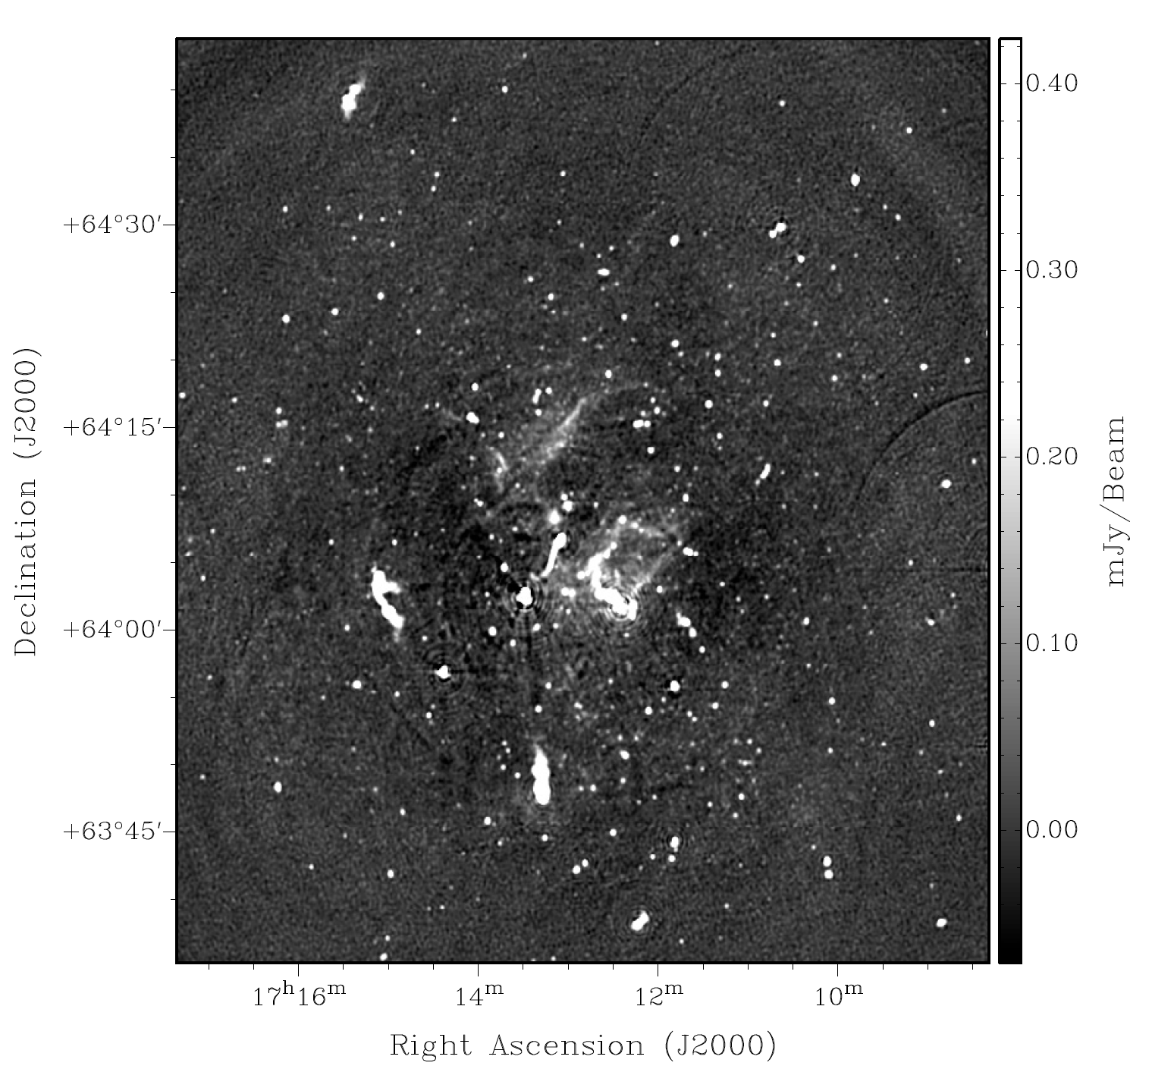
Cluster Radio Sources: RGs, Halos, & Relics
Pizzo et al. (2009)

Slide 19
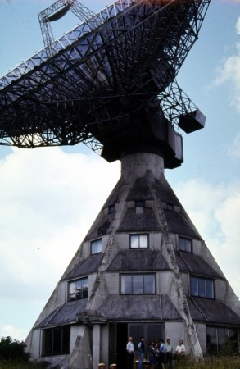
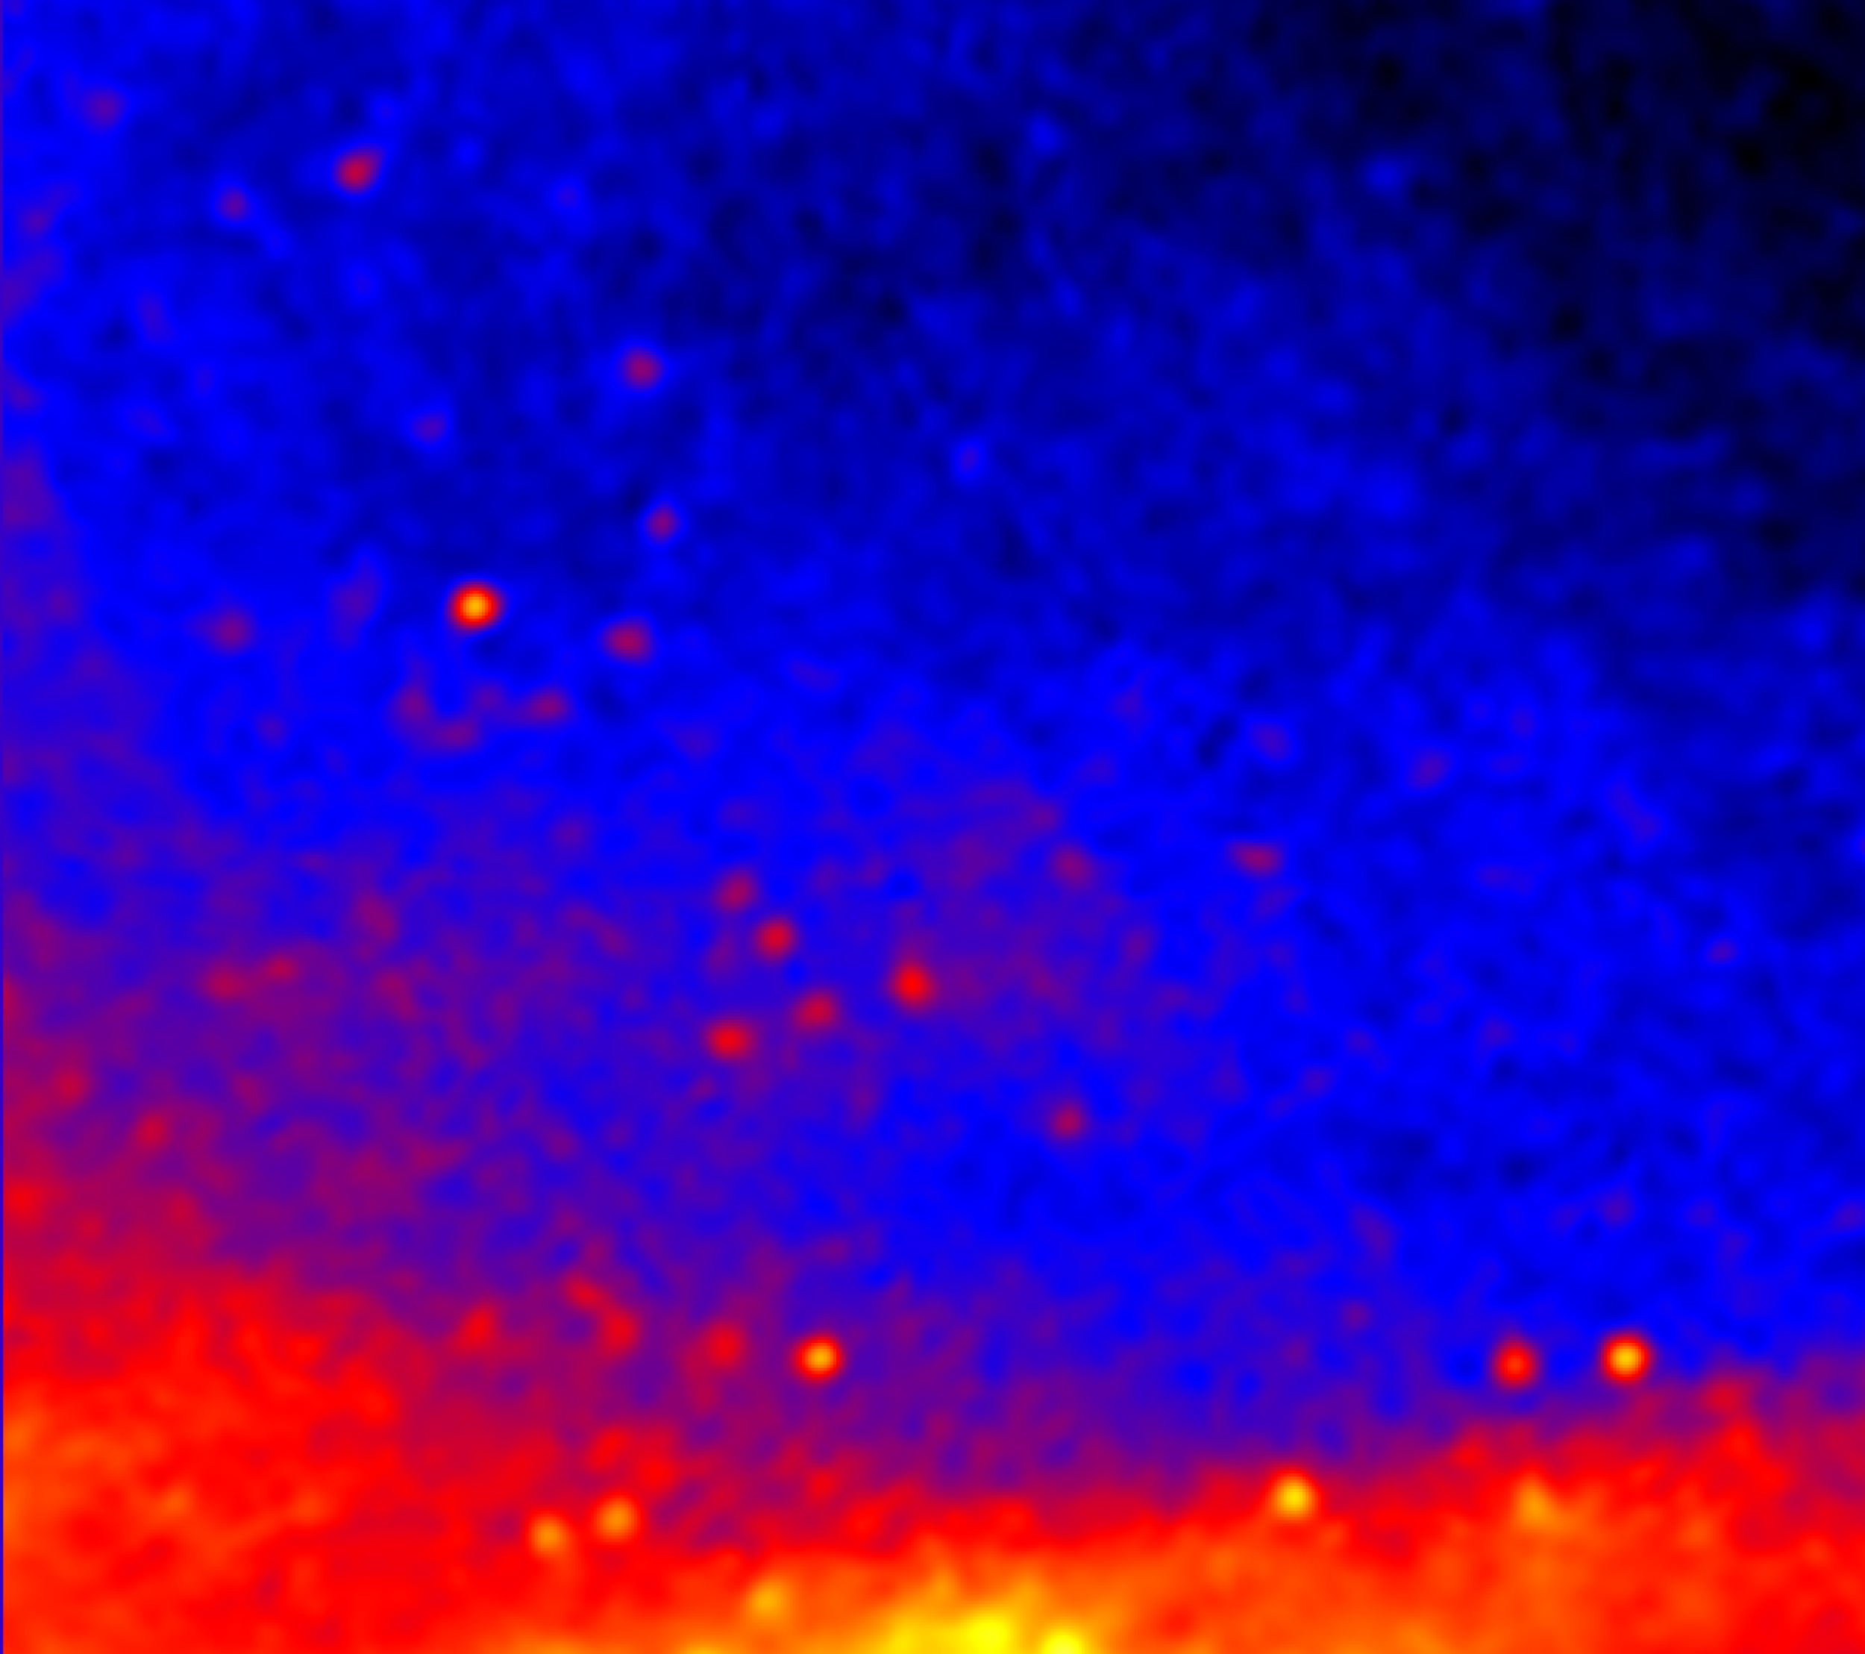
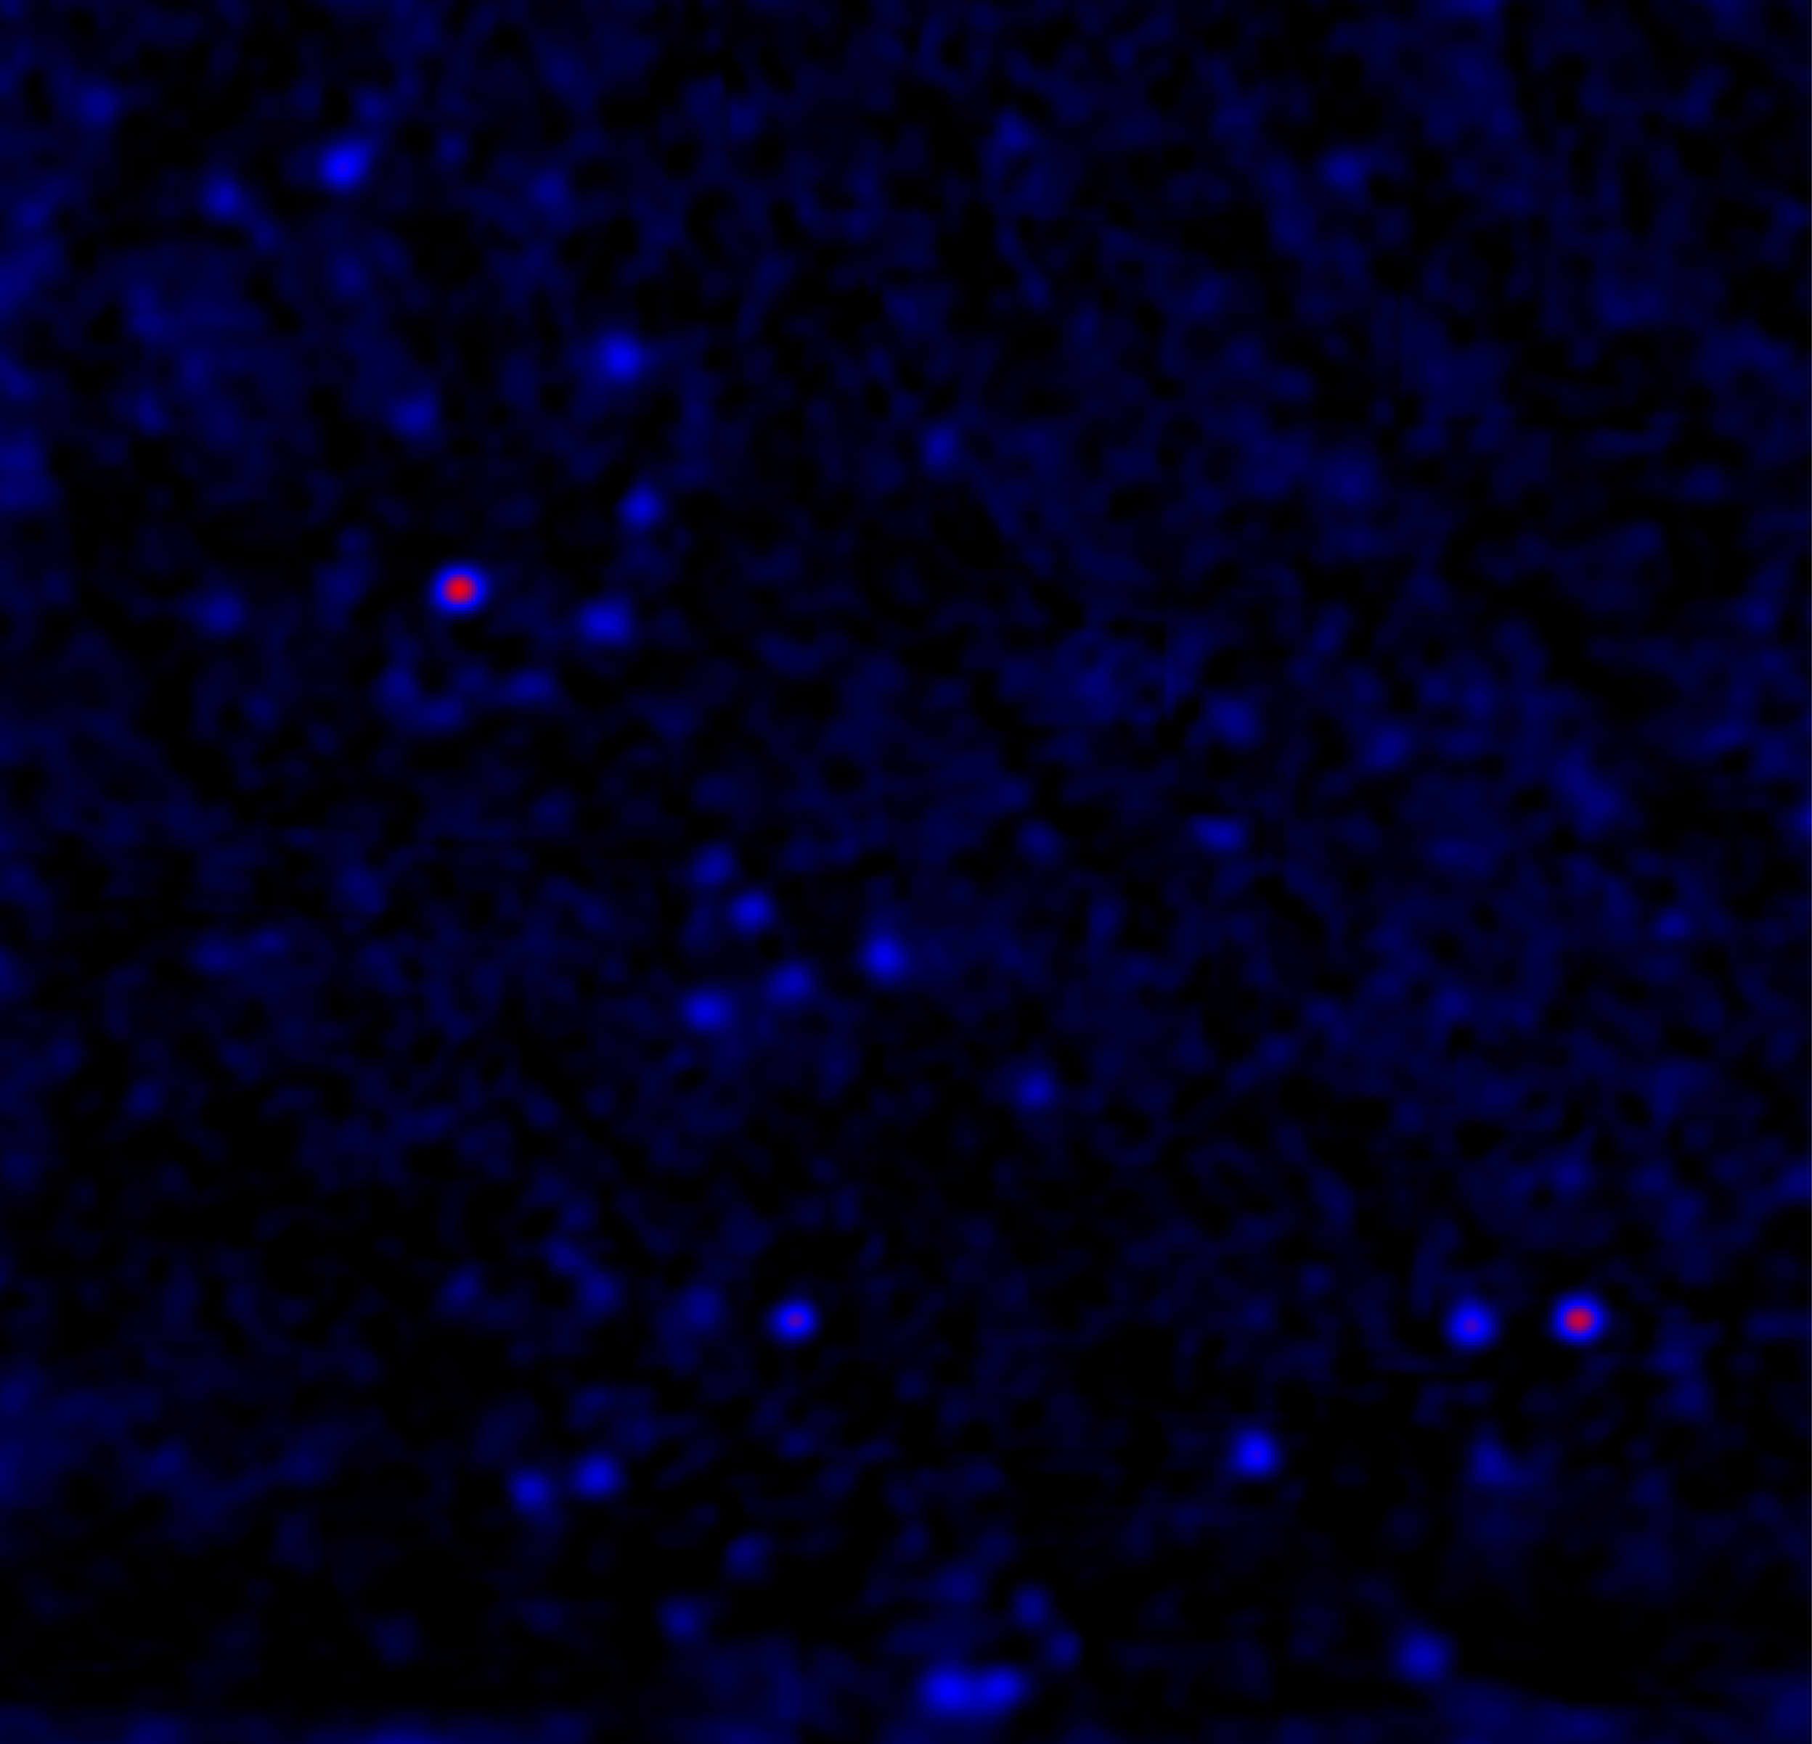
Cross-correlation: old tool, new application
Unfiltered
Filtered
Stockert 1.4 GHz survey; 36 arcmin resolution
Reich & Reich 1986

Slide 20
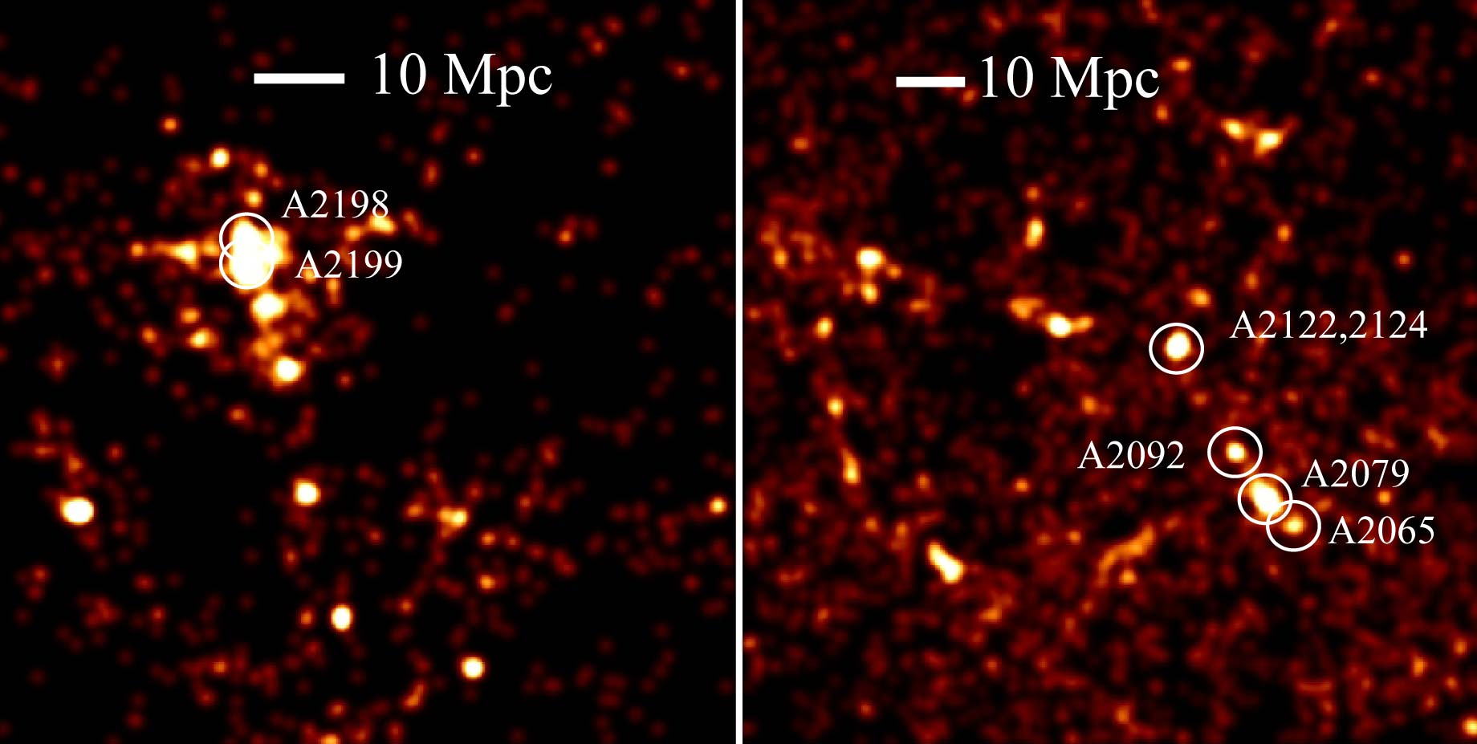
Cross-correlation: old tool, new application
z = 0.03-0.04
z = 0.06-0.07

Slide 21
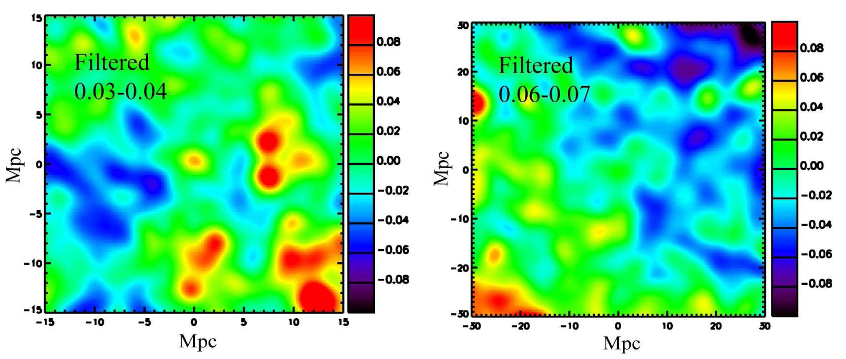
Cross-correlation: old tool, new application
No significant detection
(i.e., no bright central peak)

Slide 22
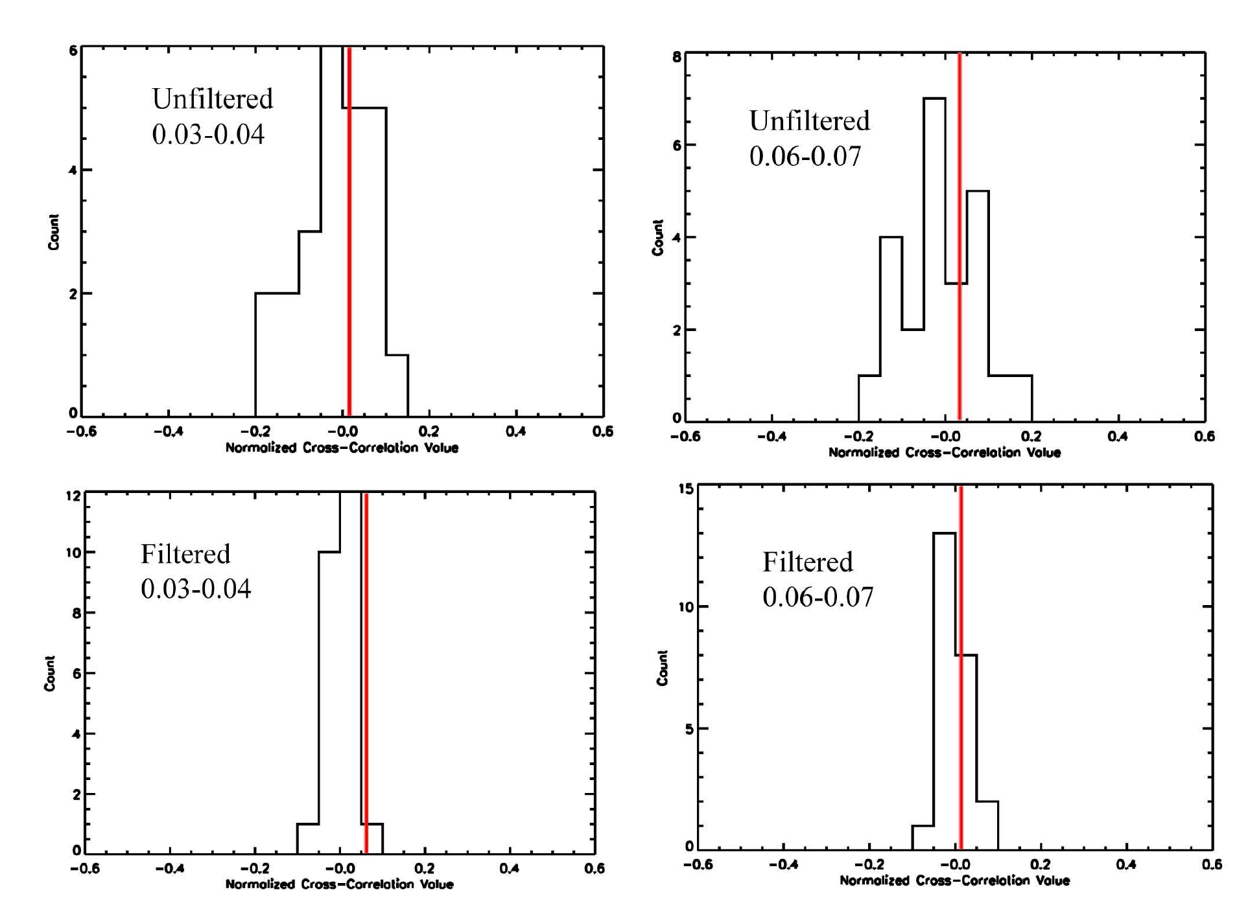
Cross-correlation: old tool, new application
Another way to assess the noise:
Use 24 random fields from the 1.4 GHz
Stockert survey and evaluate CCF(0)

Slide 23
Cross-correlation: old tool, new application
Simulate a signal by assuming the
radio emission is perfectly traced
by the galaxy surface density
Image*factor
Cross-Correlate
+
Repeat until 3sigma detection

Slide 24
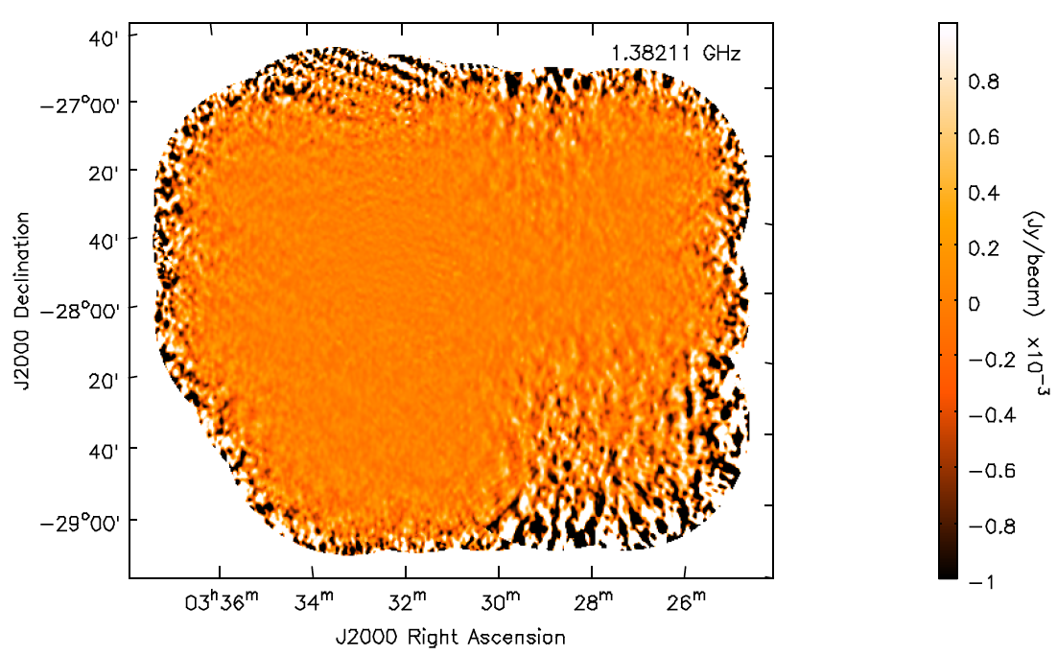
ATCA observations of CDFS: ATLAS
Ray Norris.
Emil Lenc
Chris Hales
Rob Sharp
1.4 GHz
1’ resolution
80 μJy/arcmin²

Slide 25
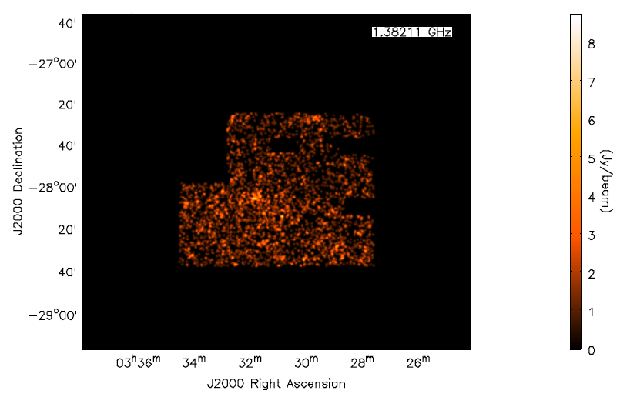
SWIRE Photo-z: 0.1 < z < 0.3

Slide 26
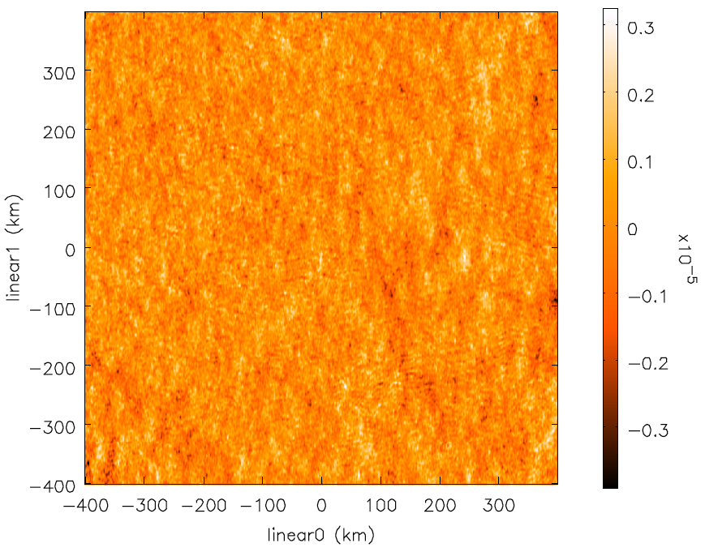
Stacked Image ~3,000 galaxies
r+Δr
r

Slide 27
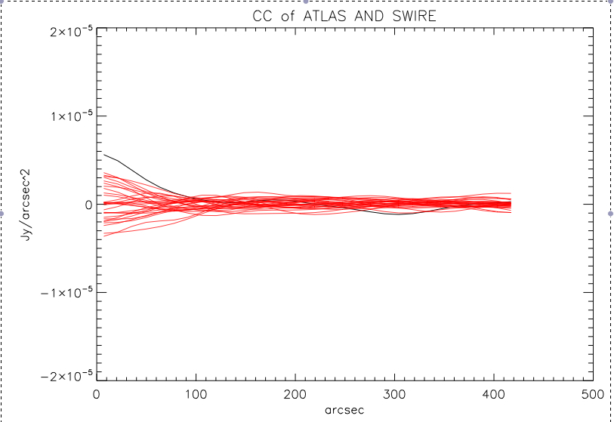
Cross-correlation Function
1 Mpc
To calculate an upper limit
I must use a model for the
synchrotron cosmic-web

Slide 28
Still To-Do
Work much harder to detect a signal
  Include ELAIS S1 field in the analysis
  More systematic search of red-shift space
  Careful masking of instrumental artifacts
  Try different cross-correlation algorithms: Learn from CMB community!
Calculate upper limits
  Non-trivial task—very model dependent
  Two issues
    Upper limit of what Cross-correlation can detect
    Upper limit of what ATLAS is sensitive to

Slide 29
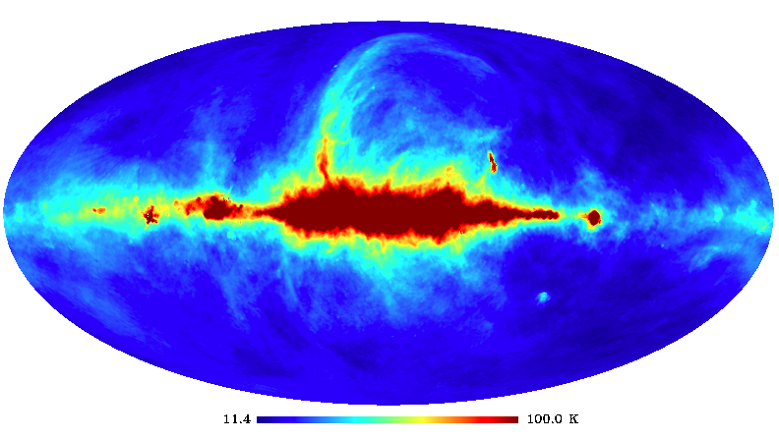
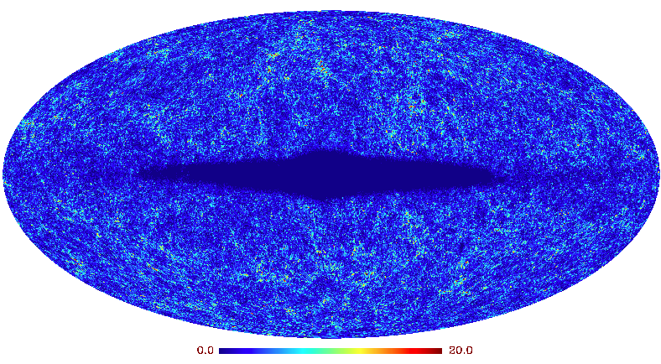
Cross-correlation: All Sky

Slide 30
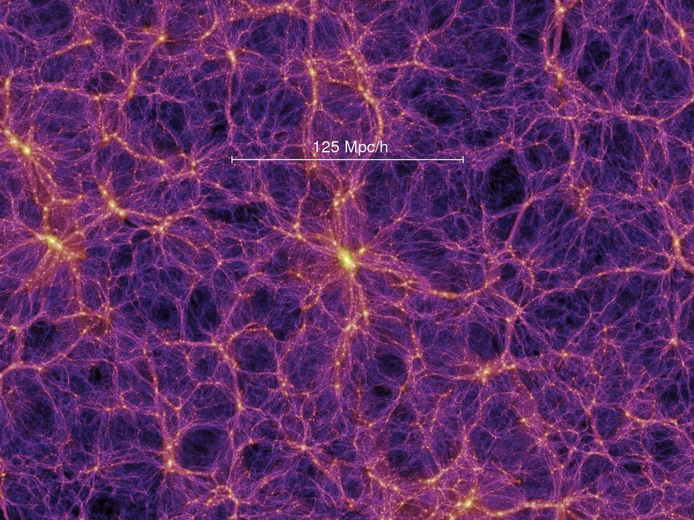
Stacking
Rotate and Average

Slide 31
Take Home Messages
Background
  Cosmological magnetic fields are important (K. Dolag’s talk)
  The “synchrotron cosmic-web” is an important way of probing cosmological magnetic fields
  Confusion and intrinsically low surface-brightness makes direct detection nearly impossible with current (and planned) observations
Cross-correlation
  Statistical detection via Cross-correlation and Stacking techniques is a powerful tool for inferring the average properties of the synchrotron cosmic-web
  Inferring upper limits from non-detections is model dependent and must be done with extreme care NEED HELP FROM SIMULATIONS!

Slide 32


Thank you
CSIRO Astronomy & Space Science
Shea Brown
Bolton Postdoctoral Fellow
Email: Shea.Brown@csiro.au
Web: http://www.atnf.csiro.au/people/Shea.Brown/

