Slide 1
Physics of Poynting dominated jets
Yuri Lyubarsky
Ben-Gurion University
Beer-Sheva, Israel

Slide 2
Poynting dominated jets.
What do we want to know?
1. What are the conditions for acceleration and collimation?
2. What is the final collimation angle?
3. Where and how the EM energy is released?
Conversion to the kinetic energy via gradual acceleration?
Or to the thermal and radiation energy via dissipation?
4. Are they stable? What is the role of possible MHD instabilities?

Slide 3
Intimate connection between collimation and acceleration
Without external confinement, the flow is nearly radial; the acceleration stops at an early stage (Tomimatsu 94;
Beskin et al 98)
Jet confined by the external pressure: the spatial distribution of
the confining pressure determines the shape of the flow boundary
and the acceleration rate (Tchekhovskoy et al 08,09; Komissarov
et al 09; L 09,10).
In accreting systems, the relativistic outflows from the central engine could be confined by the (generally magnetized) wind from the outer parts of the accretion disk. In GRBs, a relativistic jet from the collapsing core is confined by the stellar envelope.

Slide 4
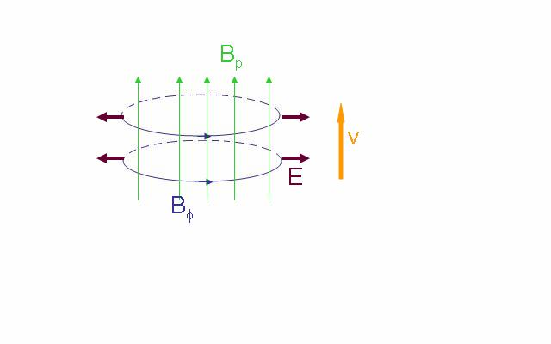
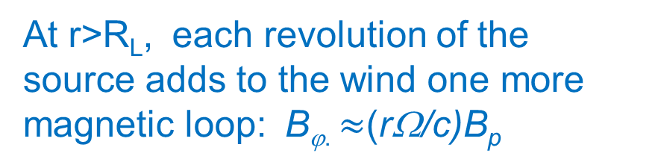
Collimation vs acceleration
1. Equilibrium jet
Transverse force balance in cylindrical configuration.
In the comoving frame, B’_{ϕ}∼B’_{p}
In the lab frame, B_{ϕ}=γB’_{ϕ}∼ γB’_{p}=γB_{p}
cylindrical equilibrium at any z
γ∼ rΩ/c
The jet is accelerated when expands

Slide 5
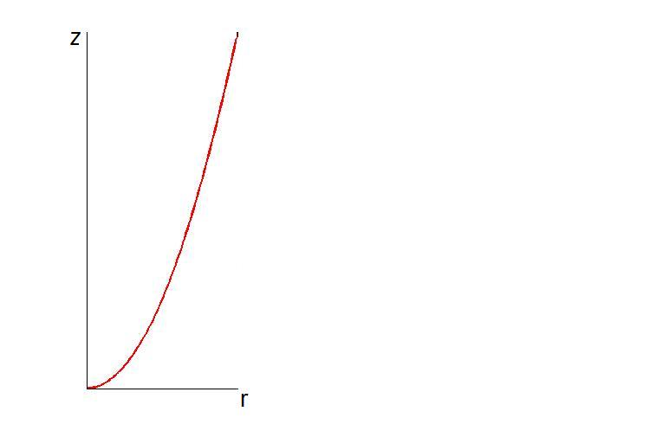
Collimation vs acceleration
1. Equilibrium jet (cont)
The flow settles into an equilibrium configuration provided a signal crosses the jet while z varies less than 2 times (strong causality).
Z=Ωr²/c
(proper propagation time, z/cγ) > (light crossing time, r/c)
equilibrium
non-equilibrium
Θγ<1
Expanding equilibrium jets are accelerated,
γ∼Θr/c, up to γ∼γ_{max}; σ∼1
γ_{max}>>1 - the Lorentz factor achieved when and if the Poynting flux is completely transformed into the kinetic energy

Slide 6
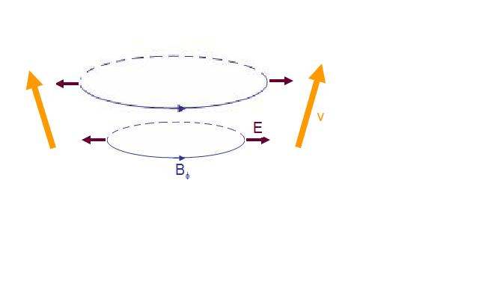
Collimation vs acceleration
2. Non-equilibrium jet
Θγ>1
Z=Ωr²/c
equilibrium
Poloidal field is negligible
Non-equilibrium jets are accelerated only up to
non-equilibrium

Slide 7
Acceleration vs causality
Causality condition: φ>Θ
In the comoving frame
fms
Θ
Jet boundary
In the lab frame
φ
Jet axis
Causality condition:
v
Poynting dominated jets are accelerated if they are causally connected

Slide 8
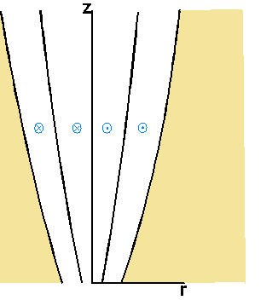
MHD jet confined by the external pressure
v
The spatial distribution of the confining pressure determines the shape of the flow boundary and the acceleration rate
B_{φ}
p_{ext}
E
B_{p}

Slide 9
MHD jet confined by the external pressure (cont)
1. Equilibrium jet; γ∼r/R_{L}
Equilibrium only if
Equilibrium jet is formed if κ<2

Slide 10
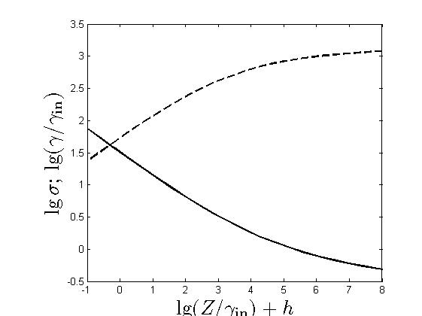
MHD jet confined by the external pressure (cont)
1. Equilibrium jet (cont)
Equipartition, σ∼1; γ∼γ_{max}, at
γ
Beyond the equipartition:
σ

Slide 11
MHD jet confined by the external pressure (cont)
2. Non-equilibrium jet; κ>2

Slide 12
MHD jet confined by the external pressure (cont)
2. Non-equilibrium jet; κ>2, (cont)
In a layer that remains in causal contact with the external boundary of the jet, the flow is accelerated up to γ∼γ_{max}, σ∼1.

Slide 13
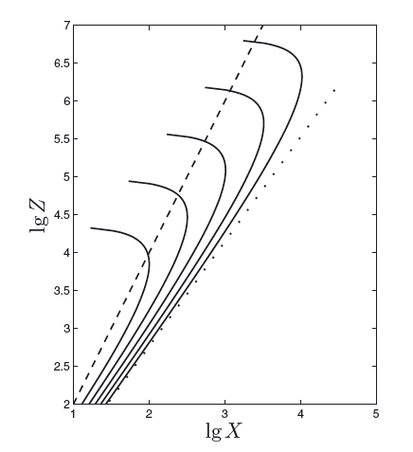
MHD jet confined by the external pressure (cont)
2. A special case; κ=2
At β<1/4, the flow is parabolic and goes to infinity
At β<1/4, the flow is accelerated
till σ∼1 and then collapses.

Slide 14
Dissipationless MHD jets; summary
Externally confined Poynting dominated outflows are efficiently
collimated and accelerated to high Lorentz factors.
2. The acceleration zone spans a large range of scales .
3. Acceleration up to equipartition between the magnetic and kinetic
energy (σ∼1) is possible in causally connected flows ( ).
Transition to the matter dominated stage, σ∼0.1, could occur only at
an unreasonably large scale.
The kinetic energy is released at shocks. But most of the flow energy could be released at a shock only if σ<0.1-0.2. Only such a flow could be considered as matter dominated
f- fraction of energy transferred to the plasma at a relativistic shock.
Compression ratio = c/v₂
4. These conditions are rather restrictive. It seems that in real systems,
some sort of dissipation is necessary in order to utilize the
electromagnetic energy completely.

Slide 15
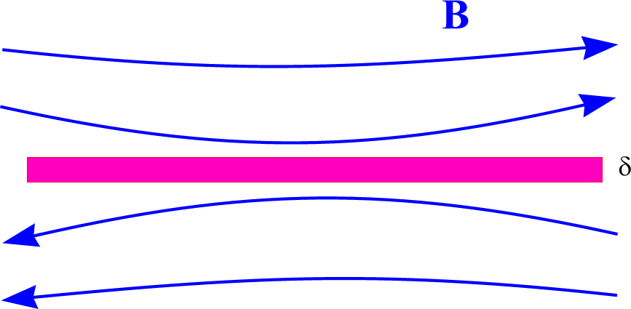
Beyond the ideal MHD:
magnetic dissipation in Poynting dominated outflows
The magnetic energy could be extracted via anomalous dissipation
that comes into play if the magnetic field varies at micoscopic scale (e.g., in narrow current sheets).
current sheet
How differently oriented magnetic field
lines could come close to each other?
Global MHD instabilities could disrupt the regular structure of the magnetic field thus liberating the magnetic energy.
Alternating magnetic field could be present in the flow from the very beginning (striped wind).

Slide 16
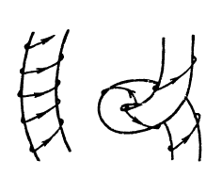
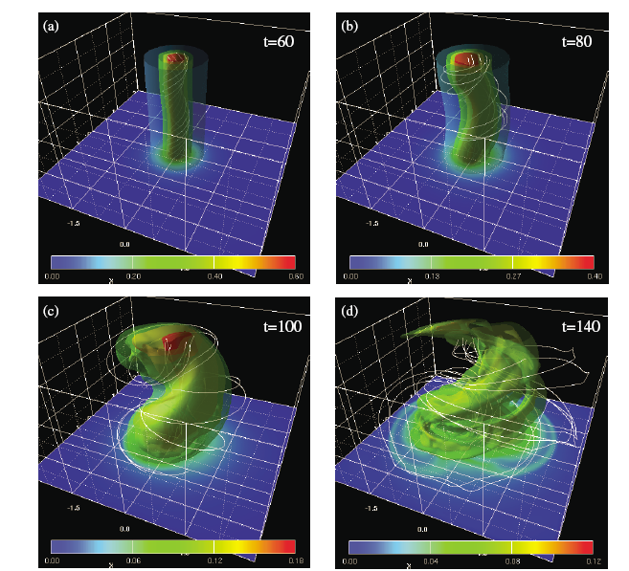
Global MHD instabilities
The most dangerous is the kink instability.
In expanding jets, the necessary condition for the instability – strong causal connection, γΘ<1. Not fulfilled in GRBs; fulfilled in AGNs.
Simulations of the kink instability; time is in units r_{j}/c (Mizuno et al 2012)

Slide 17
Kink instability in relativistic jets
The instability growth rate in the comoving frame :
For a static column, ζ∼0.1.
Cylindrical equilibrium:
Simulations of jet launching by a spinning accreting black hole reveal that in real Poynting-dominated jets, the poloidal field is very close to uniform (Tchekhovskoy et al. ‘08). The kink instability is saturated in this case (Mizuno et al ‘12).
But when the jet is accelerated up to σ ∼ 1, the poloidal flux is concentrated toward the axis (Beskin Nokhrina ‘09; L ‘09); such a configuration is subject to disruptive kink instability (Mizuno et al ‘12).
A possible scenario for the magnetic energy release in strongly causally connected jets (AGNs): they are smoothly accelerated up to σ~1 and then the regular structure is disrupted by the kink instability.

Slide 18
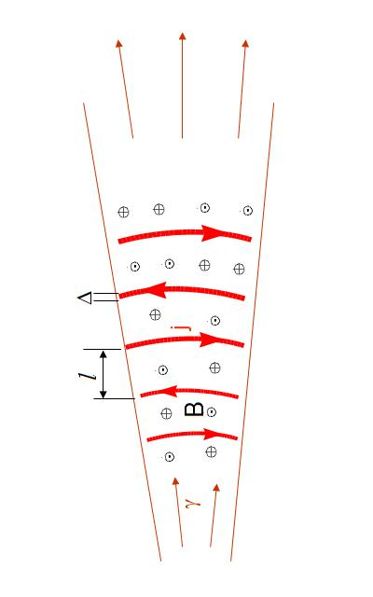
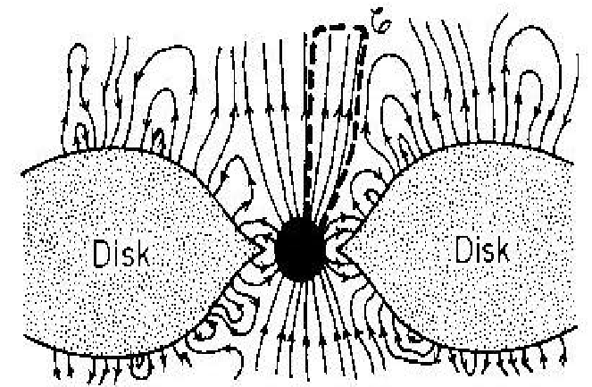
Could alternating magnetic field be presented in the flow from the very beginning?
Let alternating fields preexist in the jet
In an expanding flow, B becomes predominantly toroidal; current sheets are stretched. Local structure: plane current sheet separating oppositely directed fields. What is the magnetic dissipation mechanism in this case?

Slide 19
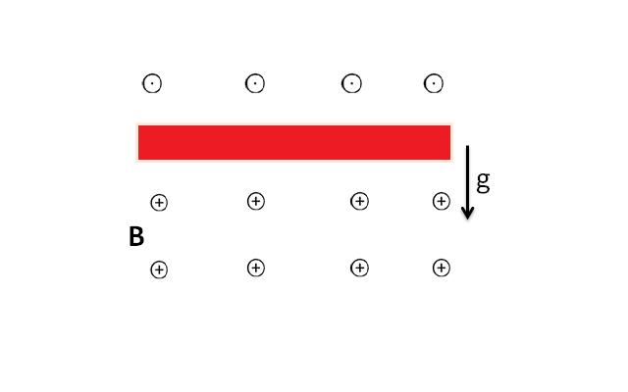
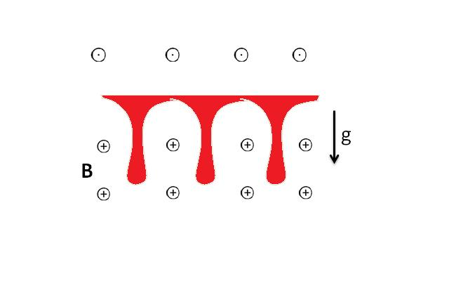


Rayleigh-Taylor instability of current sheets
in accelerating flows (L ‘10)
$$g=c^{2}\frac{dγ}{dr}$$
In an accelerating relativistic flow
$$p=\frac{B^{2}}{8π}$$
Δ
j
Time scale

Slide 20
acceleration
Rayleigh-Taylor instability
annihilation of oppositely directed fields
Due to dissipation, the magnetic field decreases faster than 1/r;
then the outward magnetic pressure gradient is not compensated by the hoop stress acceleration

Slide 21
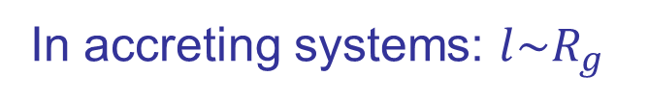
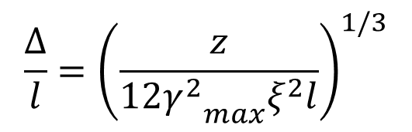
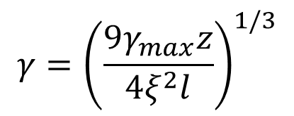
Interplay between acceleration and dissipation;
a self-consistent picture
$$γ={\left(\frac{9γ_{max}z}{4ξ^{2}l}\right)}^{1/3}$$
$$\frac{Δ}{l}={\left(\frac{z}{12{γ_{}^{2}}_{max}^{}ξ^{2}l}\right)}^{1/3}$$
Complete dissipation: $Δ\sim l; γ\sim γ_{max}; z_{diss}\sim {\left(ξγ_{max}\right)}^{2}l$
In accreting systems: $l\sim R_{g}$
AGNs
GRBs

Slide 22
Conclusions
1. External confinement is crucial for efficient collimation and acceleration
of Poynting dominated outflows.
2. Efficient acceleration is possible only in causally connected flows.
3. In Ponting dominated jets, the conventional two-step model
Poynting kinetic radiating particles
faces difficulties in both steps. A one-step process
Poynting radiating particles
looks promising. This implies either global MHD instability ( kink) or
alternating fields preexisted in the flow.
4. The magnetic energy could be released due to the kink instability in
strongly causally connected flows (γΘ<1, fulfilled in AGNs) after the
equipartition (σ~1) is achieved.
5. If alternating field preexisted in the flow, they are efficiently dissipated via
the Rayleigh-Taylor instability. The necessary effective gravity is self-
consistently maintained because magnetic dissipation results in the
acceleration of the flow.

