Slide 1

Ultra-high Resolution Space-VLBI Imaging of Jets in Nearby AGN
Tuomas Savolainen
Aalto University Metsähovi Radio Observatory, Finland
Max-Planck-Institut für Radioastronomie, Germany
On behalf of the RadioAstron Nearby AGN Key Science Program team:
J.Anderson, U.Bach, B.Boccardi, C.Casadio, G.Bruni, P.Edwards, J.Eilek, C.Fromm, G.Giovannini, M.Giroletti, K.Hada, P.Hardee, Y.Hagiwara, J.Hodgson, M.Honma, M.Kino, Y.Y.Kovalev, T.Krichbaum, A.Lobanov, S.S.Lee, D.Meier, M.Orienti, H.Nagai, S.O’Sullivan, C.Reynolds, B.W.Sohn, K.V.Sokolovsky, S.Tingay, J.A.Zensus

Slide 2
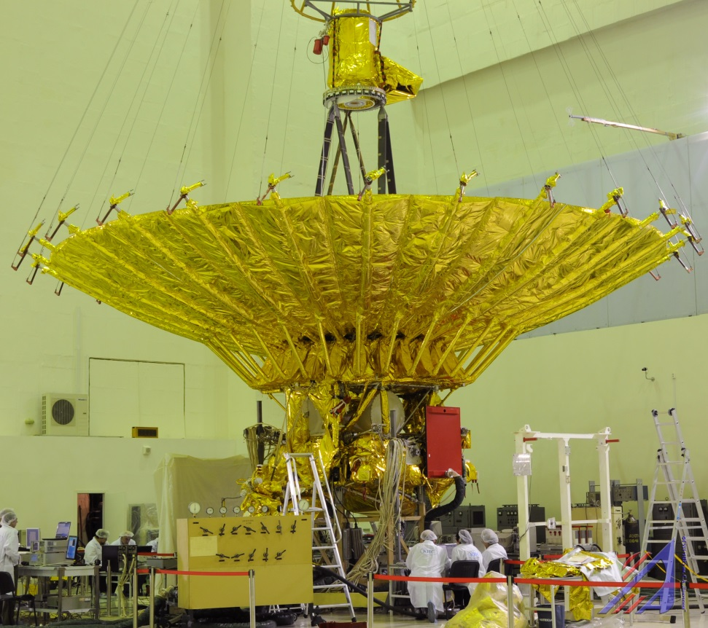
RadioAstron Space-VLBI Project
10-m orbiting antenna
Launched in July 2011
Highly elliptical orbit: baselines from ~1000 km to 350000 km
Works together with the largest ground radio telescopes to form an ultra high resolution interferometer
Receivers onboard:
  0.33, 1.6, 5 and 18-25 GHz
Max. angular resolution: 7µas
32 MHz bandwidth, dual-pol.
Project led by the Astro Space Center of Lebedev Physical Institute, Russia
Kardashev+ 2013

Slide 3
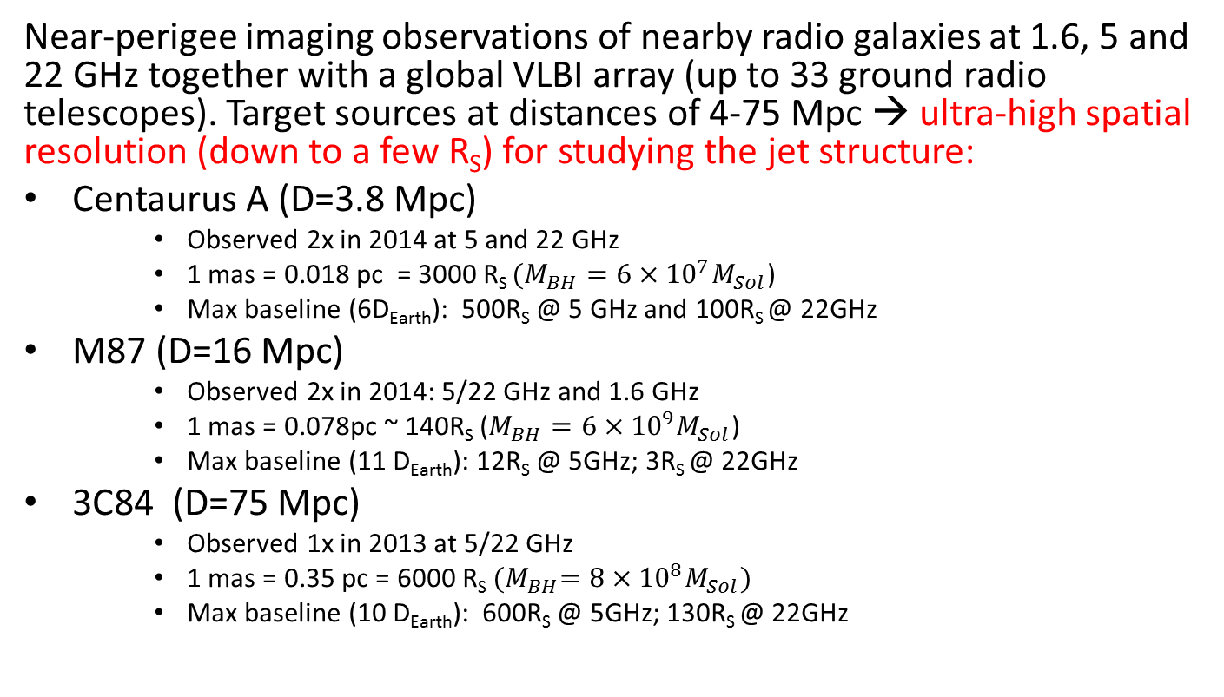
RadioAstron Nearby AGN
Key Science Program
Near-perigee imaging observations of nearby radio galaxies at 1.6, 5 and 22 GHz together with a global VLBI array (up to 33 ground radio telescopes). Target sources at distances of 4-75 Mpc → ultra-high spatial resolution (down to a few R_{S}) for studying the jet structure:
Centaurus A (D=3.8 Mpc)
    Observed 2x in 2014 at 5 and 22 GHz
    1 mas = 0.018 pc = 3000 R_{S} $(M_{BH}=6×{10}^{7}M_{Sol}$)
    Max baseline (6D_{Earth}): 500R_{S} @ 5 GHz and 100R_{S} @ 22GHz
M87 (D=16 Mpc)
    Observed 2x in 2014: 5/22 GHz and 1.6 GHz
    1 mas = 0.078pc ~ 140R_{S} ($M_{BH}=6×{10}^{9}M_{Sol}$)
    Max baseline (11 D_{Earth}): 12R_{S} @ 5GHz; 3R_{S} @ 22GHz
3C84 (D=75 Mpc)
    Observed 1x in 2013 at 5/22 GHz
    1 mas = 0.35 pc = 6000 R_{S} ${(M}_{BH}=8×{10}^{8}M_{Sol})$
    Max baseline (10 D_{Earth}): 600R_{S} @ 5GHz; 130R_{S} @ 22GHz

Slide 4
First results:
Space-vlbi imageS of 3C84

Slide 5
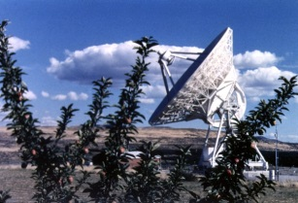
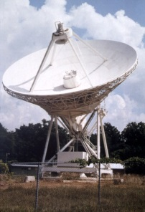
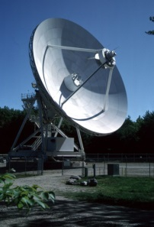
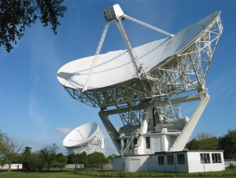
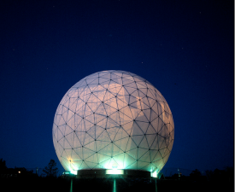
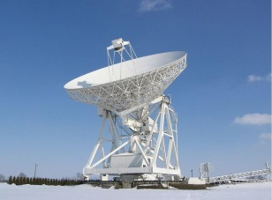
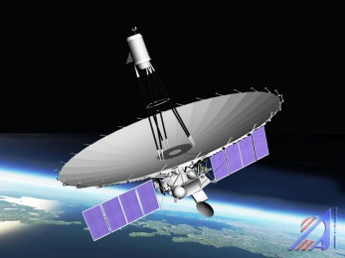
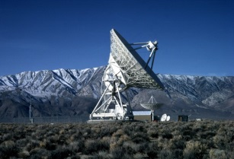
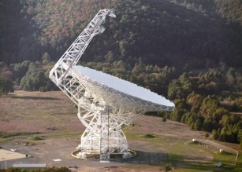
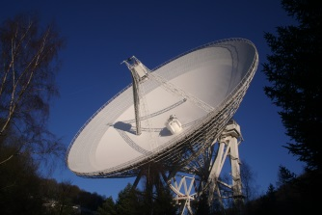
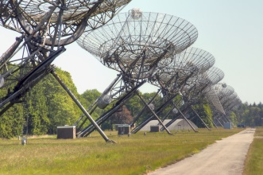
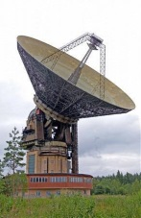
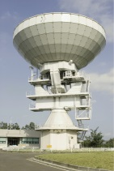
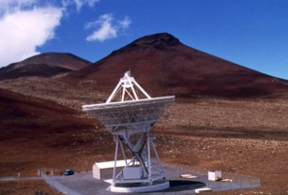
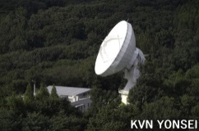
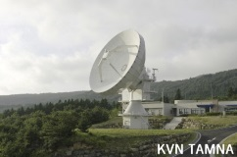

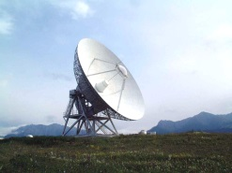
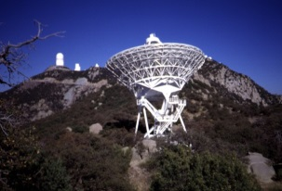
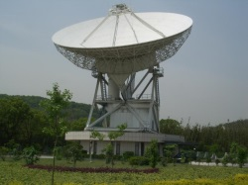
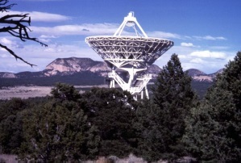
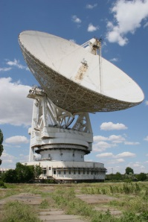
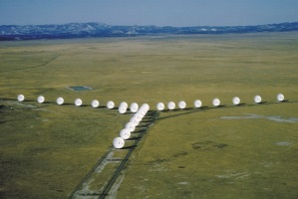
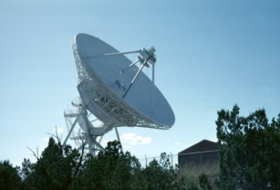
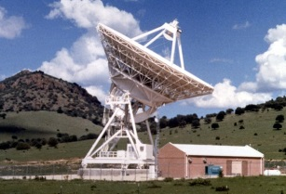
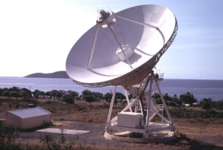
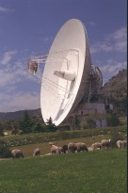
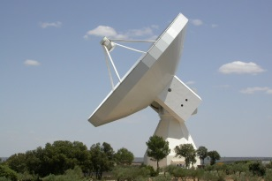
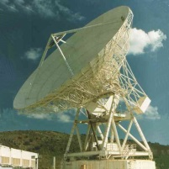
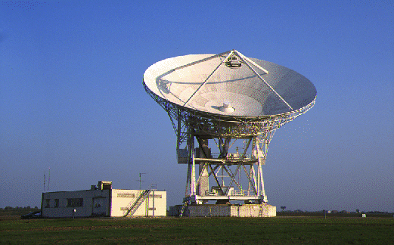
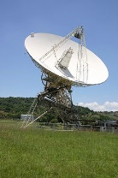
3C84 on Sep 21 2013
5 GHz 22 GHz 5/22 GHz

Slide 6
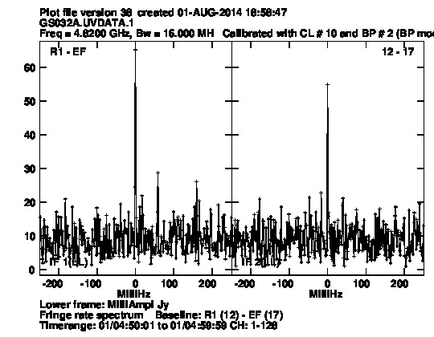
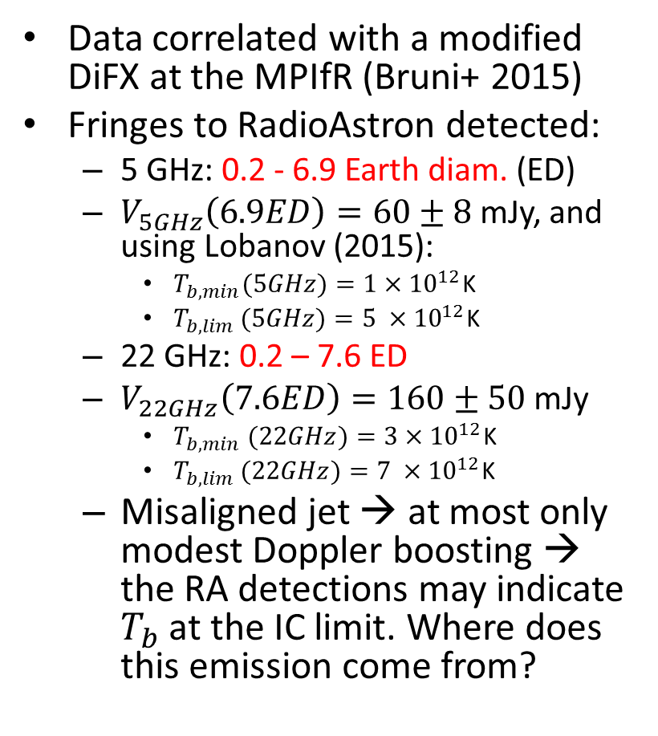
3C84 RadioAstron observations on Sep 21 2013 (5/22 GHz)
Data correlated with a modified DiFX at the MPIfR (Bruni+ 2015)
Fringes to RadioAstron detected:
  5 GHz: 0.2 - 6.9 Earth diam. (ED)
  $V_{5GHz}\left(6.9ED\right)=60±8$mJy, and using Lobanov (2015):
    $T_{b,min}(5GHz)=1×{10}^{12}$K
    $T_{b,lim }(5GHz)=5 ×{10}^{12}$K
  22 GHz: 0.2 – 7.6 ED
  $V_{22GHz}\left(7.6ED\right)=160±50$mJy
    $T_{b,min} (22GHz)=3×{10}^{12}$K
    $T_{b,lim }(22GHz)=7 ×{10}^{12}$K
  Misaligned jet → at most only modest Doppler boosting → the RA detections may indicate $T_{b}$ at the IC limit. Where does this emission come from?
5 GHz fringe on RA-EF baseline
6.9ED (1.4Gλ) SNR = 8.6

Slide 7
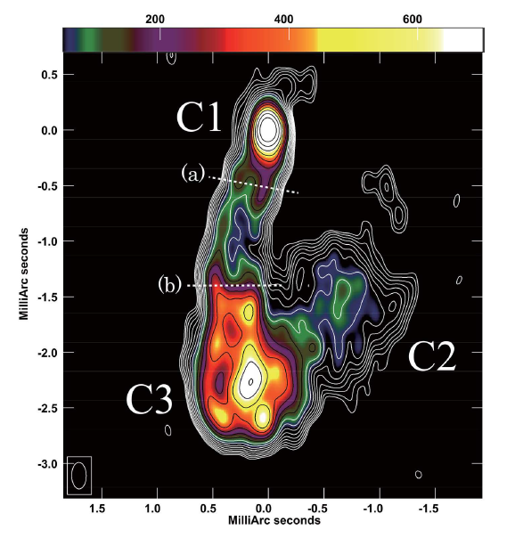
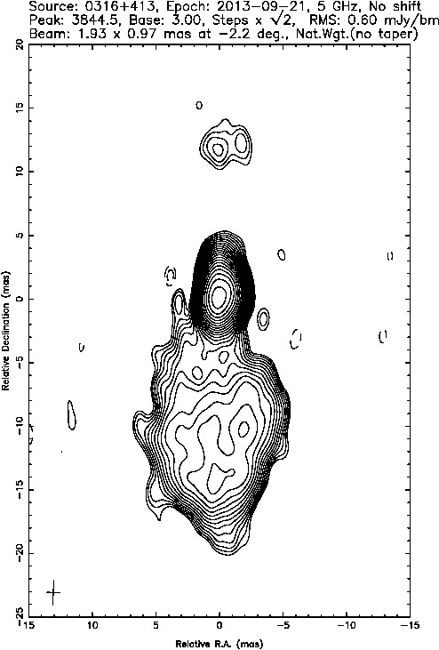
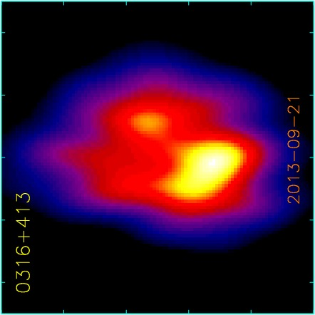
3C84
5 GHz RadioAstron image
Space-VLBI image 5GHz
Ground-VLBI image
5 GHz
1 mas
0.35 pc
43 GHz VLBA Jan 2013
Nagai et al. (2014)
T_{b} > 1x10¹² K
?
C3 is a slow feature related to the restarted jet activity in the 2000s (Suzuki+ 2012)
(u,v) range 0-700Mλ
Beam: 0.9x0.5mas

Slide 8
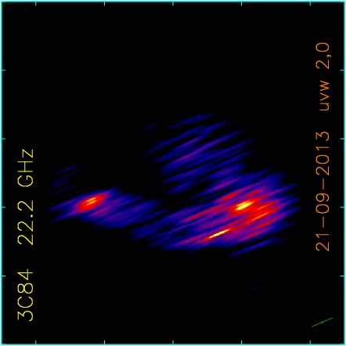
3C84
22 GHz RadioAstron image
Full resolution
1 mas
0.35 pc
Beam: 0.03x0.32 mas

Slide 9
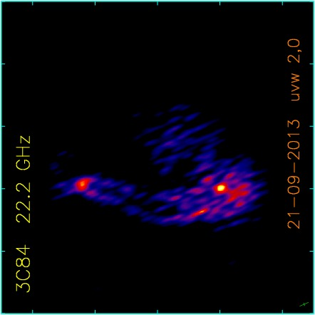
3C84
22 GHz RadioAstron image
Slightly super-resolved in one direction
1 mas
0.35 pc
Core
Clearly edge-brightened jet
Hot spot inside the moving feature C3 – the structure resembles that commonly seen in simulations of a working surface between jet and ambient medium
“Hot spot”
Mach disk /
reverse shock?
Beam: 0.05x0.15 mas

Slide 10
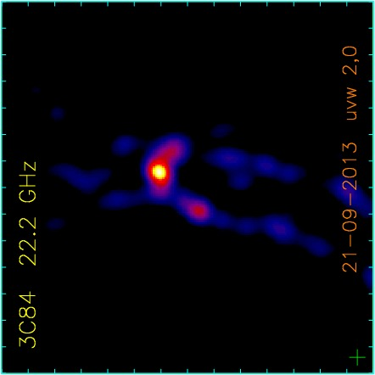
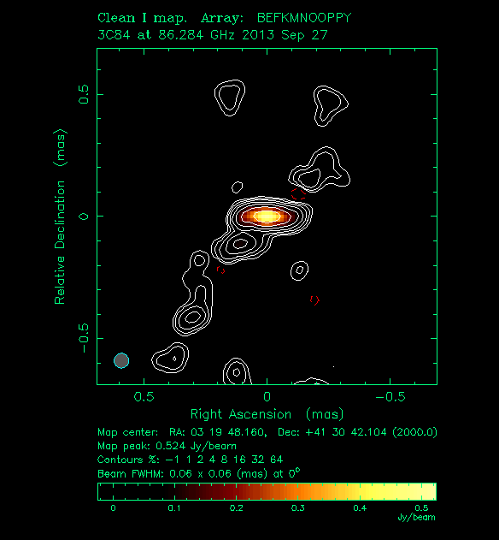

3C84 core structure
Strongly super-resolved in one direction
0.3 mas
0.1 pc
Core is resolved in direction transverse to the jet – the brightest feature is in the middle of the flow
Edge-brightened emission upstream of the core
What is the core here?
  A re-collimation shock?
  The base of jet?
$$\sim 2000r_{g}$$
GMVA
Hodgson et al.
Preliminary
0.06x0.06mas
“super-resolved”

Slide 11
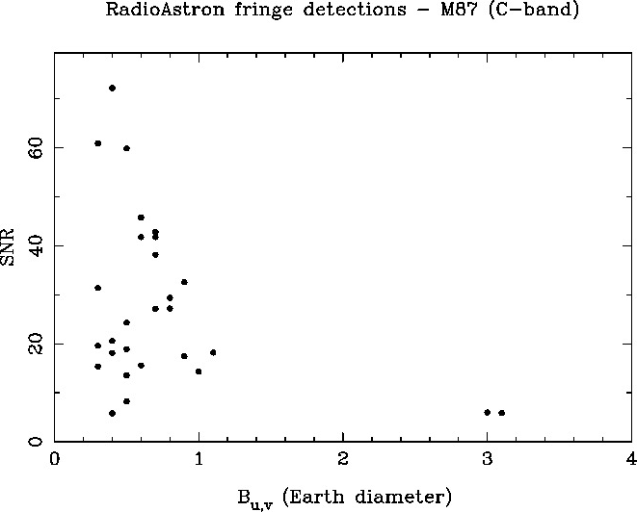
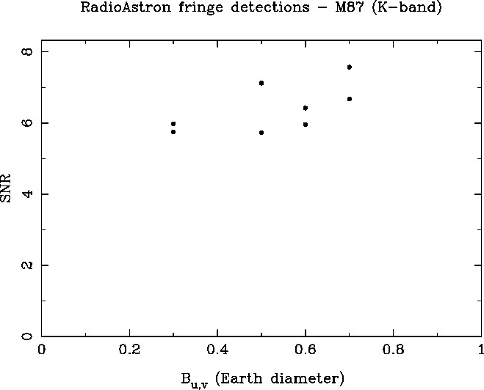
More early results:
M87 space fringes detected
5 GHz
22 GHz
Mostly no detections on baselines longer than Earth diameter → no ultra-compact structure brighter than RA detection limit
Baseline stacking could yield a few more detections, though
Imaging in progress

Slide 12
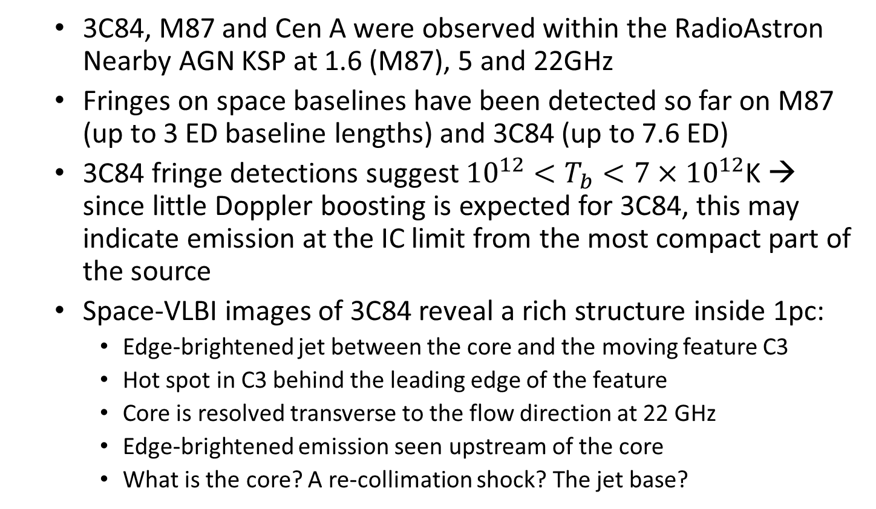
Summary
  3C84, M87 and Cen A were observed within the RadioAstron Nearby AGN KSP at 1.6 (M87), 5 and 22GHz
  Fringes on space baselines have been detected so far on M87 (up to 3 ED baseline lengths) and 3C84 (up to 7.6 ED)
  3C84 fringe detections suggest ${10}^{12}<T_{b}<7×{10}^{12}$K → since little Doppler boosting is expected for 3C84, this may indicate emission at the IC limit from the most compact part of the source
  Space-VLBI images of 3C84 reveal a rich structure inside 1pc:
    Edge-brightened jet between the core and the moving feature C3
    Hot spot in C3 behind the leading edge of the feature
    Core is resolved transverse to the flow direction at 22 GHz
    Edge-brightened emission seen upstream of the core
    What is the core? A re-collimation shock? The jet base?

Slide 13
Backup slides

Slide 14
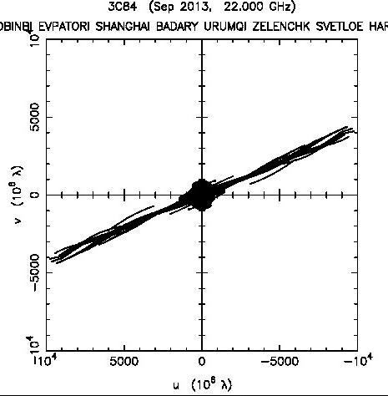
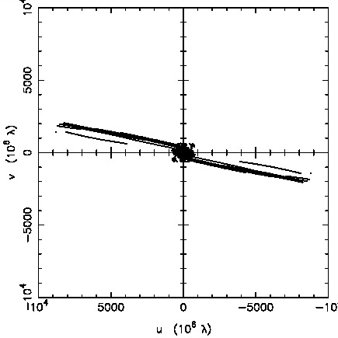
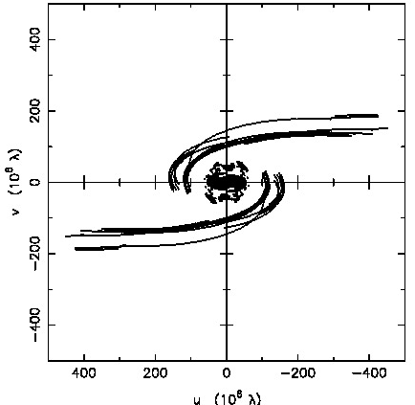
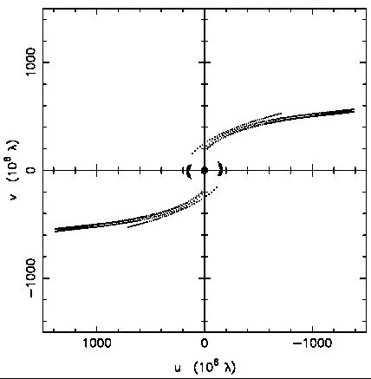
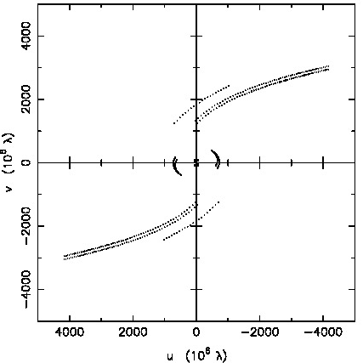
Nearby AGN KSP observations in AO-1
3C 84
5/22 GHz
Sep 21 ’13
~10 D_{Earth}
M87
5/22 GHz
Feb 4 ’14
~11 D_{Earth}
M87
1.6 GHz
Jun 4 ’14
~6 D_{Earth}
  30 ground stations
  33 ground stations
  30 ground stations
Cen A
5/22 GHz
Feb 13 ’14
~6 D_{Earth}
Cen A
22 GHz
Mar 27 ’14
~4 D_{Earth}
  5 ground stations
  6 ground stations

Slide 15
Residual acceleration of the RadioAstron
Notes:
Describe here self-calibration of RadioAstron data

Slide 16
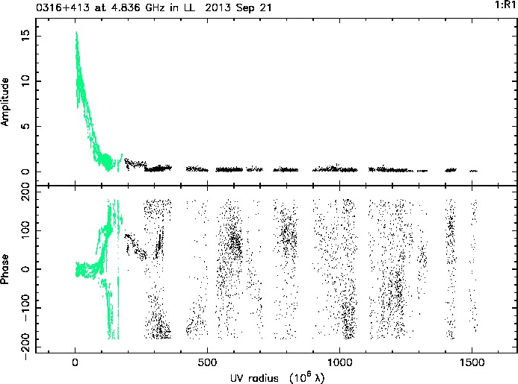
3C84 at 5GHz
RadioAstron visibilities
Green: Ground-ground baselines
Black: Baselines to RadioAstron
Notes:
Describe here self-calibration of RadioAstron data

Slide 17

3C84 at 5GHz
- calibration accuracy of the SRT
Green: Ground-ground baselines
Black: RadioAstron-Kalyazin baseline (<1ED)

Slide 18


3C84 at 5GHz with space baselines
RA data and ground-only model
RA data and ground+space model

Slide 19

3C84 at 5GHz ground-only image

Slide 20


3C 84 at 5GHz – Full resolution
uvw 2,-0.5
uvw 2,0

Slide 21


3C84 - Other frequencies
5 GHz
5 GHz
15 GHz
43 GHz
Core
1 mas
Peak: 1.5 Jy/beam
beam 0.9x0.5mas
Peak: 5.3 Jy/beam
beam 0.8x0.3mas
Peak: 2.5 Jy/beam
beam 0.4x0.15mas

Slide 22


3C84 - Spectra
C1
+1.8
C1, C2 and C3 ALL have inverted spectrum at 5GHz
+1.1
C2
C3
+1.3
+1.1
-1.0
5-15 GHz spectral index
-0.5
15-43 GHz spectral index

