Slide 2
The Jet Recollimation Shock: A Dramatic Altering of Jet Magnetic and Kinematic Structure On Difficult-to-Observe Scales
David L. Meier & Marshall H. Cohen
California Institute of Technology
Relativistic Jets: Creation, Dynamics, & Internal Physics
Krakow, Poland; 21 April 2015

Slide 3
Conclusions
Launching, acceleration, & collimation are NOT the whole jet formation story
It appears that in at least most strong AGN jets there is a significant feature/event in the propagation of a super-magnetosonic jet: a quasi-stationary (re-)collimation shock (RCS)
The RCS appears to convert the pinch-unstable flow into a stable one that continues out to the ~100 kpc lobes
This feature occurs on scales intermediate between black hole and lobes
It is very far from the BH in r_{g} (10⁴⁻⁶) but well within the galactic core
However, it is very difficult to distinguish on the sky from the BH itself:
Nearby (z ~ 0.1): 40 – 4000 μas (foreshortened blazar); 400 – 40,000 μas (if jet is in plane of sky)
Far (z ~ 1.0): 10 – 1000 μas (foreshortened blazar); 100 – 10,000 μas (if jet is in plane of sky)
The RCS in M87 (HST-1) appears to be responsible for the jet "break" (cf. Nakamura)
The RCS also may play an important role in the FR I / II dichotomy
The only telescopes that can distinguish RCS activity from BH activity are: the EVN (>5000 μas), the VLBA (>100 μas), and the EHT (> 10 μas)
VLBI IS ABSOLUTELY CRUCIAL TO UNDERSTANDING JET FORMATION

Slide 4
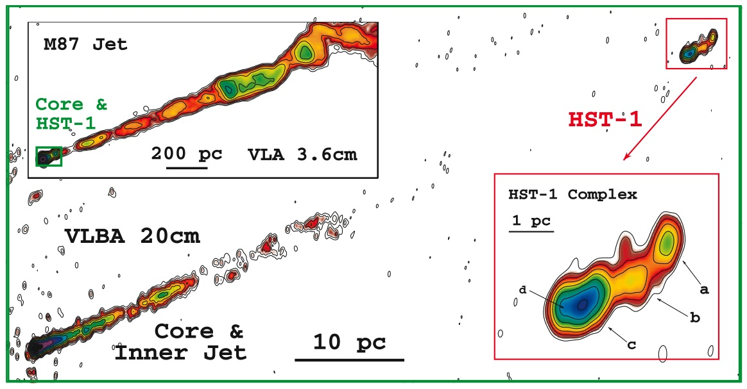
M87: The Rosetta Stone
M 87 VLA & VLBA (Cheung, Harris, Stawarz 2007)
Standard VLA View
VLBA Blowup of Core & HST-1 Region
Trans-Magnetosonic Post-Shock Flow with Strong Helical Field
Even Possible Multiple Ejections of Components
Super-Magnetosonic Jet Lead-In
(Re-) Collimation Shock
IDEAL MHD Super-Mag-sonic Jet
Lind, Payne, dlm, & Blandford (1989); Komissarov (1999) also Nakamura & dlm (2014)
Similar recollimation shock systems are seen in other BL Lac / FR I-type sources (BL Lac, OJ 287, 3C 120, etc.)
IDEAL MHD flow of a super-magnetosonic jet, without Ohmic dissipation, seems to be a good model for flow near FR I (BL Lac) recollimation shocks

Slide 5
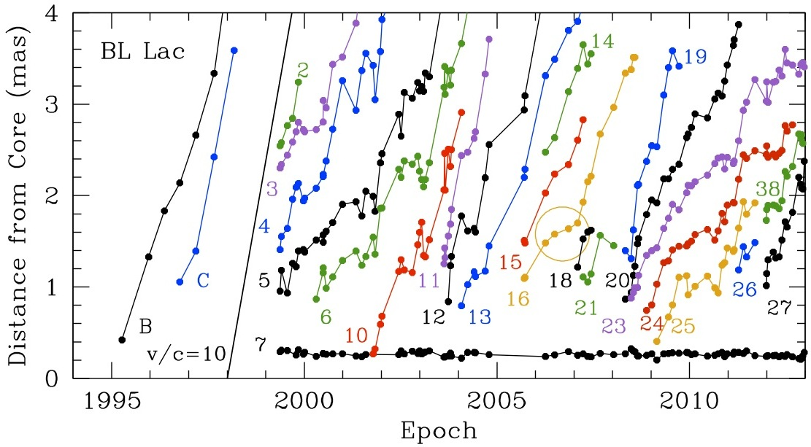
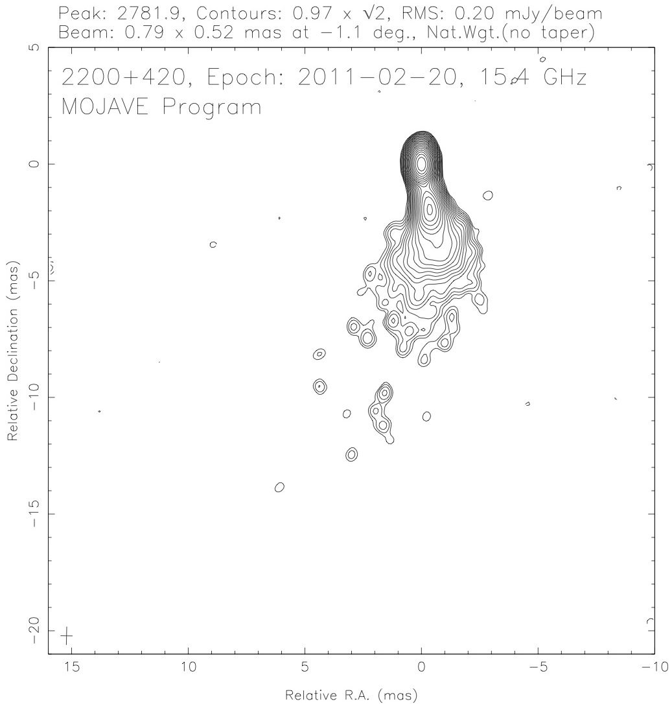
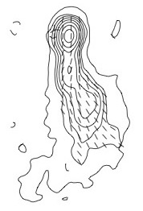
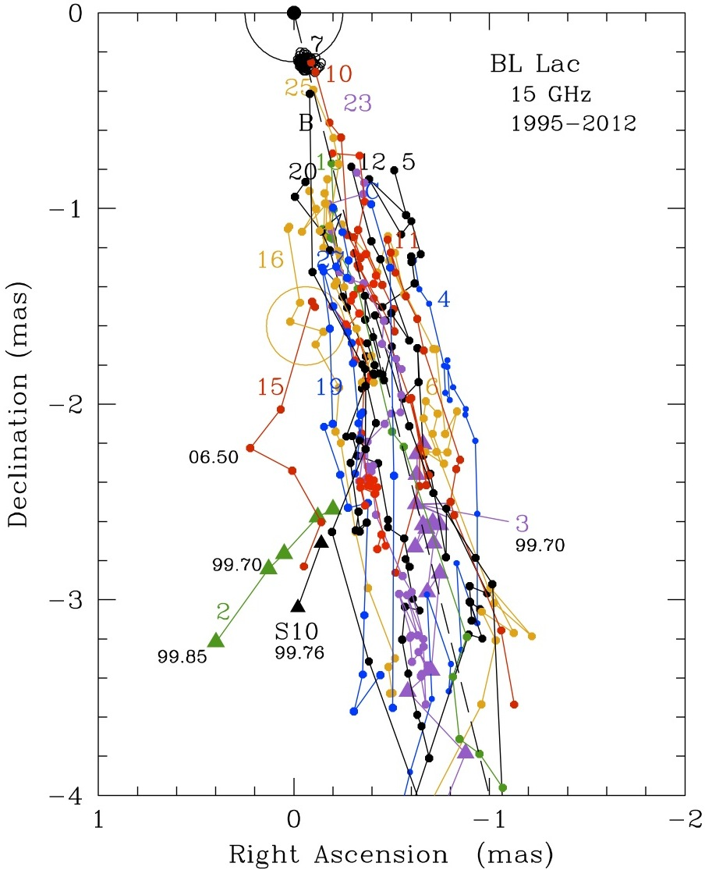
BL Lac: Confirmation of RCS (Quasi-) Stationarity (Cohen, dlm, et al. 2014)
BL Lac vs. M87
Smaller black hole ( [~0.1– 0.3 vs. ~6] × 10⁹ M)
Pointed more toward Earth (~6° vs. 14° to line-of-sight)
Further away (~270 vs. 15 Mpc [ang. size distance])
➔ RCS should be ~0.3 pc from BH or ~ 0.2 mas from core (projected)
Of all BL Lac components, only C7 & core are stationary
Moving components emanate from C7 (not the core), like HST-1
So, we suggest that C7 is the BL Lac jet recollimation shock, just like HST-1
The Post-RCS Jet (“current-carrying”)
EVPA is primarily longitudinal in BL Lac (objects) ➔ X-verse magnetic field
Fractional polarization increases with distance from core ➔ conical flow
The Moving Components in BL Lac
All are relativistic (2c < V_{app} < 10c)
We modeled the slowest component as a slow MHD wave and fastest as a fast MHD wave
Assuming V_{S} ~ 0 in jet frame, we find Γ_{F}^{jet} ≈ 1.7 in jet frame and Γ_{jet}^{gal} ≈ 3.5, in galaxy frame
This model does not allow us to determine relative magnetic field strength, V_{A} or c_{ms} in jet frame, but Γ_{jet} results similar to Nakamura’s HST-1 simulations
Cohen & the MOJAVE VLBA team (2014)
Electric Vector Polarization Angle plot
VLBA resolution = 0.1 mas !!!
ALL VLBA DATA

Slide 6
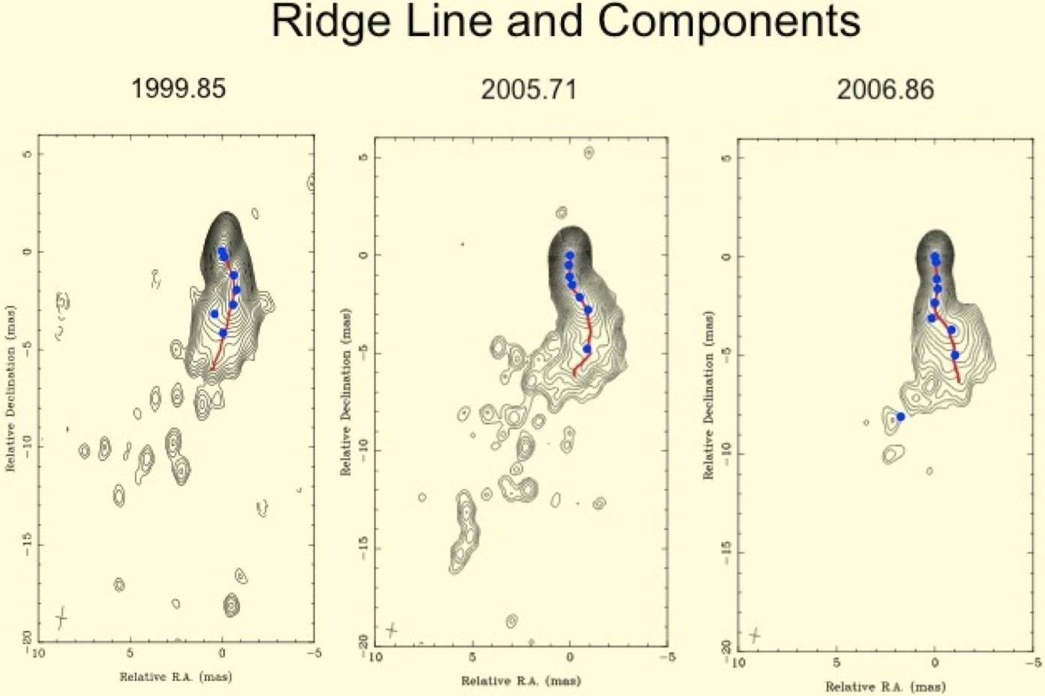
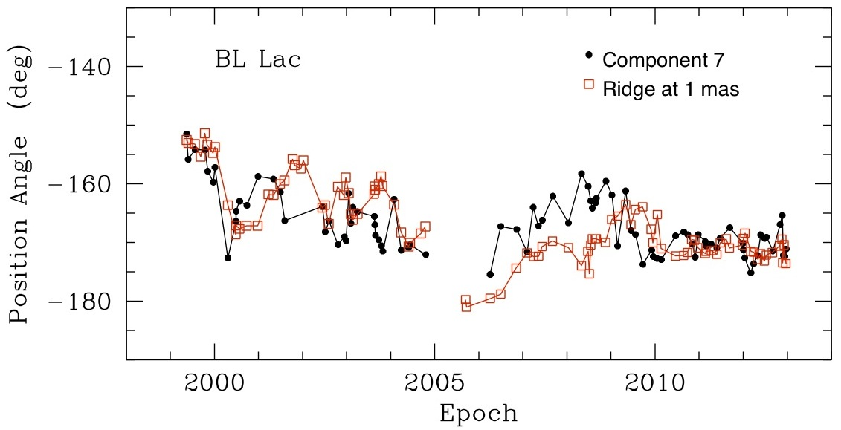
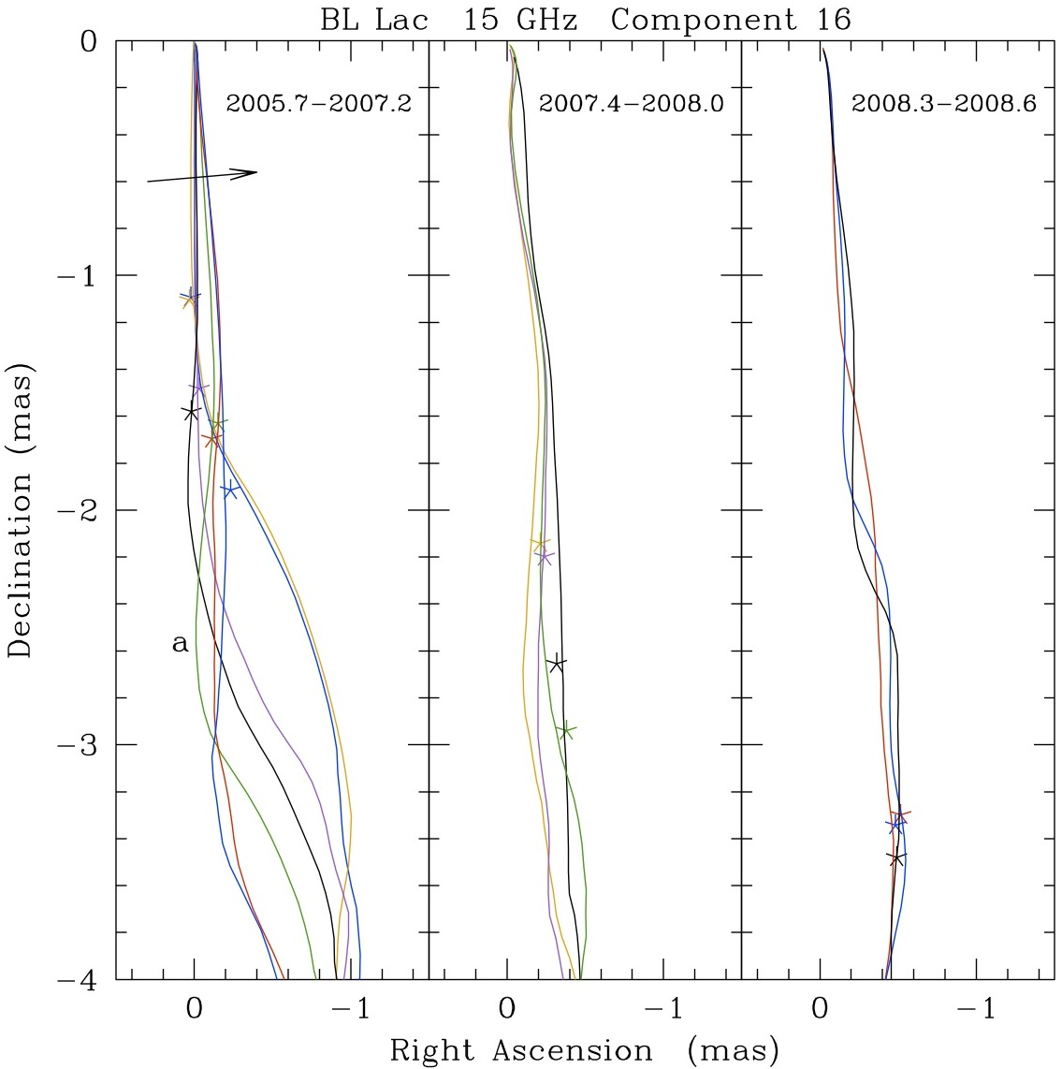
BL Lac: Confirmation of Strong Helical Magnetic Field In Post-RCS Flow (Cohen, dlm, et al. 2015)
BL Lac displays RELATIVISTIC Transverse Waves !!
Wiggles that propagate down the jet with time
These waves seem to be generated by transverse shifts in the RCS w.r.t. the core and, hence, in the inner jet position angle
Speed of the wave is between slowest & fastest components:
2c < [V_{app,wave} = 4.9c] < 10c
Moving components (e.g., C16) is drawn aside by wave
Components are not ballistic “blobs”
We modeled the transverse waves as Alfven waves on B_{Z}
Specific model:
V_{jet} ~ c_{ms} (transmagnetosonic flow; cf. LPMB, Bicknell) in galaxy frame
V_{wave} = V_{A} cos χ in jet frame (i.e., assume helical field)
Slowest & fastest components are c_{s} cos χ & V_{F} in jet frame, respectively
Model results: Γ_{jet}^{gal} ≈ 2.8 in galaxy frame;
In jet frame c_{s} = 0.3c, V_{A} = 0.857c, c_{ms} = 0.870c, M_{ms} = 1.5, χ = 43°
V_{S} = 0.22c (Γ_{S}^{jet} ≈ 1.025)
V_{wave} = 0.63c (Γ_{wave}^{jet} ≈ 1.29)
V_{F} = 0.86c (Γ_{F}^{jet} ≈ 2.0)
NOTE: pitch angle derived from MHD wave models (43°) is smaller than derived from BL Lac pol obs (>60°), but this implies M_{ms} ~ 5
MHD simulations, with shocks, are being run to get better models
V_{app} = 4.9c
ALL VLBA DATA

Slide 7
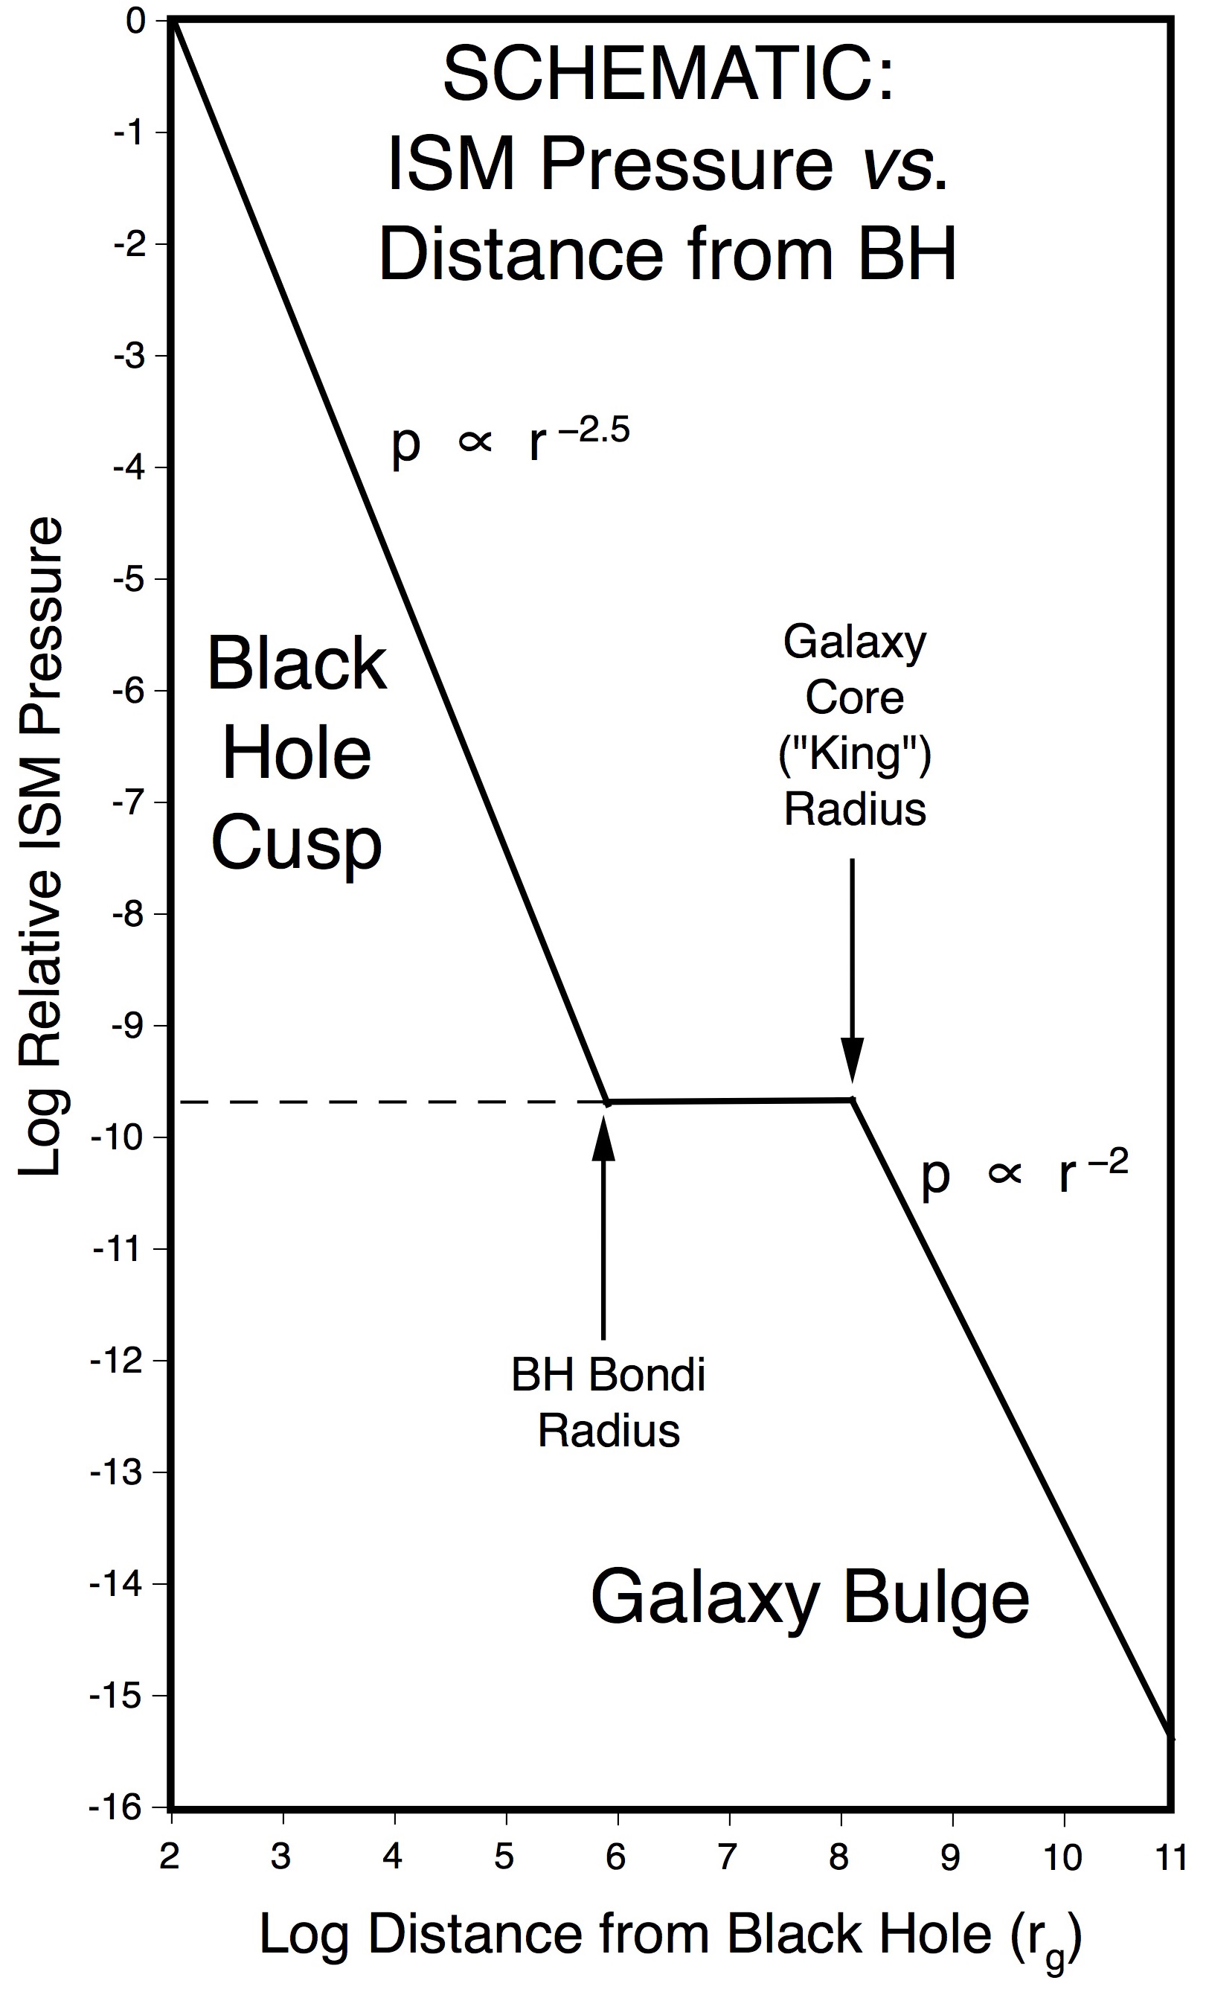
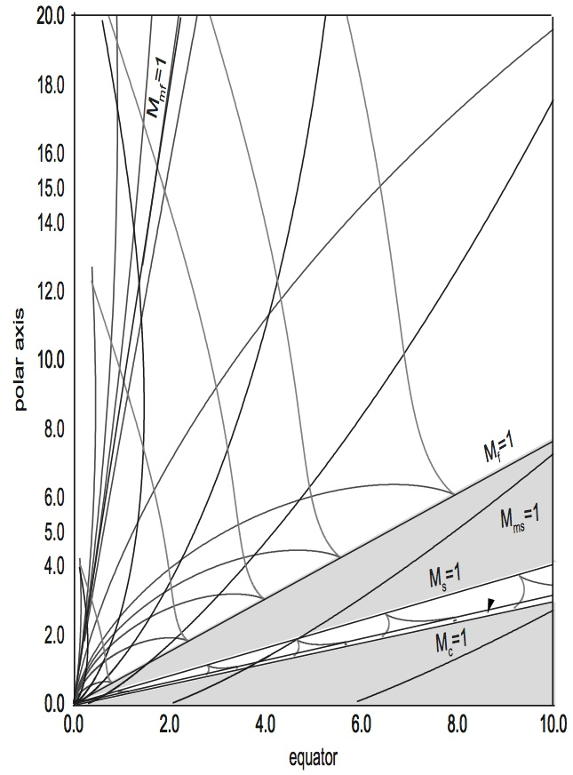
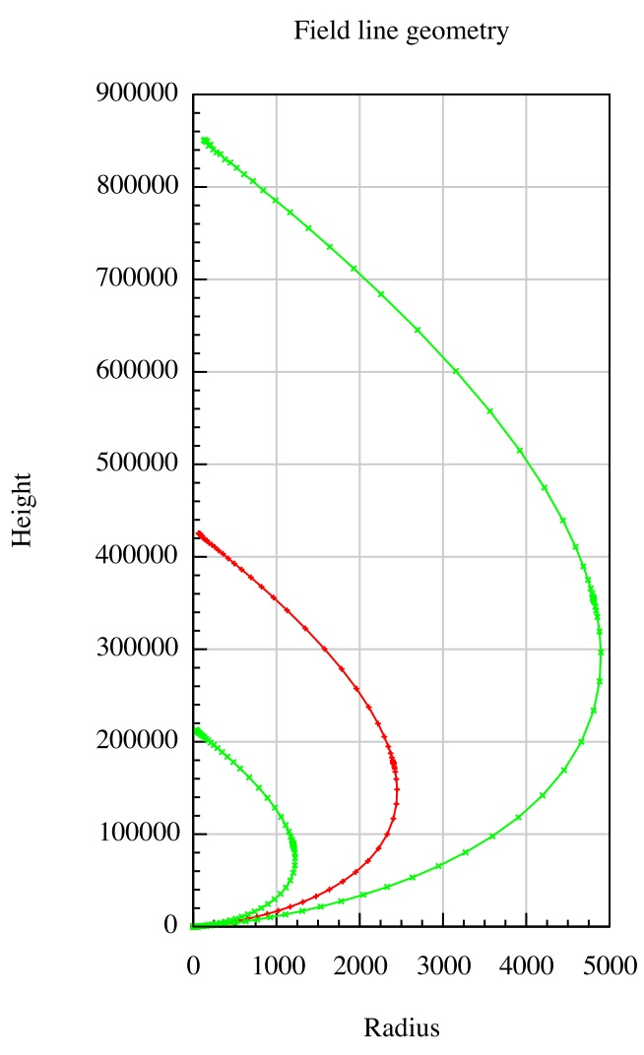
What Would Cause a Recollimation Shock to Form So Far from the Black Hole?
External collimation: change in ISM pressure profile at BH Bondi radius (Asada & Nakamura 2012; Nakamura & Asada 2013)
Jet accelerates & collimates in a decreasing BH cusp pressure gradient
Near the Bondi radius, jet enters uniform pressure region and overcollimates
Problem?: FR II-type RCSs may occur 100x closer than r_{B} (Cohen et al. 2014)
Self-collimation: magnetic focusing beyond the Fast Magnetosonic Separatrix Surface (Achterberg, Blandford, Goldreich 1983; Vlahakis et al. 2000; Polko, dlm, Markoff 2010, 2013, 2014)
Specific model: self-similar axisymmetric relativistic MHD, with 3 critical points applied (Alfven, modified fast [FMSS], modified slow [SMSS])
Requiring an FMSS (magnetosonic horizon) produces jet focusing
More careful measurements of BH – RCS distances are needed in many AGN in order to understand the over-collimation mechanism
➔ Many VLBA & EHT observations – even SPACE VLBI
SHOCK
FMSS
FR I-type
FR II-type
Vlahakis et al. (2000) (non-relativistic)
SHOCK
FMSS
Polko et al. (2010,13,14)

Slide 8
Length Scales of ~r_{B} and 10^{4.2} r_{g} are Difficult to Discern in AGN
EXAMPLE: 10⁹ M black hole
Case 1: r_{RCS} ≈ r_{B} ≈ 84 pc ➔ mas separation (certainly FR I / BL Lacs; maybe FR II also)
Nearby (z = 0.1): 45 mas (jet in plane of sky) ➔ < 5 mas (foreshortened in blazar)
Far (z = 1.0): 10 mas (jet in plane of sky) ➔ ~ 1 mas (foreshortened in blazar)
Case 2: r_{RCS} ≈ 10^{4.2} r_{g} = 0.75 pc ➔ μas separation (maybe some/all FSRQs & FR IIs?)
Nearby (z = 0.1): 400 μas (jet in plane of sky) ➔ 40 μas (foreshortened in blazar)
Far (z = 1.0): 90 μas (jet in plane of sky) ➔ 9 μas (foreshortened in blazar)
*** Most Telescopes Cannot Distinguish Between BH and RCS activity ***
Fermi LAT: angular resolution ~ 10⁶⁻⁷ mas
NuSTAR / PolSTAR (X-Calibur) ~ 10⁴⁻⁵ mas
HST / JWST ~ 50 – 100 mas
ALMA ≥ 5 mas
Only VLBA, maybe EVN, and eventually EHT
EVN ≤ 0.5 mas
VLBA ~ 0.1 mas (super-resolution mode; δθ ~ [S / N]^{−1/2})
EHT ≤ 10 μas
In order to identify where the source activity is occurring, *** Most Telescopes will Need to Correlate Time-Dependent Activity with VLBA or Other VLBI Telescope Images ***
VLBI IS ABSOLUTELY CRUCIAL TO UNDERSTANDING JET FORMATION

Slide 9
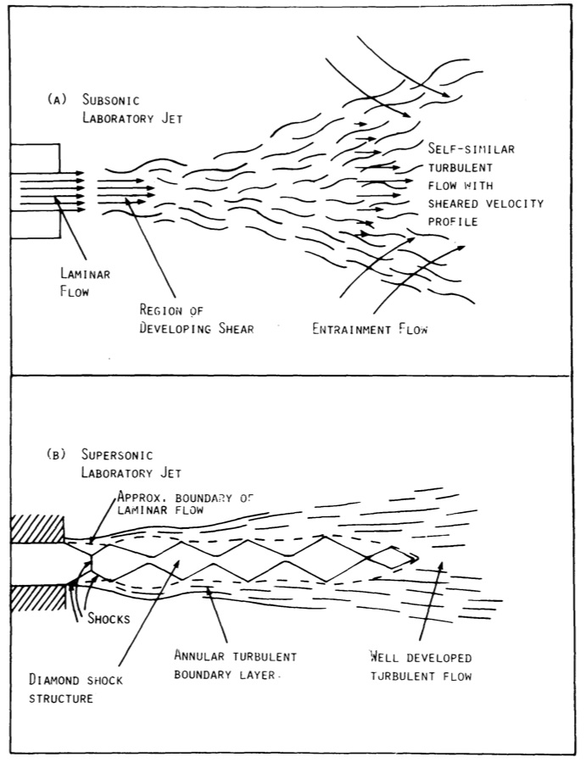
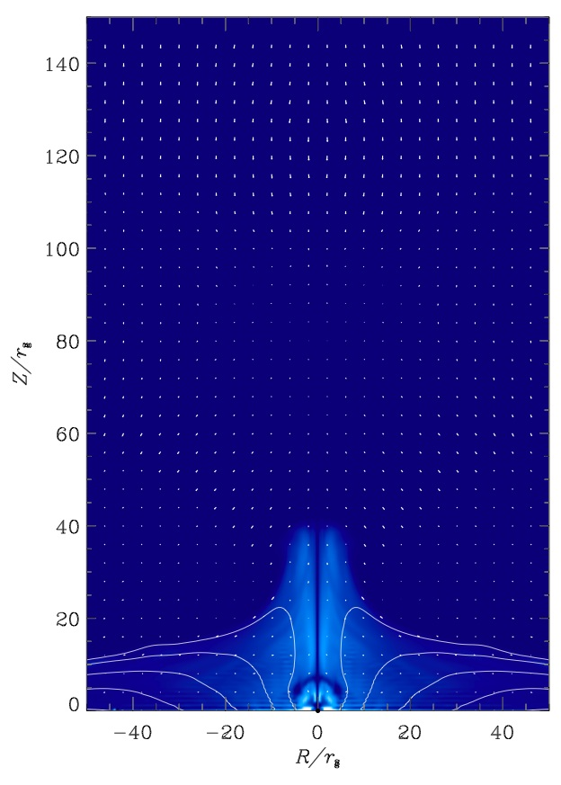
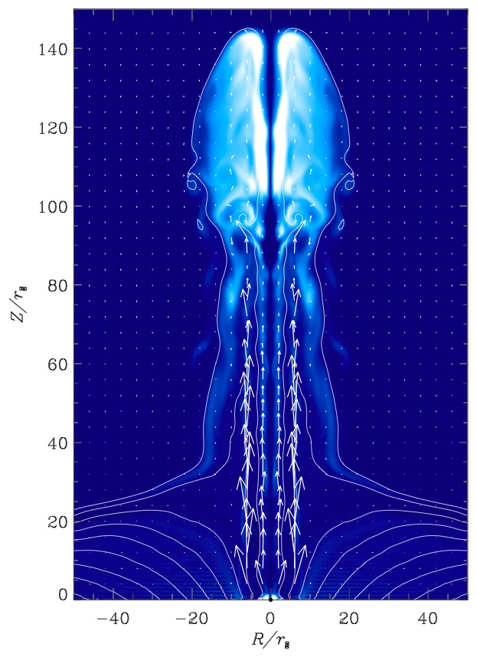
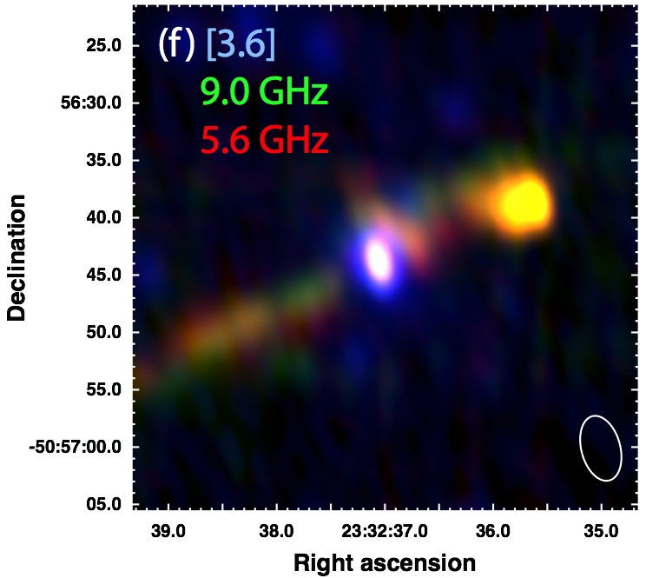
Where in its Travels Does a Jet Decide to be an FR I or II?
Bicknell (1985, 1995) identified
FR Is as transonic jets that decelerate
FR IIs as supersonic jets that continue so out to the hot spots and radio lobes
Geoff put the radius where this occurs at ~600 pc (galaxy “core” radius)
But, unified schemes (Urry & Padovani 95) indicate that (at low-mid redshift)
FR Is (> kpc scale) = BL Lacs (10-100 pc scale, deprojected)
FR IIs (> kpc scale) ≈ FSRQs (10-100 pc scale, deprojected)
***So, jets know they will be an FR I or FR II < 10-100 pc from the BH***
Meier et al. (1997) suggested the “magnetic switch” mechanism
Like an “Eddington limit” for magnetic fields
Occurs in inner accretion disk at ~10-20 r_{H} (< 10^{–3} pc)
Gopal-Krishna & Wiita (2000): the HYMOR test
HYbrid MORphology objects have one FR I jet & one FR II jet !
Such sources appear to exist for ≥ (jet travel time to the lobes) ≈ 3 x 10⁵ yr.
Time for galactic ISM weather to alter the 2 jets should be τ_{weather} ≥ 10 τ_{dyn} = r / σ_{V}
At 10-20 r_{H}, 10 τ_{dyn} ~ 6 wks! So, magnetic switch cannot be FR I / II process
For τ_{weather} ≥ 3 x 10⁵ yr, we need r > 7 pc (or less).
This is ~ r_{Bondi} (BH Bondi radius or BH sphere of influence)
switch off
(FR I)
on
(II)
Tsai et al. (2013)

Slide 10
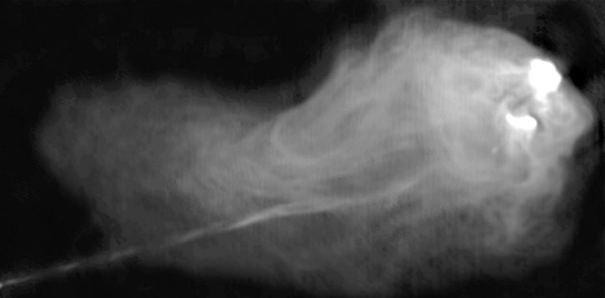
How Could RCS Determine FR I / II Nature? Application of RESISTIVE MHD to FR II (FSRQ) Sources
Magnetic Properties of FR II Sources Differ from FR Is
FR II morphology can be reproduced with HD alone (e.g. Blandford & Rees 1974; Norman et al. 1982)
More importantly, FR II Hot Spots are weakly magnetized (Werner, Murphy et al. 2012) P_{mag} = B² / 8π ~ 1% P_{plasma}
If FR II jets are launched like FR Is, why are FR II outer jets de-magnetized?
Hypothesis: Very Powerful (FR II) Sources Develop Super-magnetosonic MHD Turbulence in the Recollimation Shock (dlm 2013)
Super-MS Turbulence has a very fast magnetic field reconnection rate (Lazarian & Vishniac 1999)
t_{recon} / t_{flow} ~ M_{jet} / M_{turb}² << 1
Resistivity reconnects and dissipates magnetic field into HEAT in RCS
Heat generated is radiated away, leaving “cold”, super-sonic, HD jet
Cygnus A with VLA (Dreher et al. 1987)

Slide 11
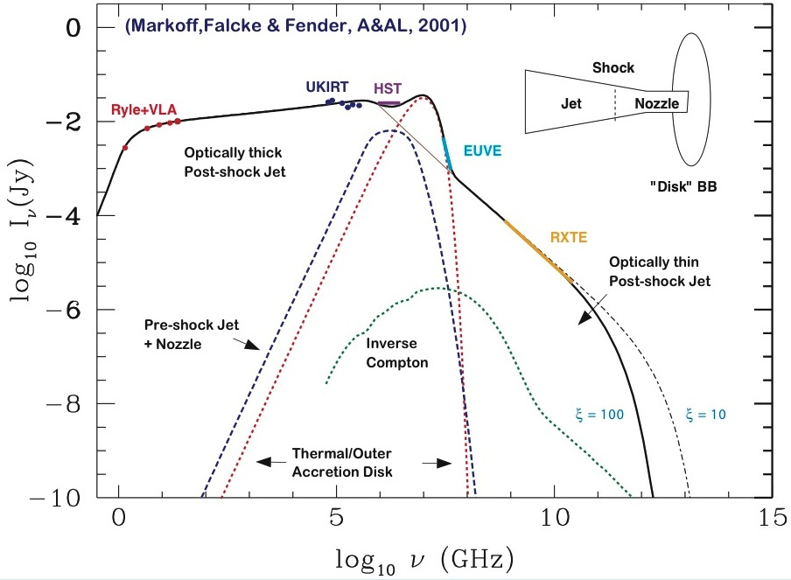
Other Types of Jetted Sources
GRBs: Dissipation in shocks below GRB photosphere (Bromberg 2011; Levinson 2010, 2012)
X-ray Binary Jets: Models of broad-band emission require a strong shock after jet collimation (Markoff et al. 2001 etc.)
Protostellar Jets: HH 212 shows (Correia et al. 2009):
(Non-relativistic) pair of strong shocks flanking central source
Multiple component (bow shock) ejections from each feature
Correia et al. (2009)

Slide 12
Conclusions
Launching, acceleration, & collimation are NOT the whole jet formation story
It appears that in at least most strong AGN jets there is a significant feature/event in the propagation of a super-magnetosonic jet: a quasi-stationary (re-)collimation shock (RCS)
The RCS appears to convert the pinch-unstable flow into a stable one that continues out to the ~100 kpc lobes
This feature occurs on scales intermediate between black hole and lobes
It is very far from the BH in r_{g} (10⁴⁻⁶) but well within the galactic core
However, it is very difficult to distinguish on the sky from the BH itself:
Nearby (z ~ 0.1): 40 – 4000 μas (foreshortened blazar); 400 – 40,000 μas (in plane of sky)
Far (z ~ 1.0): 10 – 1000 μas (foreshortened blazar); 100 – 10,000 μas (in plane of sky)
The RCS in M87 (HST-1) appears to be responsible for the jet "break" (cf. Nakamura)
The RCS also may play an important role in the FR I / II dichotomy
The only telescopes that can distinguish RCS activity from BH activity are: the EVN (>5000 μas), the VLBA (>100 μas), and the EHT (> 20 μas)
VLBI IS ABSOLUTELY CRUCIAL TO UNDERSTANDING JET FORMATION

