Slide 1
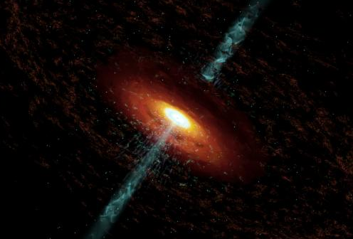
Modeling Variability of Blazar Jets with a Turbulent Magnetic Field
Alan Marscher
Institute for Astrophysical Research, Boston University
Research Web Page: www.bu.edu/blazars

Slide 2
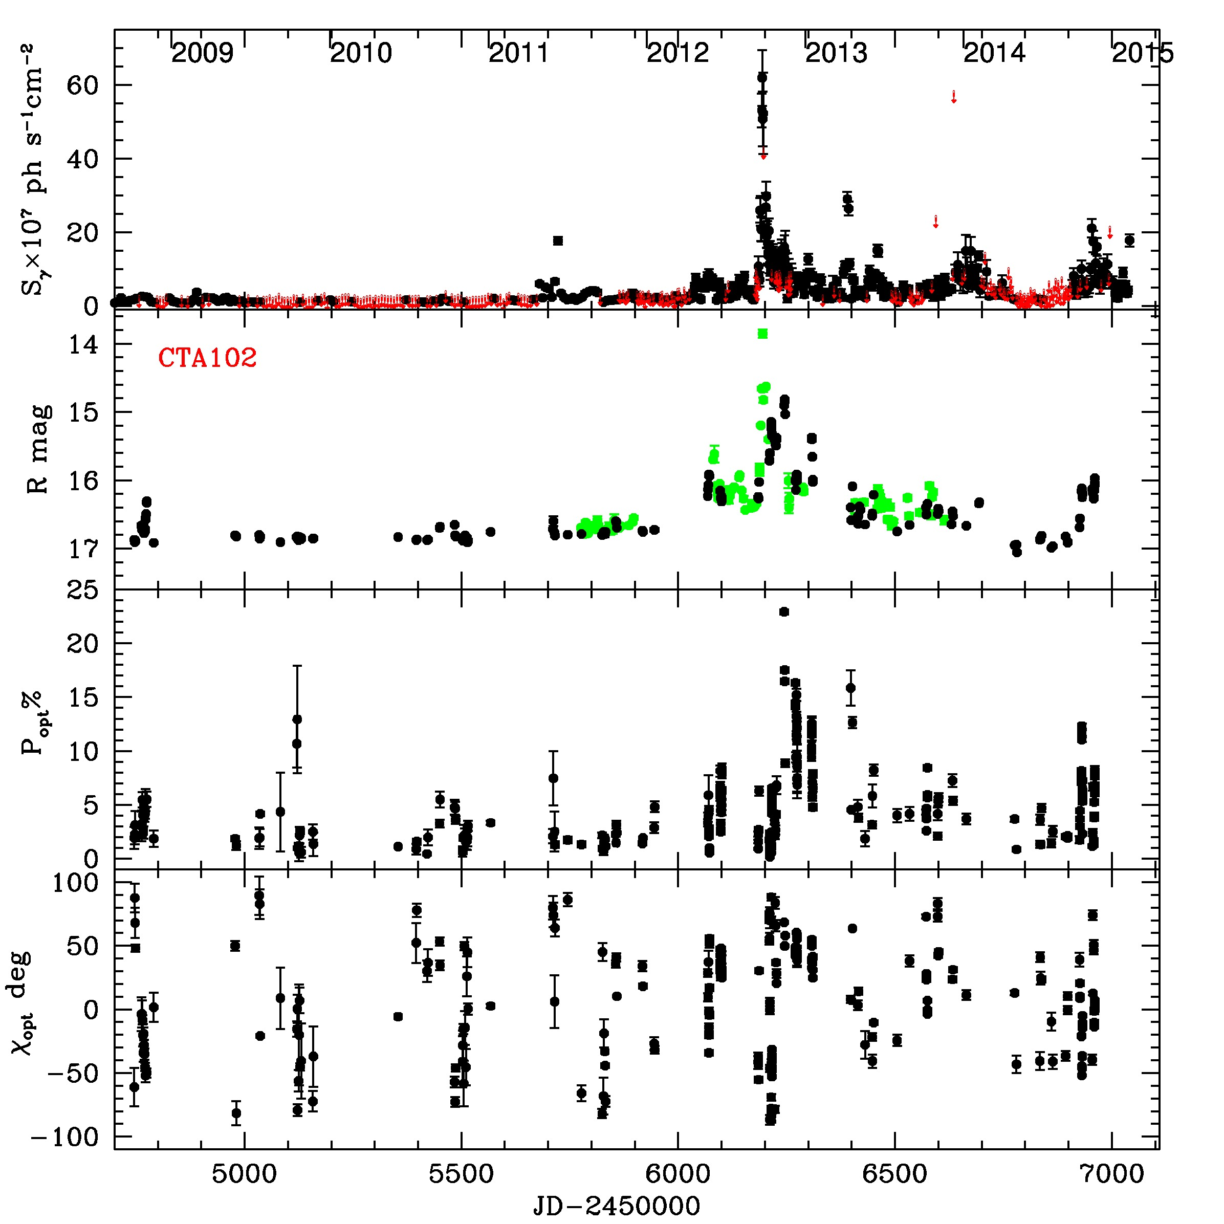
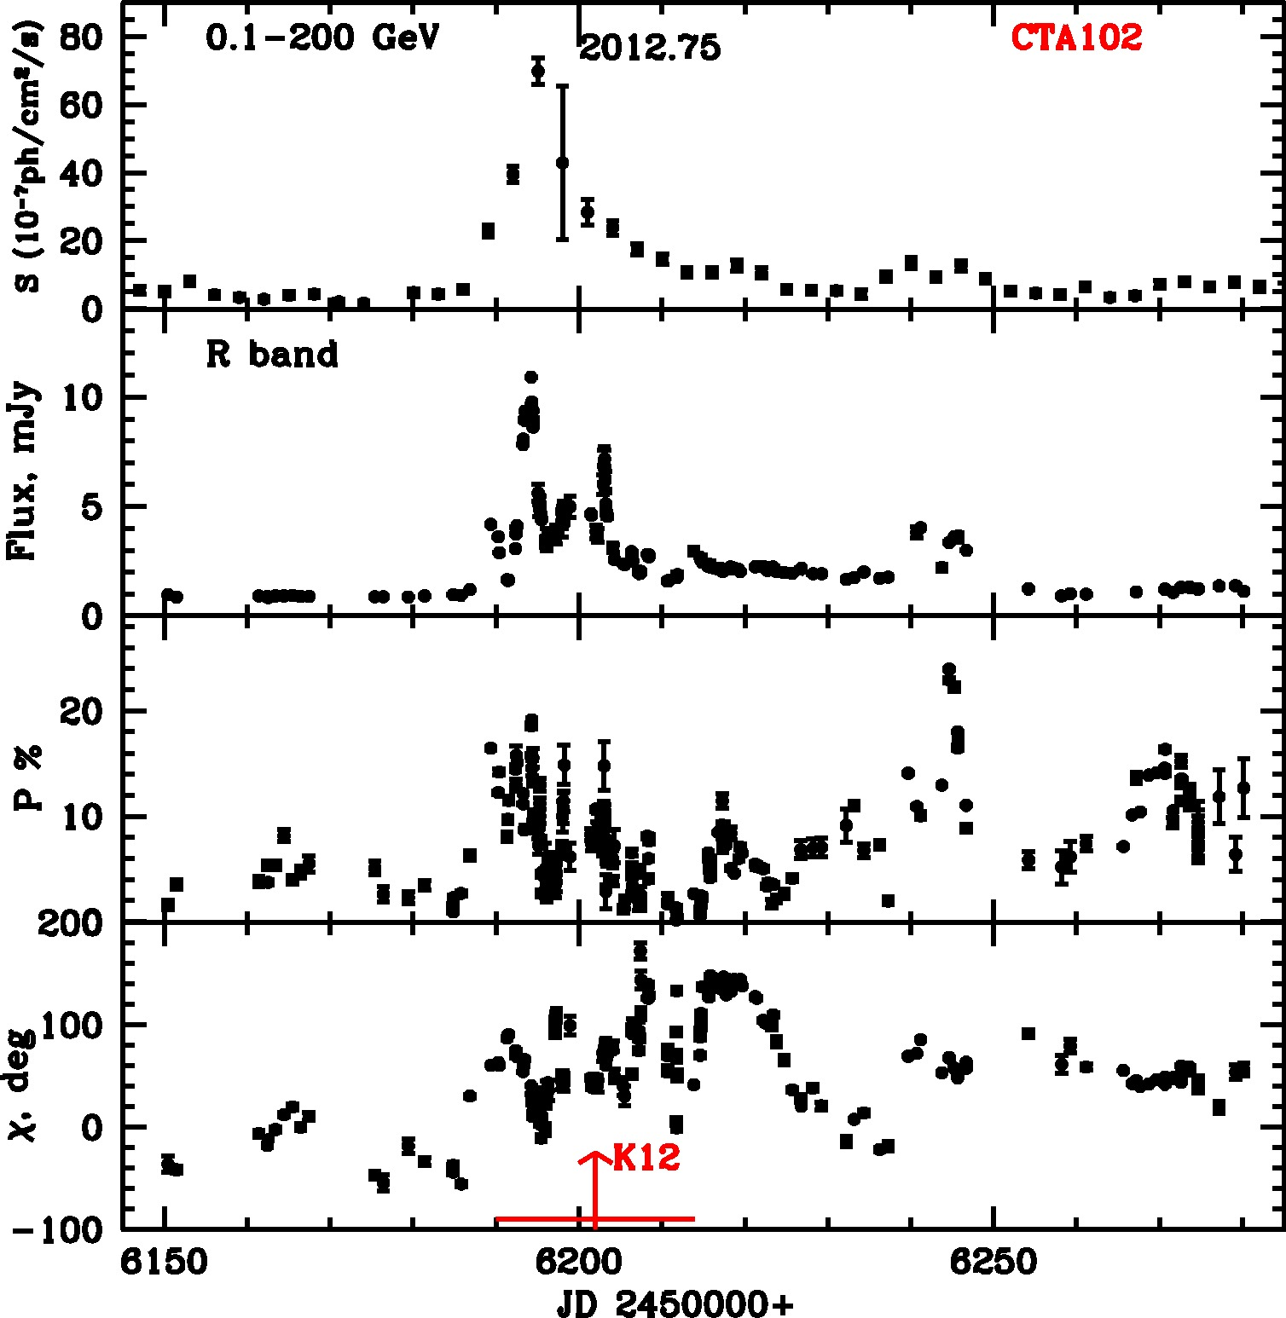
Variations in Linear Polarization: Evidence for a Disordered Magnetic Field Component: The Quasar CTA102
Polarization varies erratically, as expected if it results from turbulence (or some disordering similar to turbulence)
Notes:
Historical motivation: Do AGN show low/high/very high states like GBHs?

Slide 3
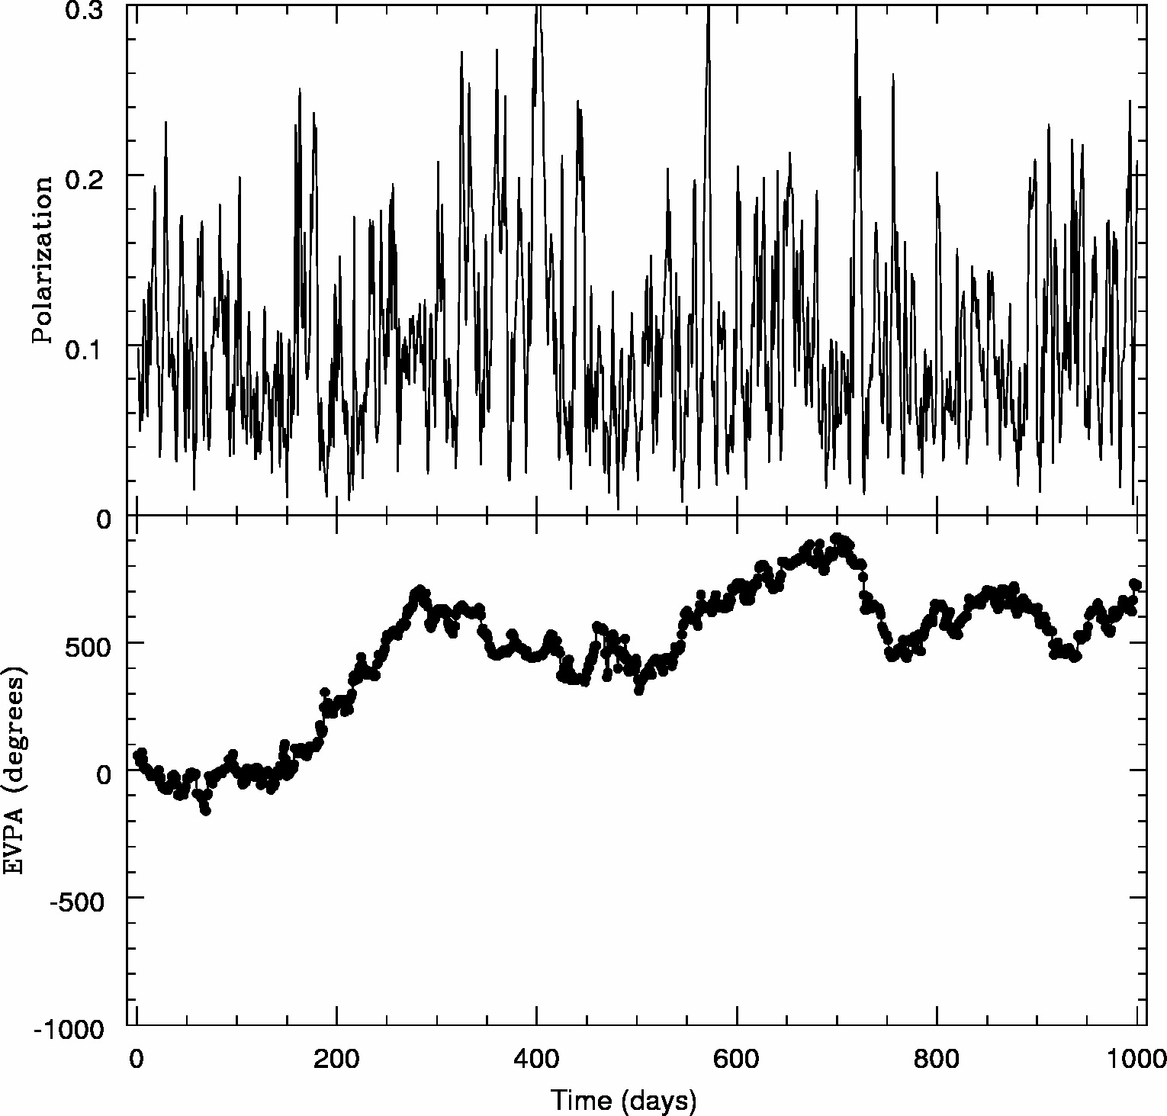
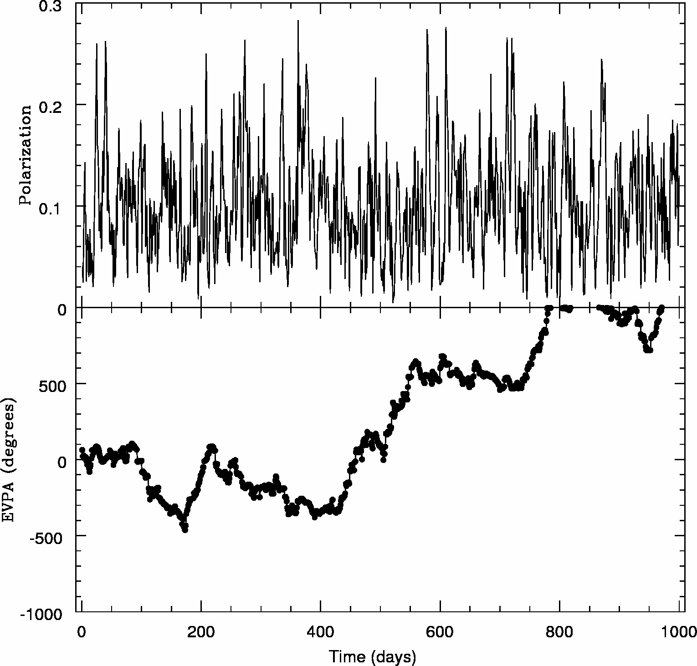
Linear Polarization from Turbulent Cells with Random Field Directions
Case of N cells, each with a uniform but randomly directed magnetic field of same magnitude
Mean polarization: <p> = p_{max}/N^{1/2} σ_{p} ≈ <p>/2 (Burn 1966, MNRAS)
Electric-vector position angle χ can have any value
→ If such cells pass in & out of emission region as time passes,
p fluctuates about <p>
χ varies randomly, often executing apparent rotations that can be > 180°, usually not very smooth, but sometimes quite smooth
(T.W. Jones 1988, ApJ)

Slide 4
Linear Polarization from a Helical Magnetic Field
Assume that helical field propagates down the jet with the plasma (as in MHD models for jet acceleration & collimation)
B’ = B_{t}’ cosϕ i ’ + B_{t}’ sinϕ j ’ + B_{z}’ k ’
Degree of polarization depends on viewing angle & Γ
(see Lyutikov, Pariev, & Gabuzda 2005, MNRAS)
Face-on (θ = θ’ = 0): p = 0 (from symmetry) if I_{ν} is uniform across jet
Side-on (θ’ = 90°): χ = 0° if B_{z}’ < B_{t}’ & χ = 90° if B_{z}’ > B_{t}’
p depends on B_{t}’/B_{z}’
Other angles: qualitatively similar to side-on case

Slide 5
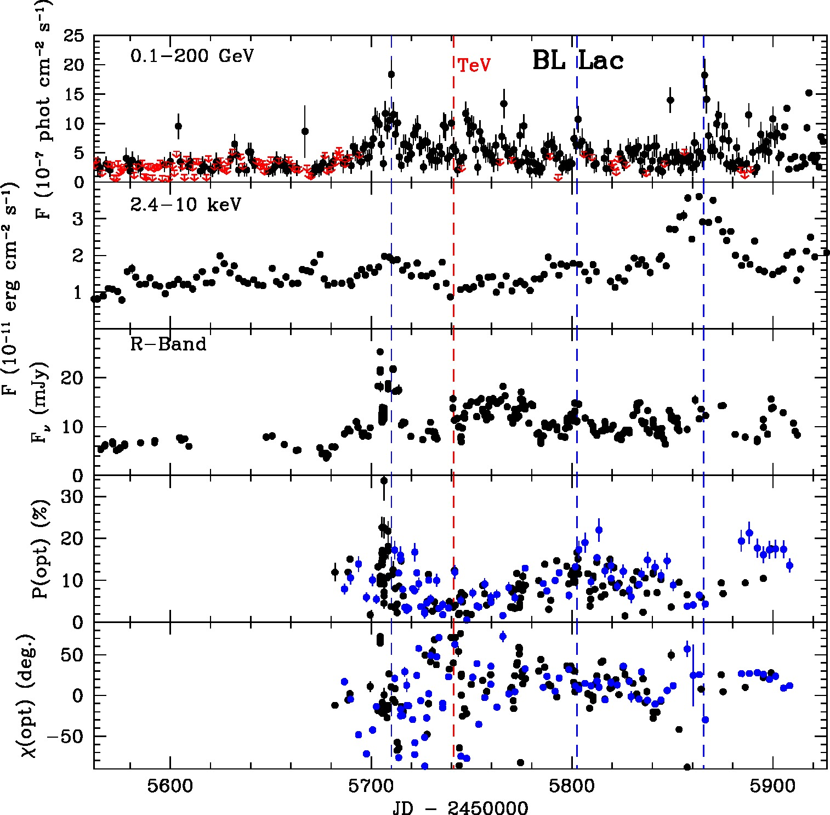
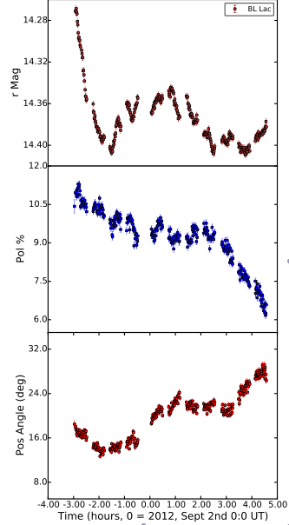
Variations in Linear Polarization: Evidence for a Disordered Magnetic Field Component: BL Lac
Erratic fluctuations in degree (Π) & EVPA (χ ) of polarization
Intra-day (Covino et al. 2015)
Π (optical)
Marscher et al. (in prep)
Π (optical)
Χ (optical)
Χ (optical)

Slide 6
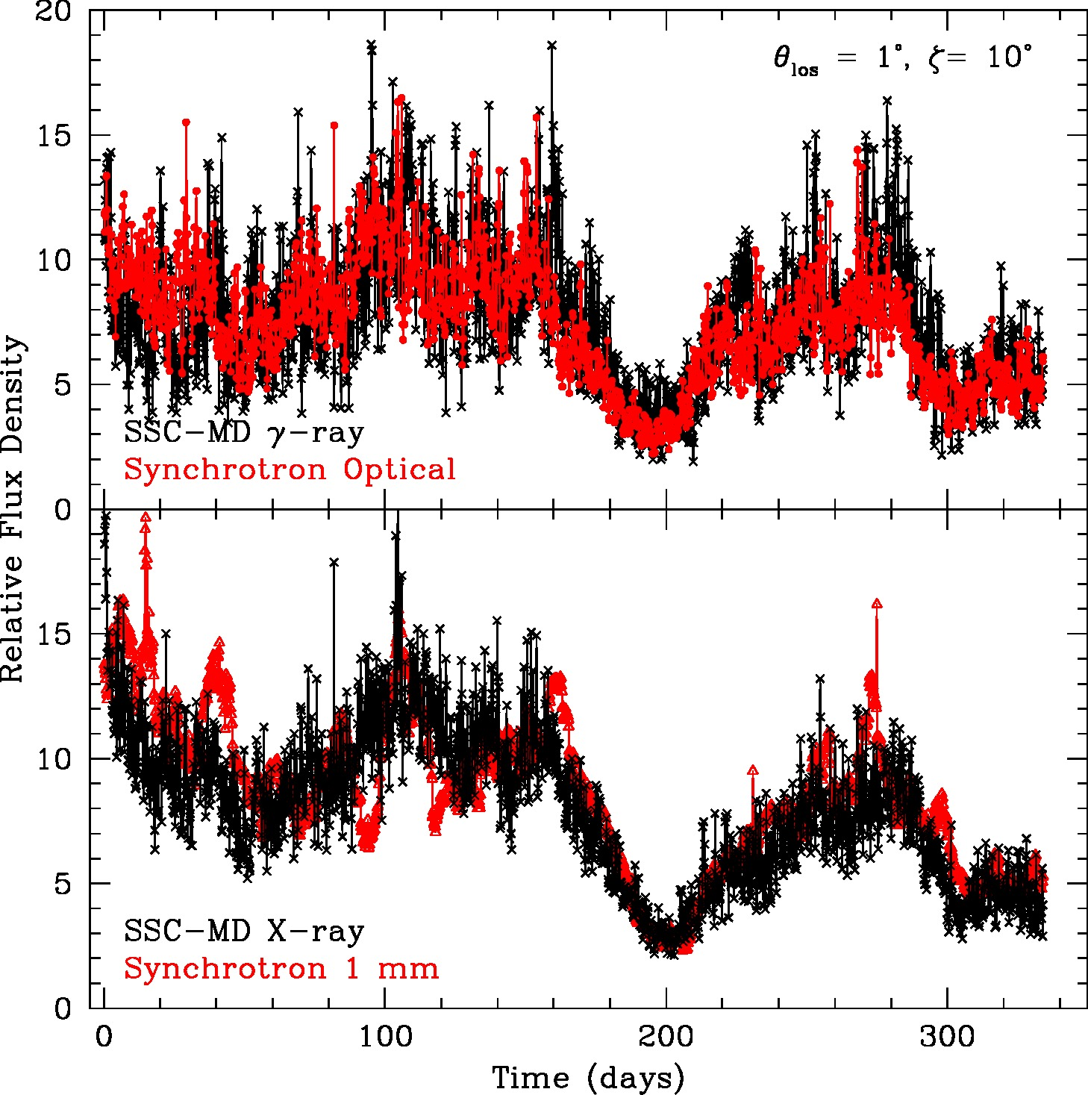
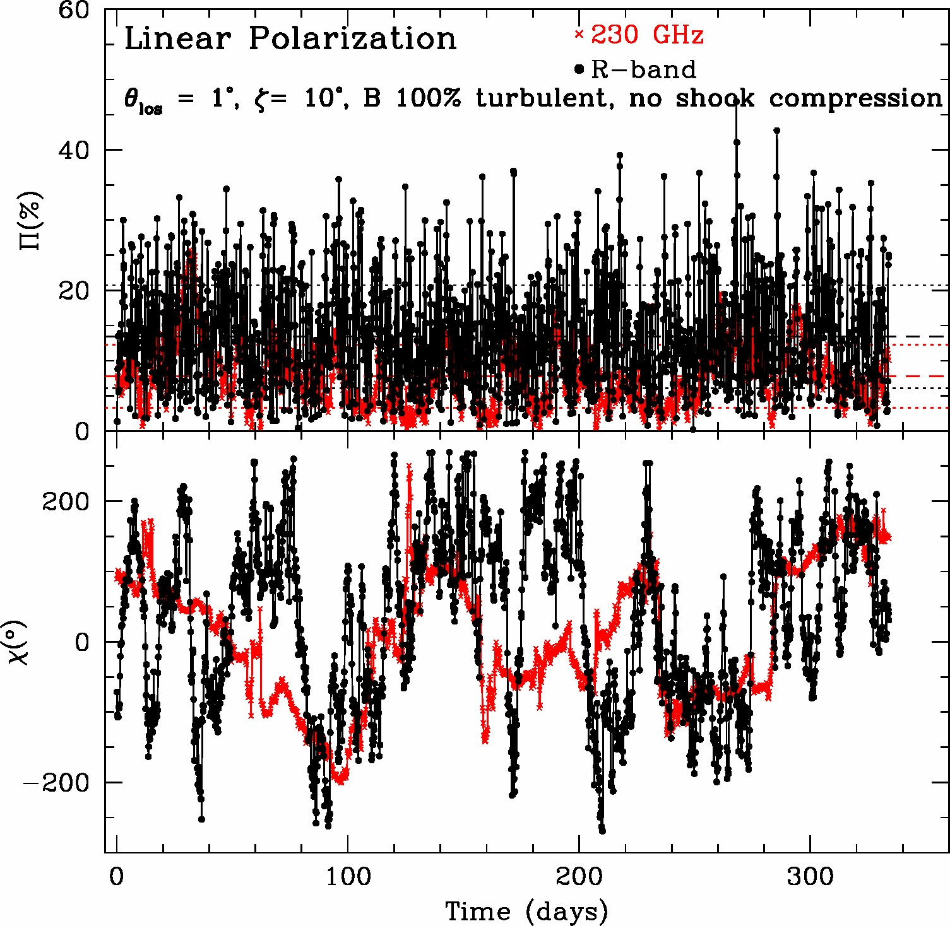
Sample Simulated Light Curve from Turbulence
- Case of 100% turbulent field with no shock
Outbursts & quiescent periods arise from variations in injected electron density
Random with red-noise probability distribution
Very rapid fluctuations result from turbulence
Polarization is stronger at higher frequencies, as generally observed
Position angle fluctuates randomly, with apparent rotations (usually not very smooth) in both directions

Slide 7
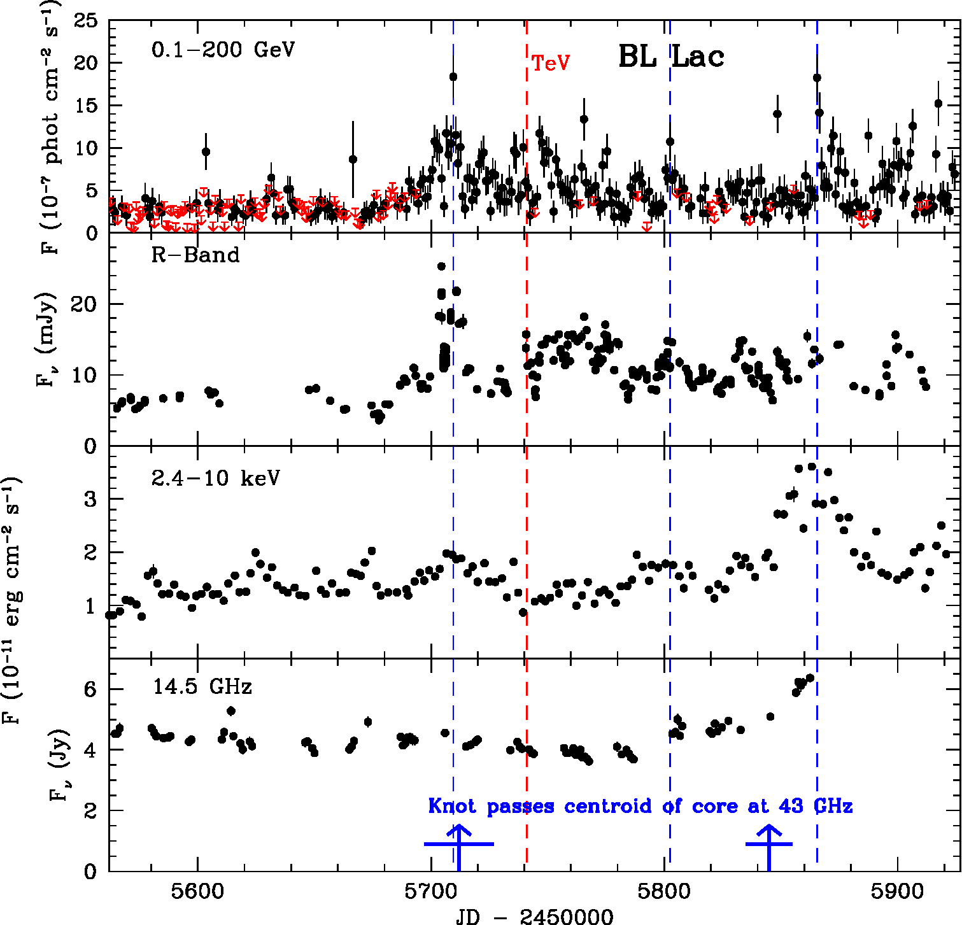
Where is the jet turbulent? Near the mm-wave “core”
Optical & γ-ray emission becomes bright as new superluminal knots pass through “core” + 2 other stationary emission features on the VLBA image
Optical polarization

Slide 8
The “Core” of Blazar Jets
Observations suggest that core on VLBI images is either:
τ ~ 1 surface (τ = optical depth to synchrotron absorption)
First standing (oblique or conical) shock outside τ ~ 1 surface
(Daly & Marscher 1988 ApJ, D’Arcangelo et al. 2007 ApJL)
Core at ~3 mm
At ~1 cm
At ~4 cm
HD simulation (Gómez et al. 1997)
τ >1 at ~3 mm
τ >1 at ~1 cm
τ >1 at ~4 cm
2 ~ stationary features with variable polarization downstream of core
BL Lac
Core

Slide 9
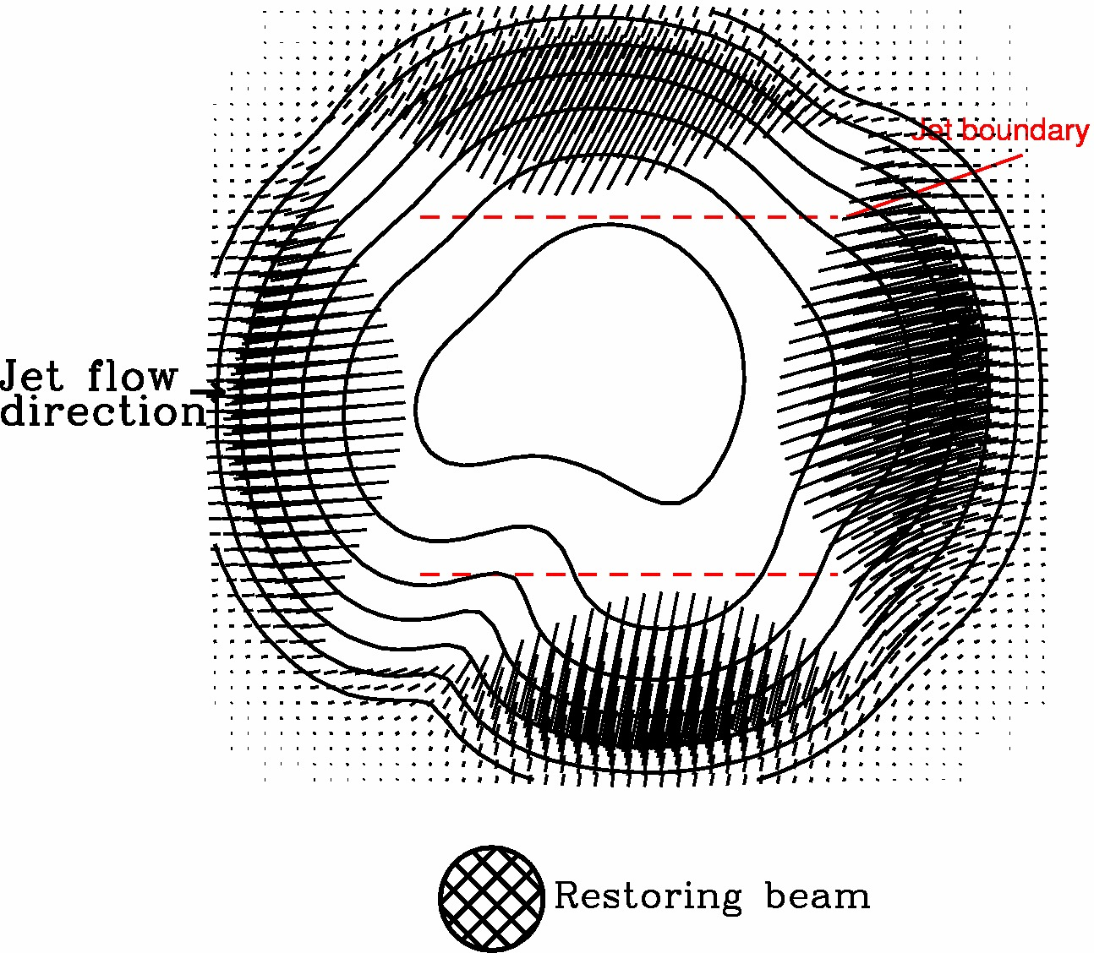
Turbulence in Blazar Jets
Cawthorne (2006, MNRAS), Cawthorne et al. (2013): “Core” seen on 43 GHz VLBA images has radial polarization pattern similar to that of turbulent plasma flowing through a standing, cone-shaped shock
(Jorstad et al. 2005)
Simulation
(Polarization sticks in center are erased to show periphery)
Notes:
Historical motivation: Do AGN show low/high/very high states like GBHs?

Slide 10
Proposed Blazar Model
- Strong helical magnetic field in inner jet, turbulence becomes important on parsec scales
Flares from moving shocks and denser-than-average plasma flowing across standing shock(s)
- Turbulent field accelerates particles via 2nd-order Fermi + magnetic reconnections
- Shocks increase energies of particles, especially in locations where B || shock normal

Slide 11
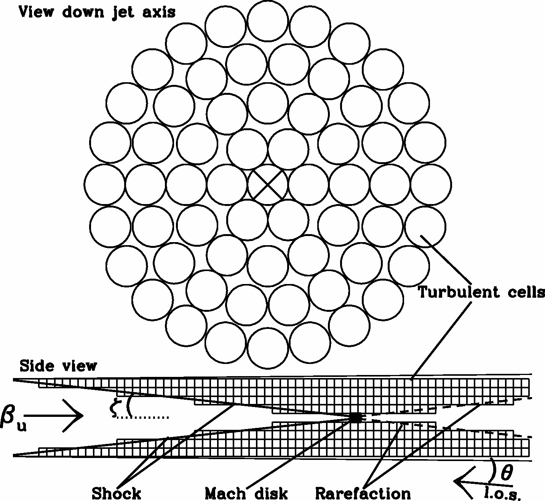
Turbulent Extreme Multi-zone (TEMZ) Model (Marscher 2014, ApJ)
Many (e.g., 169) turbulent cells across jet cross-section, each followed after crossing shock, where e⁻s are energized & Compton scatter seed photons from dusty torus & Mach disk*; each cell has its own uniform magnetic field selected randomly from turbulent power spectrum + its own e⁻ population
*Plan to add seed photons from emission-line clouds alongside the jet (Isler et al. 2013, León-Tavares et al. 2012) & SSC from other cells
Mach disk (optional)
Conical standing shock

Slide 12
Electron Energy Distribution in TEMZ Code
Power-law (slope= –s) injection into cell that is crossing the shock front
- From 2nd-order Fermi + magnetic reconnections upstream of shock
Synchrotron & external Compton energy losses downstream of shock
Maximum electron energy produced by shock depends on angle between magnetic field & shock normal
This restricts optical & γ-ray emission to a small fraction of cells near shock front
Spectral index steeper than s/2 (radiative loss value), as observed
Mean polarization is higher & fluctuations greater at higher frequencies, as observed
Optical & γ-ray flux variability more pronounced than in mm-IR & X-ray
Notes:
Historical motivation: Do AGN show low/high/very high states like GBHs?

Slide 13
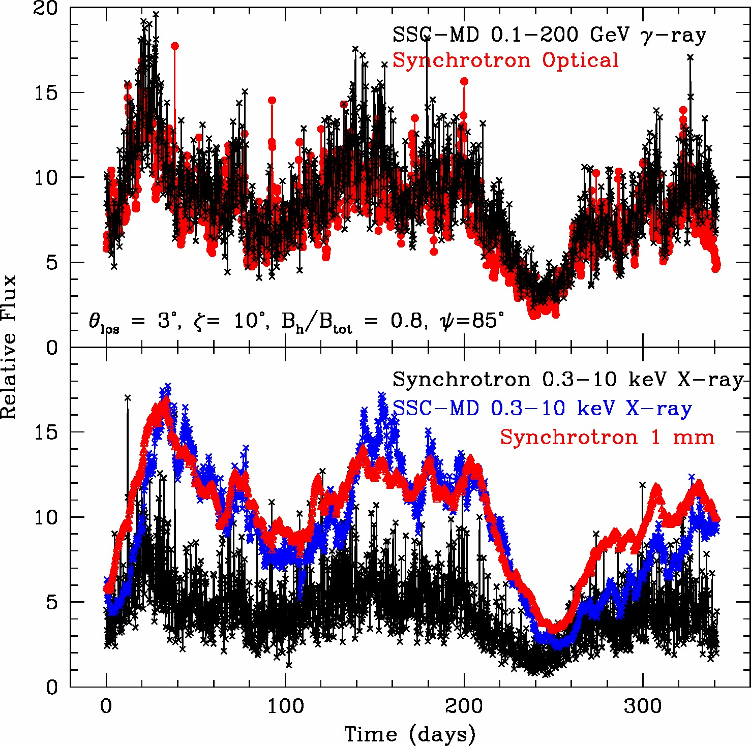
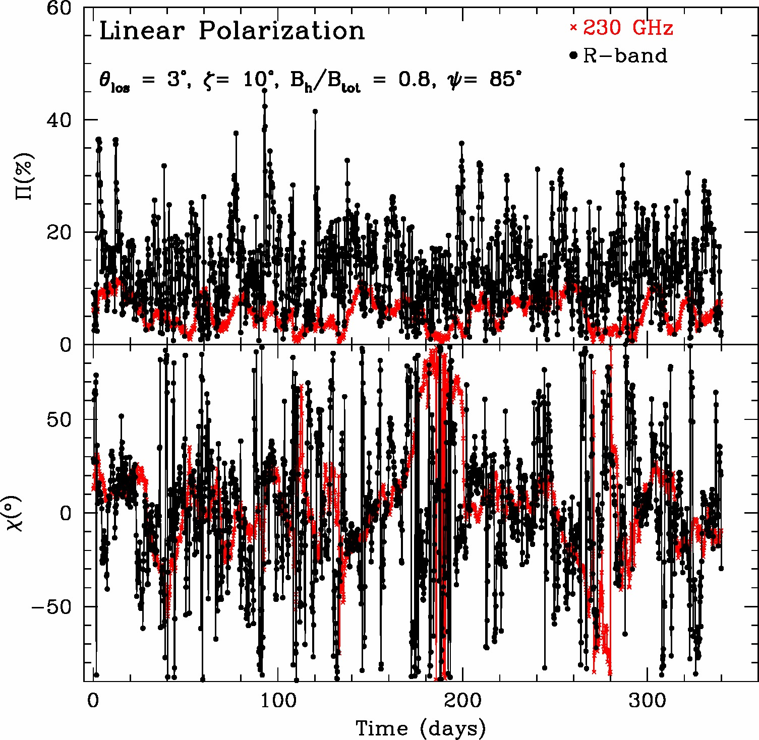
Sample Simulated Light Curve Similar to BL Lac
Case of 20% turbulent, 80% helical field ahead of standing shock
Flares start
together,
mm/X-ray peak
later
Outbursts & quiescent periods arise from variations in injected electron density
Random with red-noise probability distribution
Most flares are sharply peaked, as often observed
Polarization is stronger at higher frequencies, as generally observed
Position angle fluctuates, but is usually within 50° of jet direction (as observed in BL Lac)

Slide 14
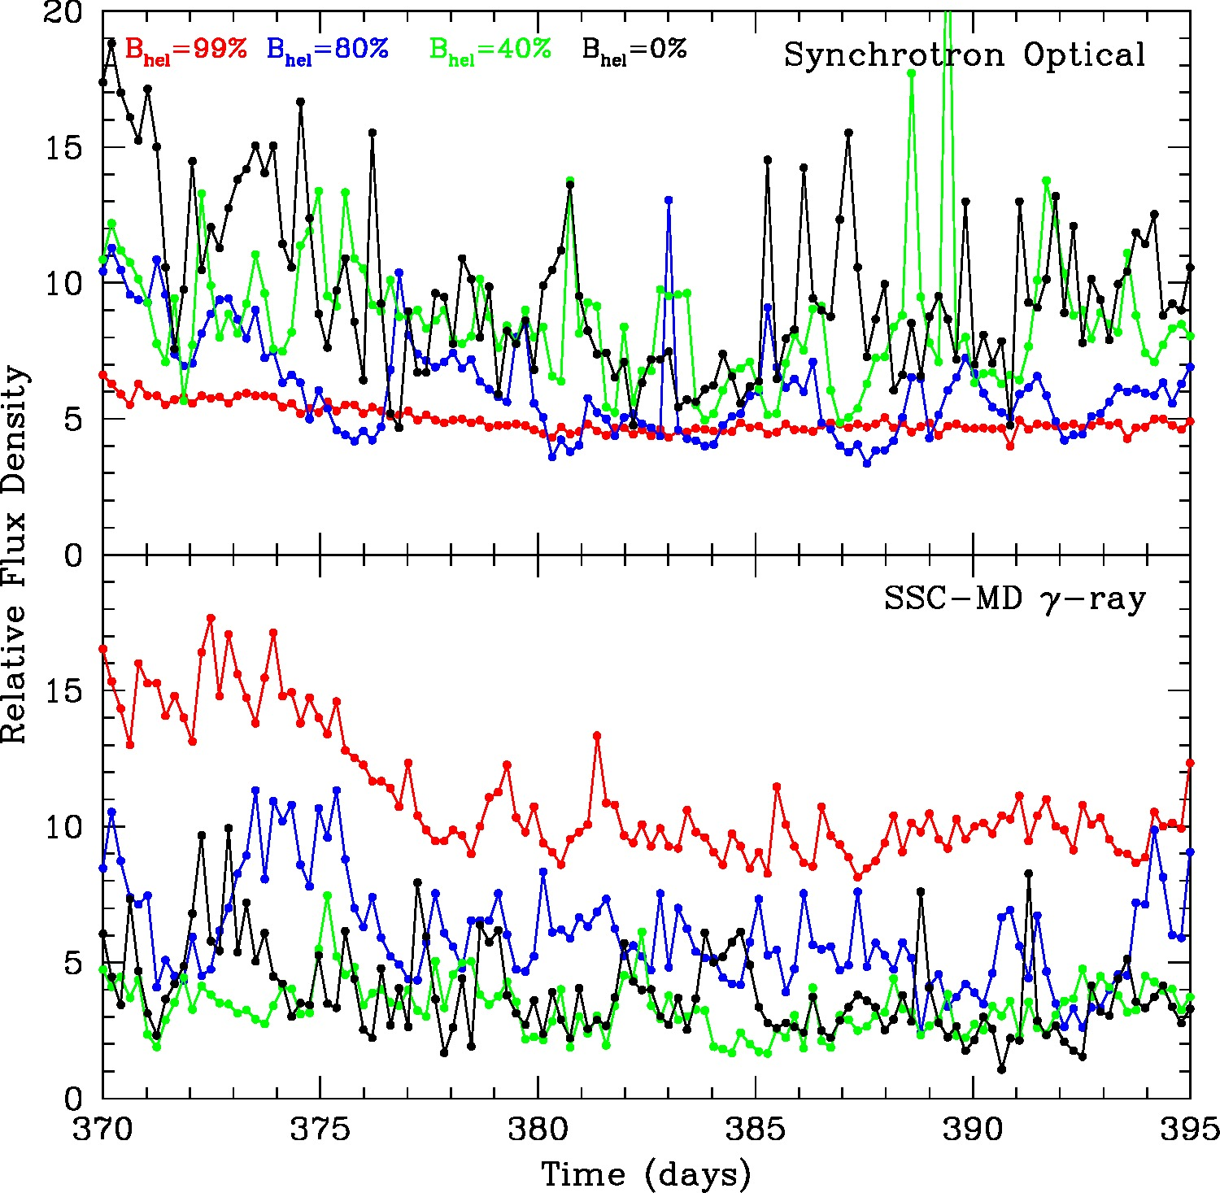
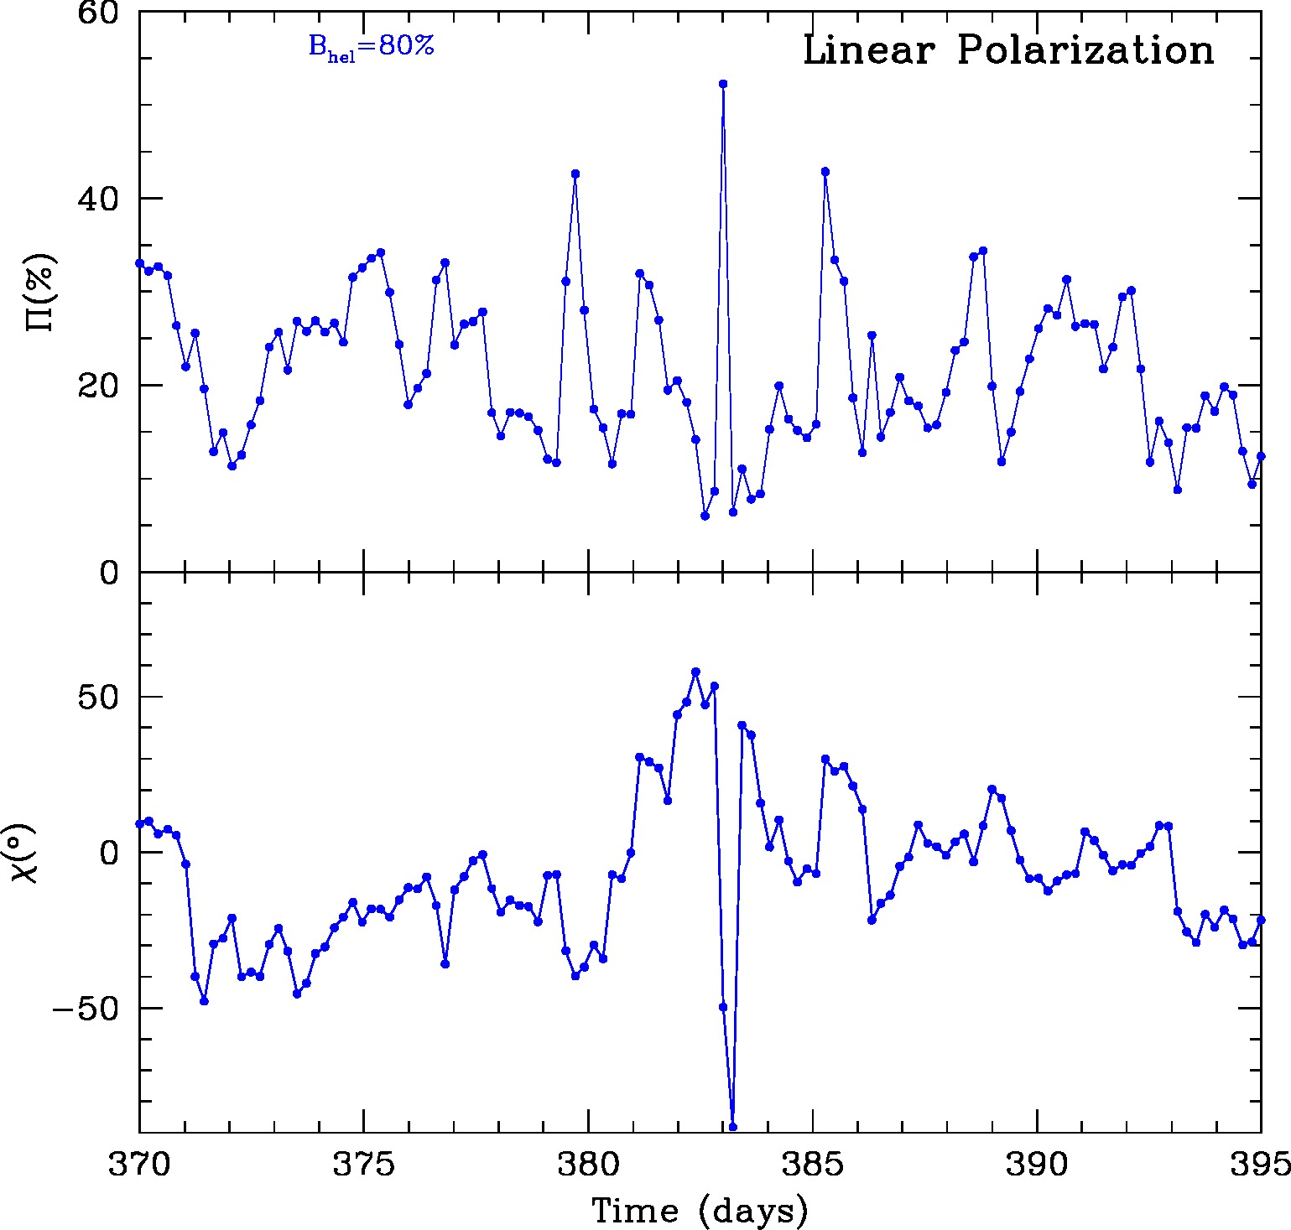
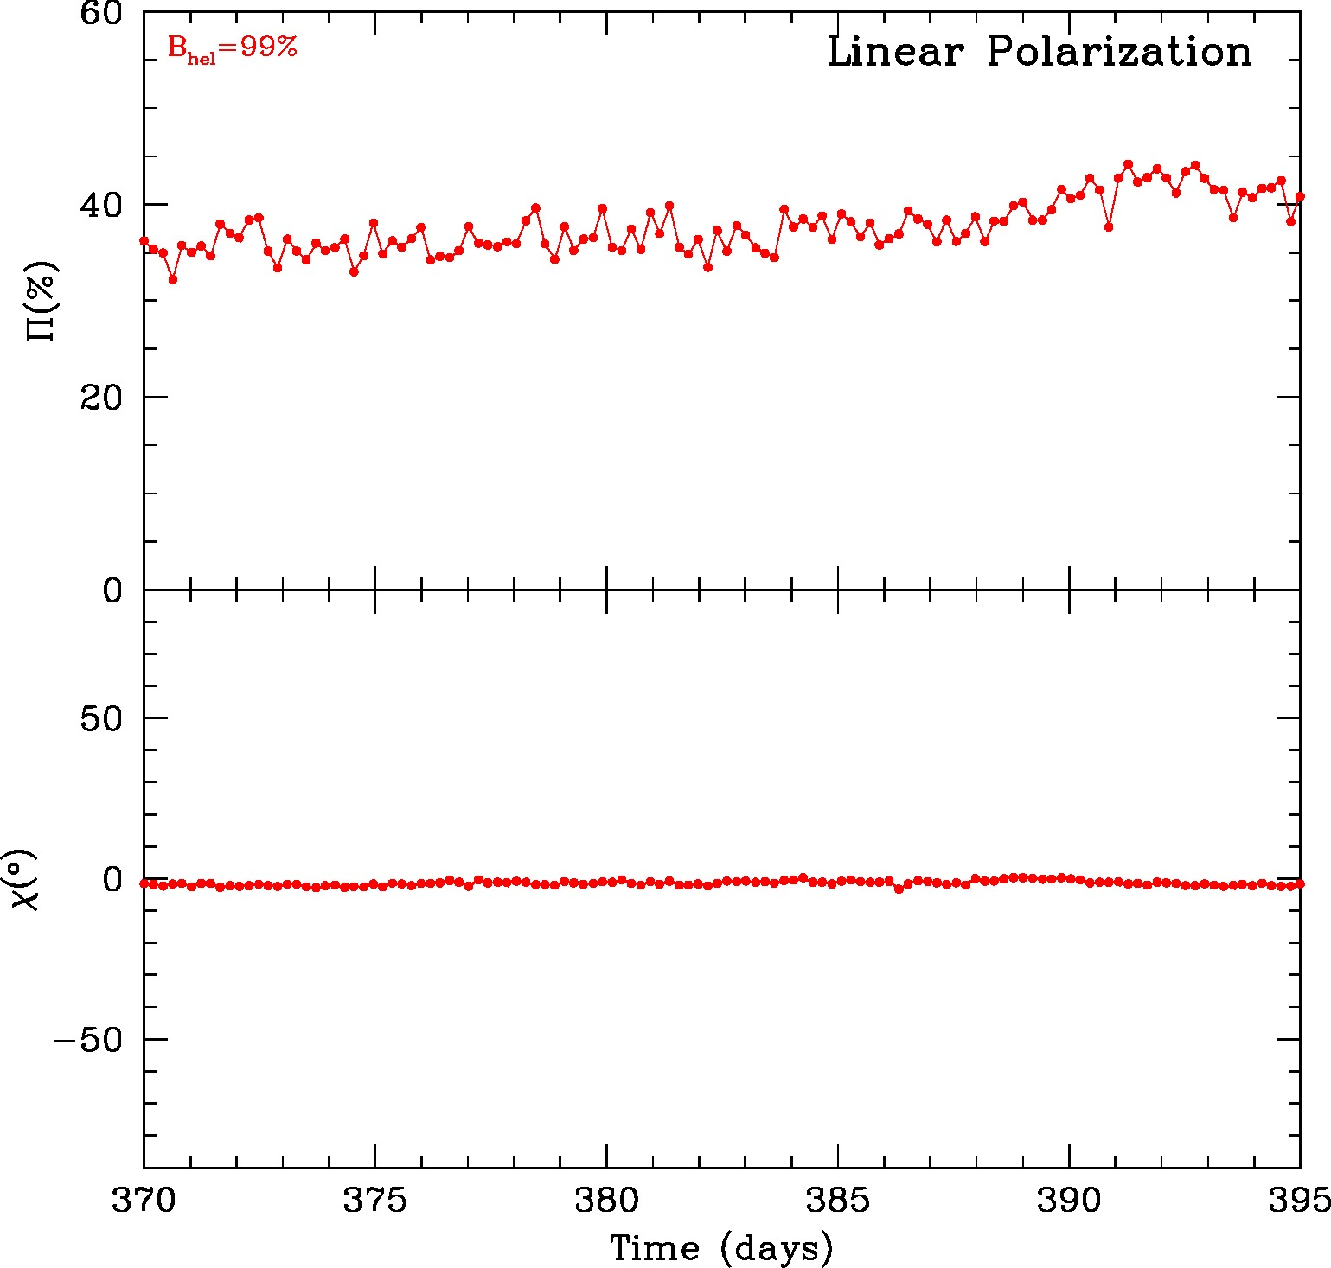
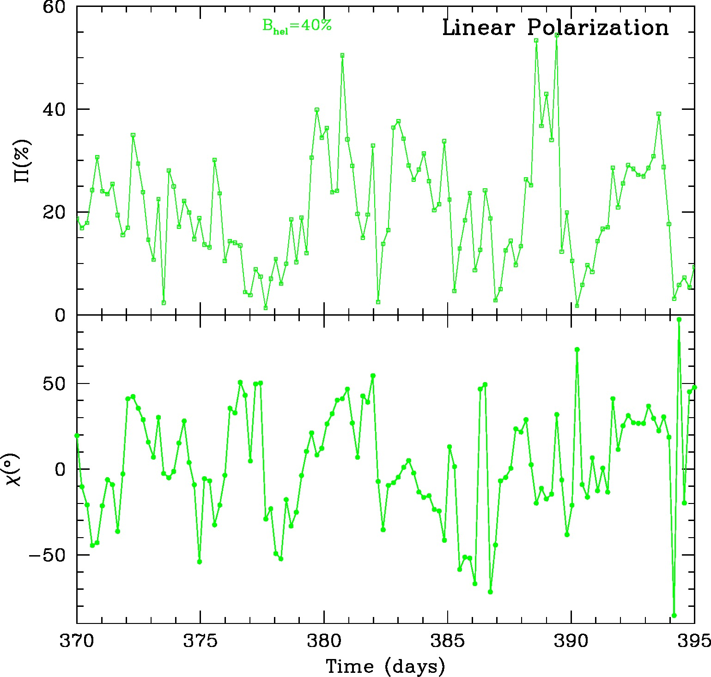
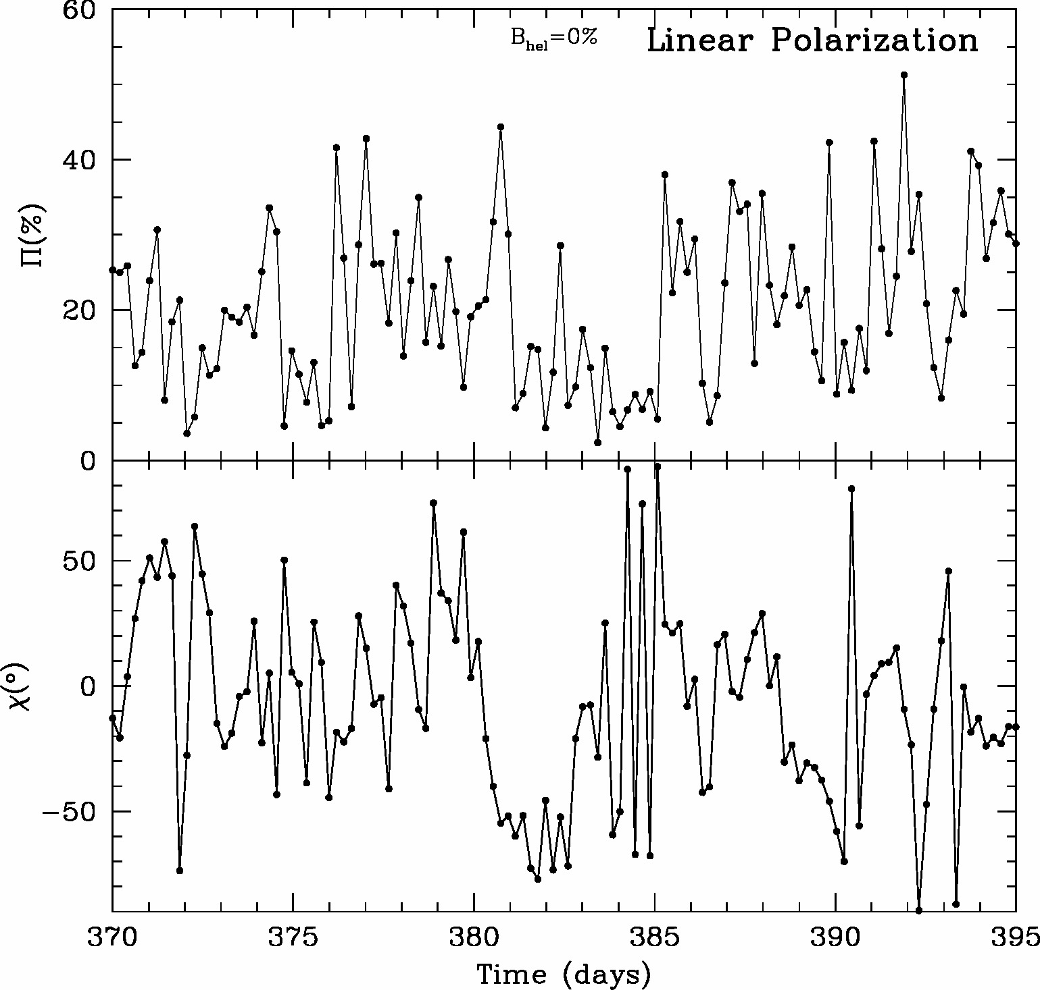
25-day Blow-up to See Details for Different Levels of Helical Field
Up to ~50% of the magnetic field can be toroidal without strongly affecting the variability characteristics of either the multi-waveband flux or the optical polarization! Even 80% toroidal varies rapidly.
For viewing angles < 1/2Γ, helical field can decrease <Π> to match observed value

Slide 15
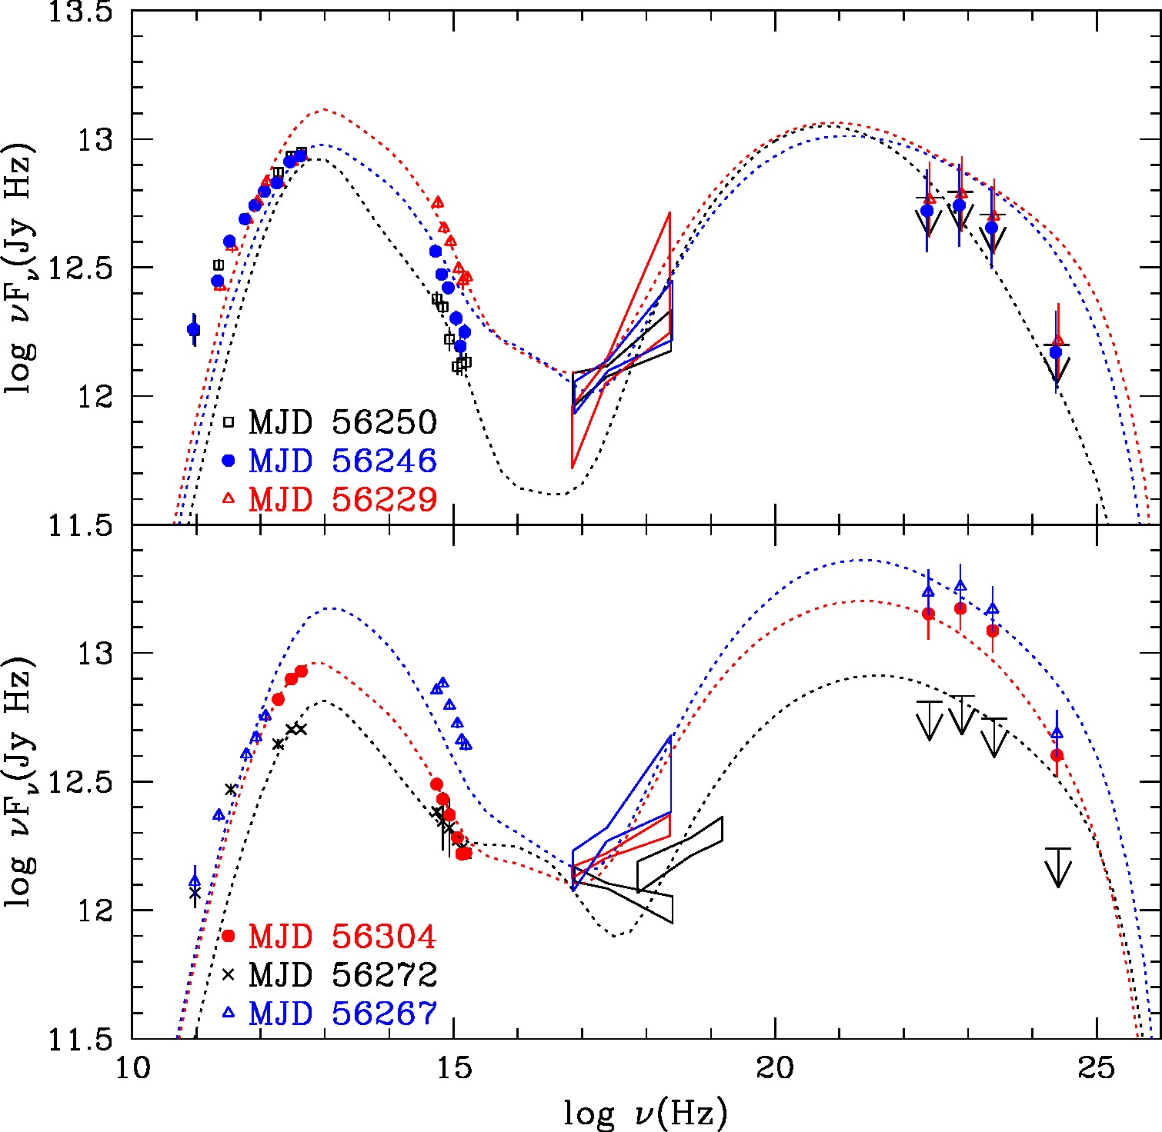
Sample Simulated Spectral Energy Distribution
Data: BL Lac at different times (Wehrle et al. 2015,
ApJ, submitted)
Notes:
Historical motivation: Do AGN show low/high/very high states like GBHs?

Slide 16
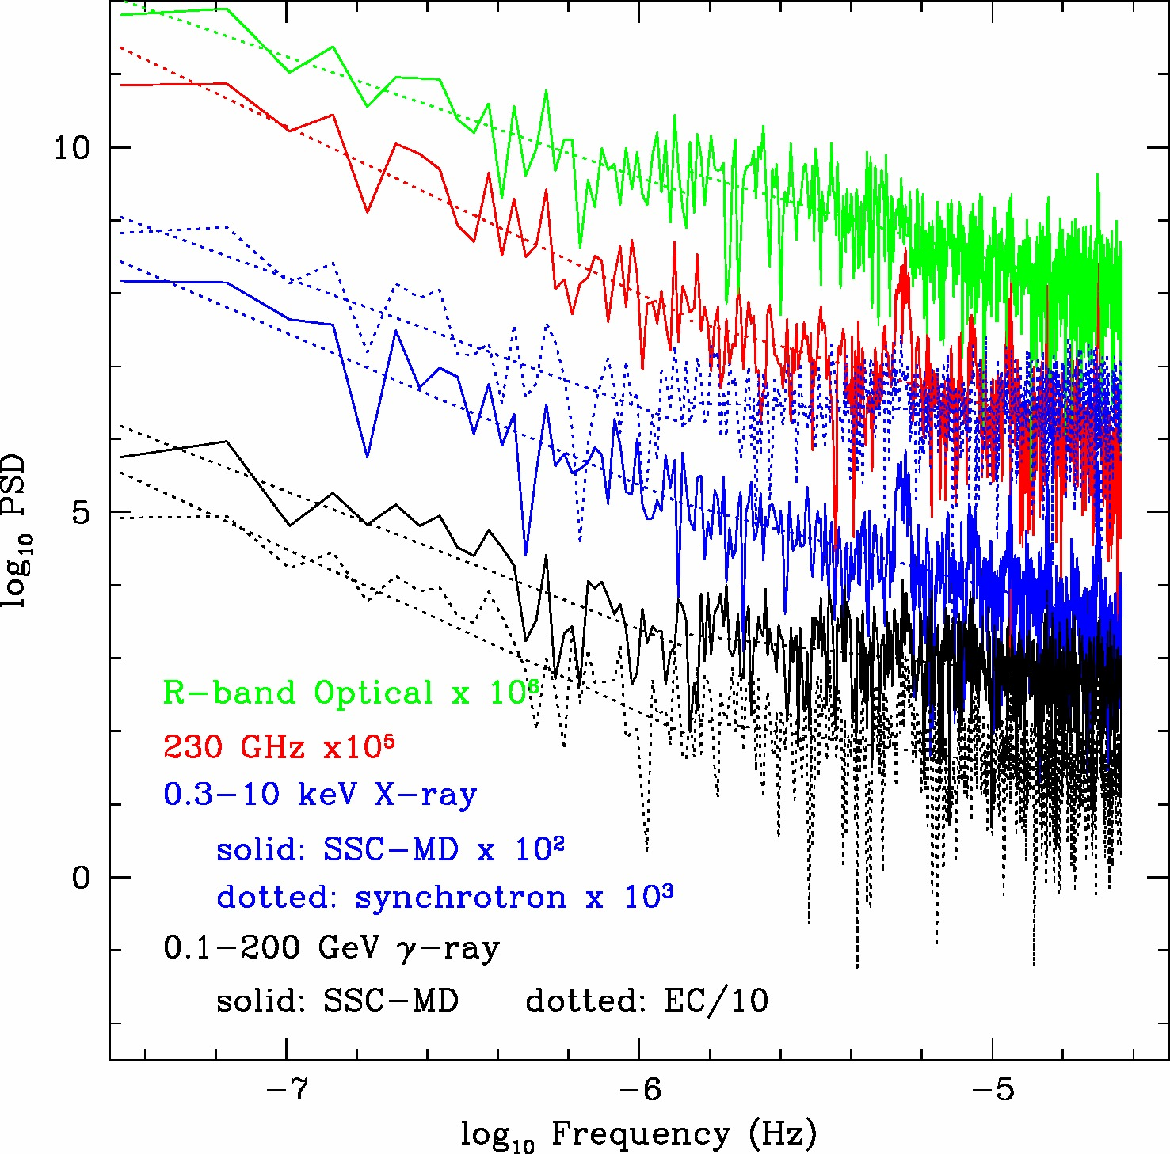
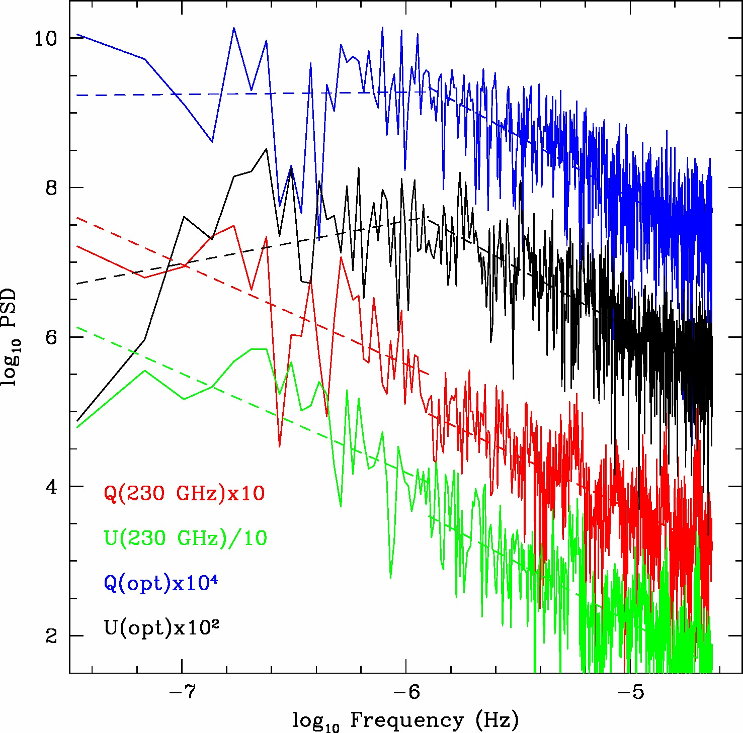
Power Spectra of Polarization Variations of Simulation
Flux Power spectrum slope -1.6 to -2.3 on long time-scales (low variational frequencies), flattens on shorter time-scales
Stokes parameters: Power spectrum slope ~ -1.6 on short time-scales (high variational frequencies), flattens on longer time-scales
Break frequency higher for more turbulent field

Slide 17
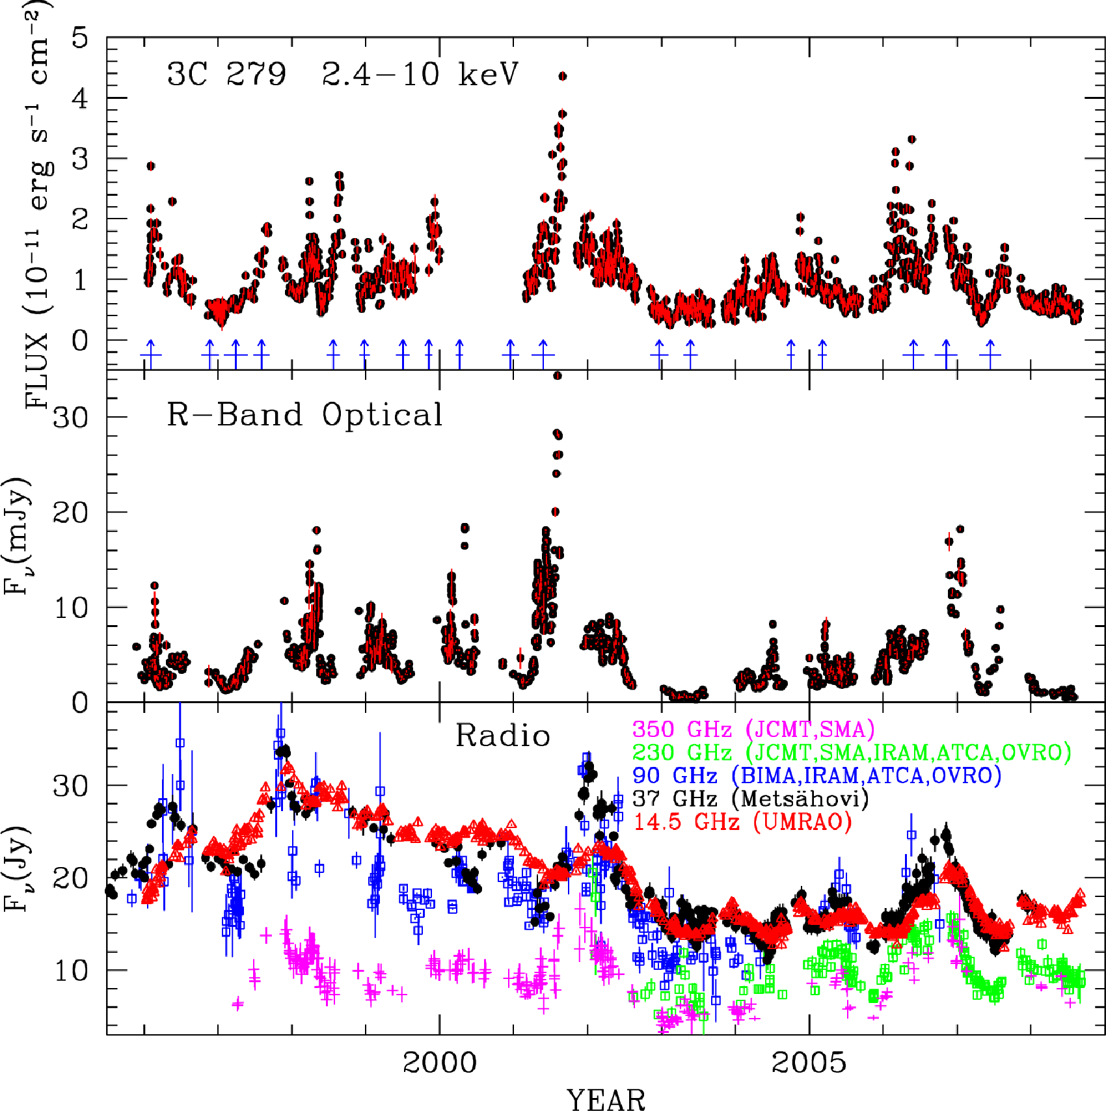
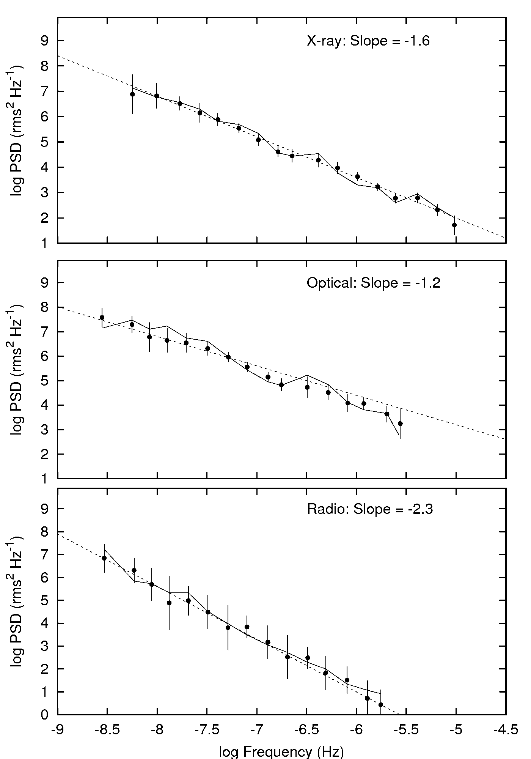
Flux Variability of Blazars: Power-law Power Spectra
Power spectrum of flux changes follows a power law → random fluctuations dominate → turbulence?
X-ray
Chatterjee et al. 2008 ApJ

Slide 18
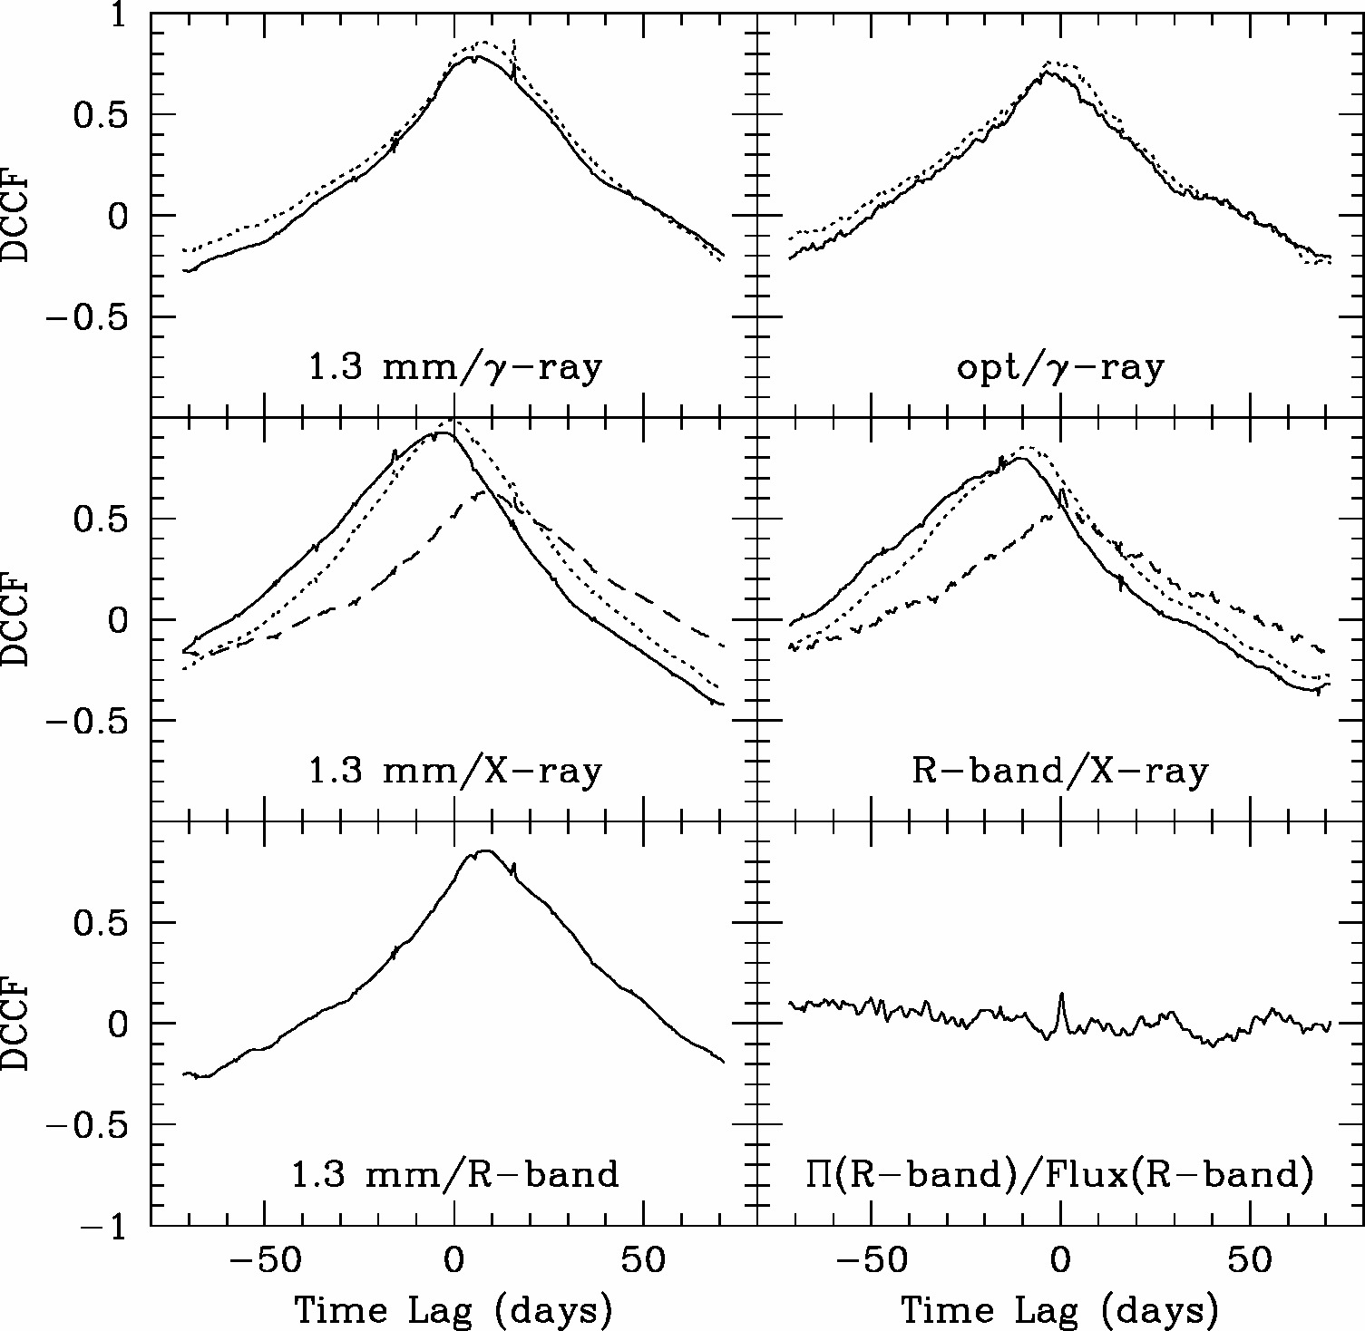
Sample Correlations from Simulations
Positive lag: 2nd waveband leads
Solid: SSC-MD
Dotted: EC-dust
Dashed: Synchrotron
Note time lags up to 10 days despite all emission occurring in “core” = standing conical shock region parsecs from black hole
No Big Blue Bump emission included; otherwise there would be a stronger Π(opt) – Flux(opt) correlation

Slide 19
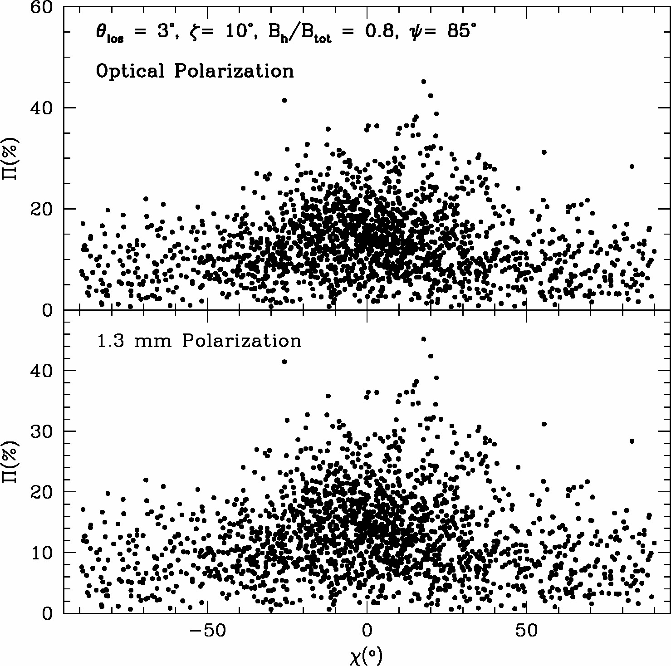
Difference between EVPA & Jet Direction vs. Degree of Pol.
Difference larger at lower polarization levels
→ Can compare quantitatively to observations

Slide 20
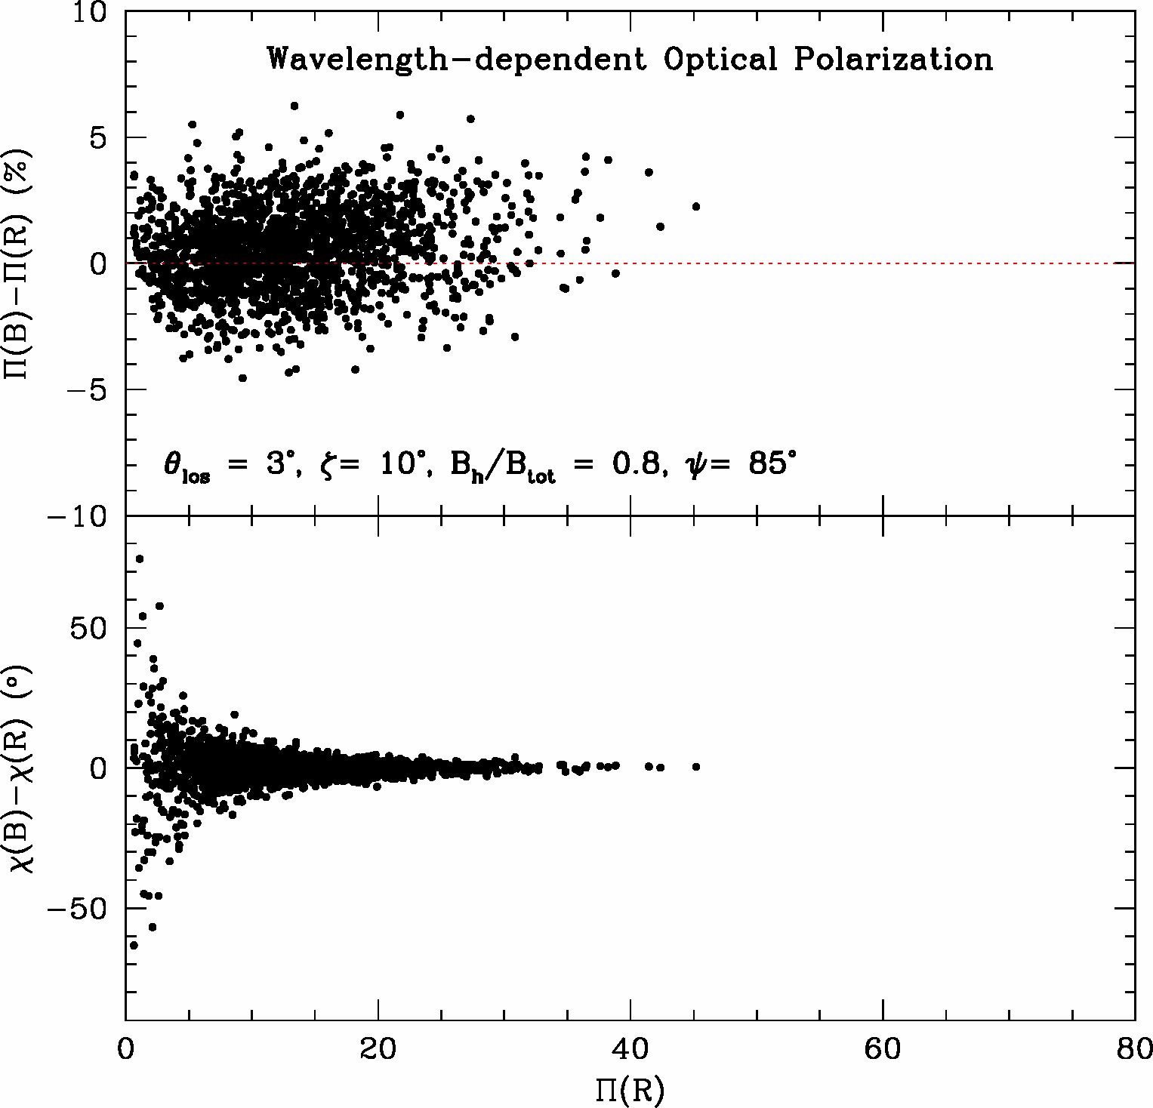
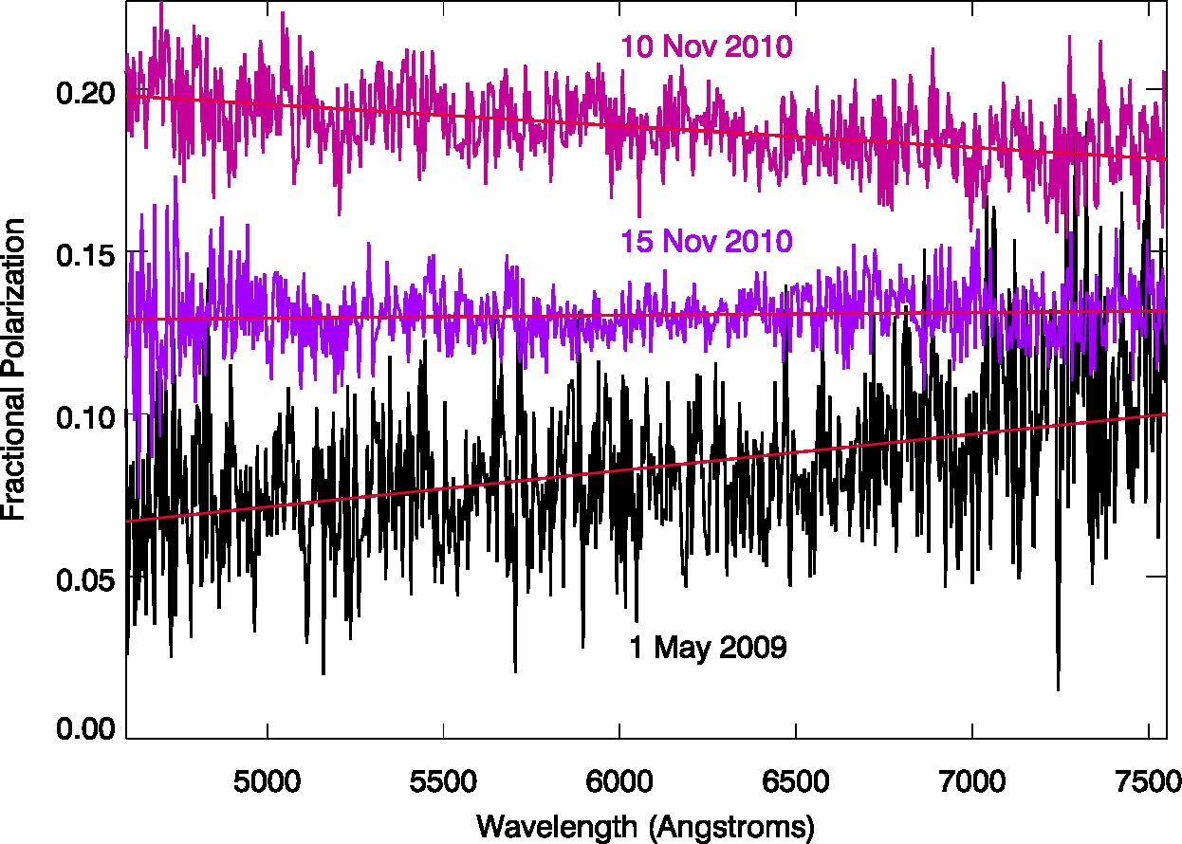
Wavelength Dependence of Optical Polarization
Simulated: More common: Π(B-band) > Π(R-band)
Large difference in χ only when Π < 3°
Sample observed wavelength dependence
3C 454.3 during brightest state (Jorstad et al. 2013)
(Note that there is significant big blue bump emission at low flux levels.)
Notes:
Historical motivation: Do AGN show low/high/very high states like GBHs?

Slide 21
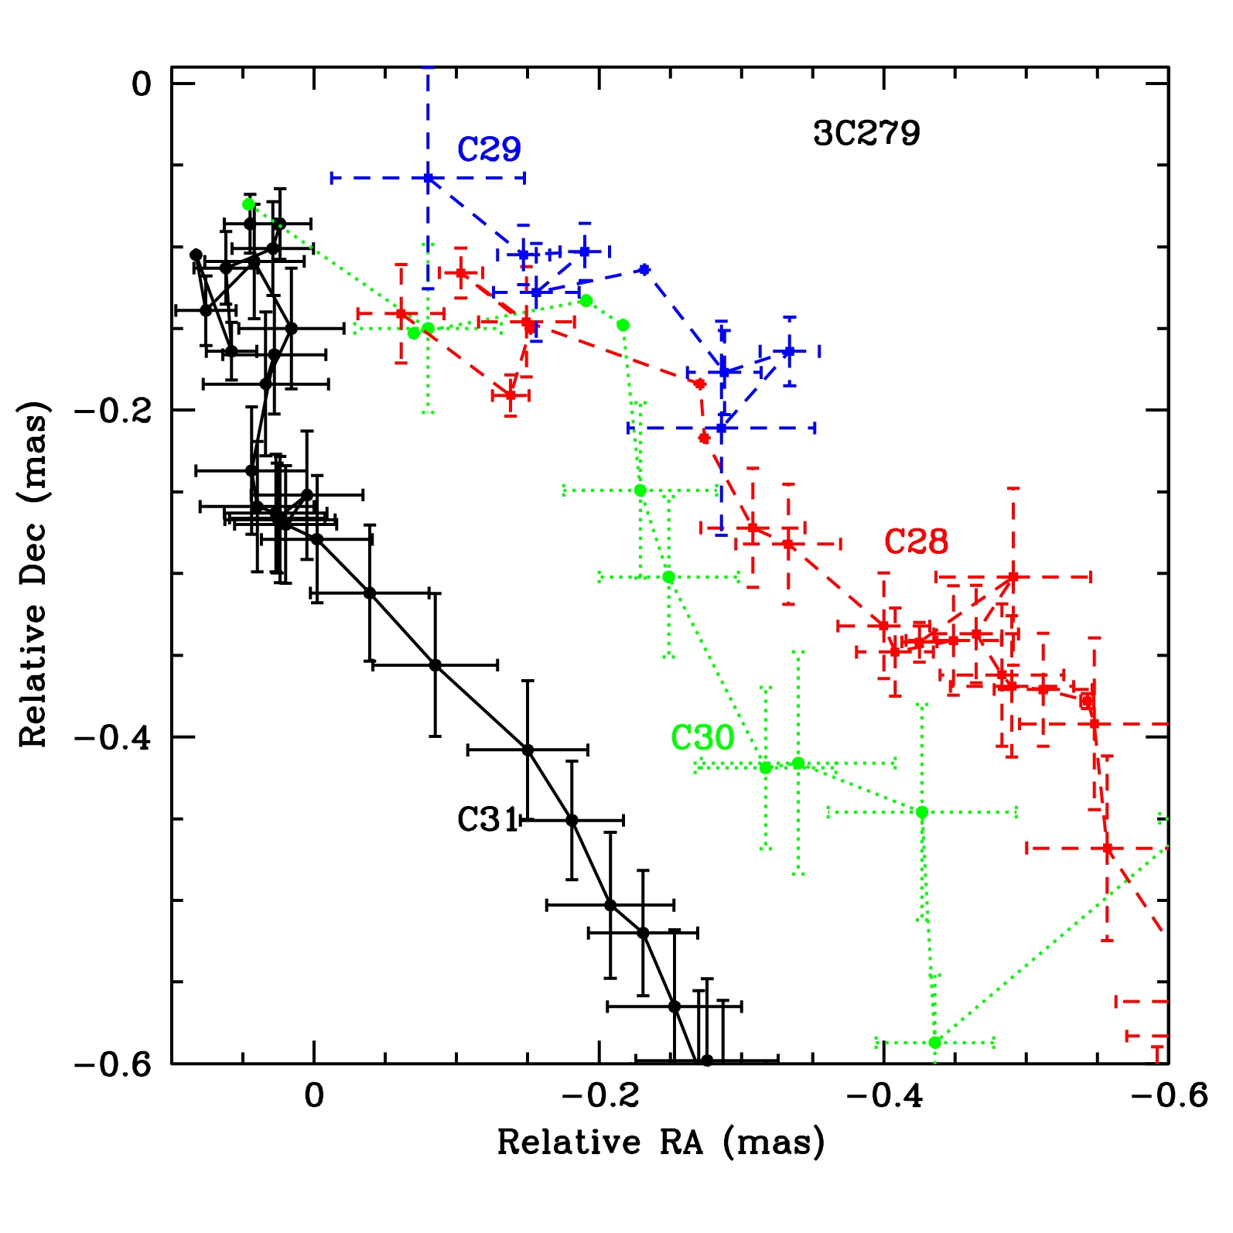
Turbulence (or reconnection) Solution to Time-scales (see also Narayan & Piran 2012)
Need to understand that opening angle of jet is very narrow: ~ 0.1/Γ_{flow} (Jorstad et al. 2005; Clausen-Brown et al. 2013)
Half-width of jet at core ~ 0.1 d(core,pc) Γ_{flow}⁻¹ pc (observed in typical quasar: ~0.1 pc)
“Blob” is ~ 5-10 times smaller than cross-section →
If filling factor f of cells with electrons of high enough energy to emit at at optical/gamma-ray frequencies is low, time-scale of variability can be very short:
t_{var} ~ 30 f^{1/2} (1+z) (Γ_{flow} δ_{flow} δ_{turb})⁻¹ d(core,pc) days
For f ~ 0.1, z ~ 0.5, Γ_{flow} ~ δ_{flow} ~ 30, δ_{turb} ~ 2, d(core) ~ 10 pc,
t_{var} ~ 2 hours
→ Minutes for smaller, less distant blazars like TeV BL Lac objects

Slide 22
CONCLUSIONS
Combined international effort is now producing multi-waveband flux & polarization data with sufficient time coverage to follow variations in dozens of blazars
Patterns are seen in data – some apparently systematic, others apparently random – that we can interpret in terms of physical properties of the jets
Erratic variations of flux & polarization indicate that turbulence is important, but there is also ordering of field relative to jet direction → shock(s)
Polarization of mm-wave “core” is consistent with conical shock
Acceleration of electrons can be combination of 2nd-order Fermi + reconnections from turbulence, with boost to highest energies in shocks
Model with turbulence + shock(s) shows promise in explaining much of the multi-waveband flux & polarization vs. time (as well as SEDs) of blazars
Statistics of flux & polarization variations are sensitive to level of turbulence
mm-wave VLBI polarized intensity images (e.g., with EHT) test “core” = conical shock scenario

