Slide 1
Long Term Kinematic Behavior of Parsec Scale Blazar Jets
Matt Lister
Dept. of Physics & Astronomy
Purdue University, USA

Slide 2
Outline
Time domain studies of AGN jets with the MOJAVE VLBA survey
Statistical trends and implications for TeV blazars
Kpc-scale radio structure of blazar jets

Slide 3
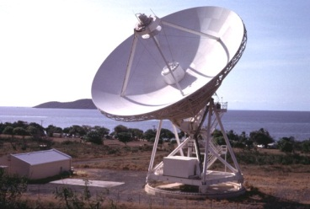
MOJAVE Collaboration
Monitoring
Of
Jets in
Active Galaxies with
VLBA
Experiments
M. Lister (P.I.), J. Richards, E. Stanley, M. Hodge (Purdue, USA)
T. Arshakian (U. Cologne, Germany)
M. and H. Aller (U. Michigan, USA)
M. Cohen (Caltech, USA)
D. Homan (Denison, USA)
M. Kadler, J. Trüstedt (U. Wurzburg, Germany)
K. Kellermann (NRAO, USA)
Y. Y. Kovalev (ASC Lebedev, Russia)
J. A. Zensus (MPIfR, Germany)
A. Pushkarev (Crimean Observatory)
E. Ros (MPIfR, Germany & U. Valencia, Spain)
T. Savolainen, T. Hovatta (Metsăhovi Obs., Finland)
Very Long Baseline Array
The MOJAVE Program is supported under NASA Fermi Grant NNX12A087G

Slide 4
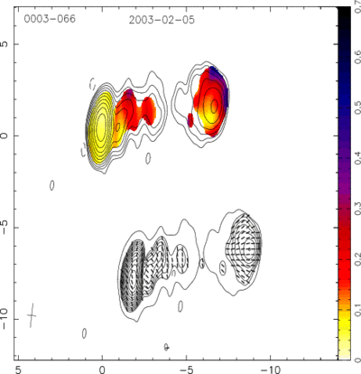
MOJAVE VLBA Program
Regular observations of radio-bright AGN
VLBA Key Science project
24 hour observing session every month
cadences tailored to individual jets
Milliarcsec-resolution images at 15 GHz
continuous time baselines on many sources back to 1994
full polarization since 2002
Blazar 0003-066 at 15 GHz
Colors: fractional linear polarization

Slide 5
Investigating Fermi blazar jets
Fermi is an excellent AGN survey instrument:
broadband coverage, sees jet flux only, no contamination from host galaxy
Quasars (red points) have low-spectral peaked SEDs
IC scattering of broad line region photons quenches high energy electron population in the jet
Highest spectral peaked (HSP) jets are of the less powerful BL Lac class (no broad line region)
X-ray
HSP
ISP
LSP
Radio
Fermi LAT Collab, 2012, ApJ 743, 171

Slide 6
MOJAVE AGN Monitoring Samples
1.5 Jy :
all AGN above δ = -30° known to have exceeded 1.5 Jy in 15 GHz VLBA flux density (1994.0 - 2010.0; Lister et al. 2013, AJ 146, 120).
Low-luminosity :
representative sample of 43 AGN with 15 GHz luminosity below 10²⁶ W Hz⁻¹ selected from the Radio Fundamental Catalog http://astrogeo.org/rfc/.
1FM γ-ray :
complete Fermi-selected AGN sample above 100 MeV (Lister et al. 2011, ApJ 742,27).
Hard Spectrum :
representative sample of hard γ-ray spectrum, radio bright AGN from Fermi 2-year catalog

Slide 7
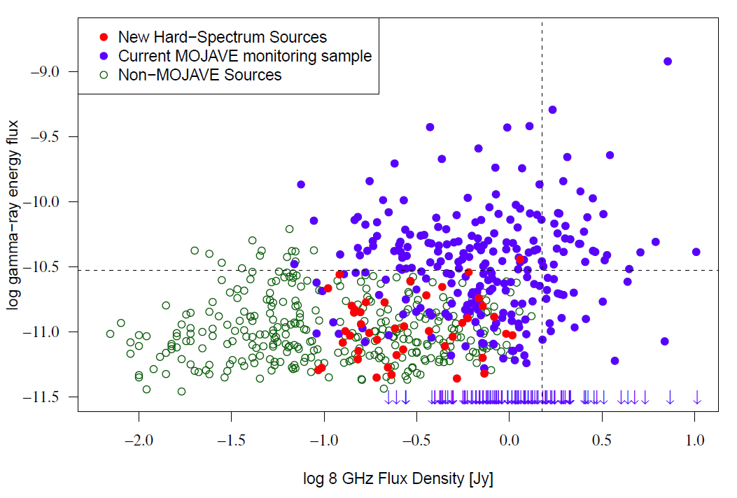
Coverage of radio/γ-ray flux plane
γ-ray
Prior
Radio

Slide 8
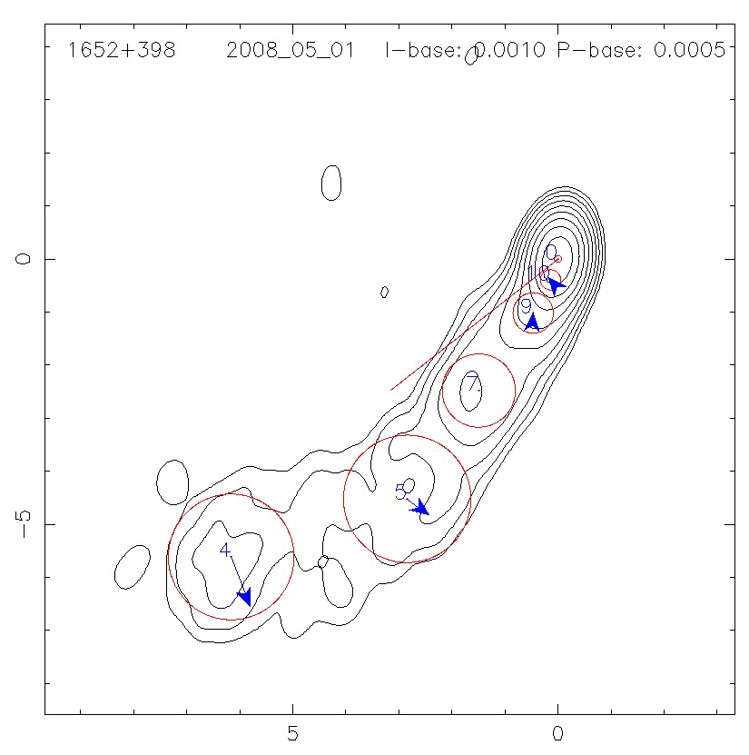
Most Recent MOJAVE Kinematics Analysis
4366 VLBA epochs of 200 AGNs from 1994 Sept - 2011 May.
Gaussian models fit to visibilities at each epoch.
Image restoring beam:
~0.5 to 1 mas
Image sensitivity:
0.1 - 0.3 mJy/beam
Positional rms accuracy:
0.05 - 0.1 mas
Mrk 501
106 ± 20 μas/y
203 ± 18 μas/y
Lister et al. 2013, AJ 146, 120
Homan et al. 2015, ApJ 798,134
Probing jet kinematics and polarization in region 10-1000 pc (de-projected) from central engine.

Slide 9
Overall Jet Speed Distribution
Peaked at low values
only 2 jets with β_{app} > 30
high Γ jets are very rare in blazar parent population
Lorentz factors of the most luminous/powerful jets range up to ~50
The typical AGN jet is weak and has a Lorentz factor of only ~ a few
Lister et al. 2013, AJ 146, 120

Slide 10
Apparent Inward Motions
Core
1458+718
Statistics:
Rare: only 2% of all moving features
Seen in only 10 of 200 jets (6 of these are BL Lac jets)
Possible causes:
Accelerated motion across the line of sight
Inward pattern speed (e.g., reverse shock)
Misidentification of true core feature

Slide 11
Slow Pattern Speeds
Defined as:
< 20 μas/y ,
non-accelerating ,
< 1/10th of max speed seen in the jet
Only 4% of all features
Found in 10% of quasar jets and 25% of BL Lacs
2134+004
M87
Notes:
25% of BL Lacs, 10% of quasars have SPS

Slide 12
Speed Dispersion Within the Jet
An AGN jet typically contains features with a range of bulk Lorentz factor and/or pattern speed
Characteristic median speed exists for each jet
Normalized speed distribution within 12 jets each having at least 10 moving features.

Slide 13
MOJAVE Jet Acceleration Study
Homan et al. 2015 (ApJ 798,134) analyzed 329 features in 95 blazar jets
All features had at least ten VLBA epochs.
Analyzed accelerations in directions || and ⊥ to apparent motion vector.

Slide 14
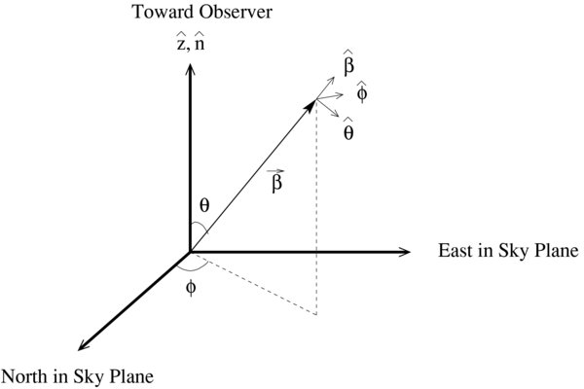
= velocity vector
No perpendicular acceleration is expected in cases of changes in speed along a straight trajectory.
If jet features are moving with constant speed on a curved trajectory, should expect to see accelerations both parallel and perpendicular to mean velocity vector.

Slide 15
AGN Jets are Accelerating
75% of the jets studied have at least one accelerating feature.
Half of all the jet features show significant acceleration.
Parallel accelerations are of larger magnitude and more prevalent than perpendicular accelerations.
Results confirmed at 8 GHz in AGN sample of Piner et al. 2012 ApJ 758, 84

Slide 16
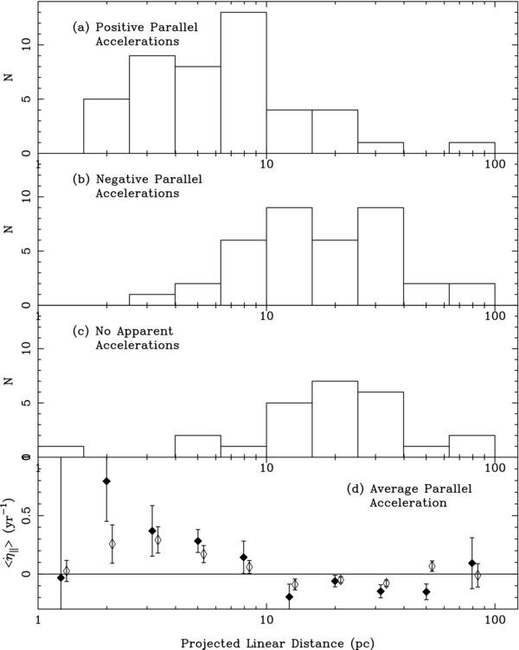
Evidence for changing Lorentz factors
Overall statistics show that observed accelerations cannot be solely due to bending
most features have a high || / ⊥ acceleration ratio.
Positive parallel accelerations are most common within 10 pc of the core
Features tend to speed up near the core, and slow down at ~ 100 pc (deprojected) farther downstream.
Changes in Lorentz factor must be the primary cause of the observed accelerations.
Outward a||
Inward a||
No measurable accel.
Average a||
Projected Distance [pc]

Slide 17
Rate of Jet Speed Changes
Inner jet:
$\dot{Γ} / Γ=$10⁻³ to 10⁻² per y
(rate is slower in the jet frame)
At > 100 pc downstream:
$\dot{Γ} / Γ=$-10⁻³ per y; enough to completely decelerate the jet by ~100 kpc, but ISM density drops off
BL Lacertae
1928+738
Cygnus A

Slide 18
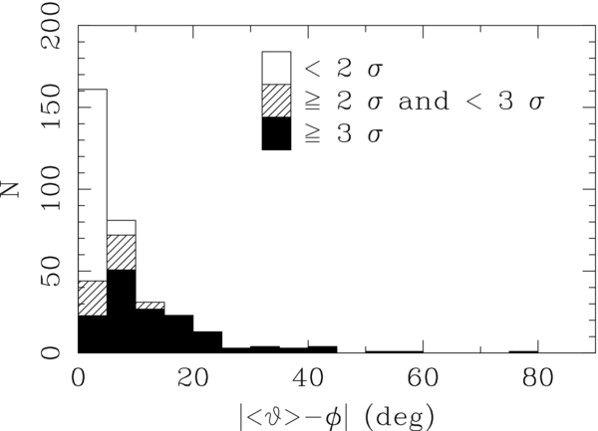
Curved Motions
A jet feature is non-radial if its proper motion doesn’t point back to the jet core.
Core
Proper motion vector direction (φ)
Mean position angle of the jet feature over time (<υ>)
Half of all the jet features are non-radial.
Many trajectories are highly curved on the sky.

Slide 19
MOJAVE Time Lapse: 20 yr of Quasar 0738+313 at z = 0.6
50 pc

Slide 20
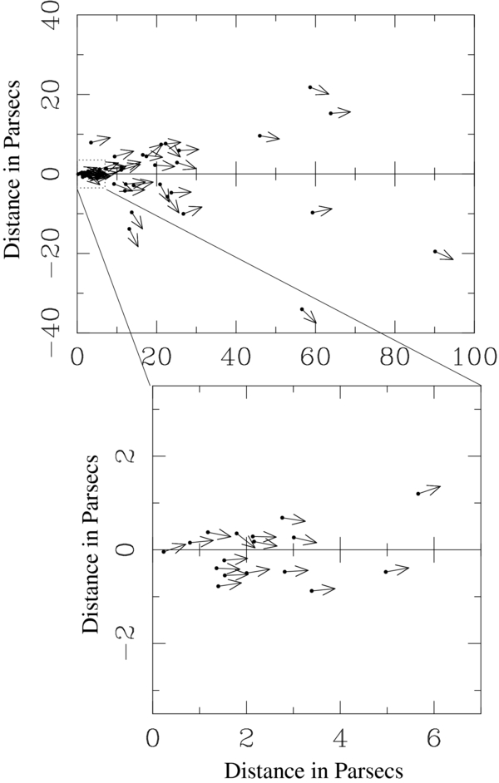
Inner Jet Collimation
Proper motion vector directions within ~50 pc (deprojected) of jet core indicate collimation.
No apparent collimation seen further out. (Major exception: 3C 279 in 1999 ; Homan et al. 2003)

Slide 21
Inner Jet Orientation Variations
Analyzed 60 jets with 12-15 years of VLBA coverage
Half show significant changes in inner jet position angle, up to several degrees/yr ; possible sinusoidal variations; large jumps also occur
Jets of weak-lined blazars (BL Lacs) typically show smaller variations than quasars
Lister et al. 2013, AJ 146, 120

Slide 22
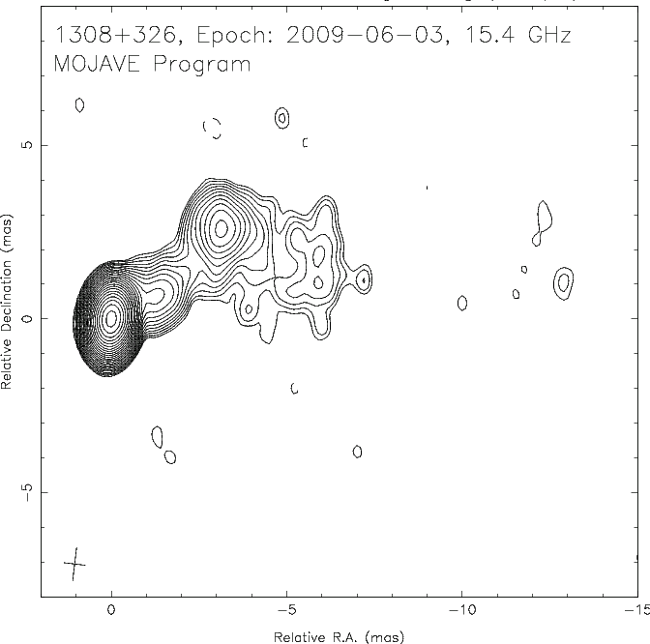
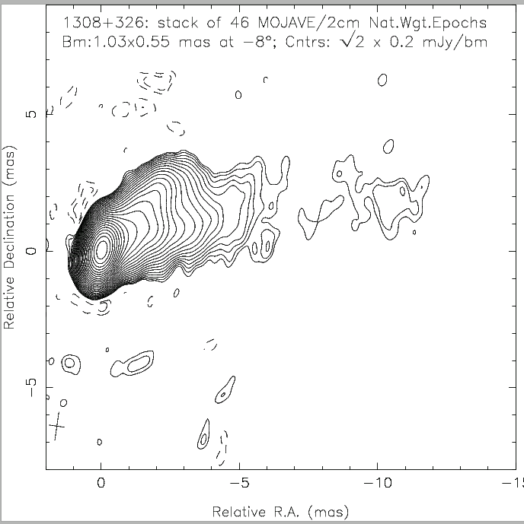
Energized Jet Channels
Quasar jet image: 2009
Stacked image: 1995-2009
Newly ejected jet features move out on successively different trajectories
At any given time, typically only a portion of the full (conical) outflow is energized/visible in a VLBA image

Slide 23
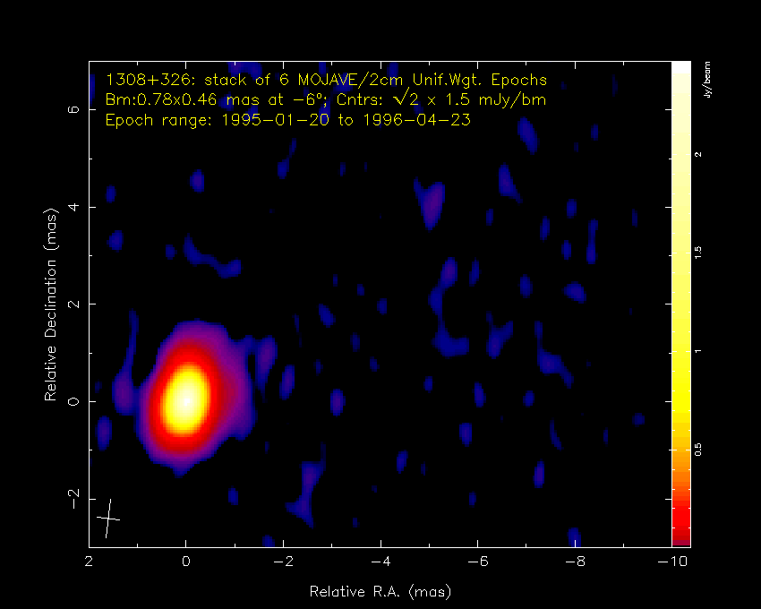

Slide 24
Statistical Trends

Slide 25
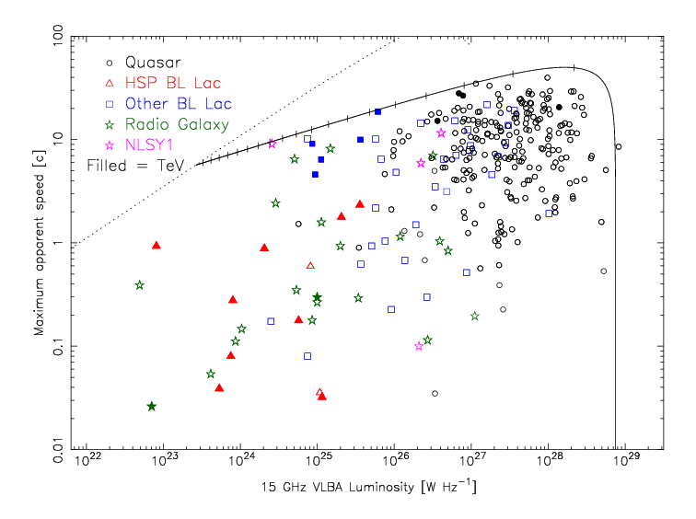
Jet Speed vs. 15 GHz Luminosity
150 mJy, 3 mas/y
$$Γ=50$$
L_{i} = 3 x 10²⁴ W
Only the most luminous jets can attain high Lorentz factors
Notes:
Only the most luminous jets can attain high Lorentz factors

Slide 26
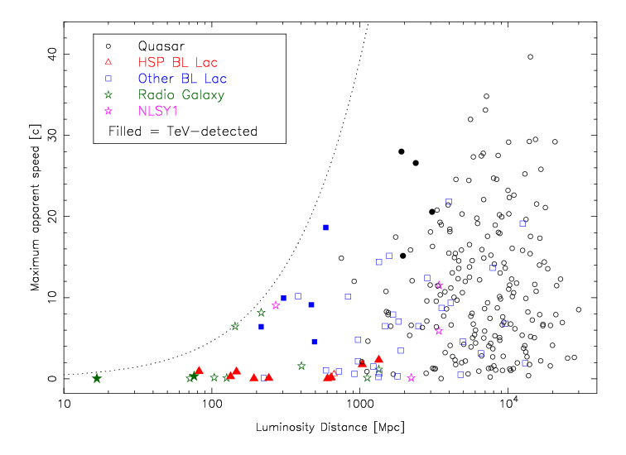
Jet Speed vs. Cosmic Distance
Two kinds of TeV AGN
Notes:
Non-HSP TeV jets are among the fastest in their distance bins.

Slide 27
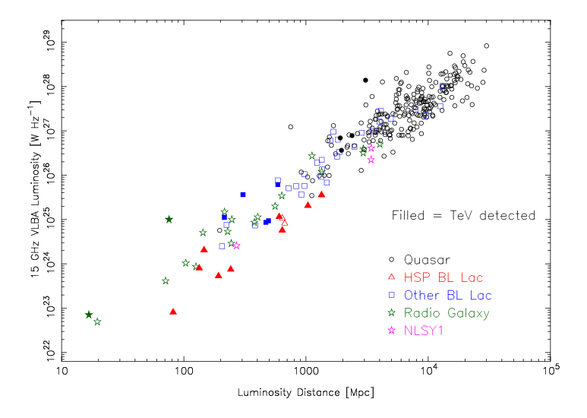
Radio Jet Luminosity vs. Cosmic Distance
HSP AGN lie at faint end of blazar radio luminosity function
3C 279
3C 273
3C 84
M87
IC 310
NGC 1052

Slide 28
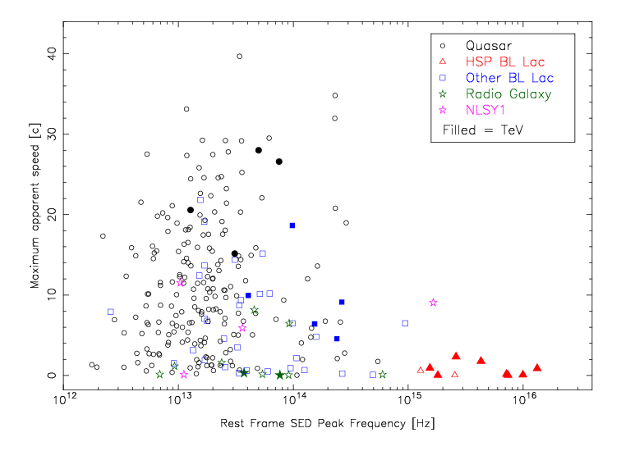
Jet Speed vs. Synchrotron Peak Frequency
More AGN speed data yet to come

Slide 29
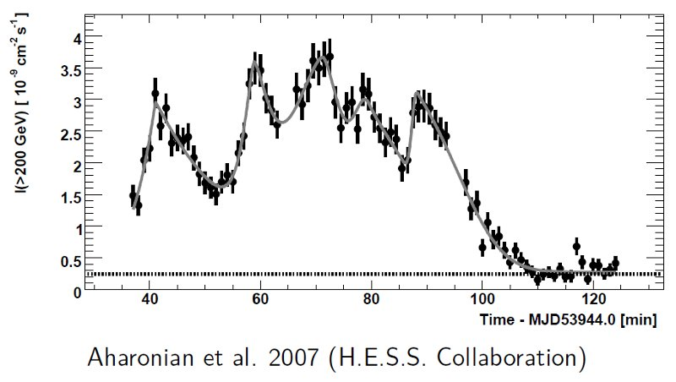
The HSP Doppler Beaming Crisis
Extreme variability of TeV Ɣ-rays imply very small emission regions
Ɣ-rays suffer huge pair losses unless HSP jets have very high beaming factors
2155-304
40 min.
Possible explanations:
Fast spine / slow sheath structure (e.g., Tavecchio et al. 2008)
Reconnection regions or misaligned ‘mini-jets’ (Giannios et al. 2010,2013)
Fast leading edges of intermittent outflows (Lyutikov & Lister 2010)

Slide 30
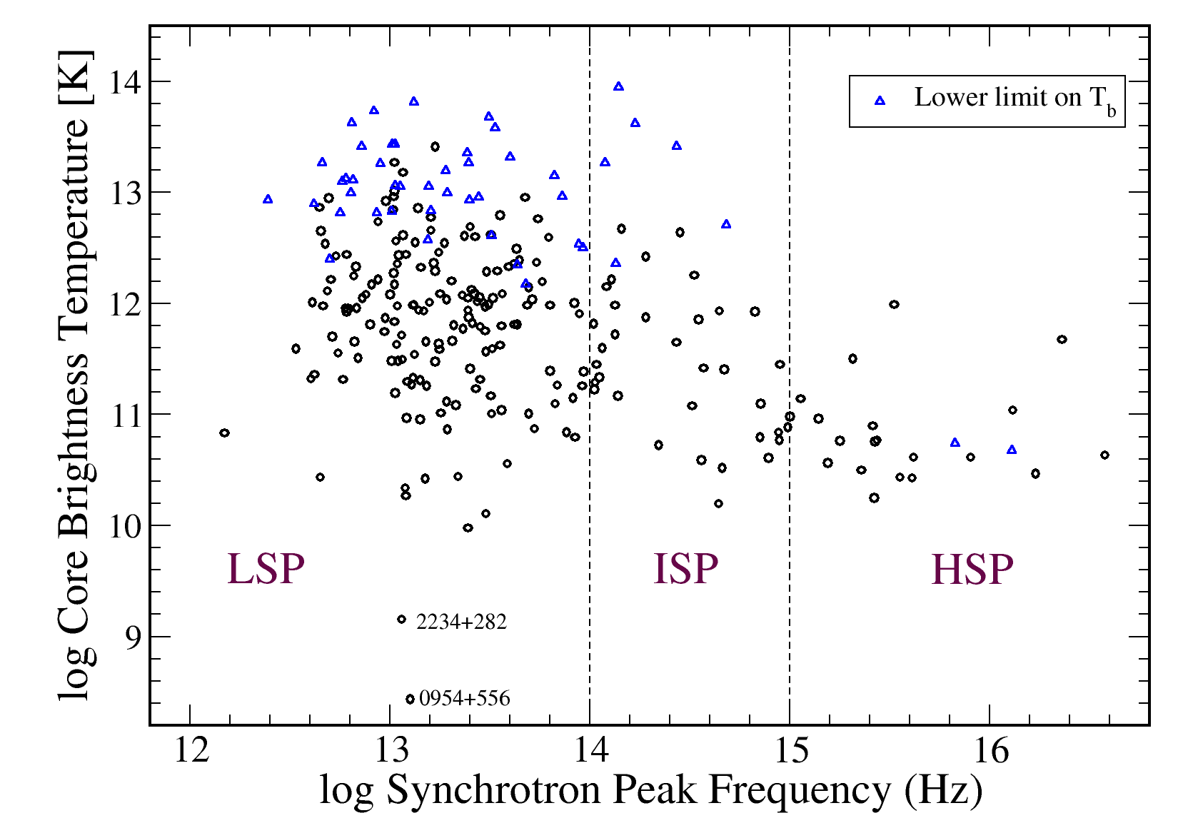
Relativistic Beaming Levels
$$T_{B,obs} ∼δ{ T}_{B,int}$$
Lower VLBI brightness temp. and variability of HSP radio cores are indicative of low radio relativistic beaming factors

Slide 31
Ramifications of a Very Fast-TeV Jet Spine
Let’s assume $δ_{TeV}>100$ , which implies
→ viewing angle < 0.6º ($\sin{θ}{<1/δ)}^{}$
Lorentz factor > 50 ( $Γ>δ/2)$
Large flux-limited jet surveys will always include some jets with $Γ \sim Γ_{max}$ (Lister et al. 1997), so fast spine model implies:
TeV emitting region is much faster than all known radio jets
Bright TeV jet population is heavily orientation biased
Parent TeV jet population must be very large
TeV-emitting jet region has to be intrinsically radio weak

Slide 32
δ_{spine} δ_{sheath}
Γ_{spine}
“Sometimes the fast spine is invisible since it is beamed away from you”
→ works only if jet viewing angle > 10º or spine δ >> 100

Slide 33
Radio Jets of HSPs in Fast Spine Scenario
Pc-scale radio jets have intrinsic opening angles ~ 1°to 2°(Pushkarev et al., arXiv 1205.0659).
radio jet viewing angle of an HSP would have to be $≲$ 3°
implies $Γ_{r} ≲δ_{r}/2$(well inside 1/ $Γ_{r}$ cone)
VLBI core brightness temperatures, one-sided morphology, and radio variability all indicate ${3 ≲ δ}_{r} ≲10$.
Radio jets of HSP AGNs would therefore have$:$
${ 1.5≲Γ}_{r} ≲5$ and ${1021≲L}_{r}≲1024$ W Hz⁻¹ (unbeamed)
This puts them at the very low end of the intrinsic luminosity range for blazar jets.
→ kpc-scale radio emission should be weak & foreshortened

Slide 34
MOJAVE Kpc-Imaging Campaigns
VLA imaging of 300 MOJAVE AGN in A and B configurations at 1.4 and 5 GHz (Ethan Stanley, Ph.D. thesis)
LOFAR imaging of MOJAVE 1.5 Jy sample (Jonas Trüstedt, Ph.D. thesis)
using international baselines to achieve 1 arcsec resolution at 140 MHz
610 MHz GMRT observations have also been proposed
LAS = 240 kpc
LOFAR image of giant radio halo of ISP BL Lac 1807+698 courtesy Jonas Trϋstedt
Notes:
Are pc-scale jet position angle changes reflected in the kpc-scale emission?

Slide 35
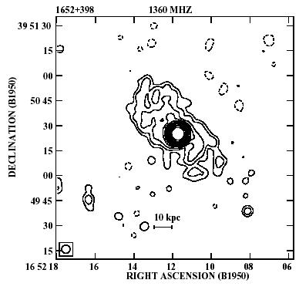
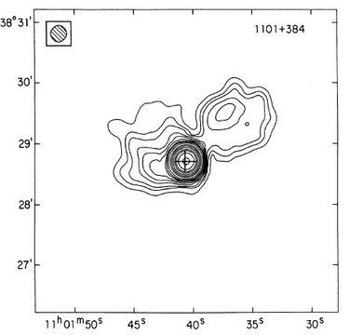
Deprojected size $≥ δ · LAS$
Mrk 501
Mrk 421
LAS = 90 kpc
LAS = 50 kpc
Cassaro et al. 1999
Machalski & Condon 1985
Deprojected size $≥$ 500 $\left(\frac{δ}{10}\right)$ kpc
Deprojected size $≥$ 900 $\left(\frac{δ}{10}\right)$ kpc
>500 kpc is considered a ‘giant’ radio galaxy (see Machalski et al. ApJ 679, 149 and poster upstairs)

Slide 36
Summary
The MOJAVE program has revealed important aspects of AGN jets:
the most powerful blazar jets have a wide range of Lorentz factors up to ~50, while typical AGN jets have Lorentz factors of ~a few.
jet features are speed up within ~50 pc of the jet base where jet is still collimating, and decelerate further out
at any given time, only a small portion of a broader pc-scale conical outflow is highly energized → be careful interpreting single-epoch images
a very fast-spine interpretation for TeV HSPs would imply that they have very weak and slow radio jets at implausibly small viewing angles.
MOJAVE VLA and LOFAR campaigns are also investigating kpc-jet morphology and trends between pc-scale properties and jet power
www.astro.purdue.edu/MOJAVE

Slide 37
Backup slides

Slide 38
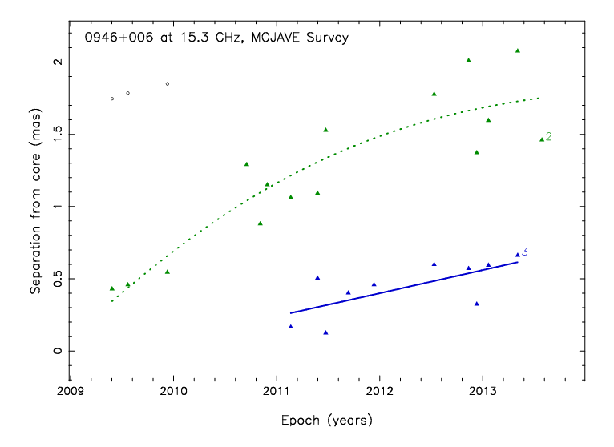
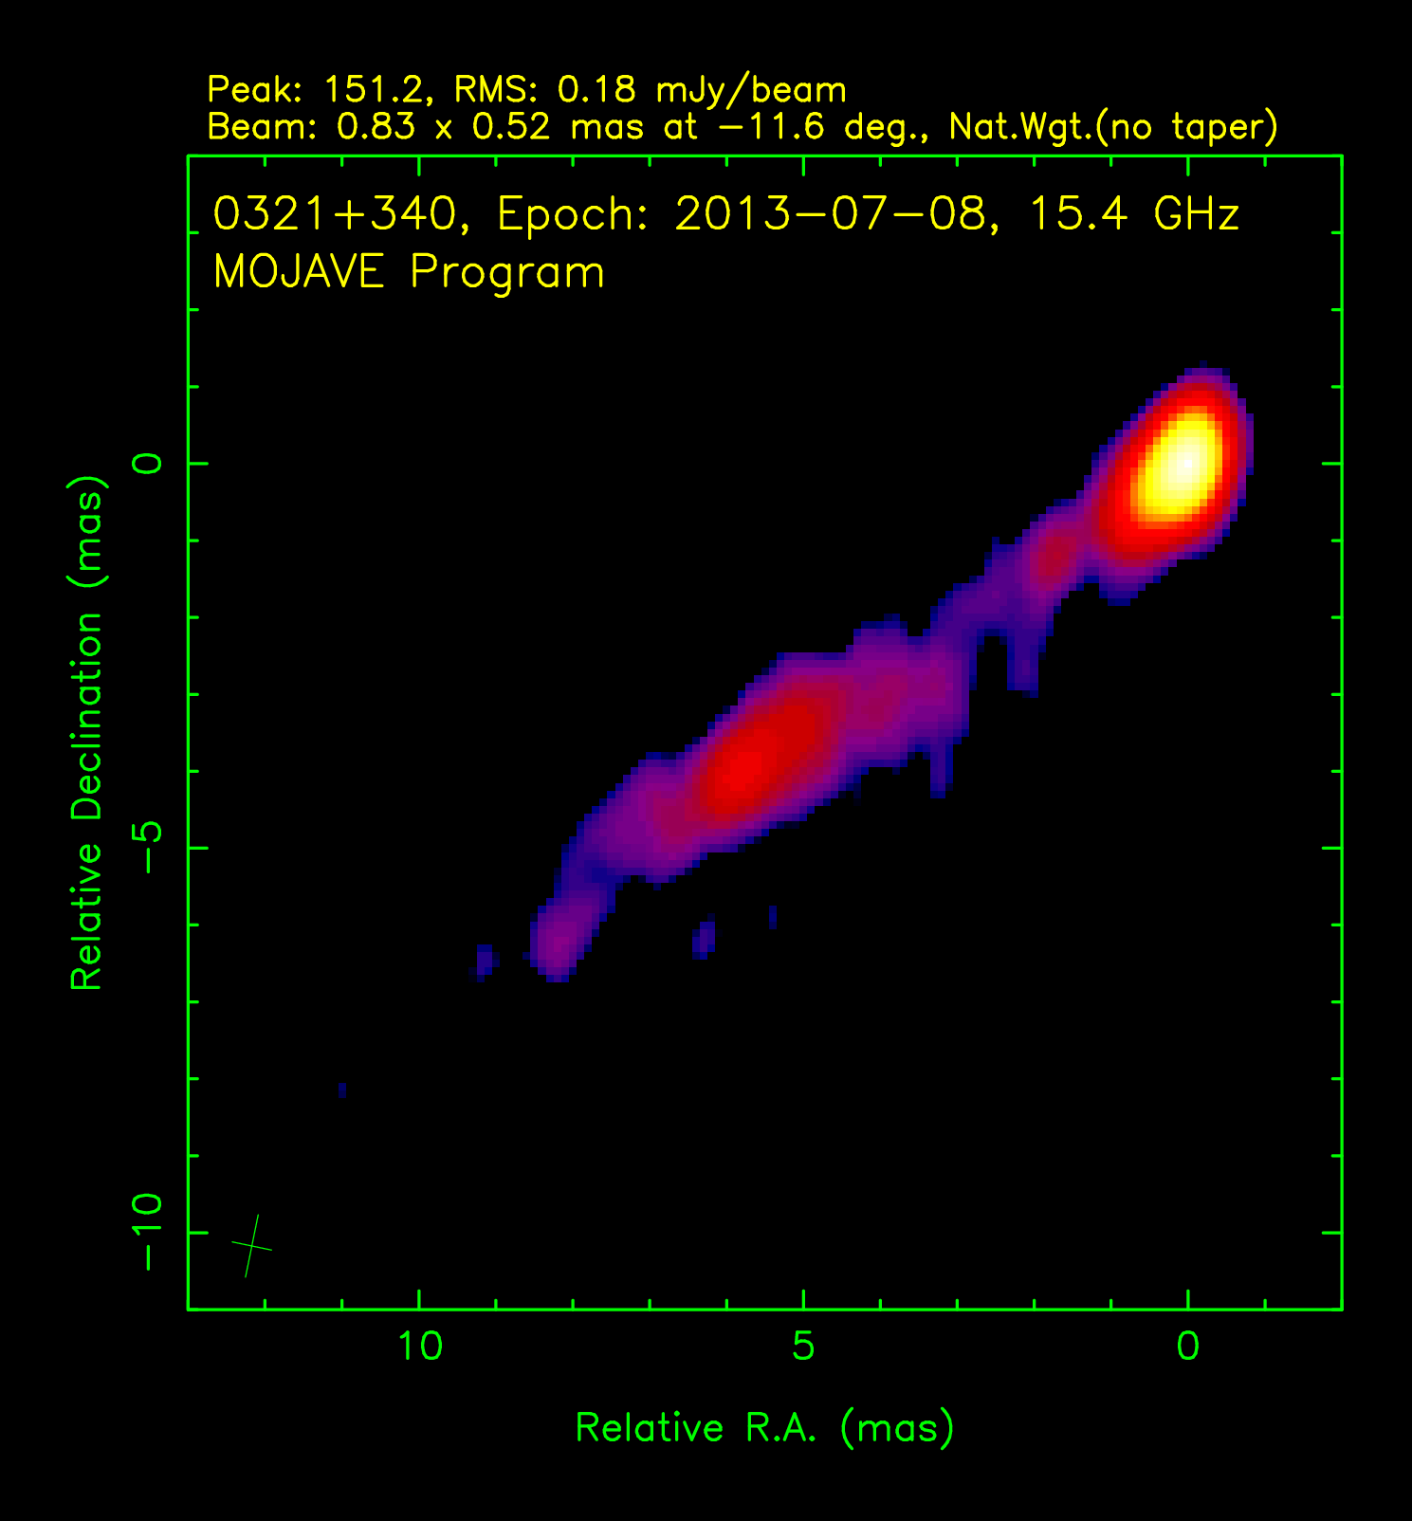
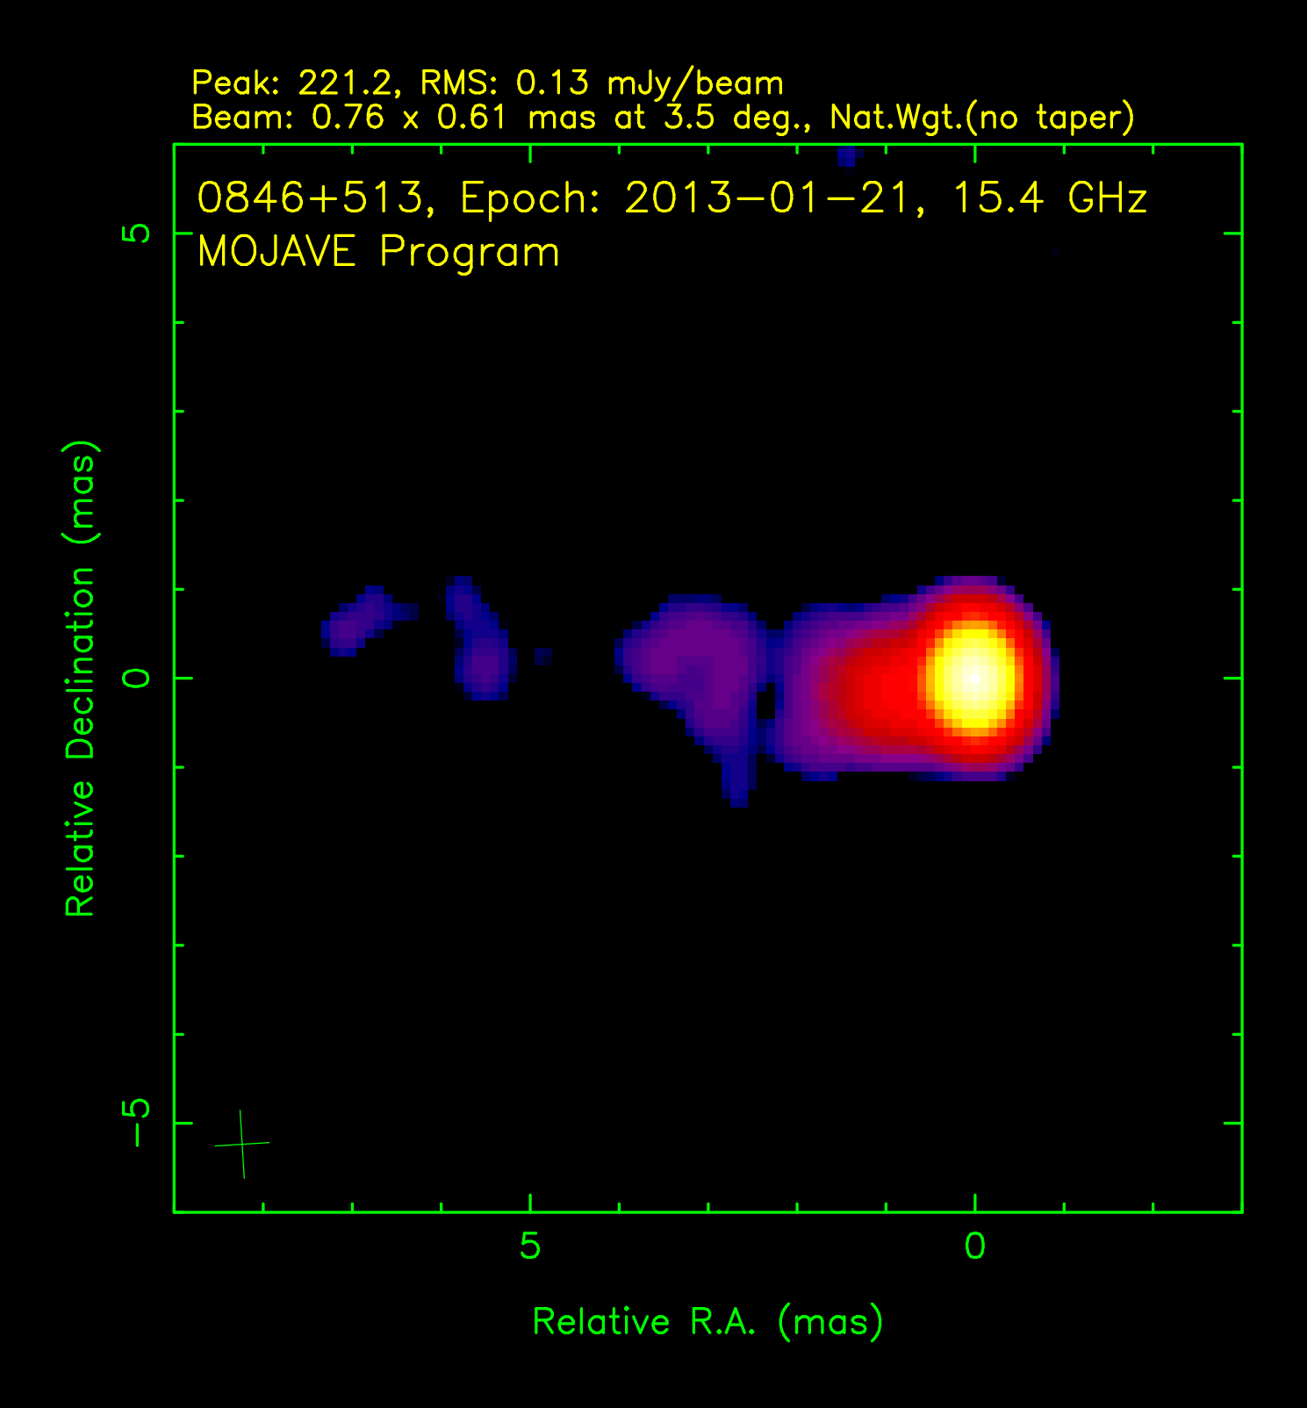
Superluminal Narrow-Lined Seyfert I Jets
NLSY1 have high low black hole mass and near-Eddington accretion rate
Rare sub-population (< 7%) are radio loud, and a scarcer few are γ-ray loud
Likely hosted in spirals
v/c = 11 ± 2
3 of 4 NLSY1 in MOJAVE have v_{app} > 6 c
Pc-scale radio jets similar to LSP BL Lacs
Low detection #s may indicate young jets (Foschini et al. 2014)
1H 0323+342
0846+513

Slide 39
Trackable features in jets of TeV AGN?

Slide 40
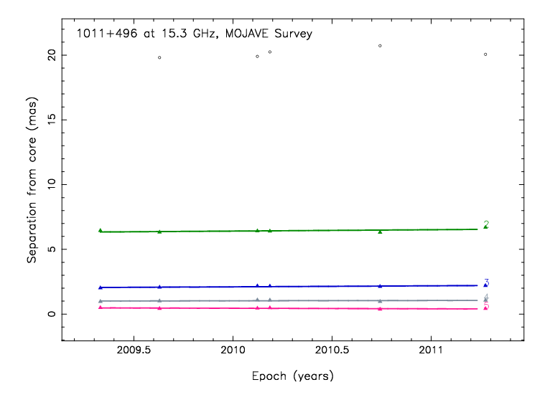
Trackable features in jets of TeV AGN?
Jet motion is < 60 μas/y ( 0.8 c )

Slide 41
Extended Jet Power
MOJAVE VLA campaign in 2007 revealed trend between apparent speed and extended lobe emission
Are the kinetic powers of high and low-spectral peaked BL Lacs consistent with the predictions of the unified model?
What are the implications for the Doppler beaming crisis?
Kharb et al. 2010, ApJ 710, 764

Slide 42
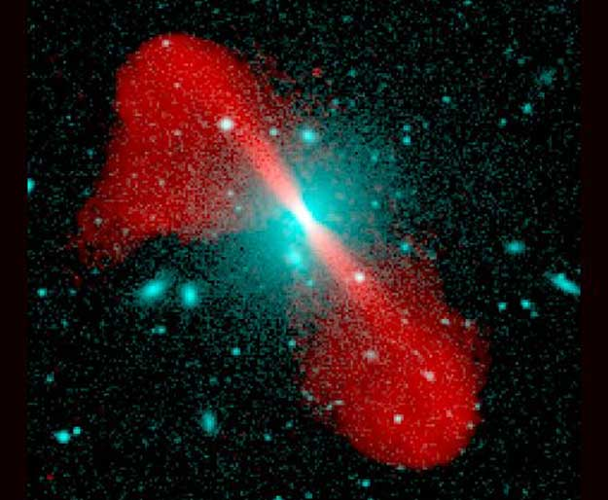
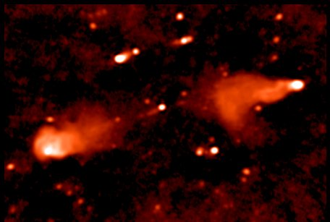
Blazar Flavors: Quasars and BL Lacs
Quasars:
broad optical emission lines
high power jets seen end-on
synchrotron peak in infrared
FR I jet
(low power)
AGN
AUI/NRAO
FR II jet
BL Lacertae objects:
weak/absent broad emission lines
low power jets seen end-on
synchrotron peaks range from infrared to optical/UV
(high power)
Hotspot
AGN
Hotspot
Palma et al.

Slide 43
Current BL Lac Paradigm
Lower jet power implies low accretion rate onto black hole:
inflow radiates inefficiently, thus no optically thick accretion disk or broad line region
No broad line photons are available for external Compton scattering
less Compton cooling of synchrotron electrons
synchrotron can peak up to optical/UV regime

Slide 44
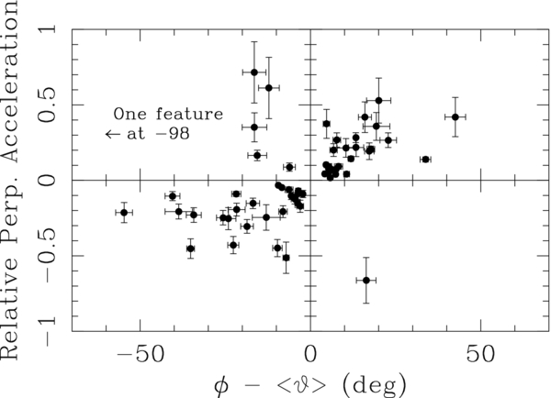

Slide 45
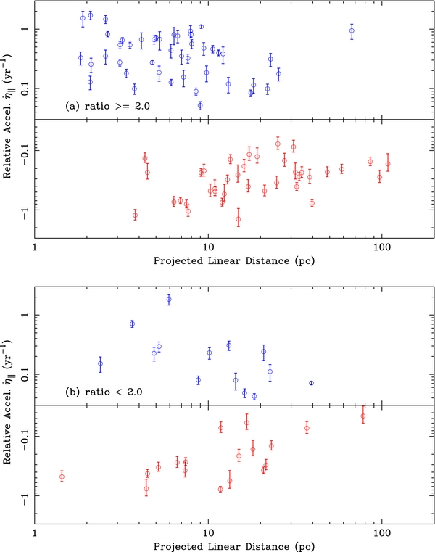
Are these trends solely due to jet bending?
Predictions:
no inward/outward acceleration trend expected with distance
parallel accelerations should be ~60% magnitude of ⊥ accelerations
features with large parallel accelerations should also show large perpendicular accelerations
Most features have a high || / ⊥ acceleration ratio.
Speed increase/decrease trend is more evident in these features.

Slide 46
Acceleration Down the Jet
Outward parallel accelerations
Inward parallel accelerations
Features tend to speed up near the core, and slow down at ~ 100 pc (deprojected) farther downstream.

Slide 47
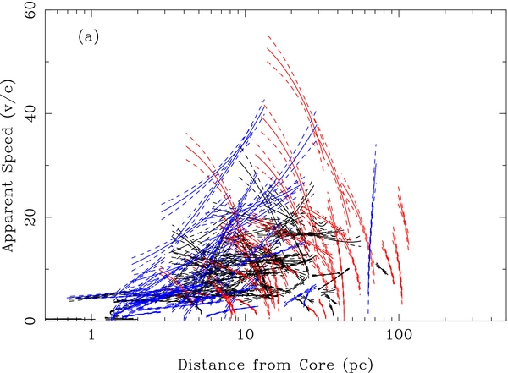
Do the observed motions reflect the underlying jet flow?
Red: inward acceleration
Blue: outward acceleration
Black: no significant acceleration
Any intrinsic shock speeds are added relativistically to the flow speed.
Broad statistical trends in MOJAVE jets are impossible to reproduce with a random collection of inward & outward moving shocks.

Slide 48
In most cases a constant acceleration model provides a good fit to the observed motions

Slide 49
Some of the best-sampled features, however, show variable acceleration

Slide 50
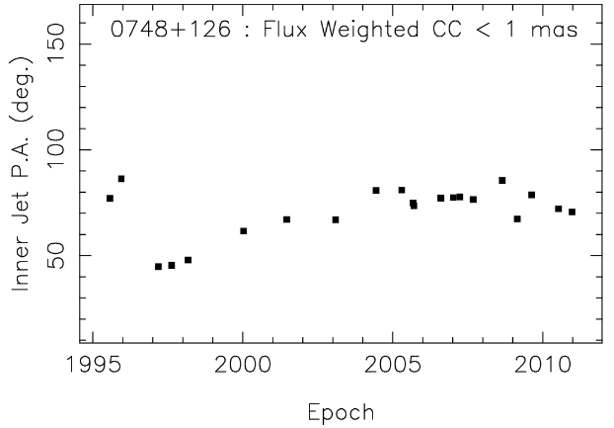
50% of jets show no trend/changes in position angle with time
43% show monotonic swings in position angle
Typically 1 to 3 degrees per year
Fastest case: quasar NRAO 150 (9.8 ± 1 degrees per y!)
NRAO 150

Slide 51
Jet Accelerations
Distance vs. time
(world line)
Many of the features move on complex curved trajectories and most are accelerating (non-ballistic)
Trajectory on sky

Slide 52
MHD Plasma Waves in BL Lacertae M. Cohen et al. ApJ, 2014, 2015

Slide 53
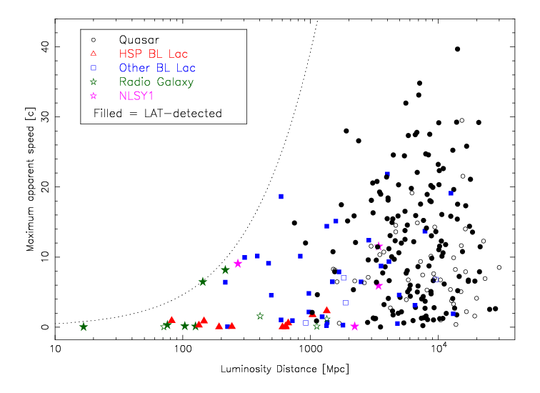
Jet Speed vs. Luminosity Distance

Slide 54
Evolution of Magnetic Field Order
Max. Fractional Linear Polarization
Mean Projected Distance from Core [pc]
Notes:
Y axis is maximum linear pol.

Slide 55
Γ= 30,
L = 10²³ W Hz⁻¹
No examples of fast, low-synchrotron luminosity features.
Only the most luminous jets can attain high Lorentz factors
Notes:
Unsampled regions
Red aspect curve: gamma = 30

Slide 56
Quasar 3C279
z = 0.54
Very bright jet feature emerged in early 1980s
In early 1998: feature brightened and accelerated from 8c to 13c
New motion vector is in the direction of the kpc-scale jet.
Jet is undergoing collimation due to a sudden change in external gas pressure in the host galaxy (Homan et al. 2003)
MOJAVE Time Lapse

Slide 57
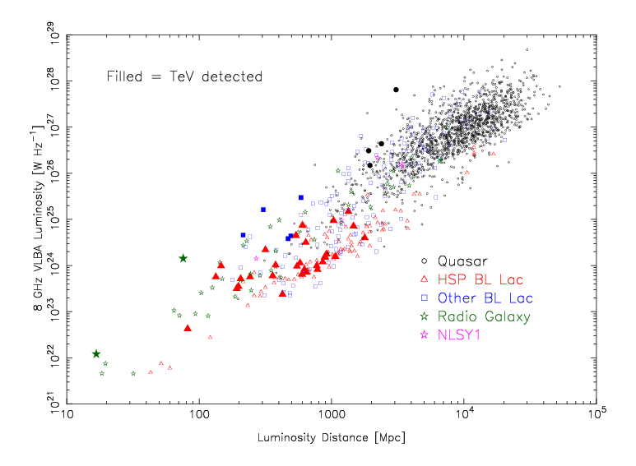

Slide 58
MOJAVE Studies of AGN Jets
Linear (I) and circular (II) polarization
Kiloparsec radio (III, Kharb et al. 2010) and X-ray (Hogan et al. 2011)
Parent population and luminosity function (IV)
Faraday rotation measure (VII) and spectral index maps (XI)
Nuclear opacity and magnetic fields (IX)
Morphology and compactness (I,V, Homan et al. 2005)
Kinematics (V, VI, VII, X, XI)
Optical properties (Torrealba et al. 2012,; Arshakian et al. 2010, 2012)
Gamma-ray properties (Lister et al. 2009, 2011, Pushkarev et al. 2010, Savolainen et al. 2010, Kovalev et al. 2009)
Roman numerals refer to MOJAVE paper series, full list at
http://www.astro.purdue.edu/MOJAVE

Slide 59
BL Lacs and radio galaxies show clear trend of increasing speed down the jet.
Situation unclear for quasars, but we can directly measure the accelerations.

Slide 60
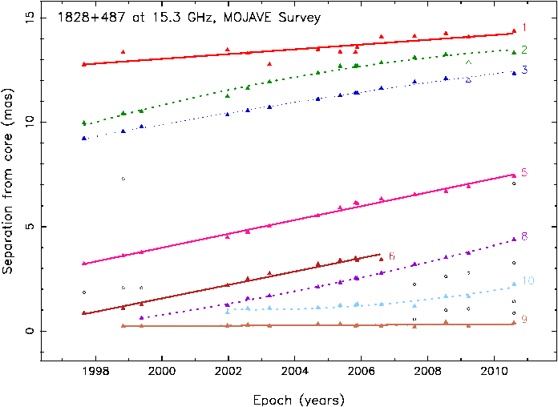
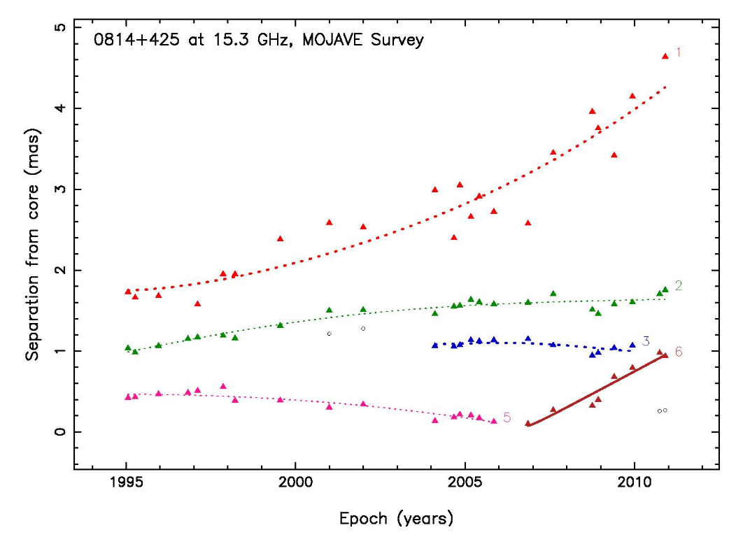
Kinematic Fits
Two-dimensional sky vector motion fits made to 887 bright features in 200 different AGN jets.
all features tracked over at least five VLBA epochs
many tracked for more than 10 years
optically thick jet ‘core’ used as a stationary reference point

Slide 61
Inner jet position angle changes are primarily driven by the emergence of new bright features
Initial sky position angle of new jet features in the quasar 1222+216

Slide 62
Sinusoid-like jet position angle variations seen in 20% of jets
Variations are too slow (decade-long) to claim periodicity (yet!)

Slide 64
Acceleration of Non-Radial Features
Define a main jet axis direction based on stacked-epoch images.
Most off-axis features have accelerations that are steering them back towards the jet axis.
We are seeing jet collimation at scales up to 50 pc
Proper motion vector direction (φ)
Acceleration
jetPA
Mean position angle of jet feature over time (<υ>)

