Slide 1




TANAMI Blazars as Possible Sources of the IceCube PeV Neutrinos
Matthias Kadler
F. Krauß, K. Mannheim, R. Ojha, C. Müller, R. Schulz
for the TANAMI and Fermi-LAT Collaborations

Slide 2
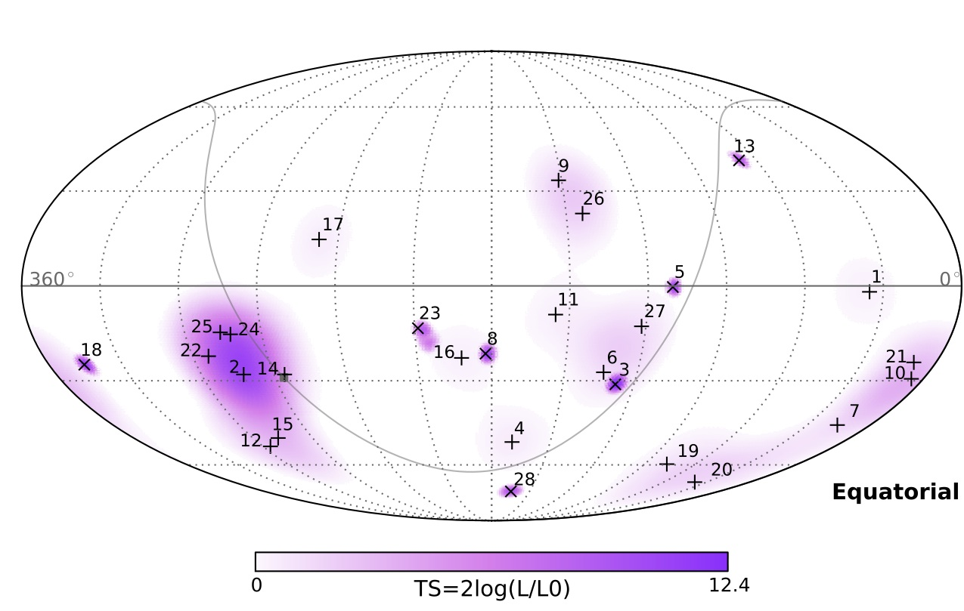
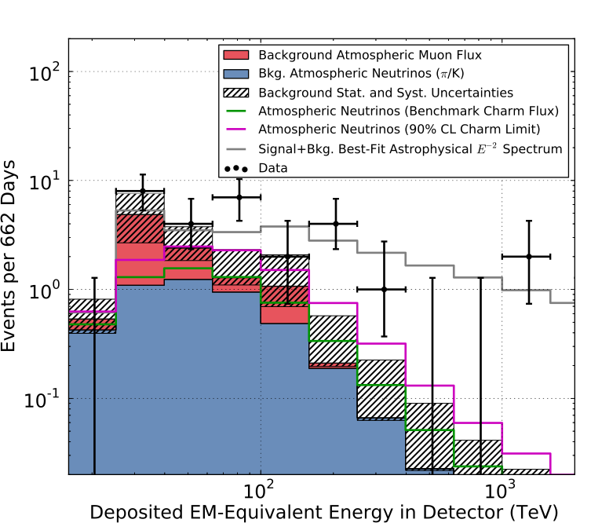
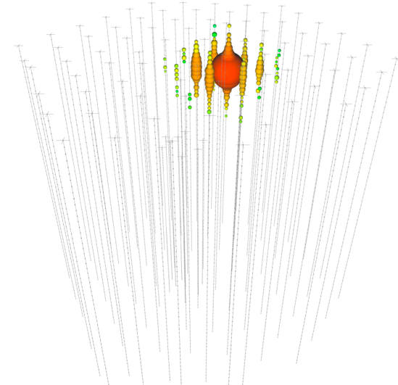
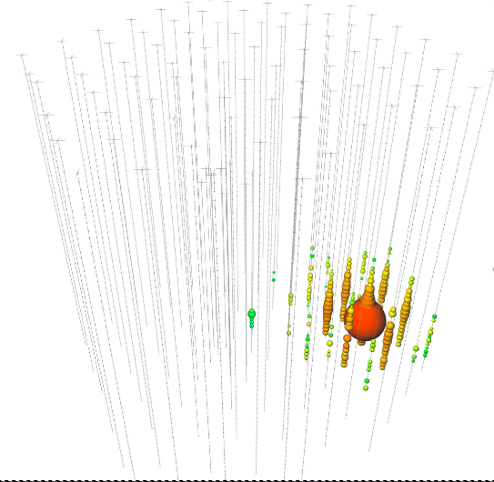


What are the Sources of the IceCube Neutrino Signal?
IceCube Collaboration 2013, Science 342, 1
R.A.= 38.3°, Dec=-67.2°, R_{err}=10.7°
R.A.=265.6°, Dec=-27.9°, R_{err}=13.2°
E~1.1PeV
E~1.0PeV

Slide 3
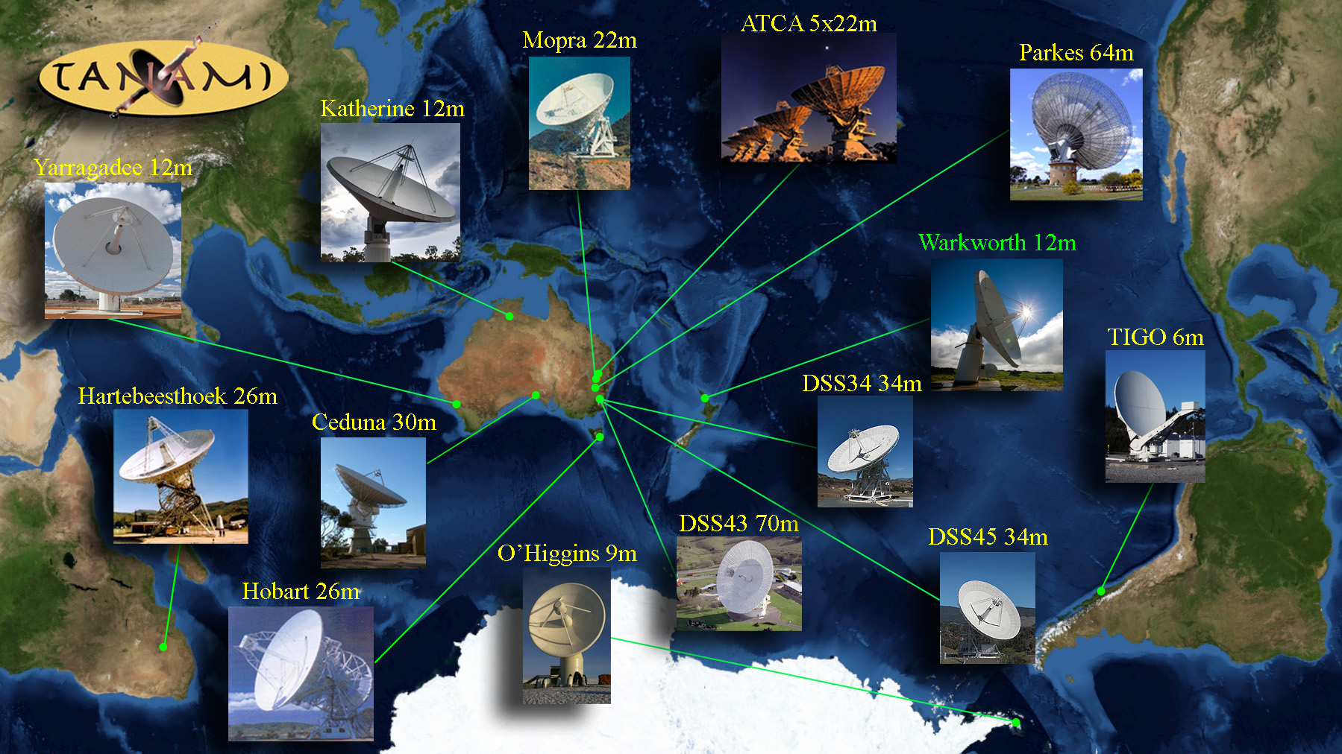
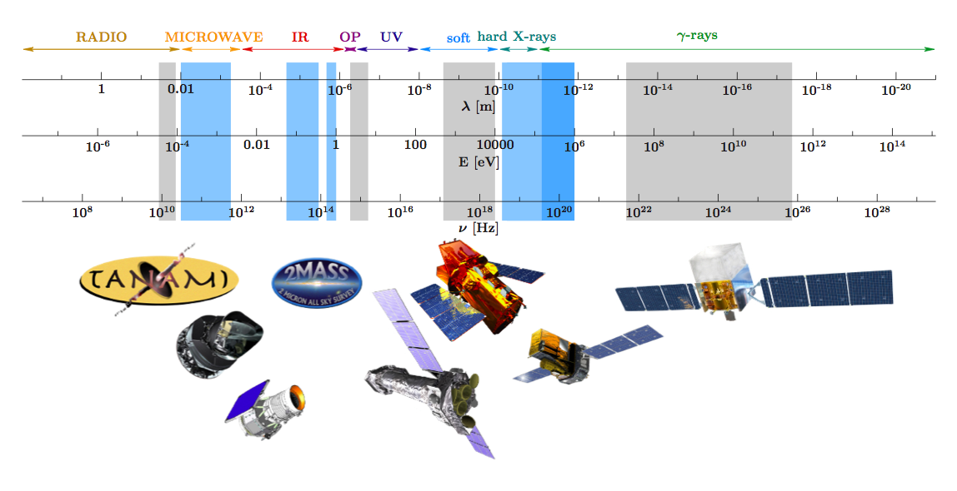
Multiwavelength Monitoring of ~90 AGN Jets South of -30◦
  Includes the six radio- and γ-ray brightest AGN in the Ernie and Bert fields

Slide 4
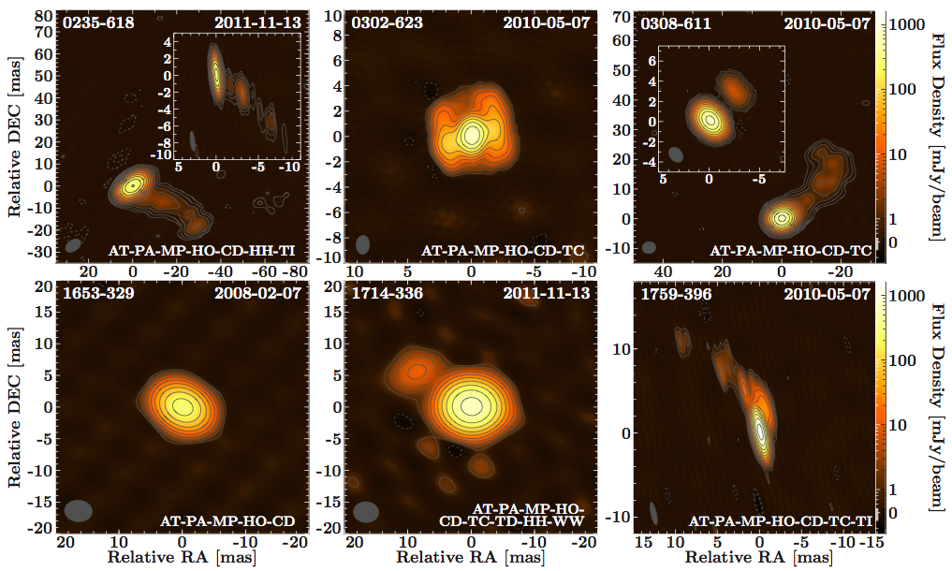
TANAMI Blazars in the IceCube PeV Neutrino Fields
Krauß et al. 2014, A&A 566, L7

Slide 5
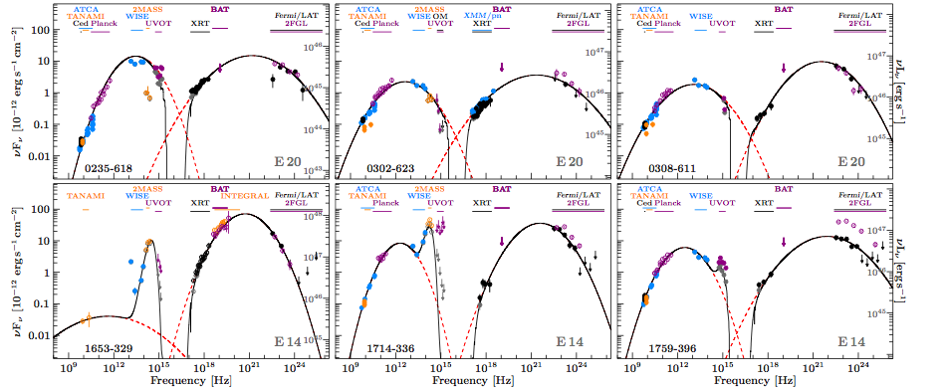
TANAMI Blazars in the IceCube PeV Neutrino Fields
Classical double-humped blazar SEDs
Blue bumps in 3 sources
Krauß et al. 2014, A&A 566, L7

Slide 6
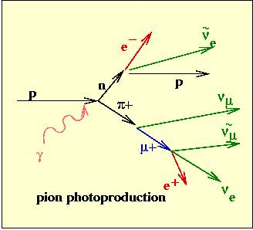

Estimate Maximum Neutrino Output
Assume presence of accelerated protons (hadronic jet models)
Pion photoproduction
Estimate neutrino flux from bolometric high-energy flux

Slide 7
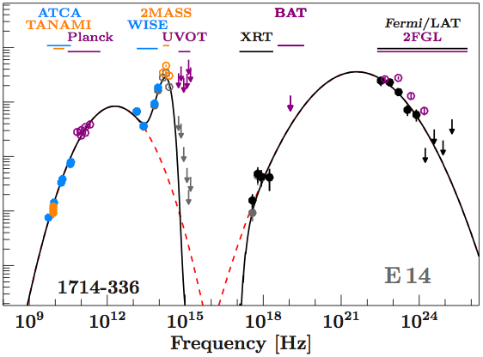
Estimate Maximum Neutrino Output
Fit SEDs with log-parabolas
(plus BB component, absorption)
Integrate from 1keV to 5GeV
Integration

Slide 8
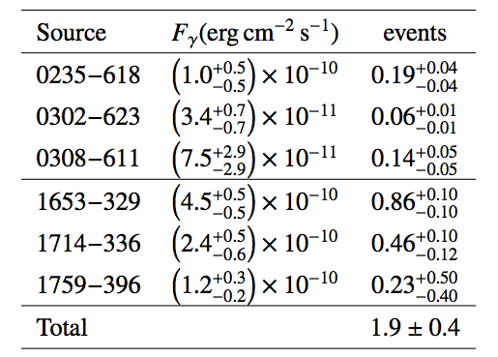
TANAMI Blazars in the IceCube PeV Neutrino Fields
The six TANAMI blazars are capable of explaining the observed IceCube signal
But:
No individual source bright enough for a direct association
  ⇒ Highest flux from 1653-329 and 1714-336
Blazar γ-ray luminosity function ~F^{-2.4}
  ⇒ Substantial contribution of faint, remote sources
  ⇒ Substantial fudge factor needed

Slide 9

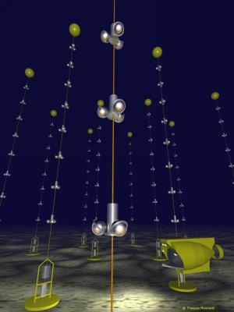
Follow-Up with
ANTARES
Neutrino Telescope in the Mediterranean (Water Ćerenkov Detector)
In operation since 2008
0.01km³
Highest sensitivity in TANAMI sky region for TeV neutrinos

Slide 10
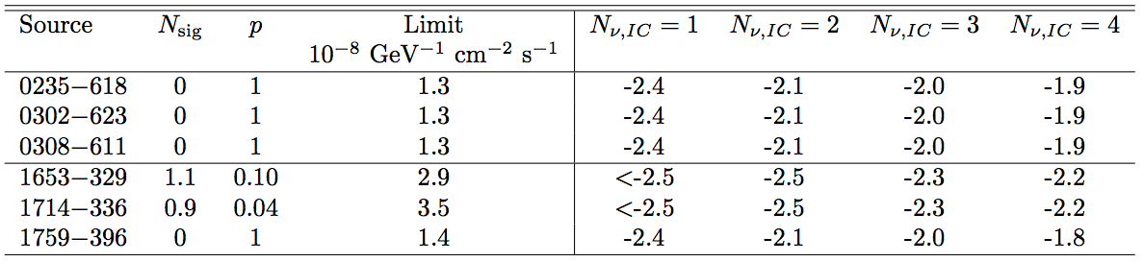
ANTARES Results
ANTARES Collaboration and TANAMI Collaboration 2015, A&A, 576, L8
1653-329 and 1714-336: one event, each.
  ⇒ Consistent with blazar-source hypothesis, but also with background
Zero events for the other four blazars.
Either:
    ⇒ Not the sources of the PeV neutrinos, or
    ⇒ Neutrino spectra flatter than -2.4

Slide 11
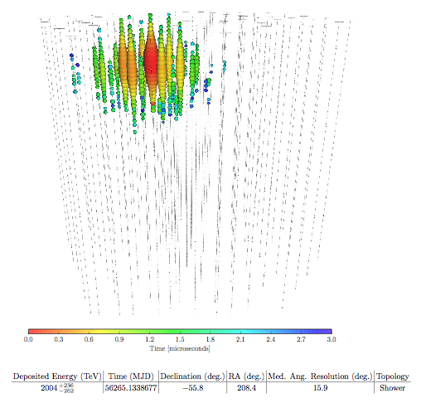

Big Bird
2PeV event on Dec 4, 2012 (Aartsen et al. 2014)
RA = 208.4◦, Dec = −55.8◦ (J2000)
Median pos. uncertainty: 15.9deg
  ⇒ 17 gamma blazars (2LAC)
Again: integral flux sufficient to explain the signal, but this time:
Output dominated by a single source: PKS B1424-418

Slide 12
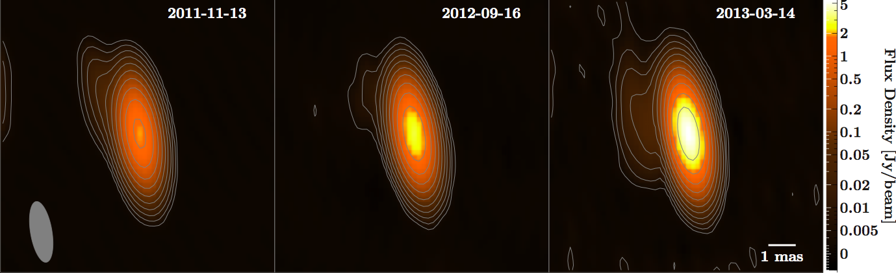
PKS B1424-418: Radio Outburst
Radio core flux density increased from 1.5Jy to 6Jy in late 2012 to early 2013
Strongest outburst ever seen by TANAMI

Slide 13
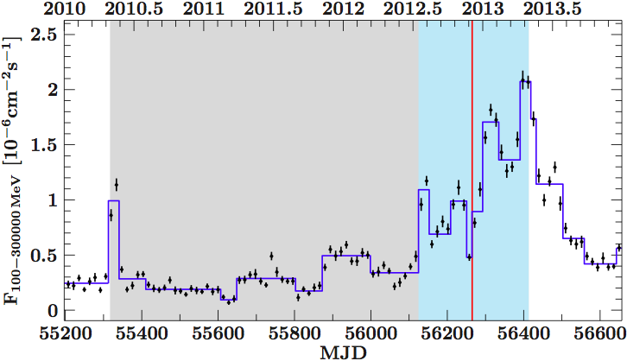
PKS B1424-418: Gamma Outburst
Outburst coincident with BigBird arrival time

Slide 14
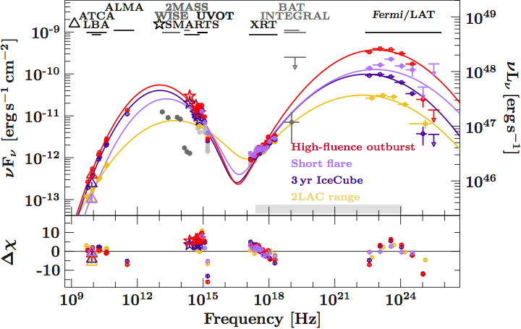
PKS B1424-418: Outburst SED
Predicted Neutrino Output: 2.2 Events

Slide 15
Chance Coincidence?
~5%
Most dramatic blazar outburst of the (far) southern sky
Highest-energy neutrino (seen in the southern sky)

Slide 16
Summary I
Integrated flux of blazars can explain the IceCube signal
Follow-up with ANTARES finds two neutrinos coincident with the two brightest candidates (still consistent with background)
Assume an association ⇒ Rather flat neutrino spectra

Slide 17
Summary II
First time that a single blazar can explain an individual PeV neutrino
Comparable blazar outbursts had substantially lower-sensitivity IceCube coverage
Still ~5% chance coincidence

Slide 19
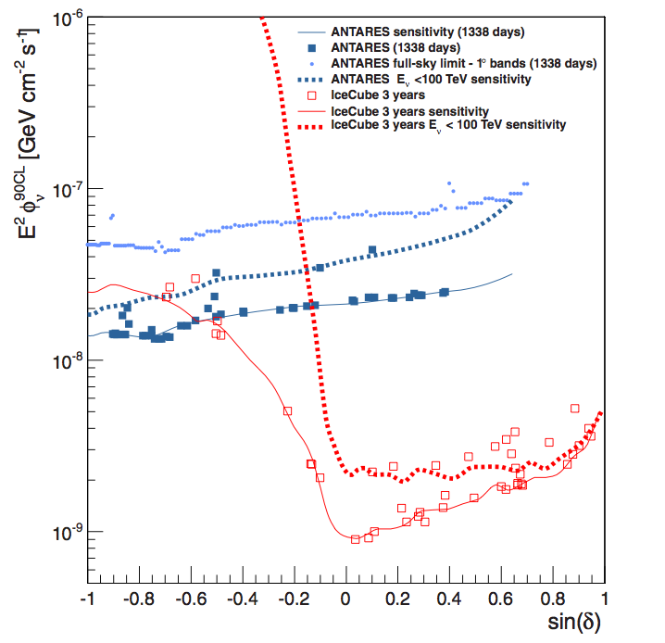
Neutrino Telescope Sensitivities
Main limitation: atmospheric background
⇒ Look down through Earth
⇒ At E<100TeV: Southern sky accessible only for ANTARES
ANTARES Collaboration 2014, ApJ 786, L5

Slide 20
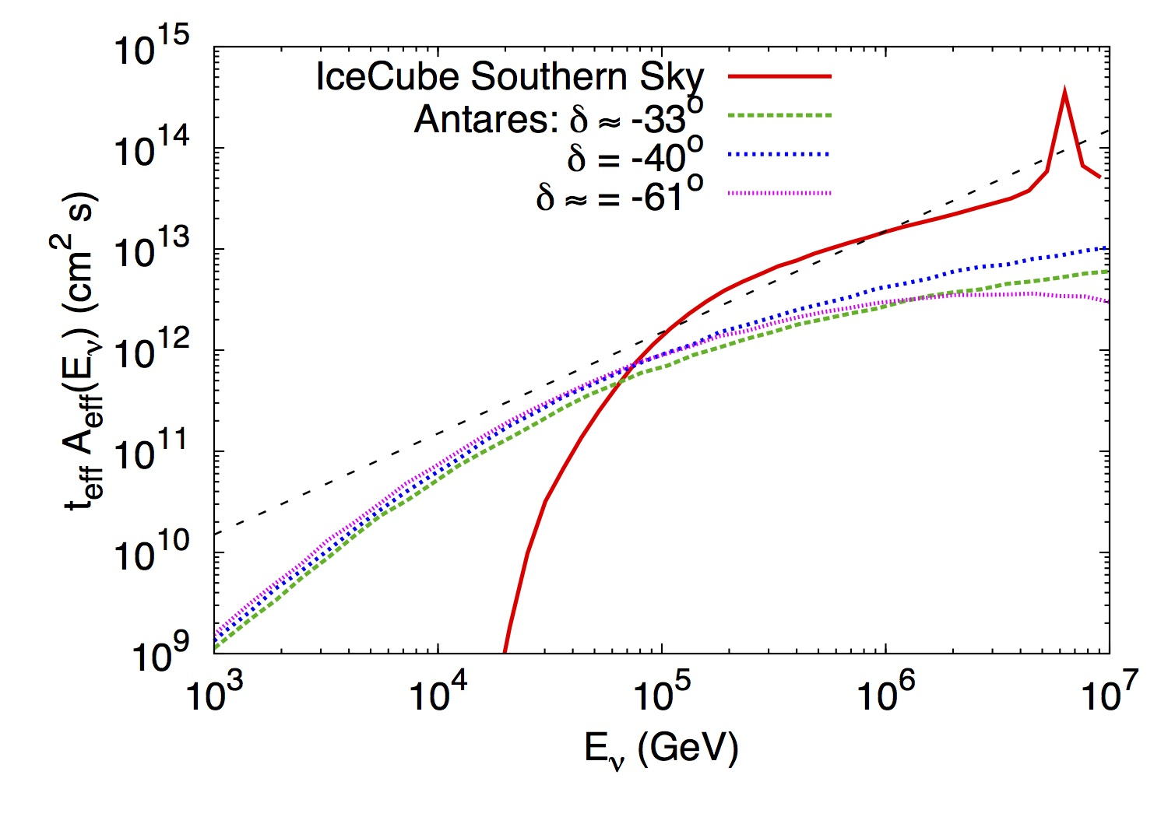
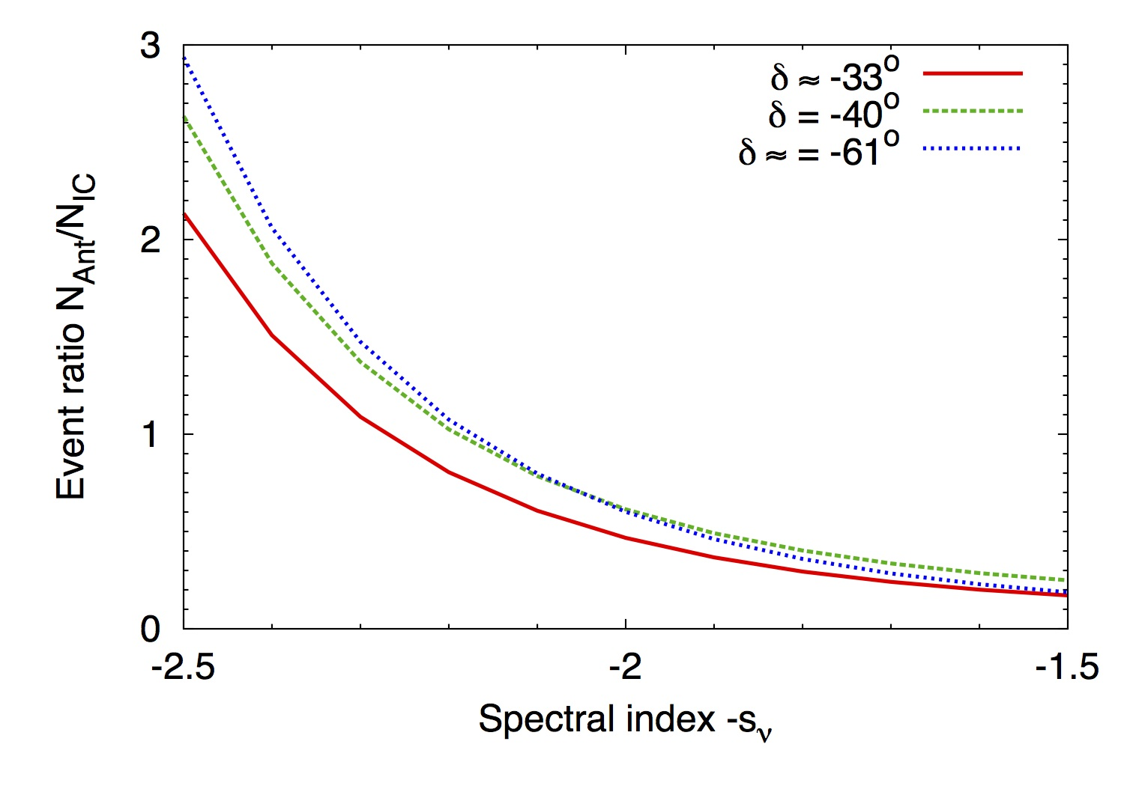
Expected ANTARES Response
Steep spectra: 2-3 events,Flat spectra: 0.2-0.3 events
⇒ ANTARES constrains the possible neutrino spectra for the candidate sources
ANTARES Collaboration and TANAMI Collaboration 2015, A&A, 576, L8

Slide 21
What are the Sources of the IceCube Neutrinos?
Single Galactic-Center source excluded (ANTARES Collaboration 2014, ApJ 786, L5)
Sky distribution consistent with isotropy
  Gamma-ray bursts excluded (IceCube 2012, ANTARES 2014)
  AGN jets (Mannheim 1995, Learned & Mannheim 2000)?

Slide 22
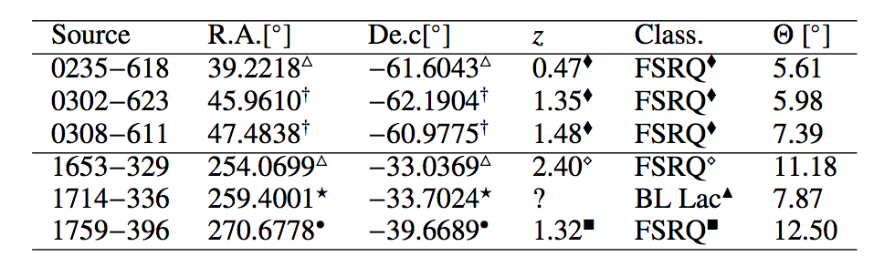
TANAMI Blazars in the IceCube PeV Neutrino Fields
The six radio- and γ-ray brightest AGN in the Ernie and Bert 1σ uncertainty regions:
  Are they capable of producing the two PeV neutrinos?

