Slide 1



Multiwavelength Polarization as a Diagnostic of Jet Physics
0
Markus Böttcher
North-West University
Potchefstroom, South Africa
Most of this work done by:
Haocheng Zhang
(Ohio University & Los Alamos)

Slide 2
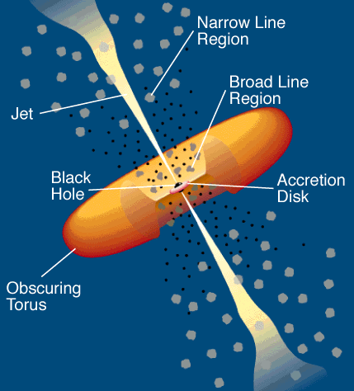
Leptonic Blazar Model
0
Synchrotron emission
Injection, acceleration of ultrarelativistic electrons
Relativistic jet outflow with Γ ≈ 10
νF_{ν}
Q_{e} (γ,t)
γ^{-q}
ν
γ₁
γ₂
γ
Compton emission
Radiative cooling ↔ escape =>
νF_{ν}
γ^{-q} or γ⁻²
Q_{e} (γ,t)
ν
γ^{-(q+1)}
Seed photons:
Synchrotron (within same region [SSC] or slower/faster earlier/later emission regions [decel. jet]), Accr. Disk, BLR, dust torus (EC)
γ₁
γ_{b}
γ₂
γ
γ_{b}:
τ_{cool}(γ_{b}) = τ_{esc}
γ_{b}
γ₁
γ₂

Slide 3
Hadronic Blazar Models
0
Injection, acceleration of ultrarelativistic electrons and protons
Proton-induced radiation mechanisms:
Relativistic jet outflow with Γ ≈ 10
νF_{ν}
γ^{-q}
ν
Q_{e,p} (γ,t)
Proton synchrotron
γ₁
γ₂
γ
pγ → pπ⁰ π⁰ → 2γ
Synchrotron emission of primary e⁻
pγ → nπ⁺ ; π⁺ → μ⁺ν_{μ}
μ⁺ → e⁺ν_{e}ν_{μ}
νF_{ν}
→ secondary μ-, e-synchrotron
ν
Cascades …

Slide 4
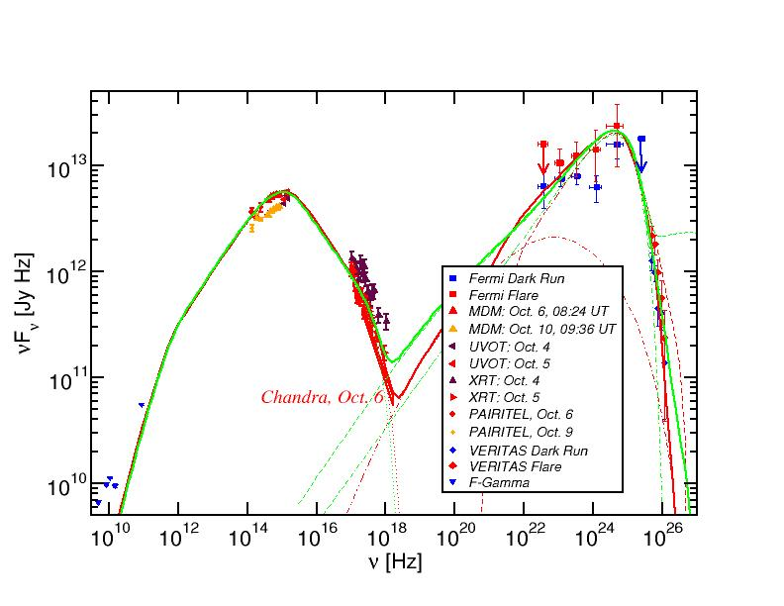
Leptonic and Hadronic Model Fits to Blazar SEDs
3C66A (IBL)
Red = leptonic
Green = lepto-hadronic

Slide 5
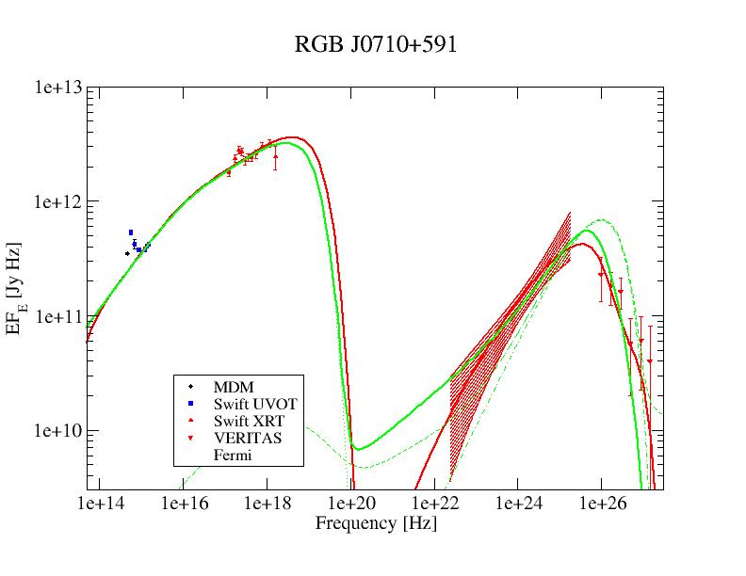
Lepto-Hadronic Model Fits to Blazar SEDs
(HBL)
Possible Diagnostics to distinguish:
Neutrinos
(→ Kadler)
Variability
Polarization
Red = leptonic
Green = lepto-hadronic
In many cases, leptonic and hadronic models can produce equally good fits to the SEDs.
Hadronic models: Jet powers sometimes L_{jet} > L_{Edd} – not possible with conventional BZ or MHD-driven jets (Zdziarski & Böttcher 2015)
But possible with radiation-driven jets from super-Eddington accretion flows (e.g., Sadowski, Narayan)

Slide 6


Possible Distinguishing Diagnostic:
Polarization
Synchrotron Polarization
For synchrotron radiation from a power-law distribution of electrons with ne (γ) ~ γ^{-p} → F_{ν} ~ ν^{−α} with α = (p−1)/2
sy
= $\frac{p+1}{p+7/3}$
= $\frac{α+1}{α+5/3}$
Π_{PL}
p = 2 → Π = 69 %
p = 3 → Π = 75 %

Slide 7
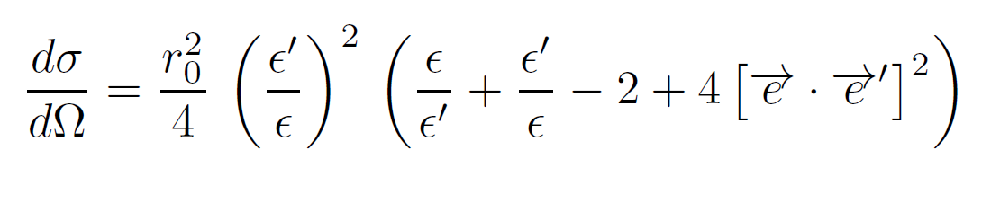
Compton Polarization
Compton cross section is polarization-dependent:
ε = hν/(m_{e}c²):
Thomson regime: ε ≈ ε’
dσ/dΩ = 0 if e∙e’ = 0
Scattering preferentially in the plane perpendicular to e!
Preferred polarization direction is preserved; polarization degree reduced to ~ ½ of target-photon polarization .
p
e
k
p’
e’
k’

Slide 8
Calculation of X-Ray and Gamma-Ray Polarization in Leptonic and Hadronic Blazar Models
Synchrotron polarization:
Standard Rybicki & Lightman description
SSC Polarization:
  Bonometto & Saggion (1974) for Compton scattering in Thomson regime
External-Compton emission: Unpolarized.
Upper limits on high-energy polarization, assuming perfectly ordered magnetic field perpendicular to the line of sight (Zhang & Böttcher 2013)

Slide 9


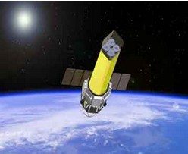
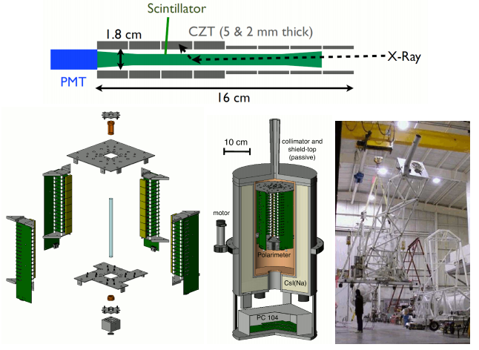
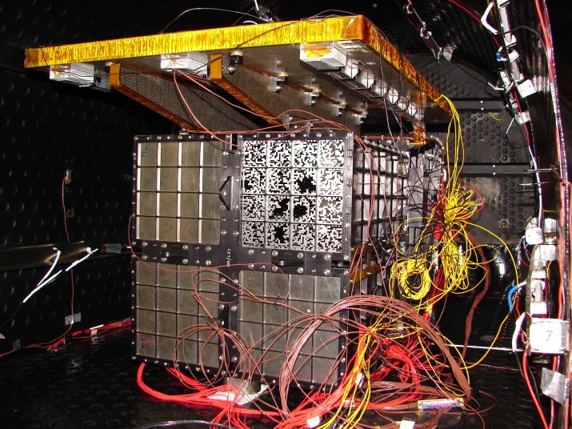
X-ray Polarimeters
Astro-H
(→ Y. Tanaka)
INTEGRAL
ASTROSAT
→ Poster by T. Chattopadhyay
X-Calibur
→ PolSTAR (A. Zajczyk)

Slide 10
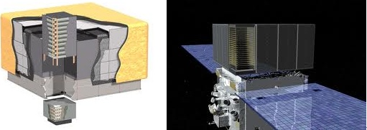
Gamma-Ray Polarimetry with Fermi-LAT
k
e
e⁻
e⁺
e⁺e⁻ pair is preferentially produced in the plane
of (k, e) of the γ-ray.
Potentially detectable at E < 200 MeV
→ PANGU

Slide 11
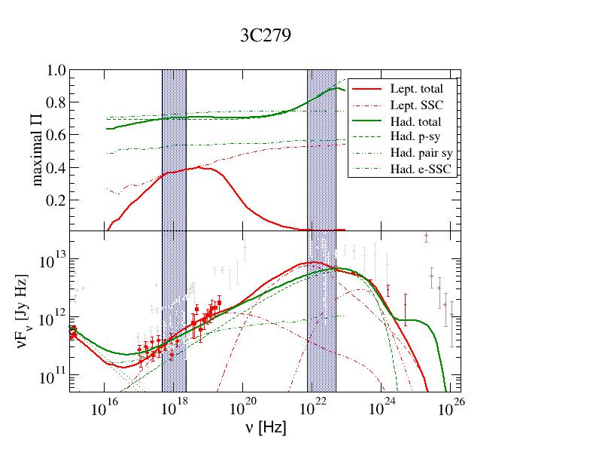
X-Ray and Gamma-Ray Polarization: FSRQs
Hadronic model: Synchrotron dominated => High Π, generally increasing with energy (SSC contrib. in X-rays).
Leptonic model:
X-rays SSC dominated:
~ 20 – 40 %;
γ-rays EC dominated
=> Negligible Π.
(Zhang & Bӧttcher, 2013)

Slide 12
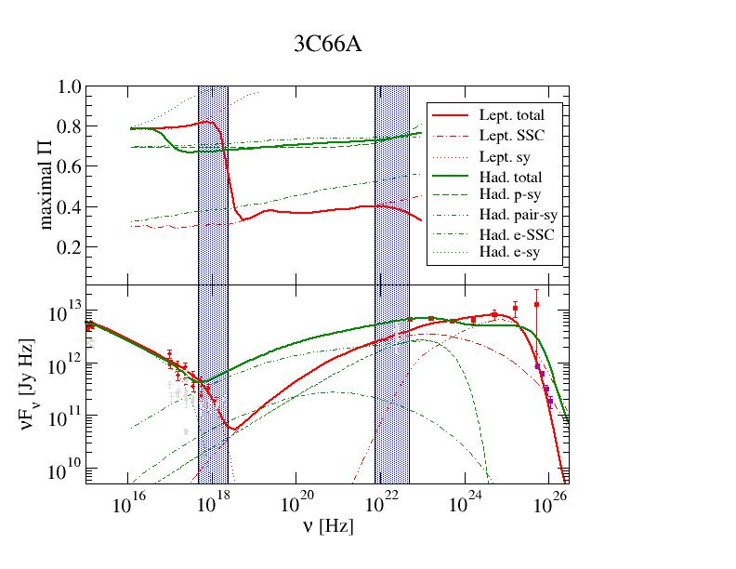
X-Ray and Gamma-Ray Polarization: IBLs
Hadronic model:
Synchrotron dominated => High Π, throughout X-rays and γ-rays
Leptonic model:
X-rays sy. Dominated => High Π, rapidly decreasing with energy;
γ-rays SSC/EC dominated
=> Small Π.
(Zhang & Bӧttcher, 2013)

Slide 13
Observational Strategy
Results shown here are upper limits (perfectly ordered magnetic field perpendicular to line of sight)
Scale results to actual B-field configuration from known synchrotron polarization (e.g., optical for FSRQs/LBLs) => Expect 10 - 20 % X-ray
and γ-ray polarization in
hadronic models!
X-ray and γ-ray polarization values substantially below synchrotron polarization will favor leptonic models, measurable γ-ray polarization clearly favors hadronic models!

Slide 14
Gamma-Gamma Absorpton /
Pair production
0
Threshold energy E_{thr} for a γ-ray interacting with a background photon field of photons with characteristic photon energy E₁:
e⁺
e⁻
ε_{thr} ~ 1/ε₁
ε = E_{ph}/(m_{e}c²)
θ
ε_{γ}
ε₁
σ_{γγ}
Lack of γγ absorption signatures in blazars and GRBs used for lower limits on Doppler factors
(Baring 1993; Dondi & Ghisellini 1995)
ε_{γ}
ε_{peak} = 2 ε_{thr} ~ 2/ε₁

Slide 15
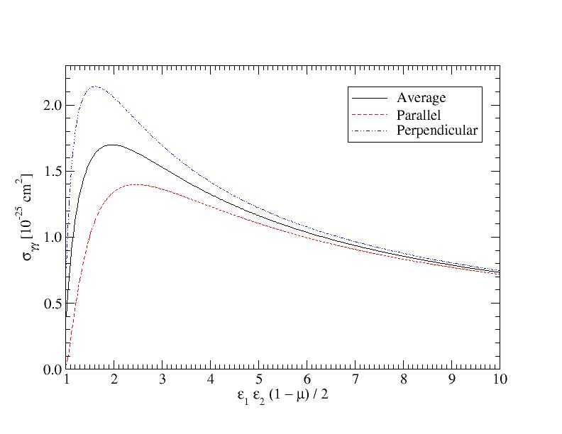
Polarization-Dependence of Gamma-Gamma Absorption
For polarized γ-rays and target photons:
ε_{γ}
ε_{t}
k_{γ}
k_{t}
γγ absorption suppressed!
γγ absorption cross section peaks about 1.5 times higher for perpendicular polarizations than parallel polarizations!
(Böttcher 2014)
Calculated in Breit & Wheeler (1934)

Slide 16
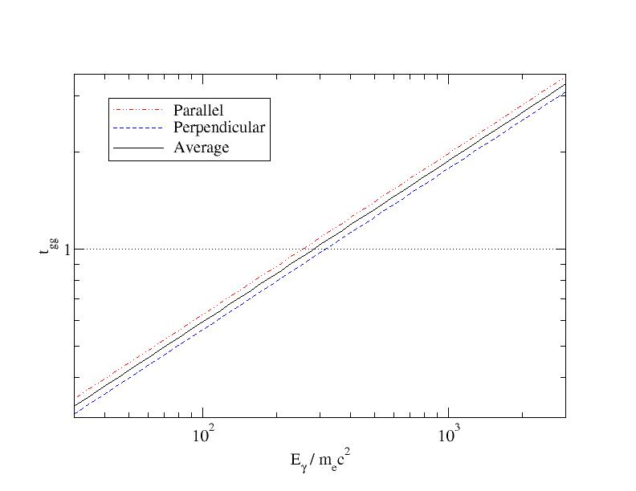
γγ absorption in a high-energy synchrotron source (GRB)
γ-ray and target photons have the same orientation of polarization (perpendicular to B-field: P┴ > P║) =>
γγ absorption is suppressed
γγ absorption is more pronounced for P║ (absorbed more strongly by P┴) => Degree of Polarization (Π) increases due to polarization-dependent γγ absorption!
τ_{γγ} ∼ ε_{γ}^{αt}
τ_{γγ}
Example: Perfectly ordered B-field, γ-rays perpendicular to B
=> ~ 20 % higher τ_{γγ} for P║
(Böttcher 2014)

Slide 17
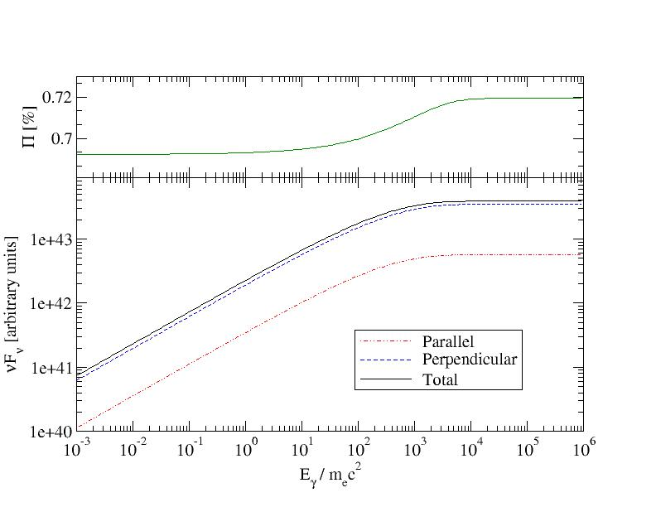
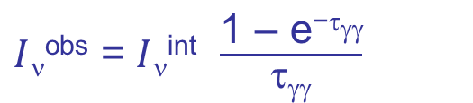
γγ absorption in a high-energy synchrotron source (GRB)
=> Expect increasing polarization at break due to γγ-absorption
$I$_{ν}^{obs} = $I$_{ν}^{int} $\frac{\text{1 – }\text{e}\text{−}\text{t}\text{gg}}{\text{t}\text{gg}}$
(Böttcher 2014)

Slide 18
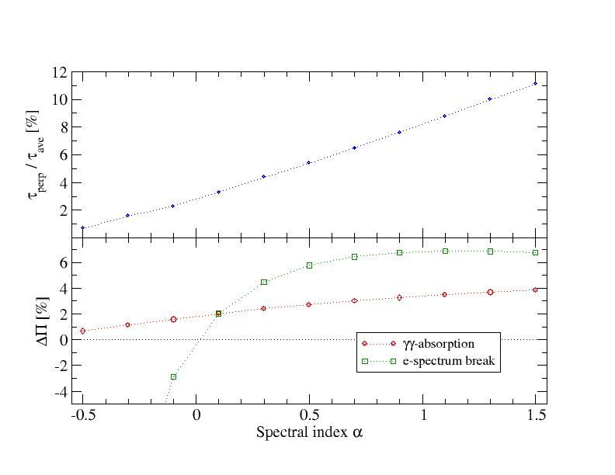

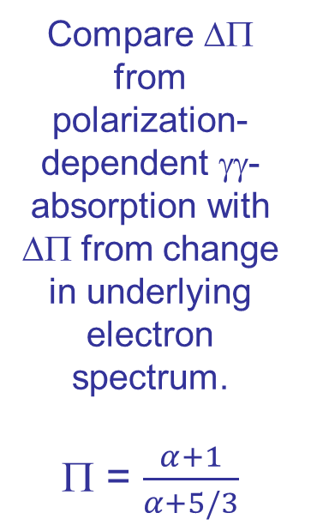
Dependence on Spectral Index
$I$_{ν}^{obs} = $I$_{ν}^{int} $\frac{\text{1 – }\text{e}\text{−}\text{t}\text{gg}}{\text{t}\text{gg}}$
=> Spectral break by Δα_{γ} = α_{t}
τ_{γγ} ∼ ε_{γ}^{αt}
γγ opacity may be over-estimated by up to ~ 10 %
Compare ΔΠ from polarization-dependent γγ-absorption with ΔΠ from change in underlying electron spectrum.
Π = $\frac{α+1}{α+5/3}$
Δτ/τ_{ave} [%]
(Böttcher 2014)

Slide 19
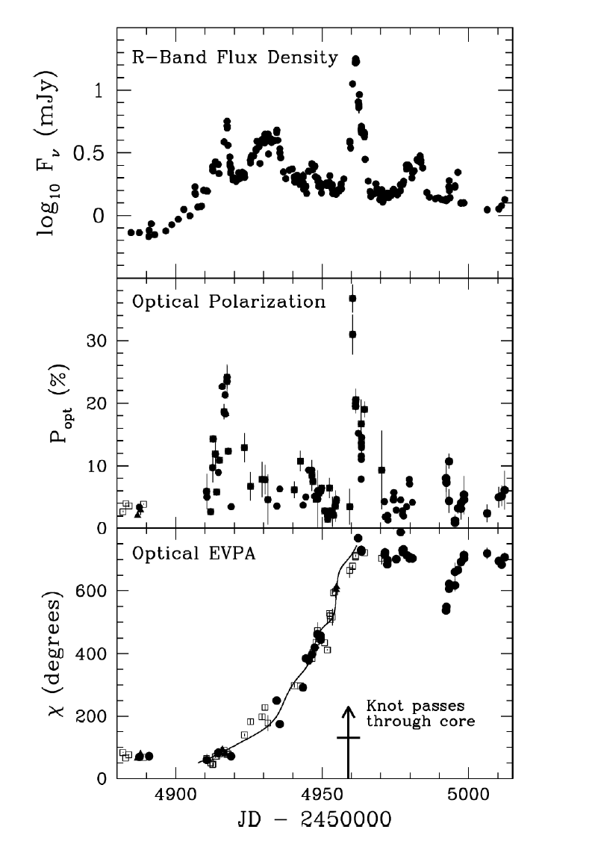
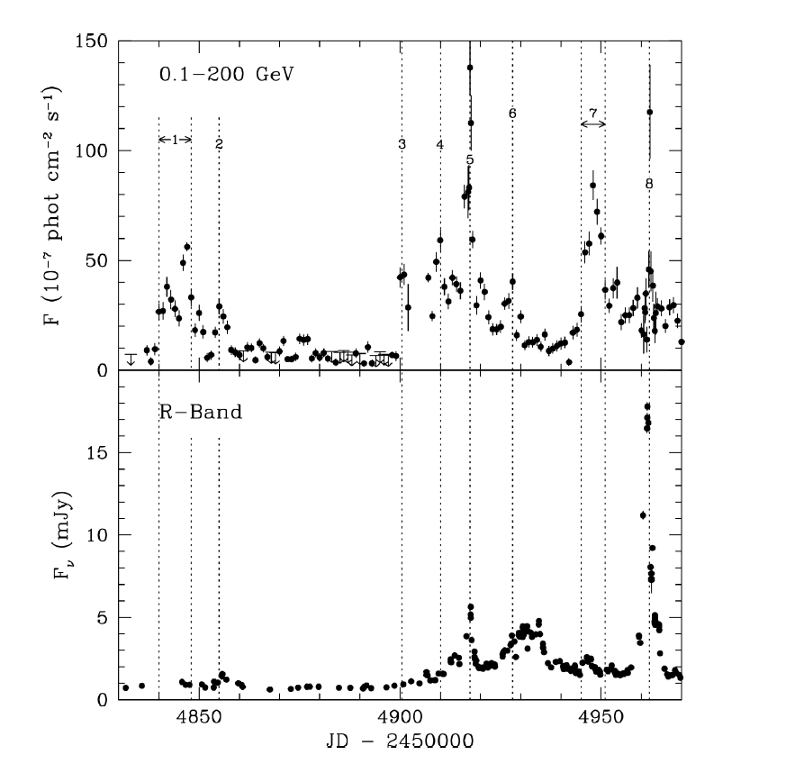
Polarization Angle Swings
Optical + γ-ray variability of LSP blazars often correlated
Sometimes O/γ flares correlated with increase in optical polarization and multiple rotations of the polarization angle (PA)
Fermi γ-rays
Optical
PKS 1510-089 (Marscher et al. 2010)

Slide 20
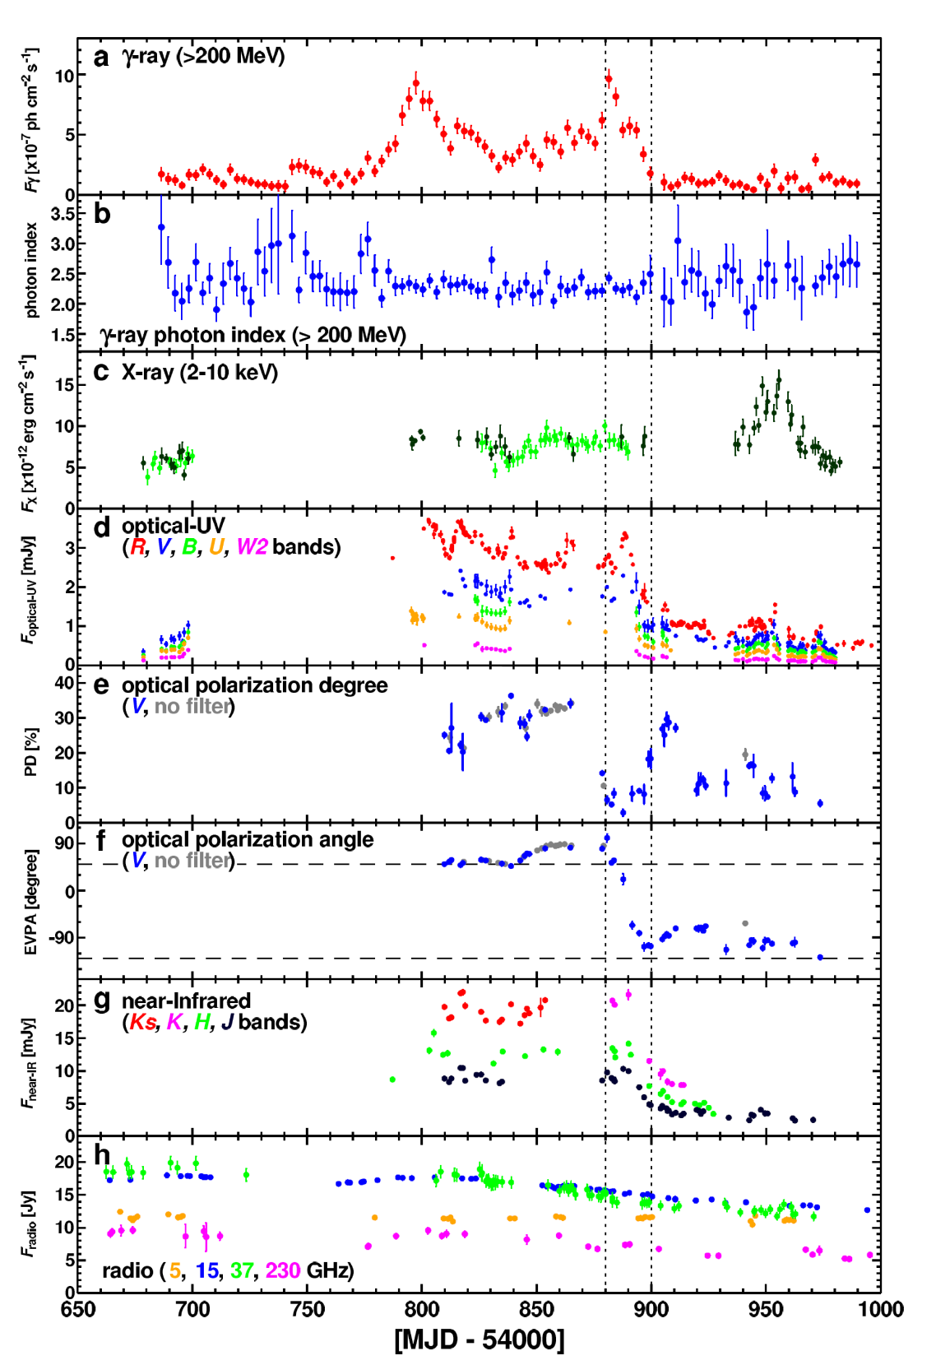
Polarization Swings
3C279 (Abdo et al. 2009)

Slide 21
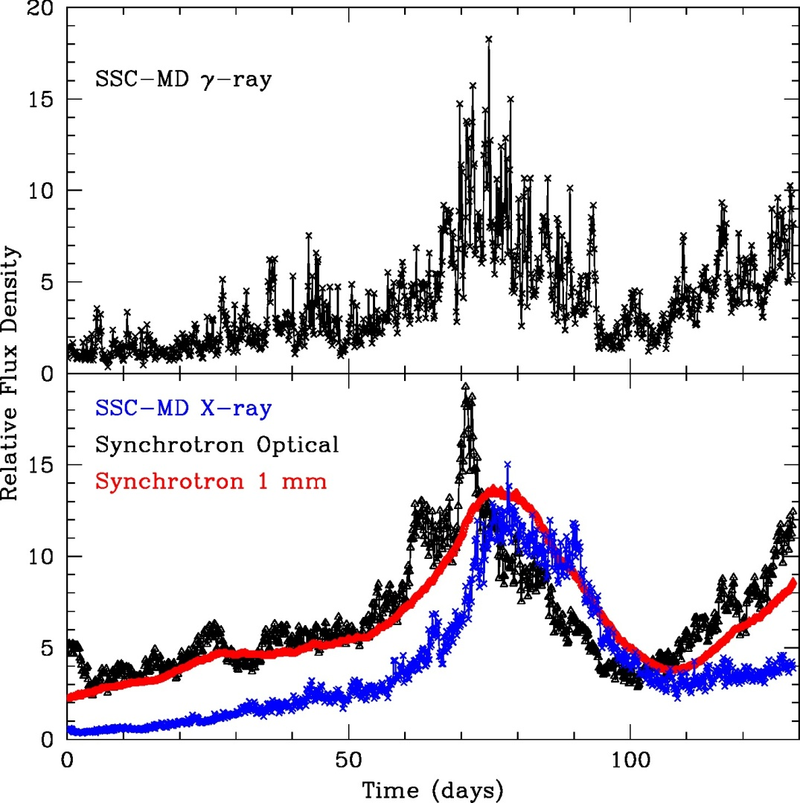
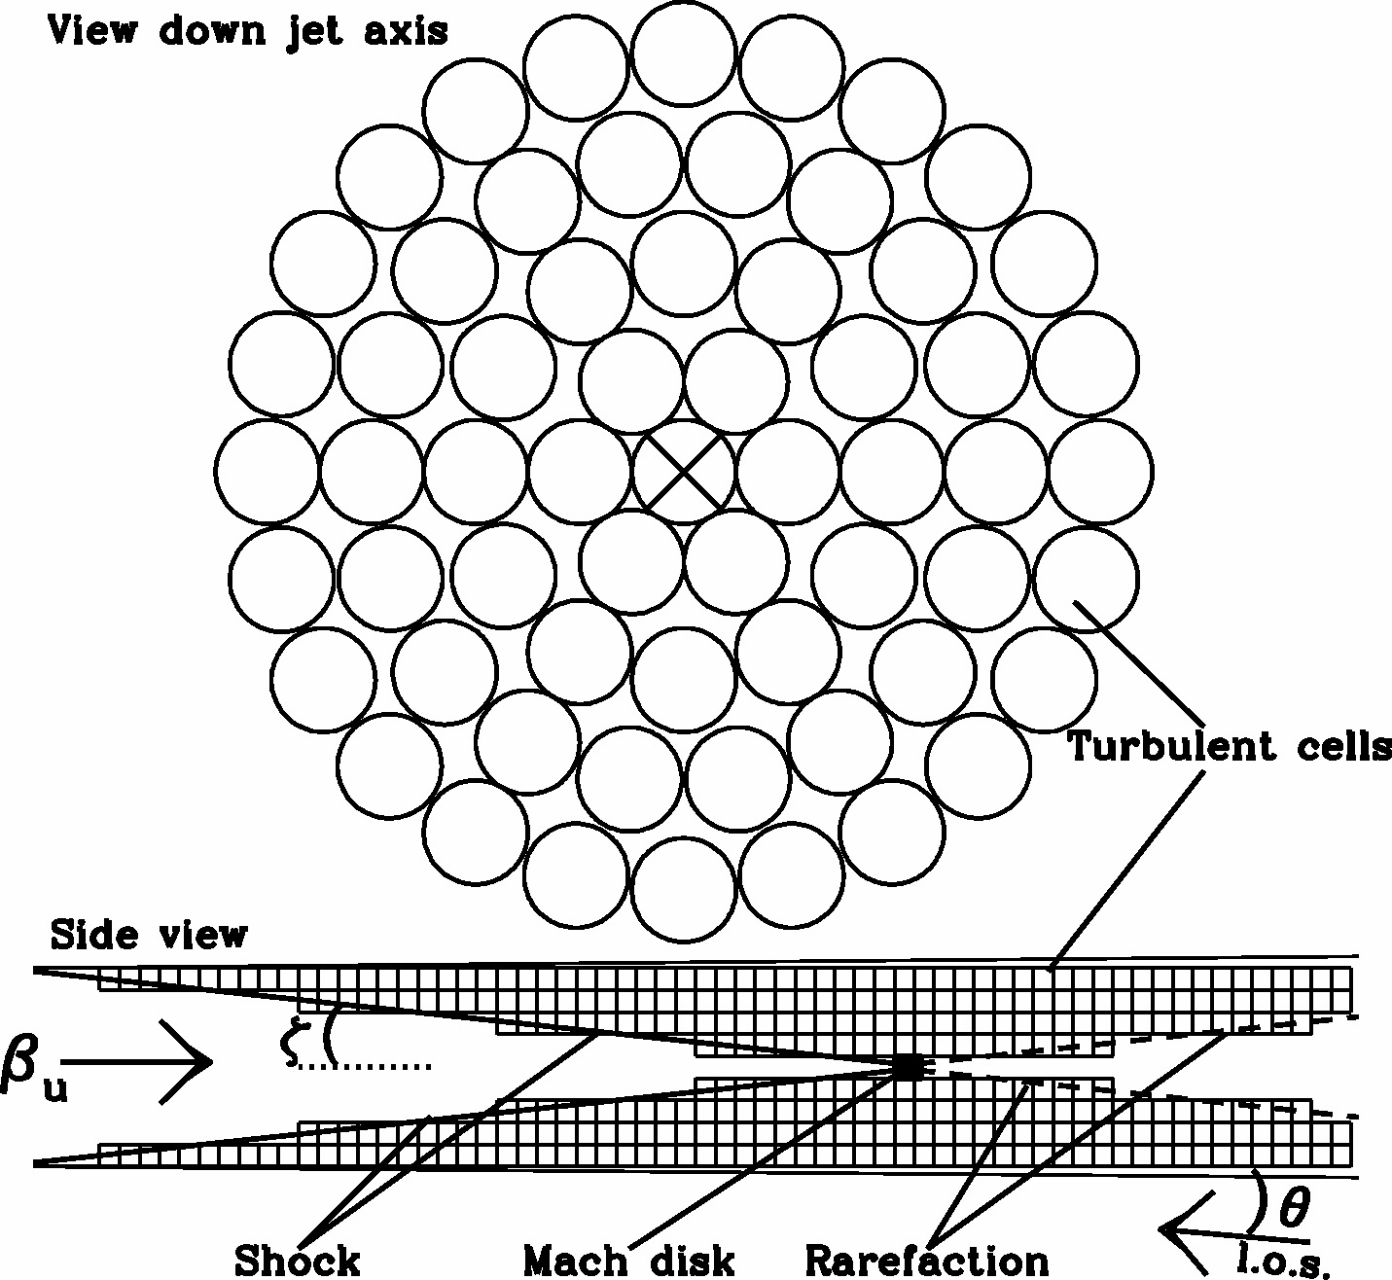
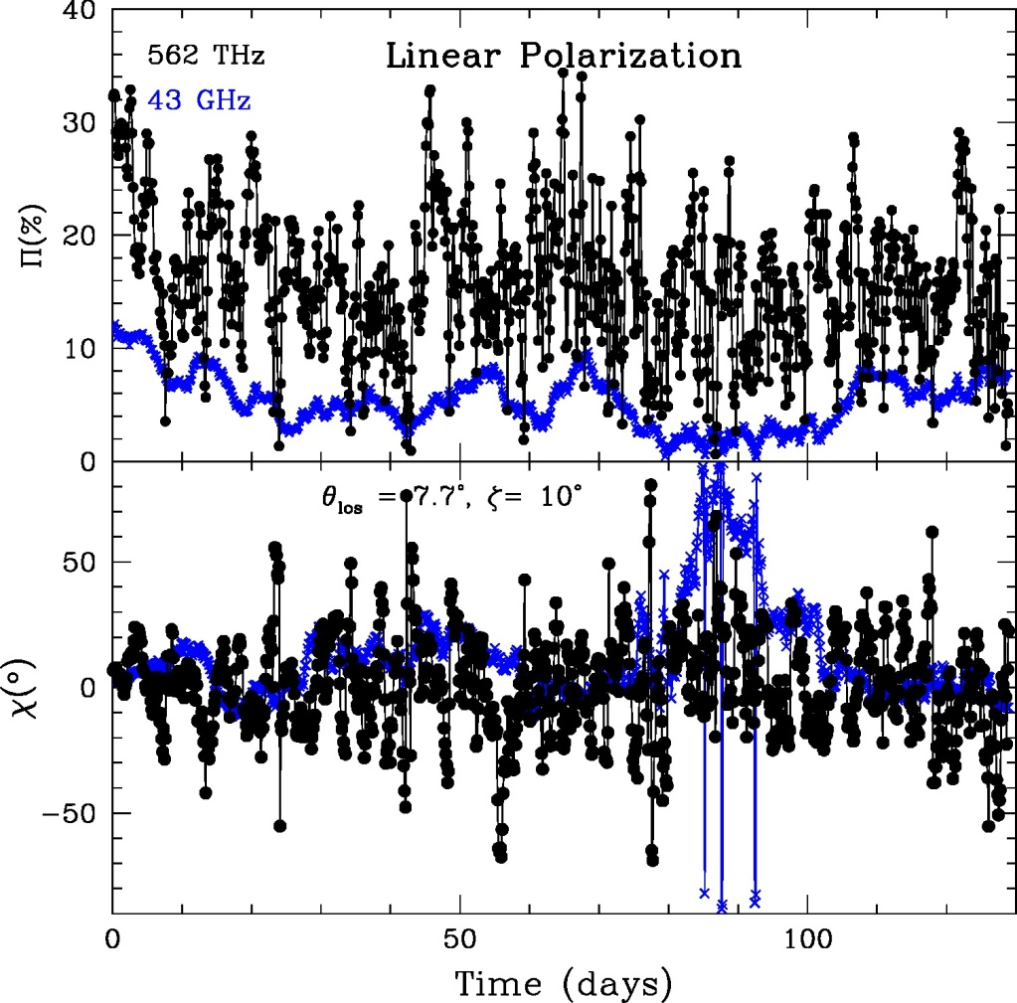
Previously Proposed Interpretations:
Helical magnetic fields in a bent jet
Helical streamlines, guided by a helical magnetic field
Turbulent Extreme Multi-Zone Model (Marscher 2014)
Mach disk
Looking at the jet from the side

Slide 22
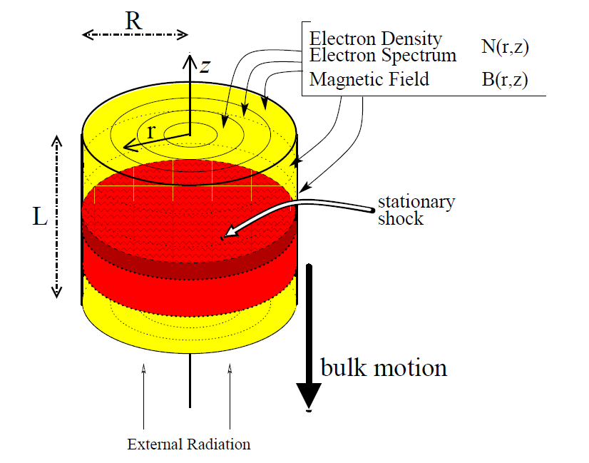
Tracing Synchrotron Polarization in the Internal Shock Model
Viewing direction in comoving frame:
θ_{obs} ~ π/2
Viewing direction in obs. Frame:
θ_{obs} ~ 1/Γ
B

Slide 23
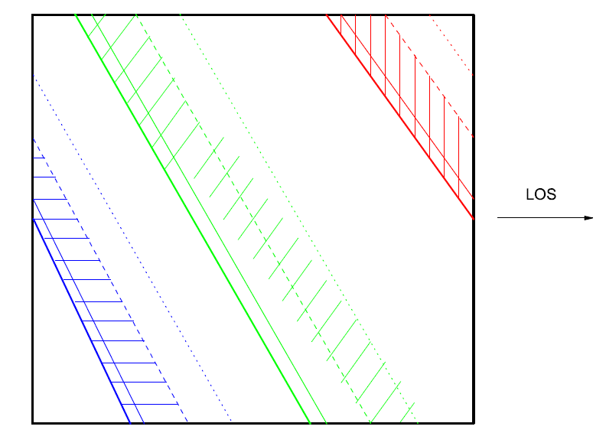
Light Travel Time Effects
B
B
Shock propagation
B
(Zhang et al. 2014)
Shock positions at equal photon-arrival times at the observer

Slide 24
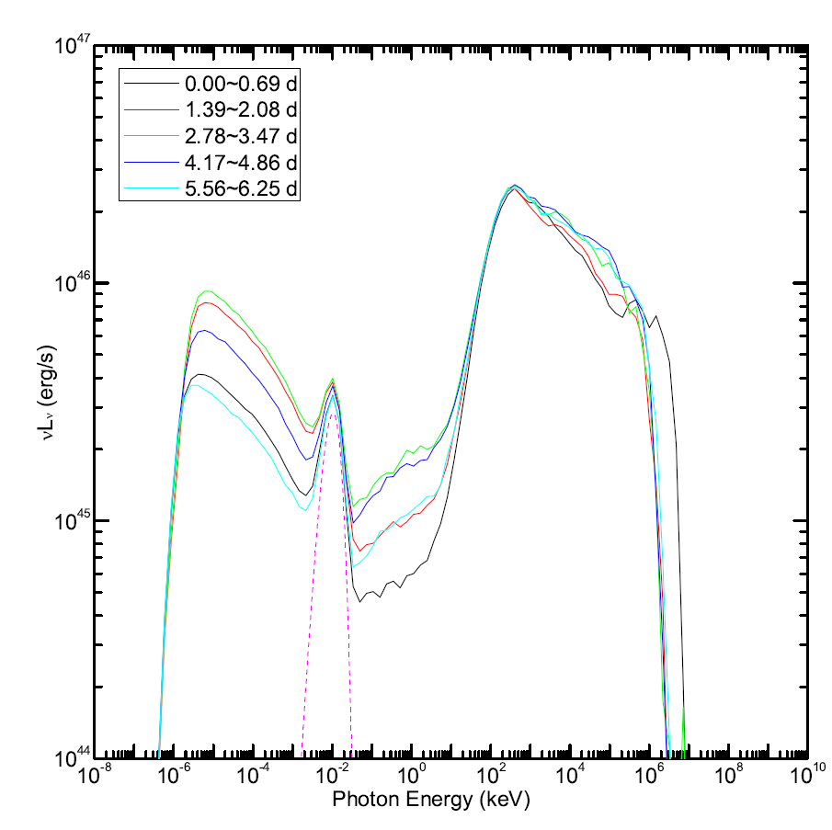
Flaring Scenario:
Magnetic-Field Compression perpendicular to shock normal
Baseline parameters based on SED and light curve fit to PKS 1510-089 (Chen et al. 2012)

Slide 25
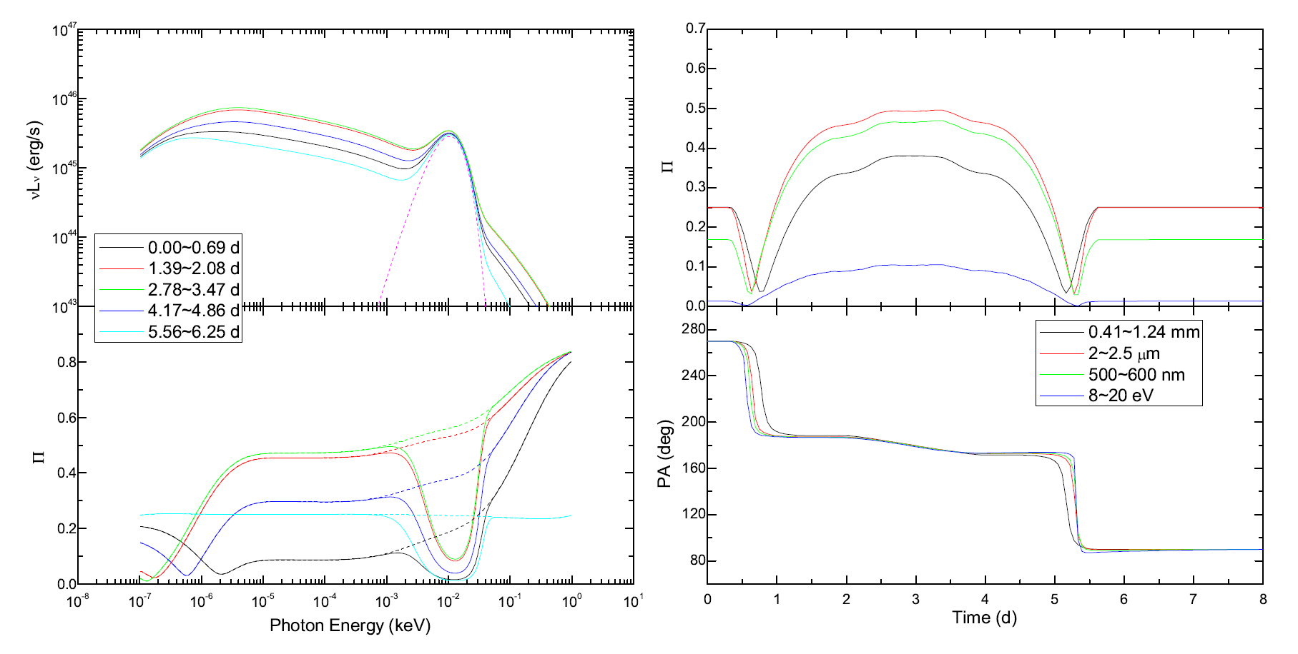
Flaring Scenario:
Magnetic-Field Compression perpendicular to shock normal
Synchrotron + Accretion Disk SEDs
Degree of Polarization Π vs. time
Frequency-dependent Degree of Polarization Π
Polarization angle vs. time
PKS 1510-089
(Zhang et al. 2014)

Slide 26
Application to the FSRQ 3C279
Simultaneous optical + γ-ray flare, correlated with a 180º polarization-angle rotation .
(Abdo et al. 2009)

Slide 27
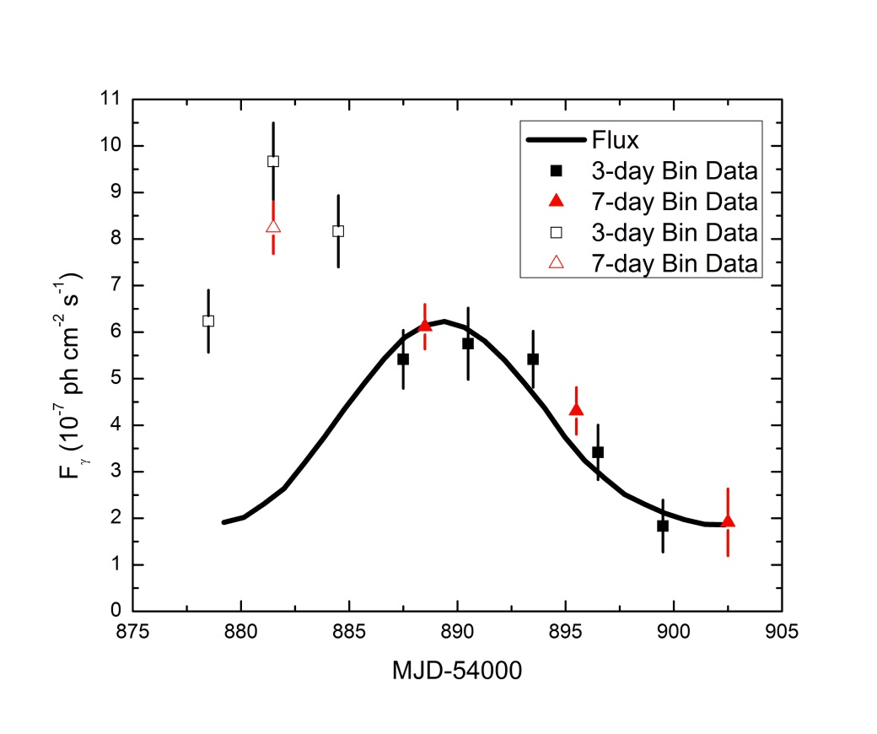
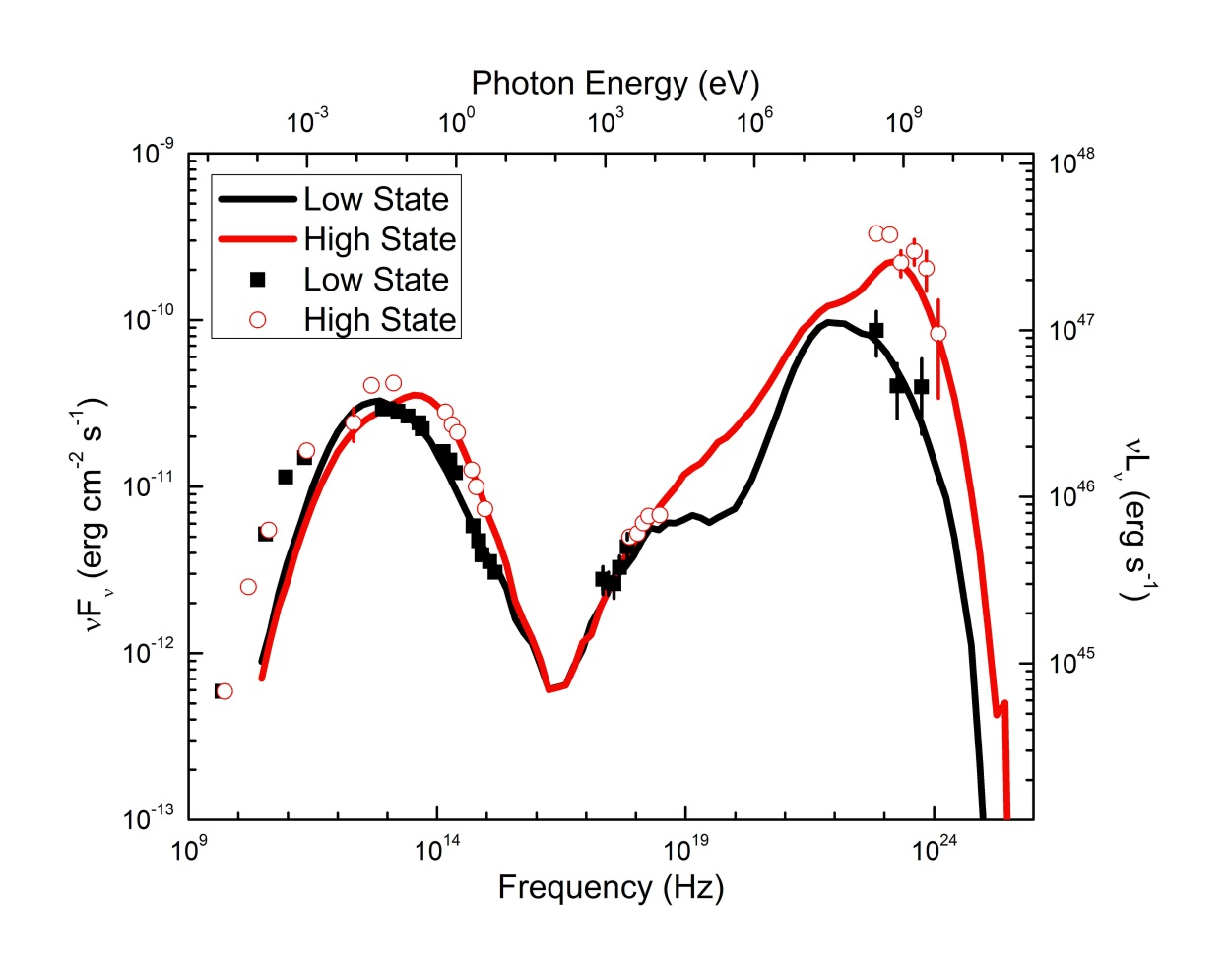
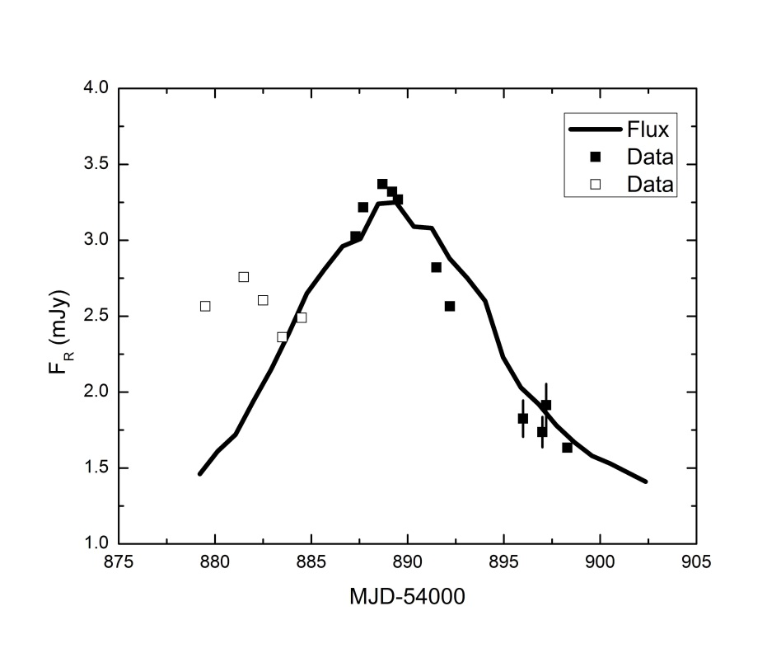
Application to 3C279
Simultaneous fit to SEDs, light curves, polarization-degree and polarization-angle swing
Fermi Lightcurve
R-Band Lightcurve
(Zhang et al. 2015)

Slide 28
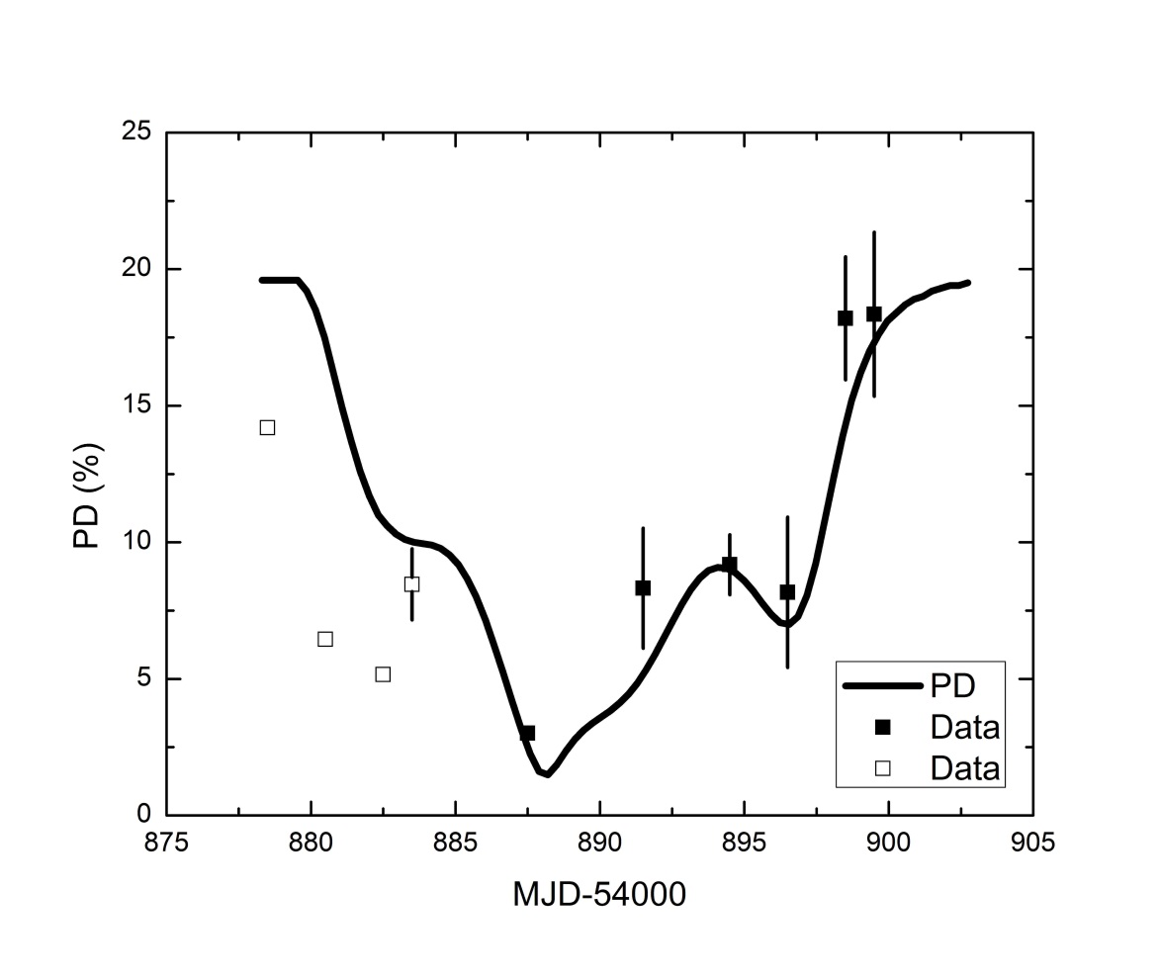
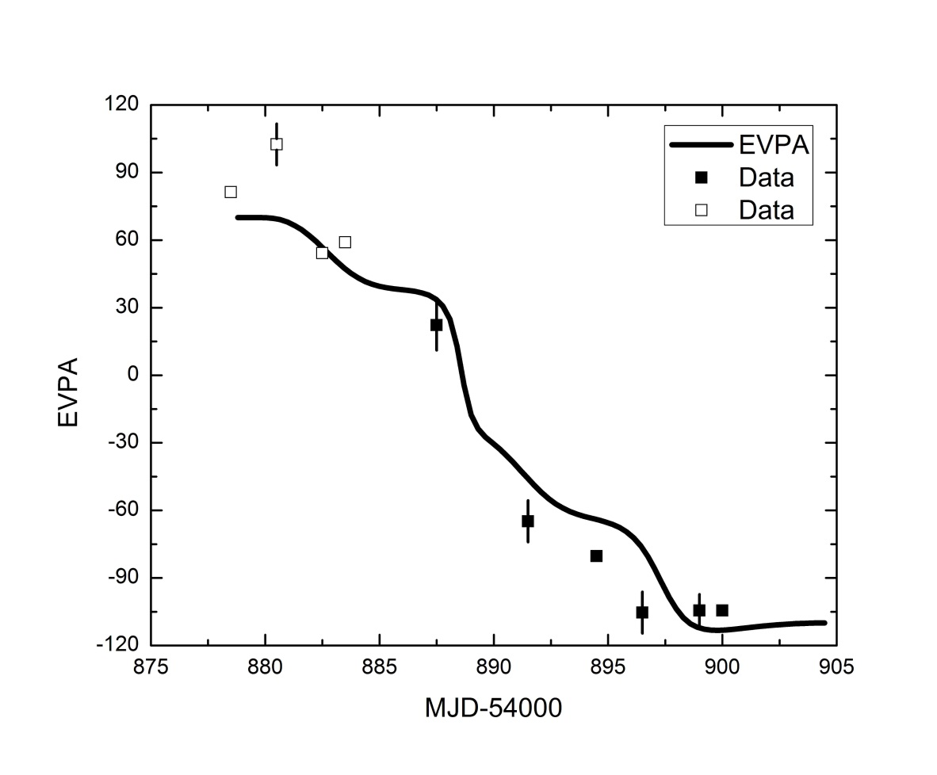
Application to 3C279
Requires particle acceleration
and reduction of magnetic field,
as expected in magnetic reconnection!
Degree of Polarization
Polarization Angle
(Zhang et al. 2015)

Slide 29

Summary
0
Both leptonic and hadronic models can fit blazar SEDs well. Possible distinguishing diagnostic: Hadronic models predict large hard X-ray / γ-ray polarization.
Intrinsic γγ-absorption of polarized γ-rays in polarized target photon fields is suppressed compared to unpolarized emission; degree of polarization is expected to increase due to polarized γγ-absorption.
Synchrotron polarization swings (correlated with γ-ray flares) do not require non-axisymmetric jet features!
Simultaneous fit to SEDs, lightcurves, polarization degree
and polarization-angle swing of 3C279 requires
magnetic energy dissipation.
Haocheng Zhang: Still looking for a postdoc position!

