Slide 1
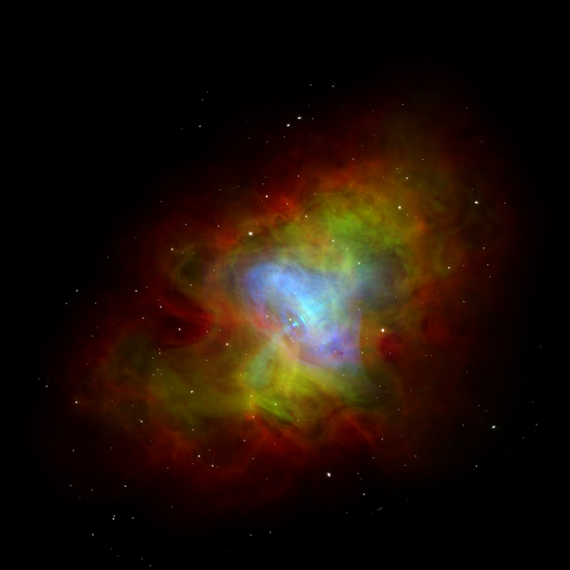
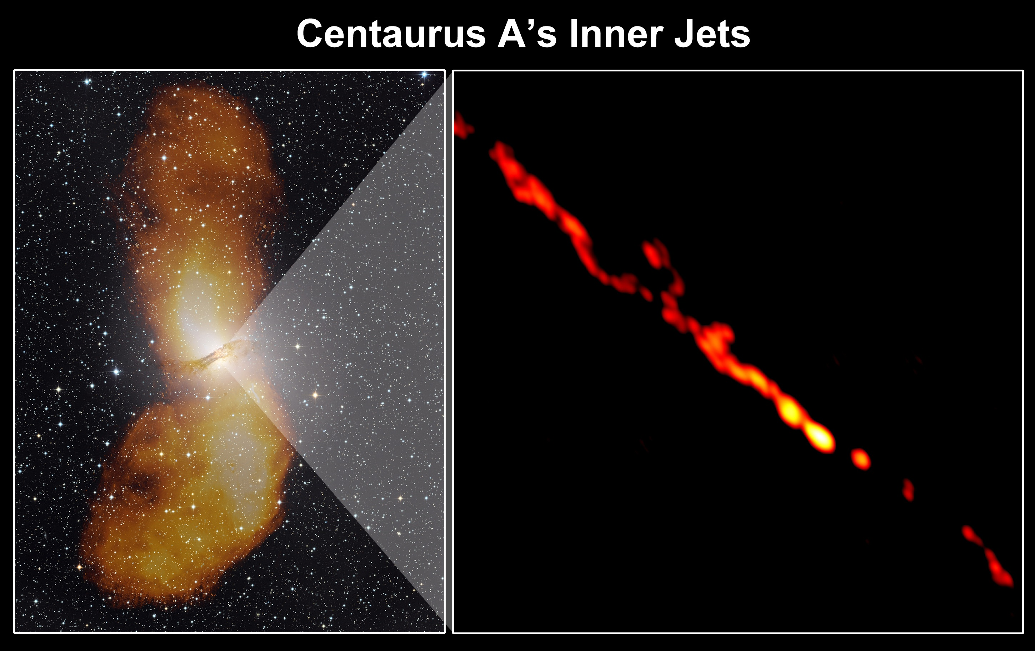
Dissipation and Acceleration in
Relativistically Magnetized Outflows:
Crab Nebula as Micro-Blazar
Jonathan Arons
University of California
Berkeley & Santa Cruz

Slide 2
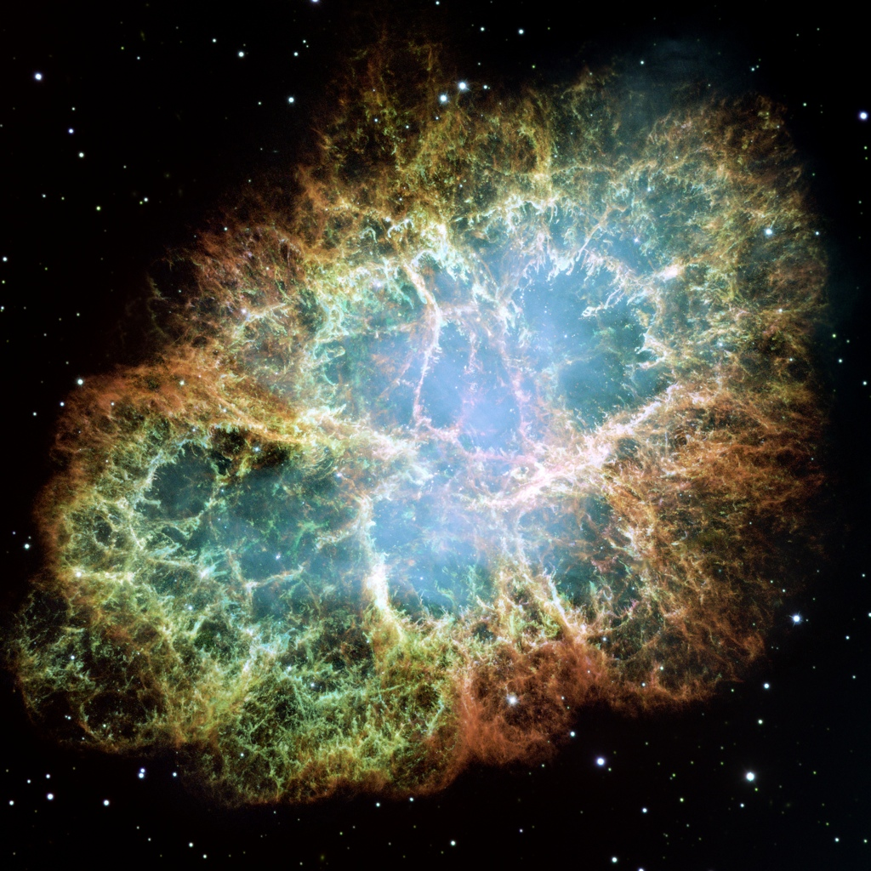
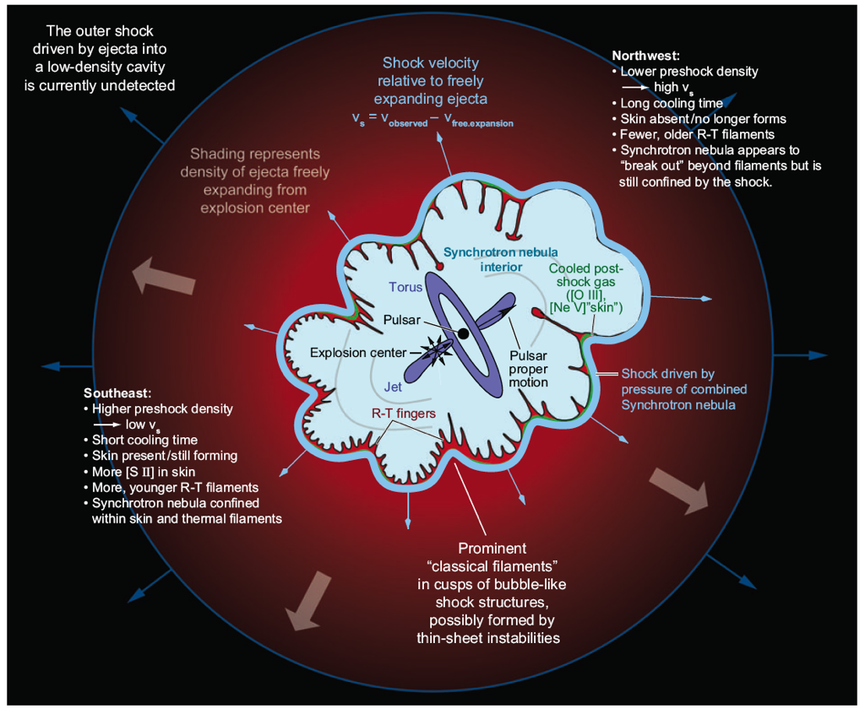
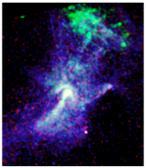
Nebular Gamma Rays (Global Energy Budget): PeVatrons
Crab, D = 2kpc
1509 D = 5 kpc
Synchroton Radiation from nonthermal electrons (+ positrons)
X-ray & optical shown, < 1” resolution; also radio, IR, gamma ray
Near IR & harder radiation needs continuous power supply – central pulsar

Slide 3
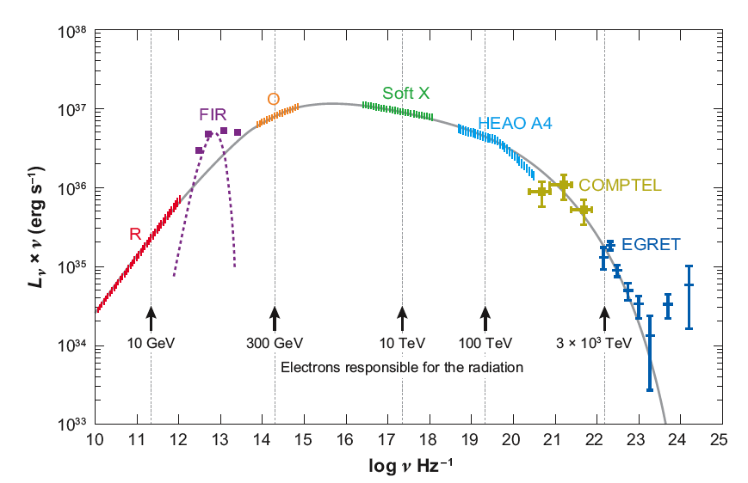
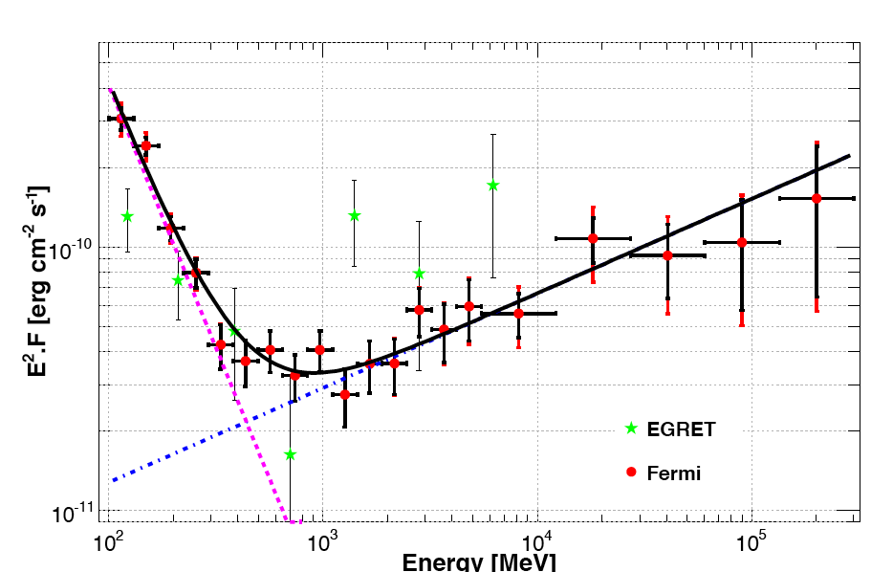
Crab Spectrum, Size vs
Synchrotron Spectrum
FERMI LAT AVG
Nebula shrinks with increasing up through 10s of keV - nebula is a cooling flow, high energy particles burn off:
VHE (100 MeV – GeV) source, accelerator compact
0.1 - 1 GeV radiation can track
days or longer accelerator variability
Recent observations (Agile, Fermi)
show variability down to hours, big
flares
Accelerating E < B: synch spectrum
exponentially cutoff ∝exp(-ε/ε_{s}), ε_{s}=236(E/B) MeV

Slide 4
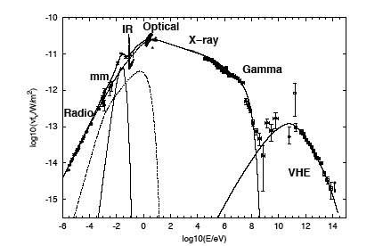
Cosmic Pevatrons: The Excitation of Pulsar Wind Nebulae
Crab Nebula - 1054 SNR
R, IR, O, X, : synchrotron emission
Particle radiative lifetime ( ): days
Continuous power supply: L_{rad} ~ 10³⁸ erg/s
Nebula contracts onto central source
with increasing (synchrotron emission)
Spectra are NONTHERMAL: acceleration
of e⁻(e⁺) to PeV energies
Central Pulsar supplies power: Spindown
Speed of features: ~0.5 c
Inferred upstream 4-speed 10³⁻⁴c (was 10⁶c)
Chandra ring stationary (no boost) lumpy
Scale: 10¹⁸ cm
Morphology: sudden deceleration
of magnetized relativistic flow - -
shock converts flow energy to nonthermally heated electron (+ positron) spectrum – synchrotron emission in post-shock flow
Basic Questions:
what carries the rotation power? - MHD wind
how is it converted to synchrotron emitting particle spectra? – relativistic “shock”
relativistic reconnection
Nebula reprocesses 20% of spindown loss
Gamma Ray Flares

Slide 5
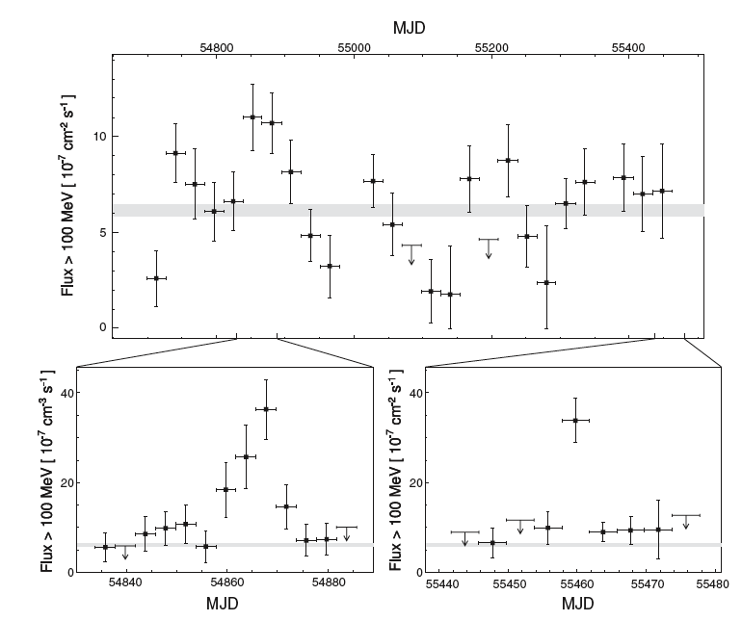
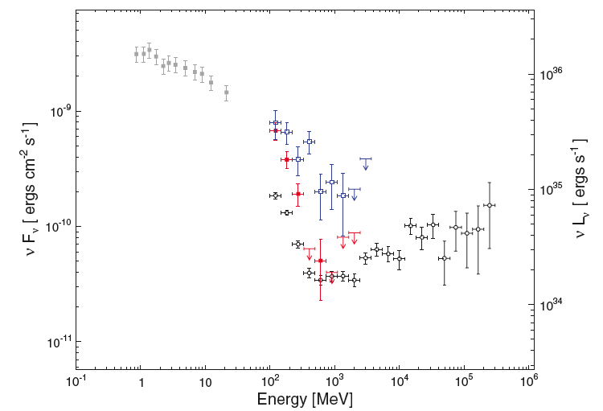
Variability (Gamma Ray)
2/2009
9/2010
Average
2/2009
9/2010
Fermi LAT
LAT
2011 April 9 to t >04/15
Spectrum peaked around 500 MeV?
Agile
9-10/2010
9-10/2007
Too fast for shocks? Reconn?

Slide 6
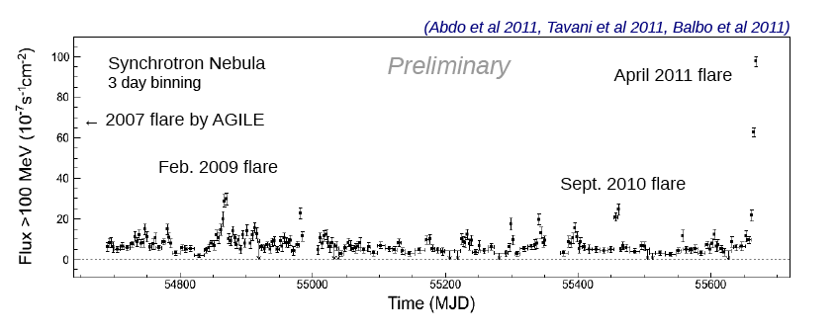
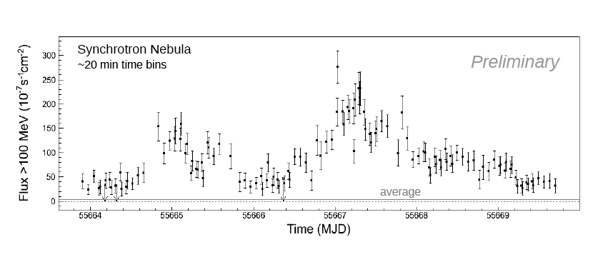
Crab Flares – brightest γ source in sky at peak in 04/2011 – a micro-blazar
Looks like a Blazar (Mrk 501,…)

Slide 7
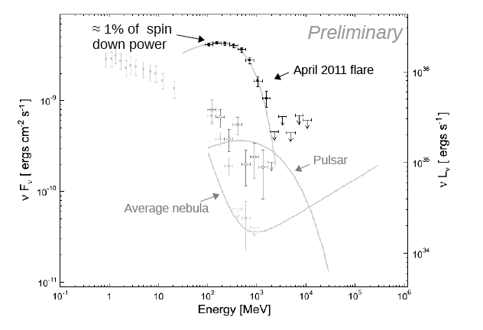
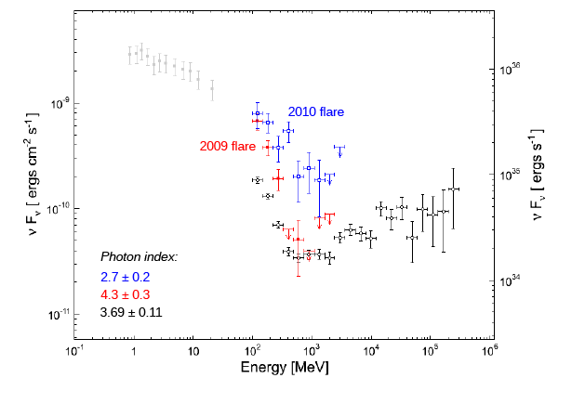
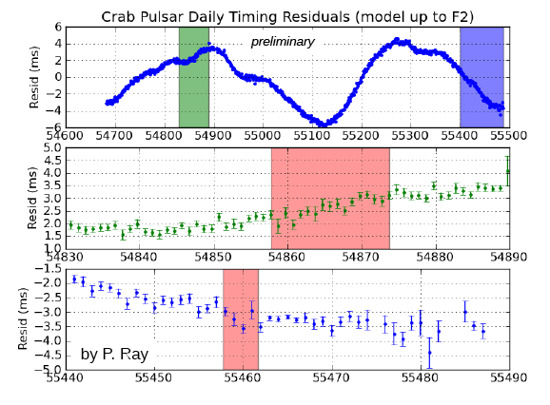
Flare Spectra – Fermi LAT
Total energy budget known - erg/s (timing)
Pulsar’s spindown unchanged – no
alteration of magnetosphere
Long delay between observed big flares –
T_{repeat} ~ 6 months – much too early
to draw conclusion, what’s big, smaller
variability always present – amplitude spectrum
Nebular Event – particle spectrum ~
beam dump – runaways in E>B zone?

Slide 8
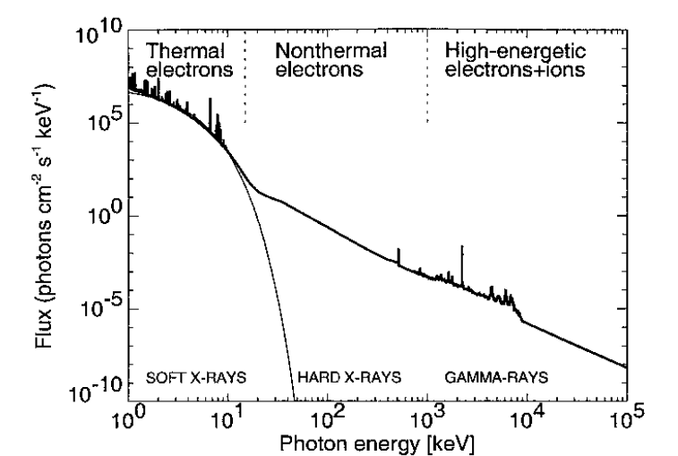
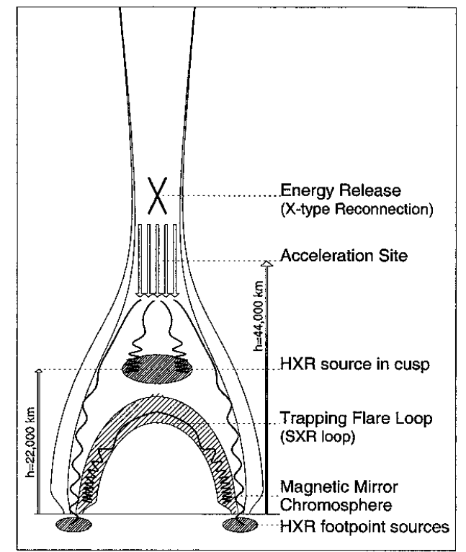
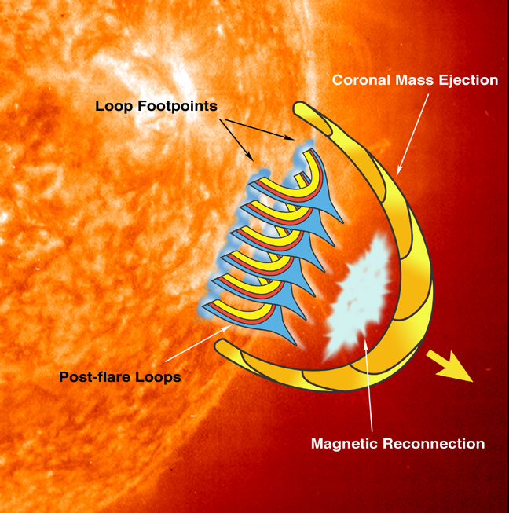
Flare accelerated spectrum – synchrotron cooled electrons + positrons (steady injection, not really OK)
Spectrum, impulsive behavior ~ ultrarelativistic clone of solar flare impulsive X-rays:
bursty reconnection accelerated electron beams – collisionless tearing (?) of
large scale current sheet into current filaments, magnetic islands
Composite large flare photon spectrum
http://solarmuri.ssl.berkeley.edu/~hhudson/cartoons/

Slide 9
Accelerator not in MHD region (a.k.a. not “standard” DSA)

Slide 10
Energy transported to world by MHD wind: outflow is dense
Outflow MHD-like ( possible) if
observations (Crab as proxy for all) - nebula as calorimeter
synchrotron cooling time < nebula age = 957 years (O, X, γ)
- nebula as pair plasma storage device (inertial confinement): R, IR

Slide 11
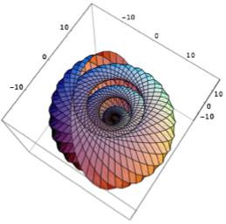
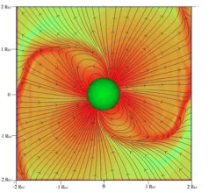
Inner Wind: Magnetically Striped, Magnetically Dominated (Force-Free)
Equatorial Current Sheet = frozen in transmission line, carries whole (return) current,
B = 0 in middle of sheet (sheet pinch)
Magnetic Dissipation at/in Current Sheet (“Reconnection”/Tearing Mode - Sironi, Zenitani): possible accelerator

Slide 12
Ideal MHD wind has low final 4-velocity
Striped B decay upstream:
Upstream decay model works well as input into detailed simulations of
nebular surface brightness:
Infer σ ≪ 1 at TS, R_{TS}=3x10¹⁷ cm = 0.1 pc, to get jet to torus brightness ratio correct

Slide 13
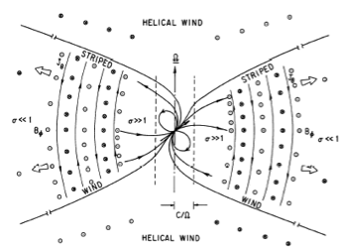
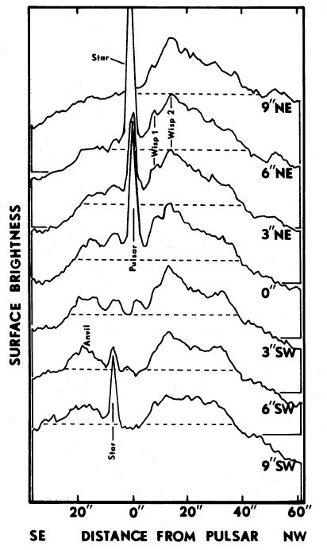
Stripe Decay: Upstream of TS? At/Near TS?
If wrinkled current thickens, striped field dissipates (B field, cold plasma
in stripes flows into thickening current sheets), magnetic energy coverts
to flow kinetic energy, “heat” (& radiation, but most of outflow volume
radiatively inefficient, wind dark - HOW DARK?
Foreground
Underluminous
cavity (wind?)
From Coroniti 1990
Sheet separation = RL=cP/2P=1576(P/33 msec) km,
wavelength = 2RL. TS lies at many RL (10⁹ RL for Crab) -
frozen in wave has very short wavelength
Decay upstream occurs if wind “ultra-dense”, :
(Γ_{wind} <10⁴) - true if average flow for radio is in the striped sector and
η_{eff} ~ Bohm - Decay radius in Crab ~ 0.8-0.9R_{shock} (JA08)
Beaver et al 1979

Slide 14
Standard Accelerator Model
“Shock Acceleration”:
Shock = collisionless magnetosonic shock in pairs;
unstructured upstream flow, B perpendicular to v.
Model problematic, such shocks make relativistic Maxwellians
(PIC: Langdon, JA & Max ’88 to Sironi & Spitkovsky 09):
perpendicular shocks with Larmor radii < 20 x skin depth thermalize
through cyclotron interactions (σ_{upstream} > 0.003)
Transverse B suppresses diffusive Fermi acceleration
(particles can’t bounce between up & downstream)
cross field diffusion inadequate:
self-consistent turbulence (including field line wandering) too weak; too slow
Modify (complicate) the flow model/physics: flow more structured – “Termination Shock” = Working Surface
Linear Accelerator (Magnetic Sandwich Current Sheet)
Linear Accelerator (Striped Wind Current Sheets)
[Other Ideas (Magnetic Pumping in Downstream Turbulence, cyclotron resonant acceleration by large r_{Larmor} component of wind –historically ions, could be runaway beam from current sheet,…)]

Slide 15
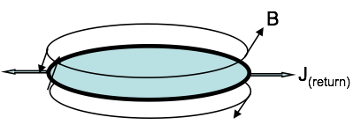
Magnetic Sandwich (stripes decay): B very weak in midplane
Upstream stripe decay relaxes
structure to magnetic sandwich,
thick equatorial current sheet,
B_{φ} oppositely directed in upper/
lower hemispheres
If , magnetized shock looks unmagnetized
Weibel turbulence scatters between up- and down-stream,
Diffusive Fermi in pairs exists (Spitkovsky 08)
B=0 and quasi-parallel (Θ_{Bn} < 1/Γ₁)
Strong turbulence localized to shock, particles escape easily;
more scattering up & downstream: turbulence created by streaming? Can
have DSA-like spectra in central sandwich filling – energy flow too small
Spectra always Maxwellian + suprathermal tail. No sign of Maxwellian. Masked by something else?

Slide 16
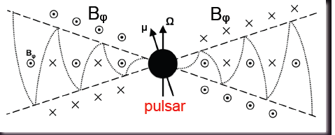
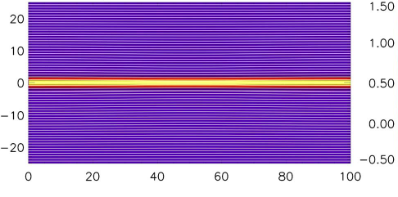
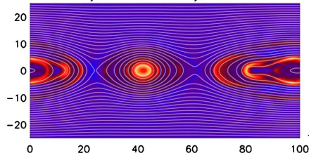
Sandwich Reconnection (continued):
B reverses across midplane, current sheet tears
High Mass loss,
L
PIC in pairs shows fast reconnection
(Zenitani, etc.)-anomalous viscosity
in diffusion region around X lines
allows radial E_{rec}
All possible reversed field decays,
Leaves non-zero B_{φ}(z) with B_{φ}(0)=0
X
X
Length scale: skin depth
~ Larmor radii (figs from Hesse & Zenitani 07)
J
J, Erec = (vrecon/c)B: radial E, J filaments
linear accelerator around X line – radial islands
Acceleration: E>B near X lines; Particles that stay in current filaments for distance L ~ R_{TS} gain energy up to PeV “easily”; Full spindown current in filaments ⇒ flare power available; efficiency depends on leakage into islands

Slide 17
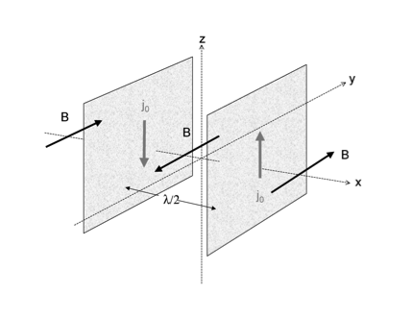
III. Reconnection in Surviving Stripes’ Current Sheets (Lyubarsky, Sironi):Low Mass Loss (e.g. )
L = circumferential distance, not radial.
If L ~ r, maximum energy same as sandwich
But small scattering sends particles into
neighboring sheet with oppositely
directed Erec. Then L might be as small as
RL ~ 10⁻⁹RTS, not useful for VHE emitting
particles. Simulations only way.
Simulations in pair plasma show reconnection
creates magnetic islands, transverse size ~R_{L}
Acceleration continues until particles drift into
islands, results in R_{L} <L<<R_{TS},
E_{max} <<0.1eΦ
Erec
Erec

Slide 18
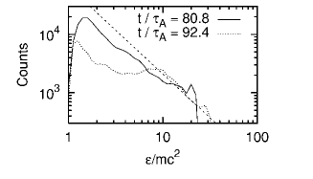
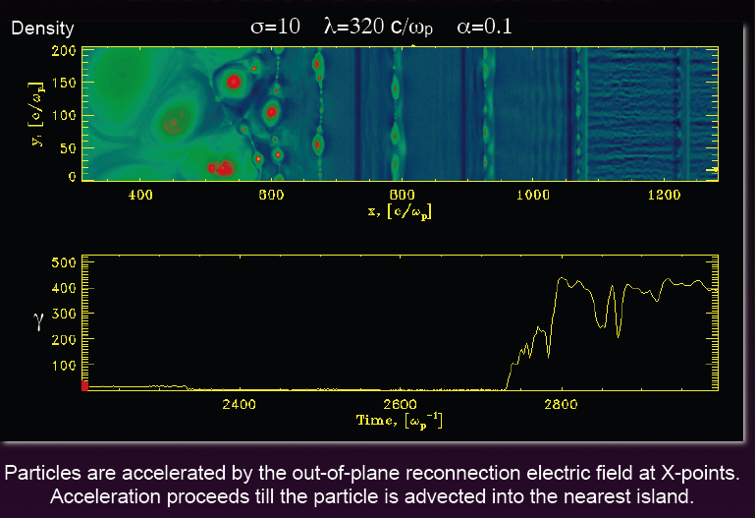
Particle Spectra (both geometries): flat, E⁻¹; much larger sims needed
Zenitani & Hoshino useful for acceleration of flat spectrum radio emitting pairs? Sironi - similar

Slide 19
Future promises
Equatorial magnetic sandwich reconnection? (JA’s favorite?)
Separate toroidal seqments causally disconnected, short flare
duration time?
Big Flare repetitions – current filament kinking, flapping? or, rare
events in amplitude spectrum?
Doppler boosts? Small since beam dumps are equatorial, flow
velocity of dumped particles ~c/3, dump ring shows no boost
Islands
Radial Current beam filaments, X-lines
Scale of filaments, beams set by vertical gradient of B_{φ} in upstream
wind after stripes are dissipated ~ R_{stripe}sin∠(Ω,μ)<0.8-0.9R_{TS}
Acceleration voltage big fraction of Φ
Beam dump = Chandra ring? Ring hotspots = filament terminations?
Reconnection bursty? (always true) = continuous flaring

Slide 20
Future Promises (continued)
Chandra Ring a puzzle
stationary ring with no sign
of outflow Doppler boost
spots vary some in position
If knots are current filament
dumps beam, are there
motion correlations with
continuous X-ray variability?
09/10 and 04/11 flares
showed transient knot, moved
out & faded (Atel 3283) –
strong current filamentation
dumps?
High resolution optical (Hubble?)
IR (ground based AO) monitoring
correlated with gamma ray
monitoring useful

Slide 21
Summary
Large Crab Gamma Ray flares suggest E > B accelerator – current sheet based linear accelerator in an extended layer (radial extent comparable to R_{TS}) of particular interest – can encompass continuously unsteady emission

Slide 22
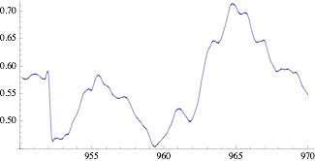
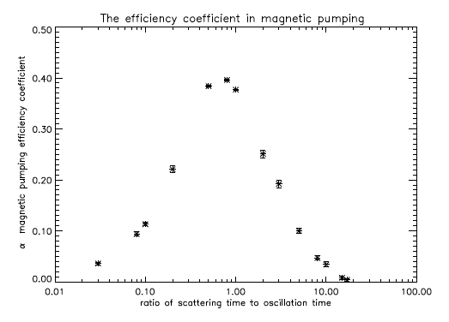
IV. Magnetic Pumping - Betatron effect with pitch
angle diffusion (or transverse spatial diffusion)
Shock, immediate downstream very
time variable (Komissarov, Bucciantini)
Axisymmetric, relativistic MHD, B toroidal, inject at shock with low sigma: Flux tubes compress, decompress - average B over (1-2)RTS
B²
High outflow speed toward us, larger Doppler
boost (Lyutikov & Komissarov), time contraction
(energy flow sufficient?)
(t-1054)years
ω = compression rate

Slide 23
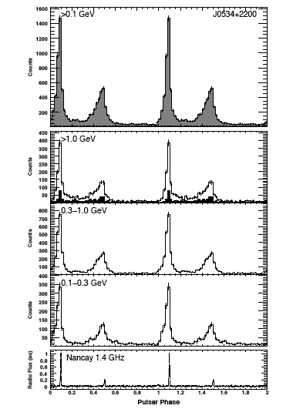
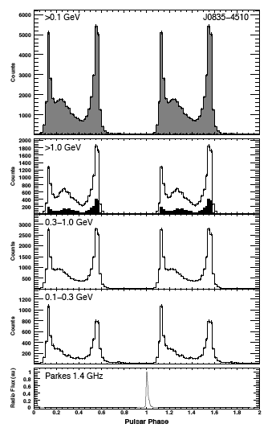
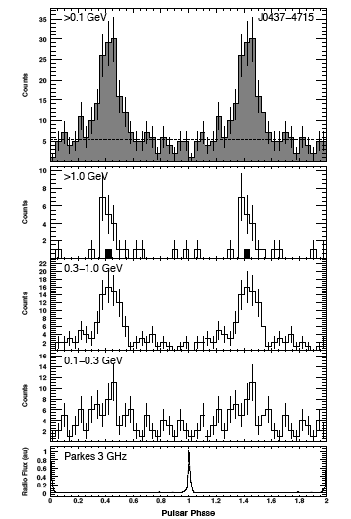
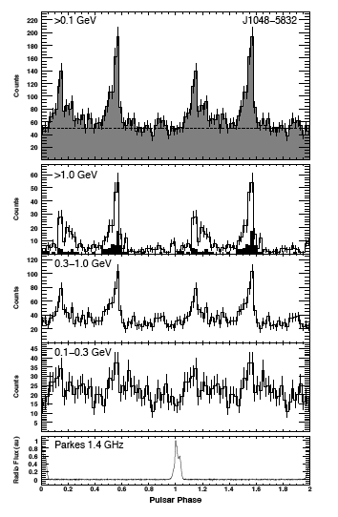
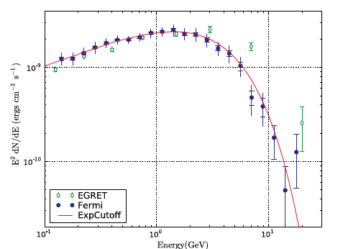
Pulsed Gamma Rays: Tevatrons
Crab P=33msec
Vela, P=89msec
J0437, 5.76msec
J1048, 124msec
A Few of the Gamma Pulsars (55 in FERMI-LAT in year 1)
Most are double peaked, wide separation in pulse phase,
Radio pulse leads two peaked gamma pulse
(B sweepback,…)
Particle energy E > photon energy : Gevatron
Radiation mechanism(s): E > 10-10⁴
(curvature, synchrotron)
Pulse Phase Averaged Vela Spectrum

Slide 24
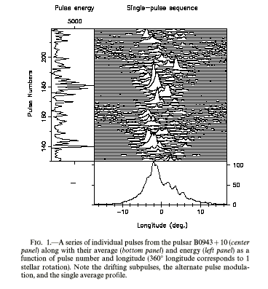
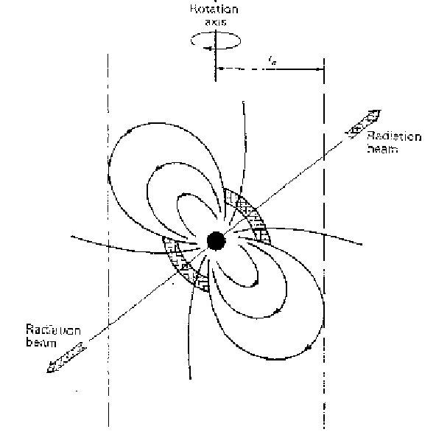
Pulsed Emission – Tevatrons
Galactic sources:
D ~ kilo-parsec
Pulsars = “Pulsating Radio Sources”
0.0017 s < P < 8.5 s
Keep accurate time (15 sf)
dP/dt > 0 - clock slows down
Lighthouse Model: Plasma
and Radio Radiation beam
Along polar B
Radio Beam Pol,
Morphology:
emission from
Low alt ~ dipole
Energetics: L_{radio}>10²⁸ erg/s~stellar coronae: stellar objects;
msec period -> neutron stars; stable periods (15 sig figs -> stellar rotation)
Energies, densities of emitting particles: ???

Slide 25
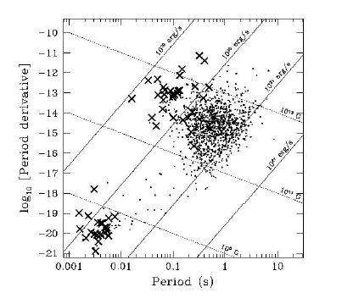
Follow the Energy: Spindown
Measure Ω to ~15 significant figures
Rotating NS Model: angular velocity
, moment of inertia I≈10⁴⁵ cgs
Φ=10¹² V
=10¹² V: “death valley”

Slide 26
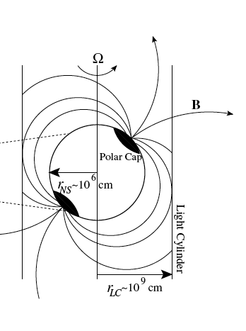
Interlude: Pulsar Theory
Rotating magnet - angular velocity (~few - hundreds)
Magnetic moment ~10²⁶ - 10³³ cgs, B* ~ 10⁸ - 10¹⁵ Gauss
Rotating Magnet has voltage (dynamo):
Electric field extracts current: Amp =Goldreich-Julian
current electrons from poles, in geometry shown; current connects to “earth”
(= nebula), causes torque – carried in Poynting flux
Energy Loss (energy from rotation, flywheel spins down):
MHD model has both displacement & conduction
currents

Slide 27
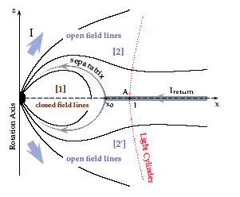
Hypothesis: Basic State is MHD co-rotating magnetopshere
(hf Radiative Output << Spindown Power),
Timokhin 2006
Magnetosphere isolated, gravity strong: no obvious source of
charges
Does NOT require quasi-nutral plasma

Slide 28
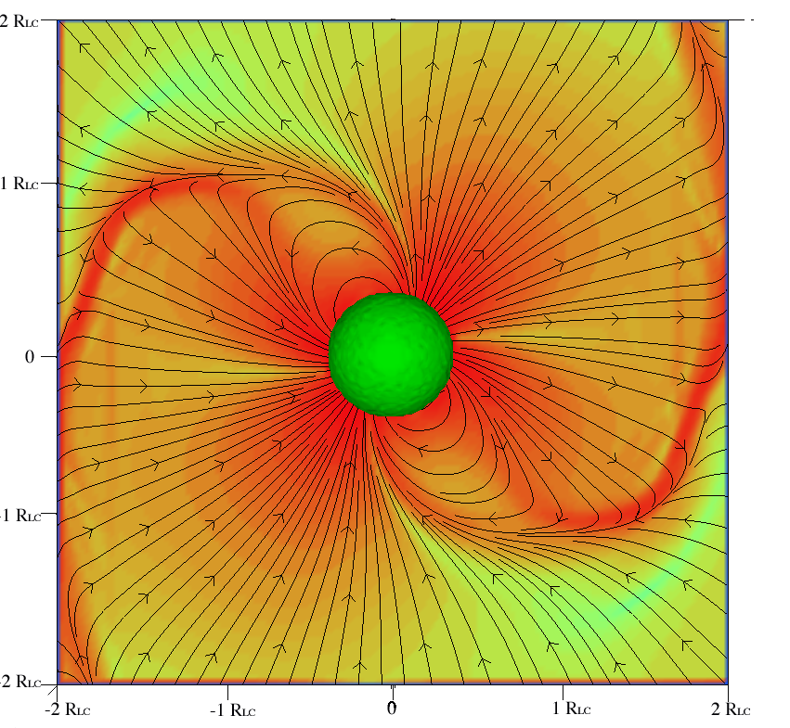
Aligned/Oblique Rotators structurally similar, J_{cond} + J_{disp} (=0 in aligned)
Spitkovsky’s (2006) oblique force free rotator
Polar Gap
Slot Gap
Outer Gap
Field Lines (with real open flux)
Total Current
Gaps = local quasi- vacuum zones inserted by hand
to model gamma ray emission and pair creation
Acceleration along B
➔ beamed photons,
rotation ➔ lighthouse
Force Free model has no gaps, no parallel accelerator

Slide 29
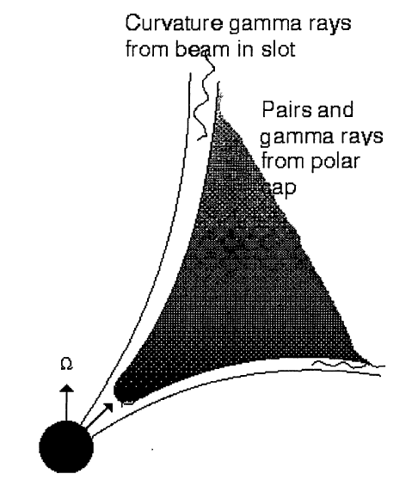
Pulsars have Dense Magnetopsheres: Pair Creation
Pulsar Wind Nebulae: Nebular Synchrotron requires
particle injection >> Goldreich-Julian current =cΦ/e
Solution(?): Pair Creation inside magnetosphere creates
dense, relativistic MHD wind, feeds nebulae
High Voltage : TV up to 10⁴ TV >> mc²/e: relativistic particle acceleration
along polar field lines? But = voltage drop ACROSS B (MHD)
relativistic motion along B is accelerated as particle follows curved B,
radiates incoherently (“curvature radiation”)
Pulsed gamma rays observed, > 55 gamma
PSR to date in FERMI observations
Pair creation physics: _{curvature} (B)
Optical Depth > 1 for one photon Pair Creation in B requires
Gamma emission models also need pairs (?)
Formation of Electric Currents need pairs
Model invokes large E║
at low altitude – some variants also make pairs at large r, but only for shorter period, larger pulsars

Slide 30
PAIR “OBSERVATIONS”
X-Rays: injection rate measured from X-rays in compact, strong B nebulae –
Crab, G54,…; rapid synchrotron cooling: calorimeters
measured calorimeter injection rates ~ existing gap model rates
κ±= ≤10⁴ pairs/current carrier
Radio measures injection rate averaged over nebular histories, inferred κ± > 10⁵⁻⁶ >> existing pair creation models
From evolutionary modeling of pulsar wind nebulae
PWN Name | ± | _{wind} | (PV) | Age (yr)
Crab | > 10⁶ | 5 x 10⁴ | 100 | 955
3C58 | > 10^{5.7} | 3 x 10⁴ | 15 | 2100
B1509 | > 10^{5.3} | 1 x 10⁴ | 121 | 1570
Kes 75 | > 10⁵ | 7 x 10⁴ | 22 | 650
(Bucciantini,
JA, Amato
2010)

Slide 31
Pulsed Gamma Rays not from pair low altitude pair creation
Gamma Rays Not from Polar Cap:
higher energy photons absorbed
with super-exponential cutoff:
γ +B e⁺ + e⁻ optical depth
Super exponential cutoff rejected:
b > 1 rejected at 16 sigma
Beamed from high altitude
more promising – tradition
has from quasi-vacuum “gaps”
inserted by hand/flow leaves
spaces where quasi-vacuum
can exist
Figures from R. Romani

Slide 32
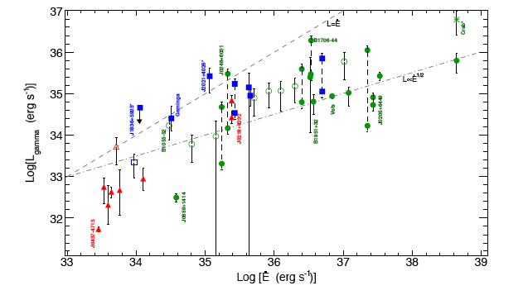
Prospect: Beam Models With Force Free Magnetospheric Structure
Magnetosphere sets time average (over 1 rotation) J║to be
the Force Free Current: Can work if dissipation/radiation energy loss small compared to ideal energy loss:
Gamma Ray Efficiency (LAT)
Assume gamma rays come from
particles in parallel current
accelerated in parallel electric field
if ΔΦ║ ~ constant over range of
- a natural consequence of pair
creation in the current flow,
pairs poison E║ (JA 1996,
“confirmed” by 5 EGRET PSR )
Probe Structure with Gamma Rays –
fold geometry with accelerator,
probe parallel electric field

Slide 33
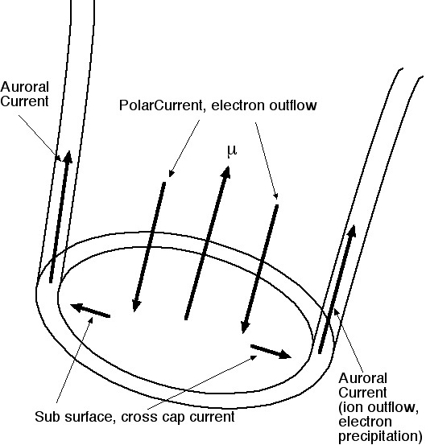
Structural Components of the Magnetosphere
Possible Acceleration sites: polar caps, outer magnetopshere
gaps or current sheets
MHD (Force-Free & Otherwise) + corotation: Charge density is

Slide 34
Implications of Force Free Rotator Model for Emission:
Polar cap/flux tube size and shape - noncircular shape, center from displaced magnetic axis - polarization - no need to invoke non-dipole B?
Electric current magnitude and sign - return currents both spatially distributed and in thin sheet - if dissipation regions (“gaps”) have parallel potential drops small compared to total magnetospheric voltage,
electric current in and outside gaps is known, averaged on magnetosphere transit time (~P/π ) - electric currents of gaps/emission sites must fit into magnetospheric circuit - or force free magnetospheric model is wrong - but energy all in field, hard to be non-FF
Location of return current layer determined - realistic site/physics for outer magnetosphere beaming models of high energy emission – Bai & AS –replace gaps by nonideal MHD physics well tested in solar system, generalized to relativistic conditions, with pair creation

Slide 35
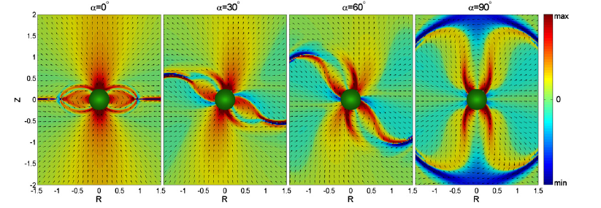
Polar Cap Current (Bai & Spitkovsky 2010):
blue = current, red = return current (aligned)
Magnetosphere and inner wind current structure (same ref)
thin sheet current component not shown – part of return current
in aligned, moderately oblique, becomes pole to pole linkage in orthogonal

Slide 36
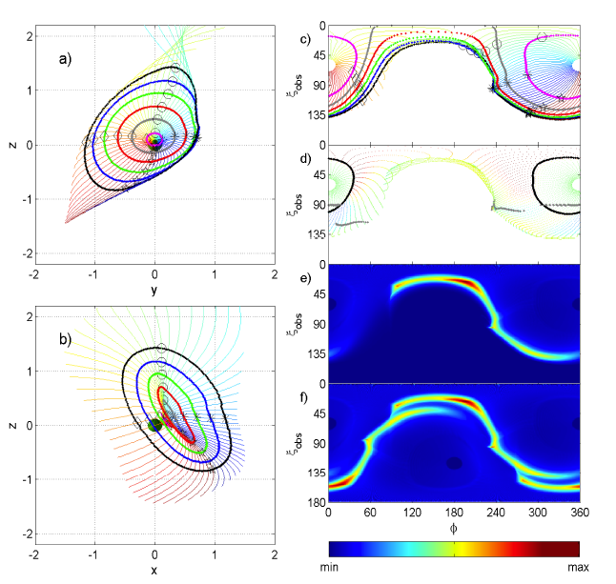
Pulsed Gamma Ray Emission from Current Sheets
Electrodynamics: Boundary layer between open and closed field lines carries an intense, thin sheet of current – current sheet into wind
Particle inertia, radiation reaction drag supports E parallel to B (?)
Acceleration in current sheet rotates
wide open cone of emission across sky:
geometry from force-free model ( ) by Bai & Spitkovsky (2010)
Sky
maps
Return current flows in separatrix
current sheet & neighboring layer
(“Separatrix Layer” = emission zone?)

Slide 37
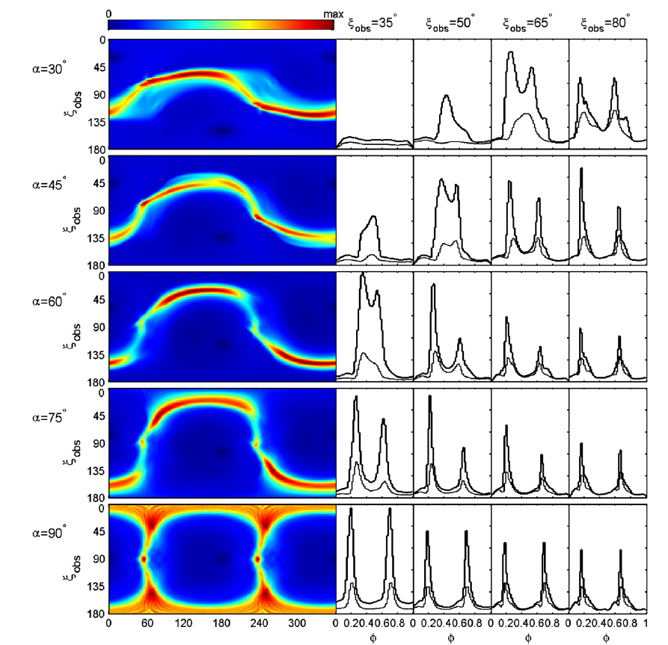
Light Curves from Separatrix Layer Emission (Bai & Spitkovsky 2010)
Phenomenological emission model – paint separatrix layer with
assigned emissivity (e.g. constant along B), beamed along particle
trajectories in force free fields (particles have E x B drift + parallel
slide along B, v < c)
Peaks are caustics –
photons beamed along orbits
from separate sites but times of
flight and beaming directions
conspire to have many arrive
together – strong through LC,
field lines become straight
Simple beaming model = good
account of light curves
Physical emission needs accelerator
like Aurora?

Slide 38
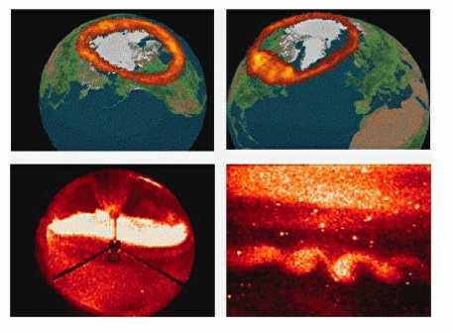
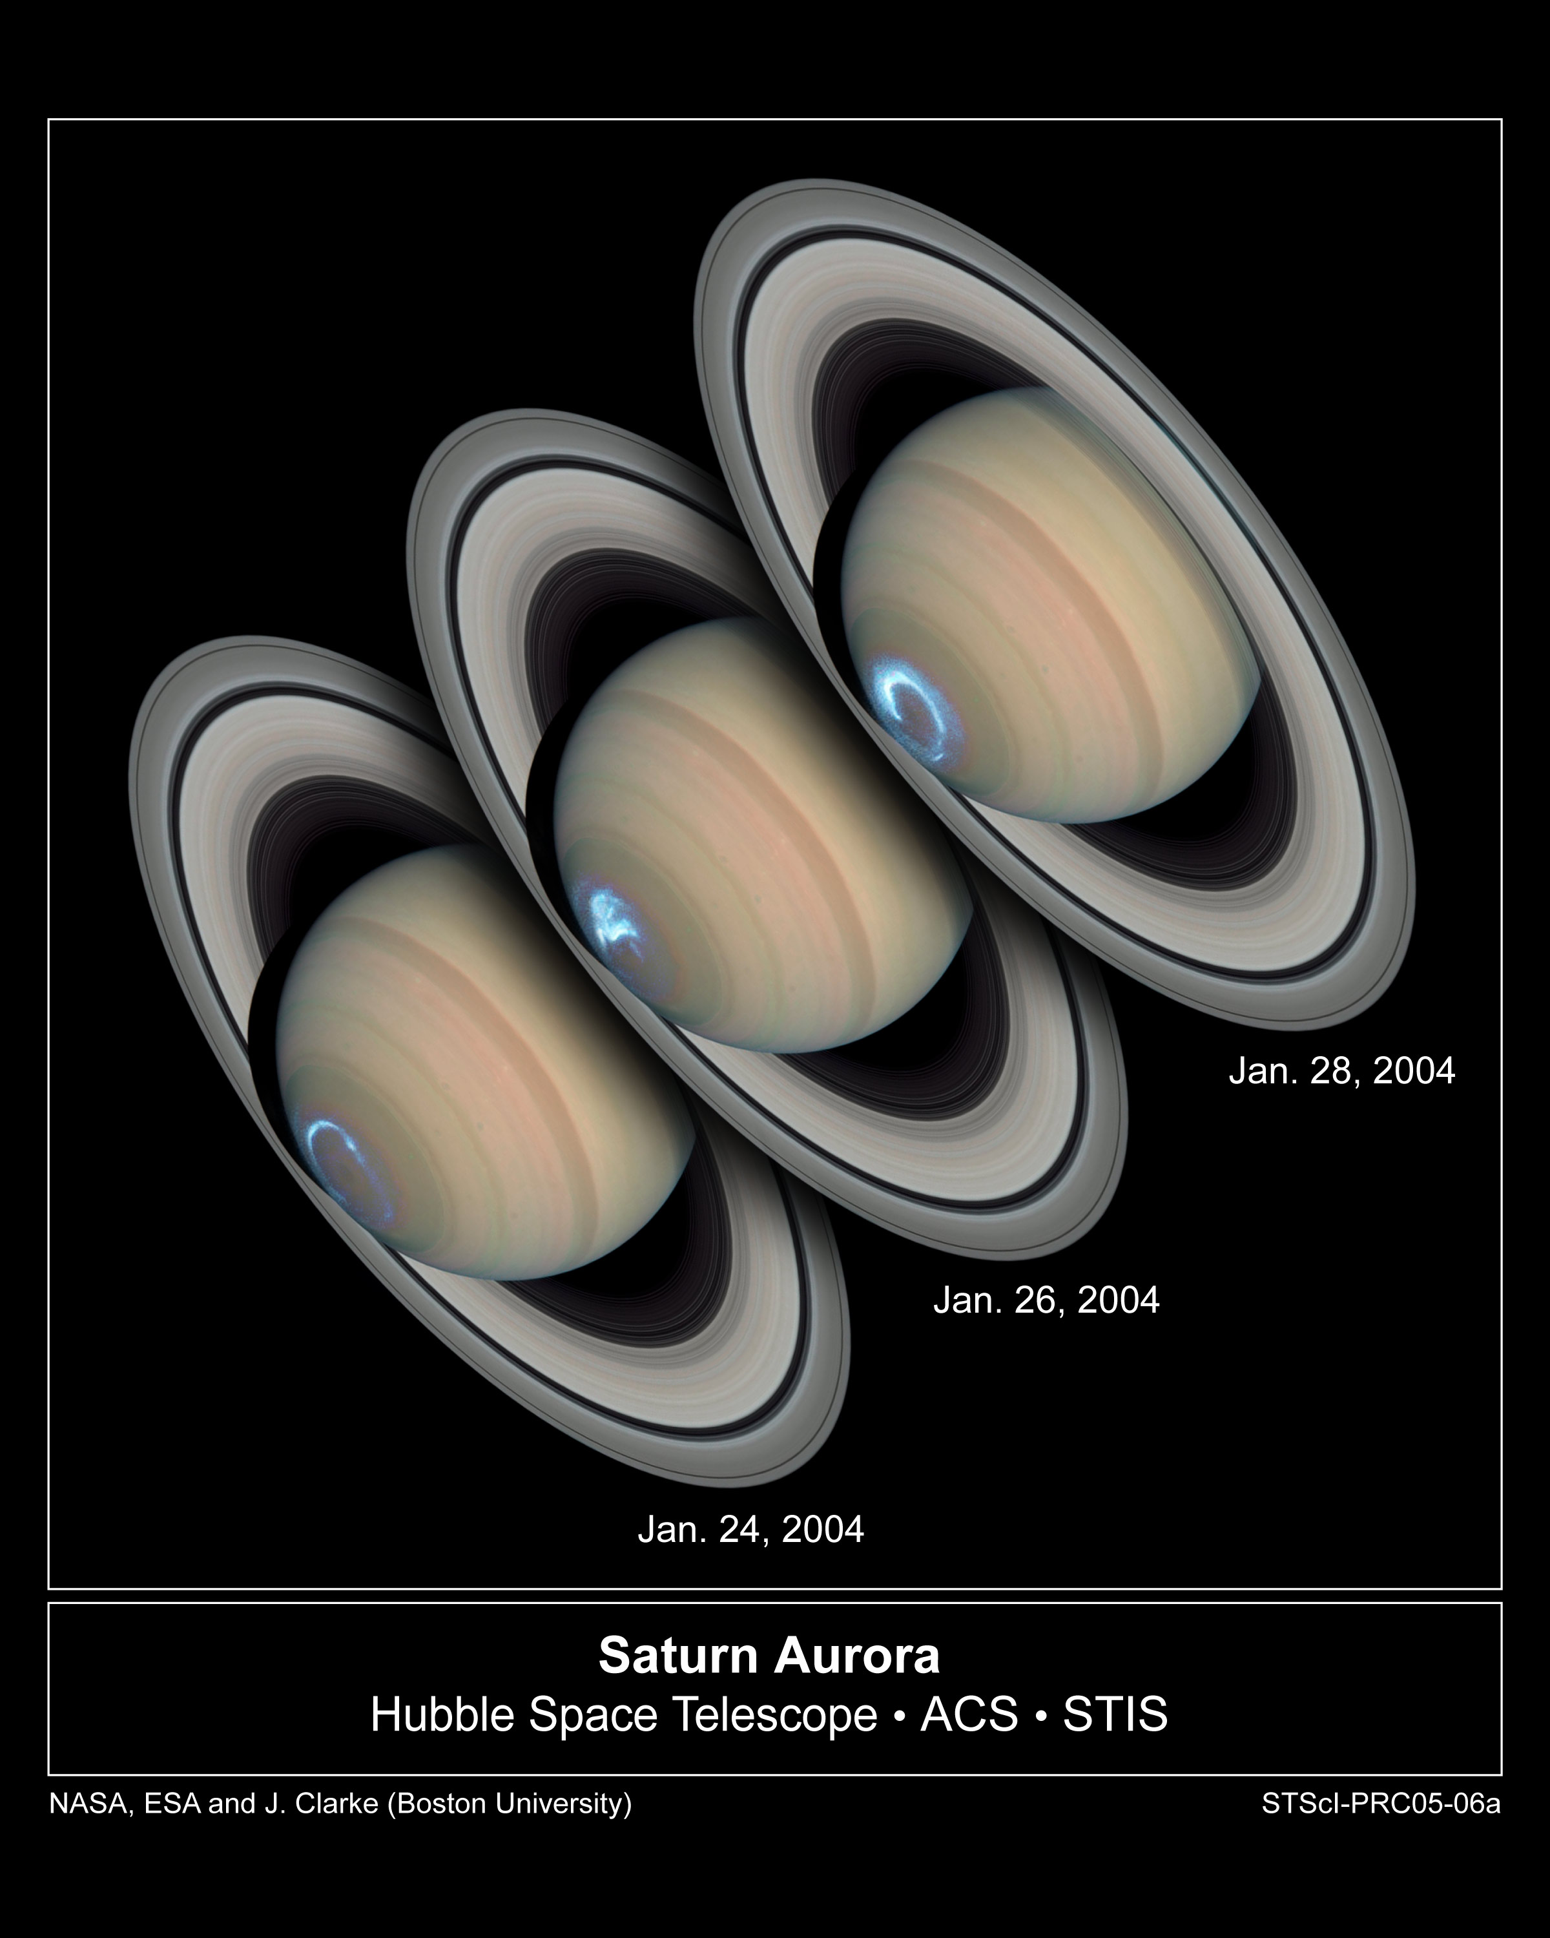
Auroral Model-a radiating sheet accelerator in globally FF
Earth Auroral oval from
space – current flow along
B driven by solar wind
Mechanical stress coupled to magntosphere by reconnection
Atmospheric molecular lines stimulated
by accelerated, precipitating
e⁻ beam (thin arcs) often ,
Density>>> GJ:
Don’t need vacuum to have
strong
Jupiter, Saturn similar

Slide 39
Outflow v = c
☉
╳
Reconnection inflow
l_{D}
Field Aligned current
precipitating electrons
+ ions from surface
Plasmoid
R_{L}
Reconnection E (radial in geometry shown)
sustained by off diagonal pressure tensor
(“collisionless viscosity” – relativistic
reconnection simulations)
X
w=relativistic enthalpy; anomalous resistivity neglected
Polar Cap
Obtuse geometry has precipitating positrons , electron outflow
Acute rotator

Slide 40
Acceleration in the Return Current Channel (including current sheet
Beyond the light cylinder)
Total value of current fixed by the force free magnetosphere
Current density of precipitating and outgoing beams in the
return current channel depends on the length of the diffusion region
l_{D,} which could be as small as the width = formal Larmor radius
and as much as many % of the macroscopic scale, the light cylinder
distance. Can be estimated & simulated, here treat as parameter.
Inertia of beams in the channel supports parallel E (kinetic Alfven wave)
Simple estimates: lower limit to accelerating voltage
V_{recon}/c ~0.1 (pair reconnection PIC simulations)
l_{D}/R_{l} macroscopic: e.g., ~0.1, as in FF simulations due to numerics, parallel
voltage drop ~ 1-10 TV, enough for GeV gamma ray emission by curvature radiation,
possible pair creation
l_{D}/R_{l} microscopic (multiple skin depths): voltage drop 1-10 GV, gammas from
synchrotron radiation – colliding beams unstable, excite Larmor gyration
Story to be finished “soon”

Slide 41
Follow the Mass Loss: From Whence all the Pairs?
Pulsar Wind Nebulae: Nebular Synchrotron requires
particle injection >> Goldreich-Julian current =cΦ/e
PAIR PROBLEM
X-Rays:current injection rate (compact, strong B nebulae - Crab, G54,…)
measured rates ~ existing (starvation) gap rates κ±= / ≤10⁴ pairs/GJ
Radio measures injection rate averaged over nebular histories,
κ± > 10⁶

Slide 42
Low σ = B²/8πm±c²n±Γ_{w} at termination Γ_{w} = eΦ/2m±c²κ± < 10^{4.3}
PWN Name | ± | _{wind} | (PV) | Age (yr)
Crab | > 10⁶ | 5 x 10⁴ | 100 | 955
3C58 | > 10^{5.7} | 3 x 10⁴ | 15 | 2100
B1509 | > 10^{5.3} | 1 x 10⁴ | 121 | 1570
Kes 75 | > 10⁵ | 7 x 10⁴ | 22 | 650
From one zone evolutionary model of observed spectrum including
radio (with Bucciantini, Amato) – injection spectrum convex, γ^{-1.3} γ^{-2.3}
Crab
PSR B1509/MSH 15-52
3C58

Slide 43
Polar Cap Pairs – Largest Source, All (?) PSR, all radio?
“Starvation” Electric Fields
Strong g=10¹⁴ cgs, T*~10⁶ K: no corona, charge separated magnetosphere
Model: Atmosphere freely releases charge
residuum of vacuum electric field pulls charge out
into a relativistic beam, shorts out most of E_{ǁ}
unshorted E_{ǁ} would drop all of Φ within
height = polar cap width = R*(R*/R_{LC})^{1/2} = 100m – 1 km
Beam electron (positron) moves on curved B, emits γ rays
γ’s go one absorption length in superstong B turn into e±,
multiply in a cascade
Beam density = electric current density ≃ GJ = eΦ/c*(area),
~ Force free expectation
Newborn pairs poison residual vacuum, shut off E_{ǁ} at a
fixed voltage drop ≈ 10¹² V = radio death boundary in
≈ L_{γ} in gamma ray data
Polar beam model like a diode:
cathode =stellar atmosphere, anode = surface of first pair creation
diode operates with ΔΦ fixed by anode at τ=1 ↔ Φ=10¹² V
current voltage characteristic: J║=B/P exactly
All has been “perfect” for the last 30 years

Slide 44
PIC + Monte Carlo Simulation of Standard Model
1D, applies to young pulsars
Concept: Atmosphere freely emits charge, assume monotonic
acceleration to v║=c; accel in unshorted vacuum E║ (some? all?);
(flow is steady in corotating frame on time << P); charge density of
beam ≄ η_{R} ≡-Ω∙B/2πc = charge density ∋ E║=0 – idea is to accelerate
up until charges emit curvature + inverse Compton γs,convert to pairs,
pairs short out E║ (“pair formation front” = PFF) where τ_{γB} = 1
ΔΦ║≈10¹² V almost independent of parameters (if τ_{γB} = 1
possible at all)
Defines a cathode (stellar atmosphere) – anode (PFF) pair with E║=0
at both ends – unique beam charge ῃ=J║/c
If η_{R} = constant, unique answer is
J║/c=η_{R}
then E║ =0, no acceleration!
Total Φ huge, small variation of η_{R} allows ῃ - η_{R} ≠0, ΔΦ║≫10¹² V if no
pairs
Biggest effect – dragging of inertial frames,
effective Ω increases with r, vaccum starvation goes up
Diode operates at fixed ΔΦ║, fixed J║ - not what magnetosphere wants

Slide 45
Relativistic Space Charge Limited Flow (A Timokhin)

Slide 46
Poison Worms in the bottle:
1) Pulsar death line ( ) models need dense (E║=0)
pairs over all space – works fine at large Φ, young stars,
but fails badly at longer period, greater age
2) J║=B/P =ρ_{charge}c is what was expected to
order of magnitude for the force free
magnetosphere, but actual force free
solutions need something different
May be solved by simple modification
of exact star centered dipole geometry
near surface – offset dipole with dipole
axis tipped away from radial direction
increases optical depth, more pairs
2) Solutions of force-free structure show
|J║| ⋚|η_{c}|c and J║ with sign opposite to
cη_{c} over part of open flux tube
(distributed return current), behavior
not the relativistic acceleration of
unidirectional beam – cathode-anode
operate with current fixed, “gap” adjusts
quickly to slowly changing global B
Hibschman & JA 01

Slide 47
Low Altitude Accelerator with J║/cη_{R} ≠1
what happens if beam extracted from stellar atmosphere
has “wrong” charge density (ῃ≠ῃ_{R})? (Timokhin & JA, 1D PIC+MC)
0< j≡J║/cη_{R}<1: Low voltage beam
+non-neutral trapped cloud
blue on polar cap current plots
J║/cη_{R}<0 (return current, red)
J║/cη_{R}>1
>TV unsteady discharges with pairs
Cold beam flow has stationary, γ~few
non-monotonic flow. Stationary finite
amplitude spatial plasma oscillation
with E║ cusped at velocity zeros (MW, Bel)
J║/cη_{R}=-1.5
J║/cη_{R}=+0.5
p=γβ
/ϖ_{c}
/λ_{D}
J║/cη_{R}=+1.5 similar
Wave breaks immediately, trapped particles
provide the rest of the co-rotation charge
density
No pair creation, γ too small

Slide 48
J║/cη_{R}=+0.5
/λ_{D}
p=γβ
Quasi-stationary non-neutral warm beam
+ trapped cloud particle spectra
J║/cη_{R}=-1.5
Positron (solid), electron (dashed) & gamma ray
(dotted) spectra with unsteady clouds
Direct radio emitter?

Slide 49
J║/cη_{R}=+0.5
J║/cη_{R}=-1.5
Mostly escapes to wind
All escapes to wind
Many unanswered questions – what happens to non-neutral outflow

Slide 50
SUMMARY
PeVatron: Pulsar Wind Nebulae – Wind Termination Working Surface
is time dependent, associated with nebular synchrotron emission
transverse shocks don’t work, some kind of reconnection might do
- gamma rays in flares need region with E/B > 1 (like X-lines)
(go to Spitkovsky’s talk)
TeVatron: Pulsed Gamma Rays from Magnetosphere
Force Free MHD Model for Spindown
return current: current sheet + extra distributed
current in magnetosphere & wind
possible formation of return current from reconnection at
cusp
possible auroral model for acceleration in current sheet
pair creation at polar caps (needed for MHD to work)
30 year old polar beam model being replaced by
discharges in return current, MHD in main volume of wind
by fully charge separated flow (?) – force free just
needs enough charge to make E∙B=0, does not need
quasineutrality
time dependent discharges make radio emission?

Slide 51
Pulsars as Particle Accelerators:
A Tale of (Two) Current Sheets*
Jonathan Arons
University of California, Berkeley
Collaborators: D. Alsop, E. Amato, D. Backer, P. Chang, N. Bucciantini, B. Gaensler, Y. Gallant, V. Kaspi, A.B. Langdon, C. Max, E. Quataert, A. Spitkovsky, M. Tavani, A. Timokhin
* With apologies to Charles Dickens

