Slide 1
Magnetic Reconnection and Particle Acceleration in Some Extreme Places
Dmitri Uzdensky
(University of Colorado Boulder)
with B. Cerutti, M. Begelman, J.McKinney, D. Giannios,
K. Nalewajko, M. Sikora
Krakow, Poland, May 26, 2011

Slide 2
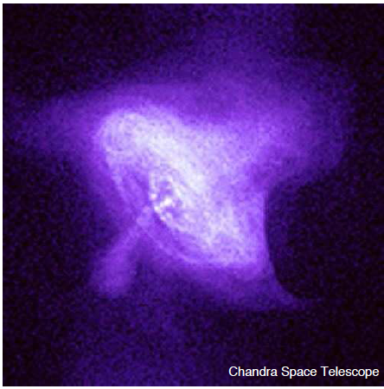
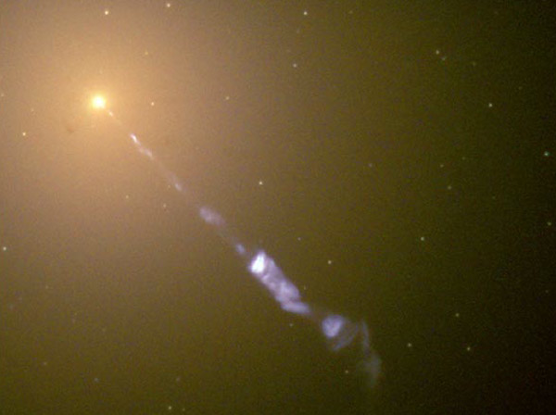
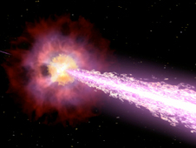
Dissipation and emission in relativistic astrophysical flows
Crab
M87
GRB
relativistic flows shine, one way or another.
Often, radiative cooling time is << travel time from central source → in-situ particle acceleration.

Slide 3
Dissipation Mechanisms
AVAILABLE FREE ENERGY
Bulk Kinetic
- longitudinal:
shocks
(e.g., termination shock,
colliding shells)
- transverse:
shear (KH) instability → turbulence
(e.g., boundary btw fast jet and slower wind)
Magnetic (Poynting flux)
Magnetic reconnection
current sheets:
- advected from central engine
- developing spontaneously,
(e.g., kink MHD instabilities)
Structure

Slide 4
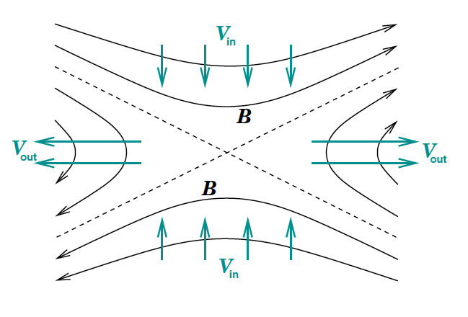
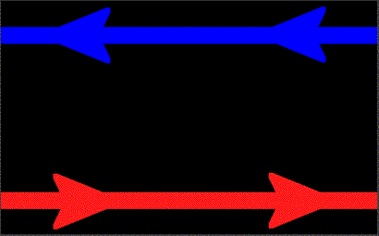
Introduction: Magnetic Reconnection
Magnetic reconnection is a rapid rearrangement of magnetic field topology
Reconnection often results in violent release of magnetic energy and its conversion to:
  electron and ion heating
  bulk kinetic energy
  non-thermal particle acceleration

Slide 5
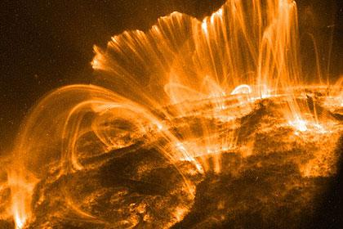
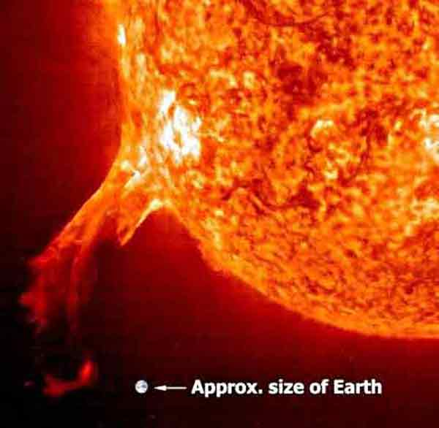
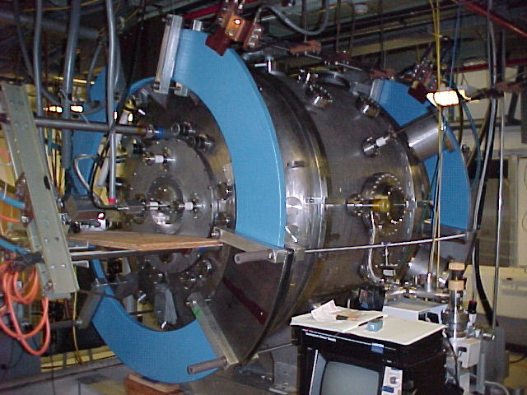
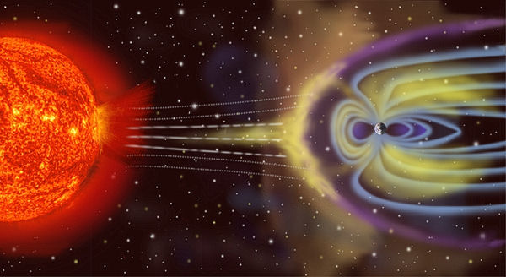
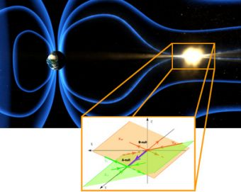
Traditional Magnetic Reconnection in the Solar System

Slide 6
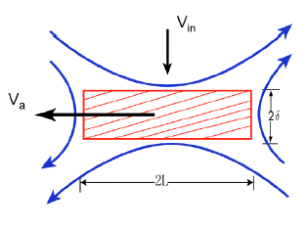
Reconnection: main questions
Current sheet formation and reconnection onset:
how/when does reconnection start?
Reconnection rate: how rapid is it?
Released energy partitioning:
  kinetic vs. thermal vs. nonthermal particle acceleration
  electrons vs. ions

Slide 7
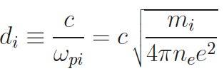

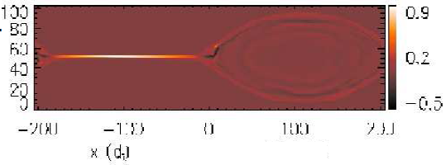
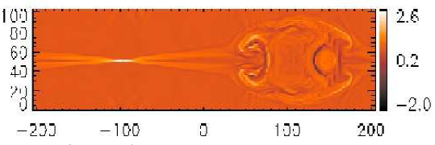
Traditional paradigm: steady laminar reconnection
2 regimes based on plasma collisionality: δ_{sp} vs. d_{i}, ρ_{i},
Collisional (resistive): δ_{sp} > d_{i},
Sweet—Parker layer thickness:
(sims by Cassak et al. 2005)
Sweet—Parker ---- SLOW
(cE ~ S^{-1/2} B₀ V_{A}, S = LV_{A}/η)
Collisionless (e.g., Hall) : δ_{sp} < d_{i},
Ion skin depth:
Petschek --- FAST (cE ~ 0.1 B₀ V_{A} )

Slide 8
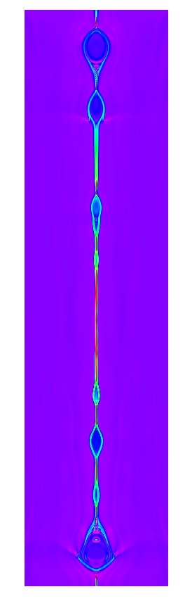
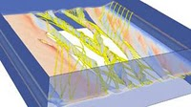
Modern paradigm: nonsteady, dynamic plasmoid-dominated reconnection
(Loureiro et al. 2007, 2009; Lapenta 2008; Samtaney et al. 2009; Daughton et al. 2009; 2011; Bhattacahrjee 2009, Cassak et al. 2009, 2010; Uzdensky et al. 2010; Huang et al. 2010)
Loureiro et al. 2011
Long current sheets (with L/δ > 100) are tearing-unstable and break up into chains of plasmoids (flux ropes in 3D).
Statistically steady-state self-similar plasmoid hierarchy (Shibata & Tanuma 2001) develops with fast reconnection rate even in collisional plasma): cE ≈ 0.01 B₀V_{A} .
The hierarchy provides a route towards small scales and facilitates transition to collisionless reconnection (with cE ≈ 0.1 B₀ V_{A} )
Collisionless reconnection in large systems is also plasmoid-dominated
Daughton et al. 2011

Slide 9
Conventional Reconnection Research:
Conditions:
Electron-ion plasmas
Non-relativistic
Non-radiating
Main Applications:
Solar corona
Earth magnetosphere
Laboratory plasmas
In contrast, in high-energy astrophysical reconnection, radiation is often important !!
Radiative reconnection is in its infancy
(Dorman & Kulsrud 1995; Jaroschek & Hoshino 2009; Giannios et al. 2009; McKinney & Uzdensky 2010; Uzdensky & McKinney 2011; Uzdensky 2011; Nalewajko et al. 2011)

Slide 10
Main topic:
Reconnection in high-energy radiative astrophysical environments
Radiation effects:
  radiation pressure,
  radiative cooling,
  Compton resistivity,
  radiative viscosity.
Other important effects:
  Special-relativistic effects
  Pair creation
  QED in ultra-strong B-fields

Slide 11
Examples of extreme reconnection in astrophysics: radiative reconnection at Peta-scale
Crab PWN flares
Blazar TeV flares
GRB jets
Magnetar (SGR) flares
Low B
High B
collisionless
collisional
10⁻³ G
1 G
10⁸ G
10¹⁵ G
Crab
Blazars
GRB
magnetars

Slide 12
I. Reconnection of magnetar fields
The most extreme example of high-energy-density astrophysical reconnection
Applications:
  SGR flares;
  central engines of GRBs and SNe.

Slide 13
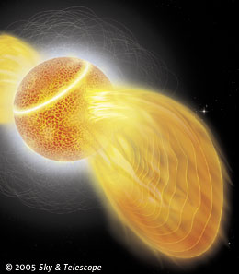
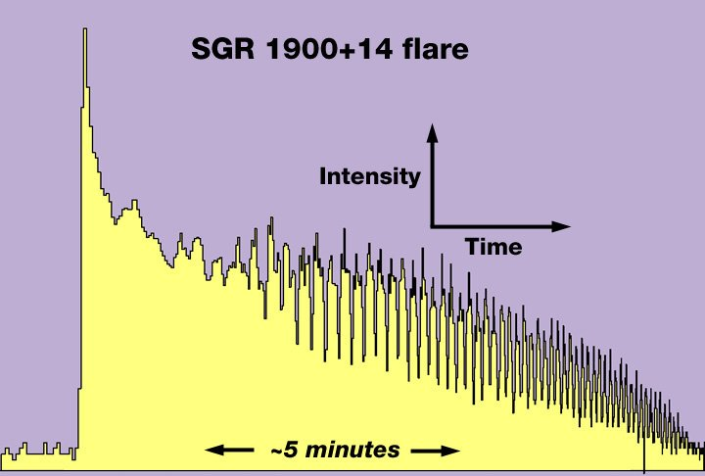
Motivation: Magnetar (SGR) Flares
Magnetars: isolated neutron stars with Peta-Gauss fields.
• Soft Gamma Repeaters (SGRs): magnetars exhibiting
powerful (up to 10⁴⁴ − 10⁴⁶ ergs in ∼ 0.3 sec) γ-ray flares.
Reconnection interpretation: Thompson & Duncan 2001; Lyutikov 2003, 2006

Slide 14
Physics
of
ultra-strong field reconnection

Slide 15
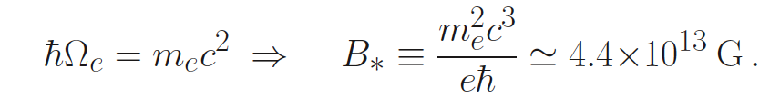
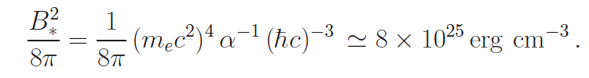
Critical Quantum Magnetic Field
Critical Quantum Magnetic Field:
Magnetic Energy Density:

Slide 16
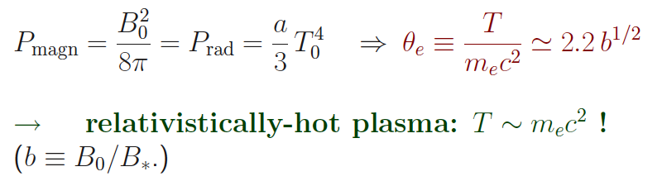
Radiation and Pair Production
Pressure balance (if no guide field) across layer or energy conservation determine central temperature, T₀:

Slide 17






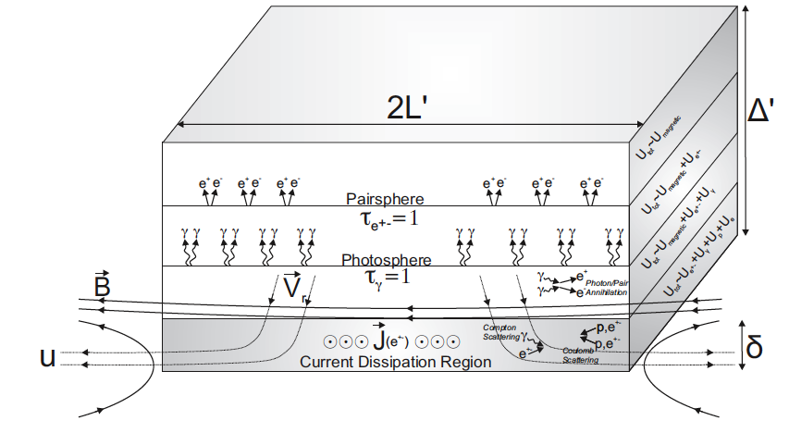
Pair Production
Copious pair production (Saha equilibrium):
where
Current layer is dressed in optically-thick pair coat!

Slide 18
Role of Pair Production:
Extremely high pair density:
makes reconnection layer optically thick, and yet radiative cooling time may be < advection time
radiative transfer problem!
makes the layer highly collisional
→ radiative resistive MHD should apply!

Slide 19

Pairs trap radiation:
High pair density ⇒ layer is optically thick:
τ = n σ δ >> 1
– in sharp contrast with conventional reconnection.
Yet, photon diffusion time across layer may be << global advection time along layer:
if τ << L/ δ
Radiative cooling may dominate over advection!
Fundamentally, the reconnection problem becomes
a radiative transfer problem! (c.f., accretion disks)

Slide 20
Collisionality of Reconnection Layer
EXAMPLE (Uzdensky & MacFadyen 2006; see also McKinney & Uzdensky 2010):
B₀ = 0.5 B∗ = 2 x 10¹³ G, T ∼ 300 keV, n_{e} ∼ 2 x10²⁹ cm⁻³.
Spitzer resistivity: η_{S} = 0.1 cm²/sec
(photon drag gives comparable contribution)
Typical global scale: L = 10 km
Lundquist number: S = Lc/η_{S} ∼ 10¹⁸
Sweet-Parker layer thickness: δ_{SP} = L S^{−1/2} ≃ 10⁻³ cm.
δ_{SP} ≪ L, but δ_{SP} ≫ d_{e} , ρ_{e} ∼ 10⁻¹⁰ – 10⁻¹⁰ cm, λ _{e,mfp} ∼ 10⁻⁶ cm.
Thus, reconnection layer is highly collisional,
resistive MHD (with Compton drag) should apply!

Slide 21
II. GRB Jets
(McKinney & Uzdensky 2010; Jon McKinney’s talk yesterday!)

Slide 22
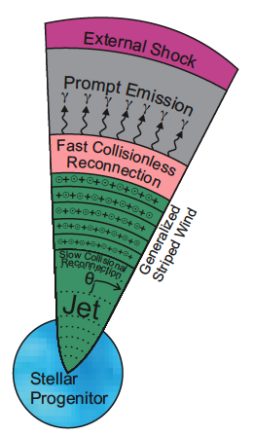
Reconnection Switch to Trigger GRB Jet Dissipation (McKinney & Uzdensky 2010)
Reconnection current layers near central engine are collisional.
At larger distances, B drops, temperature drops, pairs recombine, density drops.
Somewhere at peta-cm distances, reconnection layer becomes collisionless → switch to faster energy dissipation

Slide 23
III. Reconnection in Blazar Jets: jet-in-a-jet
(Giannios, Uzdensky, Begelman 2009 (Blazars) , 2010 (M87)
Nalewajko, Giannios, Begelman, Uzdensky, & Sikora 2011)

Slide 24
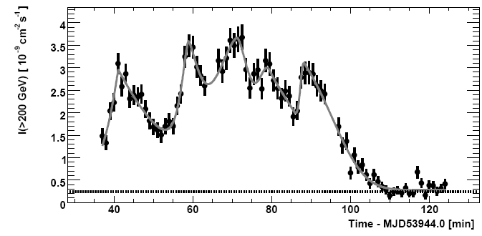
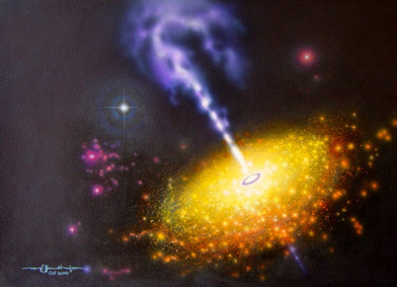
Extremely Rapid TeV variability in blazars
Doppler factor crisis
Variability timescale τ < 5 min
at γ-ray luminosity L > 10⁴⁶ erg/s.
Pair-production opacity constraint
for single-zone models Γ ~ 50
(Begelman, Fabian, & Rees 2008).
AGN unification models and VLBI
kinematics of pc-scale jet in BL Lacs imply Γ ~ 10.
BL Lac PKS 2155-304 (z = 0.116)
July’06 HESS VHE (>200 GeV) outburst
PKS 2155-304 (image by J.J. van Ellinckhuijzen)

Slide 25
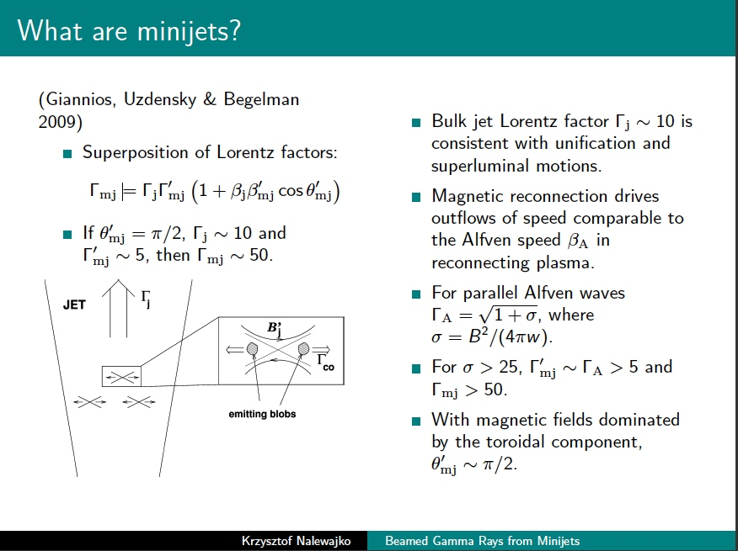

Slide 26
IV. Gamma-ray flares in Crab PWN
DAU, B. Cerutti, & M. Begelman 2011 – see Benoit Cerutti’s poster!

Slide 27
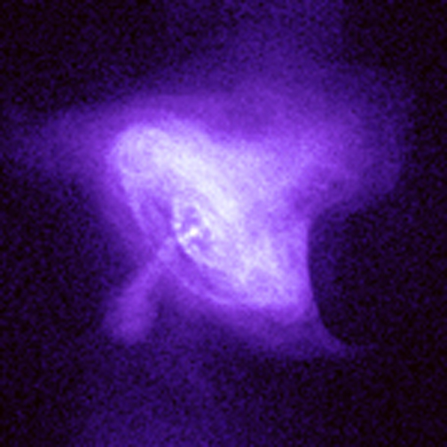
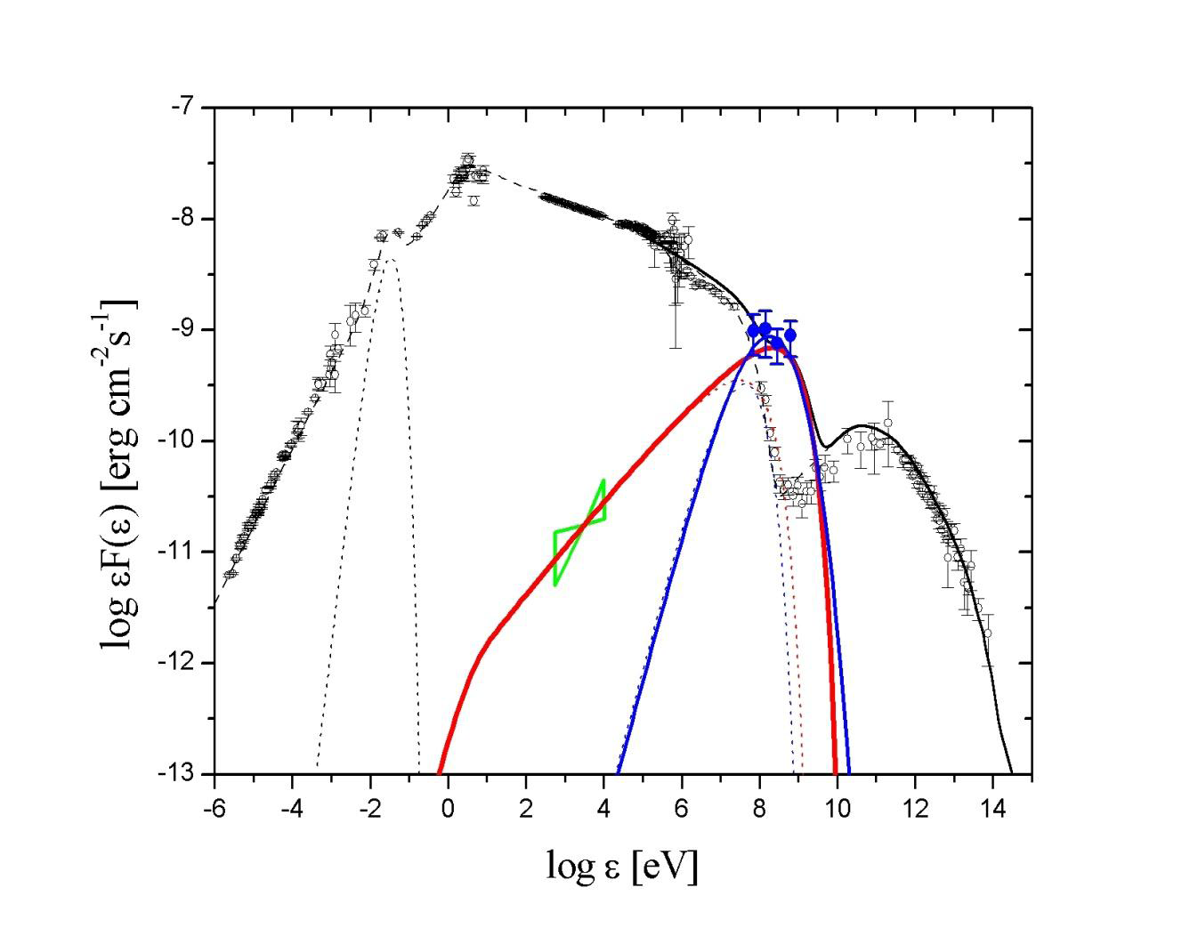
Gamma-Ray Flares in the Crab
September 2010 AGILE/FERMI γ-flare

Slide 28
Simple Estimates
Observational constraints:
  Flare duration: τ = 1 day --> l ~ 3 x 10¹⁵ cm
  Photon energy: > 100 MeV --> γ₉ ~ 3 B₋₃^{-1/2} -- PeV!!
  Isotropic flare energy: E ~ 4 x 10⁴⁰ erg
Simplest assumptions: isotropic synchrotron emission, no Doppler boosting.
Synchrotron cooling constraint: τ_{flare} > τ_{sync} ➔ B₋₃^{3/2} τ_{flare,5} > 3
Flare energetics : E_{flare}< V B²/8π → V₄₈B²₋₃ > 1 → B₋₃ > 5 (τ_{flare,5})^{-3/2}
Strong (a few milligauss) magnetic field is required!
Notes:
Just to set the stage

Slide 29
Main Problem: production of synchrotron emission > 100 MeV challenges classical models of acceleration
Maximum electron energy is limited by radiative losses:
Accelerating electric force: f_{acc}=eE
Radiation reaction force: f_{rad}=2/3 r_{e}² γ² B²
Synchrotron photon energy: ε_{max}=3/2 γ²_{max} ħ ω_{c} = 160×(E/B) MeV
In classical acceleration mechanisms: E<B ➔ ε_{max}< 160 MeV
f_{acc}=f_{rad} ➔ γ_{max}
  (e.g., de Jager et al. 1996; Lyutikov 2010)
Possible resolution: relativistic Doppler boosting effect:
[e.g. Komissarov & Lyutikov 2010, Bednarek & Idec 2011]
ε_{max}=D×160 MeV
But required D≈3-4, unlikely for Crab (bulk motion < 0.5 c) [Hester+2002]

Slide 30
Another Way Out: Reconnection
ε_{max}=3/2 γ²_{max} ħ ω_{c} = 160×(E/B) MeV
A way out of the Crab flare paradox:
relax E < B_{perp} assumption!
Impossible in ideal MHD (E + v x B/c = 0)
Reconnection layers are a natural place for this to happen.

Slide 31
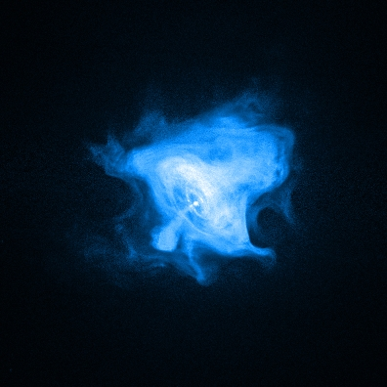
Where could magnetic reconnection operate in the Crab?
Pulsar wind
Current sheet (striped wind)
Polar region
High magnetic field (Z-pinch)
Kink unstable [Begelman 1998]
© NASA-CXC-SAO F.Seward et al.

Slide 32
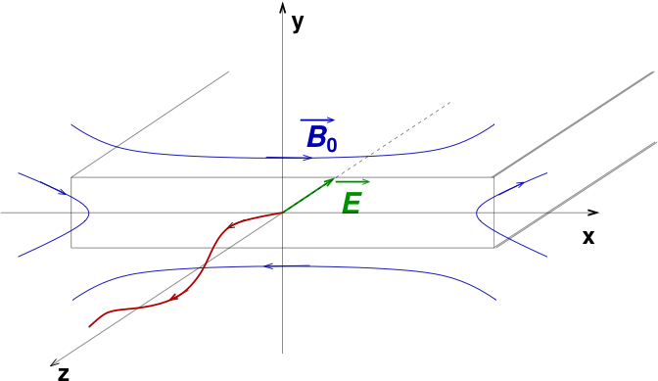
Motion of PeV particles
Gyroradius ρ ~ 3 x 10¹⁵ cm ~ L → motion is controlled only by large-scale electro-magnetic fields:
  Reconnecting (x) magnetic field B₀
  Reconnection (z) electric field E_z = β_{rec} B₀
  Guide (z) magnetic field, B_{z}
(β_{rec} ~ 0.1 in rel. pair recn. even without Hall effect --- Zenitani & Hoshino 2001-2008)

Slide 33


What limits the acceleration?
Maximum particle energy is limited by:
  - accelerating potential available (finite length):
  - radiation reaction:
Corresponding synchrotron photon energies:

Slide 34
Main Idea
(Uzdensky, Cerutti, & Begelman 2011; see also Kirk 2004)
Energetic particles travel in relativistic analog of Speiser orbits:
  accelerated by reconnection E_{z} in z-direction;
  confined to reconnection midplane by reversing reconnection magnetic field B_{x}.
We show, by explicit analytical example and direct numerical integration, that orbits shrink towards the midplane.
Particles get focused into the layer, where B is small and hence radiation reaction is reduced.
Particles can reach higher energies and emit photons with ε > ε_{sync,*}

Slide 35
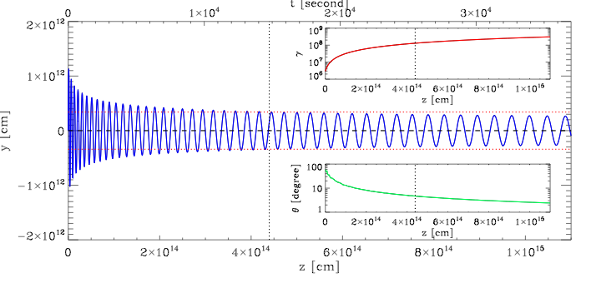
Numerical Calculation of 3D trajectories
(Uzdensky, Cerutti, & Begelman 2011, Cerutti et al. 2011)
Includes:
  Finite layer thickness: B_{x}(y) = B₀ tanh(y/δ)
  Guide magnetic field: B_{z}
  Radiation reaction force

Slide 36
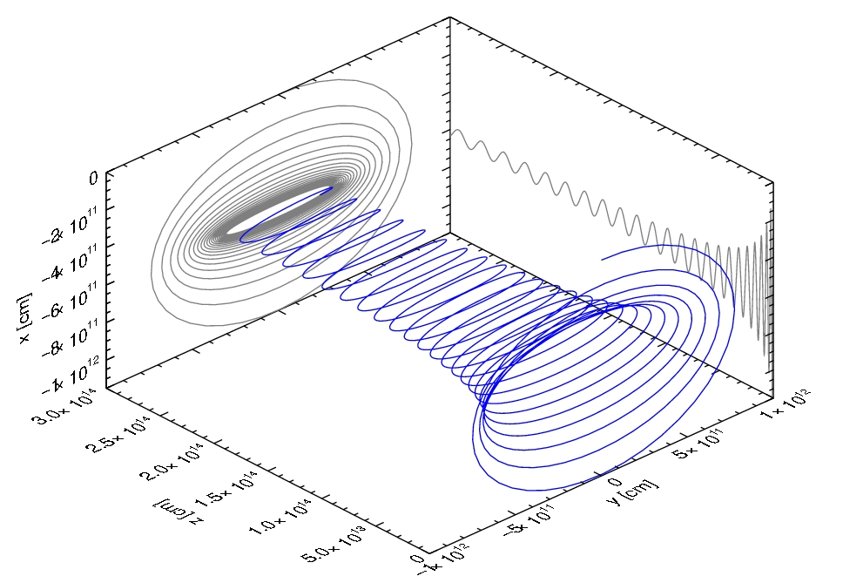
Particle Orbit in 3D

Slide 37
Why does this matter?
Eventually particle’s orbit is entirely inside layer: y_{max} < δ
Inside the layer, B ≈ B₀ y/δ < B₀ ,
whereas E = β_{rec} B₀ is unchanged.
Thus, particles can get to higher energies before achieving radiation reaction limit:
γ_{rad} ≈ γ_{rad,*} δ/y_{max} > γ_{rad,*}
Can emit above the standard limit:
ε_{sync} ≈ ε_{sync,*} δ/y_{max} > ε_{sync,*}

Slide 38
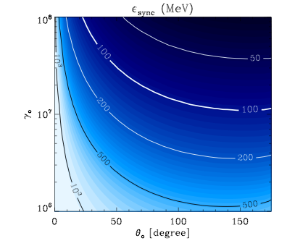
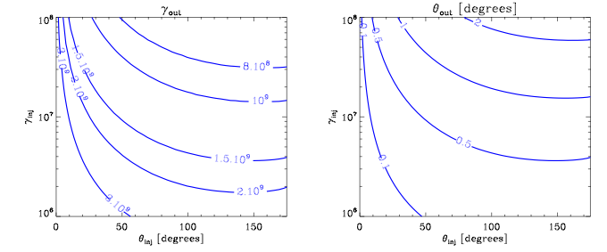
β_{rec} = 0.1
B₀ = 5 mG
B_{z} = 0
l = 4 days
Typical synchrotron photon energy at the end of reconnection layer

Slide 39
Summary
In contrast to traditional solar-system plasmas, in many high-energy astrophysical systems magnetic reconnection and particle acceleration are often affected by radiation.
Radiative reconnection is a new frontier in reconnection research.
Examples:
  Magnetar reconnection: highly collisional, optically thick “dressed” layer;
  GRB jets: pairs annihilate, photons escape → transition to fast collisionless reconnection;
  Blazar gamma-ray flares: reconnection minijets to get short time-scales, prompt radiation cooling may be important on global transit time-scale;
  Crab PWN gamma-ray flares: radiative drag presents strong, but not insurmountable, difficulties for highest energy particle acceleration necessary to explain > 100 MeV synchrotron photons.
Crab gamma flares challenge particle acceleration models: may require extended regions with E > B_{perp} → reconnection current layers.
100 MeV - 1 GeV photons are emitted by PeV electrons that feel only the large-scale EM fields.
As particles get accelerated by straight reconnection electric field, they are focused into a tight beam along the layer midplane.
Eventually, particles travel completely inside the layer, where they sample a reduced perpendicular magnetic field.
This suppresses synchrotron losses and increases radiation reaction limit, circumventing the synchrotron energy limit.

