Slide 1

Disk Winds and Dusty Tori:
Theory & Observations
Moshe Elitzur
University of Kentucky

Slide 2
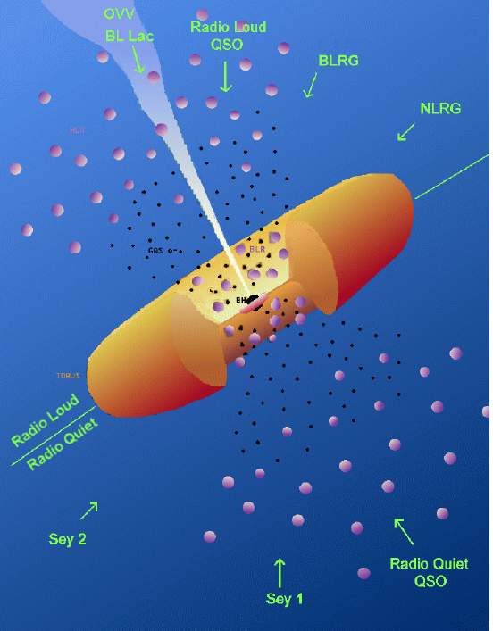
Unified Scheme for AGN
Toroidal
Obscuration
Required by
Unification
Schemes
M ~ 10⁶ – 10¹⁰ M
R_{s} ~ 10¹¹ – 10¹⁵ cm
Obscuring matter — optically thick dusty clouds Krolik & Begelman ‘88

Slide 3
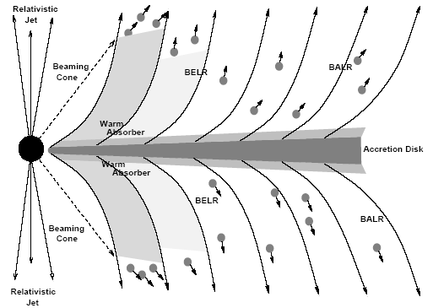
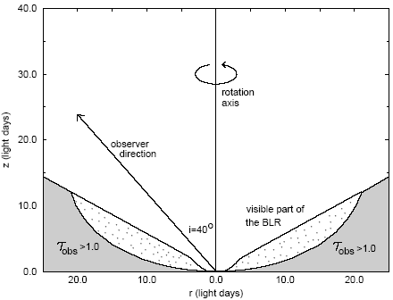
The Disk Wind Paradigm
0
Blandford & Payne ‘82
Everett & Konigl ‘00
Bottorff+ 97

Slide 4
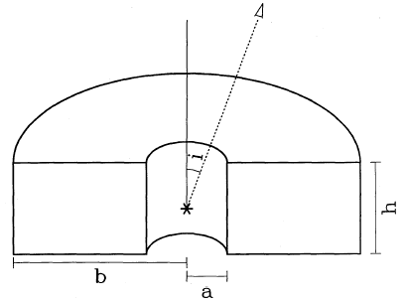
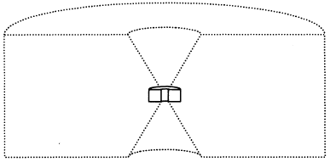
Origin of the 100’s pc Torus – Modeling IR emission
0
Pier & Krolik 92
Pier & Krolik 93
5-10 pc
~100 pc
Dearth of IR emission in smooth-density models T ↔ r
Granato et al ’94, ‘97:
  Uniform density
  R_{out} ~ 100 – 300 pc

Slide 5
Torus – direct evidence: NGC 1068
Jaffe et al ‘04
r ≤ 1.7 pc: T = 320 K
D = 14.4 Mpc
0.1” = 7.2 pc
T > 800 K
VLTI 8-13 μm
Close proximity of hot and cooler dust
Very compact torus

Slide 6
Torus Size
0
Size scale – dust sublimation radius R_{d} = 0.4 L₄₅^{½} pc
All observations are consistent with R_{out}/R_{d} no larger than ~20−30, and perhaps even only ~5−10

Slide 7
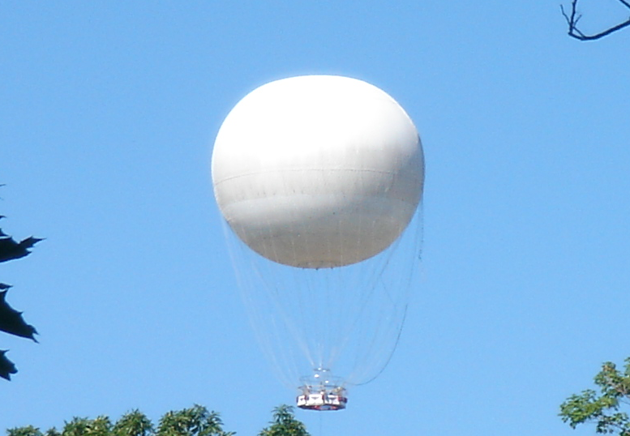

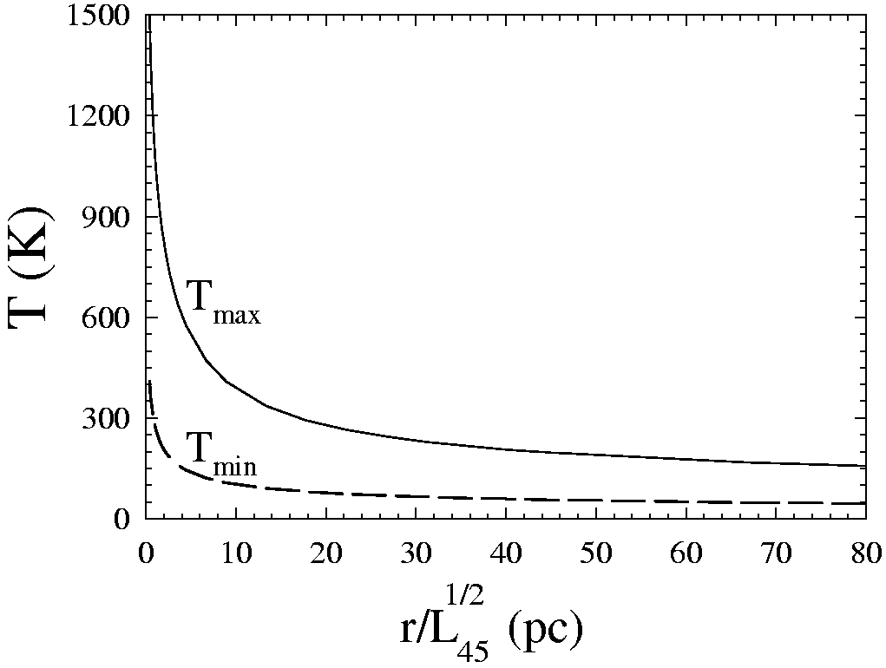
Temperature in a Clumpy Medium
T_{max}
T_{min}
Smooth density –
T & R uniquely related
Clumpy density –
different T at same R
different R, same T
Nenkova+ 08a

Slide 8
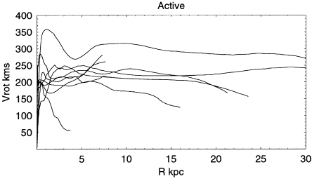
Black-Hole Influence Radius R_{BH}
0
At R_{BH}: Ω(R_{BH}) = Ω(R_{BH}) ⇒ M(R_{BH}) = M
v_{rot} ~ 100 km/s
R ~ 100 pc
Sofue et al 99
R_{BH} = 35pc (M_{7}/Ω²₁)^{1/3}

Slide 9
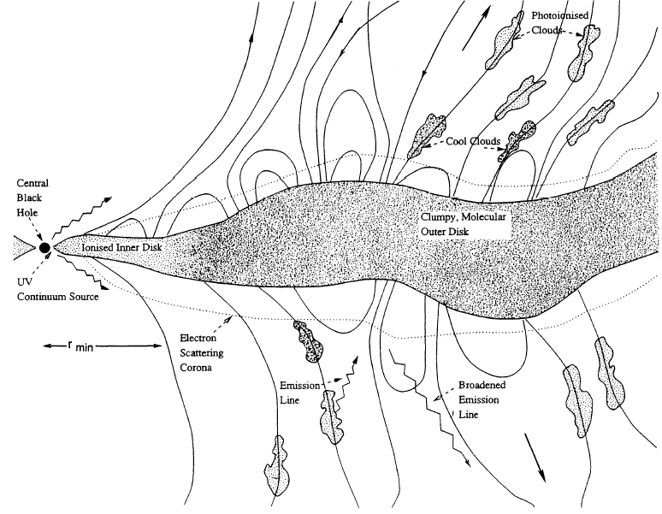
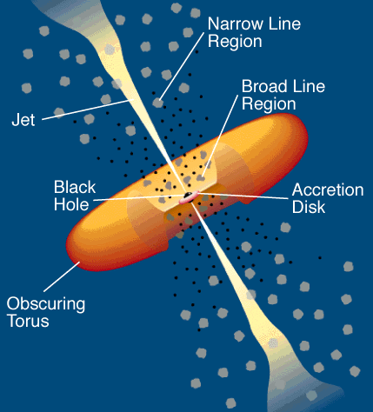
Grand Unification Theory – the Disk Wind Scenario
0
Emmering, Blandford
& Shlosman 92
masers
BLR
TOR
Broad Line Region
Toroidal Obscuration Region
WA
Warm Absorber

Slide 10
Cloud Properties in TOR Outflow
IR modeling:
τ_{v} ~ 30 – 100 ⇒ N_{H} ~ 10²² – 10²³ cm⁻²
Resistance to tidal shearing:
n > 10⁷ M_{●7} / r_{pc}³ cm⁻³
R_{c} < 10¹⁶ N_{H,23} r_{pc}³ / M_{●7} cm
M_{c} < 7·10⁻³ N_{H,23} R_{c,16}² M
B ~ 1.5 σ_{1km/s} n₇^{1/2} mG
Elitzur & Shlosman 06

Slide 11
Circinus Water Masers
0.2 pc
Greenhill+ 03

Slide 12
Circinus VLTI Imaging
Tristram+ 07

Slide 13
BLR/TOR Mass Outflow Rate
R_{d} ∝ L^{½}
v_{z}(R_{d}) ∝ v_{K}(R_{d}) ∝ (M•/R_{d})^{½} ∝ (L_{Edd}/L^{½})^{½}
α < 1
BLR/TOR outflow must disappear at small L!

Slide 14
TOR Disappearance at L <~ 10⁴² erg s⁻¹
Obscuration disappears in
  FR I (Chiaberge+ 99)
  Liners (Maoz+ 05)
  low-luminosity Sy2 (Panessa & Bassani 02)
No torus dust emission
  in M87 (Whysong & Antonucci 04; Perlman+ 07)
  in FR I and ~ half of FR II (van der Wolk+ 09)

Slide 15
BLR Disappearance in LLAGNs
BLR existence: L > C M^{2/3}
i.e., L > C (L_{Edd}/L)²
log L = 35 + 2/3 log M
log L = 28.8 – 2 log (L/L_{Edd})
Elitzur & Ho 2009
η ≈ 4·10⁻⁴ ⇒ radiatively inefficient accretion!

Slide 16
BLR
TOR
Wind diminishes — mass outflow directed to jets (?)
Ho ‘02, Sikora et al ‘07: Radio loudness (L_{rad}/L_{opt})
varies inversely with M_{acc}!
.

Slide 17
Radio-loudness; Ho ‘02
R’ = L_{rad}/L_{opt} λ = L/L_{Edd}

Slide 18
Radio-loudness; Sikora+ ‘07
R = L_{rad}/L_{opt} λ = L/L_{Edd}

Slide 19
Wind diminishes — mass outflow directed to jets (?)
Ho ‘02, Sikora et al ‘07: Radio loudness (L_{rad}/L_{opt})
varies inversely with M_{acc}!
Similar effect in X-ray binaries
.

Slide 20
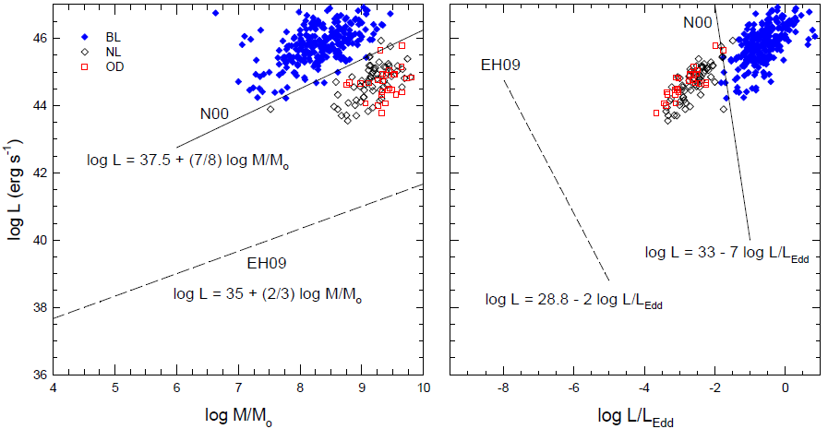
COSMOS AGN
Trump+11

Slide 21
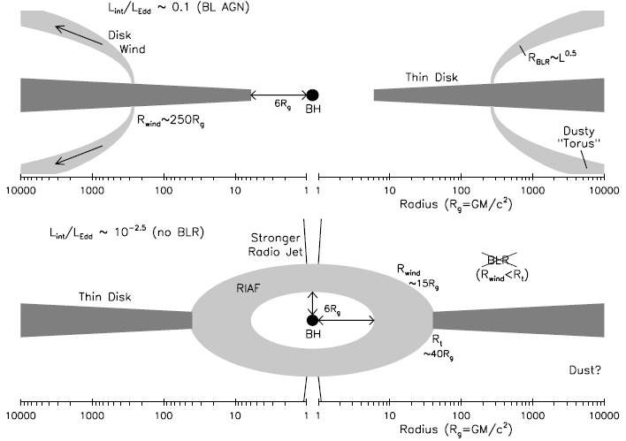
Alternative BLR/TOR Disappearance
P_{rad} = P_{gas}
Trump et al ‘11 variant of Nicastro ‘00

Slide 22
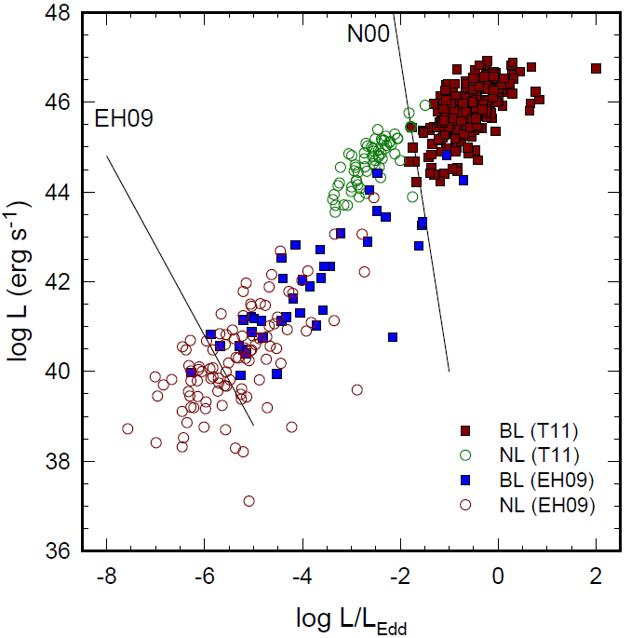
Two Independent Boundaries
N00 bound — dynamics
EH09 bound — “kinematic”
“intermediate” Sy1.x: Hβ/[OIII]λ5007 < 1

Slide 23
A Two-Component BLR?
Many Sy1.8 & 1.9 show broad double-peaked Balmer lines — interpreted as disk emission
A wind+“disk” mix could naturally produce the sequence Sy1 → 1.2 → 1.5 → 1.8/1.9

Slide 24
The “AGN-Galaxy Connection”
M_{BH} ∝ σ⁴ — why are BH and bulge mass correlated?
Causal connection: same outflows quench both star formation and BH growth
L_{kin} ~ 1% L_{AGN}
Ionized outflows detected (Arav+’10)
Affect star formation — molecular outflows
Winds origin:
  Central QSO?
  Surrounding starburst?

Slide 25
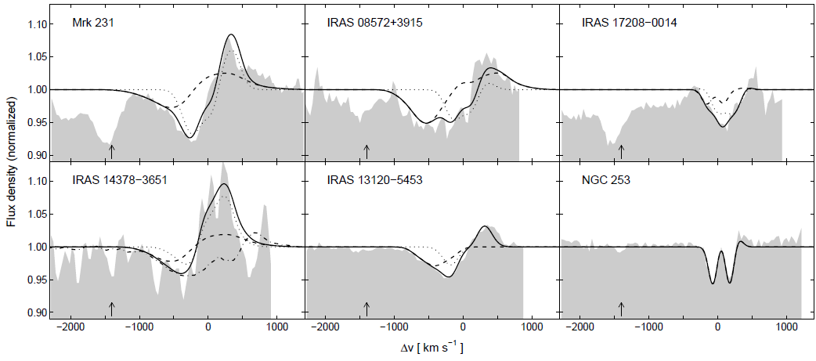
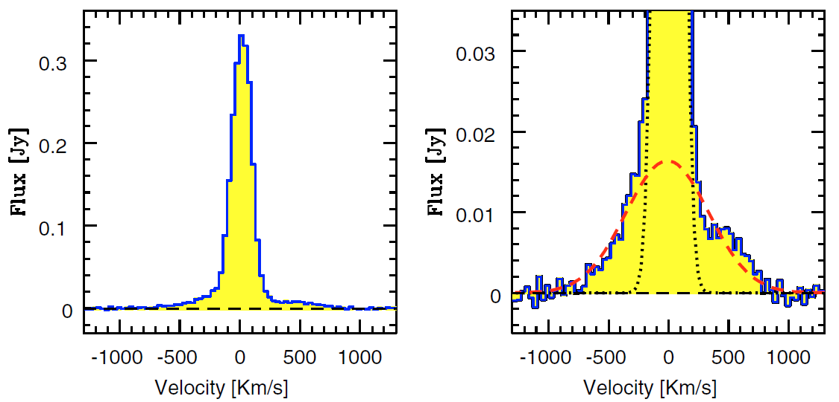
Herschel OH(79μm) Observations
Sturm+’11
Mrk231 CO interferometry (Feruglio+’10)

Slide 26
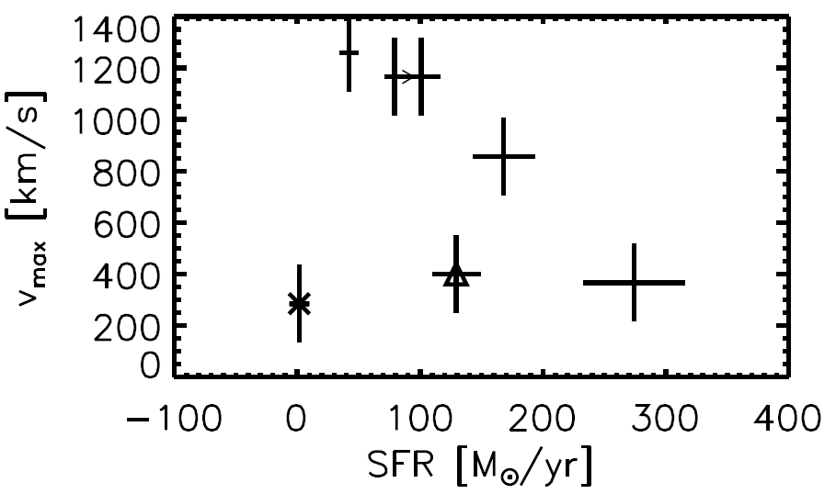
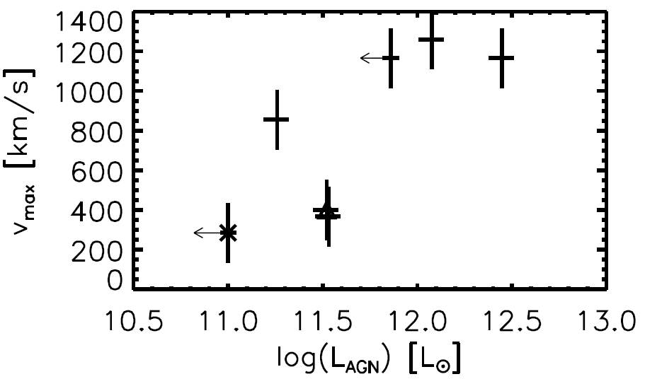
SB or AGN Wind?

Slide 27
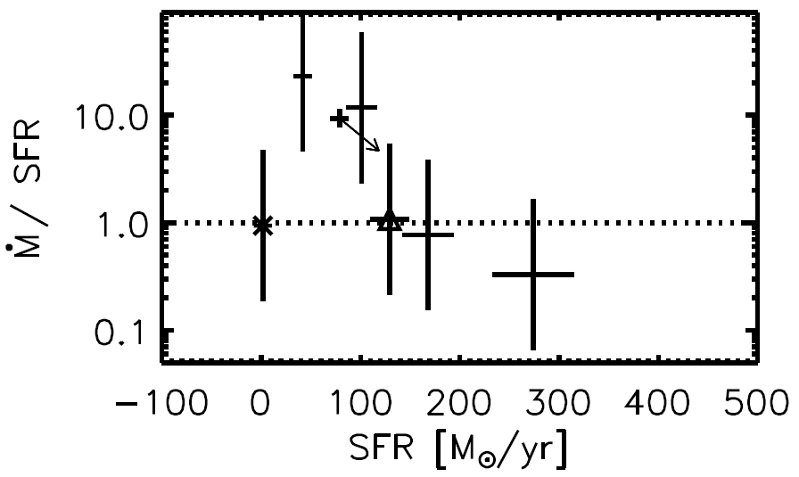
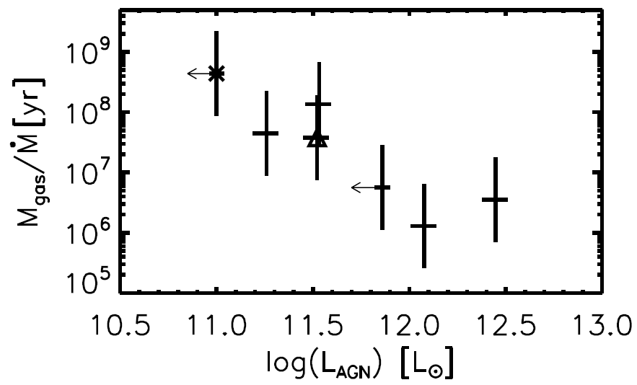
AGN Plausible Connection
←AGN-dominated
Powerful Outflows
← SF-dominated
Clear-Up Timescales
High outflow rates are short lived, AGN dominated

Slide 28
BLR/TOR Energy Outflow Rate
Negligible in the AGN energy budget

Slide 29
Outflow Origin?
Source | f_{AGN} (%) | L_{AGN} (10¹¹L_{o}) | Mdot (M_{o}/yr) | L_{AGN}/ηc² (M_{o}/yr)
Mrk231 | 71 | 28 | 1190 | 1.96
IRAS08572+3915 | 72 | 12 | 970 | 0.84
IRAS13120-5453 | 9 | 1.8 | 130 | 0.13
IRAS14378-3651 | <45 | <7.2 | 740 | <0.50
IRAS17208-0014 | 11 | 3.4 | 90 | 0.24
NGC253 | 0 | 0 | 1.6 | 0.00
L(outflow) ~ 1%L_{AGN}, but…
Mass outflow rate incompatible with BH accretion

Slide 30
Challenges
BLR/TOR outflow
  Launch mechanism
  Detailed structure
  Reverberation mapping
LLAGNs
  BLR & TOR disappearance
  Sy1.x — 2-component BLR?
  Jet dominance
  AGN—XRB analogy
AGN-Galaxy connection
  Outflow mechanism?

