Slide 1
Jet Launching and Observation in AGN
Roger Blandford,
KIPAC
Stanford

Slide 2
Phenomenology

Slide 3
Some Issues
Anatomical
  Multi-frequency jet structure
  Kinematics
  Composition
Physiological
  Emission mechanisms
  Pressures and powers
  Confinement
Sociological
  Counts, LF, multivariate properties
  Backgrounds

Slide 4
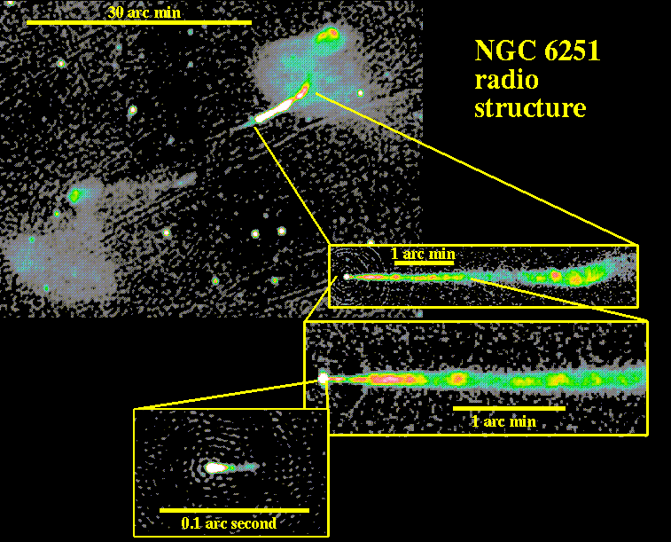
The Bigger Picture
Prime Mover?
  Stars, superstars, supernovae, pulsars… holes
Black Hole Engineering?
  Energy flow: disks or holes to jets
  Mechanism: (Electro)magnetic vs gas, Accretion vs spin?
Galaxy Formation, Evolution/Feedback
  Major vs Minor mergers
  Gas vs Stars
  AGN vs Starbursts
  Jets vs Winds
Environmental impact
  (Re-)ionization
  Cluster evolution…
Scale?

Slide 5
Ten Challenges
Locate the sites of radio, γ emission
Map jet velocity fields and causality
Verify the emission mechanism
Understand the changing composition
Measure external pressure
Deduce jet confinement mechanism
Infer jet powers, thrusts
Test Central Dogma
BHGRMHD capability
Quantify role in clusters

Slide 6
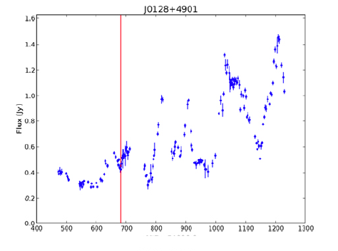
Observation and Simulation
FGST, ACT…OP…Radio, ν all working well
N~1000 sources sampled hourly-weekly
Large data volumes justify serious statistical analyses of multi-λ data
  Irregular sampling, selection effects
  Work in progress
Account for Extreme Jets
  Most variable, fast, bright, polarized…
Modeling must match this increase in sophistication
Simulations are now becoming available
  Understand kinematics, QED, fluid dynamics
  Ignorant about particle acceleration, transport, radiation, field evolution
Simulation
Analysis
Physical
assumptions
Statistics
Observations

Slide 7
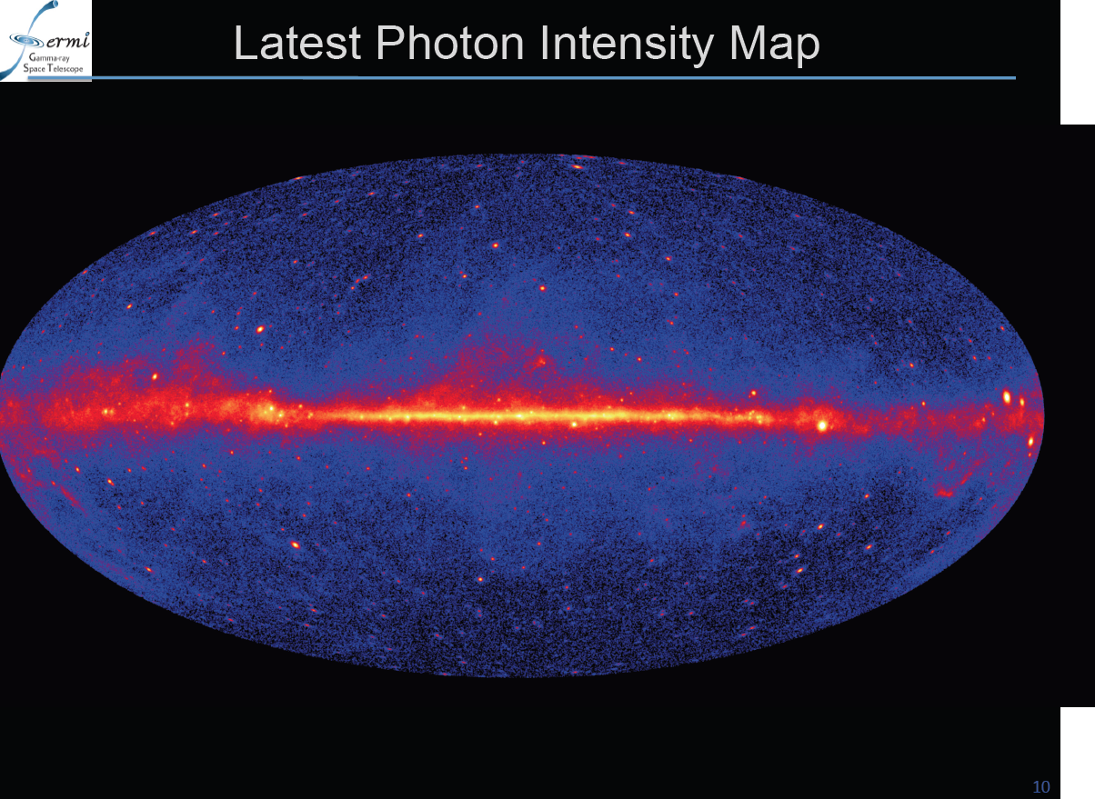
832AGN+268Candidates+594Unidentified!

Slide 8
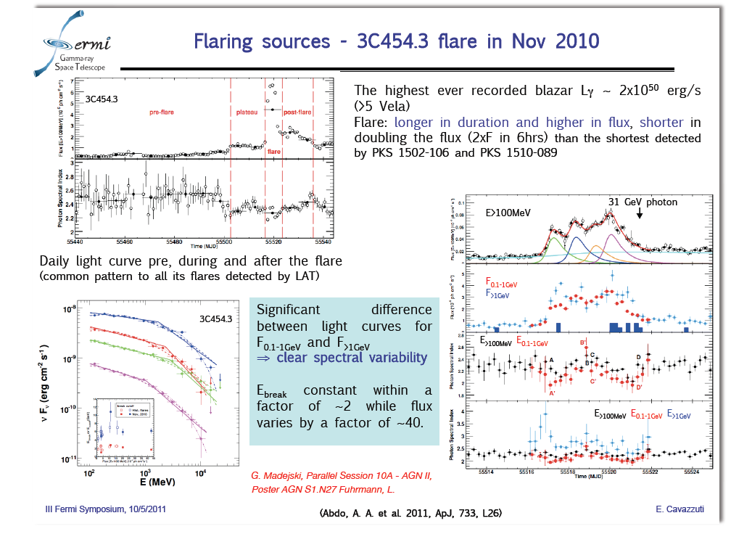
Optical lags by 1d??

Slide 9
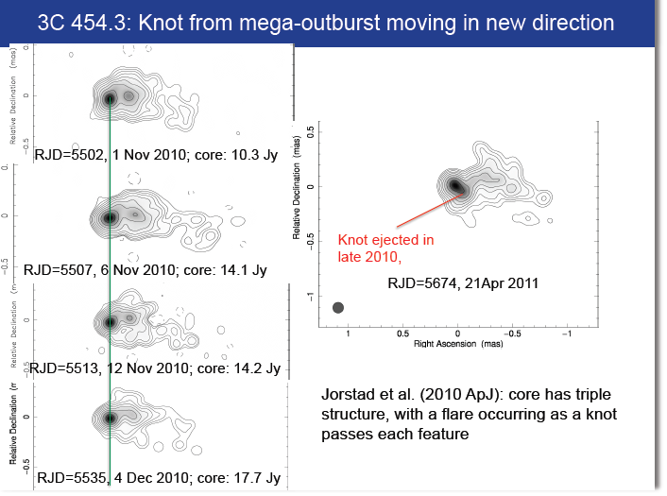
Marscher et al
V_{app}=10c

Slide 10
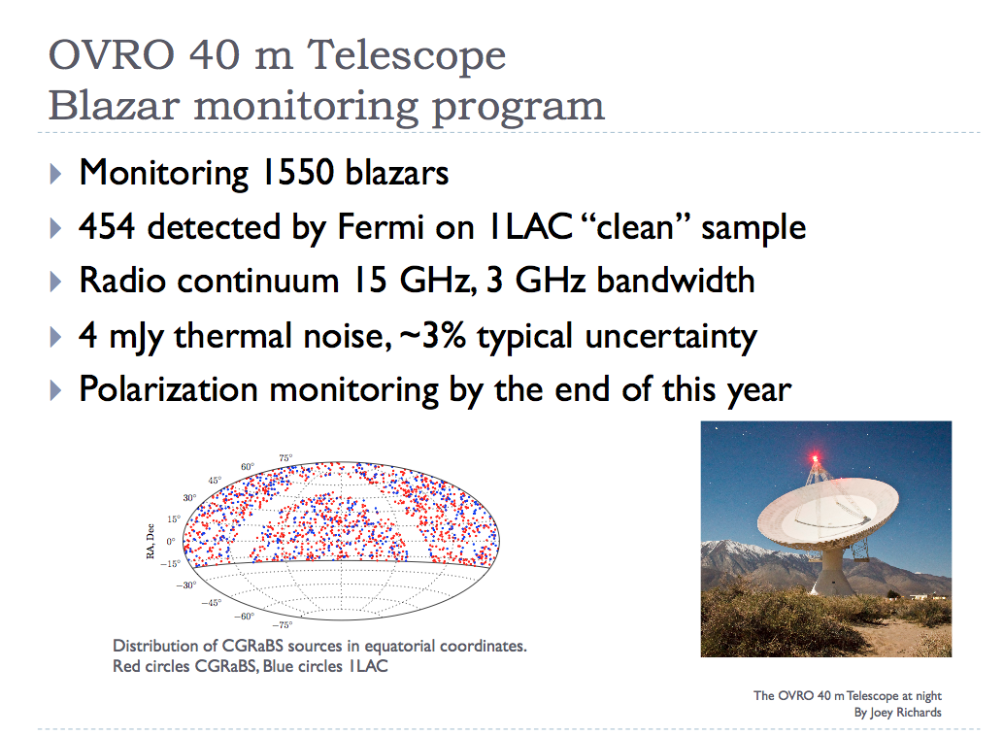
Max-Moerbeck et al
γ-ray loud vary more
4/52 show 3σ correlation
Stay Tuned!
γ-rays from within the radio photosphere?

Slide 11
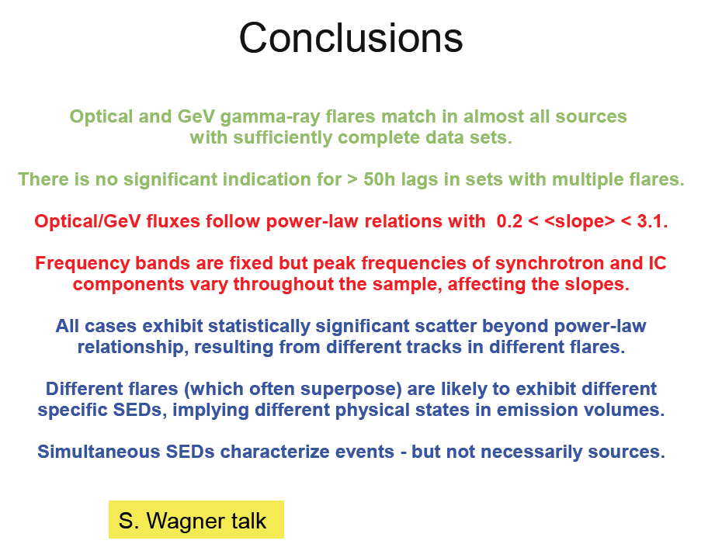

Slide 12
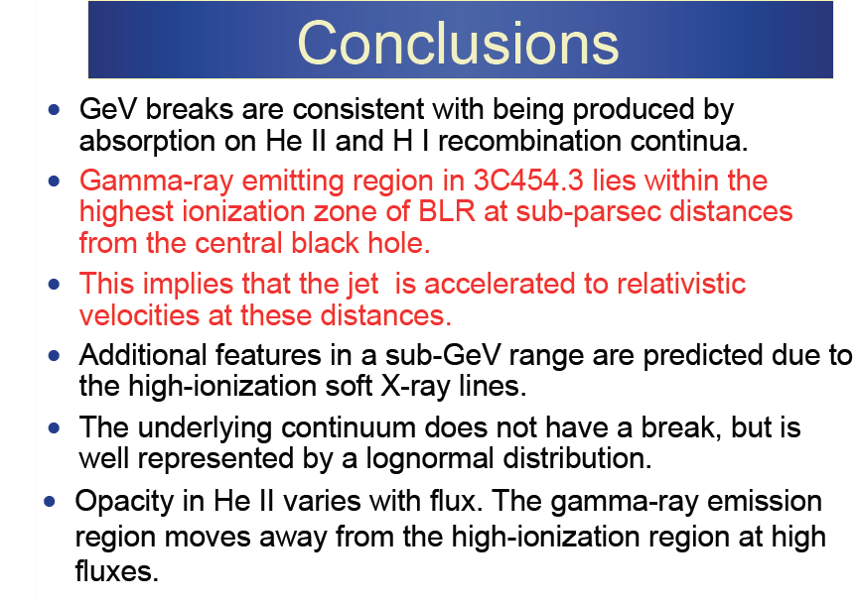
Stern & Poutanen

Slide 13
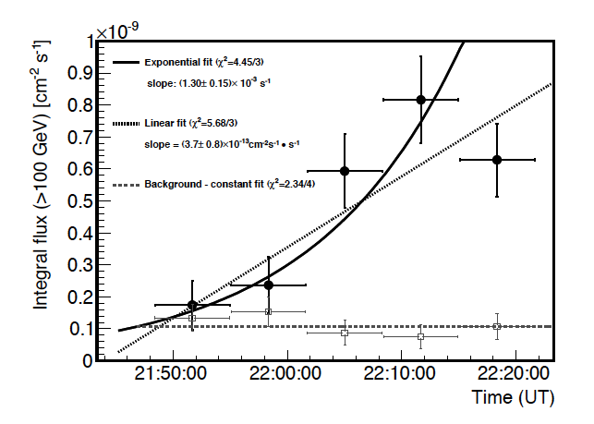
Rapid MAGIC & H.E.S.S variation
PKS 1222+21
  10 min
MKN 501
  2min?
PKS 2155-304
  3min
PKS 1222+21 (Aleksik et al)
How typical?
How fast is GeV variation?

Slide 14
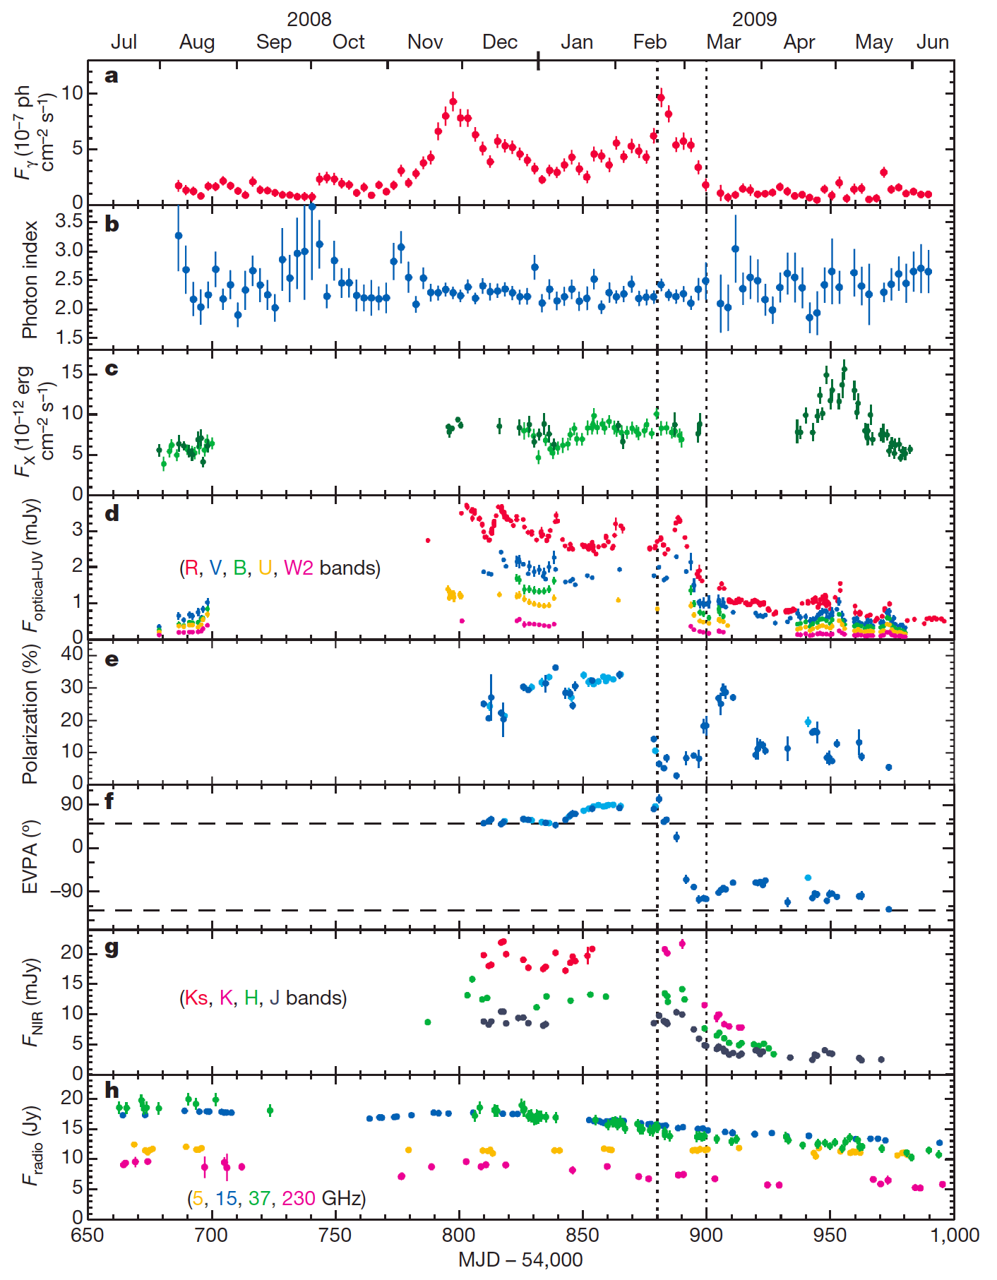
3C 279: multi-λ observation of γ-ray flare
~30percent optical polarization => well-ordered magnetic field
τ~ 20d γ-ray variation
=> r~γ²cτ ~ pc or τ_{disk}?
Correlated optical variation? => common emission site
X-ray, radio uncorrelated => different sites
Rapid polarization swings ~200º => rotating magnetic field in dominant part of source
r ~ 100 or 10⁵ m?
Abdo, et al Nature, 463, 919 (2010)

Slide 15
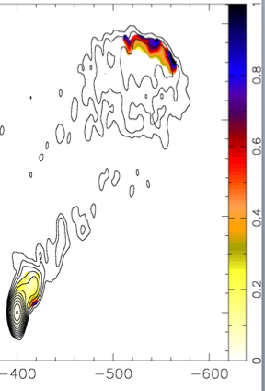
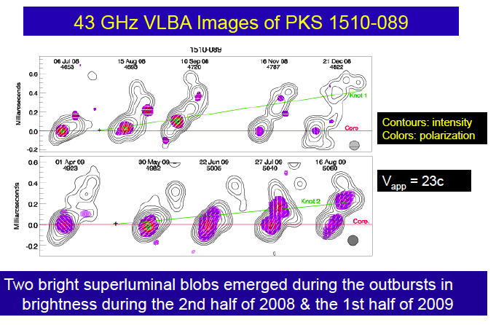
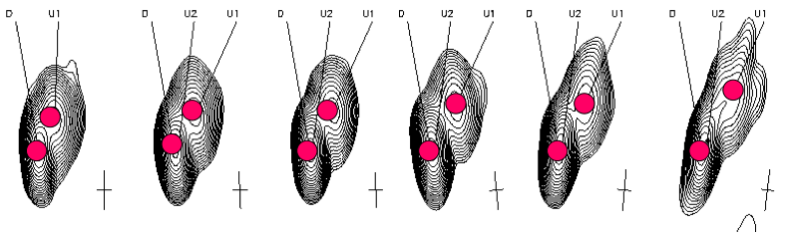
PKS1510+089
(Wardle, Homan et al)
β_{app}=45
Rapid swings of jet,
radio position angle
High polarization
~720º (Marscher)
Channel vs Source
TeV variation
(Wagner / HESS)
EBL limit
r_{min} ; r_{TeV}>r_{GeV}
(B+Levinson)
z=0.36

Slide 16
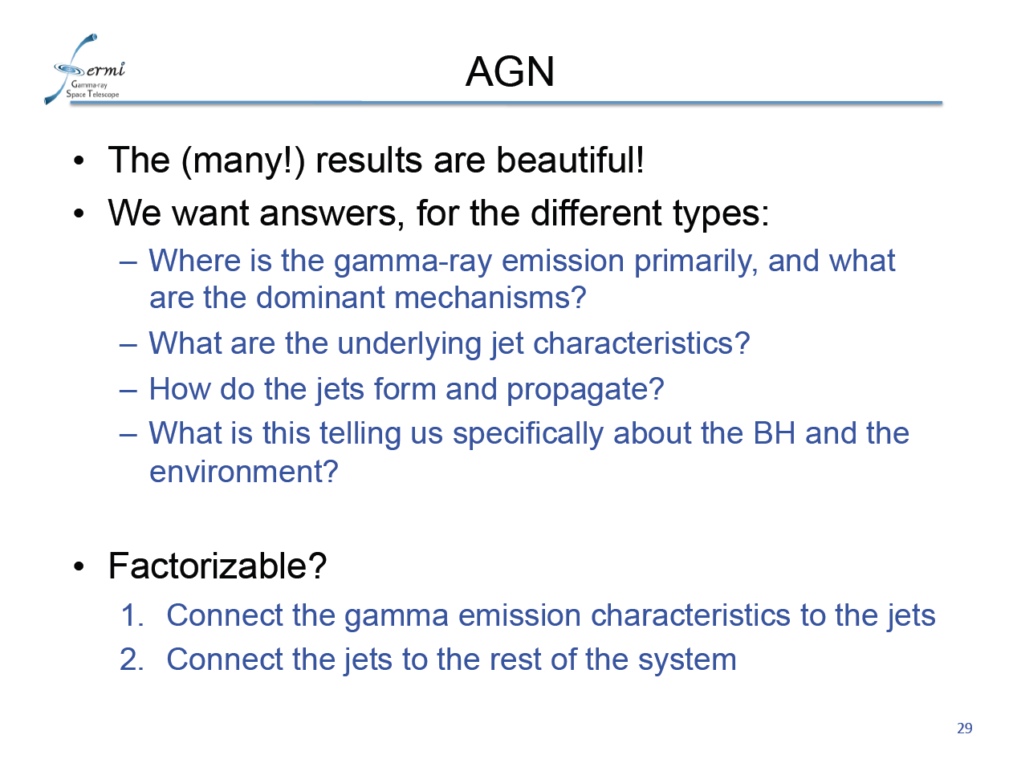
S. Ritz Rome

Slide 17
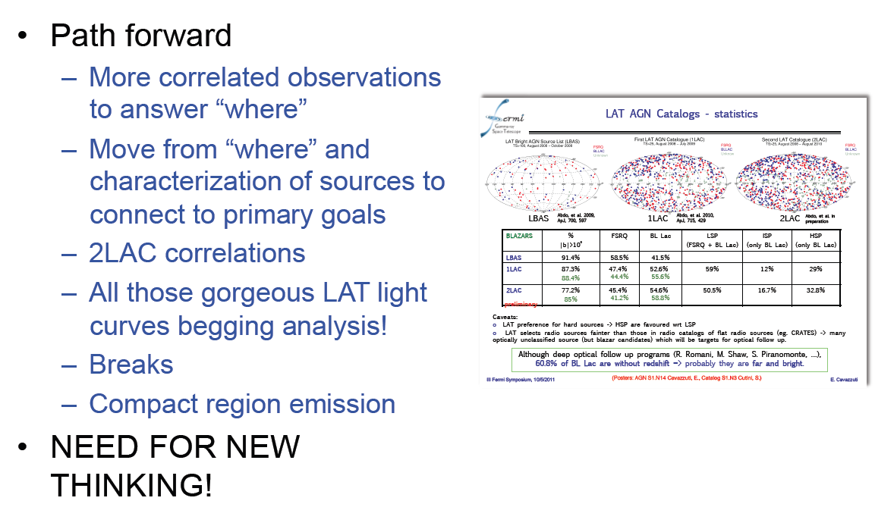
S Ritz

Slide 18
Tentative Inferences??
r_{γsphere} < r_{γ} < Γ²ct_{var} < r_{radio}
  r_{γsphere} determined by high ionization BLR in luminous objects?
    May not have r-E mapping
Outflows important
  Elitzur, Proga talks
  It’s complicated – thermal, radiation, magnetic…
Organized magnetic field is important
  Dynamically important
  Quadrupolar vs dipolar symmetry
    Faraday rotation, YSO

Slide 19
Theory and Simulation

Slide 20
Flow Descriptions
Hydrodynamics
  Inertia, isotropic P, strong shocks,
  Efficient impulsive acceleration
Force Free
  No inertia, anisotropic P, no shocks
  Electrostatic and stochastic acceleration
Relativistic MHD
  Mixture of both,
  Relativistic reconnection acceleration

Slide 21

Simulating Jets
T Abel et al
Hydrodynamical flows

Slide 22
Dipolar vs Quadrupolar
Odd field
Even current
Even field
Odd current
Ω
x
x
x
x
.
Lovelace, Camenzind, Koide, RB

Slide 23
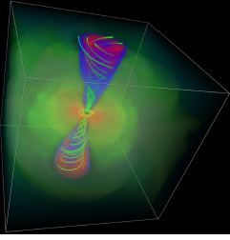
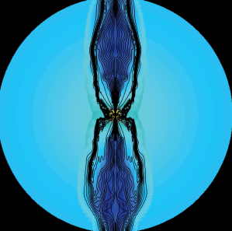
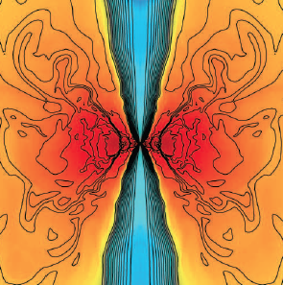
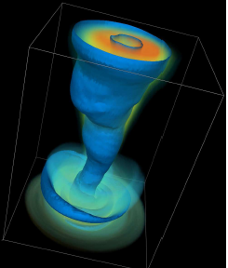
3D GR MHD simulations
HARM Code
  Rxθxφ=512x768x64 – a=0.93 -Kerr-Schild
  Convergence test, transmissive BCs
Dipolar jets
  H/r~0.2; MRI -> turbulence; L_{j}~0.01m’c²
  Jets stable to r ~ 1000m with Γ~(r/10m)^{1/2}
    10⁵m in planning
  m=1 helical instability driven
Quadrupolar jets
  Current cone, mass loading ->instability due to toroidal current cones
  Thin disk??
McKinney % RB,cf also Nakamura & Meier, Komissarov et al, Tchekovsky
et al, Hawley et al, McKinney &Narayan, Hardee……

Slide 24
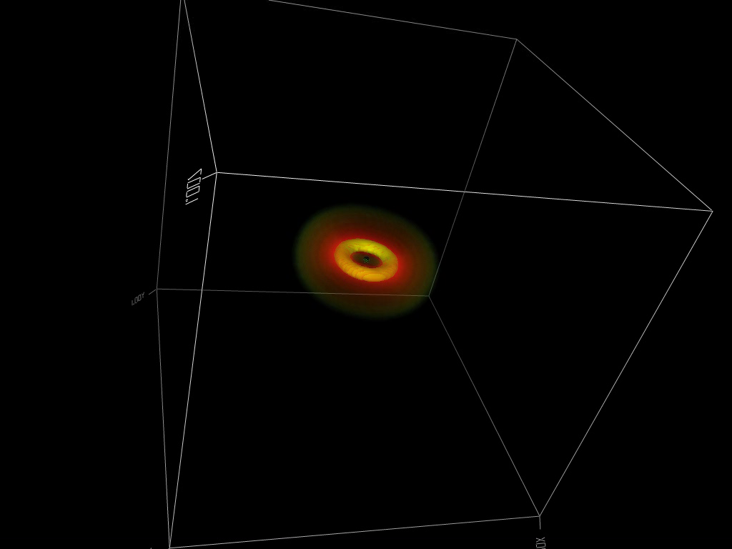

Slide 25
General Inferences
FRII/FSRQ?
  a>0.9
    Hole powered
  Long range order in field
    Groups not clusters, few mergers
  Thick disk?
    Large mass relative to mass supply rate
  Low gas density
    Ellipticals not spirals
What happens to radial/horizontal field?
Is polarity maintained along jet?

Slide 26
General Inferences II
FRI/BL Lac
  a<0.9
    Disk powered
  Short range order in field
    Many mergers, spin according to FP equation with deceleration (Hughes & B)
  Thick disk
  Low gas density

Slide 27
“Observing” Simulated Jets
Synchrotron Radiation
t_{o}
t
We know P’, B’, N’, V on grid
Work in jet frame
Rotate spatial grid so that observer along z direction
Shear in t – z space introducing t_{o}=t-z
z
z’
z
Make emission model
  eg j’ ~ P’ B’^{3/2}ν’^{−1/2}; κ’∼ P’B’²ν’⁻³
Polarization – perpendicular to projected field in cm frame
Vß

Slide 28
“Observing” Simulated Jets
Inverse Compton Radiation
Work in jet frame
Compute incident radiation along all rays from earlier observer times
Compute j_{νΩ} directly
r
z
Observer
θ
s
[r-s,t_{o}-s(1-cosθ)]

Slide 29
“Observing” Simulated Jets
Pair Opacity
External and internal radiation
Internal radiation varies

Slide 30
Quivering Jets
Observe γ-rays (and optical in 3C279)
Gammasphere τ_{γγ}~1, 100-1000m ~ Eγ
Rapid variation associated with convected flow of features (2min in Mkn 501)
Slow variation associated with change of jet direction on time scale determined by dynamics of disk (precession?) or limited by inertia of surrounding medium or both as with m=1 wave mode.

Slide 31
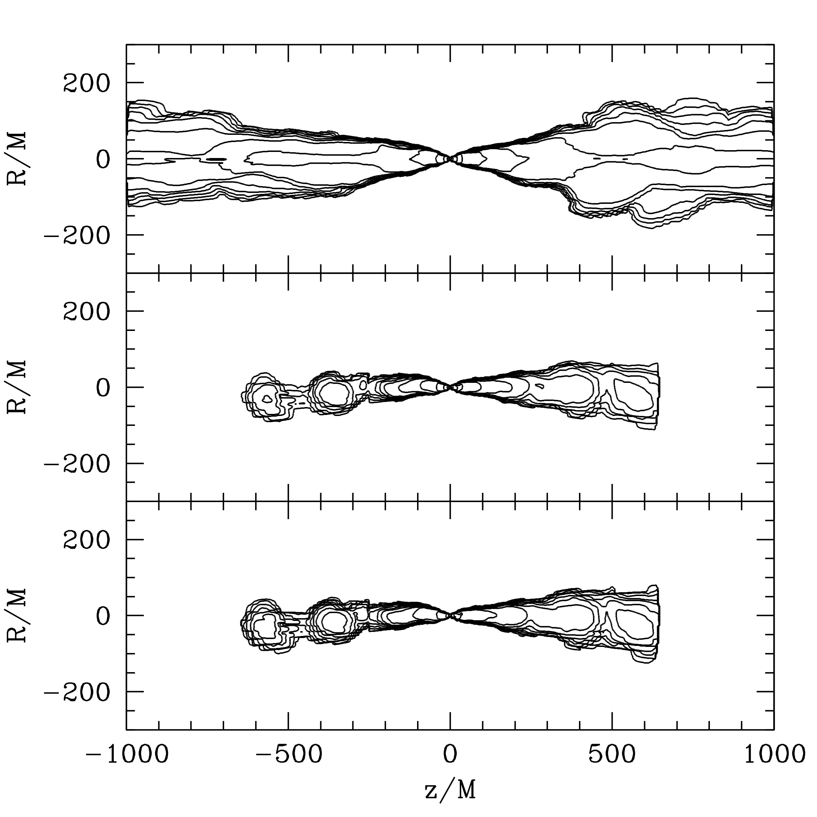
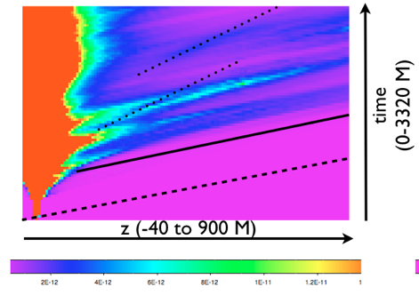
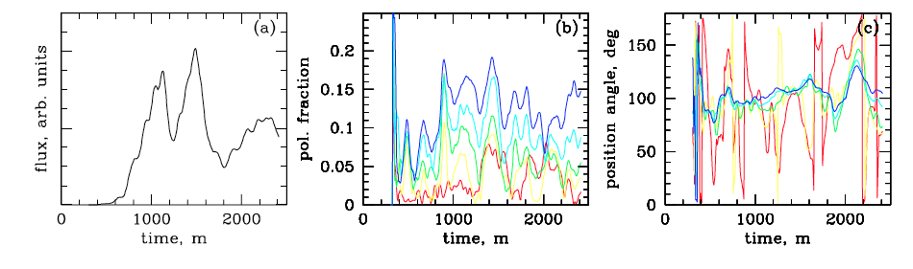
Optical emission from jet with γ ~ 3-4
Disk
Light
Zakamska, RB & McKinney in prep

Slide 32
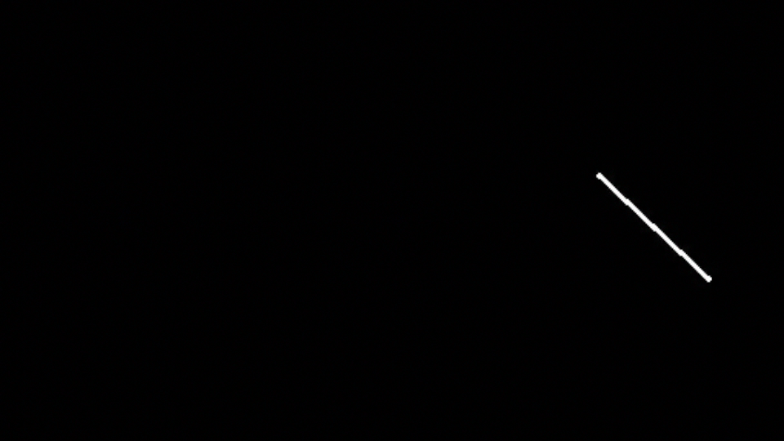
Rest frame emissivity ~ P B^{3/2}

Slide 33

Rest Frame Emissivity ~ B^{7/2}

Slide 34
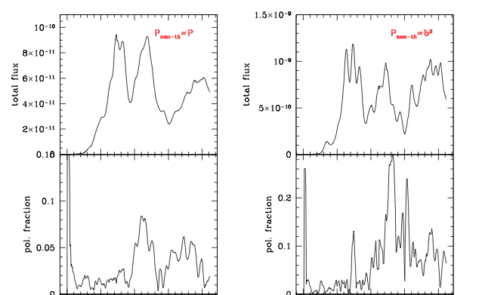
Total Flux and Degree of Polarization

Slide 35
Dynamical elements
Bulk flow
Shocks
Shear flow
Plasmoids, flares, minijets,magnetic rockets…
  Lorentz boosting
Precession
  Disk
  m=1 instability
Turbulence
Each of these elements changes the field and the particles

Slide 36
Pair vs Ion Plasmas
Pairs must be heavily magnetized to avoid radiative drag
Circular polarization, Faraday rotation/pulsation
Expect? pairs, field todecrease, ions to increase along jet

Slide 37
Particle acceleration in high σ environments
Internal shocks are ineffectual
Reconnection can be efficient
  E>B??
Shear flow in jets
  Full potential difference available particles accelerated when undergo polarization drift along E
  UHECR (eg Ostrowski & Stawarz, 2002)
Fast/intermediate wave spectrum
  Nonlinear wave acceleration(Blandford 1973…)
    Mutual evolution of wave cascade and particle distribution function
  Charge starvation (eg Thompson & Blaes 1997)
Force-free allows E>B - catastrophic breakdown

Slide 38
Unipolar Induction
B
Rules of thumb:
  Φ ∼ B R² ; V ~ Ω Φ;
  I~ V / Z₀; P ~ V I
PWN AGN GRB
B 100 MT 1 T 1 TT
Ω/2 10 Hz 10 μHz 1 kHz
R 10 km 10 Tm 10 km
V 3 PV 300 EV 30 ZV
I 300 TA 3 EA 300 EA
P 100 XW 1 TXW 10 PXW
Ω
M
UHECR!

Slide 39
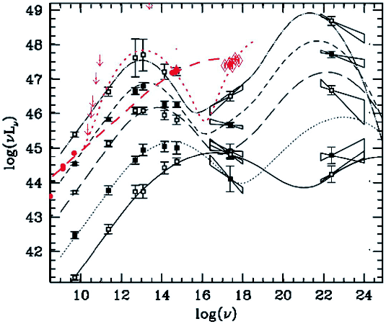
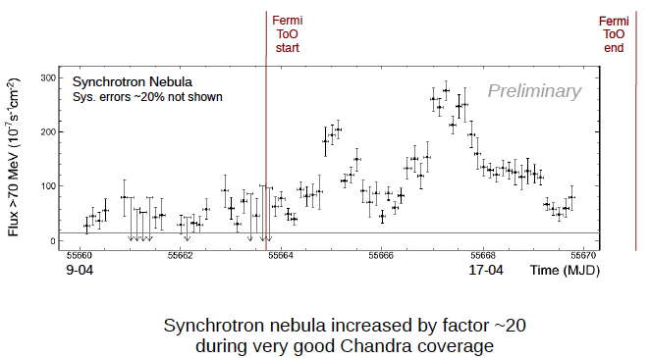
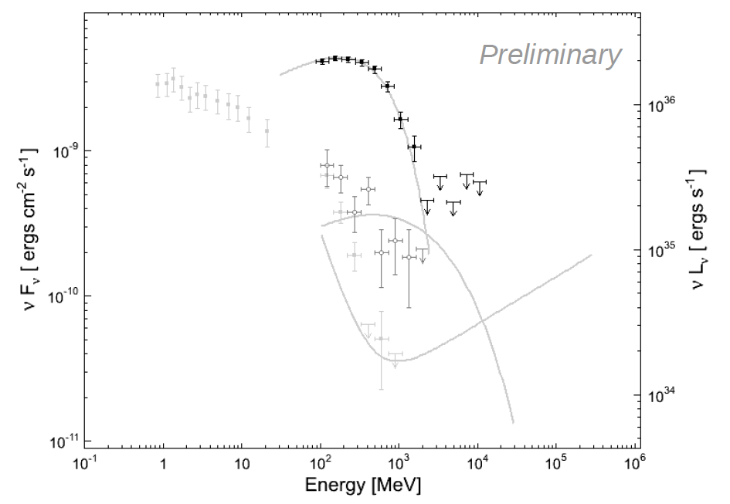
Particle Acceleration
S-C⁻¹ transition quite high in BLLacs
“Theoretically” E_{γ}<α⁻¹ m_{e}c²~60MeV
cf Crab Nebula, UHECR
Large scale electric fields
Lossy coax??
Follow particle orbits.
Which particles carry the current
Is the momentum elctromagnetic?

Slide 40
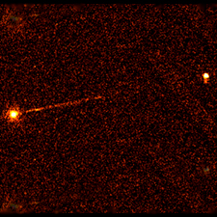
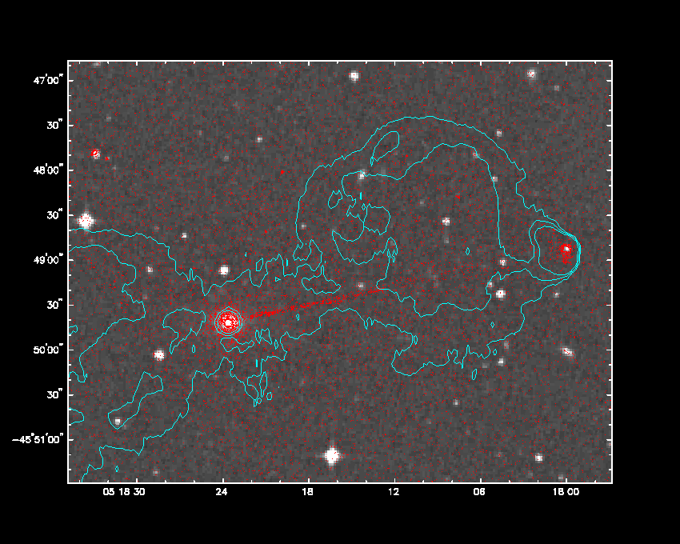
Pictor A
Wilson et al
Electromagnetic Transport
10¹⁸ not 10¹⁷ A
DC not AC
No internal shocks
New particle acceleration mechanisms
Current Flow
Nonthermal emission
is ohmic dissipation
of current flow?
Pinch stabilized by
velocity gradient
Equipartition in core

Slide 41
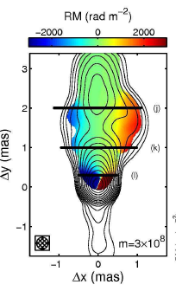
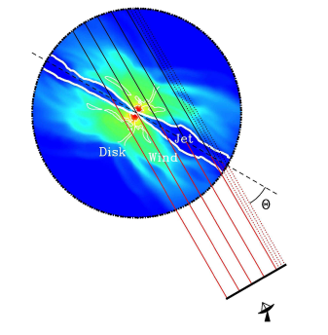
Faraday Rotation
Simulation
Signature of toroidal field/axial current
Rotation from sheath
Observations ???
Broderick & McKinney

Slide 42

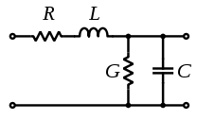
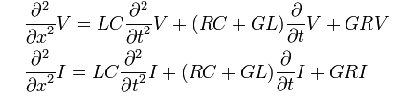
Telegraphers’ Equations

Slide 43
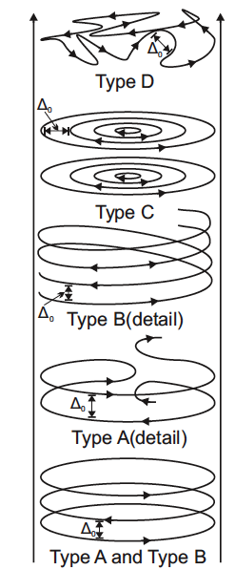
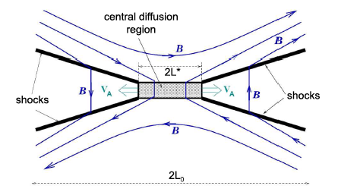
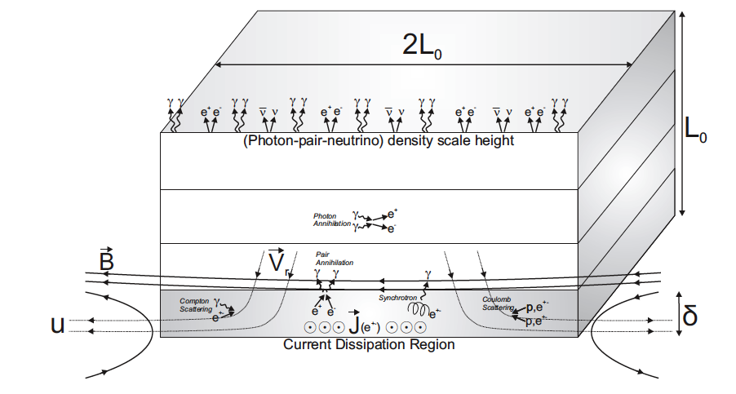
Relativistic Reconnection
High σ flow
Hall effects may save
Petschek mechanism
Anomalous resistivity?
Also for AGN
Petschek
GRBs
McKinney & Uzdensky

Slide 44
Inhomogeneous Sources
Radio synchrotron photosphere, r ~ λ
  Doppler boosting
Compton gammasphere, r ~ E?
  Internal, external radiation
  Test with variability, correlation
Electron acceleration
  >100 TeV electrons
S
C⁻¹
S
ν
E

Slide 45
Intermediate Mass Supply
Thin, cold, steady, slow, radiative disk
Specific energy e = -Ωl/2
G
Energy radiated is 3 x the local energy loss

Slide 46
Low, High Mass Supply
M’<<M’_{E}, tenuous flow cannot heat electrons and cannot cool
M’>>M’_{E}, dense flow traps photons and cannot cool
Thick, hot, steady, slow, adiabatic disk
Bernoulli function: b =e+h
G
Energy transported by torque unbinds gas => outflow
ADiabatic Inflow-Outflow Solution

Slide 47
Summary
Location, mechanism, collimation, origin…?
FGST+TeV+multi-λ observations of blazars
High rotating polarization suggesting magnetic collimation and moving emission
Numerical simulations are becoming instructive about phenomenology as well as pure theory
Major monitoring campaigns are underway
Numerical simulations need to be analyzed in a corresponding fashion

