Slide 1
Interaction between cosmic rays and background plasmas on multiple scales Tony Bell University of Oxford Rutherford Appleton Laboratory

Slide 2
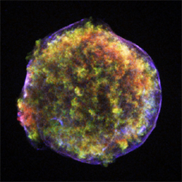
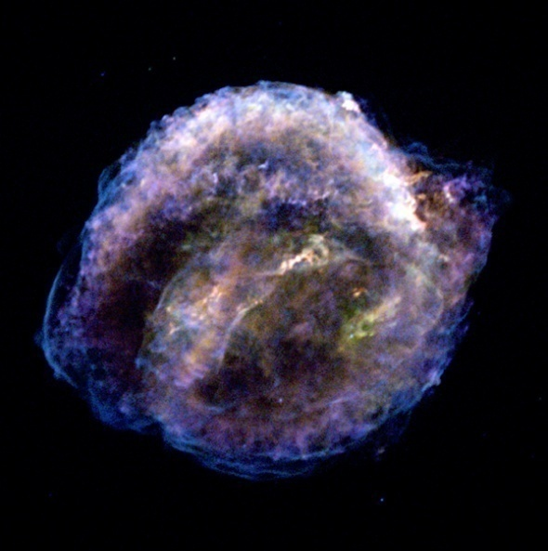
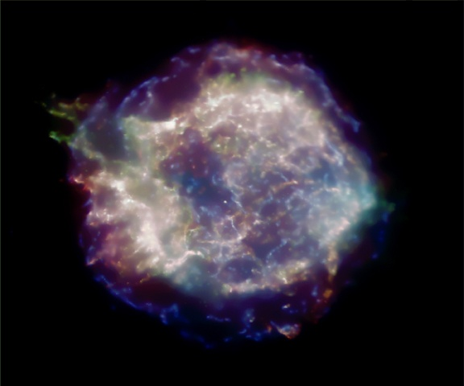
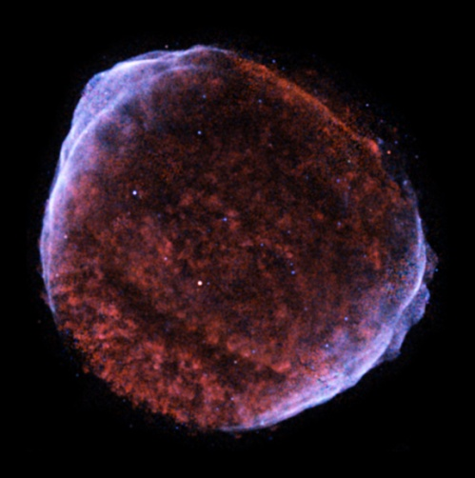
Instabilities driven by streaming energetic particles
Tycho 1572AD
Kepler 1604AD
Magnetic field due to
CR/MHD interaction
SN1006
Cas A 1680AD
Chandra observations

Slide 3
Instability on Larmor scale
thermal Larmor radius < scalelength < CR Larmor radius

Slide 4
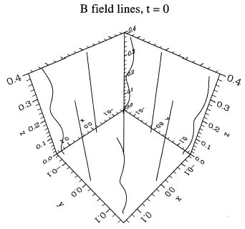
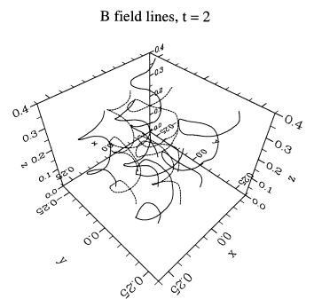
Streaming instability driven by cosmic rays
Lucek & Bell 2000
CR
Cavity forms inside spirals
δB/B>>1 scatters energetic particles

Slide 5
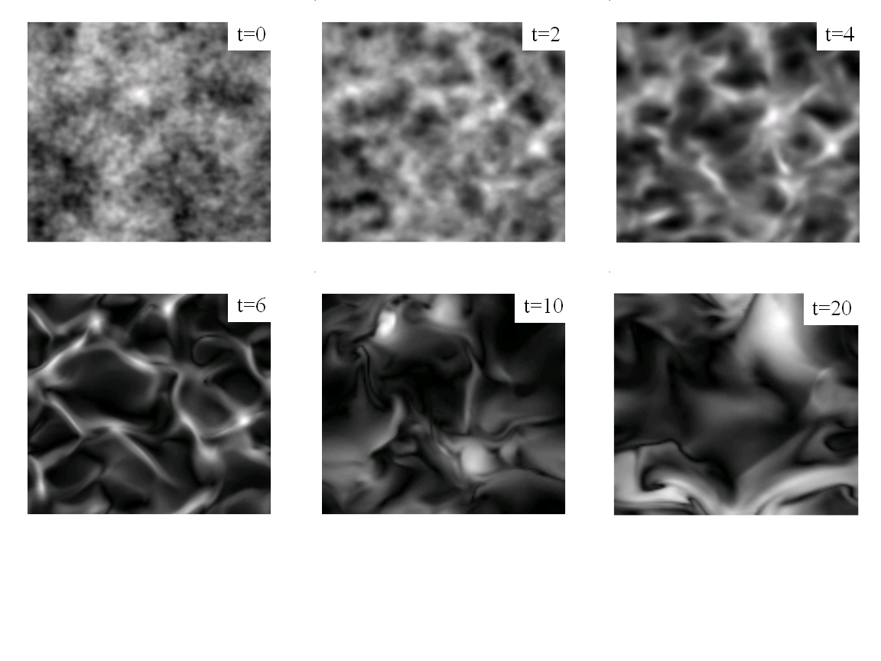
Essence of instability: expanding loops of B
B
j x B
j x B
|B|
CR current
jxB expands loops
decreases mass attached to field line element
increases jxB/ρ acceleration
Loops expand more rapidly
Positive feedback - instability
CR/MHD calculation

Slide 6
Estimate saturated magnetic field
Conditions for instability
1) loop radius R < CR Larmor radius
2) Mag tension < jxB
CR energy (eV)
Growth requires
CR efficiency
Saturation mag field
Consistent with obs. (Vink, Völk, et al)

Slide 7
Self-organisation on intermediate scale

Slide 8
Filamentation & self-focussing
B
imposed
proton beam j
velocity v_{beam}

Slide 9
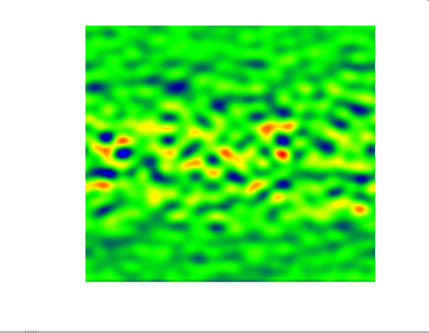
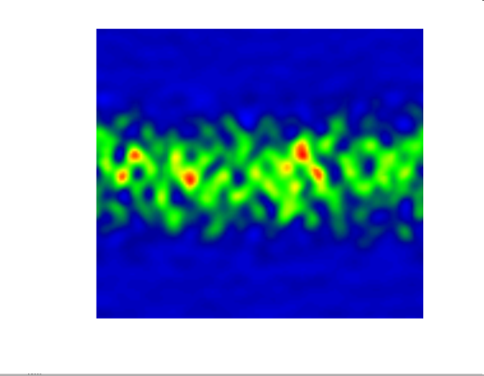
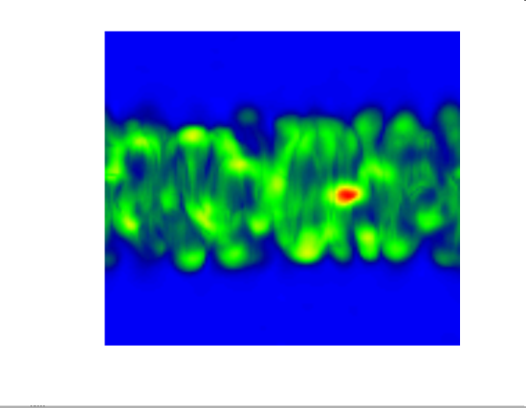
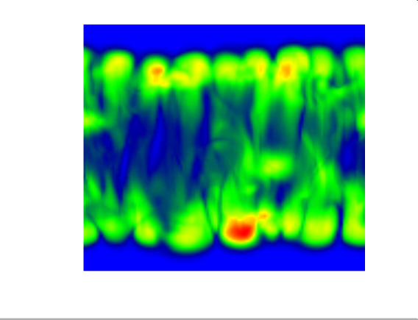
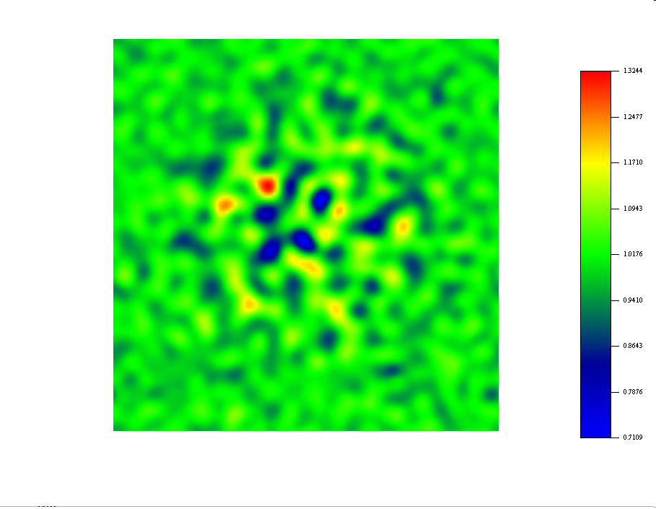
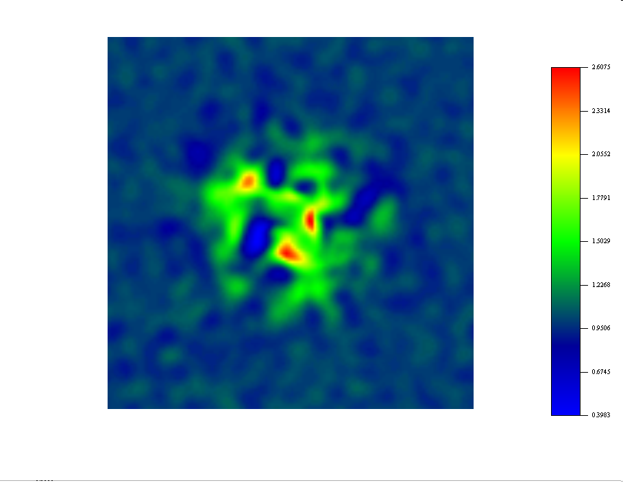
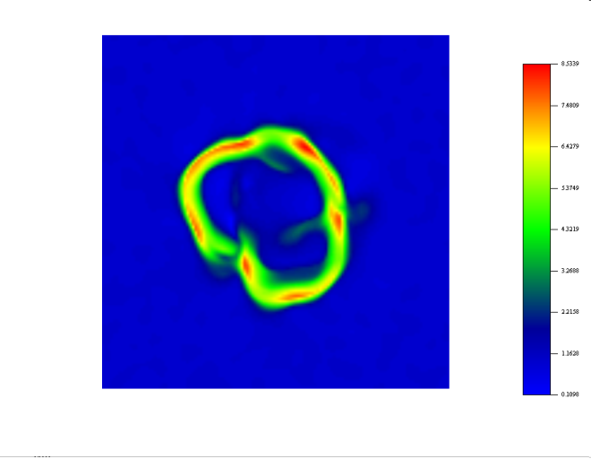
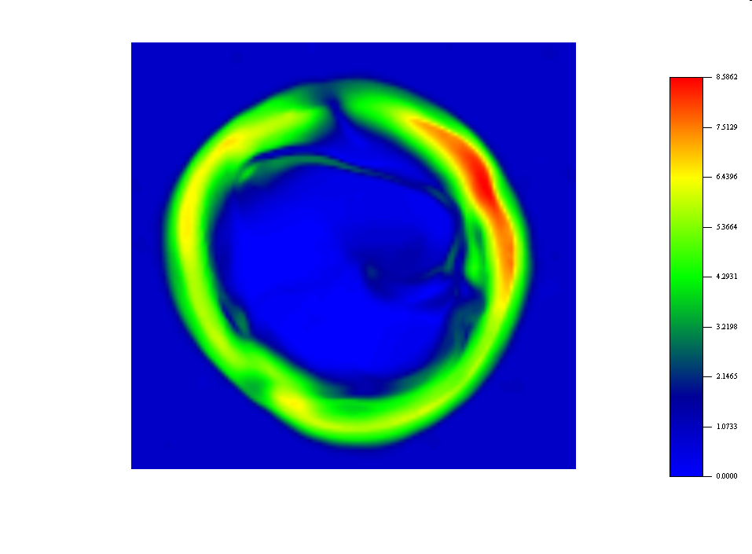
Time sequence: magnitude of |B| - across beam
Same results – sections through beam

Slide 10
Filamentation & self-focussing
B
E=0
R
proton beam j
velocity v_{beam}
E drives turbulence
slows beam
E=0
Maxwell equation
Energy conservation
Magnetic field growth
Always focuses CR onto axis

Slide 11
Saturation power carried by filament/beam
Apply saturation conditions
Beam radius = CR Larmor radius
Magnetic tension = jxB
Beam carries Alfven current
CR energy
Power in beam
=10¹⁵eV
1.7x10²⁸ W = 3x10⁻¹² M_{o}c²yr⁻¹
=10²¹eV
1.7x10⁴⁰ W = 3 M_{o}c²yr⁻¹

Slide 12
Structures on scale of shock radius
scalelength > CR Larmor radius
CR behaviour: diffusive rather than ballistic

Slide 13
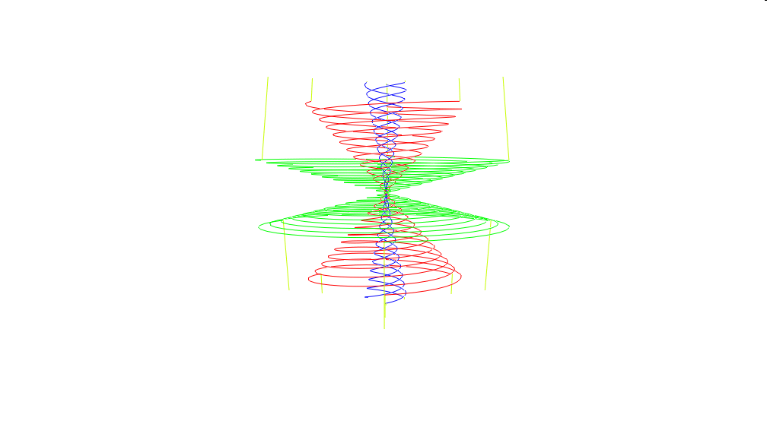
SN in dense wind with Parker spiral magnetic field

Slide 14
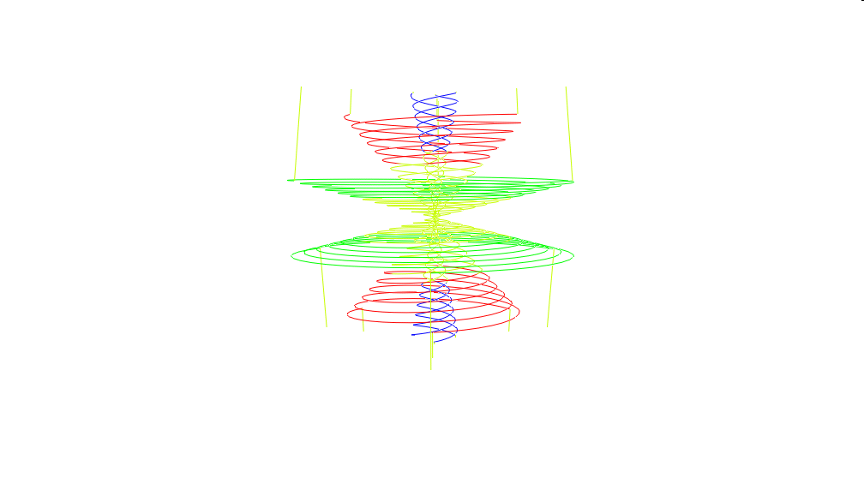
SN in dense wind with Parker spiral magnetic field
Perpendicular shock
CR drift at perpendicular shock
shock

Slide 15
CR distribution f₀ in a circumstellar wind
Self-similar solution in (r,θ)
latitude
Allows for density ~ r⁻²
Radius normalised to shock radius u_{s}t

Slide 16
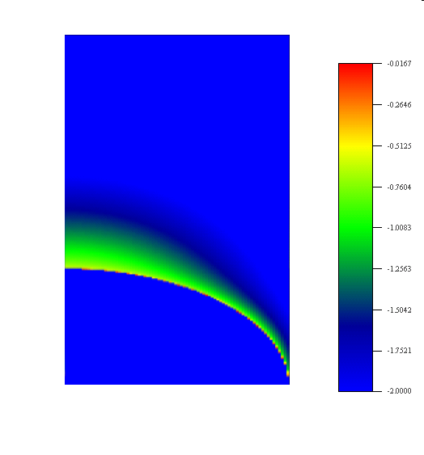
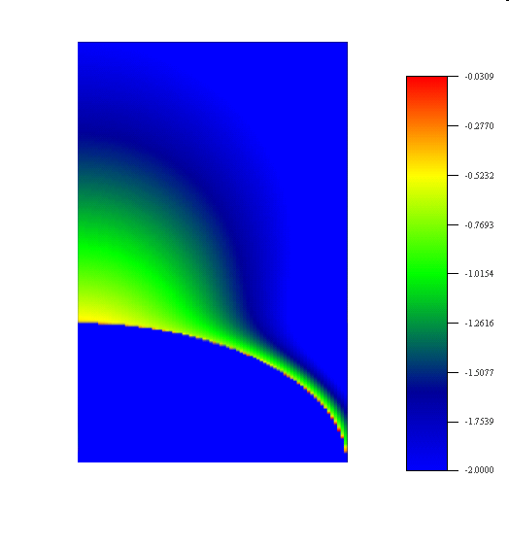
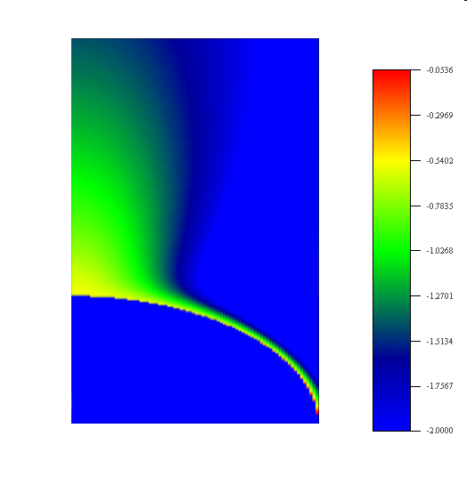
Self-similar solution for CR distribution
log CR pressure for different collisionalities h₀=(ωτ)_{max}
h₀=1
h₀=3
h₀=10
10⁰
shock
10⁻²
Spiral field deflects diffusive CR flux towards axis
Small B on axis allows escape

Slide 17
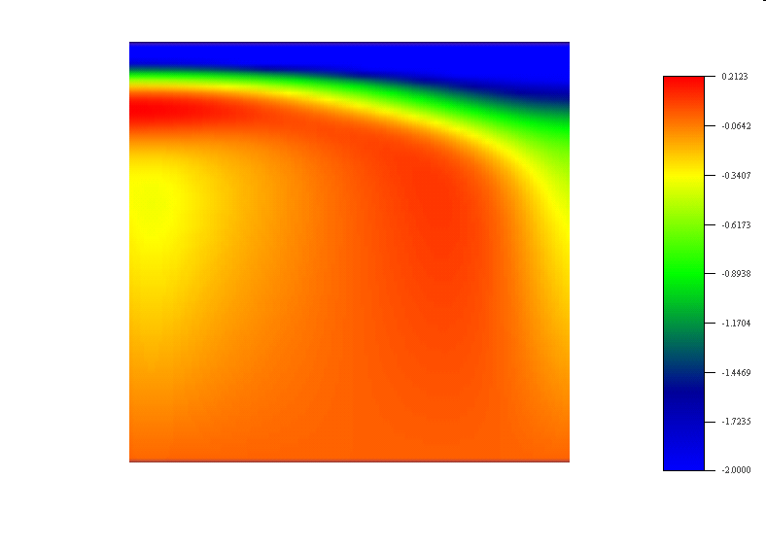
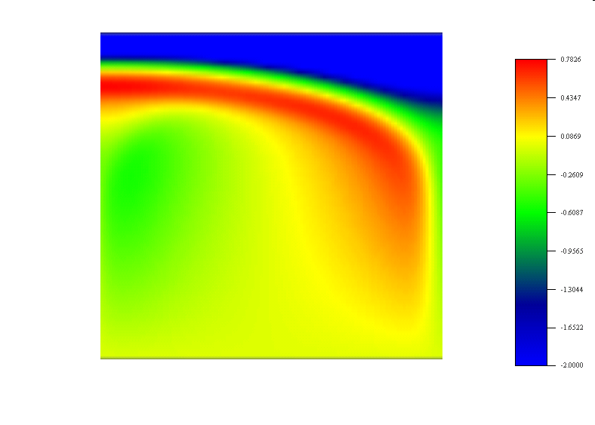
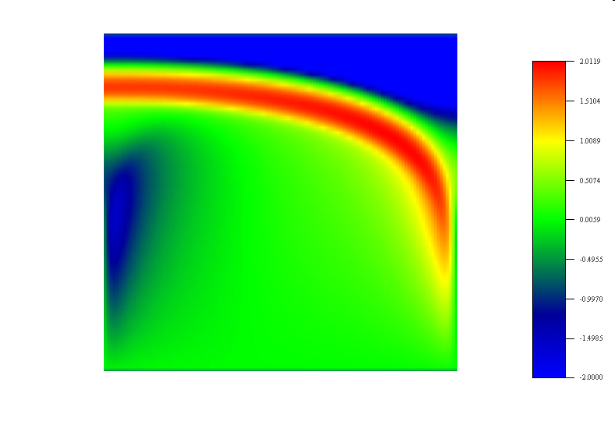
CR spectrum (p⁻⁴f) at the shock
for different collisionalities h₀=(ωτ)_{max}
Dominated by highest
energy CR at pole
10²
10¹
10^{0.2}
10^{0.8}
p
p_{max}
CR momentum
h₀=1
h₀=3
h₀=10
10⁻⁶
0
θ
π/2
0
θ
π/2
0
θ
π/2
10⁻²
10⁻²
10⁻²
latitude
pole
equator

Slide 18
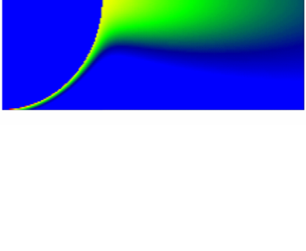
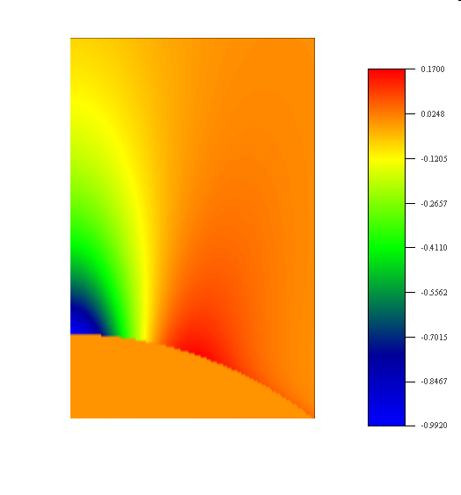
CR pressure in Parker spiral
Self-similar linear hydrodynamics
Density perturbation near pole
shock
Large CR pressure polar cavity in B ρ
CR escape along axis

Slide 19
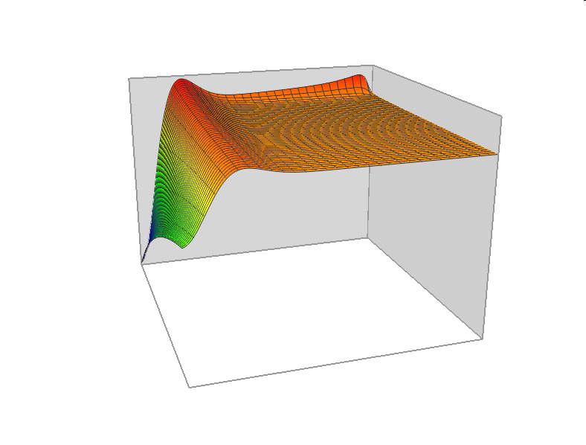
Density structure in front of shock, h₀=10
equator
non-linear density
increase at shock
Plasma pushed
away from axis
pole
shock
Cavity due to high
CR pressure on axis
Unperturbed upstream
plasma, ρ₁=0
r_{shock}
radius
1.3xr_{shock}
latitude
10-50% CR efficiency
full cavity on axis

Slide 20
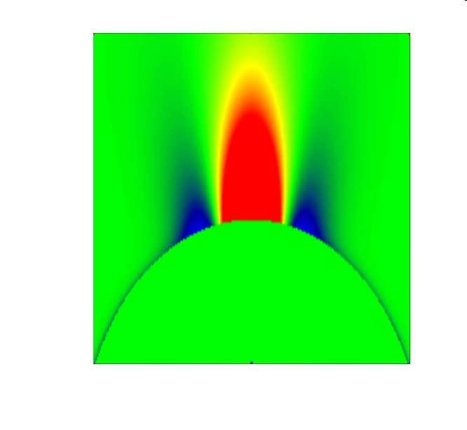
CR-driven relativistic expansion into low density
Shock
around
cavity
Magnetic
spiral
expansion
instability
CR flow into cavity
P_{CR}>ρu_{s}²
shock
CR acceleration/drift begins at shock breakout
Shock steepens – non-radiation-dominated
Coulomb collisions
Inverse Compton losses
Pair-production
Proton-proton losses
May produce non-thermal effects
anisotropy on SN shock breakout
eg x-ray flashes (XRF)

Slide 21
Summary
Similar effects on many scales
jxB focuses CR flux towards centre of spiral magnetic field
Reactive force: expands spiral
increases magnetic energy
creates cavity on axis

