Slide 1
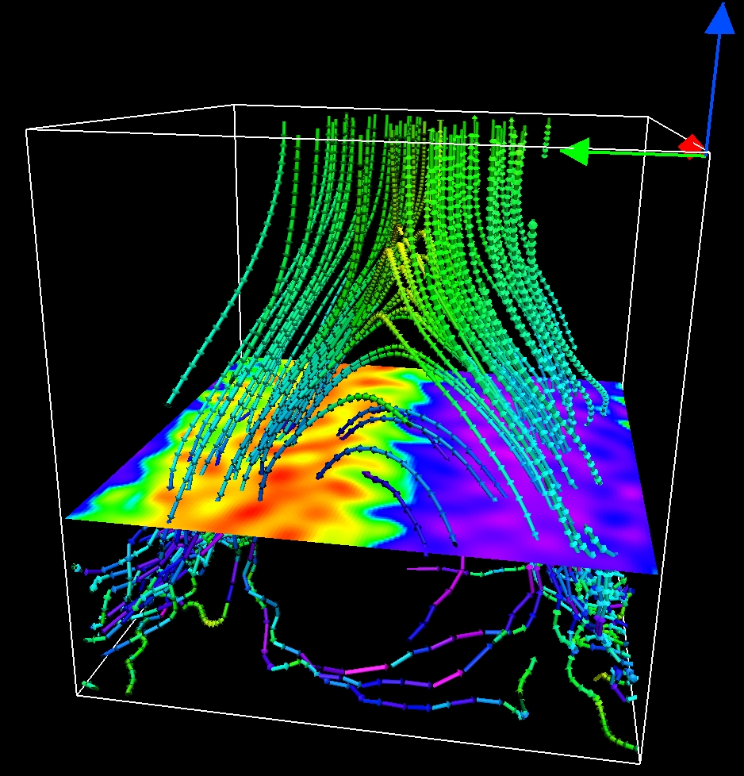
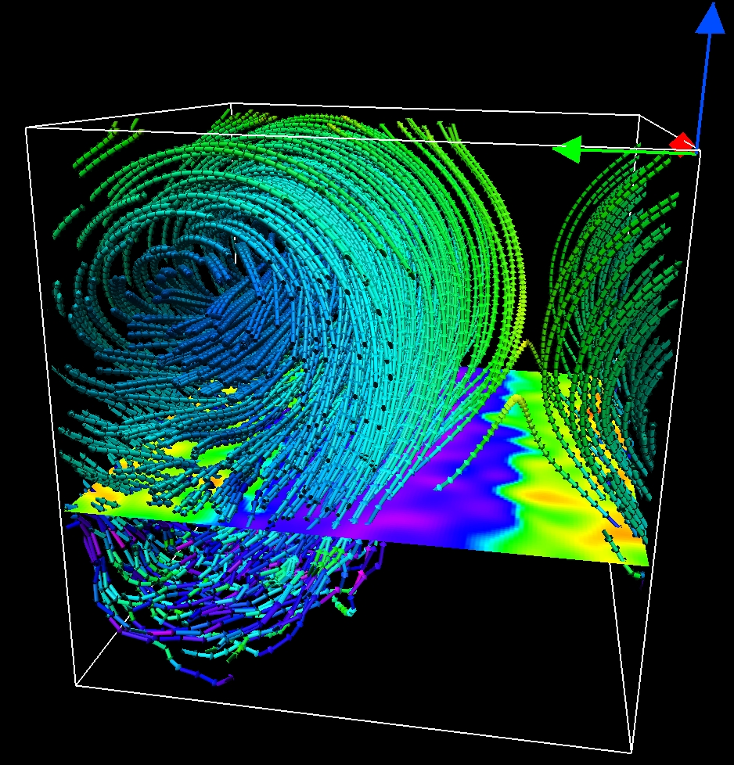
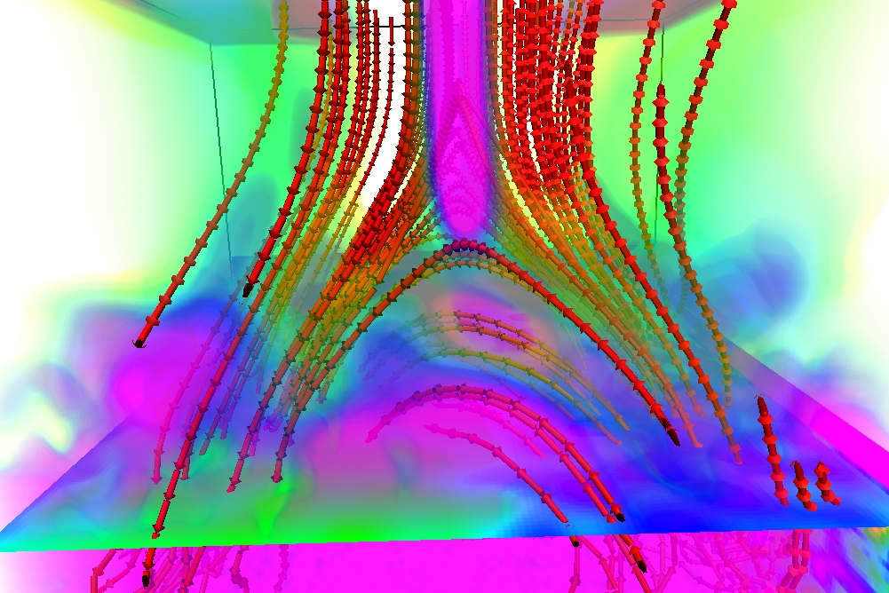
Surface appearance of dynamo generated large-scale fields
Jörn Warnecke^{1,2} and Axel Brandenburg^{1,2}
¹ Nordita, Stockholm, Sweden
² Department of Astronomy, Stockholm University, Sweden

Slide 2
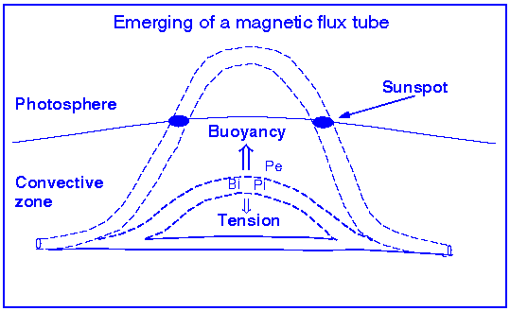
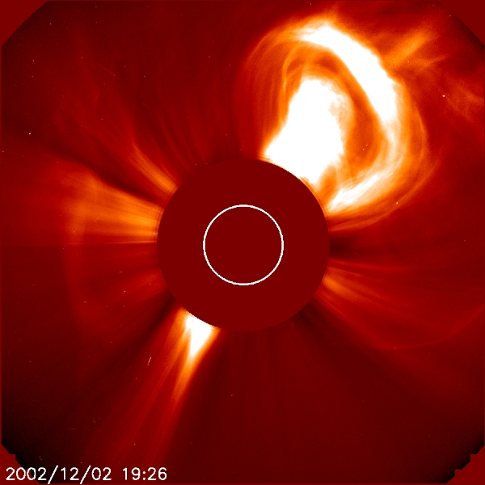
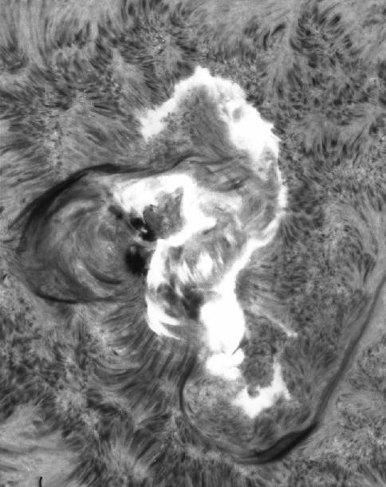
Flux Emergence, CME and Flares
2nd of december 2002
LASCO C2, SOHO
usually magnetic buoyancy
but suppressed by downward pumping
(Nordlund et al 1992, Tobias et al 1998)
Turbulence can prevent flux tubes rising
(Käpylä et al. 2008)
7th of august 1972
Big Bear Solar Observatory

Slide 3
Task
Two layer system
Magnetic field with turbulence in lower layer
Helical forcing to get twisted magnetic fields
Investigating flux emergence above the surface

Slide 4
The Model
The Pencil Code
(Brandenburg & Dobler (2002)
Comp Phys Comm 147, 471)
Physics in the box
Lower layer
Upper layer
High-order modular code using MPI parallelisation („clusters“)
128³ grid points
Boundary conditions:
In x and y periodic
top and bottom stress-free
bottom: perfect conductor
top vertical-field
Induction equation
Continuum equation
Momentum equation
2/3 of the box
Forcing f with helical transversal plane waves with wave numbers around k_{f}

Slide 5
Results

Slide 6
Dynamo Saturation
Exponential growth:
100 < τ < 250
Saturation:
τ > 500
at 10% of B_{eq}

Slide 7
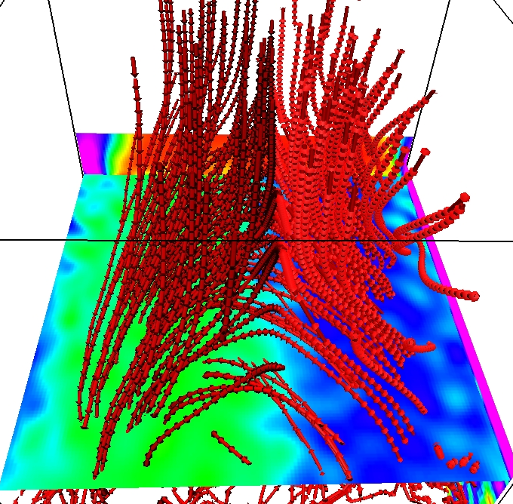
Field Structure
Large scale field in B_{z}
Arcade structure of the magnetic field lines
The field lines have helical shape & twist

Slide 8
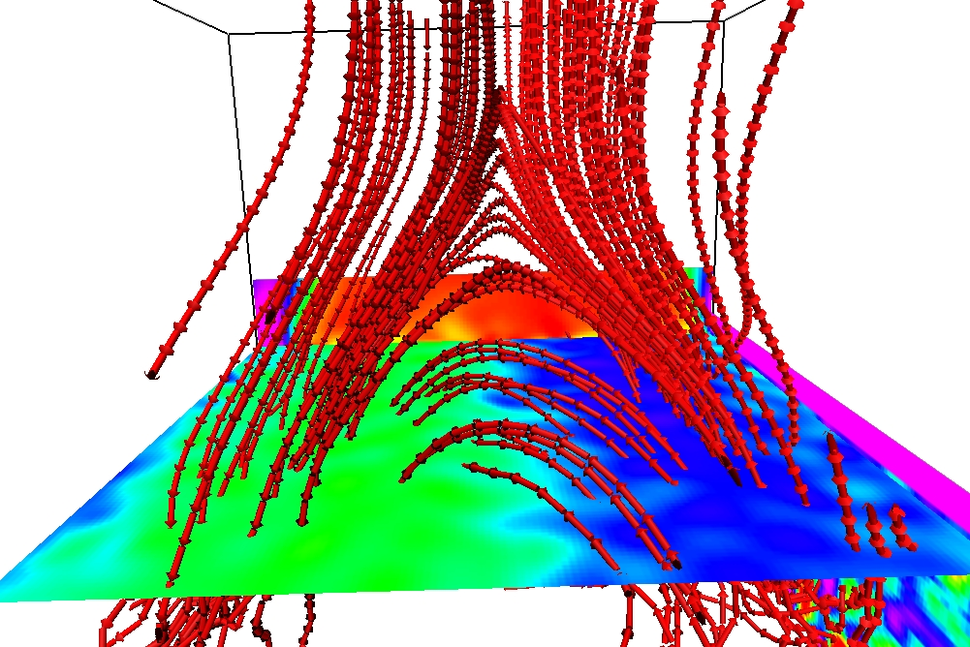
X-Point and Current Sheet

Slide 9
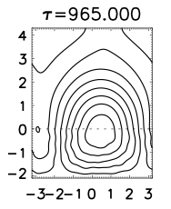
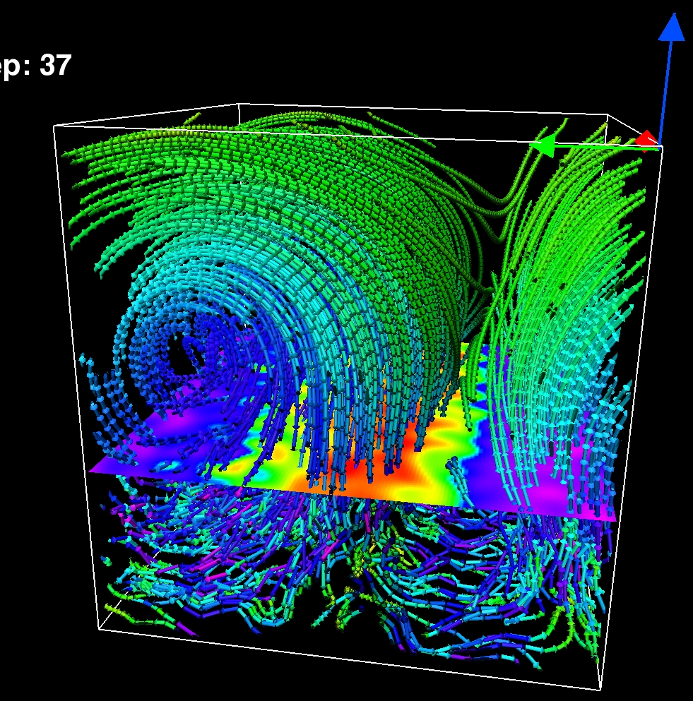
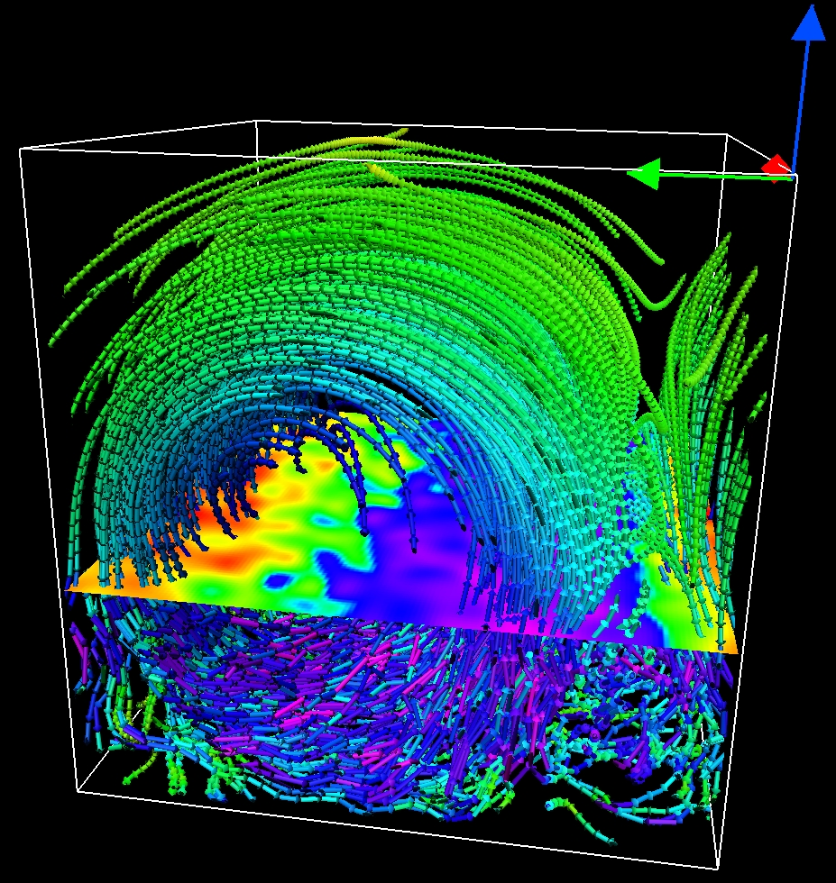
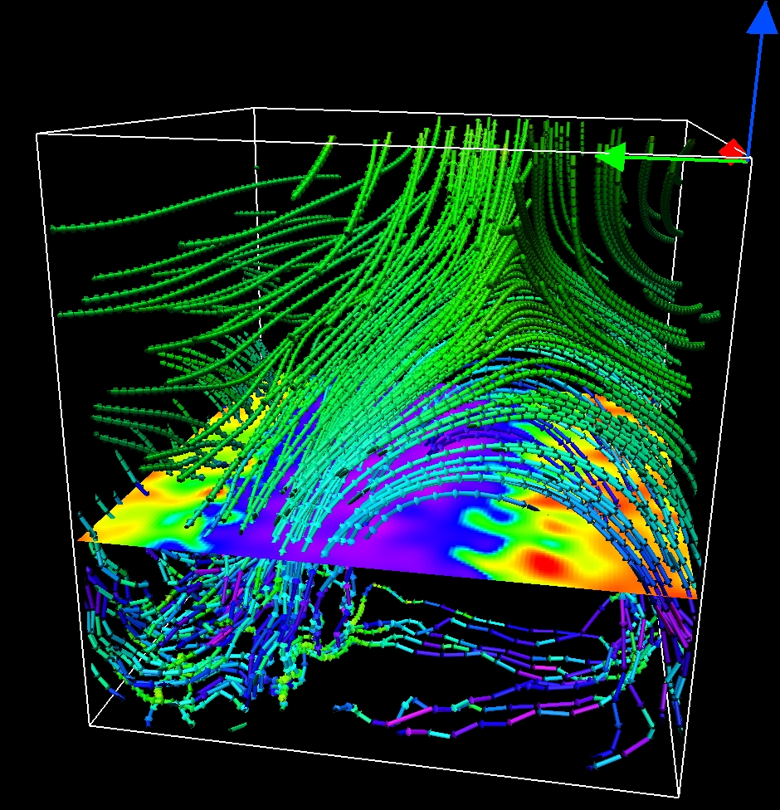
<A_{X}(y,z)> contours shows the ﬁeld lines of <B>_{X}

Slide 10
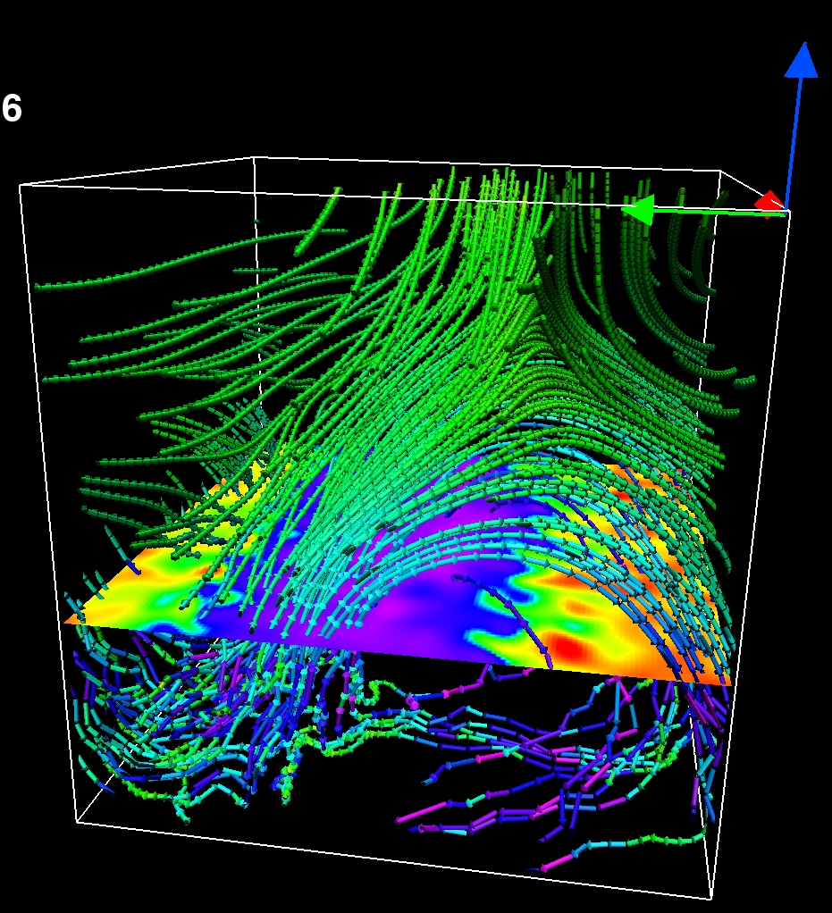
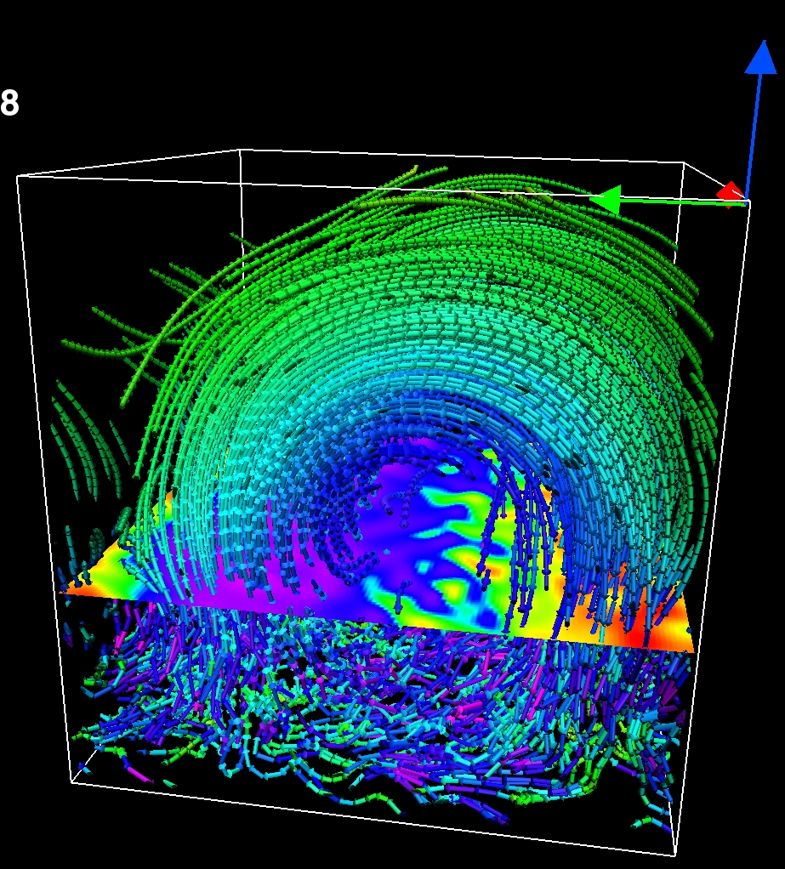
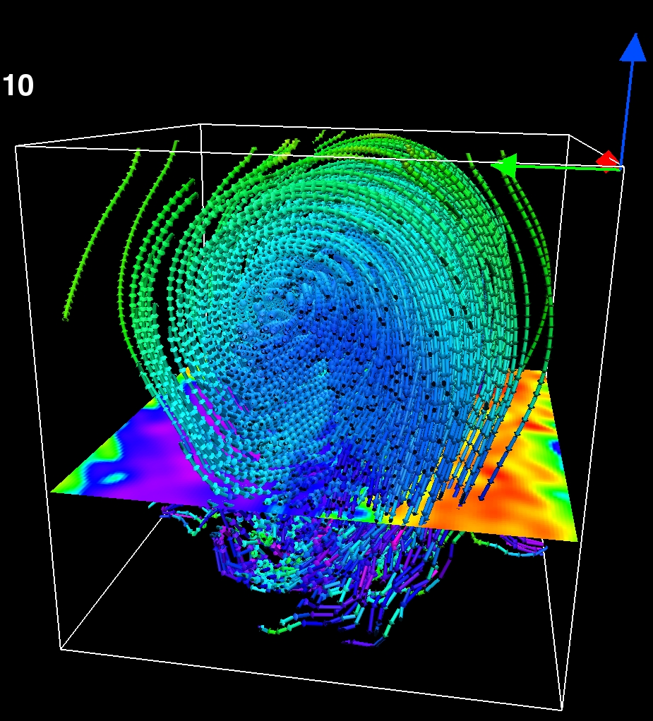
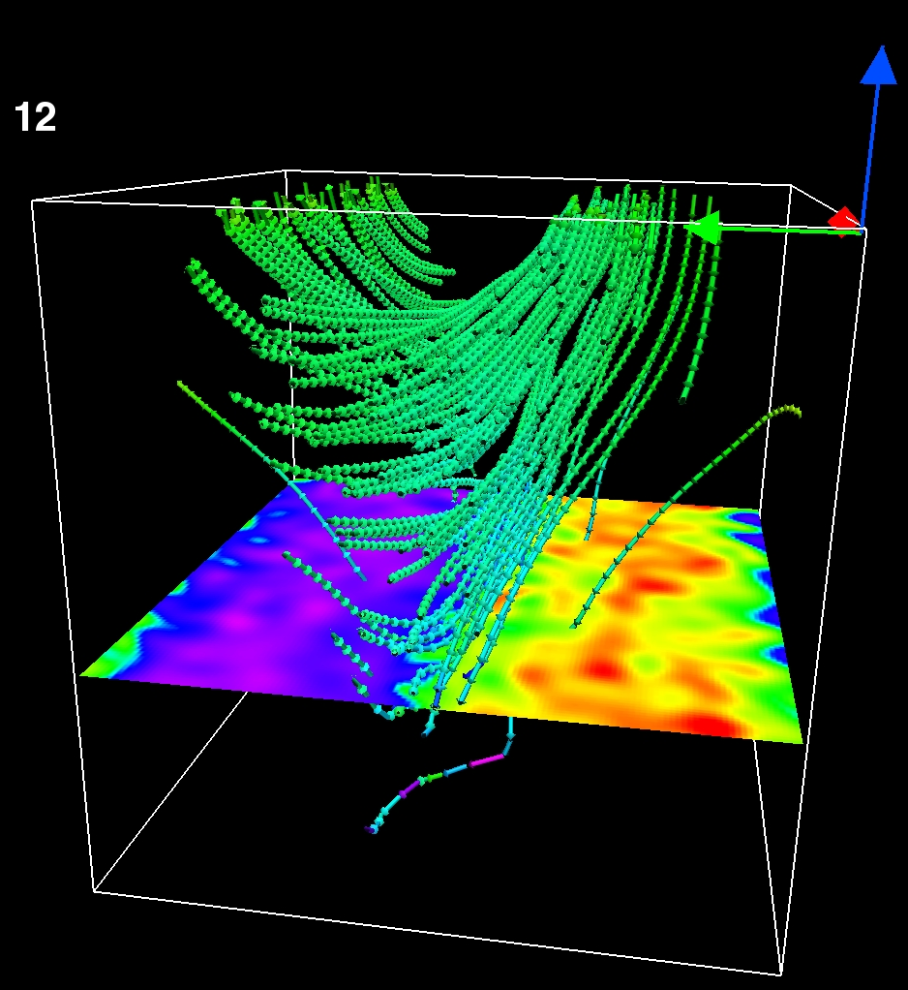
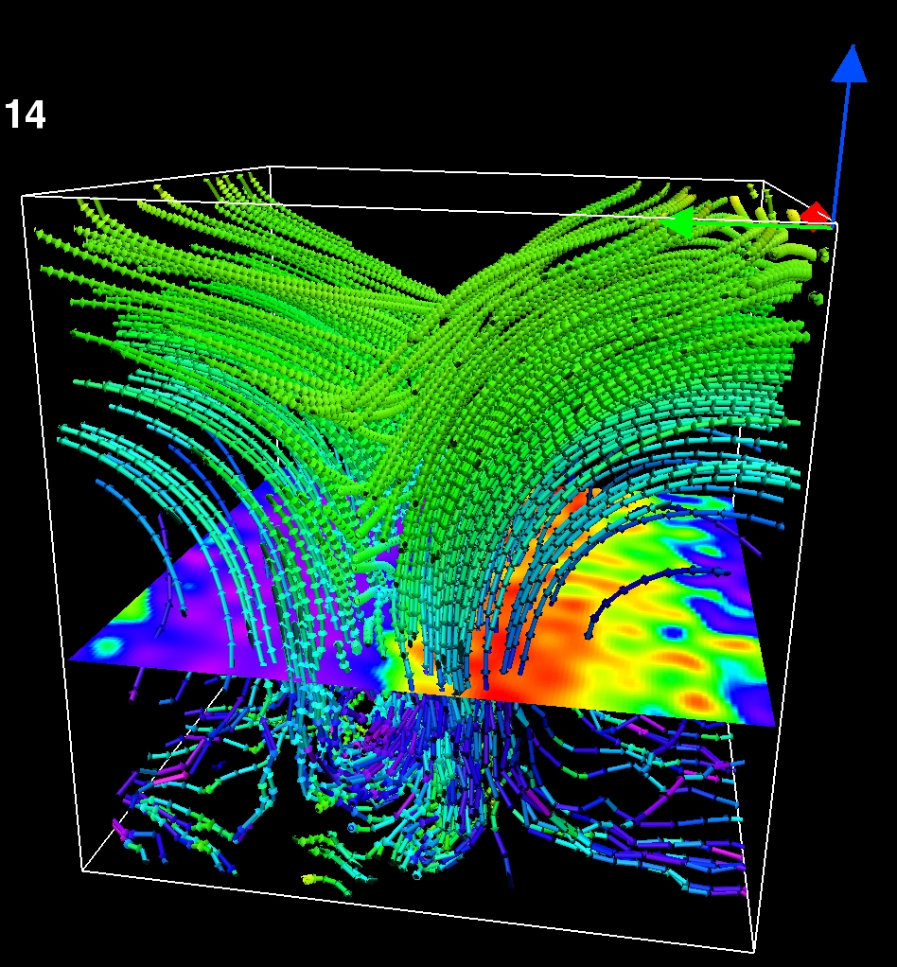
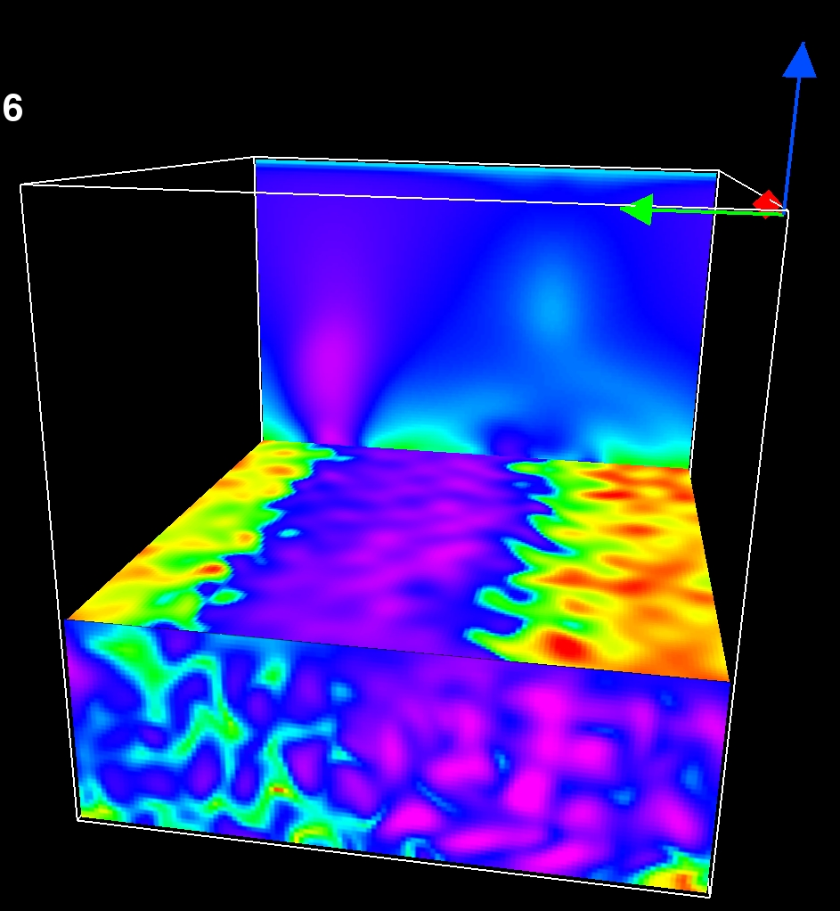
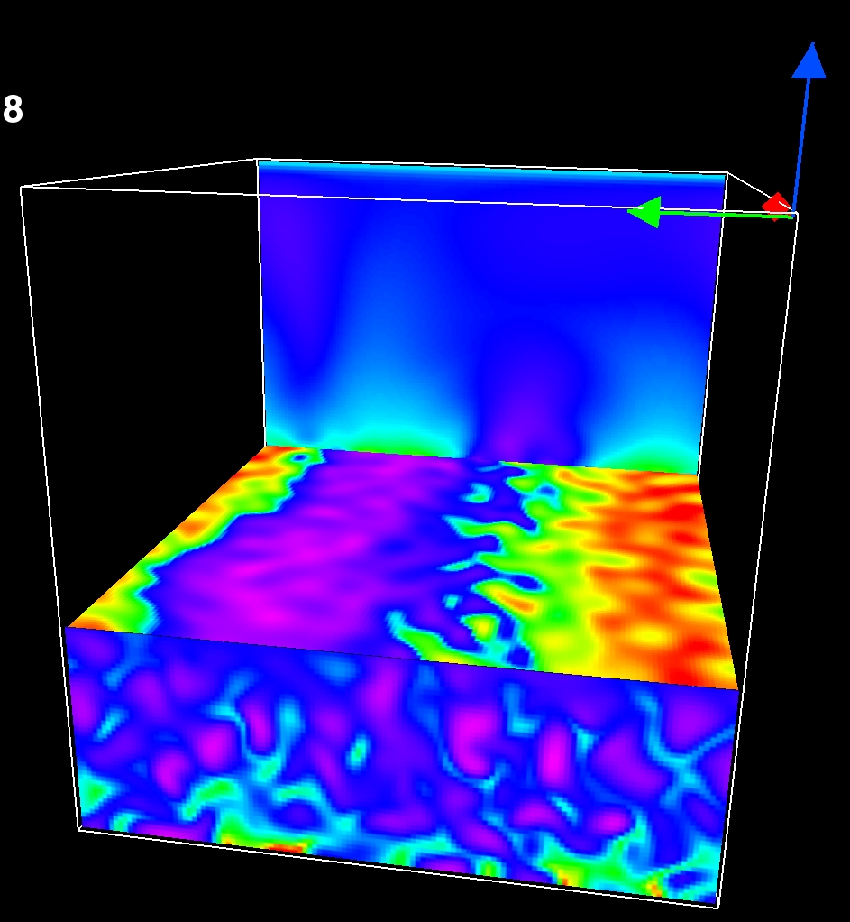
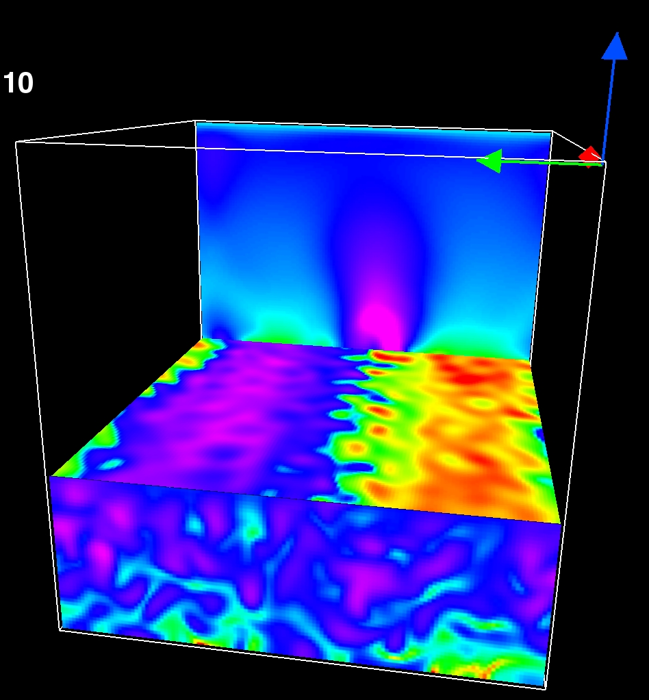
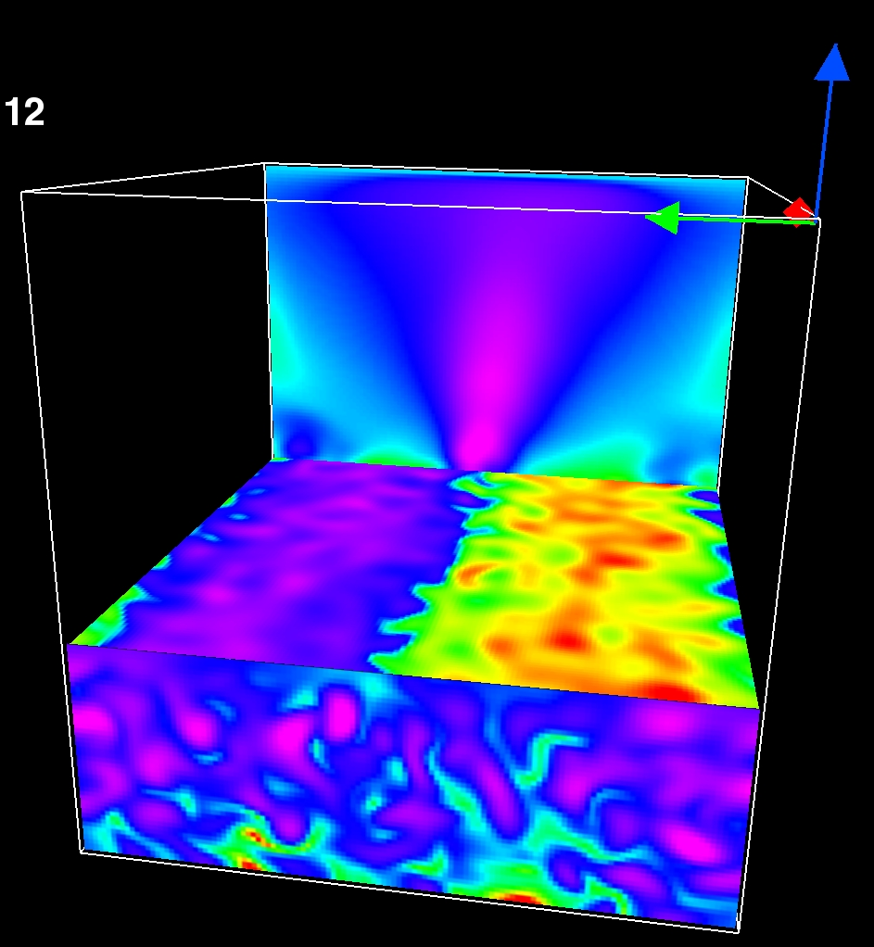
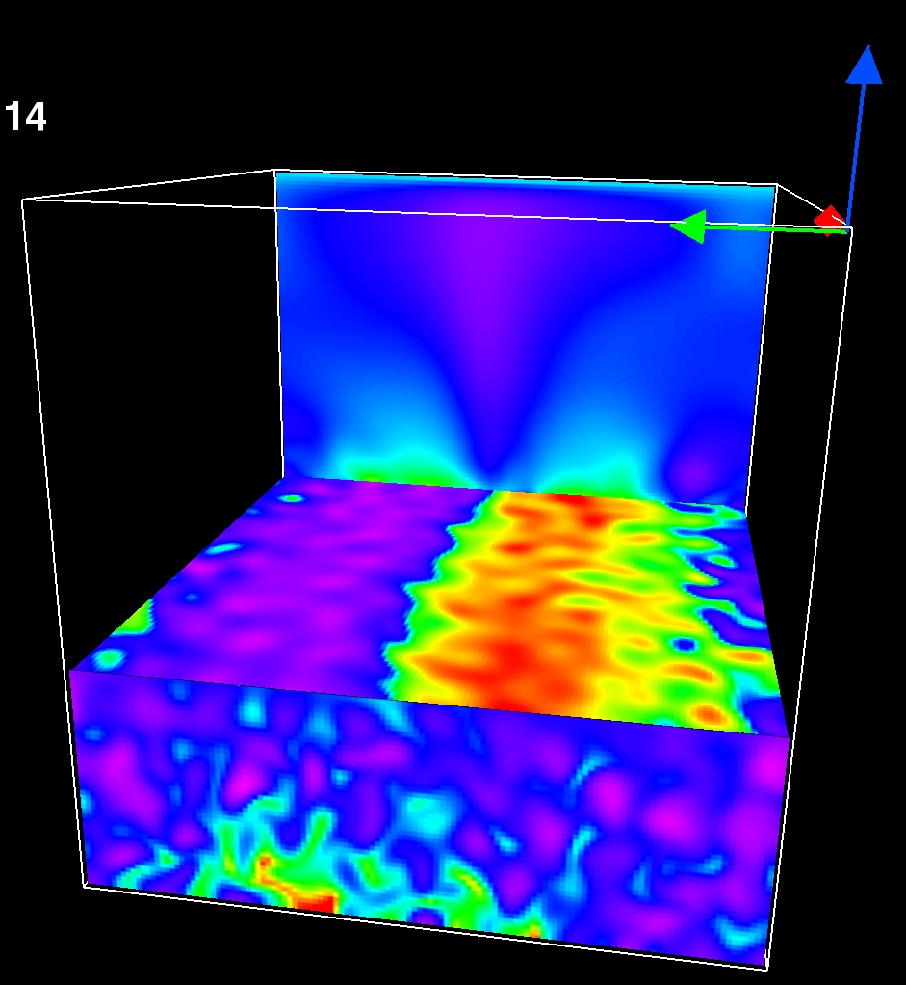
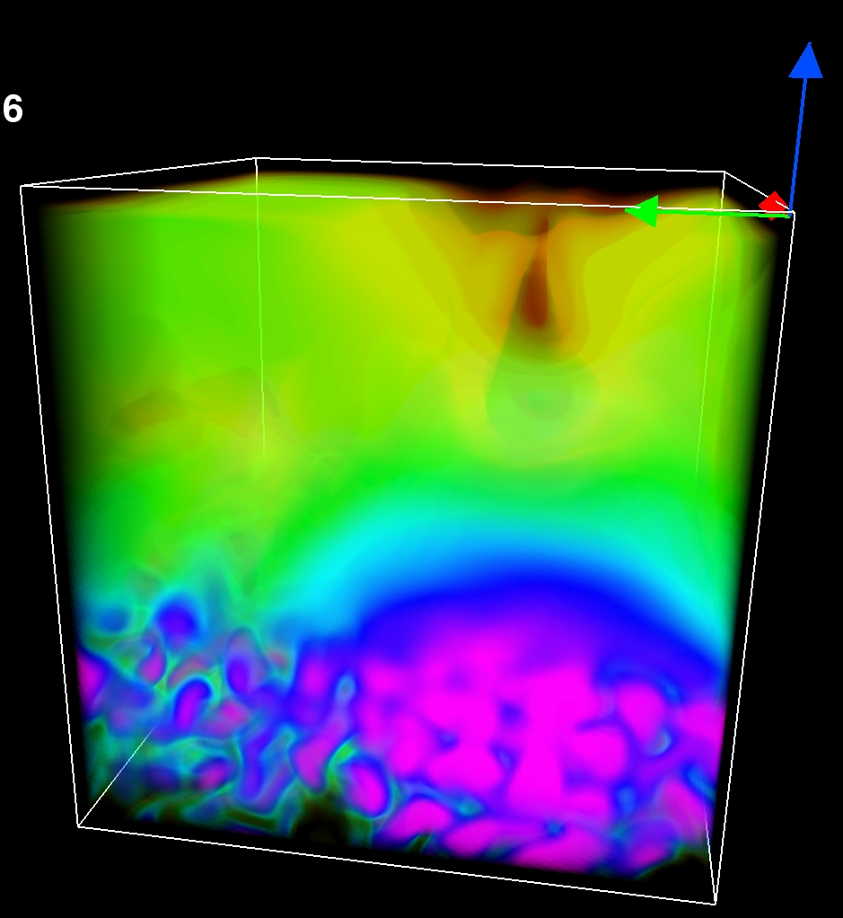
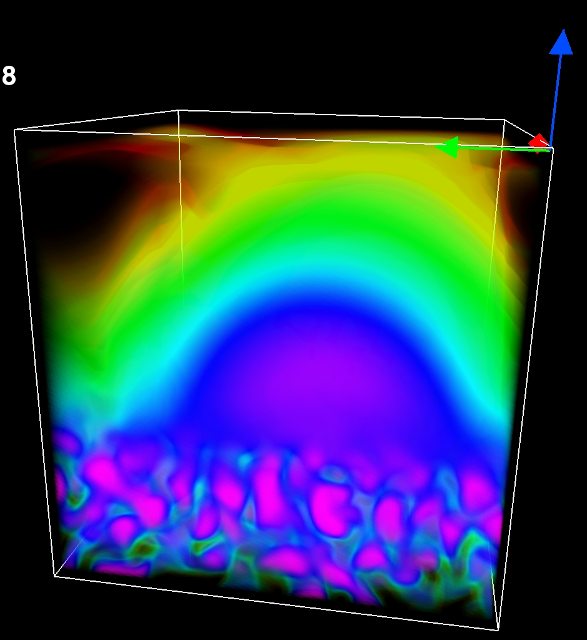
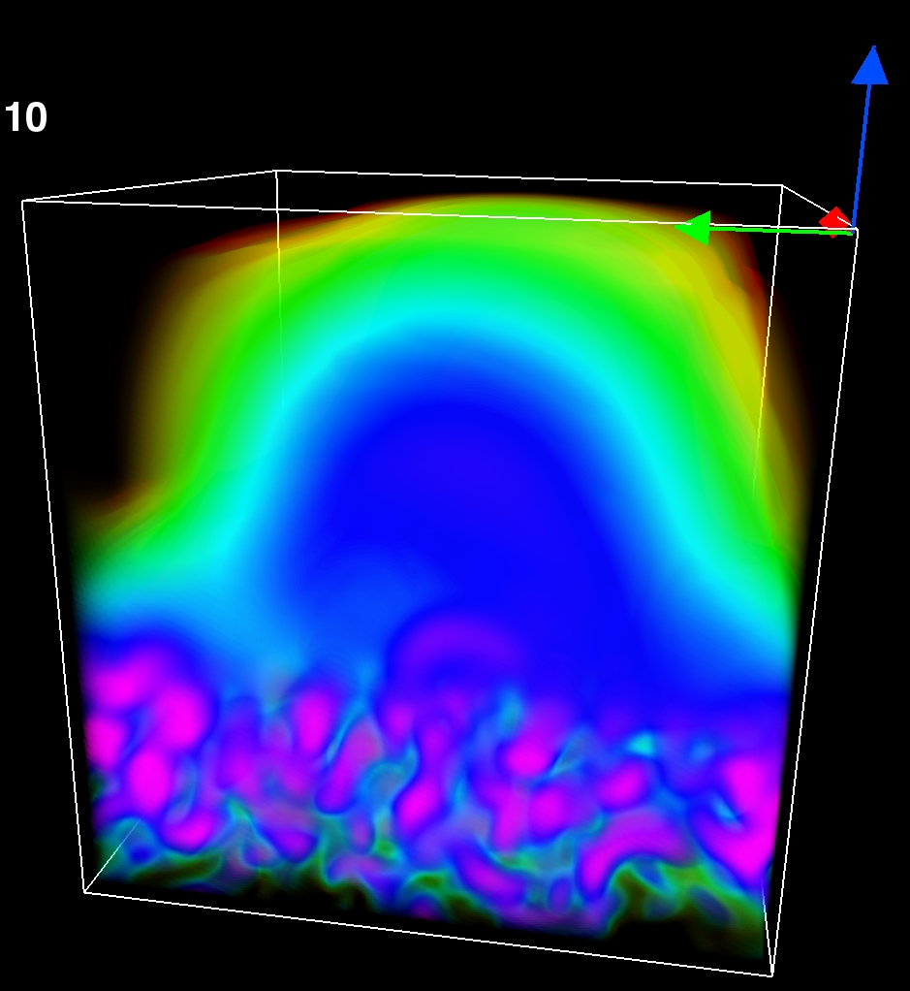
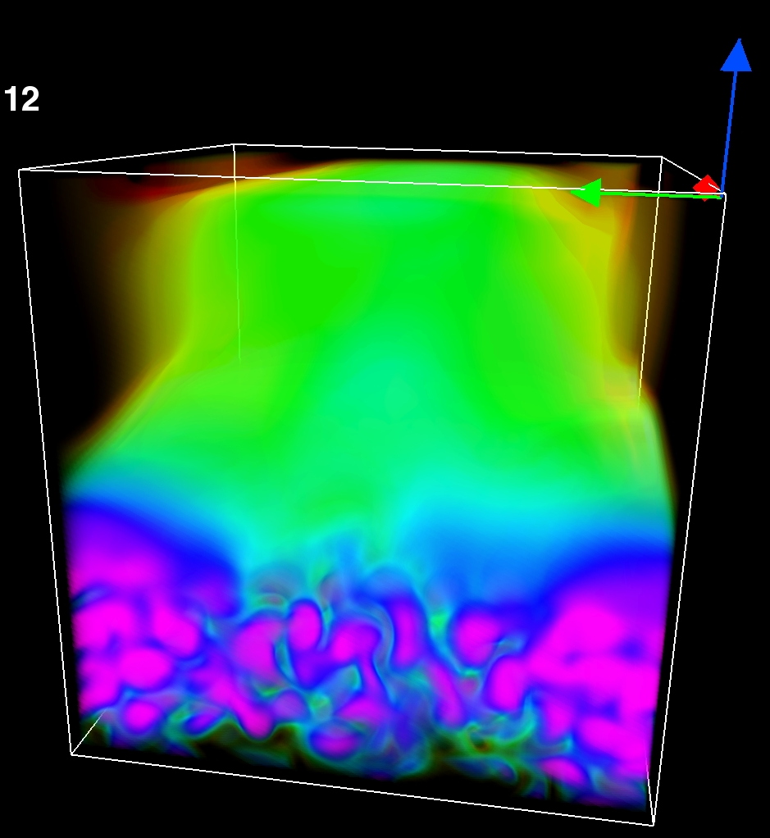
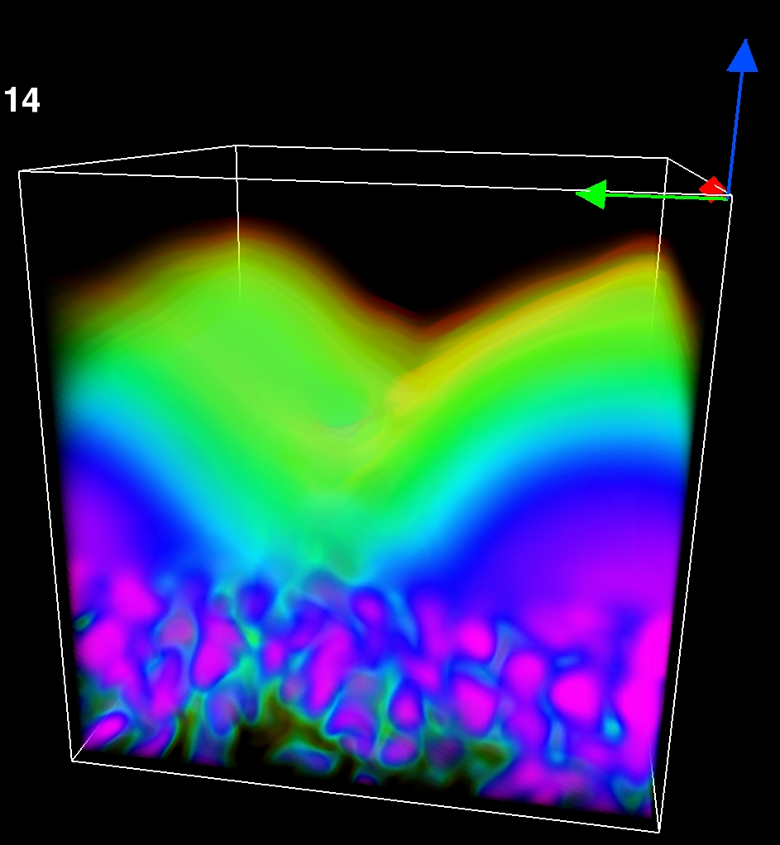
Time τ= 1081
1104
1150
1196
1242
Magnetic field lines
Vertical velocity and magnetic field & magnetic energy

Slide 11
Conclusion
Dynamo: exponential growth, then saturates.
Large-scale field: here B_{z} ~ sin ky.
Recurrent helical arcade structures
Reconnection events with plasmoid ejection.
Dynamo below the surface can produce
flux emergence similar to in the sun

Slide 12
Outlook
How does magnetic helicity fluxes depend on the magnetic Reynolds number?
Including shear to this model
Global geometry with curvature and gravity
Convection instead of forcing
Realistic model of the solar atmosphere ?

Slide 15
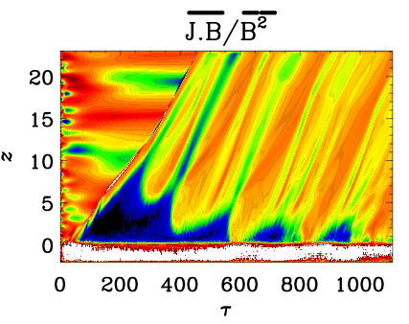

Slide 16
Dynamo generated twisted magnetic field below the surface
can produce
flux emergence like in the sun

Slide 17
Force-free
The exterior part is nearly
force-free:
the J × B is much smaller than J • B
the angle between B and J is nearly π

Slide 18
Field Structure II
Periodic, nearly sinusoidal variation in y direction.
B_{x} and B_{z} show a relative rapid decline in the exterior part.
Our model is suitable to describe the magnetic field in the dynamo exterior.

Slide 19
Comparing with a mean field model
Mean field equations:
Error function for α
Parameters
α ≈ u_{rms}/3
η_{t} ≈ u_{rms}/3k_{f}
_{(turbulent diffusivity)}
same conditions

Slide 20
Upward wind
Upward wind in the upper layer.
Increase during the simulation
Possible reason for the freely extension of the magnetic field

Slide 21
magnetic field
vz
Bz
Concentration of flux
B²
Emerging of flux
Dissipation of flux
j²
B²

