Slide 1
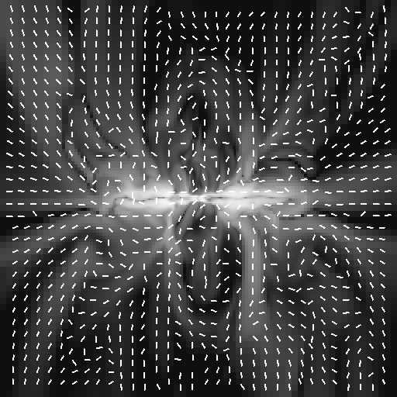
The formation of magnetized galactic winds
Yohan Dubois
University of Oxford
Romain Teyssier – UTH Zürich / CEA Saclay

Slide 2
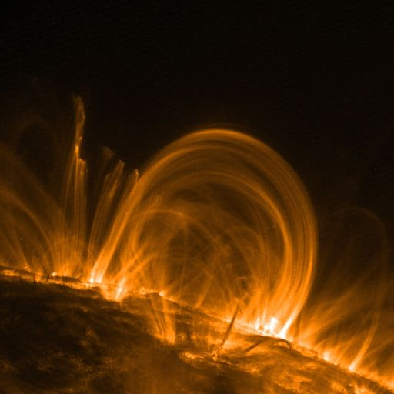
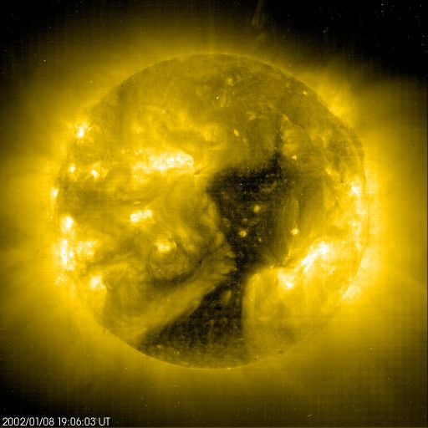
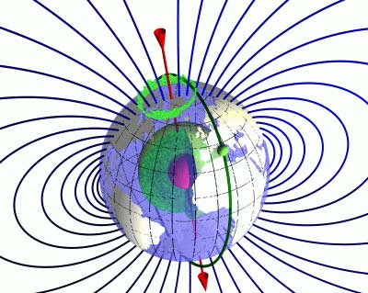
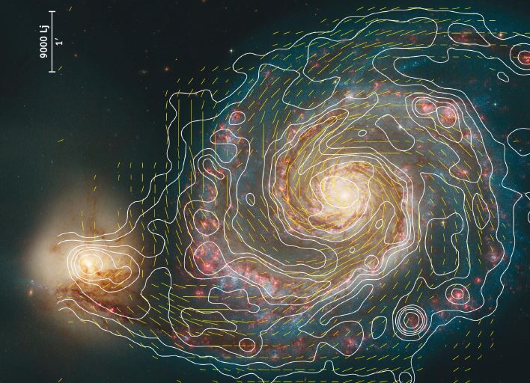
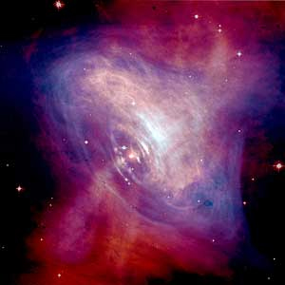
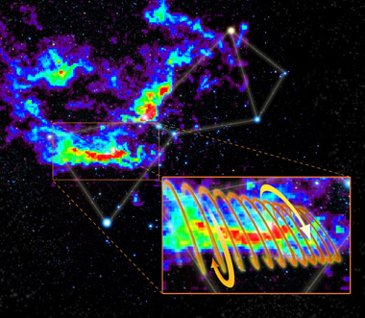
Magnetic fields are everywhere in the Universe
Earth
Sun, stars
Compact objects
Interstellar Medium (ISM)
Galaxies
Galaxy Clusters
Large scales ?
TRACE
EIT
CHANDRA+HST
GBT
HST+VLA+Effelberg
Notes:
First we have to keep in mind that B field are everywhere in the Universe
The problematic is the following : where does the B field comes from ? How does it evolve ?

Slide 3
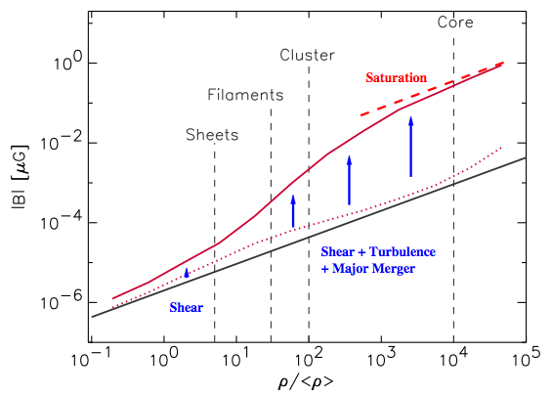
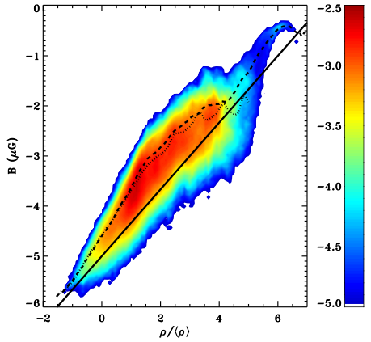
MHD simulations of galaxy clusters
Mass fraction (cooling)
Lagrangian technique (Gadget MHD)
Eulerian technique (Ramses MHD)
cooling run
adiabatic run
Dolag et al 2005
Dubois & Teyssier 2008
Uniform initial magnetic field:
B_{IGM} ~10⁻⁵ μG
Collapse of an homogenous sphere of gas
Magnetic flux conservation
Notes:
We have to choose an arbitrary intial magnetic field

Slide 4
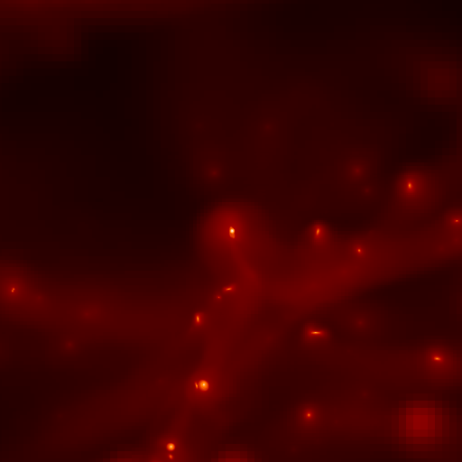
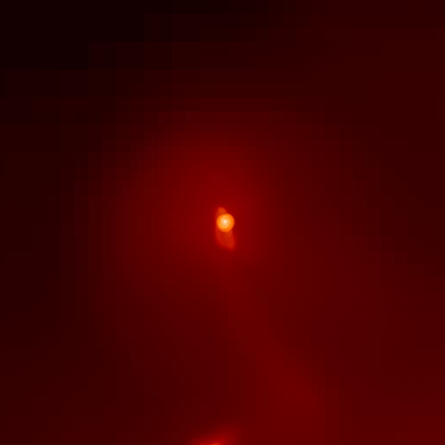
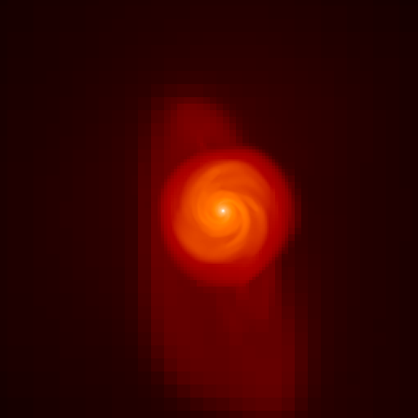
Problem
Magnetic field in galaxy clusters are consistent with observations if B_{IGM} ~10⁻⁵ μG
Origin of the magnetic field in the inter-galactic medium?
Primordial (Biermann battery) ? (10⁻¹⁴ μG)
Galactic (dynamo + winds) ?
Cosmic web
Halo
Galaxy
Notes:
We will take a look at galaxies show large-scale winds that could carry B field from galaxies to the IGM

Slide 5
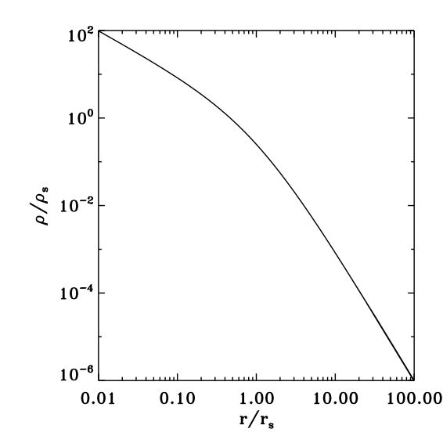
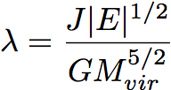
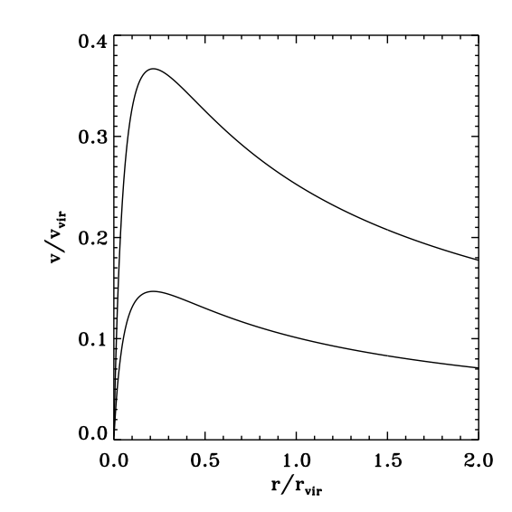
Idealised simulations of galaxy formation
Isolated and spherical gaseous halo (NFW):
Dark matter: static analytical potential (NFW)
Cosmological rotation profile
Initial gas fraction:
Self-gravity + cooling down to 10⁴ K + metal enrichment + star formation + feedback from Supernovae
Navarro, Frenk & White 1996
Bullock et al. 2001
Notes:
Boundary conditions are outflow for gas and divB=0

Slide 6
Density
300 kpc
75 kpc
Notes:
Halo collapse / centrifugally supported disc / large-scale wind with low density / hard to break the gas acrretion onto the disc / disc remains

Slide 7
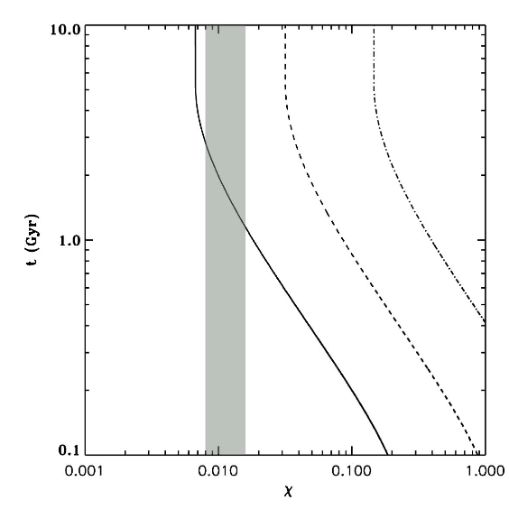
Constraints on the formation of winds
Hydrodynamic efficiency: Supernovae energy fraction converted into galactic wind energy fraction
density
MW is here !
160 kpc
Dubois & Teyssier 2008
Fundamentaly: the structure of the ISM controls this efficiency (porosity of the ISM, Silk 1997)

Slide 8
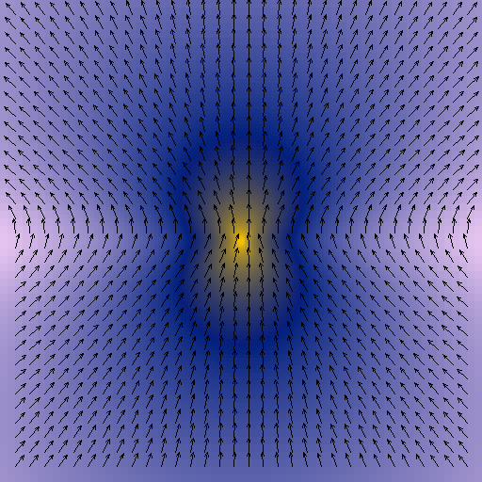
Initial conditions for a magnetic field
Magnetic field is consistent with the density profile
z
Magnetic field
equipartition
Dipole structure aligned with the rotational axis of the halo
Notes:
Initialise the B field following the density as the pure collapse amplification suggest

Slide 9
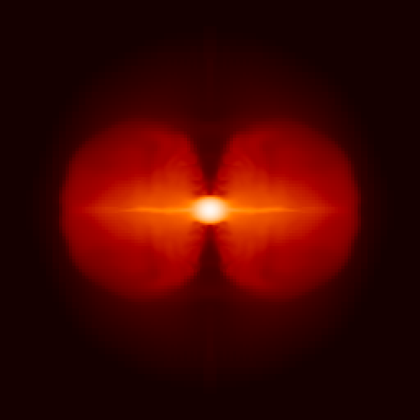
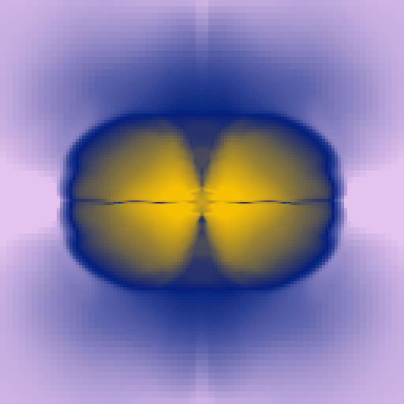
Upper limit for the magnetic normalisation
38 kpc
38 kpc
Notes:
High field regime does not form a disc but a torus / irrealistic
10^-5 microG field OK is about the field needed for galaxy clusters
Coincidence ? Auto-regulation process ?

Slide 10
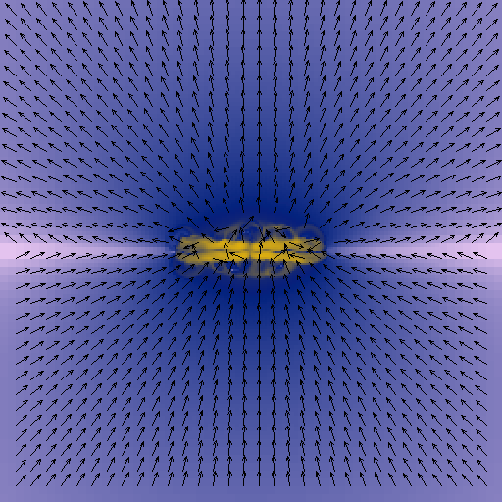
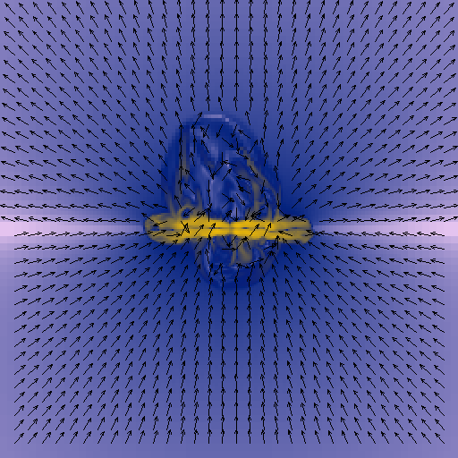
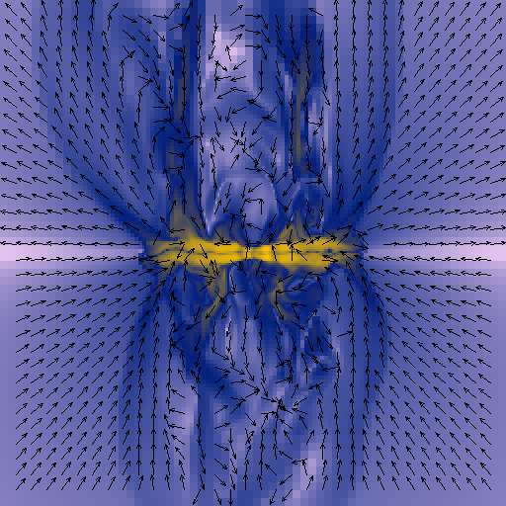
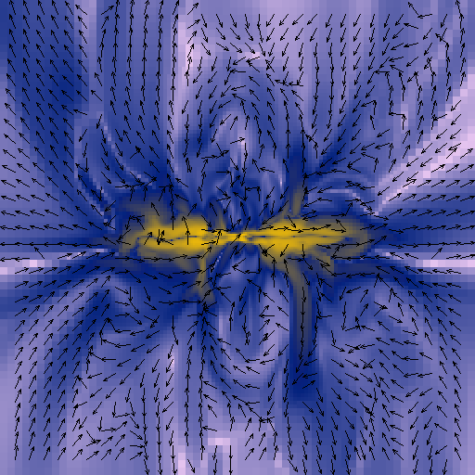
A magnetized galaxy wind
t =1 Gyr
t =1,5 Gyr
Turbulent structure of the magnetic field
t =2 Gyr
t =3 Gyr
38 kpc
38 kpc
Notes:
We can point out the turbulent structure of the B field in the wind
microG in disc / 10^-2 microG in the wind
What is the quantity of magnetic energy ejected in the IGM

Slide 11
Amplification in the disc
Saturation of the field
Dubois & Teyssier, submitted
Differential rotation amplifies the magnetic field (linear amplification)
Average angular velocity
Notes:
Magnetic energy decreases due to expansion
Significant final amplification (10-15 times)
Remember B_IGM= 2.10^-5 microG

Slide 12
Magnetic energy flux into the large-scale wind
Close to the disc
Far from the disc
Analytical prediction from Bertone et al. (2006) for from the wind and galaxy properties and magnetic energy in the galaxy
Bertone et al. 2006
Energy injection at the bottom of the wind
Magnetic energy decreases as bubble expands
Notes:
Magnetic energy decreases due to expansion
Significant final amplification (10-15 times)
Remember B_IGM= 2.10^-5 microG

Slide 13
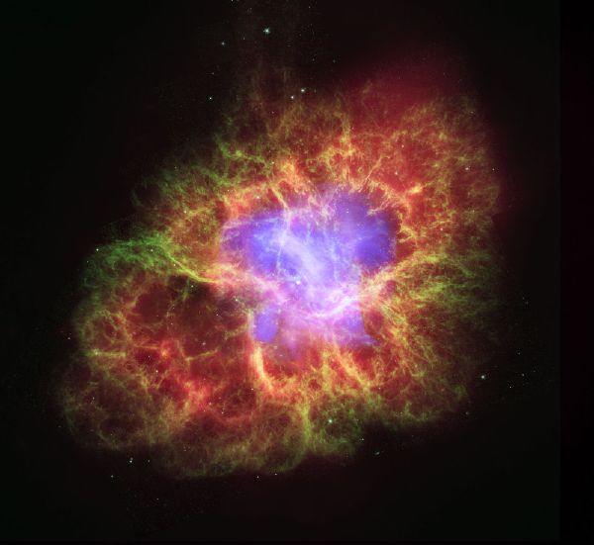
Is there a more fundamental problem with dwarves ?
Our results are consistent with more idealized though higher resolution simulations from Gressel et al. (2008): a galactic dynamo proceeds when Ω>25 Gyr⁻¹
Problem for galaxies with low rotation like dwarf galaxies
How to reconcile the strong magnetic field observed in starburst galaxies ?
(50 μG in the halo of M82, Klein et al., 1988)
The key role of stars and supernovae for amplifying magnetic fields
(Rees 1987, Kowalik & Hanasz 2007)
Magnetic field in the Crab nebula

Slide 14
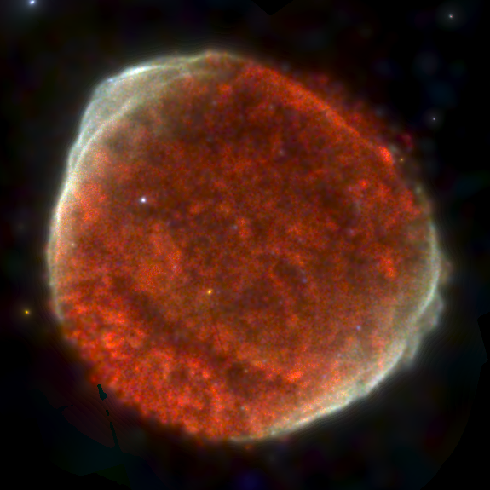
Supernovae = magnetic dipoles
B_{SN}=10⁻⁵μG
B_{SN}=10⁻⁵μG
m
m
Notes:
New way of creating B field in galaxies

Slide 15
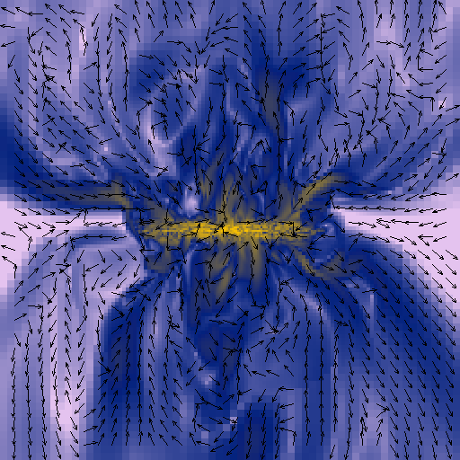
Galactic magnetic field creation
z
x
y
x
38 kpc
38 kpc
Notes:
No initial B field / magnetic field is created inside the galactic disc / expelled in the wind / with the same type of turbulent structure than before

Slide 16
Enrichment of the primordial magnetic field
Each galactic wind creates a superbubble with
no initial magnetic field
Dubois & Teyssier, submitted
In this scenario, a unique dwarf galaxy generation can magnetize the Universe up to 10⁻⁵ μG !!!
Notes:
Measure the final B field in the superbubble poluting the IGM in the same way than before ( Bertone et al )

Slide 17
Summary and future prospects
The classic α-Ω dynamo very unlikely in dwarf galaxies
Low rotation
Dwarf galaxies are able to magnetise the IGM
Galaxy formation in a cosmological framework ?
Test of the cosmological amplification from successive mergers between galaxies
Magnetic field in clumpy galaxies ?
High-redshift vs low-redshift galaxies
What happens when a galactic fountains operates ? (Milky-Way like halo)
Test the supernovae magnetic seeding with simulated radio maps and polarisation maps.
What about AGN feedback acting on magnetic field in clusters ?
Radio intensity for a simulated clumpy galaxy
Thiébault et al. (2009)
Dubois et al., 2009

Slide 18
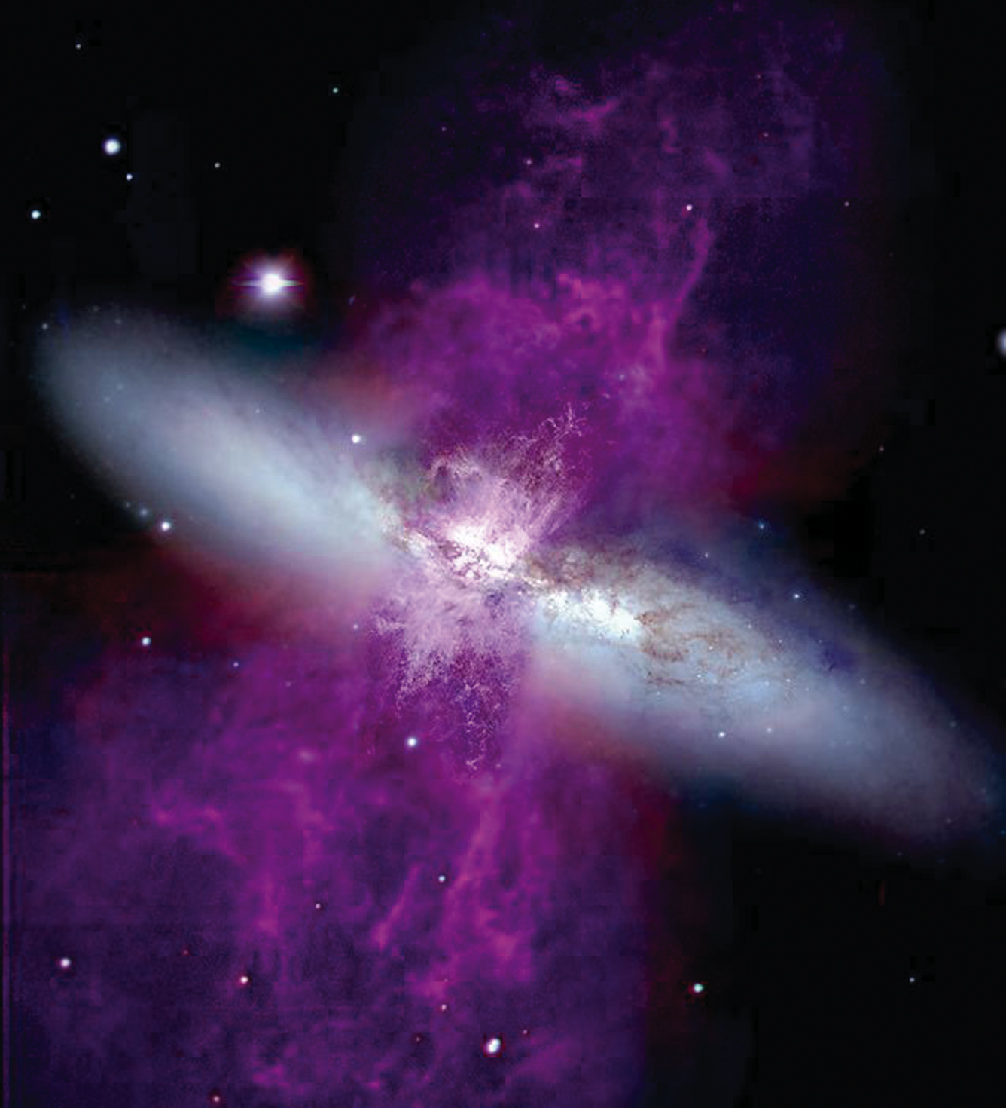
Thank you

Slide 19
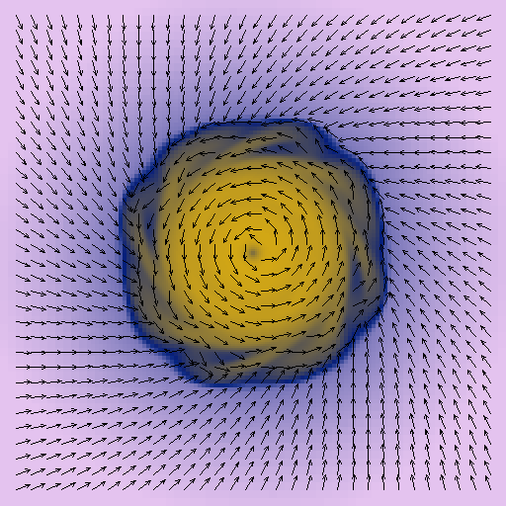
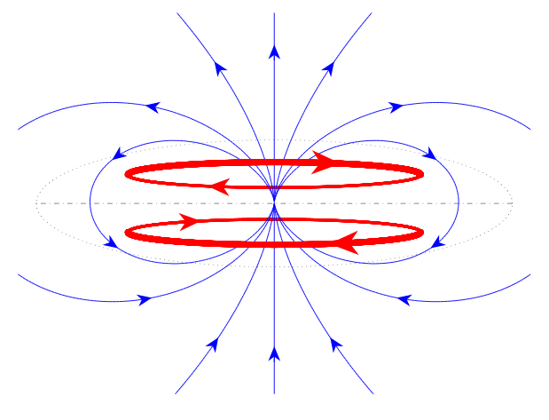
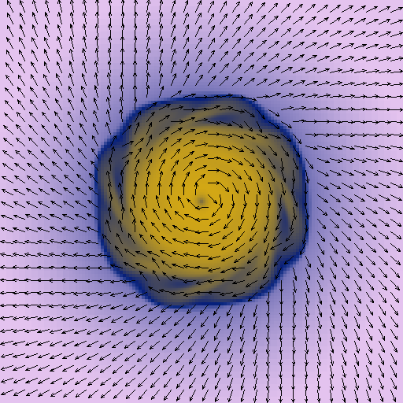
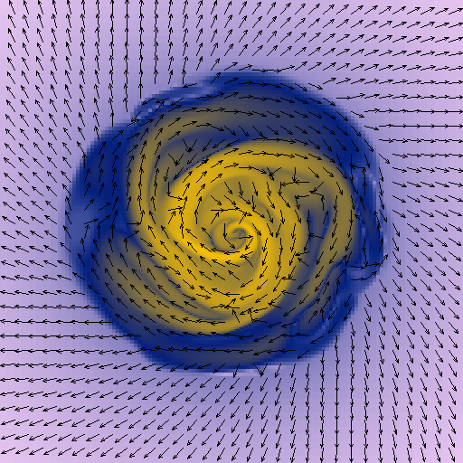
Magnetic field topology
up
A0 symmetry : polar mode m=0 + anti-symmetric along z
down
38 kpc
Spiral arm structure
38 kpc
Notes:
Propriétés champ magnétique avec une physique de plus en plus complexe

Slide 20
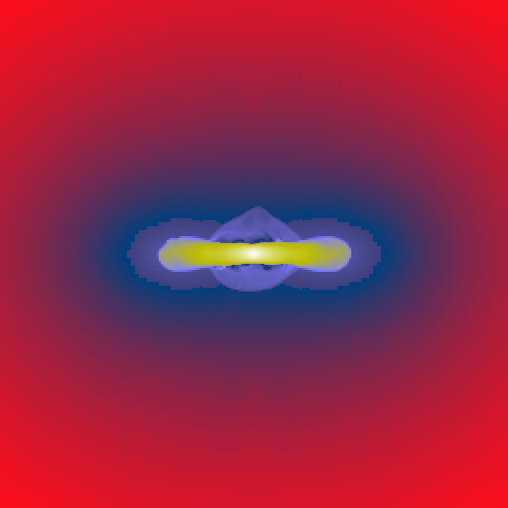
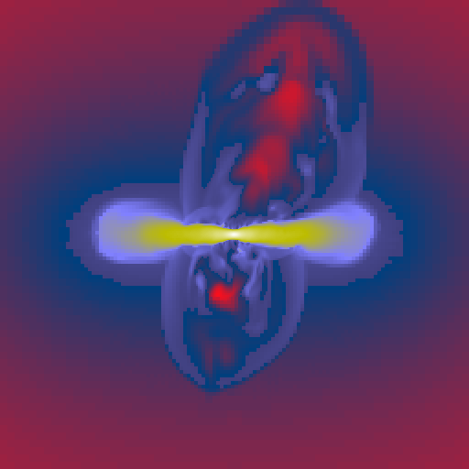
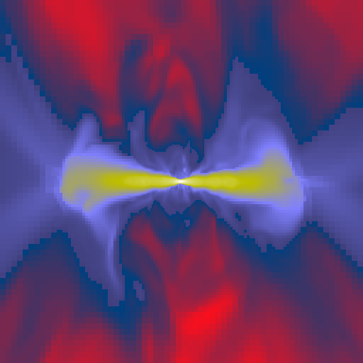
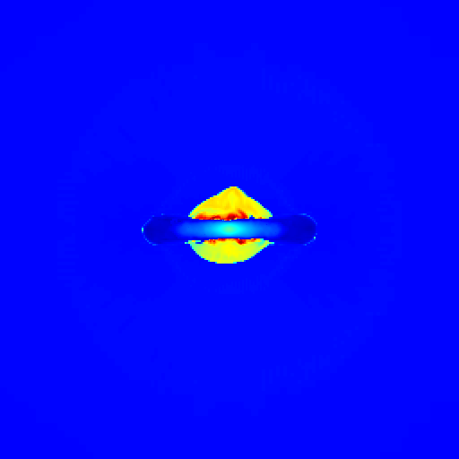
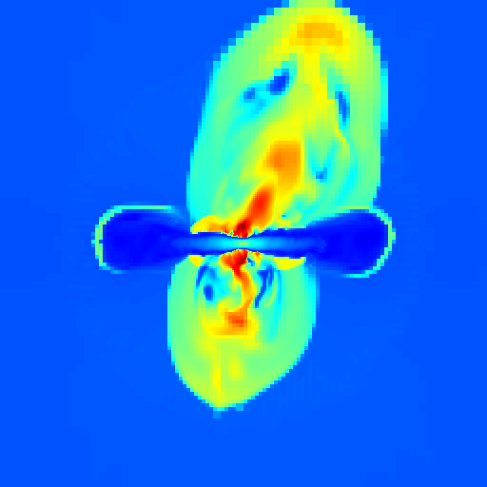
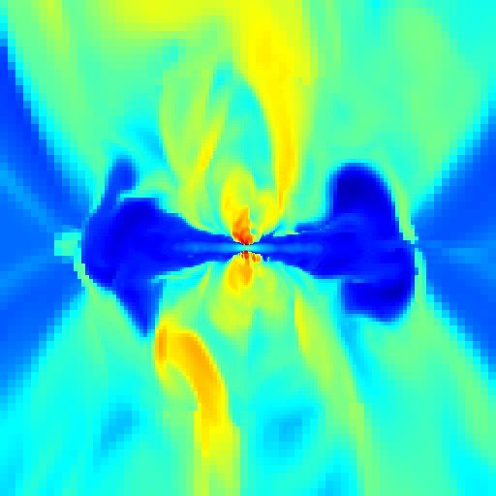
Large-scale galaxy wind formation
1. Buoyancy
2. Snow plow
3. Blow away
t=1Gyr
t=2Gyr
t=3Gyr
D
E
N
S
I
T
Y
T
E
M
P
E
R
A
T
U
R
E
38 kpc
38 kpc
38 kpc
Notes:
buoyancy

Slide 21
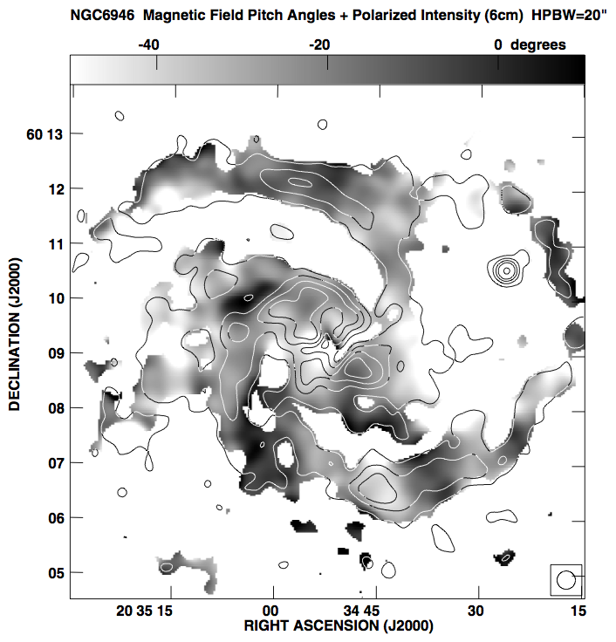
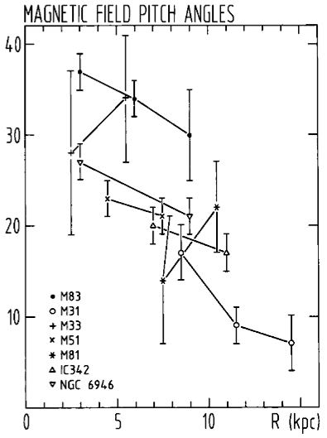
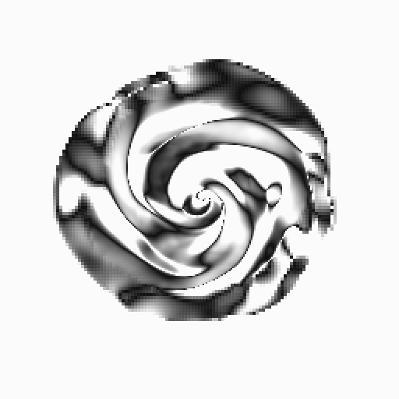
Observations and pitch angle
Galactic centre
Beck 2007
Beck et al. 1996
38 kpc
Notes:
Marche bien avec les observations
Mais pas de vents
Donc besoin de SNe

Slide 22
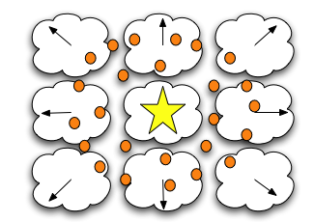
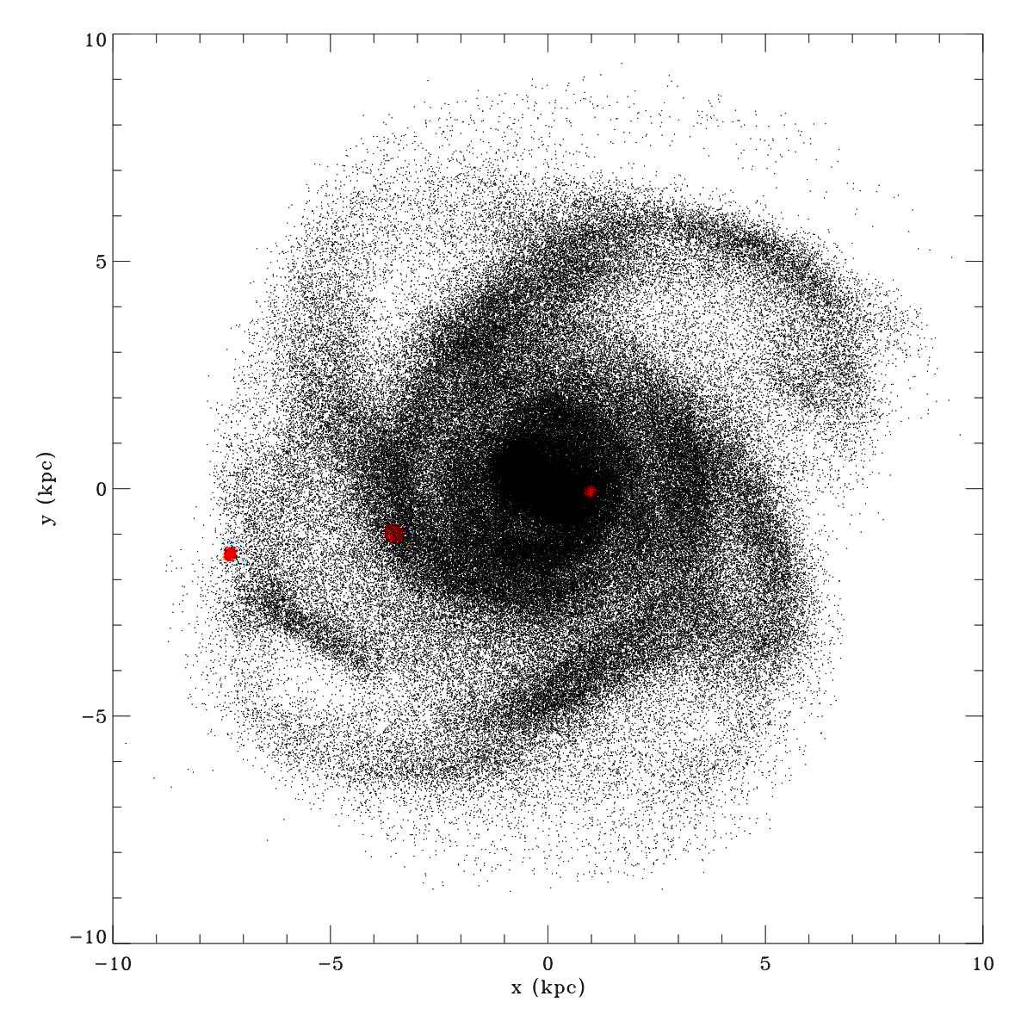
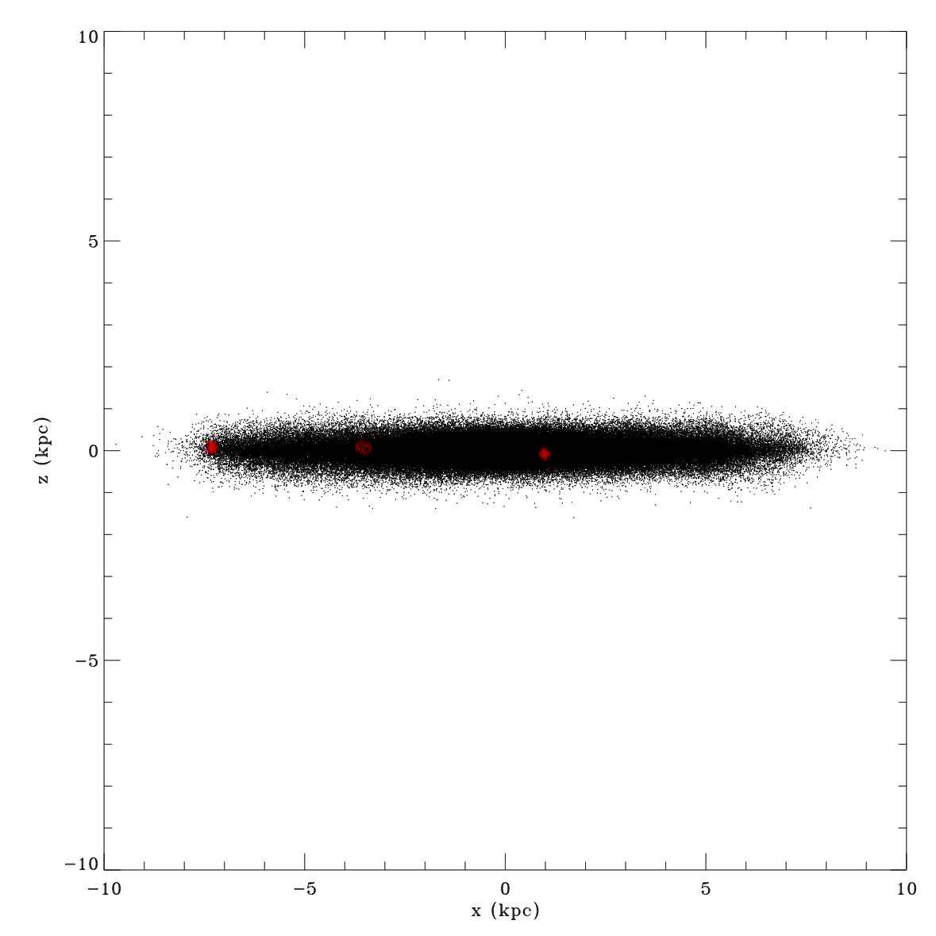
Numerical implementation of supernovae feedback
Notes:
Gas in the neighbouring cells following Sedov profile

Slide 23
Constraints on the formation of winds
Hydrodynamic efficiency: Supernovae energy fraction converted into galactic wind energy fraction
density
Springel & Hernquist, 2003
Dubois & Teyssier 2008
Fundamentaly: the structure of the ISM controls this efficiency (porosity of the ISM, Silk 1997)
… as much as the numerical assumptions and the nature of the code (see the galactic wind formation in Springel & Hernquist, 2003)

Slide 24
Final magnetic field in the bubble
(1)
from Bertone et al. (2006)
assuming
Solving (1) gives
for an initial zero magnetic energy in bubble
with
Magnetic energy efficiency to transfer magnetic field from the disc to the IGM
And finally reduces to
Notes:
Magnetic energy decreases due to expansion
Significant final amplification (10-15 times)
Remember B_IGM= 2.10^-5 microG

Slide 25
A channel for a cosmological dynamo ?
Consider a pure compression of magnetic field lines from the halo to the galaxy
Radius of the galaxy is related to the radius of the halo and its spin parameter (Mo et al., 1998)
then
For an amplification by differential rotation in the disc
Knowing that
and that
It comes
Exponential growth with e-folding time ~500 Myr (see Dubois & Teyssier, submitted)
Notes:
Magnetic energy decreases due to expansion
Significant final amplification (10-15 times)
Remember B_IGM= 2.10^-5 microG

Slide 26
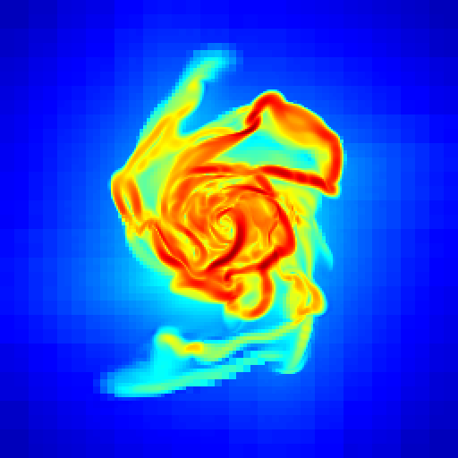
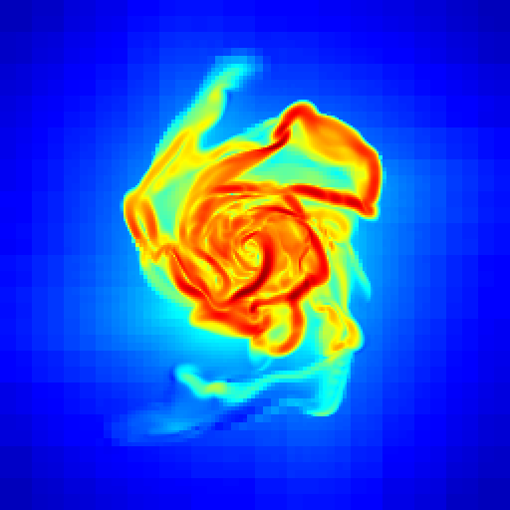
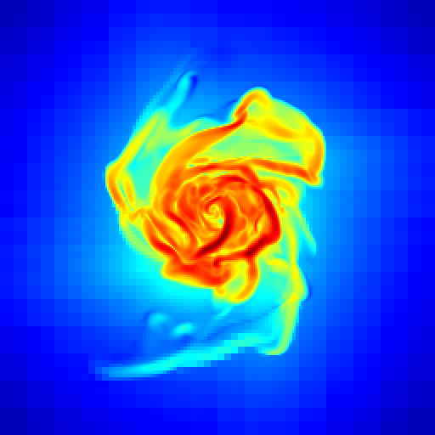
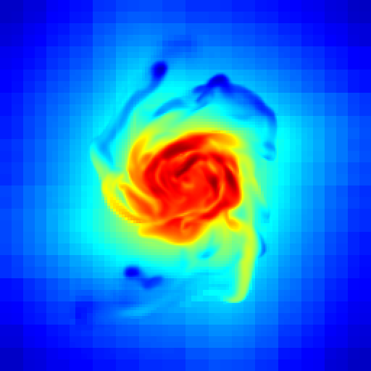
The absence of dynamo in the disc of dwarves : a resolution effect ?
Increase the resolution up to 10 pc (instead of 100pc).
Lower the temperature floor down to 300 K.
-> Clumpy ISM : drives higher turbulence. A path to a galactic dynamo ?
no SN
SN
no physical diffusivity
Similar to Wang & Abell (2008): linear growth only
10 kpc

Slide 27
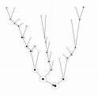
A cosmological dynamo ?
A single dwarf with a pure Ω amplification (linear)
x10 amplification (from 10⁻⁵ to 10⁻⁴ μG)
10⁻⁵ μG needed to explain galactic field in galaxy clusters (e.g. Dolag et al. 2005)
Our results are consistent with more idealized though higher resolution simulations from Gressel et al. (2008): a galactic dynamo proceeds when Ω>25 Gyr⁻¹
What could amplify the magnetic field more efficiently ?
Cosmic ray-driven dynamo (Hanasz et al.,2009)
Mergers between galaxies that provides strong turbulence (see Kotarba et al.,2010)
The magnetic seeding from supernovae (see Hanasz et al., 2009 and Dubois et al., submitted)

Slide 28
High redshift galaxy with ultra high resolution
Zoom simulation:
High resolution region 3 Mpc (comoving) within a larger low resolution box (10 Mpc)
Δx_{min}=0.5 pc (!)
Including metal line cooling, star formation, supernova feedback.
M_{vir} =5 10⁹ M_{sun} at z=9
Smaller stellar clumps are a few
10⁴ M_{sun}
projected gas density
z = 9
Projected temperature
~100 kpc
~ 1 kpc
gas stars within 10% r_{vir}

Slide 29
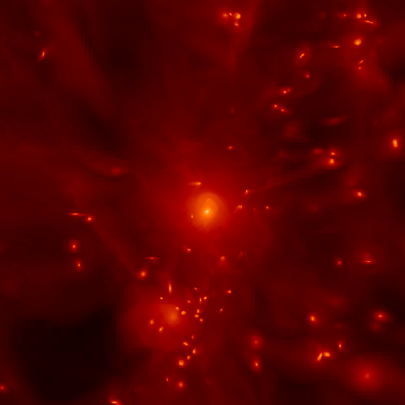
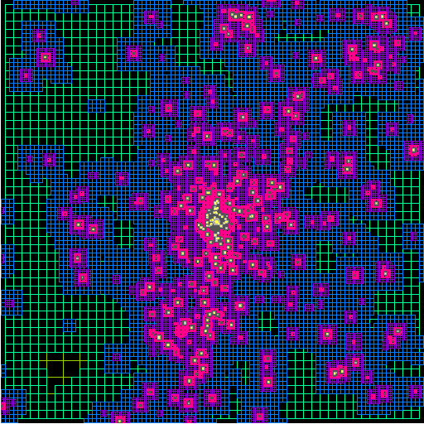
Adapting the grid resolution
cluster
galaxies
void
Local mass criterion :
if
then
Notes:
Galaxy cluster simulation
Cells are concentrated in densest regions where relevant physical processes occur
Mass threshold -> refine the cell / split in smaller cells

