Slide 1








Radiation from acceleration Particles in relativistic jets with shocks and shear-flow
Ken Nishikawa UAH/Physics
Collaborators: Y. Mizuno (Goethe-Universität Frankfurt am Mein) P. Hardee (Univ. of Alabama, Tuscaloosa) J. Niemiec (Institute of Nuclear Physics PAN) A. Meli (Unv. of Gent) B. Zhang (Univ. Nevada, Las Vegas) I. Duţan (Institute of Space Science, Romania) Å. Nordlund (Niels Bohr Institute)
J. Frederiksen (Niels Bohr Institute)
H. Sol (Meudon Observatory)
M. Pohl (U‐Potsdam/DESY)
M. Medvedev (Univ. of Kansas)
J. Gómez (IAA, CSIC)
Relativistic Jets: Creation, Dynamics, and Internal Physics,
April 22, 2015

Slide 2
Outline of talk
1. Introduction and Weibel instability
2. Recent 3-D particle simulations of relativistic jets
* e±pair jet into e±pair, γ= 15 and
electron-ion (m_{i}/m_{e} = 20) into electron-ion γ= 15
shock structures (Choi et al. 2014, PhPl)
3. Magnetic field generation and particle
acceleration in kinetic Kelvin-Helmholtz
instability (Nishikawa et al. 2014, ApJ)
4. Global jet simulations with shock and KKHI
5. Synthetic spectra in shocks generated by
the Weibel instability
6. Summary
7. Future plans

Slide 3
Key Scientific questions
• How do shocks in relativistic jets evolve?
How do magnetic fields affect shocks and reconnection?
How are particles accelerated?
What are the dominant radiation processes?
How do 3-D relativistic PIC simulations reveal the dynamics
of shock fronts and transition regions (CD and RS)?
How do shocks in relativistic jets evolve in various ambient
plasma- and magnetic field configurations?
How do magnetic fields generated by the Weibel
instability contribute to the emerging radiation?
• How do velocity shears generate magnetic fields and
accelerate particles?
• How the Weibel instability and kKHI affect the evolution
of shock with global jets?

Slide 4
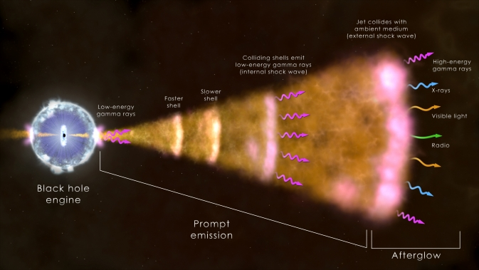
Gamma-ray bursts
Global jet simulation
Simulation box
Collapsar
Merger

Slide 5
injected at z = 25Δ
3-D simulation
Y
jet
with MPI code
Weibel inst
Z
Weibel inst
X
4005 ×131×131 grids
(not scaled)
1.2 billion particles
jet front
ambient plasma

Slide 6
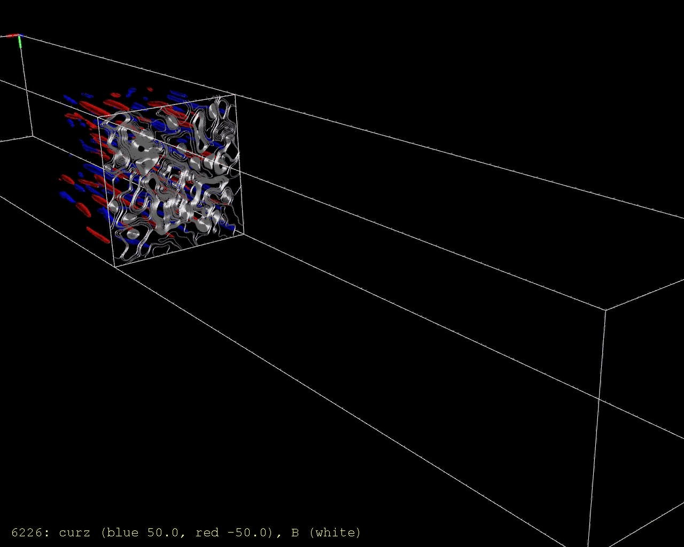
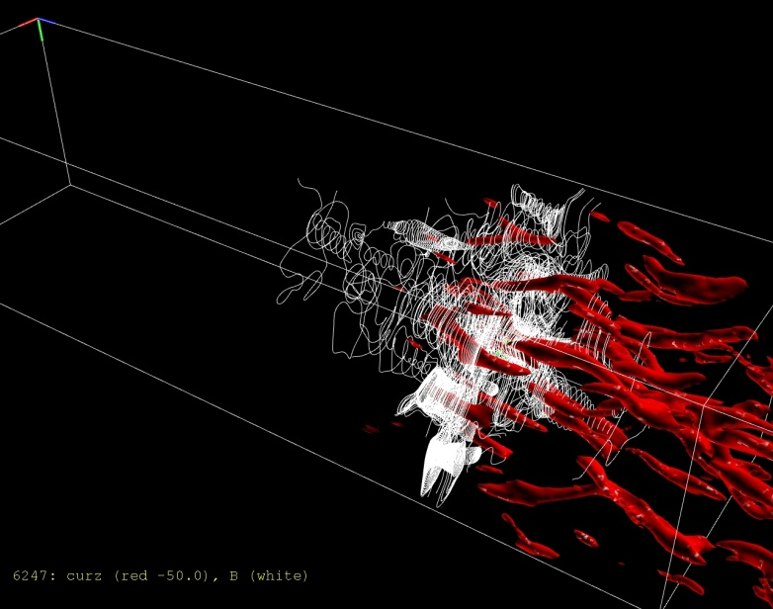
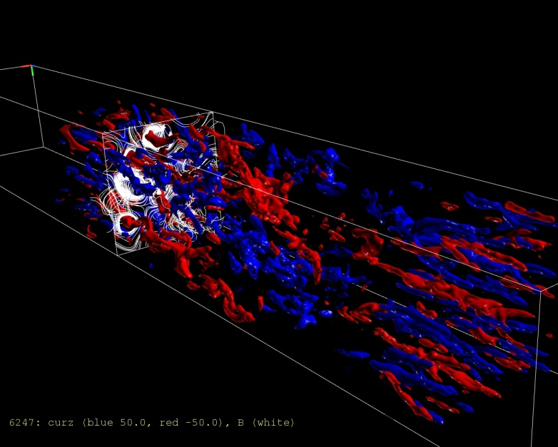
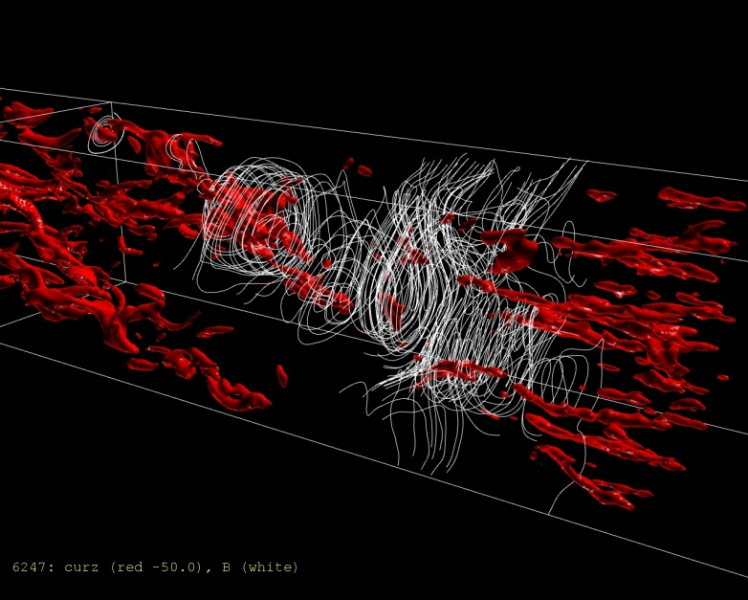
3-D isosurfaces of z-component of current Jz for narrow jet (γv||=12.57)
electron-ion ambient
t = 59.8ω_{e}⁻¹
-J_{z} (red), +J_{z} (blue),
magnetic field lines (white)
Particle acceleration due to the local
reconnections during merging current
filaments at the nonlinear stage
thin filaments
merged filaments

Slide 7
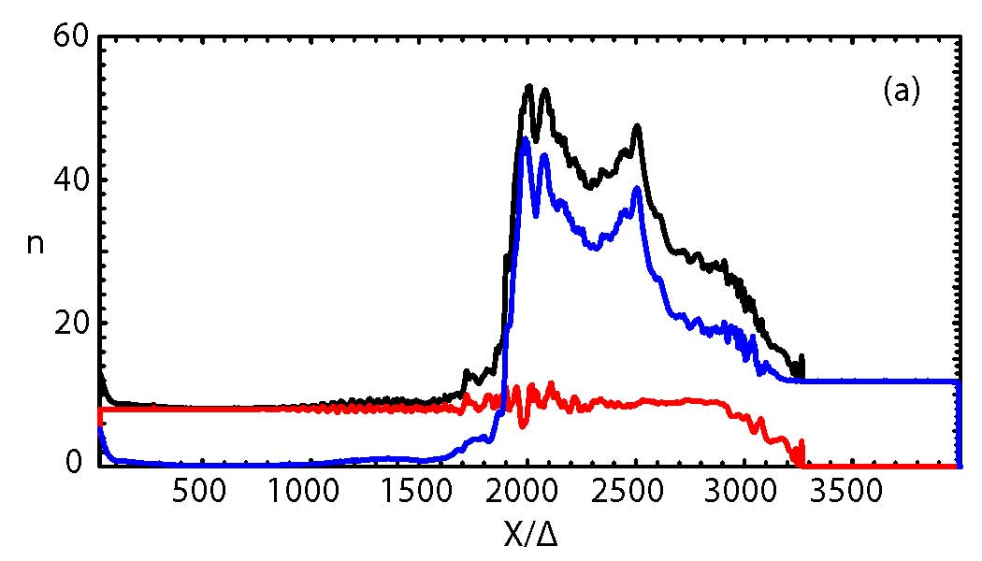
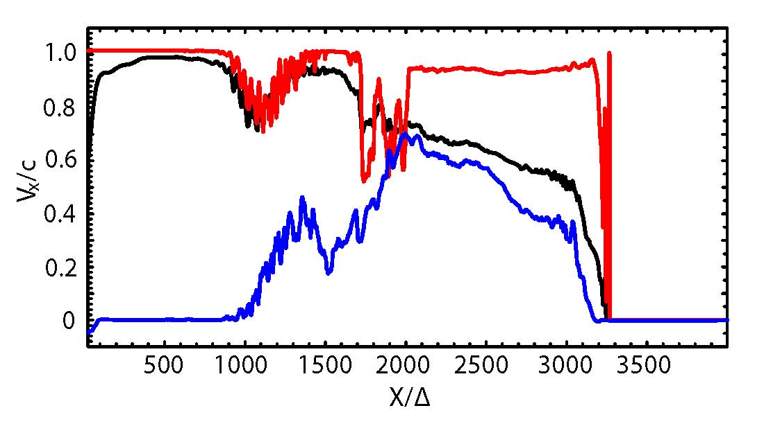
Shock velocity and bulk velocity
contact discontinuity (CD)
reverse shock
leading shock
(forward shock)
(trailing shock)
trailing edge
leading edge
jet electrons
Fermi acceleration ?
total electrons
ambient electrons
(Nishikawa et al. 2009)

Slide 8
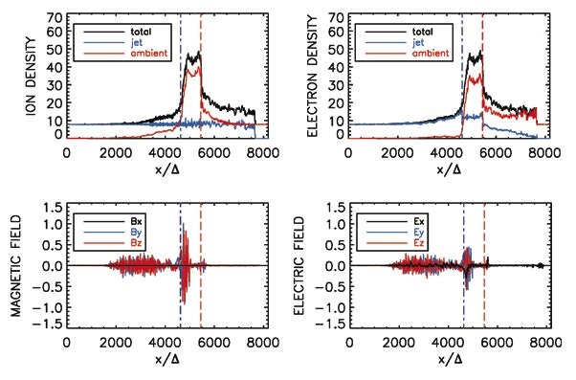
Recent electron-ion simulation (Electrostatic shock and double layer)
m_{i}/m_{e} = 20
(Choi et al. PhPl, 2014)

Slide 9
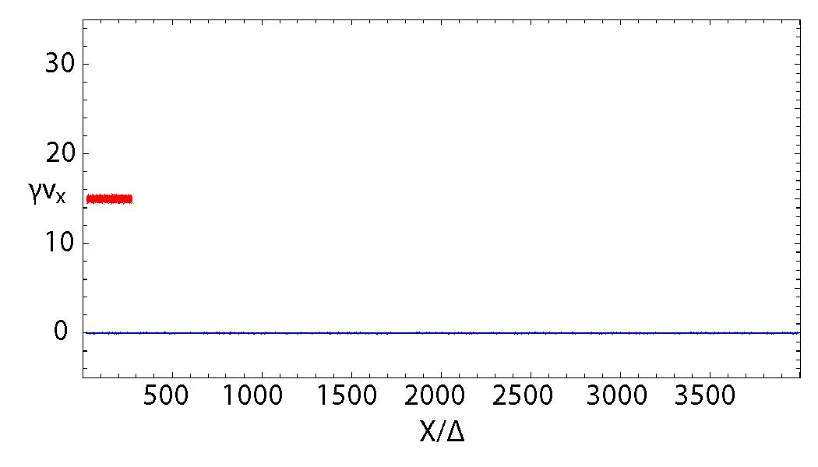
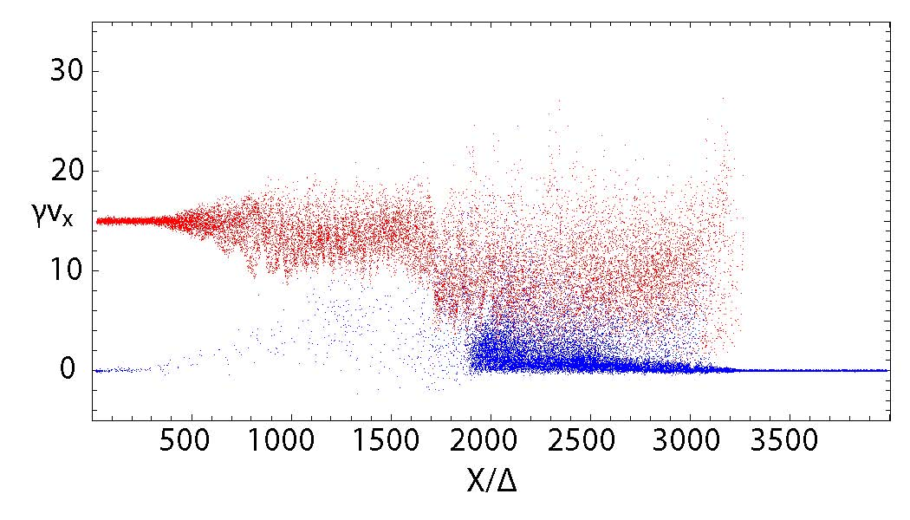
Phase space of electrons
red: jet electrons, blue: ambient electrons
Phase space of electrons in the x/∆−γv_{x} at t = 3250ω_{pe}⁻¹.
Red dots show jet electrons which are injected from the left with γv_{x} =15
(Nishikawa et al. ApJ, 698, L10, 2009)

Slide 10
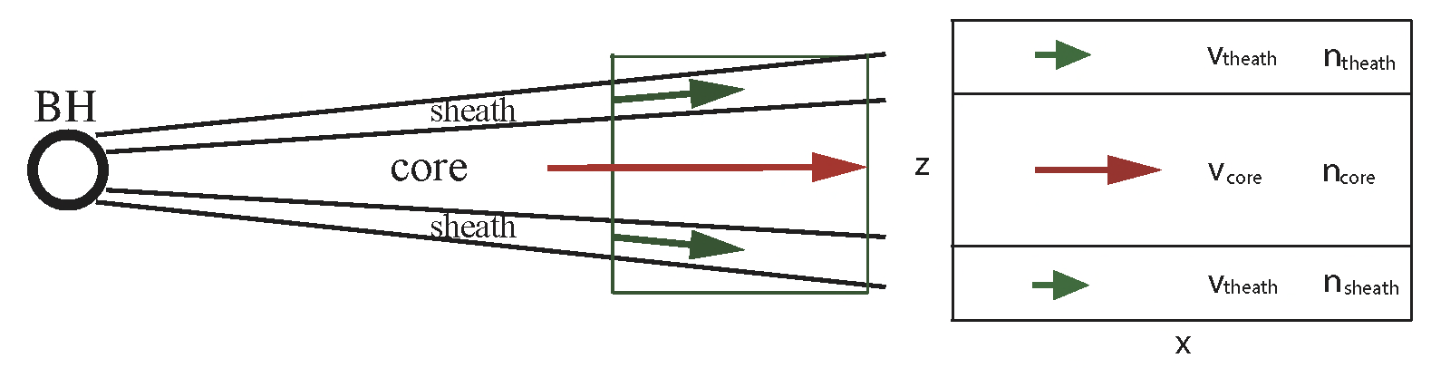
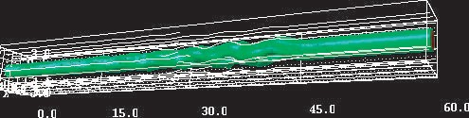
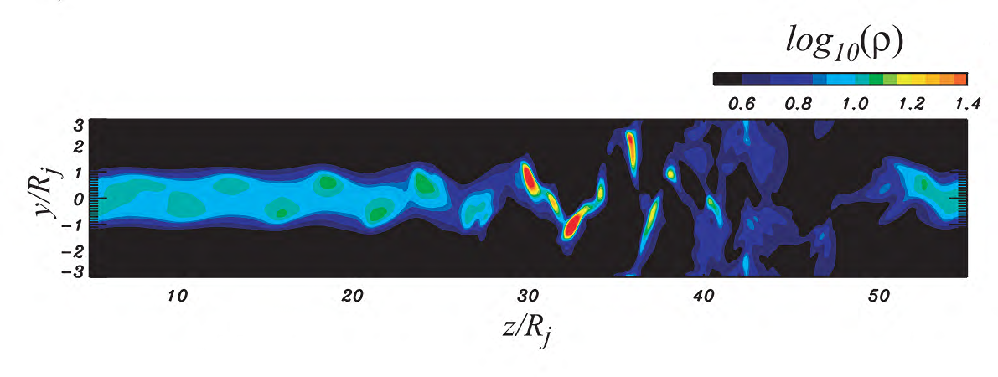
Simulations of KHI with core and sheath jets
slab model
RMHD, no wind ω=0.93, time=60.0
case of V_{theath} = 0
Mizuno, Hardee & Nishikawa, ApJ, 662, 835, 2007

Slide 11
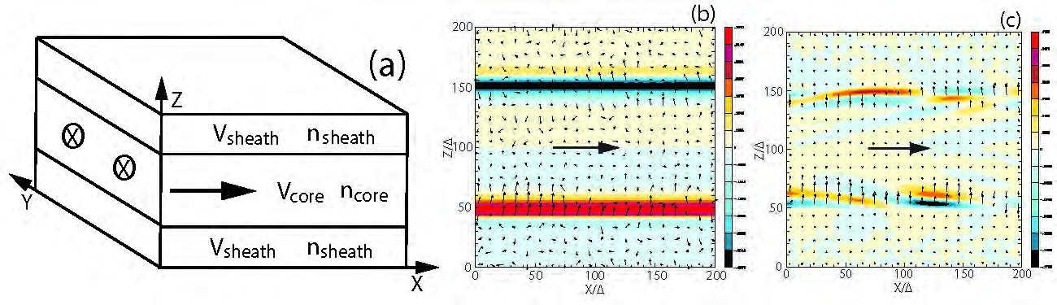
KKHI with Core-sheath plasma scheme
γ_{jt} = 15
B_{y}
V_{sheath} = 0 n_{core} = n_{sheath}
e - p
e±
(Nishikawa et al. 2014, ApJ)

Slide 12
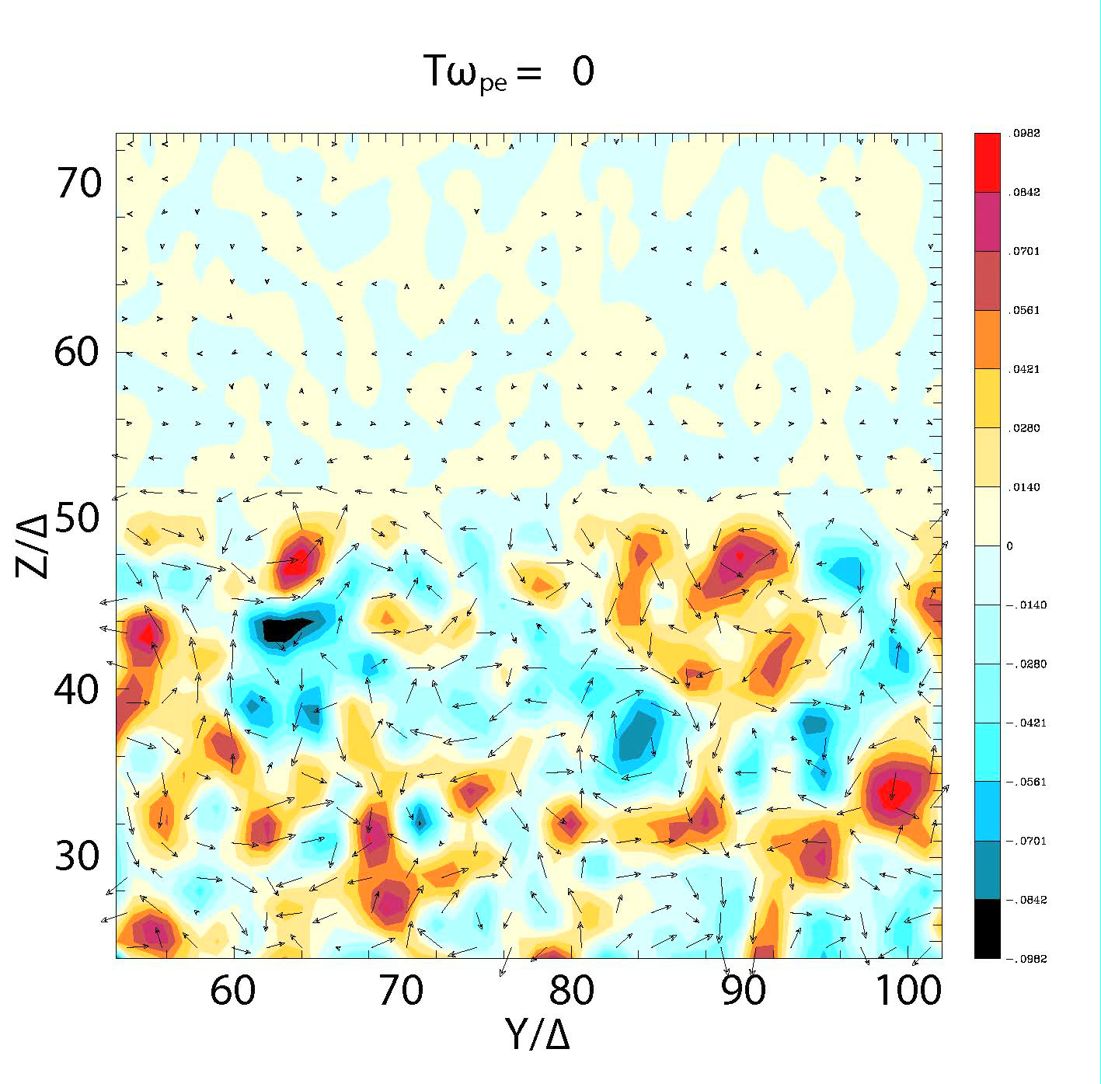
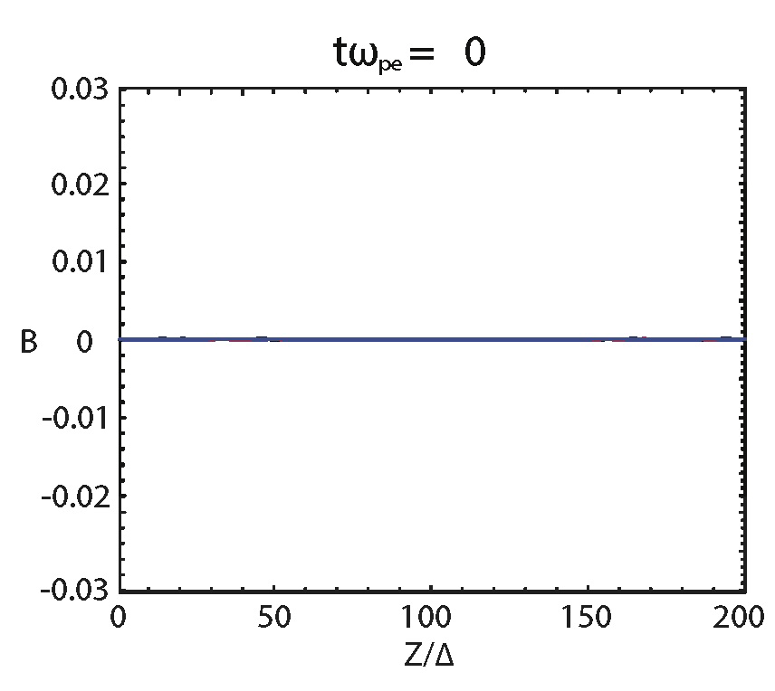
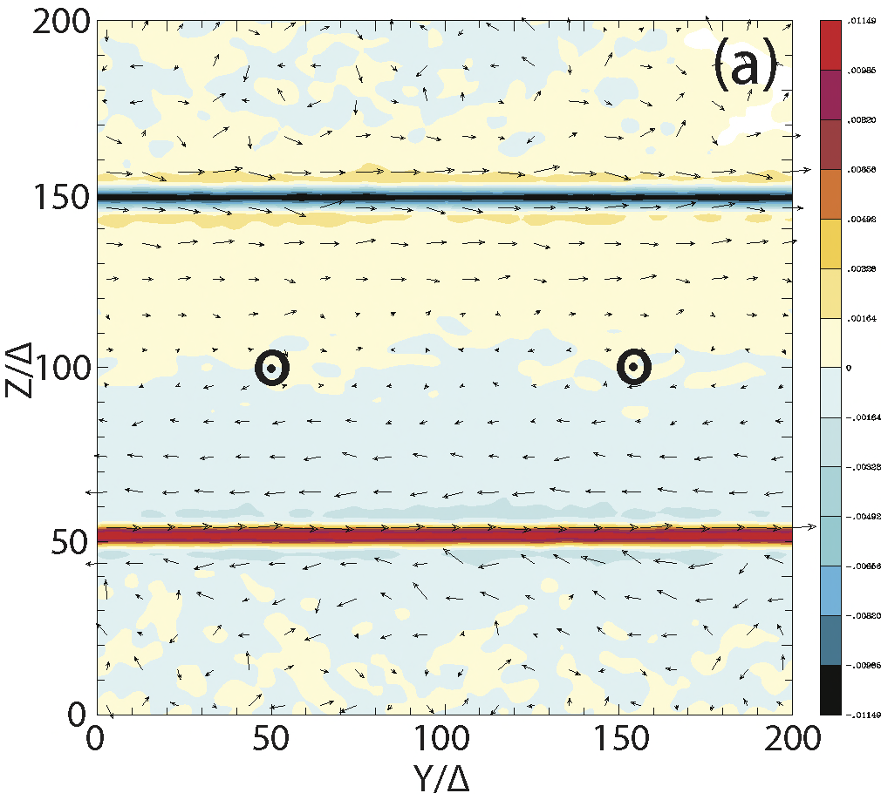
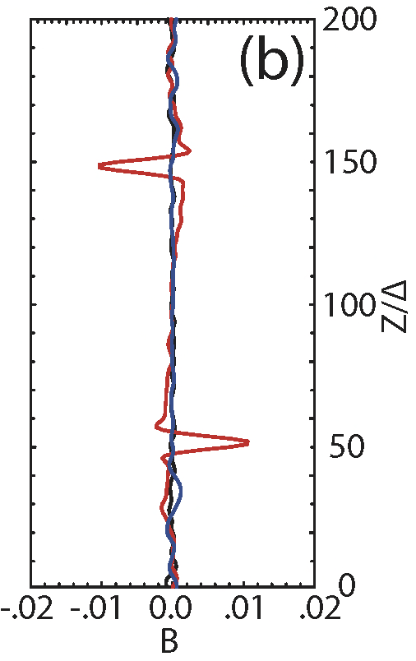
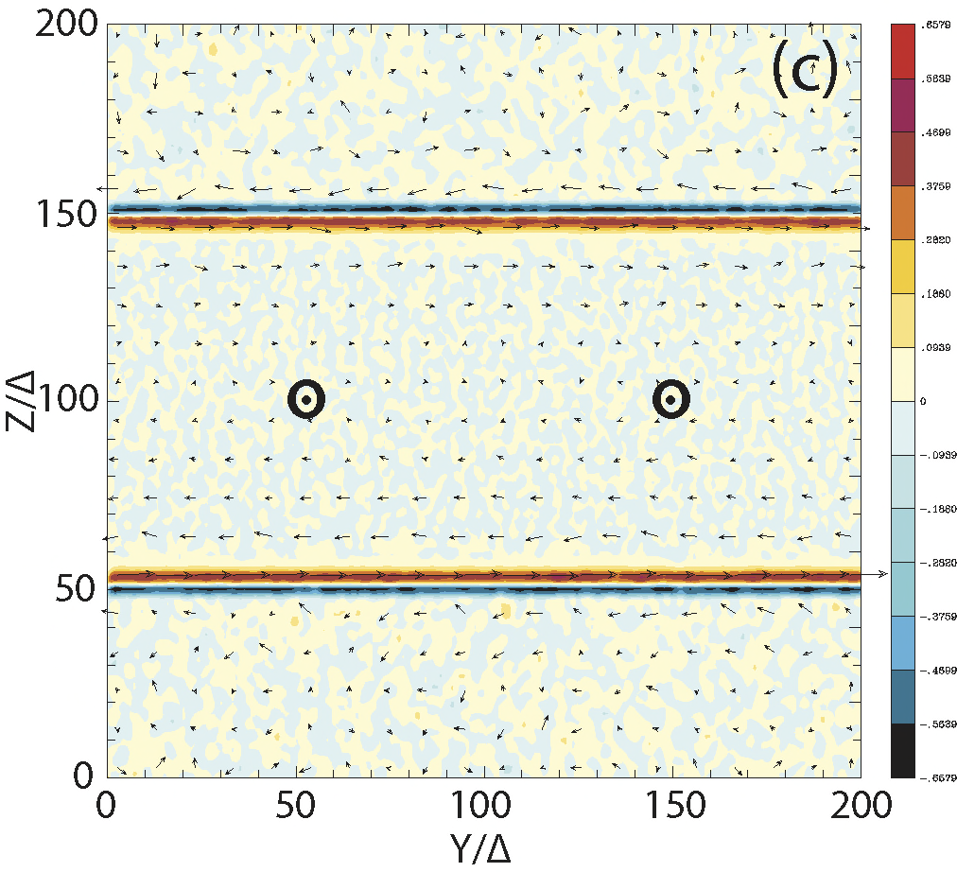
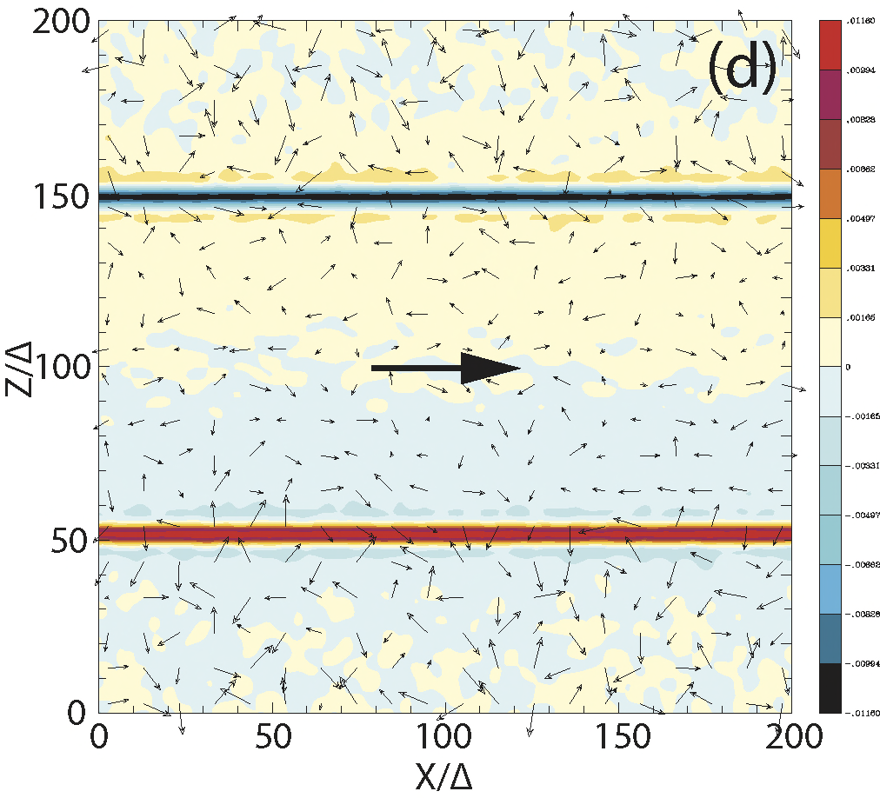
New KKHI simulations with core and sheath jets in slab geometry
γ_{j} = 15, m_{i}/m_{e} = 20
B_{y}
Nishikawa et al. 2013
eConf C121028
(arXiv:1303.2569)
B_{y}
(Nishikawa et al. Ann.
Geo, 2013)
J_{x}
B_{y}

Slide 13
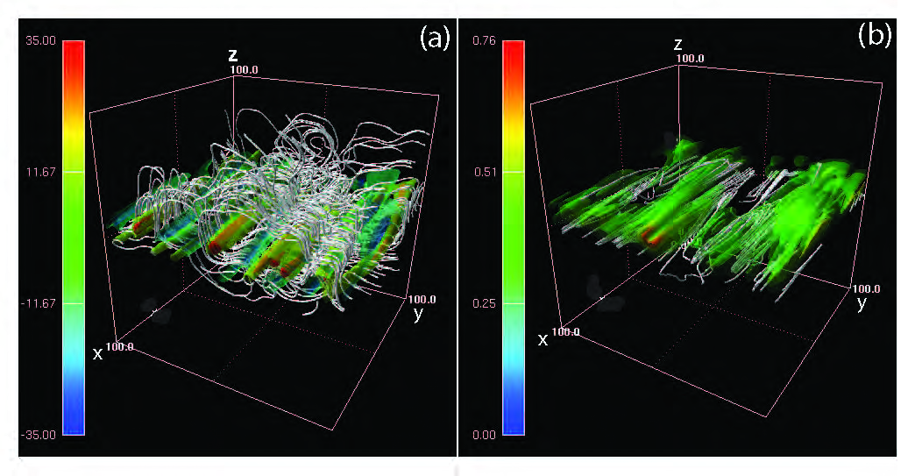
3D structure of current filaments and magnetic field
e±
γ_{jt} = 5
J_{x} with magnetic field lines
B² with current streaming lines
(Nishikawa et al. 2014, ApJ)

Slide 14
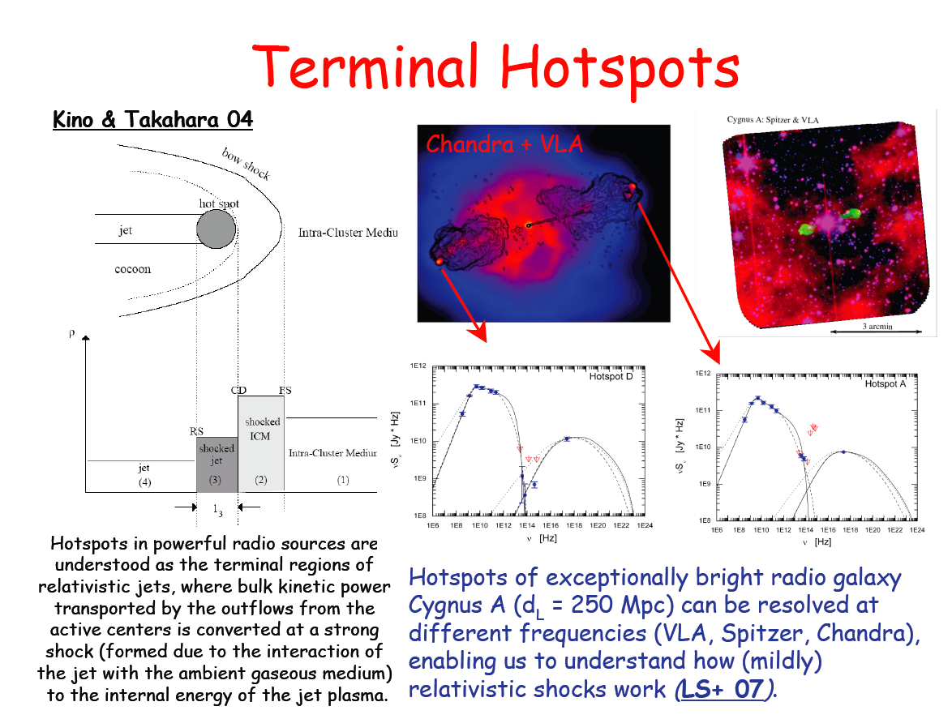
Global jet
in RPIC
mixed
courtesy of L. Stawarz

Slide 15
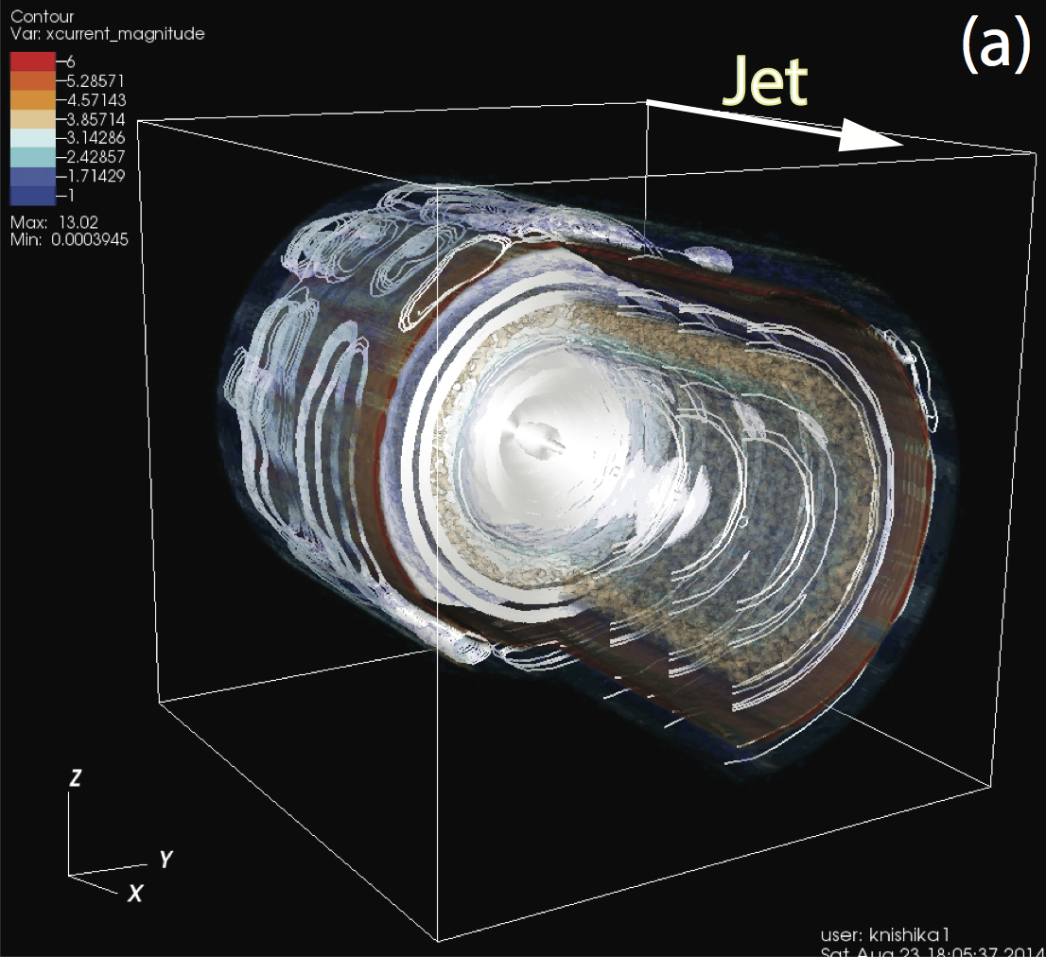
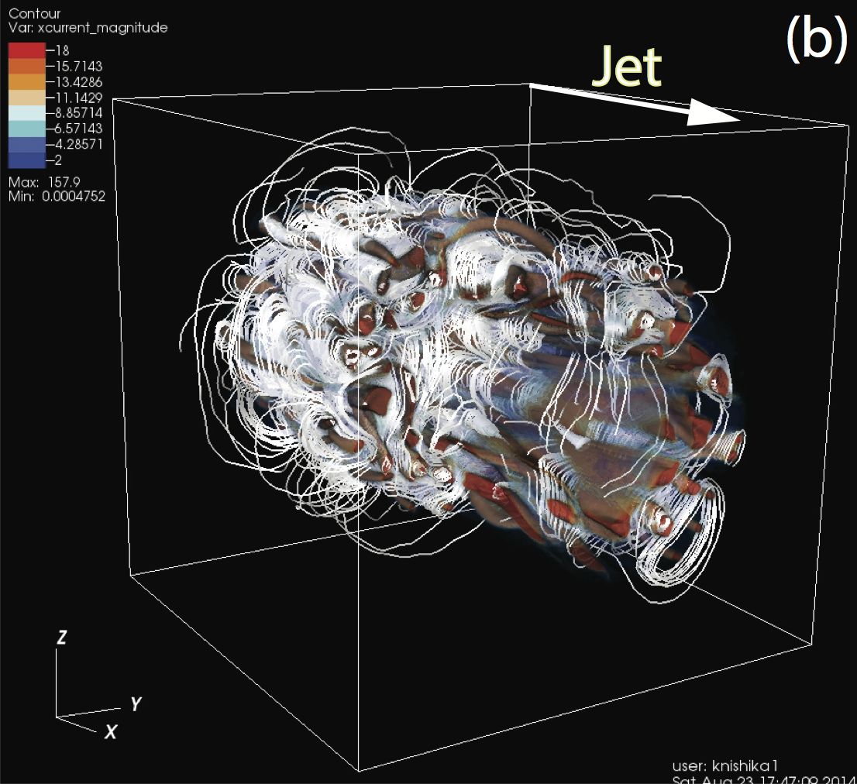
Cylindrical kKHI simulations
γ_{jt} = 5
n_{jet} = n_{sheath}
e - p
e±

Slide 16
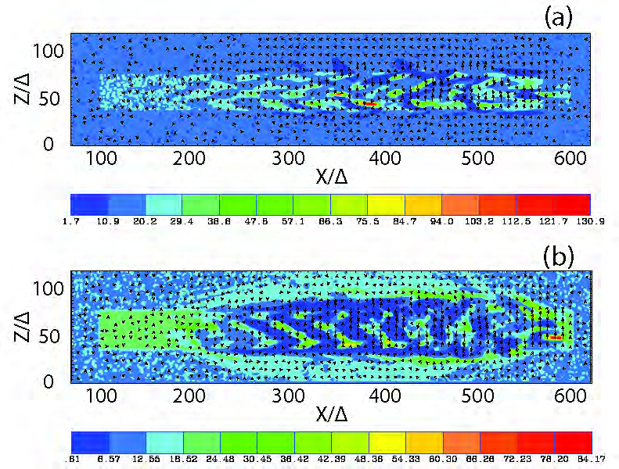
Snap shot of electron density of global jet simulations
γ_{jt} = 15
n_{jet} = 0.67n_{amb}
Jet head
jet
480
580
e - p
e±
(Nishikawa et al. 2014)

Slide 17
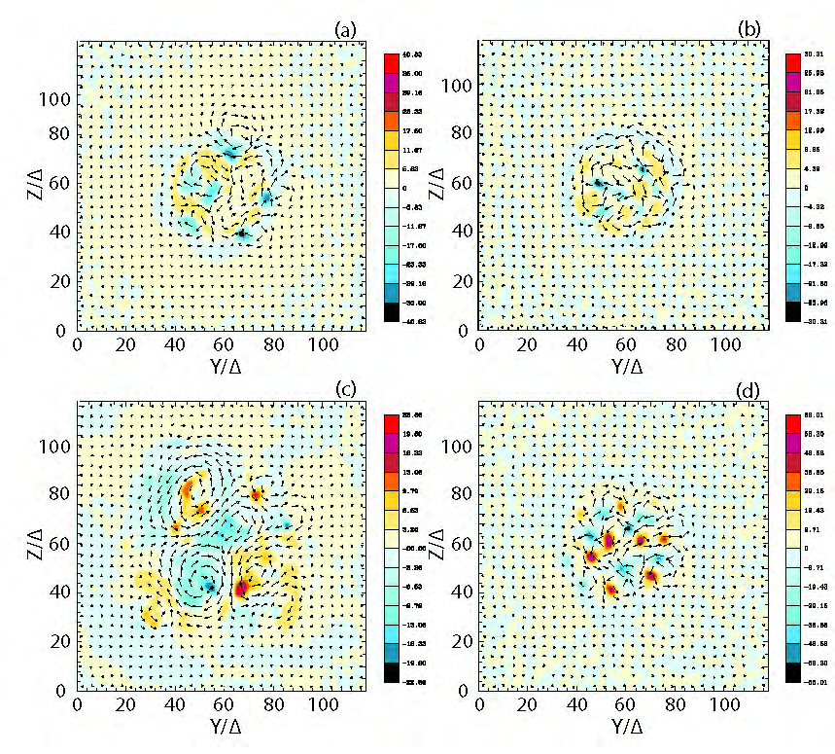
Snap shots of current structures with transverse magnetic fields
γ_{jt} = 15
X/Δ = 480
X/Δ = 580
◉
Jet center
e - p
◉
◉
e±
◉
◉
(Nishikawa et al. 2014)

Slide 18
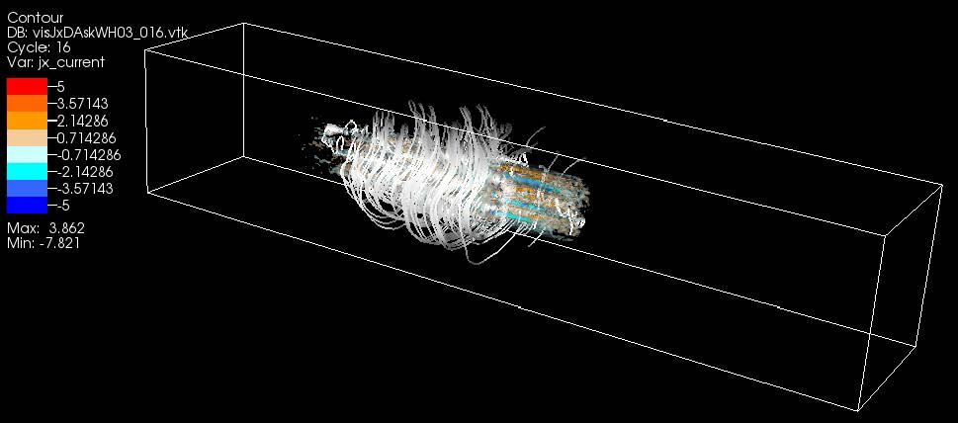
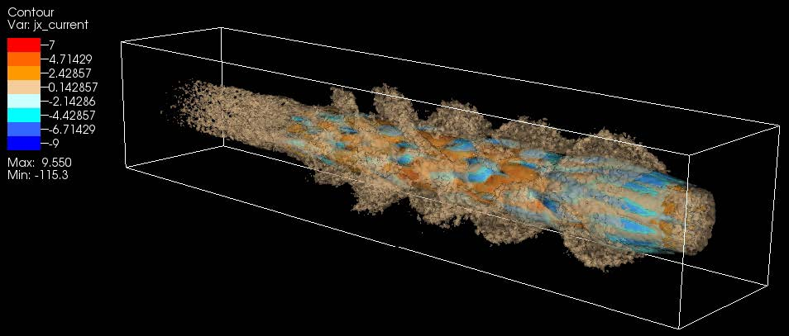
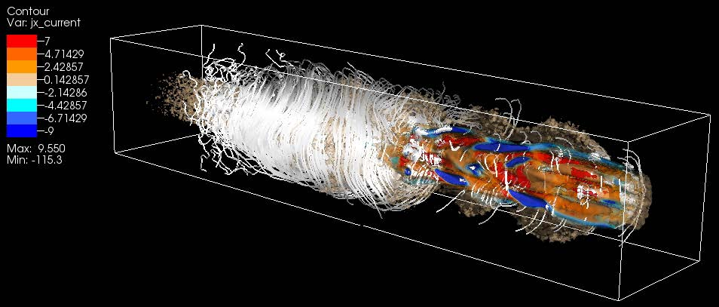
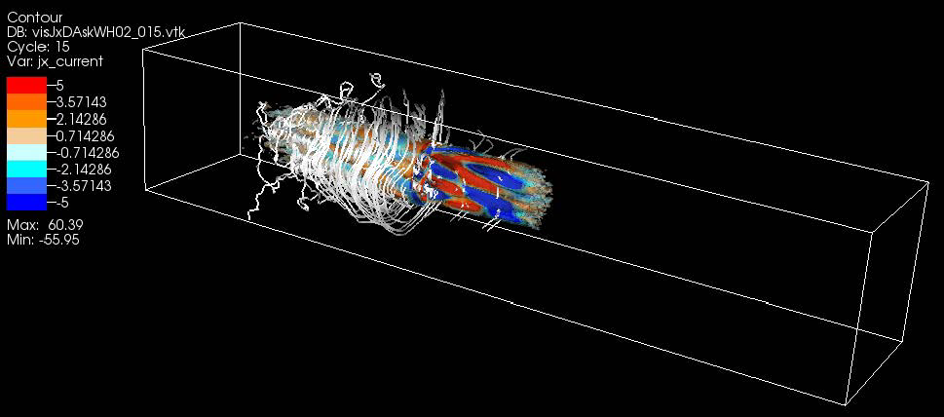
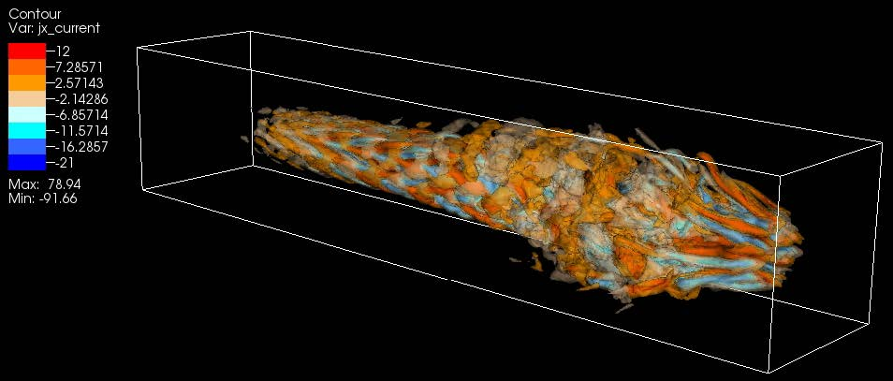
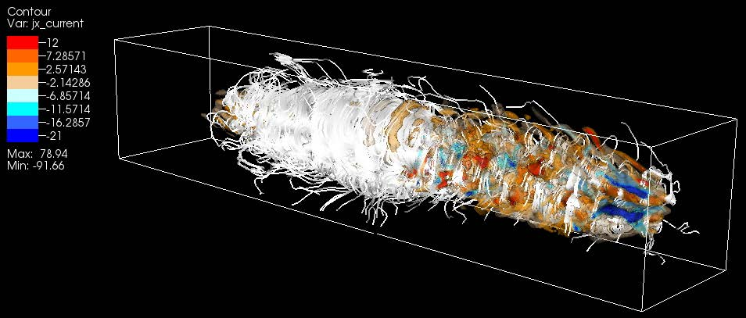
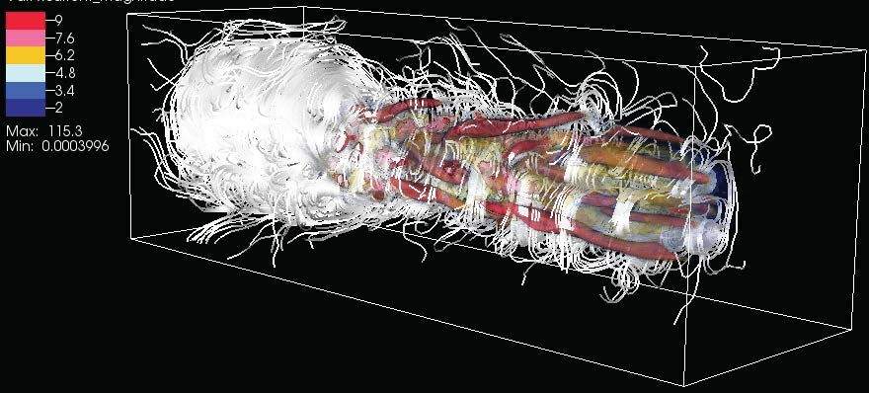
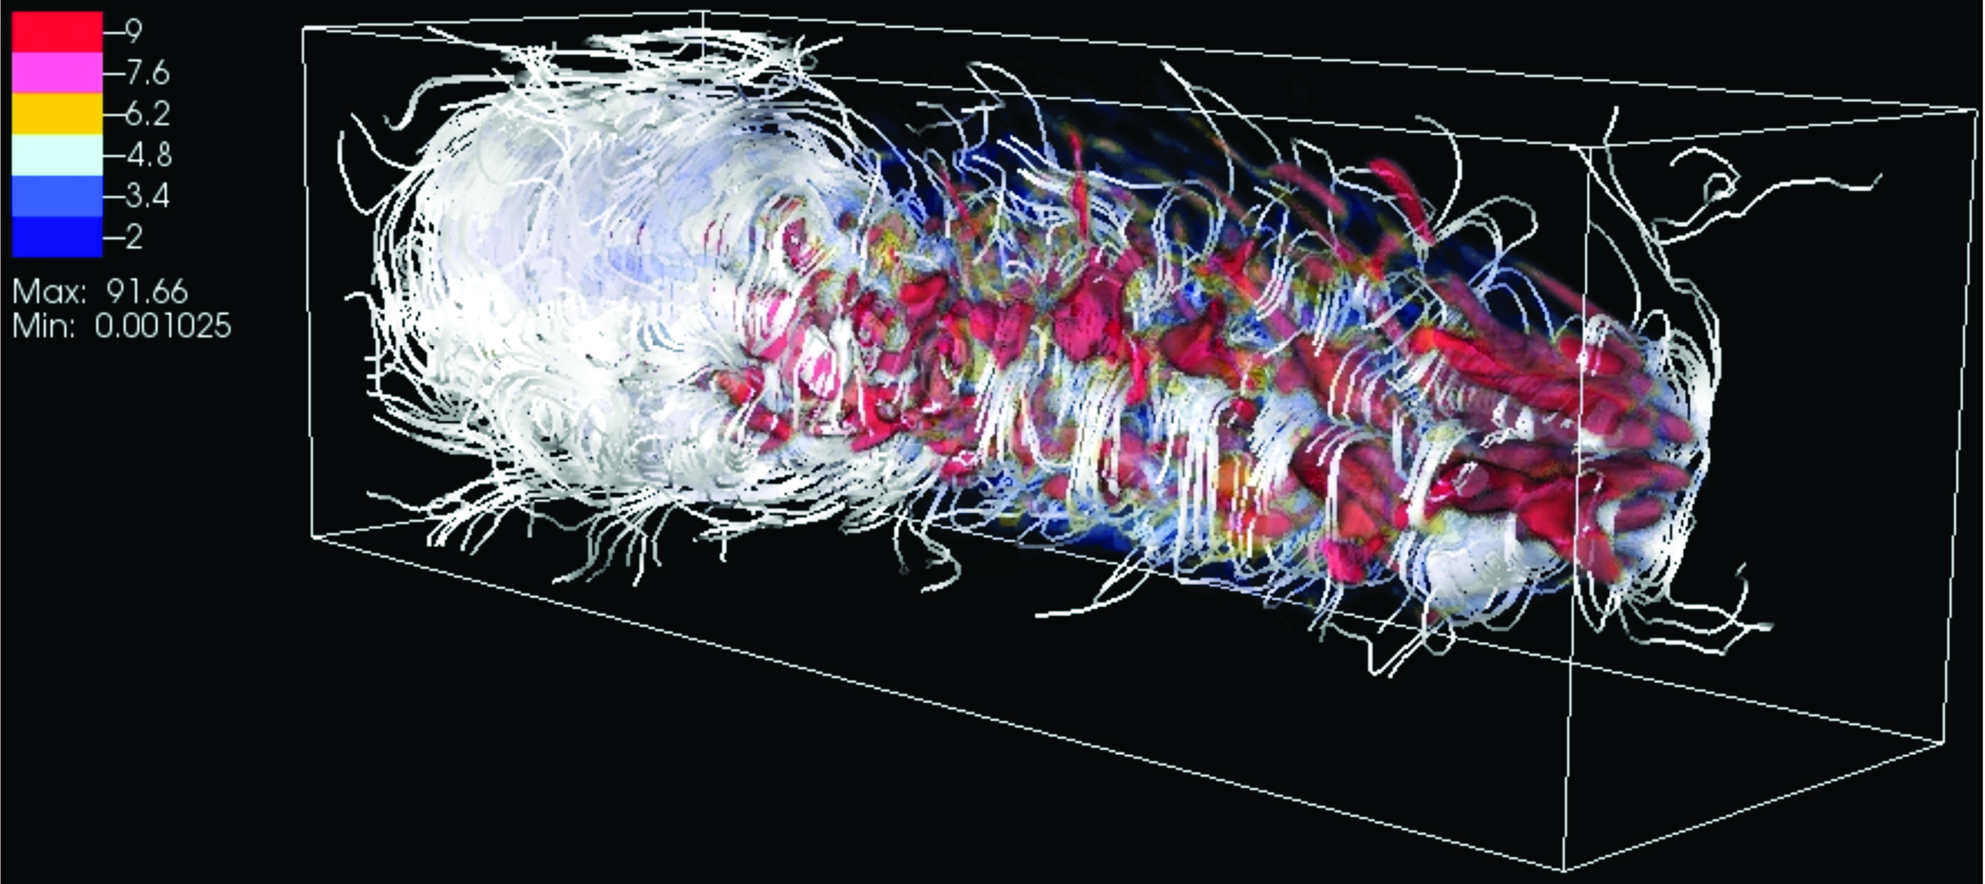
3D snapshots of current (J_{x}) isosurfaces with magnetic field lines
Evolution of shock and instability is different for electron-proton
and electron-positron
γ_{jt} = 15
e - p
white lines: magnetic filed lines
e±
(Nishikawa et al. 2014)
e-p jet
e-p jet
e-p jet
e± jet
e± jet
e± jet

Slide 19
Snap shot of electron density of global jet simulations
γ_{jt} = 15
n_{jet} = 0.67n_{amb}
e-p
e±
(Nishikawa et al. 2015)

Slide 20
Snap shots of current structures with transverse magnetic fields
γ_{jt} = 15
X/Δ = 500
X/Δ = 700
e-p
◉
◉
◉
Jet center
e±
◉
◉

Slide 21
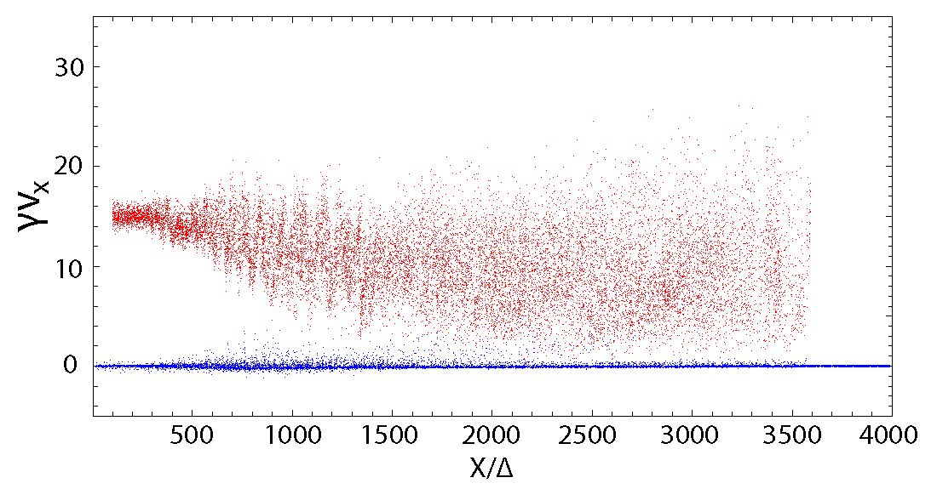
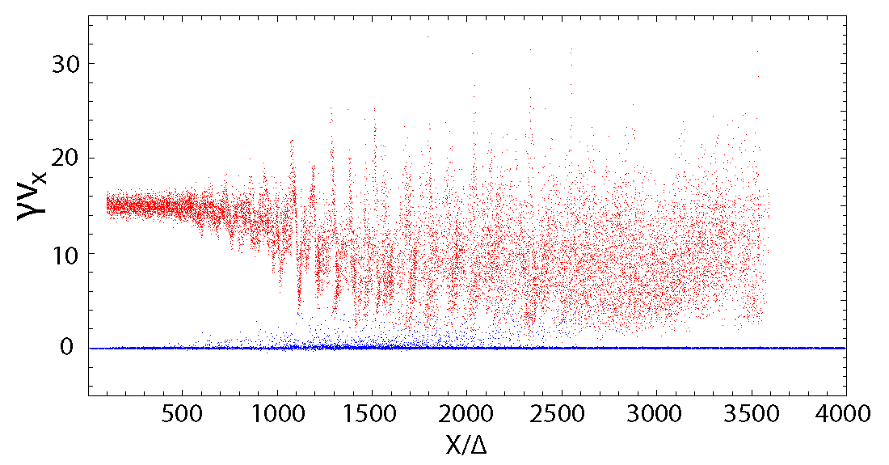
Phase space plot x - γv_{x}
γ_{jt} = 15
red: jet electrons blue: ambient electrons
e-p
e±

Slide 22
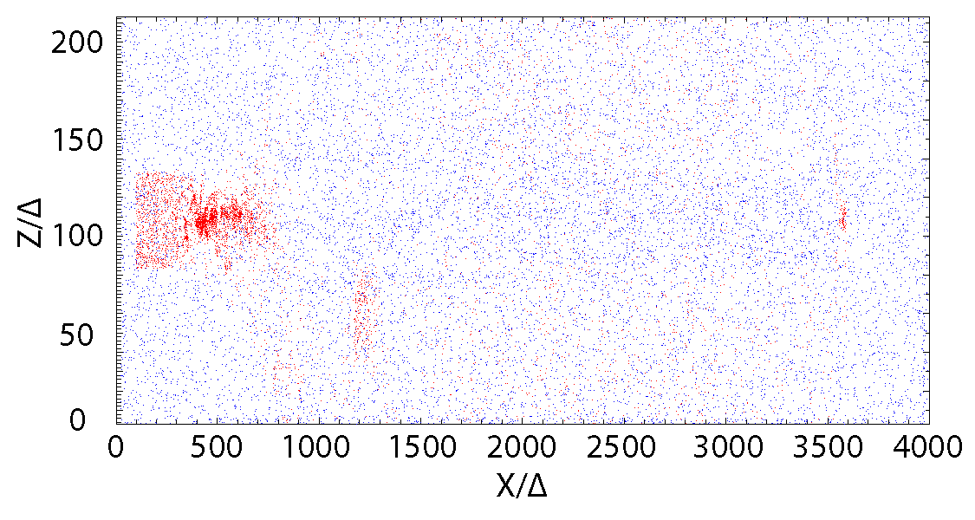
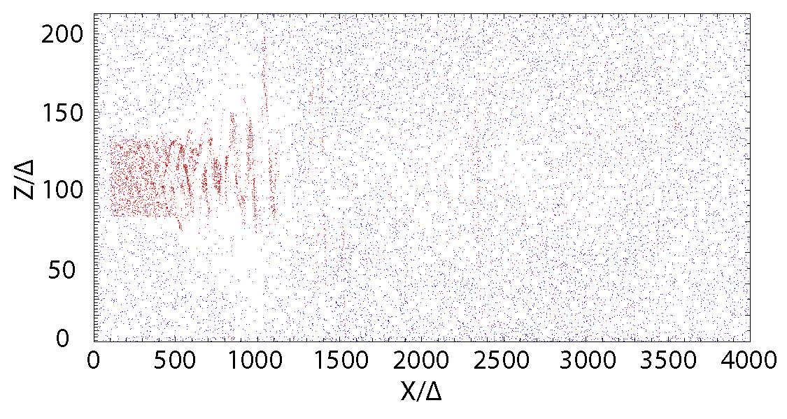
Phase space plot in x – z plane (105<y/Δ<101)
red: jet electrons blue: ambient electrons
γ_{jt} = 15
e-p
e±

Slide 23
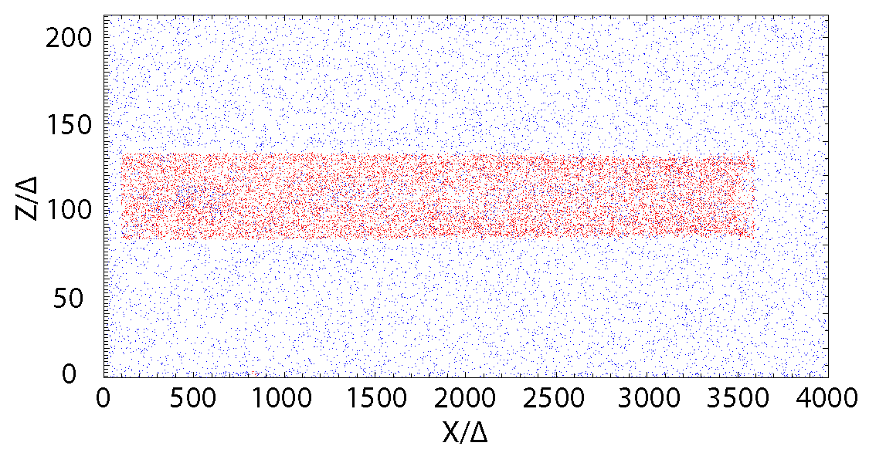
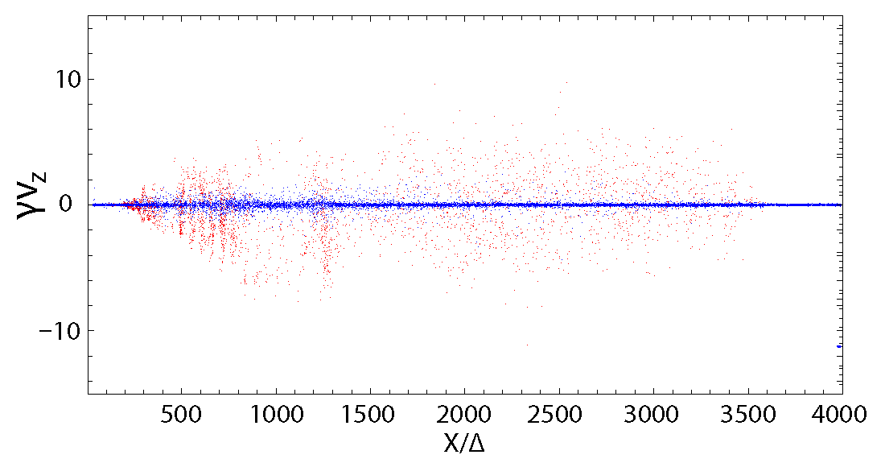
Phase space plot in x –z plane for e-p jet (105<y/Δ<101)
red: jet ions blue: ambient ions
γ_{jt} = 15
red: jet electrons blue: ambient electrons

Slide 24
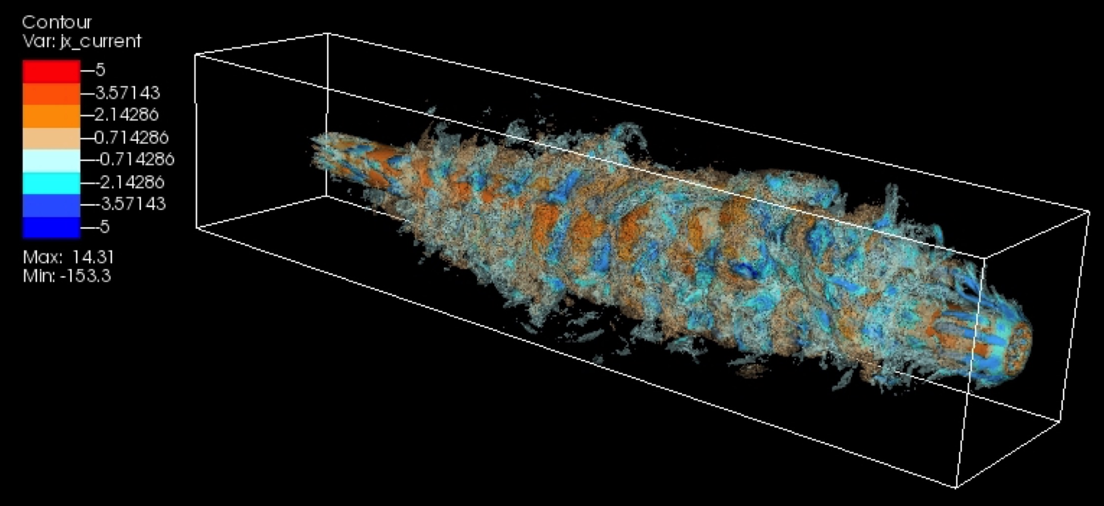
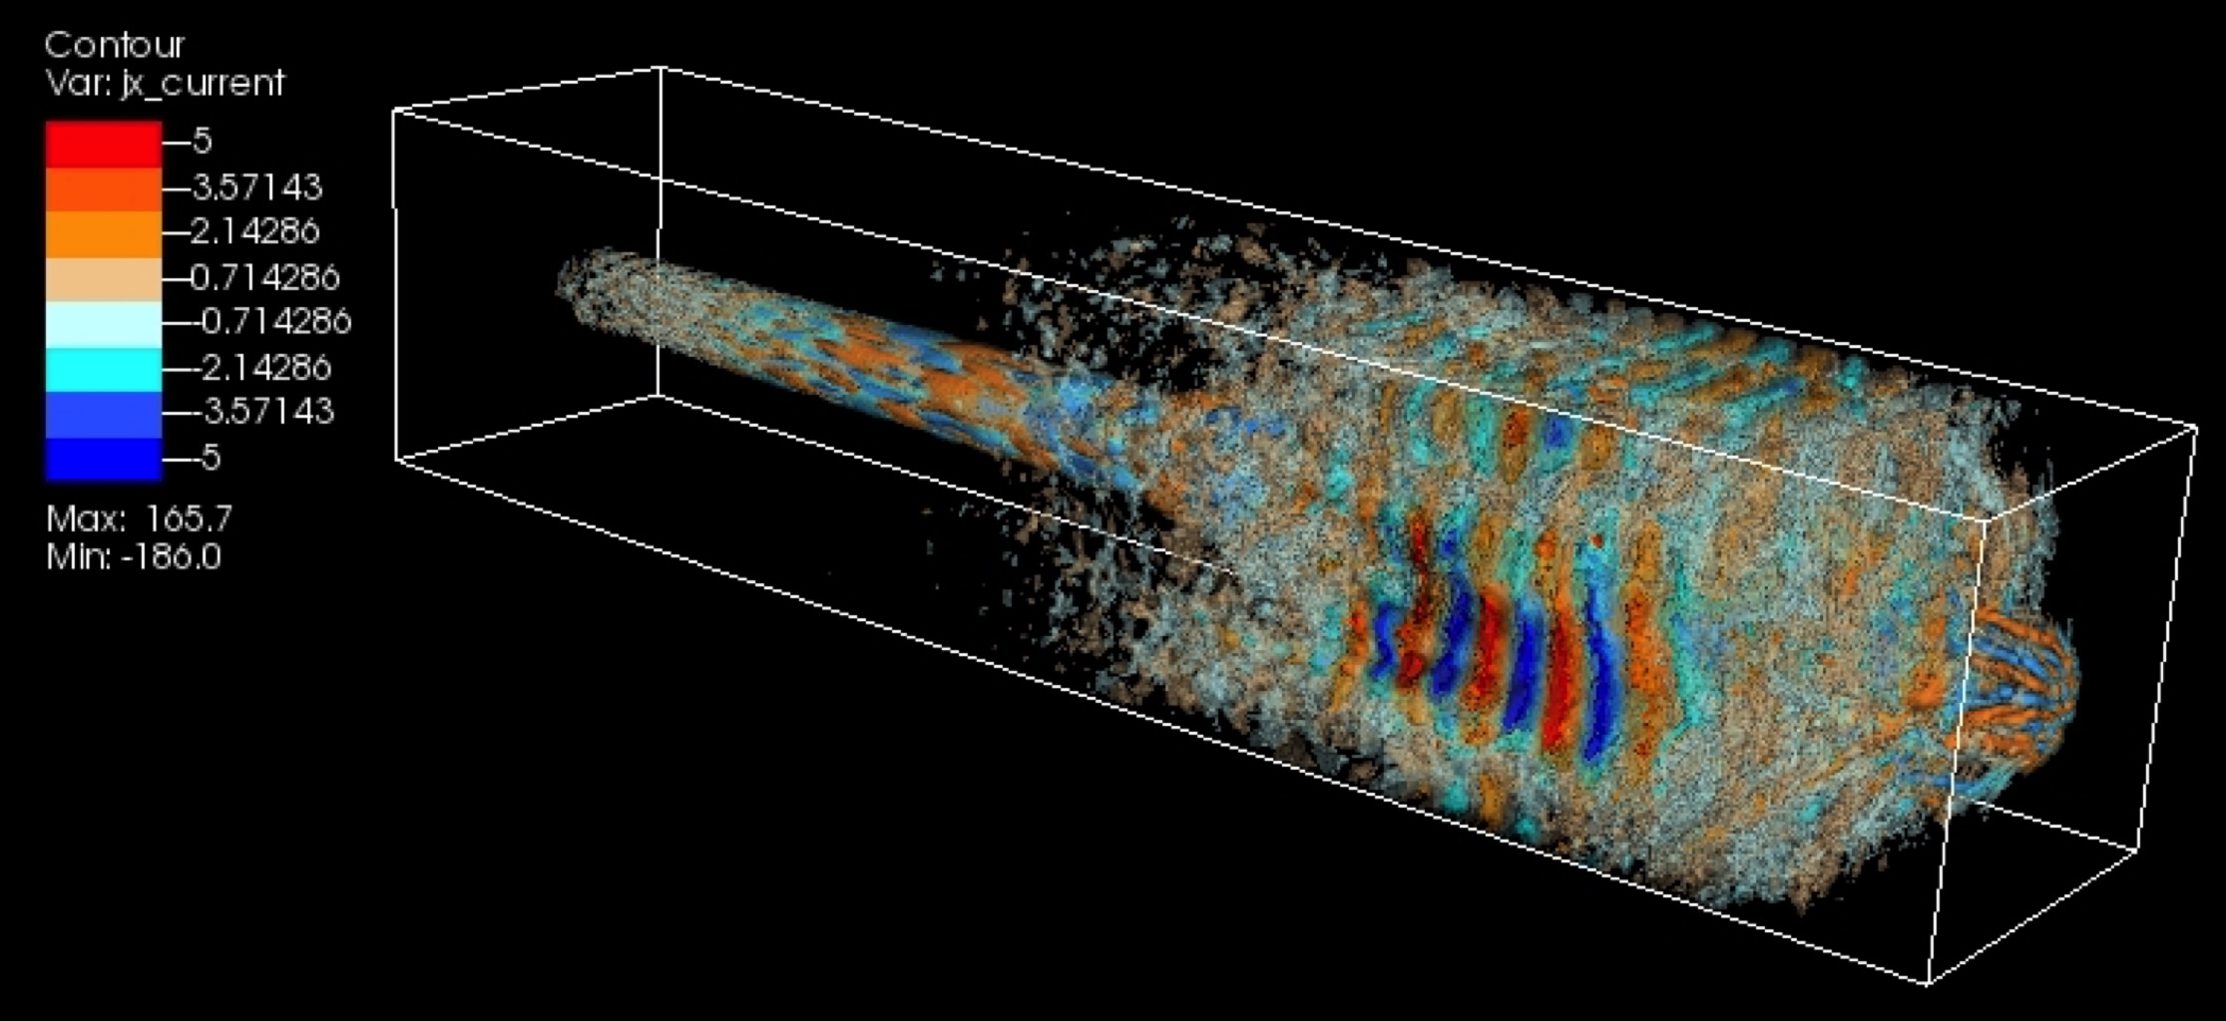
3D snapshots of current (J_{x}) isosurfaces without magnetic field lines
Evolution of shock and instability is different for electron-proton
and electron-positron
γ_{jt} = 15
e-p
e±

Slide 25
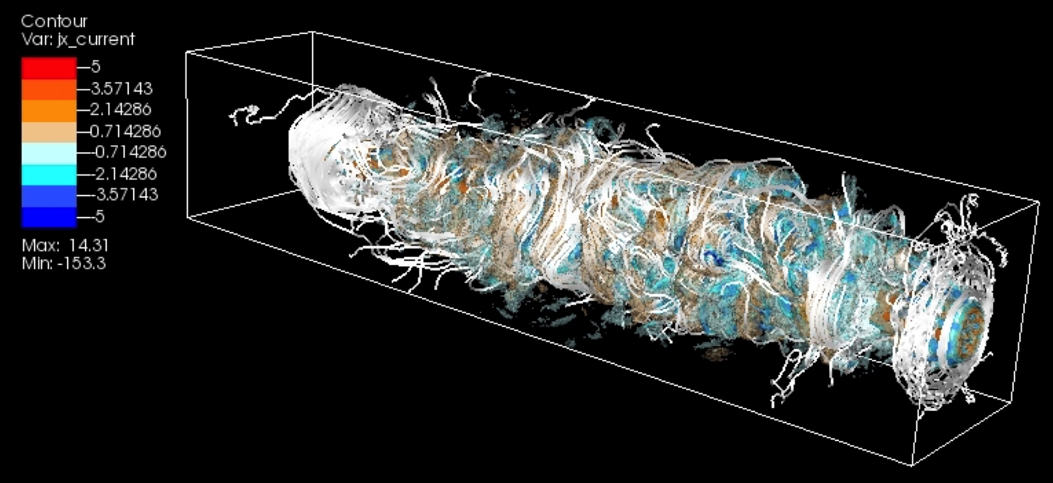
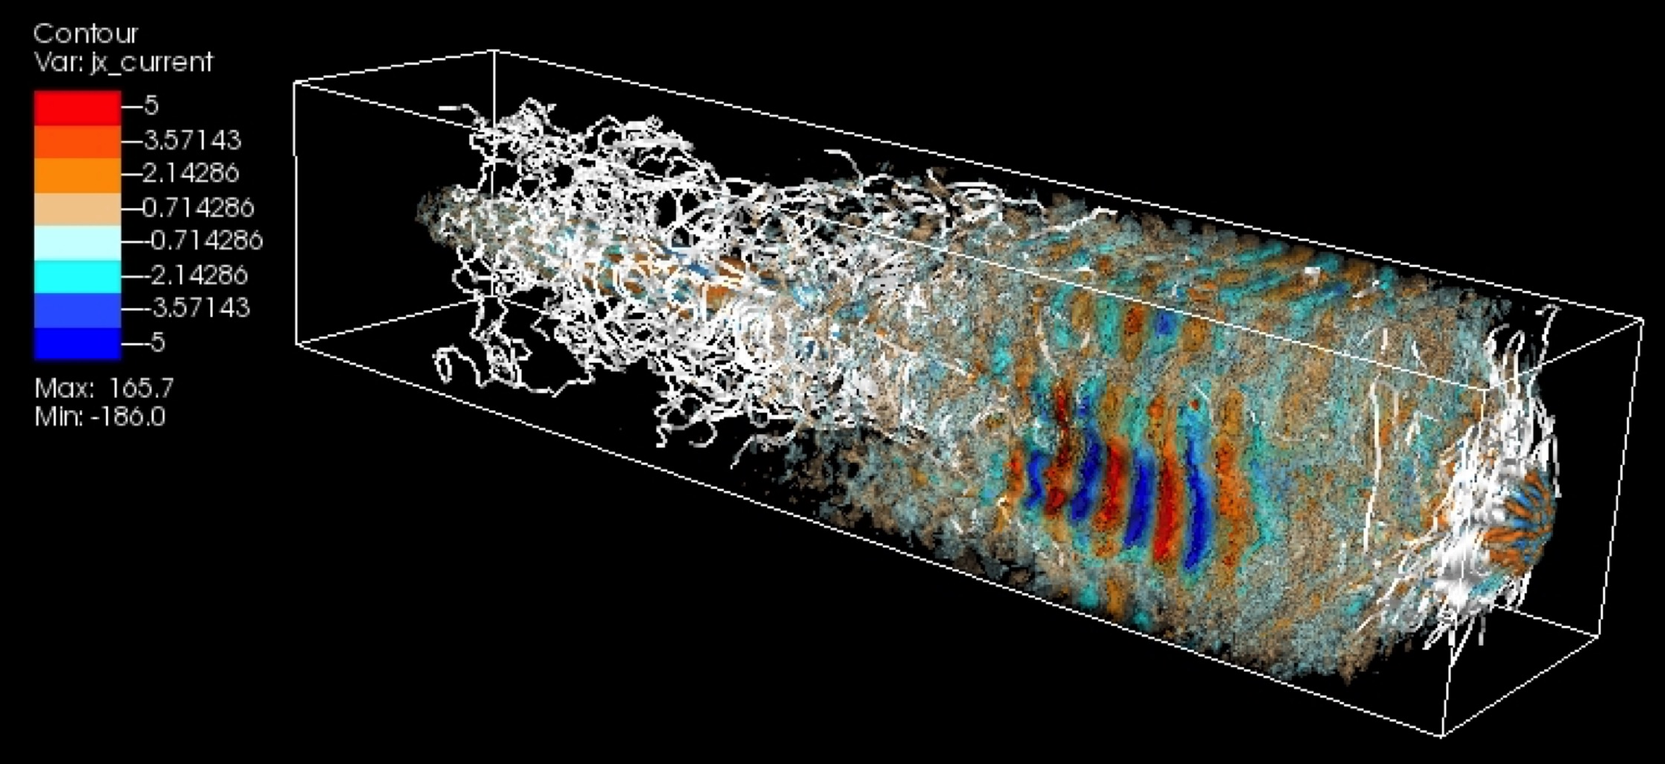
3D snapshots of current (J_{x}) isosurfaces with magnetic field lines
e-p
e±

Slide 26
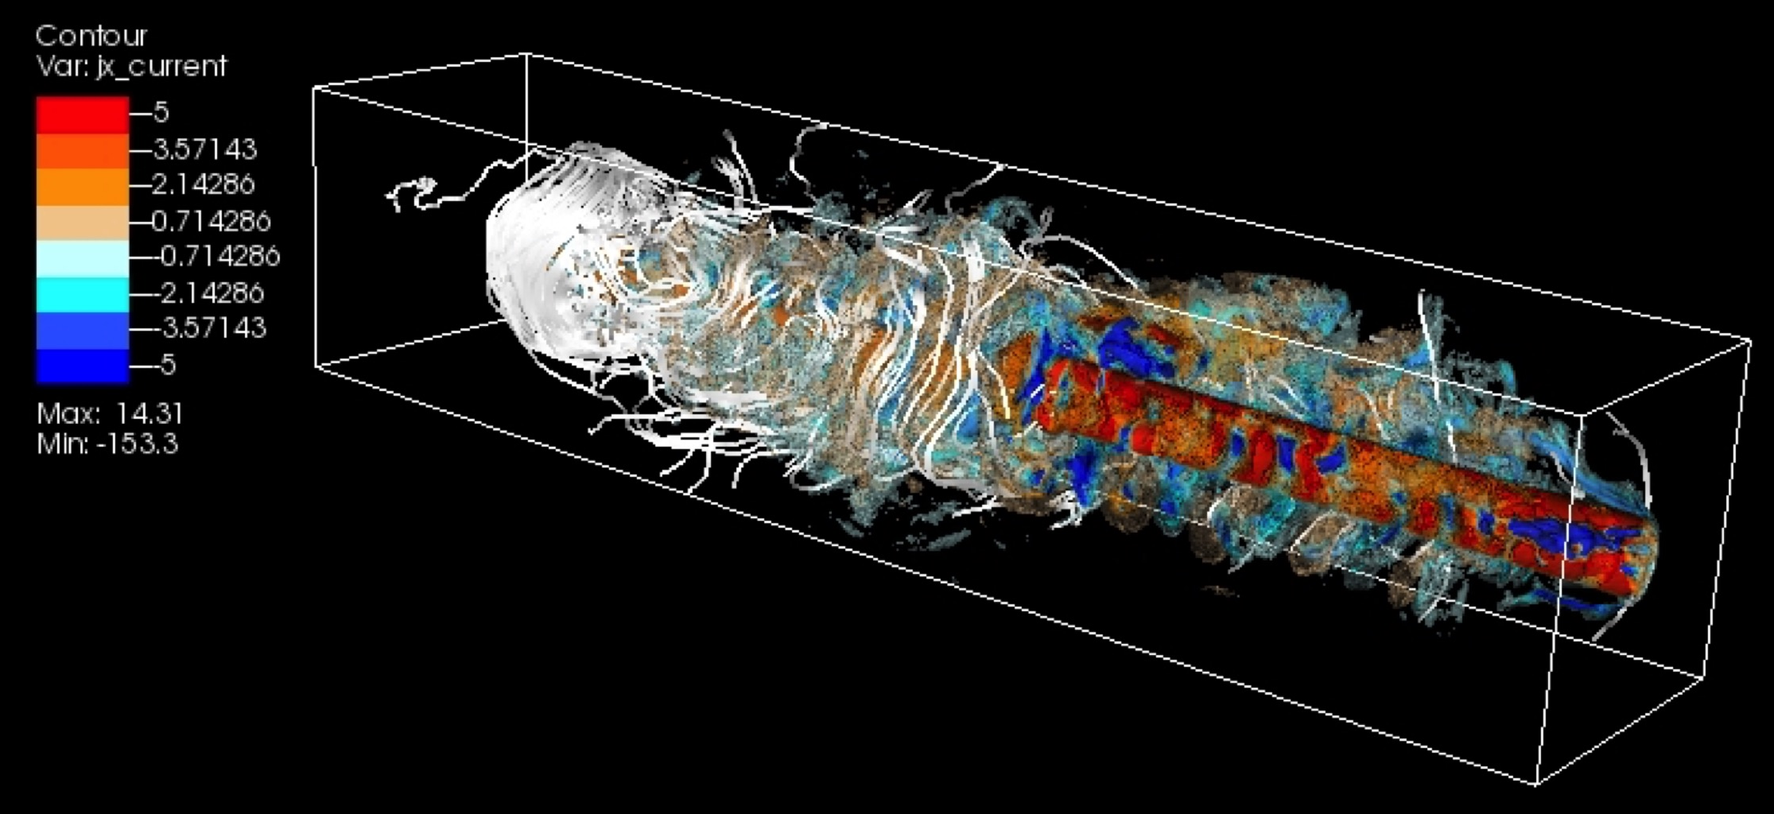
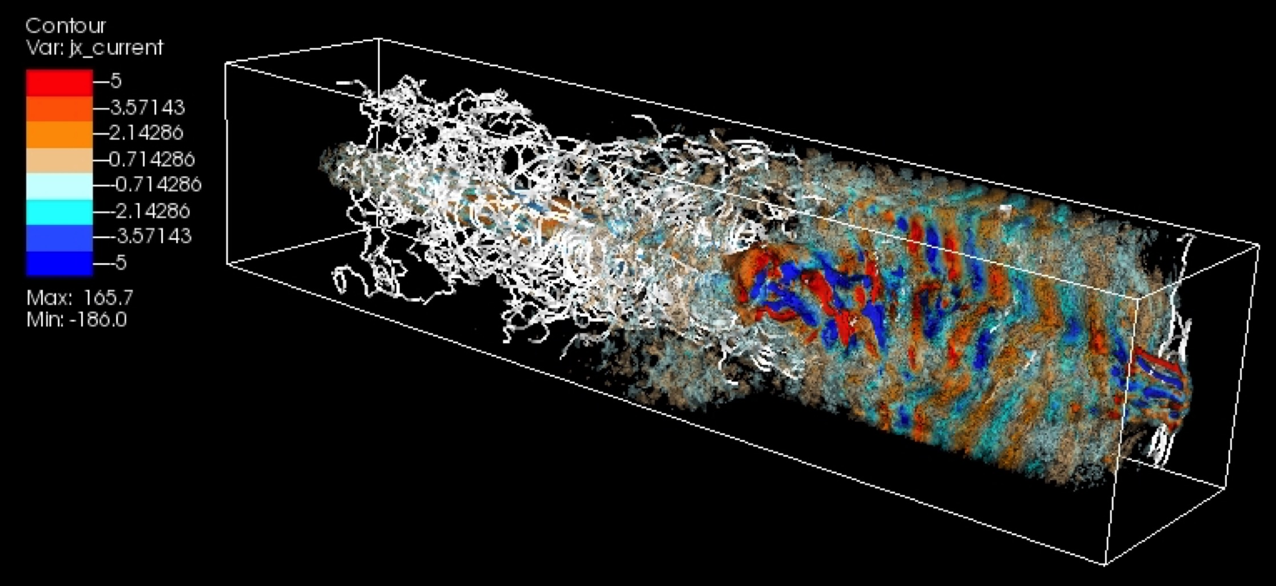
3D snapshots of current (J_{x}) isosurfaces with magnetic field lines
clipped at the center of jet
e-p
e±

Slide 27
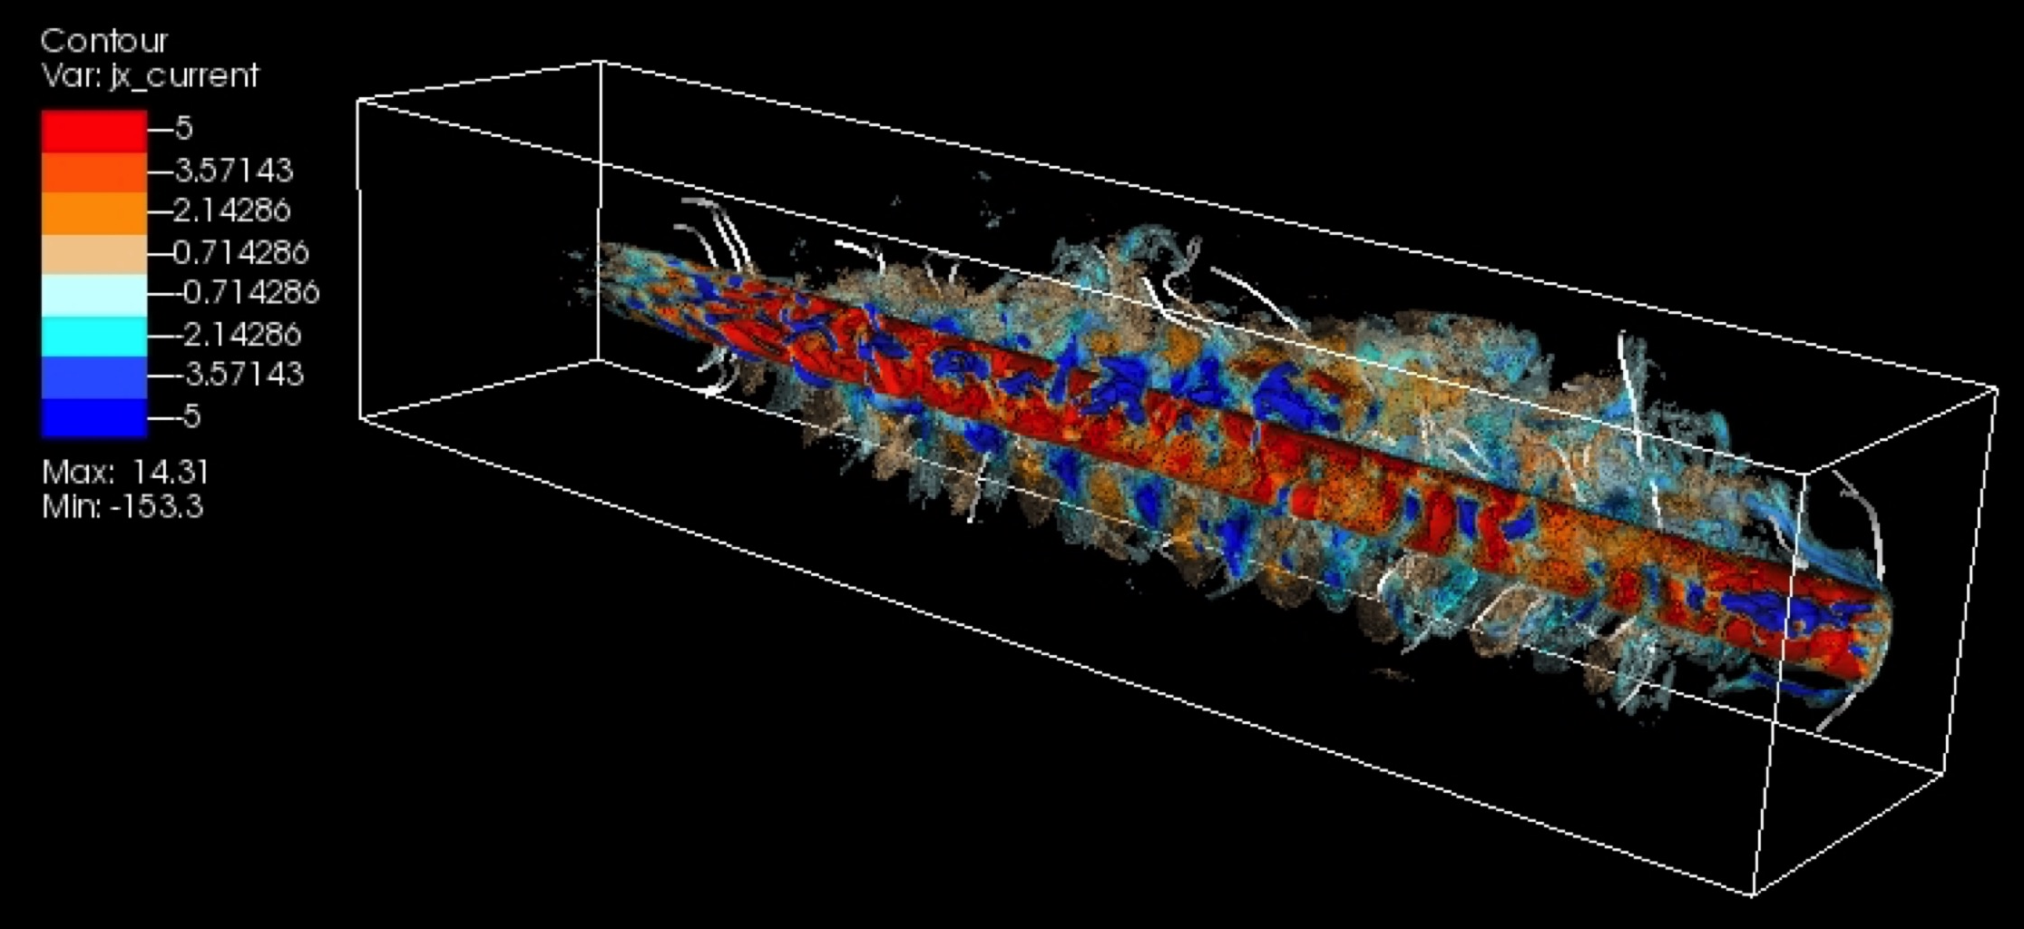
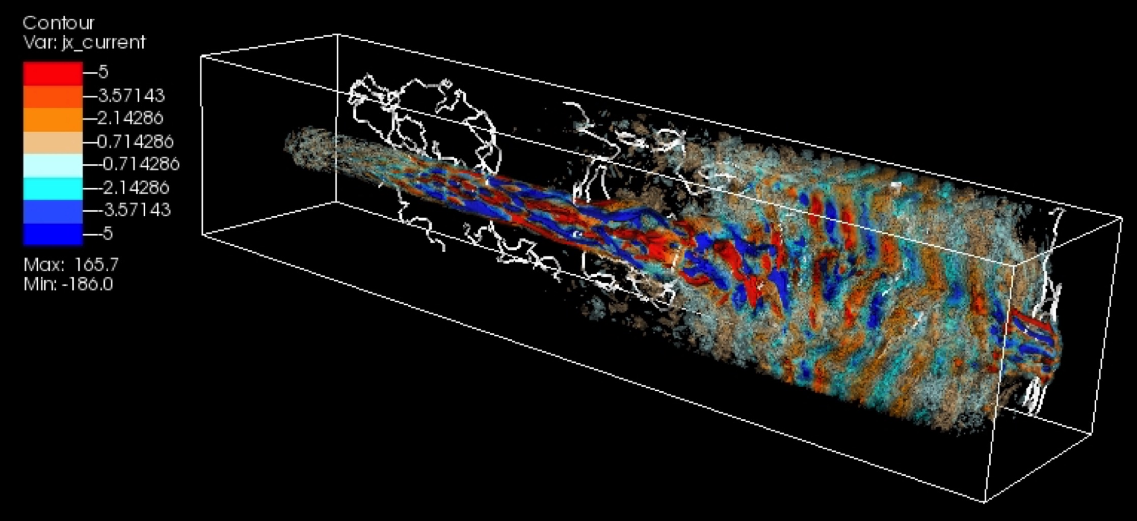
3D snapshots of current (J_{x}) isosurfaces with magnetic field lines
clipped at the center of jet (2D plane)
e-p
e±

Slide 28
Jet structure at the head of jets
γ_{jt} = 15
e-p
electron density
e±
current density

Slide 29
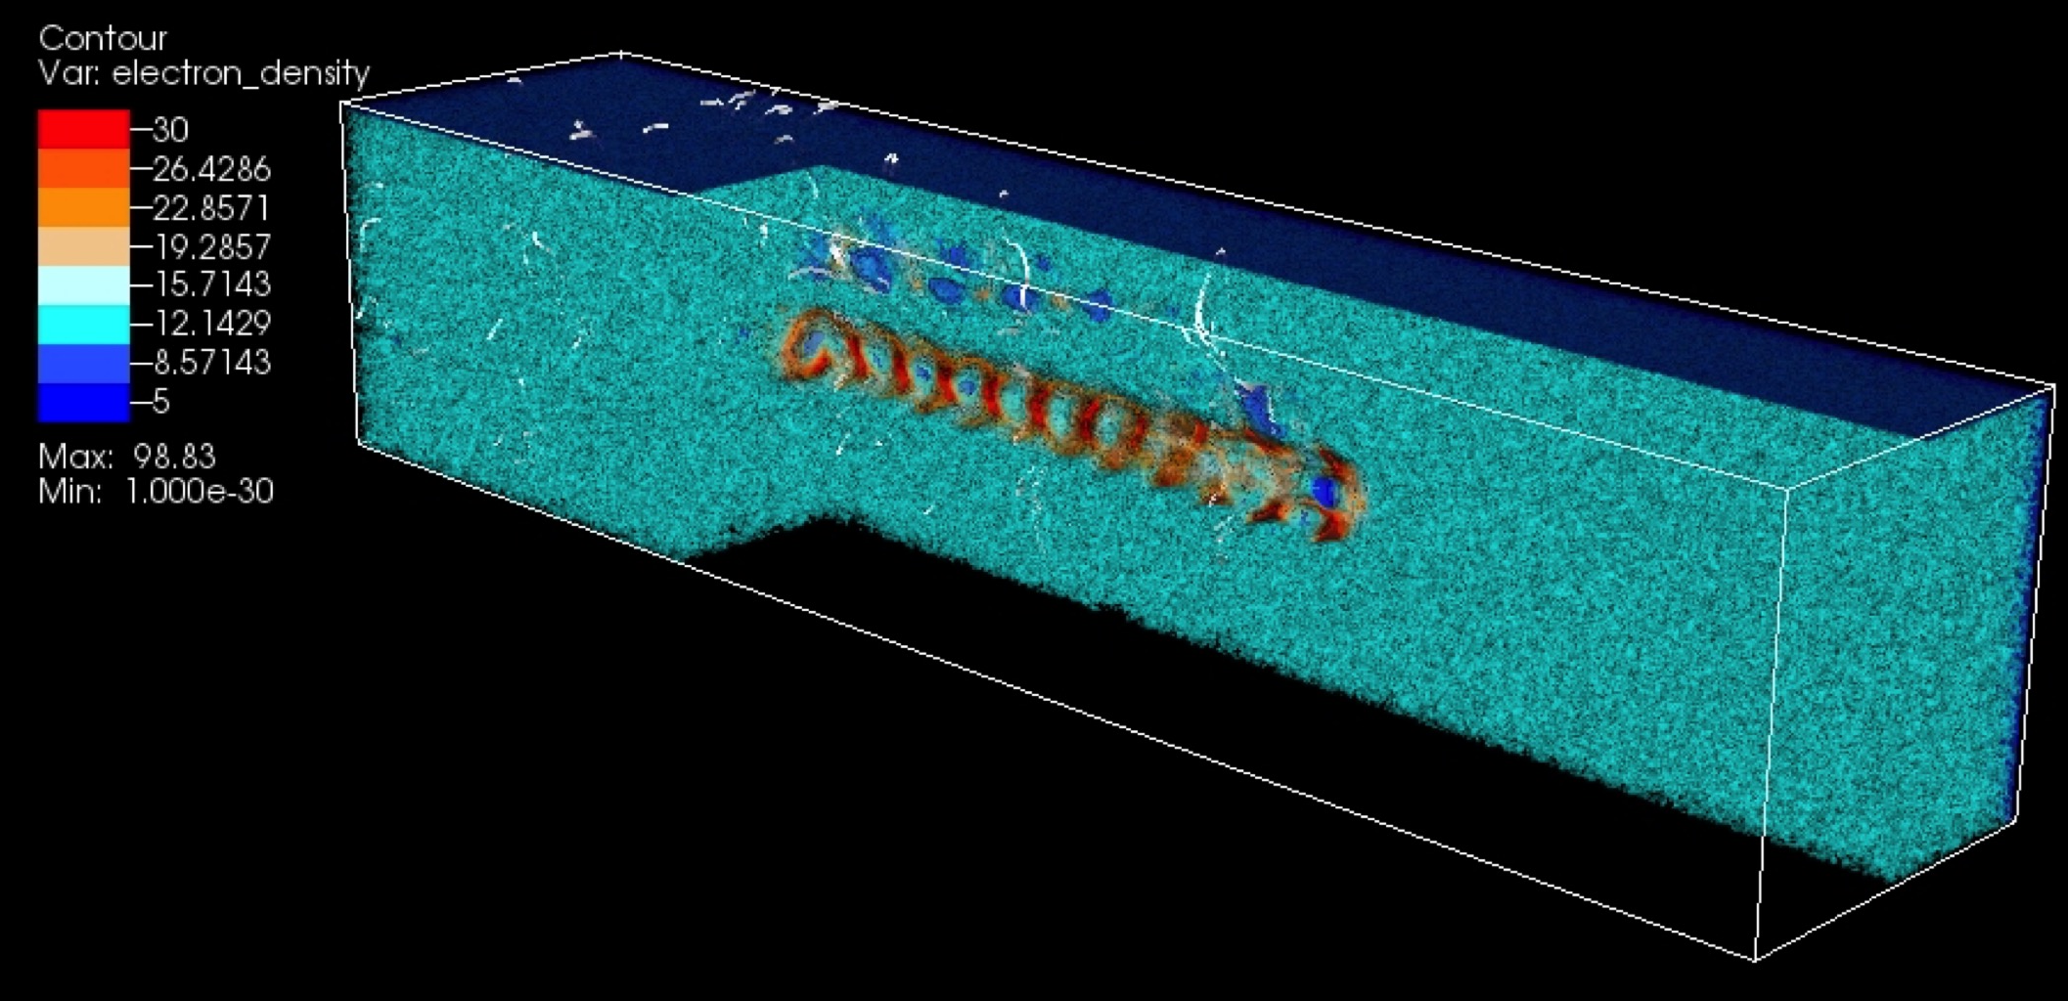
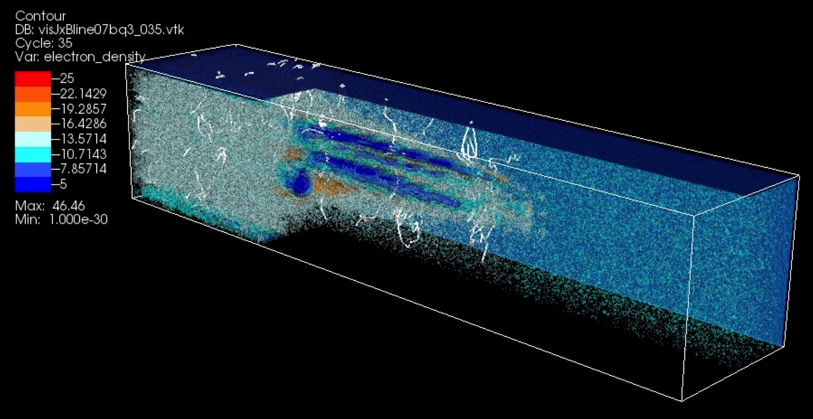
Jet structure at the head of jets in 3D
γ_{jt} = 15
e-p
electron density
e±

Slide 30


Jet structure at the head of jets in 3D
γ_{jt} = 15
e-p
current density
e±

Slide 31
Summary of Kinetic Kelvin-Helmholtz Instability
Static electric field grows due to the charge separation by the
negative and positive current filaments
Current filaments at the velocity shear generate magnetic field
transverse to the jet along the velocity shear
Jet with high Lorentz factor with core-sheath case generate higher
magnetic field even after saturated in the case counter-streaming
case with moderately relativistic jet
Non-relativistic jet generate KKHI quickly and magnetic field grows
faster than the jet with higher Lorentz factor
For the jet-sheath case with Lorentz factor 15 the evolution of
KKHI does not change with the mass ratio between 20 and 1836
6. Strong magnetic field will affect electron trajectories and create
synchrotron-like (jitter) radiation which will be investigated
7. Global jets with combined of Weibel instability and kKHI need to
be investigated further and with helical magnetic field
(for detail please see (Nishikawa et al. 2014, ApJ)

Slide 32
Self-consistent calculation of radiation
Electrons are accelerated by the electromagnetic field
generated by the Weibel instability and KKHI (without
the assumption used in test-particle simulations for
Fermi acceleration)
Radiation is calculated using the particle trajectory in
the self-consistent turbulent magnetic field
This calculation includes Jitter radiation (Medvedev
2000, 2006) which is different from standard
synchrotron emission
Radiation from electrons in our simulation is reported
in Nishikawa et al. Adv. Sci. Rev, 47, 1434, 2011

Slide 33


Radiation from particles in collisionless shock
New approach: Calculate radiation from integrating position, velocity, and acceleration of ensemble of particles (electrons and positrons)
Hededal, Thesis 2005 (astro-ph/0506559) Nishikawa et al. 2008 (astro-ph/0802.2558), 2011 Sironi & Spitkovsky, 2009, ApJ Martins et al. 2009, Proc. of SPIE Vol. 7359 Frederiksen et al. 2010, ApJL

Slide 34



Observations and numerical spectrum
a
GRB 080916C
b
e
c
d
a ≈ 1
a ≈ 1
Abdo et al. 2009, Science
(Nishikawa et al. 2012)

Slide 35
Summary
The magnetic fields created by the Weibel instability
generate highly inhomogeneous magnetic fields, which
are responsible for jitter radiation (Medvedev, 2000, 2006;
Fleishman 2006; Frederiksen et al. 2010, Medvedev et al
2011, Nishikawa et al. 2011)
Our new numerical approach of calculating radiation from
electrons based on self-consistent simulations provides
more realistic spectra including jitter radiation
Need further calculation of synthetic spectra with
spectral evolution
Reconnection is very important to release magnetic field
energy to kinetic energy
Recollimation shock may create gamma-ray flash by
moving perturbation

Slide 36
Future plans
Further simulations with a systematic parameter
survey will be performed in order to understand
shock dynamics including KKHI and reconnection
Further simulations will be performed to calculate
self-consistent radiation including time evolution
of spectrum and time variability using larger systems
Investigate radiation processes from the accelerated
electrons in turbulent magnetic fields and compare
with observations using global jet simulation of shock,
KKHI and reconnection with helical magnetic field
in jet (GRBs, SNRs, AGNs, etc)
• Polarization of global jets needs to be investigated
including helical magnetic field

Slide 37


GRB progenitor (collapsar, merger, magnetar)
Fushin
relativistic jet
(god of wind)
Gravitational waves
EM emission
(shocks, acceleration)
Raishin
(god of lightning)
(Tanyu Kano 1657)

