Slide 1
Jets in GRBs
Tsvi Piran
Racah Institute of Physics,
The Hebrew University
Omer Bromberg, Ehud Nakar
Re’em Sari,
Franck Genet, Martin Obergaulinger, Eli Livne

Slide 2
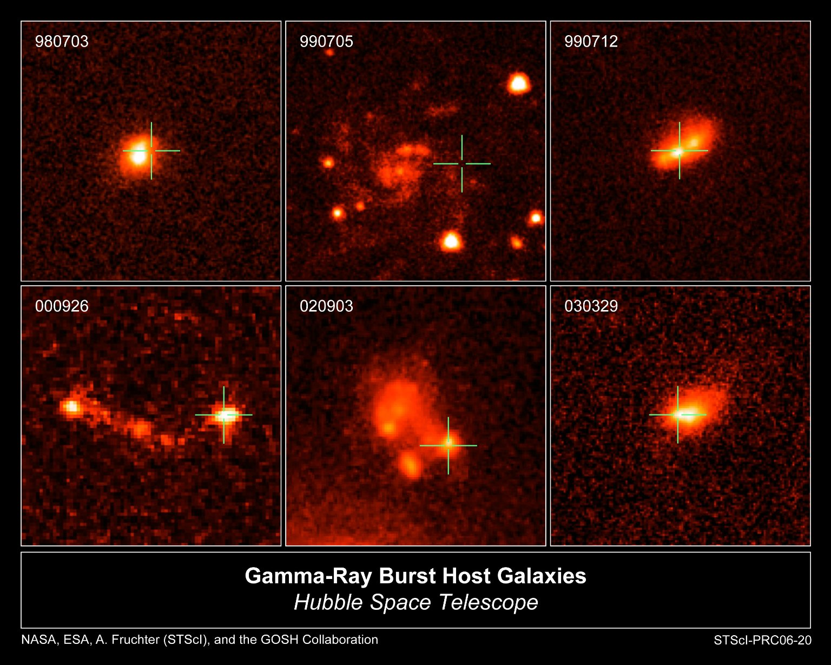
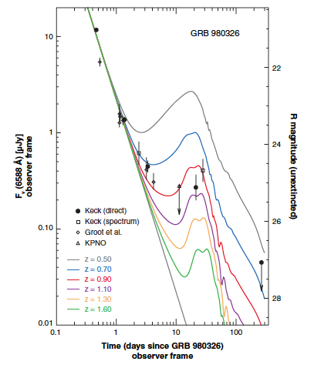
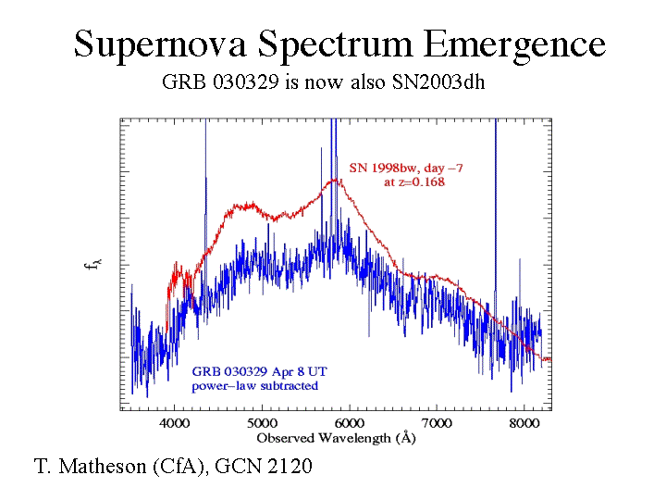
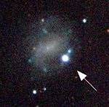
The (long) GRB-Supernova connection
Observational indications
  Long GRBs arise in star forming regions (Paczynski 1997)
  Association with Sne (Ibc) Galama et al. 1998
  SN bumps.
  GRB030329-SN 2003dh
1998bw-GRB980425

Slide 3
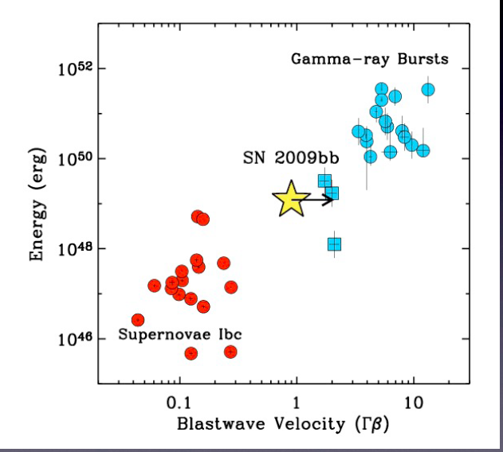
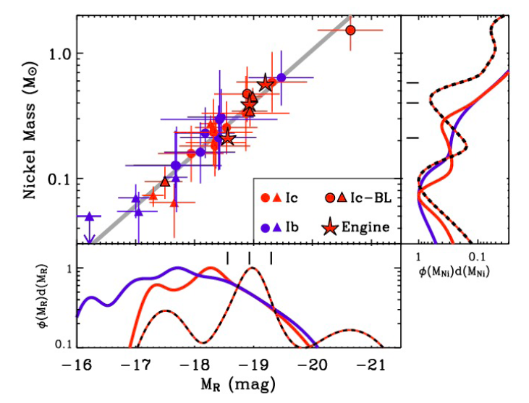
SNe of GRBs
Very bright (Hypernova) – but not unique
Broad lines (high velocity outflow >0.1c)
Possibly engine driven (Soderberg)
Soderberg
Soderberg

Slide 4
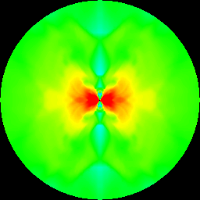
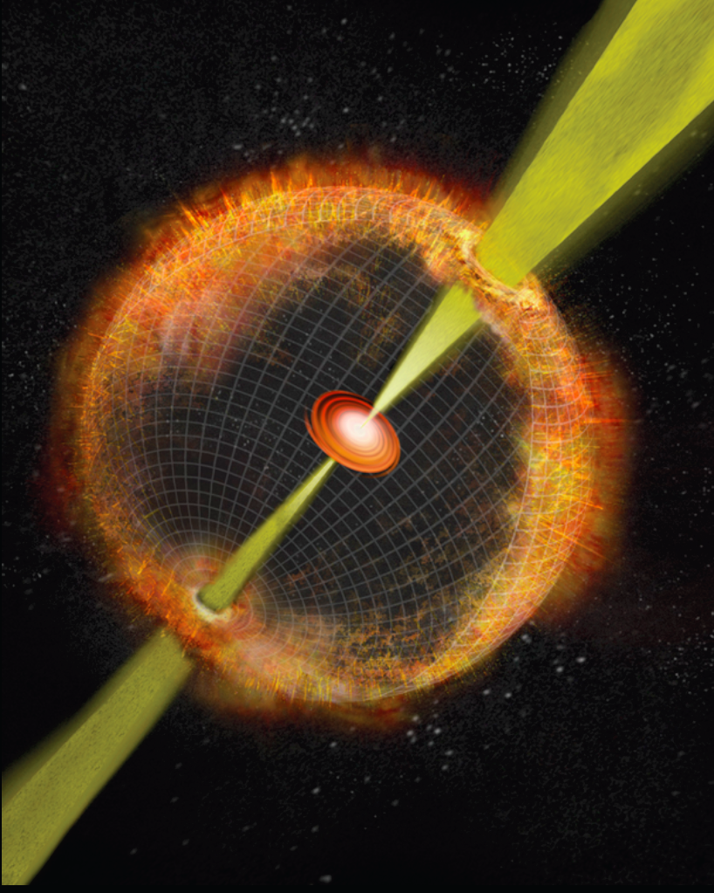
The Collapsar Model
(Woosley 1993, MacFadyen & Woosley 1998)

Slide 5
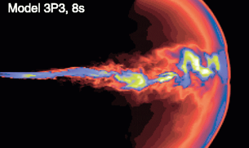
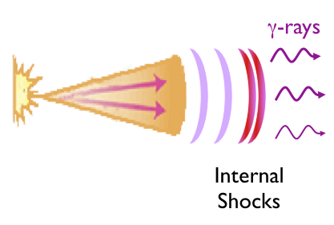
The Collapsar Model
(Woosley 1993, MacFadyen & Woosley 1998)
Zhang, Woosley & MacFadyen 2004

Slide 6
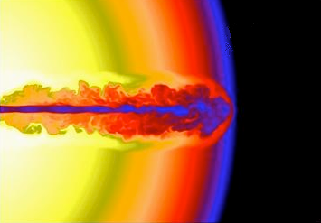
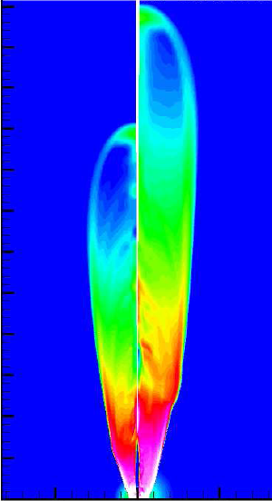
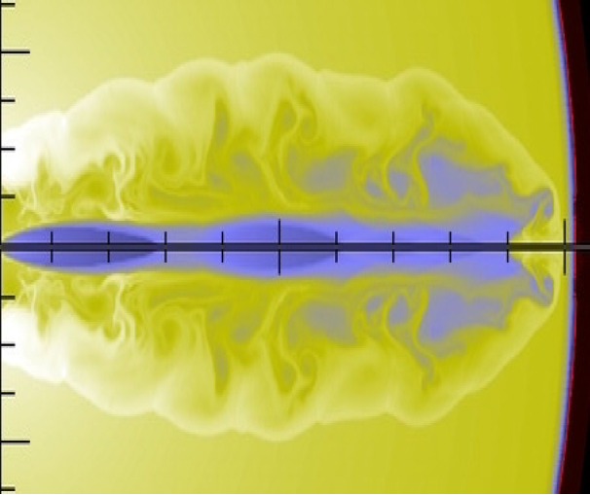
Numerical modeling
Zhang et al., 04
Zhang et al., 04
Mizuta & Aloy 09
Morsony et al., 07

Slide 7
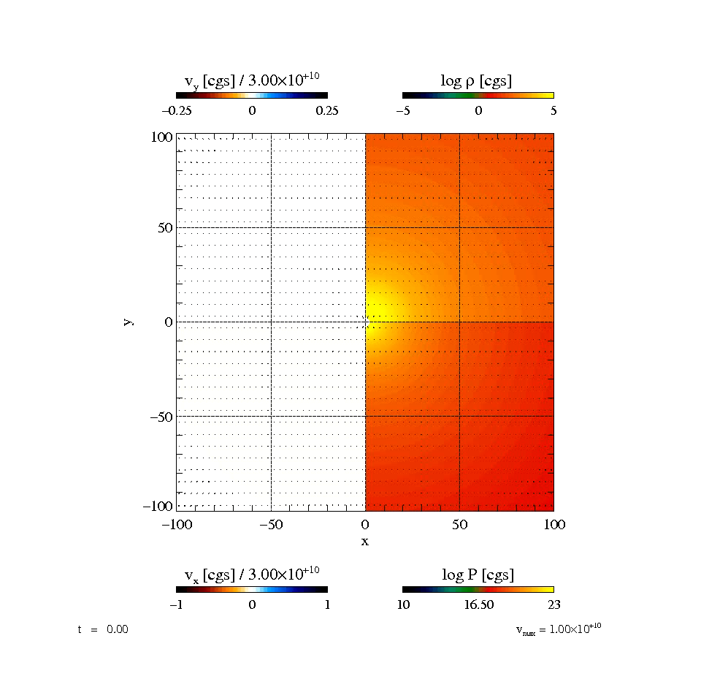
Jet Simulations
Obergalinger+ 11
Opening angle of 15º degrees at 2000 km
into a star of 15 solar masses and solar metallicity. Constant energy injection rate, 5 * 10⁵⁰erg /s, through the entire run of the model.Lorentz factor at injection 7

Slide 8
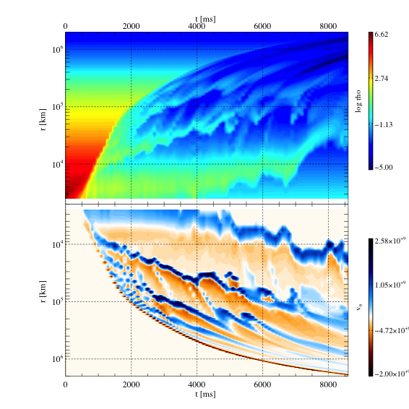
Jet Simulations
Obergalinger, TP

Slide 9
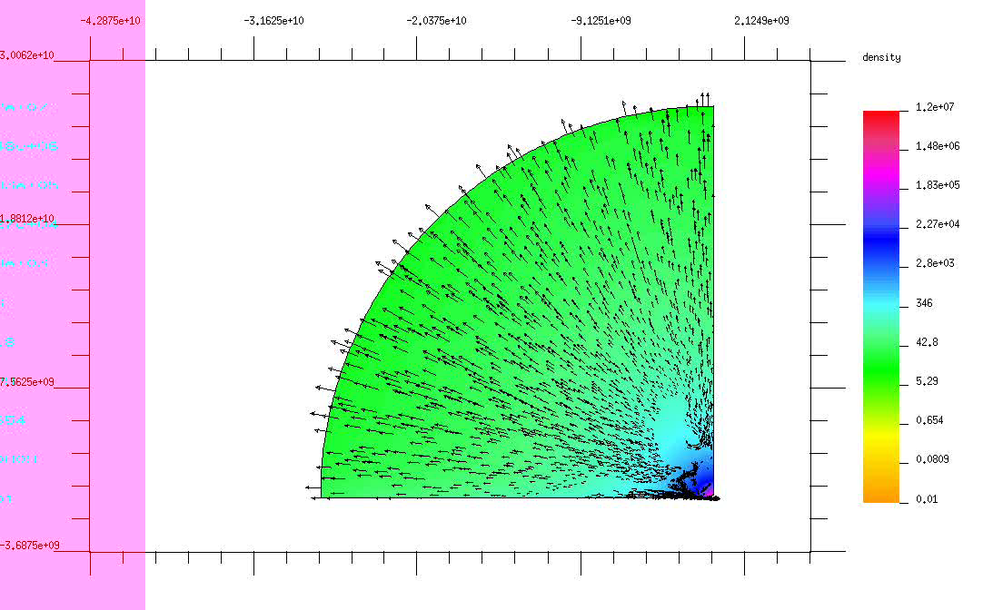
Disruption of the Stellar envelope by the jet - Genet, Livne & TP
Conditions in the inner shocks might be suitable for explosive Nucleosynthsis?

Slide 10
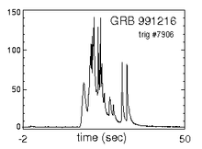
The engine must be active until the jet’s head breaks out!
T₉₀ = T_{engine} -T_{B}
T_{B}
T₉₀
T_{engine}

Slide 11
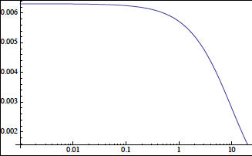
T₉₀ = T_{engine} - T_{B}
T_{B}
T₉₀
T_{engine}

Slide 12
GRB Duration Distribution

Slide 13
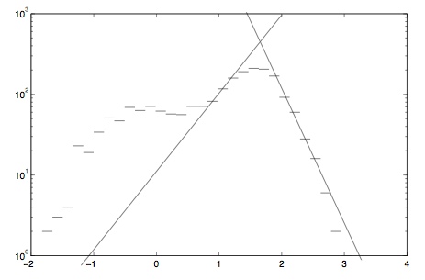
Observations
T_{B}~35 sec
P(T_{E})~T_{E}⁻⁴
Short GRBs
long GRBs

Slide 14
Implications
Breakout time is about 35 sec ⇒ (as we see later stellar radius of a few solar radii).
Engine duration distribution falls sharply (might be partially an observational bias).
⇒ There are many “failed GRBs” in which the jet doesn’t get out and all the energy is deposited in the envelope.

Slide 15
Numerical modeling
Zhang et al., 04
How do the properties of the jet and the star affect the evolution?
Mizuta & Aloy 09
Mizuta & Aloy 09
Morsony et al., 07

Slide 16
Numerical modeling
Jets do break through.
A Cocoon is created.
Extremely narrow jets.
Jet heads are sub-to-trans relativistic
Zhang et al., 04
How do the properties of the jet and the star affect the evolution?
Mizuta & Aloy 09
Mizuta & Aloy 09
Morsony et al., 07

Slide 17
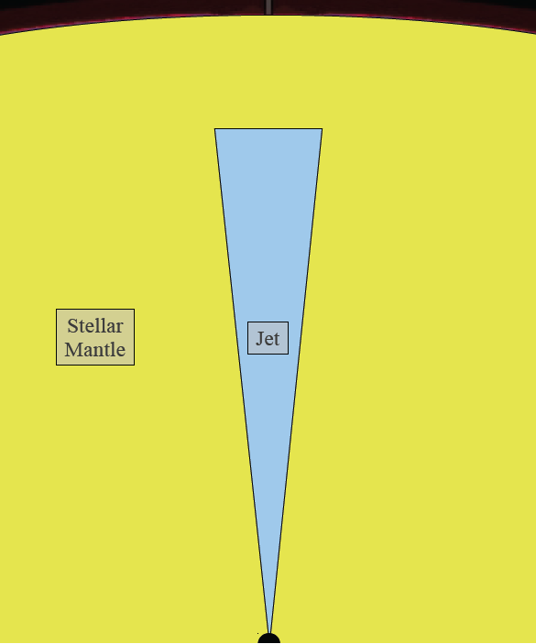
The Jet-Cocoon Model

Slide 18
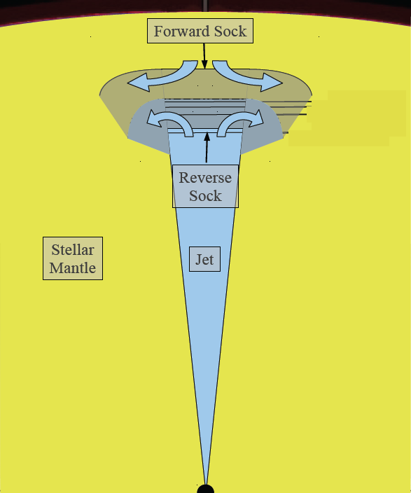
Reverse shock

Slide 19
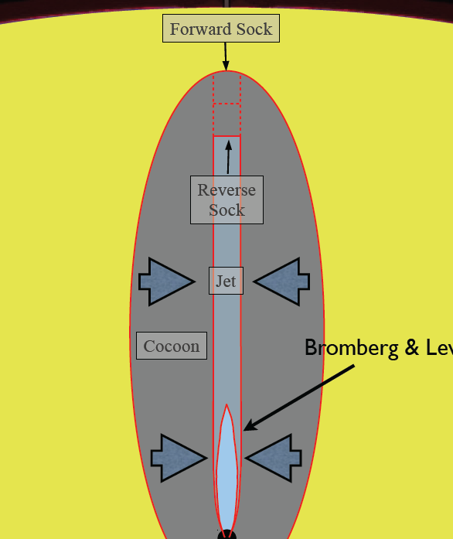

Happy Birthday Marek
Nalewajko &
Sikora 11
Collimation
Shock – Radiation mediated
Weak source of neutrinos
Bromberg &
Levinson 07; 09

Slide 20
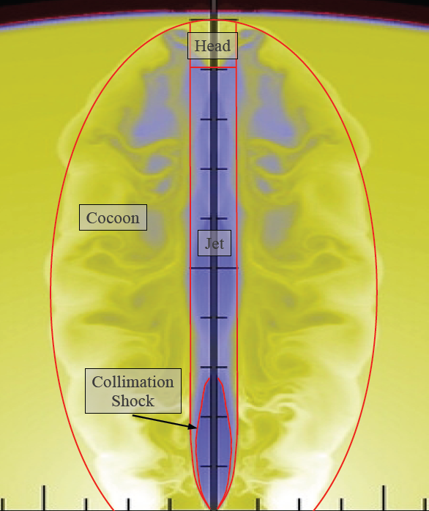
Morsony et al., 07

Slide 21
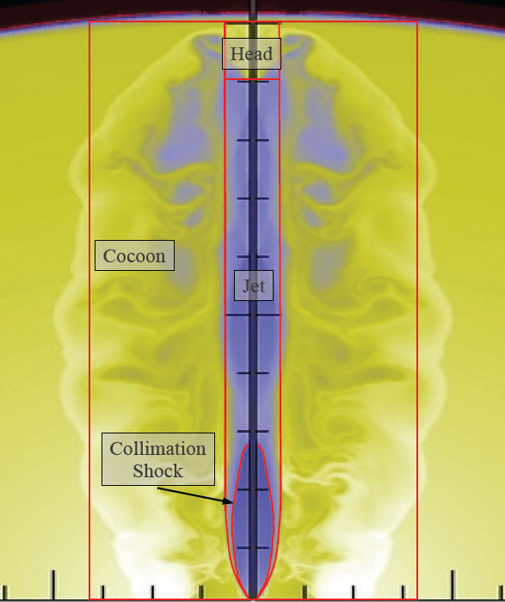
Unknowns:
Cocoon pressure
Cocoon size
Head velocity
Jet cross-section
Jet Lorentz factor
Initial conditions:
luminosity – L_{j}
Injection angle – θ₀
External Density- ρ(z)
Morsony et al., 07

Slide 22
Log₁₀(ρ)
Z/10⁹cm
Mizuta & Aloy 09
R/10⁹cm

Slide 23
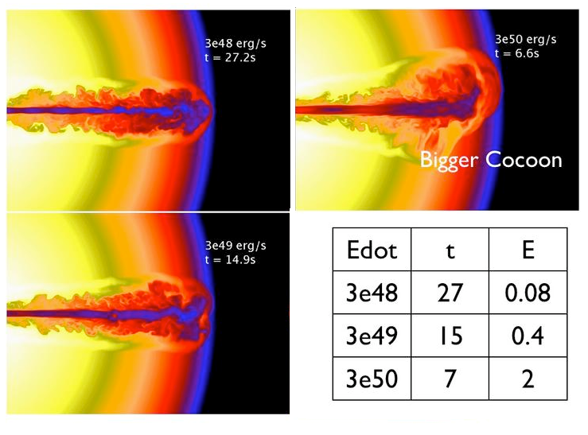
Comparison with simulations
T
25
12
6
Zhang et al., 04

Slide 24
Collimation Regimes
Uncollimated Jet
Collimated Jet
Ambient
medium
Jet’s head
Ambient
medium
Jet’s head
Σ_{j}
Σ_{j}
jet
jet
Collimation
Shock
Collimation
Shock
Cocoon
Cocoon

Slide 25
Collimation Condition
Uncollimated Jet
Ambient
medium
z
θ₀
Cocoon

Slide 26
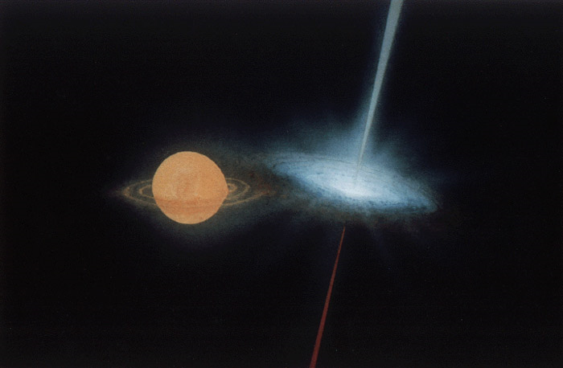
Collimation of Astrophysical Jets
Microquasars:
Luminosities ~ 10³⁹ erg/s
Ambient medium
ISM - g/cm³
The jet is collimated for:
Miller-Jones (2006): MQ are collimated if Γ_{j} < 10
~

Slide 27
Collapsar Jets: break out time and energy
ʘ
ʘ
ʘ
ʘ

Slide 28
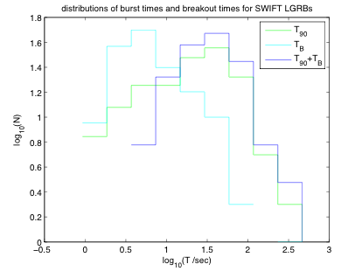
T₉₀ = T_{engine} - T_{B}

Slide 29
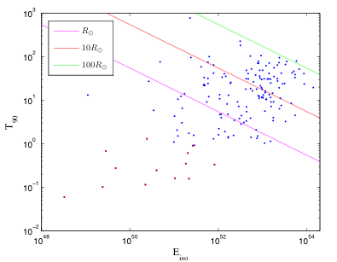
Distribution of T₉₀ for Swift Bursts vs Energy
T₉₀>T_{B} ➔
LGRBs must have small progenitors
(e.g. WR stars who lost their H envelope)

Slide 30
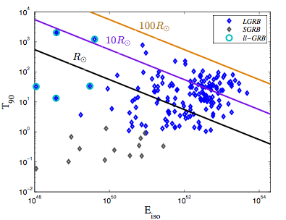
Distribution of T₉₀ for Swift Bursts vs Energy
Short GRBs
Cannot be produced in Collapsars

Slide 31
Distribution of T₉₀ for Swift Bursts vs Energy
Low luminosity GRBs llGRBs
98bw

Slide 32
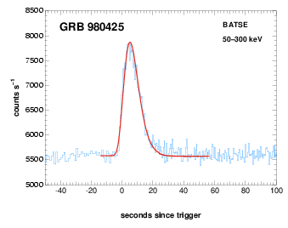
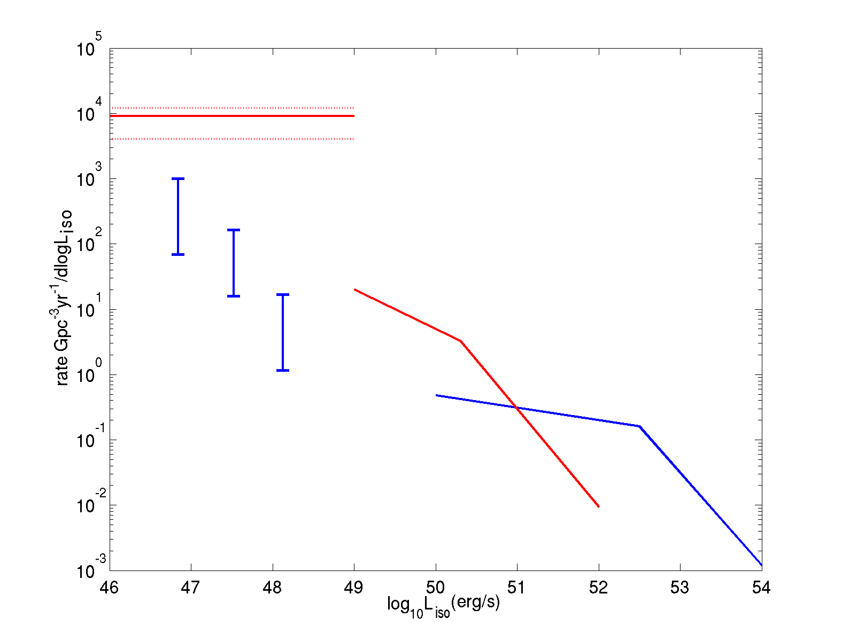
Low Luminosity GRBs - llGRBs
Low luminosity GRBs:
  E_{iso}~10⁴⁸-10⁴⁹ ergs
  Smooth single peaked light curve.
  Soft Emission (E_{peak} <150 keV)
  Wide opening angle θ>20º (otherwise rate will exceed type Ibc)
  T₉₀~ 10-1000 sec
  All GRBs associated with SNe apart from GRB 030329 are llGRBs

Slide 33
The local GRB rate and luminosity function (Wanderman & TP)
SN Ib/c
The rate of llGRBs is comparable to the rate of type Ibc broad line Sne (Soderberg et al., 2006)
llGRBs
Short
Long
Notes:
3333

Slide 34
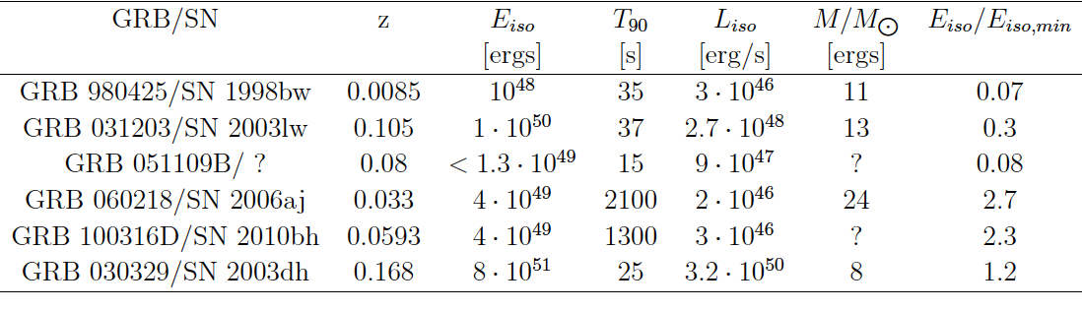
llGRBs associated with SNe
ʘ
Only the longer bursts may originate from jets which break out of the star.
Shorter duration low luminosity bursts cannot arise from a jet breaking out from a star!

Slide 35
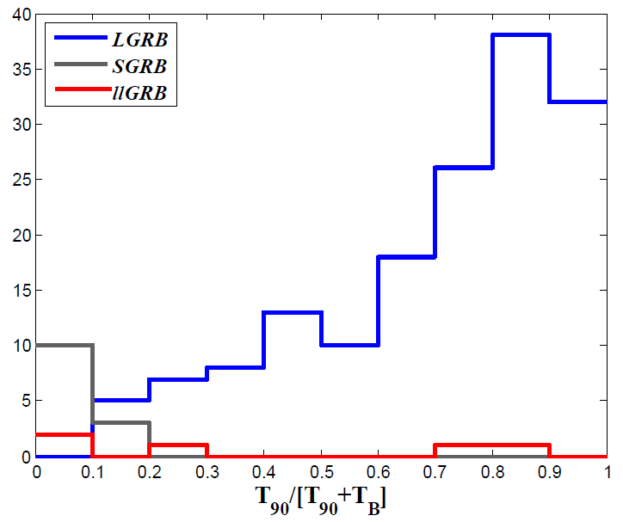
Distribution of T₉₀/ T_{engine}
The distribution of the llGRBs is different from both GRB populations.

Slide 36
llGRBs are NOT produced by jets breaking out from Stellar envelopes. llGRBs are not “regular” long GRBs
For 2 bursts with duration ~T₉₀/T_{B}<0.1 we expect 20 bursts with duration 0.1<T₉₀/T_{B}<. We see one.
Put differently if T_{E}<T_{B} we expect T₉₀ to cluster around T_{B}.

Slide 37
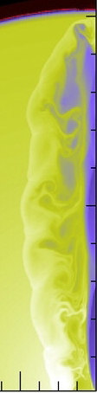
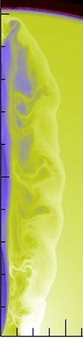
What are llGRBs?
A weak jet which fail to break (“a failed GRB”) leads to a shock brekout on the stellar envelope.
For a detailed model see Nakar, 2011.

Slide 38
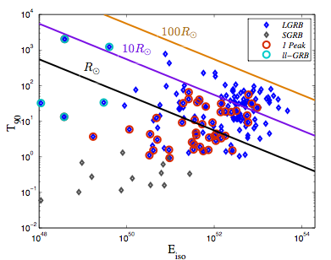
Distribution of T₉₀ for Swift Bursts vs Energy
Are most single peaked GRBs llGRBs?

Slide 39
TeV neutrinos in failed GRBs
TeV neutrinos require acceleration of particles to high energy.
All shocks in the buried jet are radiation mediated: can’t accelerate particles.
Not likely to occur.
Collisionless shocks
Photosphere

Slide 40
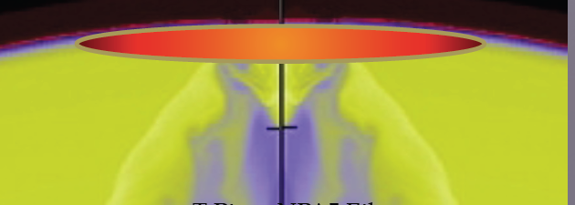
Summary:
Breakout time is about 35sec ⇒ Stellar radii of a few solar radii
Engine duration distribution falls sharply (might be partially an observational bias).
Minimal break energy and minimal engine time are required for a jet to cross the stellar envelope.
Common low energy GRBs with T₉₀~ 10 sec cannot be produced by Collapsars. They are “failed GRBs”.
This suggests a revision of the SN-GRB association that is based now only one clear event: GRB030329 - SN 2003dh.
But … ?

Slide 41


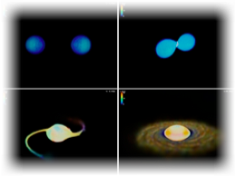
Radio Flares - Electromagnetic signals that follow the Gravitational Waves
Tsvi Piran¹ and Ehud Nakar²
¹ The Hebrew University
² Tel Aviv University

Slide 42
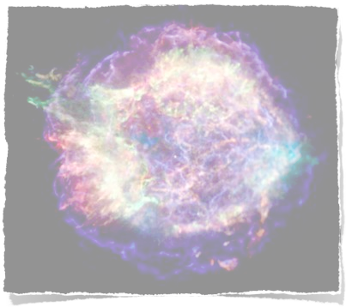

Basic ingredients of the Model
Numerous numerical simulations show that NS merger eject Sub - or Mildly relativistic outflow with E~10⁴⁹ erg
Lorentz factor (Γ-1)≈1
Interaction of the outflow with the ISM

Slide 43



Dynamics
log R
Sedov-Taylor
log t

Slide 44
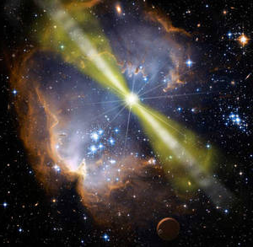
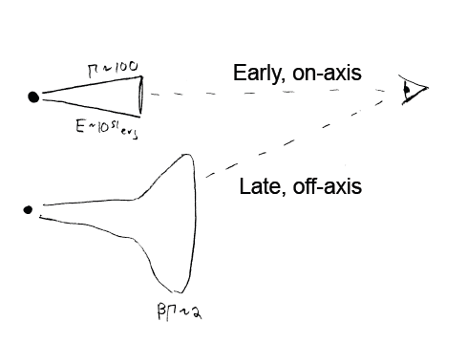
Orphan Afterglow

Slide 45
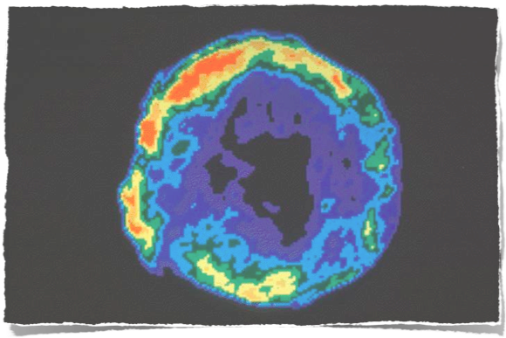
Radio Supernova e.g. 1998bw (Chevalier 98)
ee=εee
eB=B²/8π=εBe
N(γ)∝ γ-^{p} for γ> γm
p=2.5 - 3
γm= (mp/me)ee (Γ-1)
ν=(3/4π)eB γ²
Fν=(σTc/e)NeB
Tycho's supernova remnant seen at radio wavelengths

Slide 46
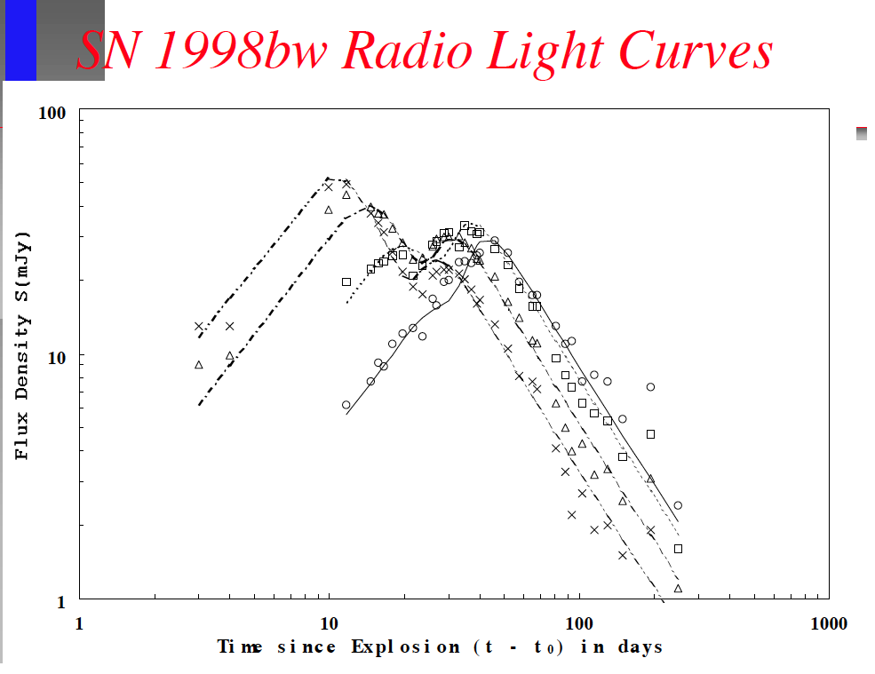
Tom Weiler

Slide 47




Slide 48


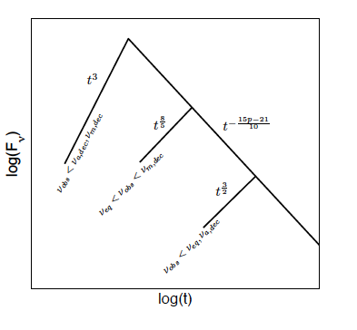

The light curve
Fν
ν
νm
νeq
νobs
νa
tdec
t
tdec
t
Text
Text

Slide 49
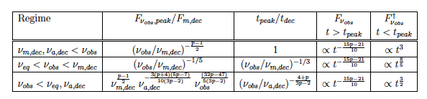

Slide 50
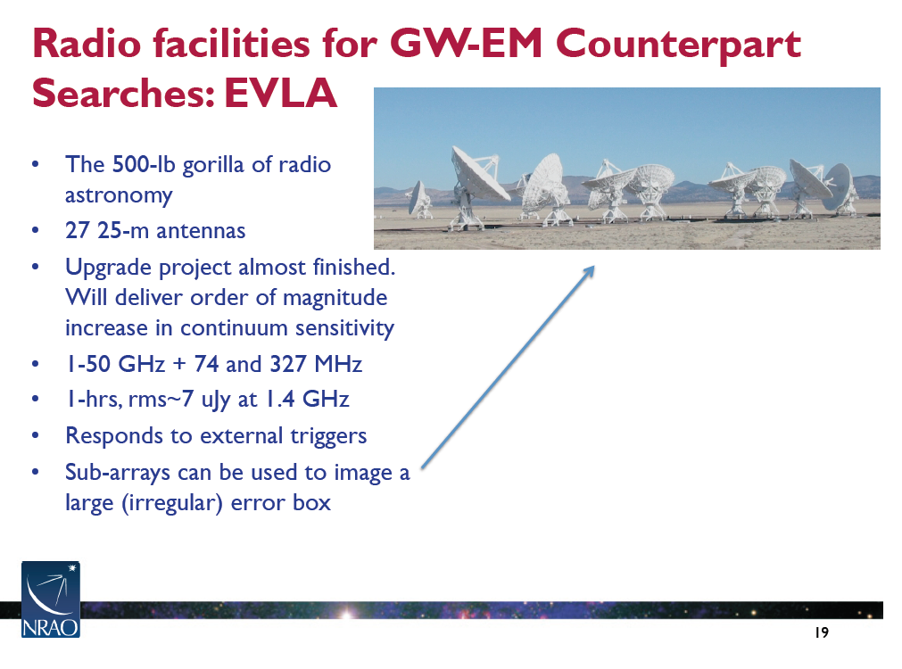
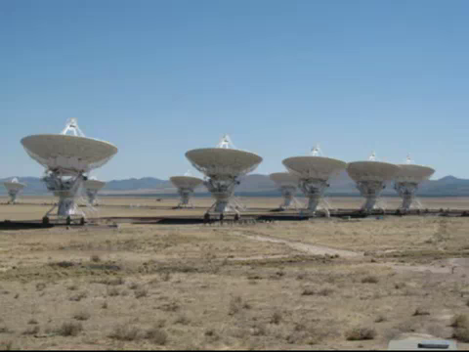
Dale Frail

Slide 51
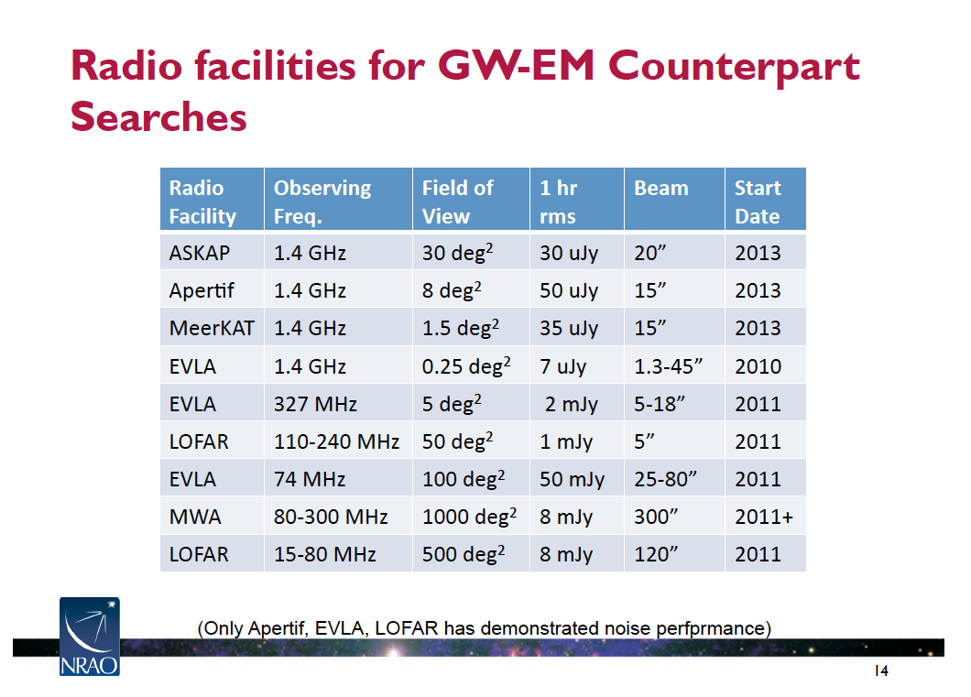
Dale Frail

Slide 52



Detection
1.4 GHz
150 MHz

Slide 53


Slide 54
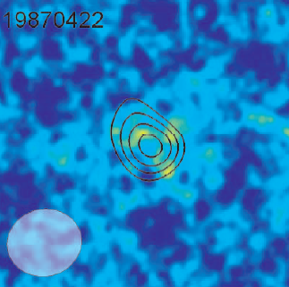
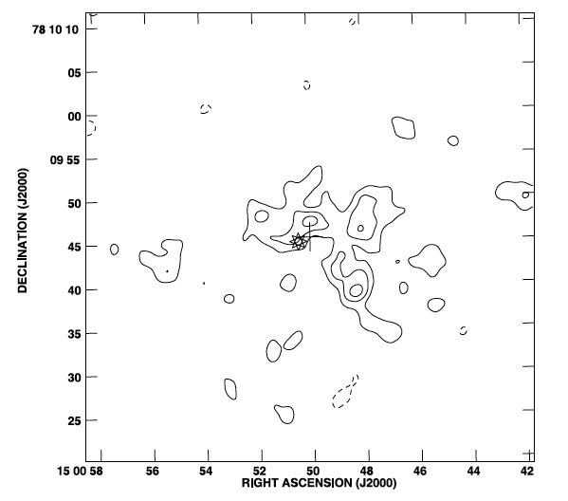

The Bower Transient
19870422
5GHz 0.5mJy (<0.036 mJy) tnext =96 days 1.5’’ from the centroid of MAPS-P023-0189163 a blue Sc galaxy at z=0.249 (1050Mpc) with current star formation

Slide 55



Conclusions
A long lived (month) strong (sub-mJy) radio remnant of a compact binary merger is a robust prediction.
With typical parameters 1.4GHz is the optimal observation band
The signal depends on the energy of the outflow, its Lorentz factor and the surrounding circum-merger density.
The outflow parameters can be easily determined from neutron star simulations.
We have probably observed such an event.
It is relatively easy to test this hypothesis by radio searches.

